Slide 1

Capítulo 7
Template by Jared Speight
Content by Beatrice Tseng
con la Profesora Tseng

Slide 2

CASA y CUARTOS | OBJETOS de la CASA | APARATOS DOMÉSTICOS | QUEHACERES DOMÉSTICOS | LUGARES en la CIUDAD
100 | 100 | 100 | 100 | 100
200 | 200 | 200 | 200 | 200
300 | 300 | 300 | 300 | 300
400 | 400 | 400 | 400 | 400
500 | 500 | 500 | 500 | 500

Slide 3

MÁS LUGARES en la CIUDAD | MUEBLES | MÁS OBJETOS de la CASA | MÁS QUEHACERES | COLOMBIA y PANAMÁ
200 | 200 | 200 | 200 | 200
400 | 400 | 400 | 400 | 400
600 | 600 | 600 | 600 | 600
800 | 800 | 800 | 800 | 800
1000 | 1000 | 1000 | 1000 | 1000

Slide 4
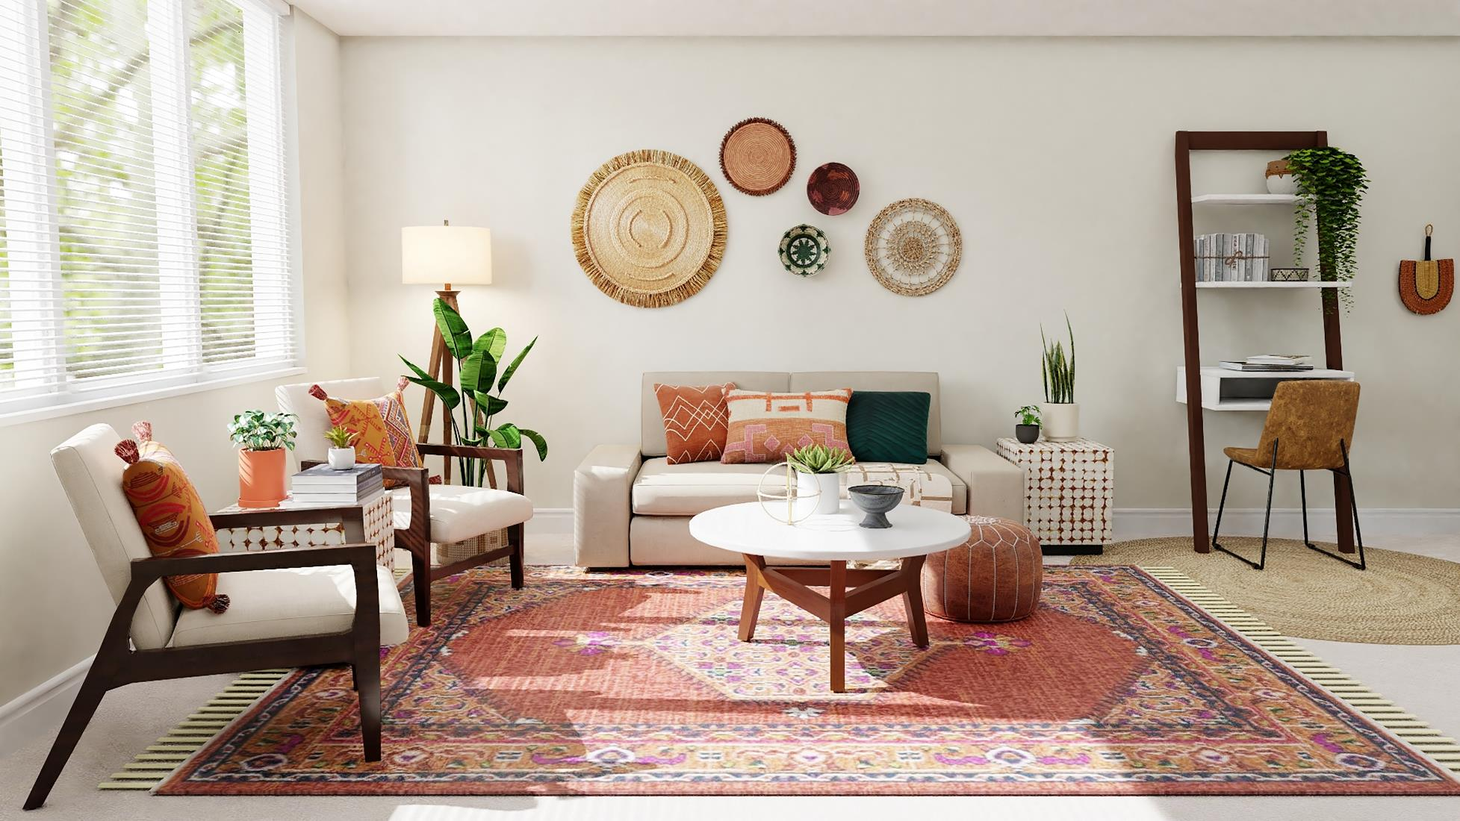
Photo by Spacejoy on Unsplash
CHECK

Slide 5

sala

Slide 6
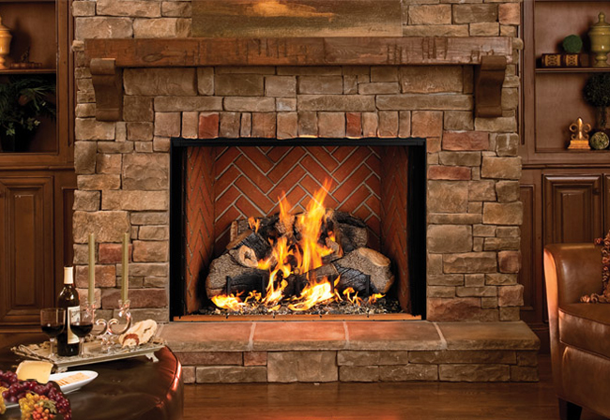
CHECK
Photo from A Cozy Fireplace

Slide 7
chimenea

Slide 8
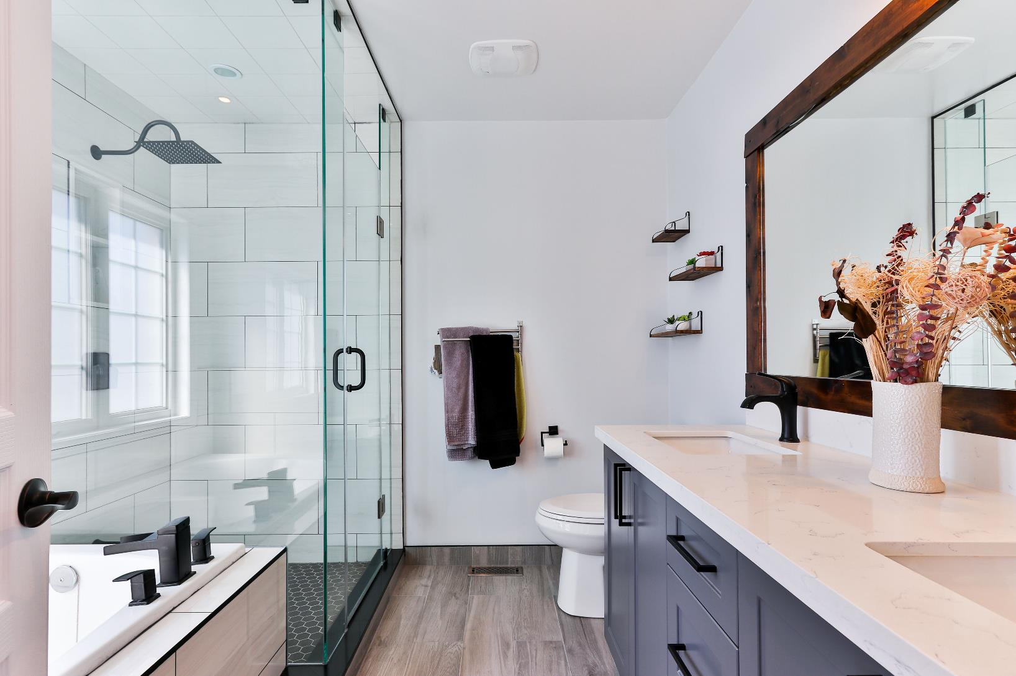
Photo by Sidekix Media on Unsplash
CHECK

Slide 9
baño

Slide 10
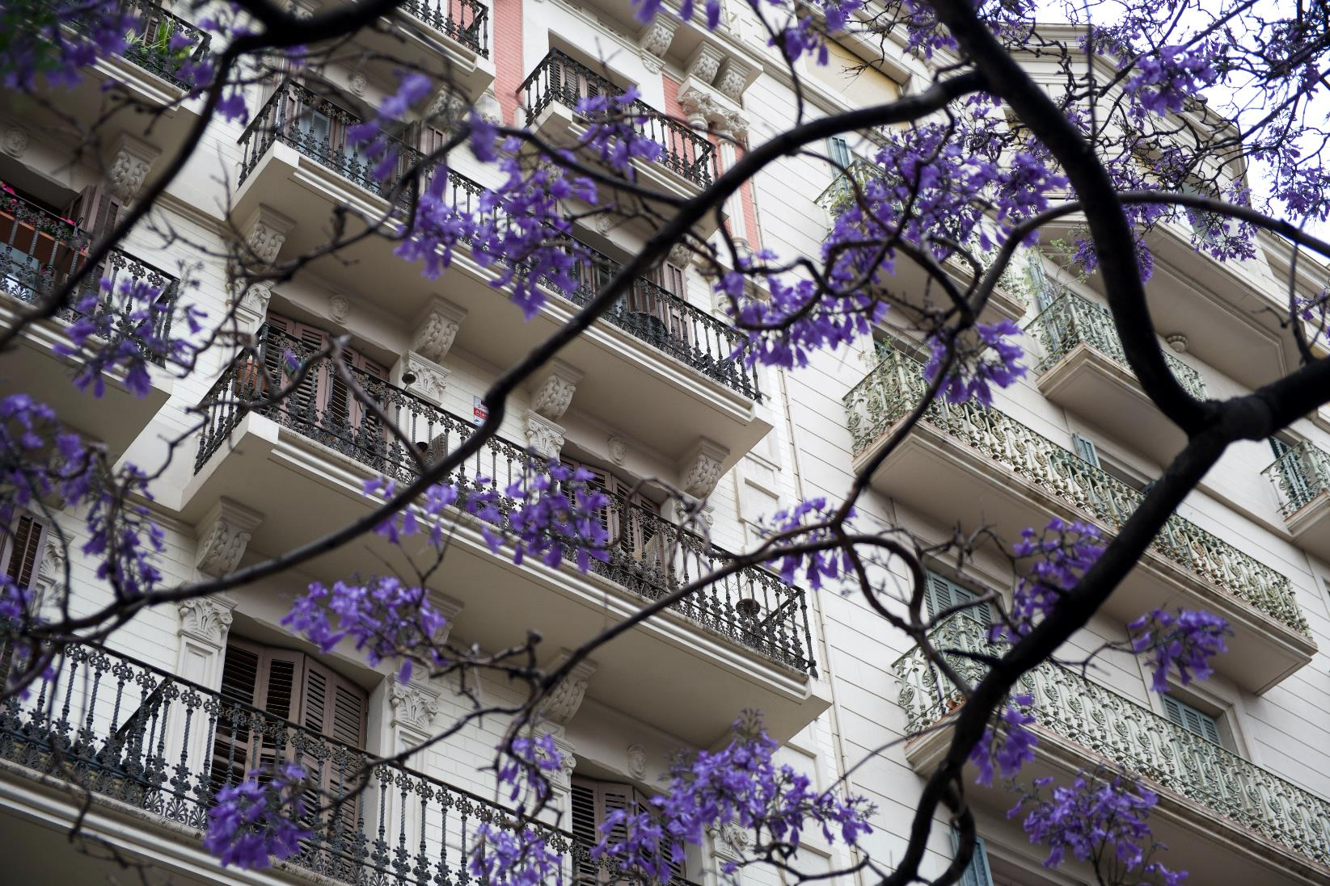
Photo by Ruan Martinelli on Unsplash
CHECK

Slide 11
balcón/balcones

Slide 12
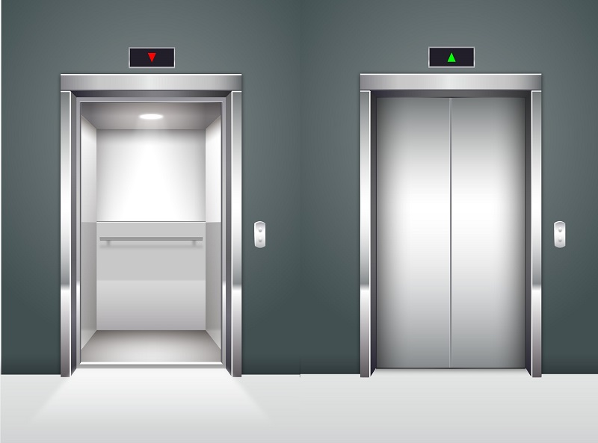
CHECK
Photo from Imperium

Slide 13
ascensor

Slide 14
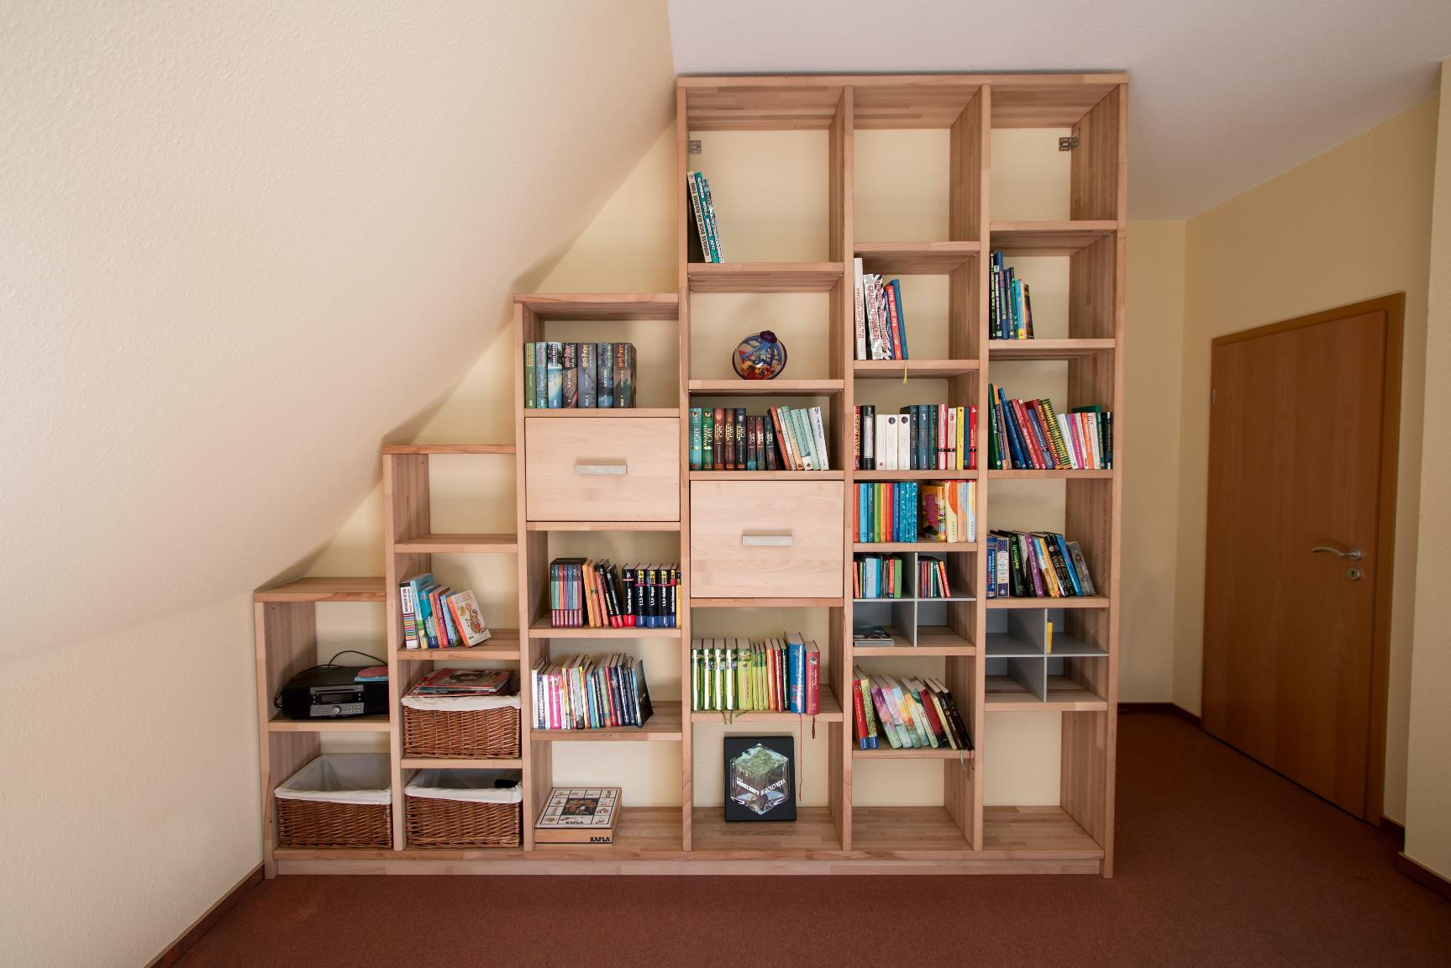
Photo by Pickawood on Unsplash
CHECK

Slide 15
estante

Slide 16
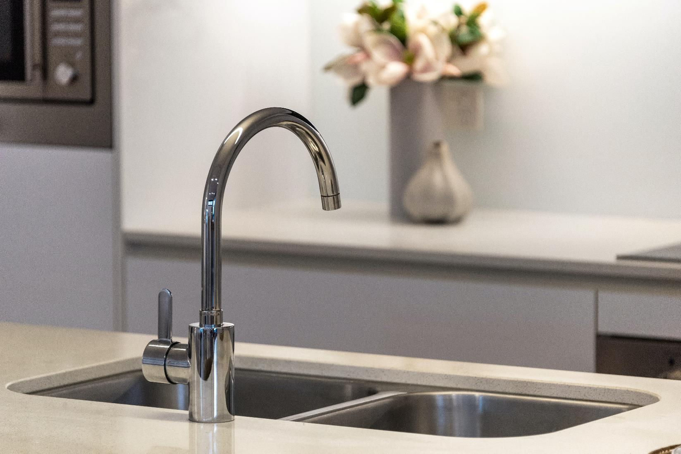
CHECK
Photo by Steven Ungermann on Unsplash

Slide 17
fregadero

Slide 18
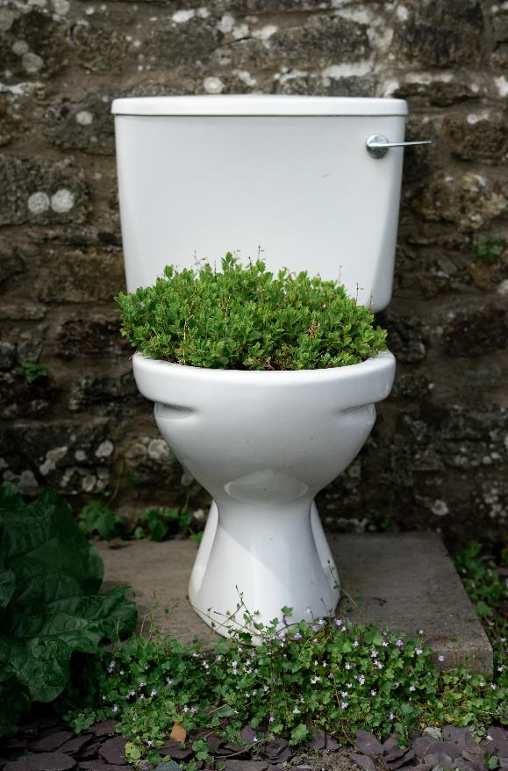
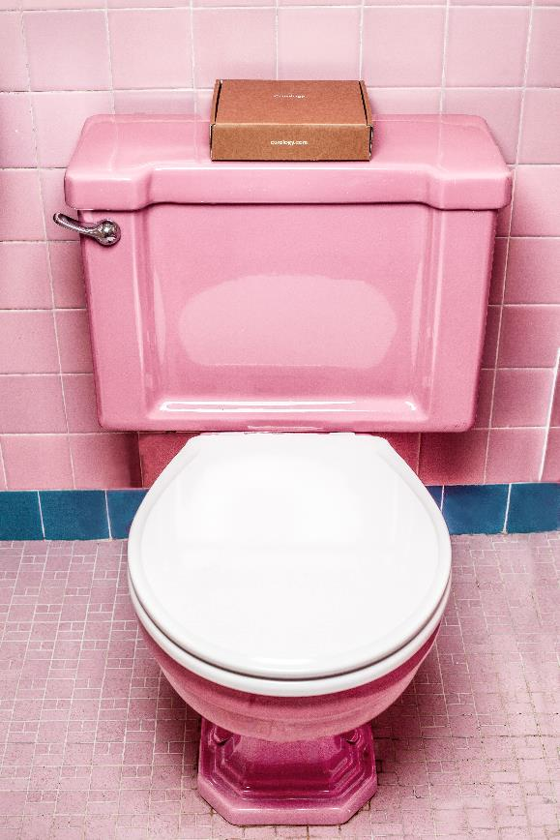
Photo by Will Wright on Unsplash
Photo by Curology on Unsplash
CHECK

Slide 19
inodoro

Slide 20
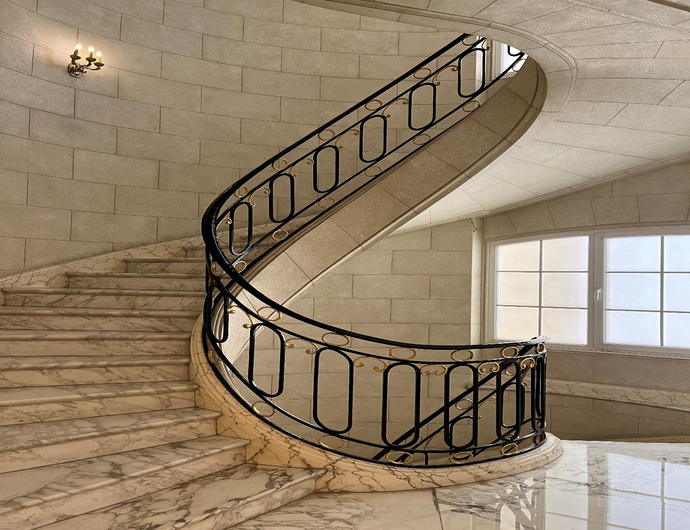
Photo by Beatrice Tseng
CHECK

Slide 21
escaleras

Slide 22
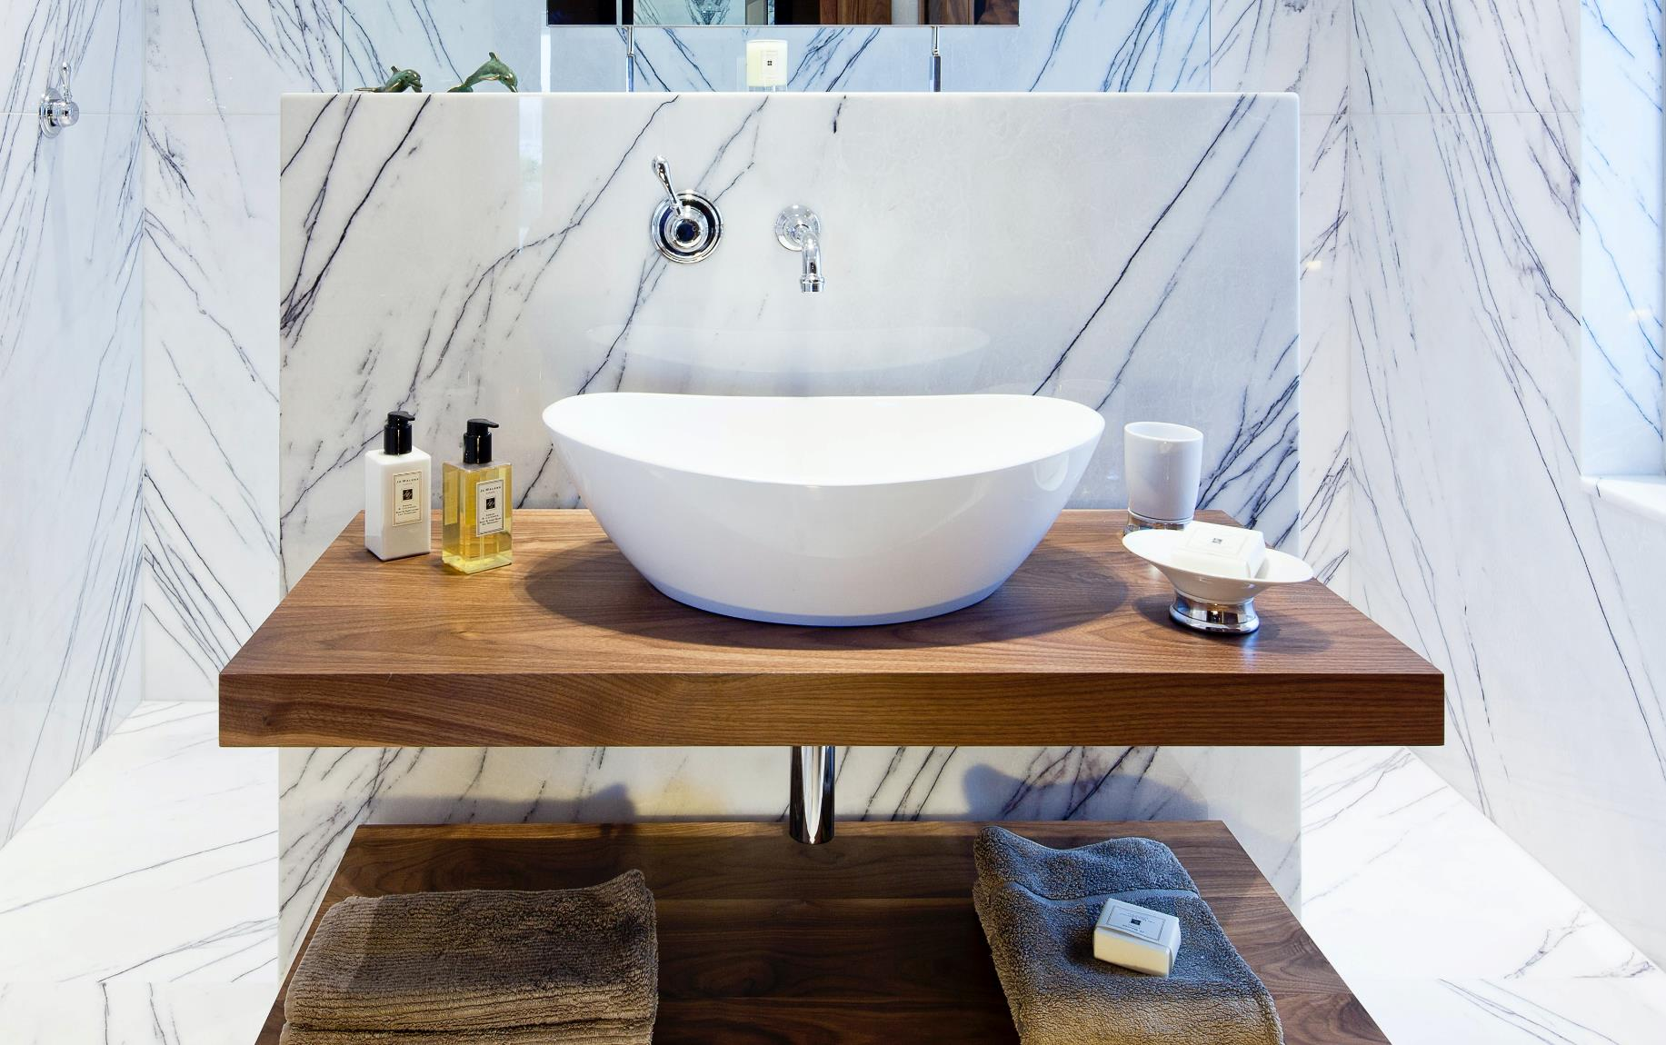
CHECK
Photo by Claire Rendall on Unsplash

Slide 23
lavabo

Slide 24
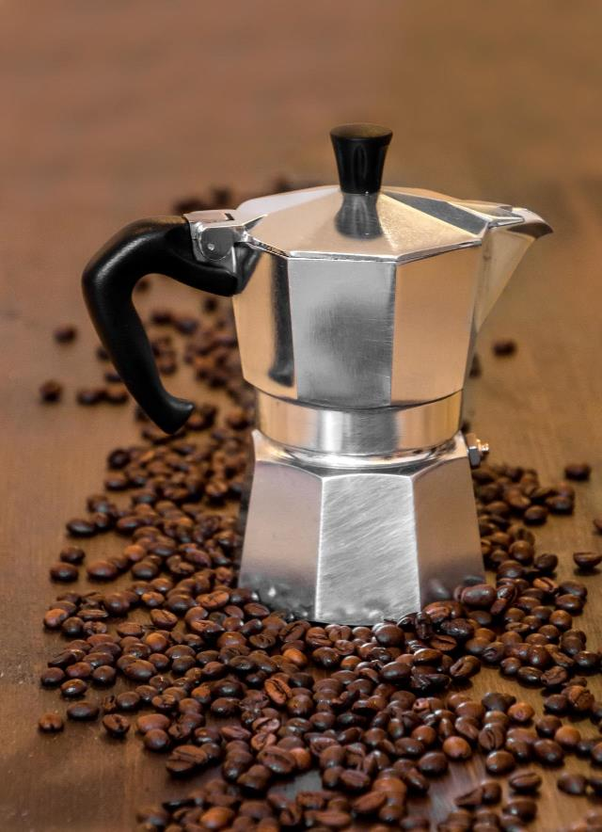
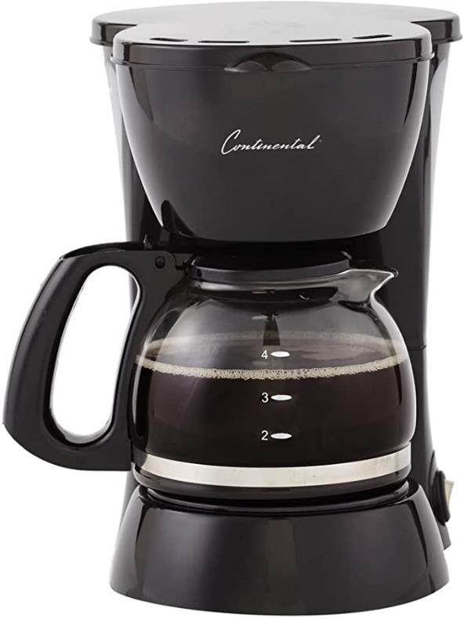
Photo from Amazon
Imagen de Pfüderi en Pixabay
CHECK

Slide 25
cafetera

Slide 26
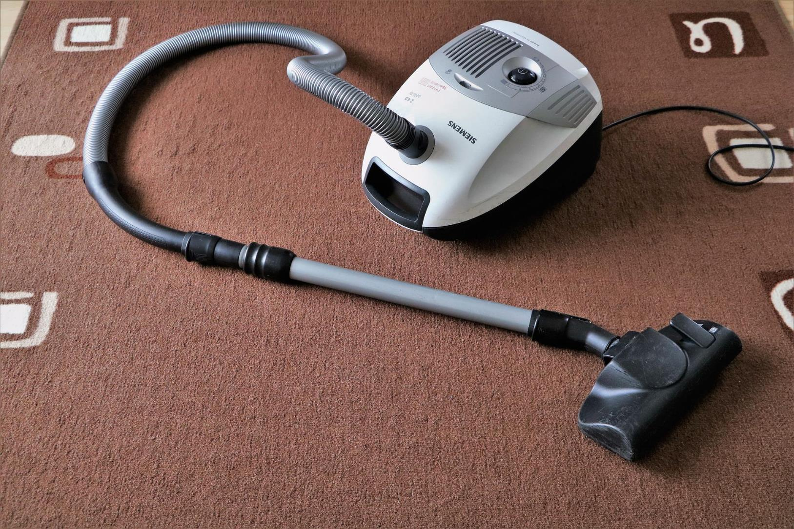
CHECK
Imagen de 22594 en Pixabay

Slide 27
aspiradora

Slide 28
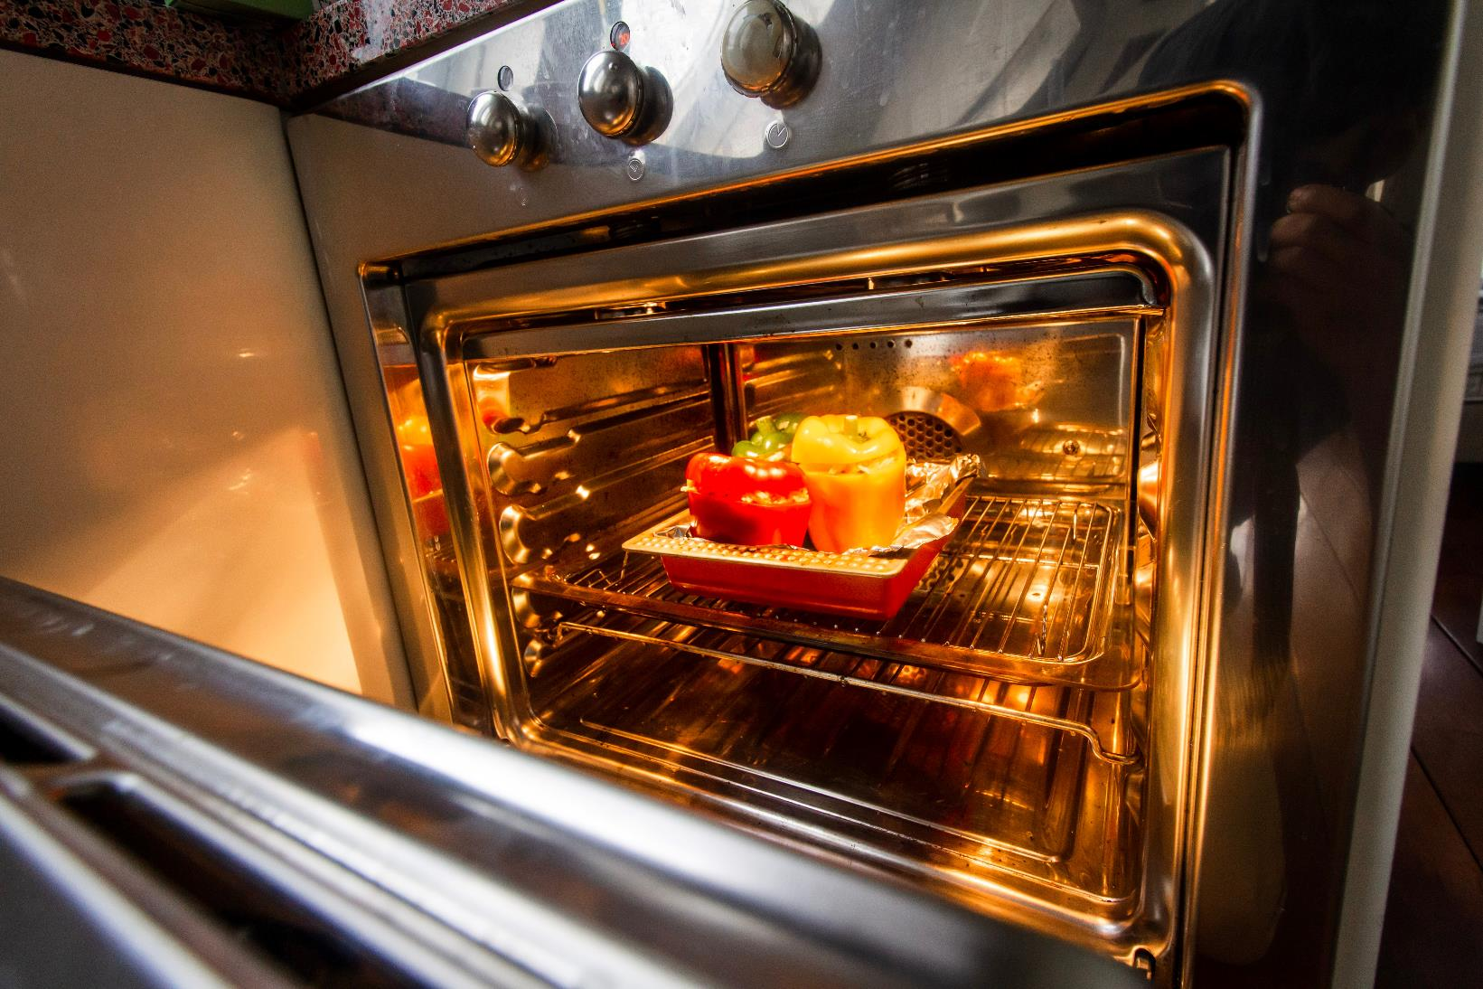
Photo by Louis Hansel on Unsplash
CHECK

Slide 29
horno

Slide 30


Third Category - 400
INSERT QUESTION HERE
CHECK
Notes:
You will have to move the Daily Double picture out of the way to write the question. If you do not wish to have the Daily Double in the game, delete it and the sound clip (speaker) from this slide. For a Daily Double, the contestant has to wager at least $5 and at most the highest point value of any player/team at that point in the game. It is considered a True Daily Double if they wager all of their points and go “double or nothing”.

Slide 31
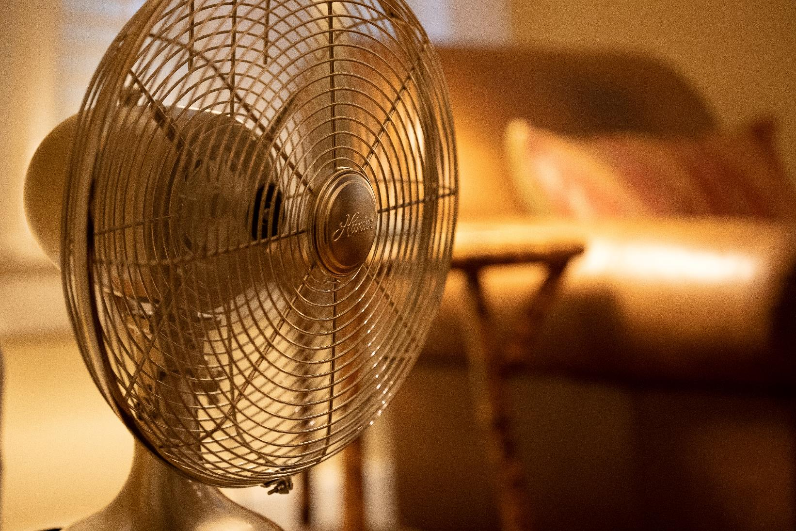
Photo by Delaney Van on Unsplash
CHECK
Notes:
You will have to move the Daily Double picture out of the way to write the question. If you do not wish to have the Daily Double in the game, delete it and the sound clip (speaker) from this slide. For a Daily Double, the contestant has to wager at least $5 and at most the highest point value of any player/team at that point in the game. It is considered a True Daily Double if they wager all of their points and go “double or nothing”.

Slide 32
ventilador

Slide 33
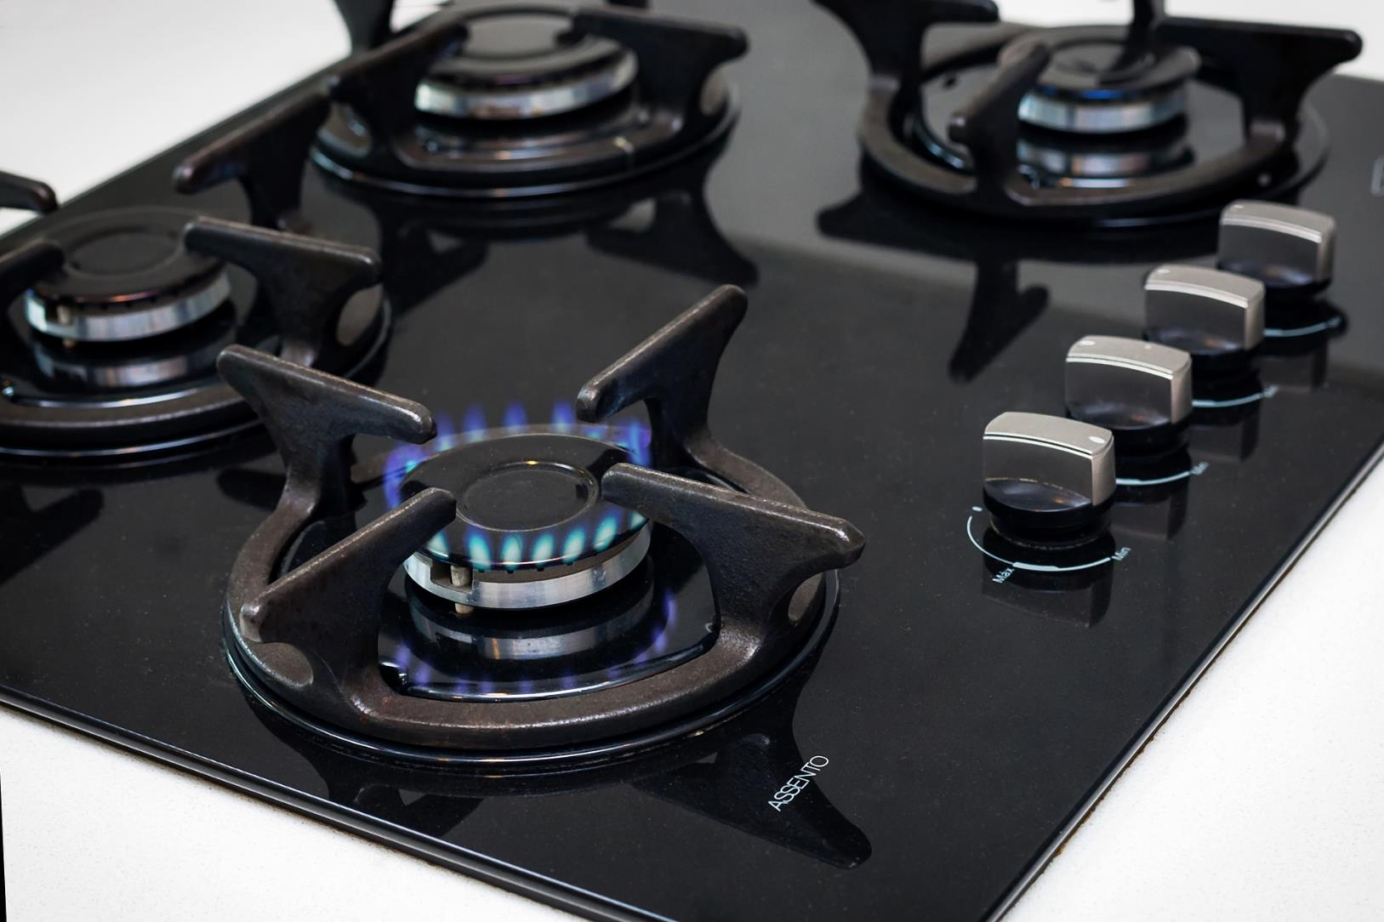
CHECK
Imagen de Fernando Arcos en Pixabay

Slide 34
estufa

Slide 35
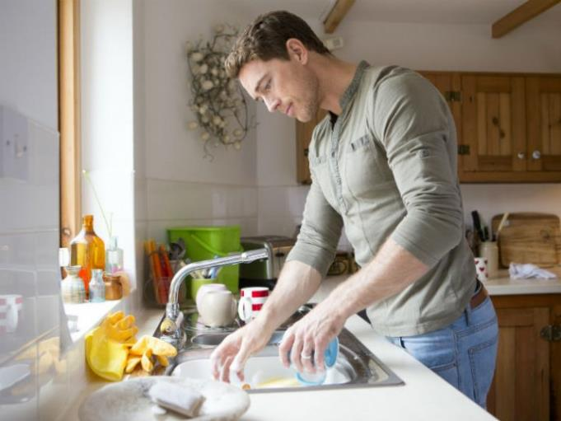
¿Qué hizo el hombre ayer?
Photo from Cocina Delirante
CHECK

Slide 36
El hombre lavó los platos.

Slide 37
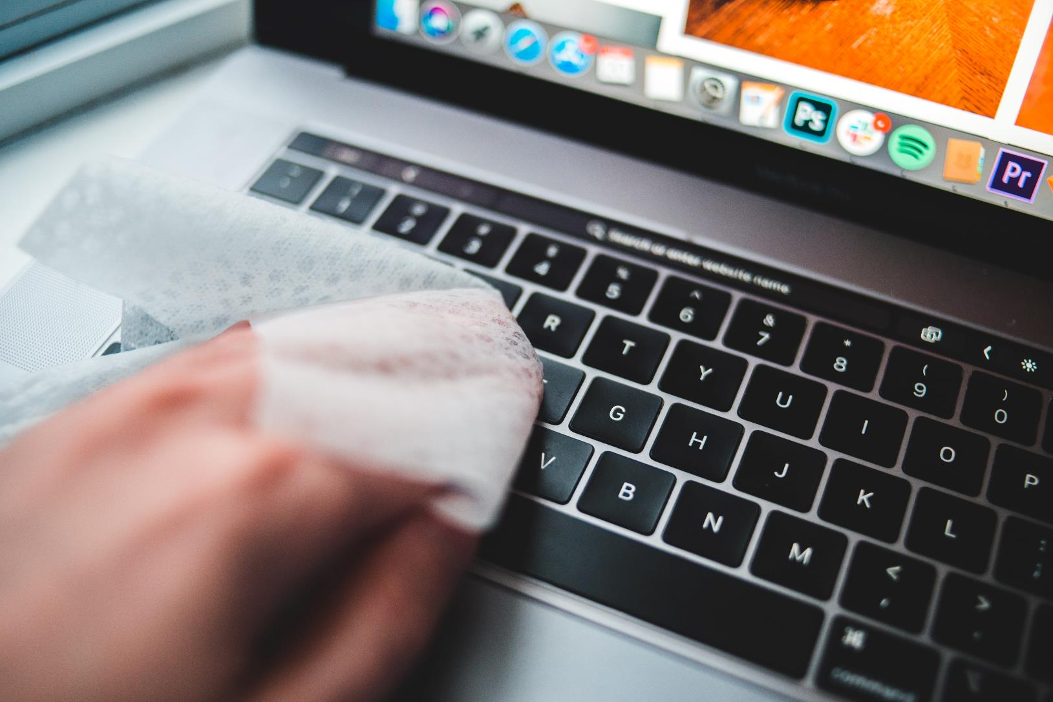
CHECK
Photo by Erik Mclean on Unsplash

Slide 38
El joven limpió los teclados de su computadora.

Slide 39
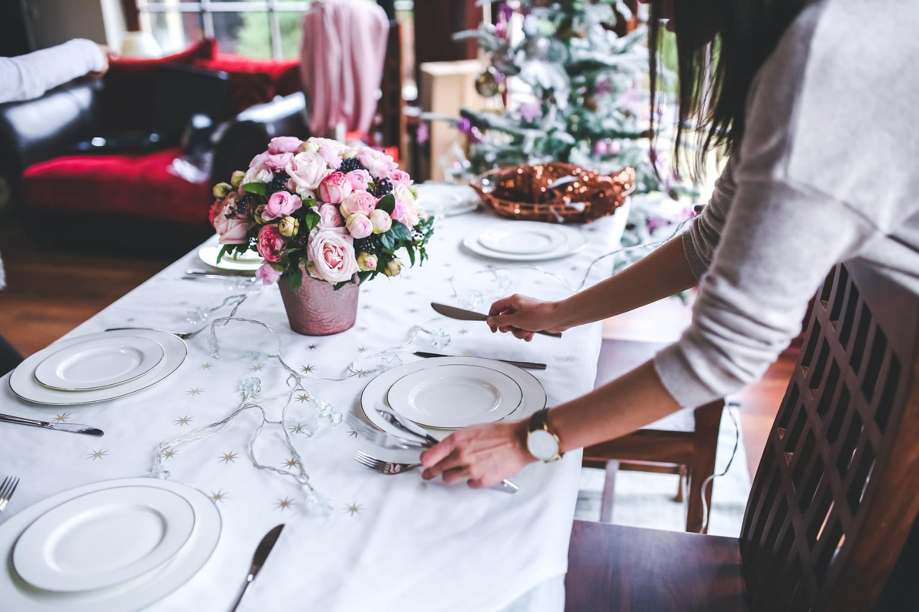
CHECK
Imagen de Karolina Grabowska en Pixabay

Slide 40
La joven puso la mesa para la fiesta.

Slide 41
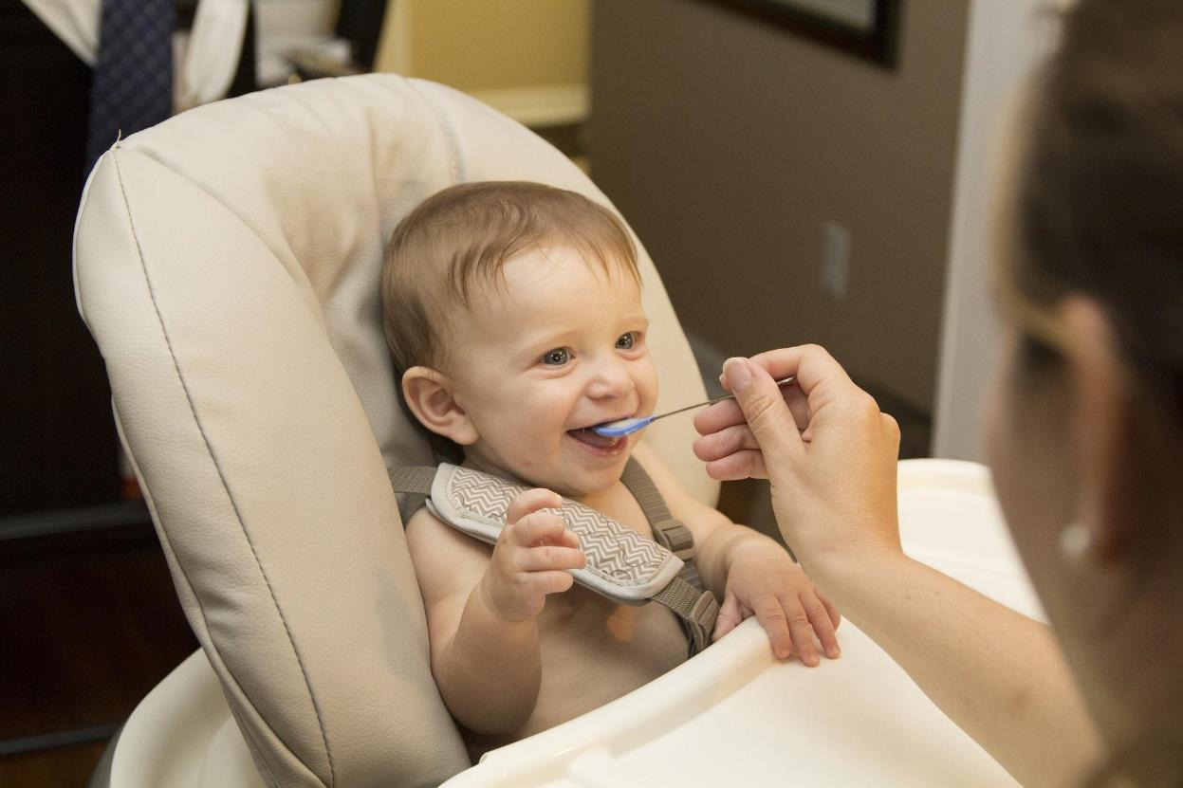
La mamá le ___ de comer a su hijo.
Imagen de 5686750 en Pixabay
CHECK

Slide 42
La mama le dio de comer a su hijo.

Slide 43
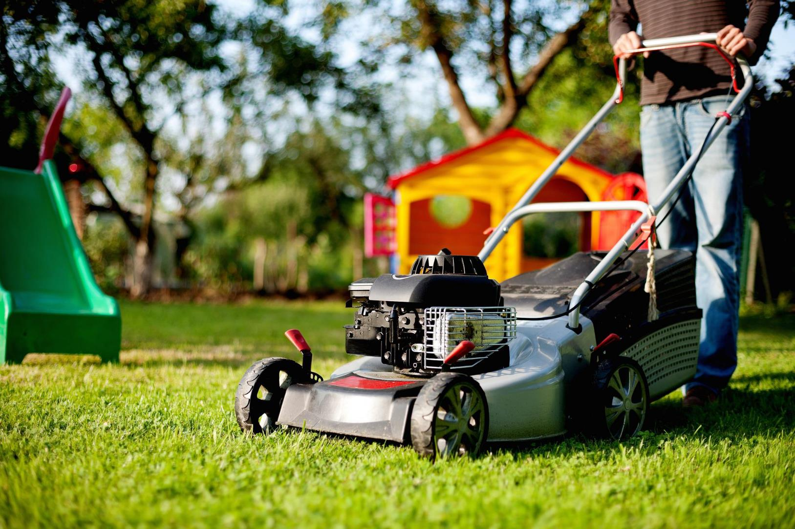
Imagen de andreas160578 en Pixabay
CHECK

Slide 44
El hombre cortó el césped.

Slide 45
En este lugar miramos exhibiciones de arte.
CHECK

Slide 46
museo

Slide 47
En este lugar vemos partidos de fútbol y béisbol.
CHECK

Slide 48
estadio

Slide 49
En este lugar compramos zapatos.
CHECK

Slide 50
zapatería

Slide 51
En este lugar bailamos.
CHECK

Slide 52
discoteca

Slide 53
En este lugar rezamos y asistimos a misa.
CHECK

Slide 54
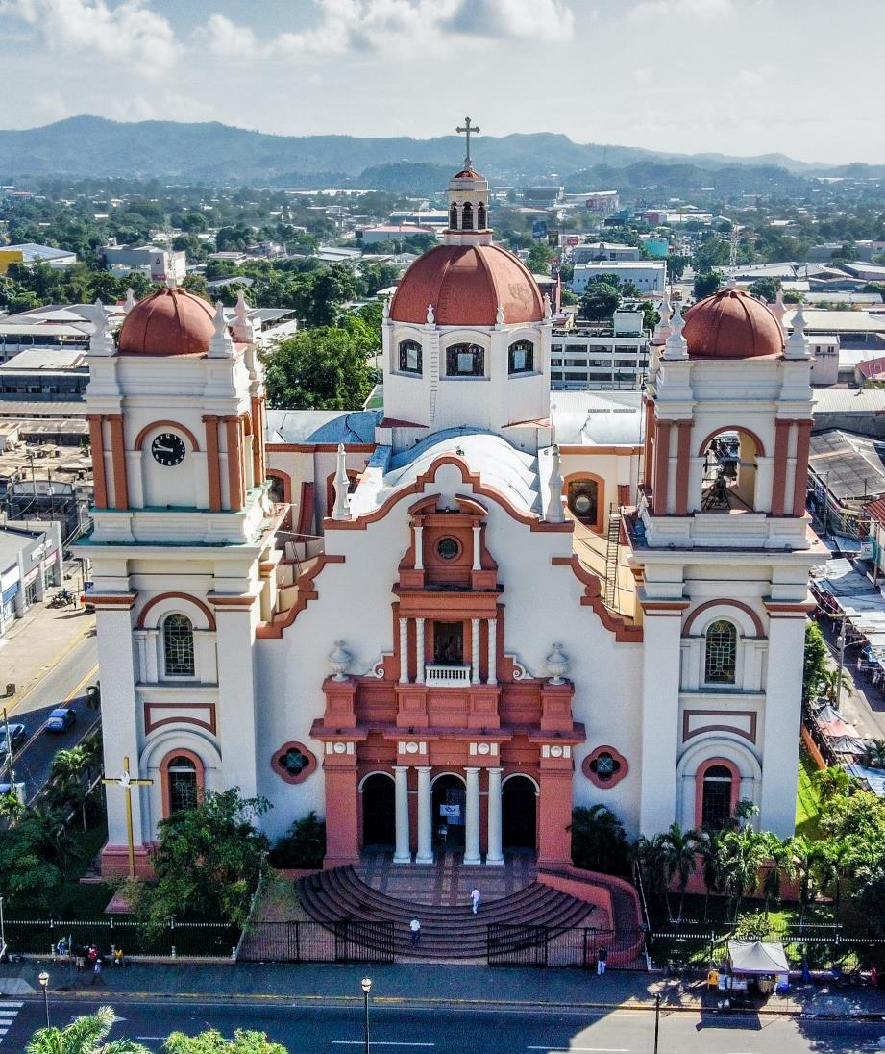
iglesia
Photo by Héctor Emilio Gonzalez on Unsplash
San Pedro Sula,
Honduras

Slide 55
En este lugar compramos ropa.
CHECK

Slide 56
almacén/tienda

Slide 57
En este lugar hay muchos libros, computadoras y estudiantes leyendo.
CHECK

Slide 58
biblioteca

Slide 59
En este lugar compramos verduras y carnes.
CHECK

Slide 60
(super)mercado

Slide 61
En este lugar lavamos la ropa sucia.
CHECK

Slide 62
lavandería

Slide 63
En este lugar compamos estampillas y mandamos cartas y paquetes.
CHECK

Slide 64
correo (central)

Slide 65
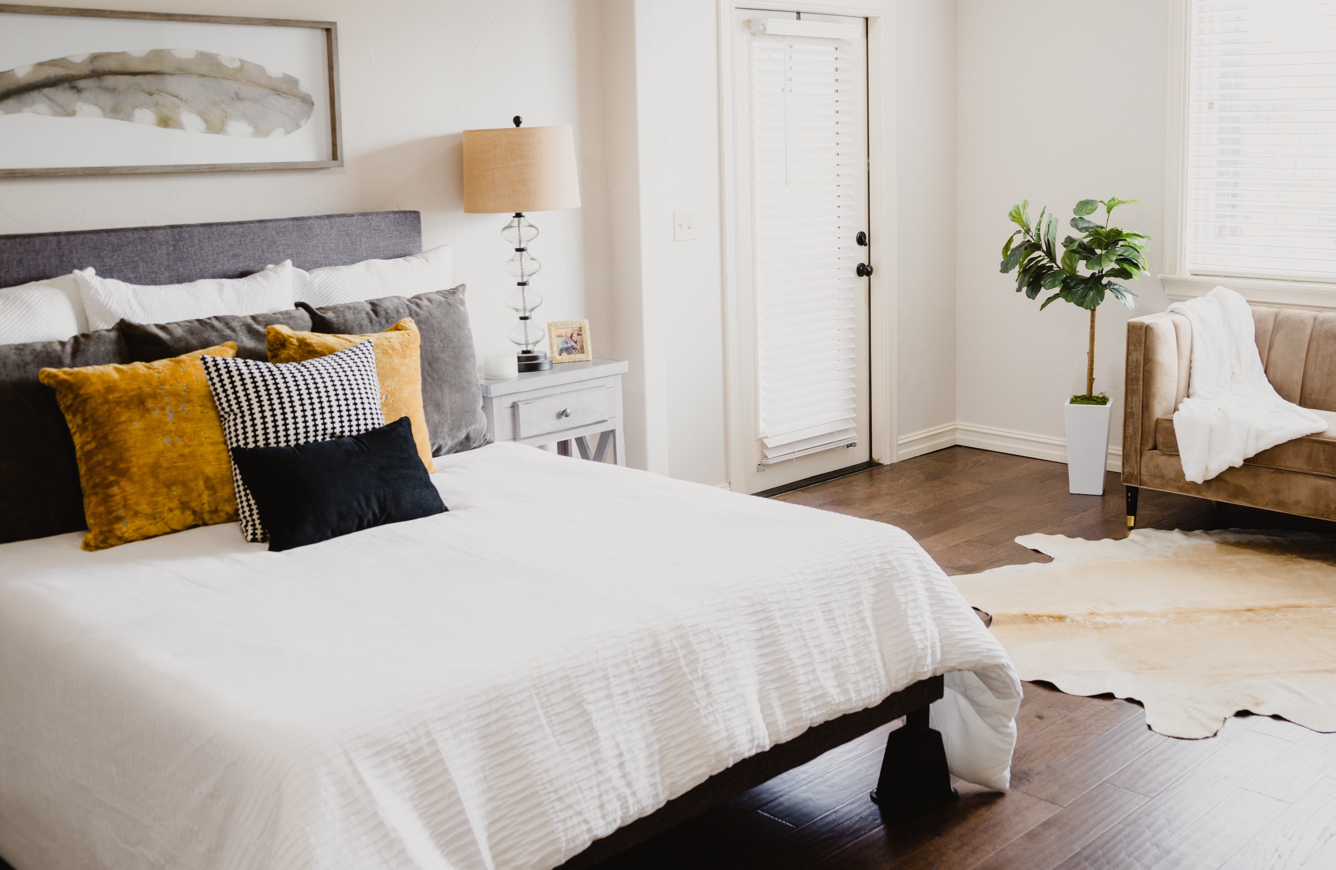
CHECK
Photo by Isaac Martin on Unsplash

Slide 66
cama

Slide 67
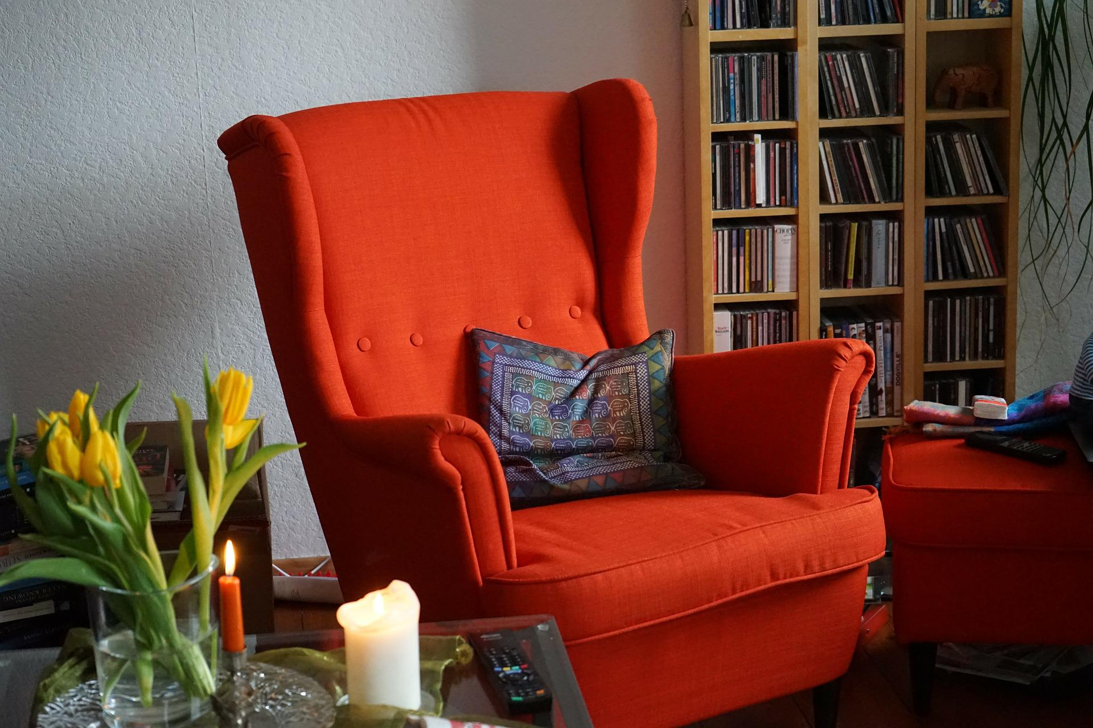
Imagen de Hans Braxmeier en Pixabay
CHECK

Slide 68
sillón

Slide 69
SEVENTH Category - 600
INSERT QUESTION HERE
CHECK
Notes:
You will have to move the Daily Double picture out of the way to write the question. If you do not wish to have the Daily Double in the game, delete it and the sound clip (speaker) from this slide. For a Daily Double, the contestant has to wager at least $5 and at most the highest point value of any player/team at that point in the game. It is considered a True Daily Double if they wager all of their points and go “double or nothing”.

Slide 70
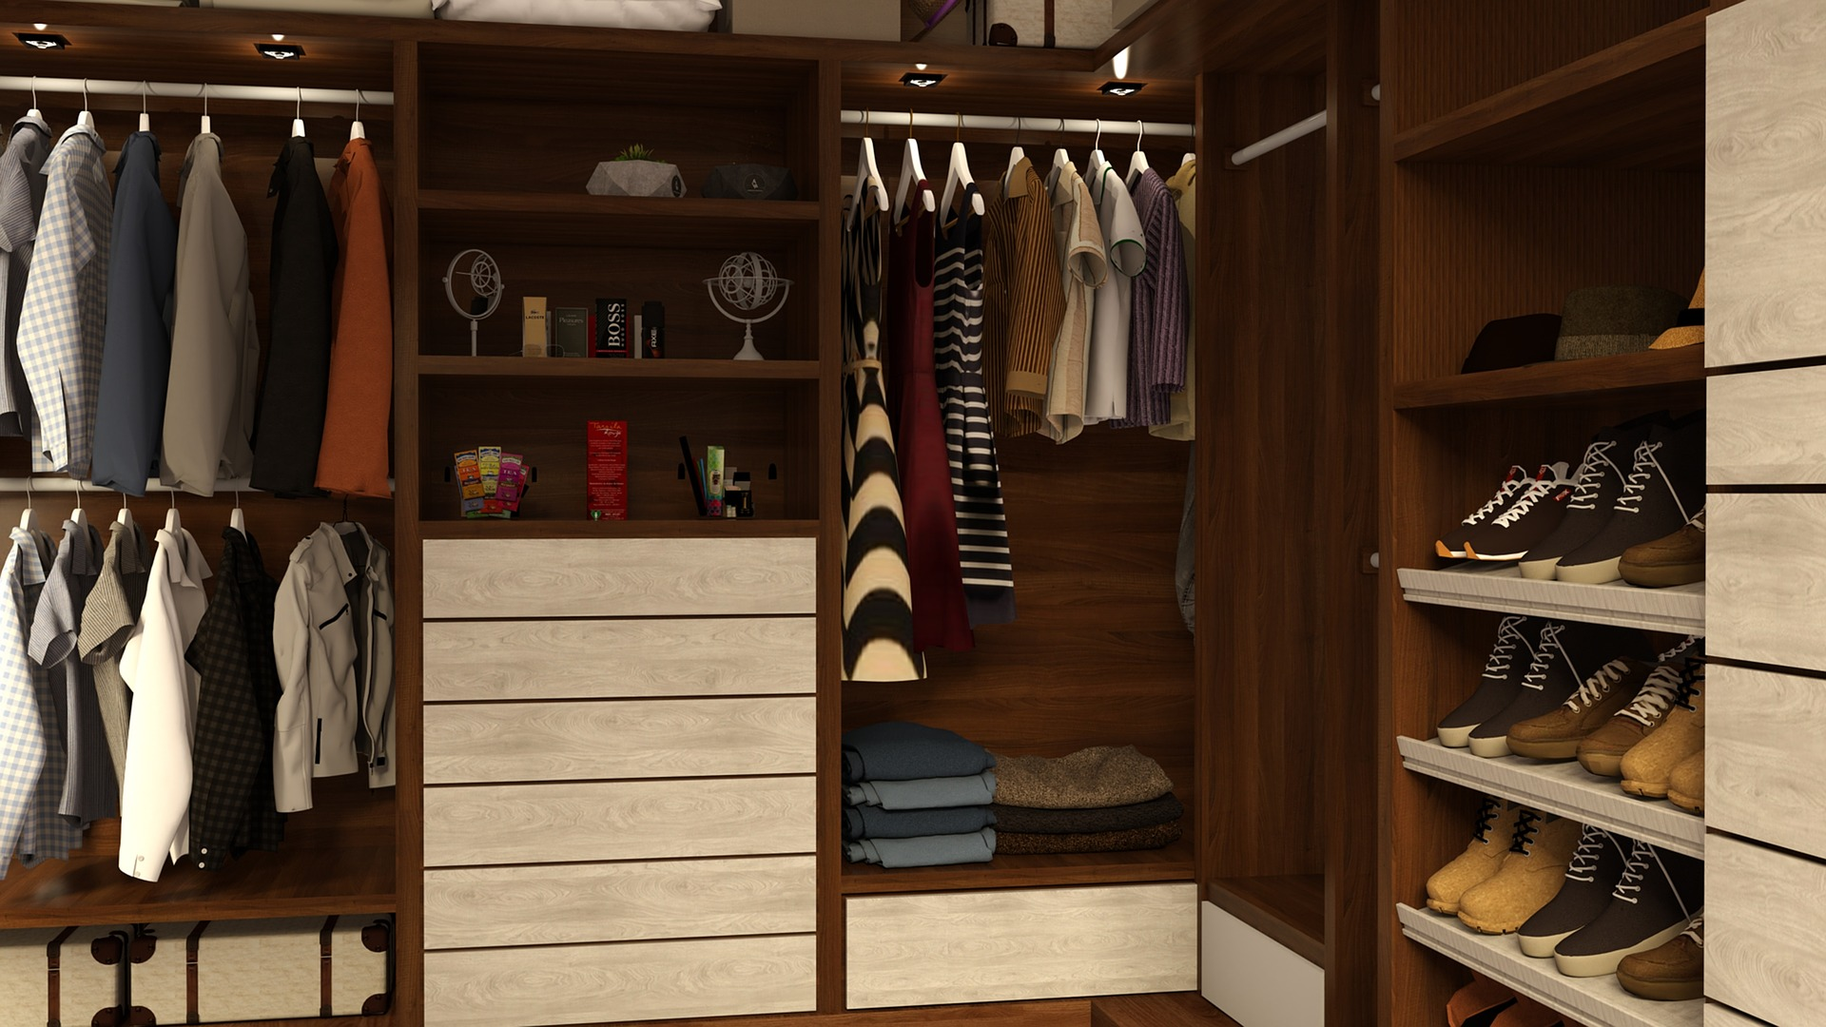
CHECK
Imagen de BUMIPUTRA en Pixabay
Notes:
You will have to move the Daily Double picture out of the way to write the question. If you do not wish to have the Daily Double in the game, delete it and the sound clip (speaker) from this slide. For a Daily Double, the contestant has to wager at least $5 and at most the highest point value of any player/team at that point in the game. It is considered a True Daily Double if they wager all of their points and go “double or nothing”.

Slide 71
armario

Slide 72
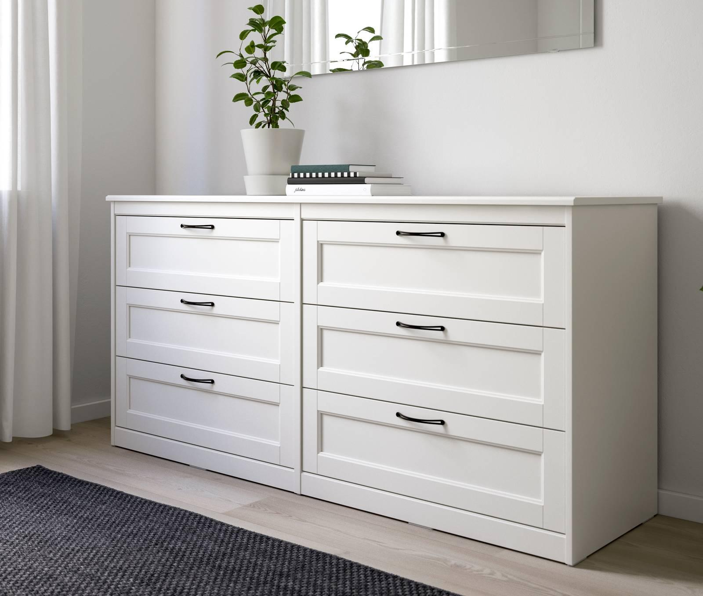
CHECK
Ikea image from Trinus.com

Slide 73
cómoda

Slide 74
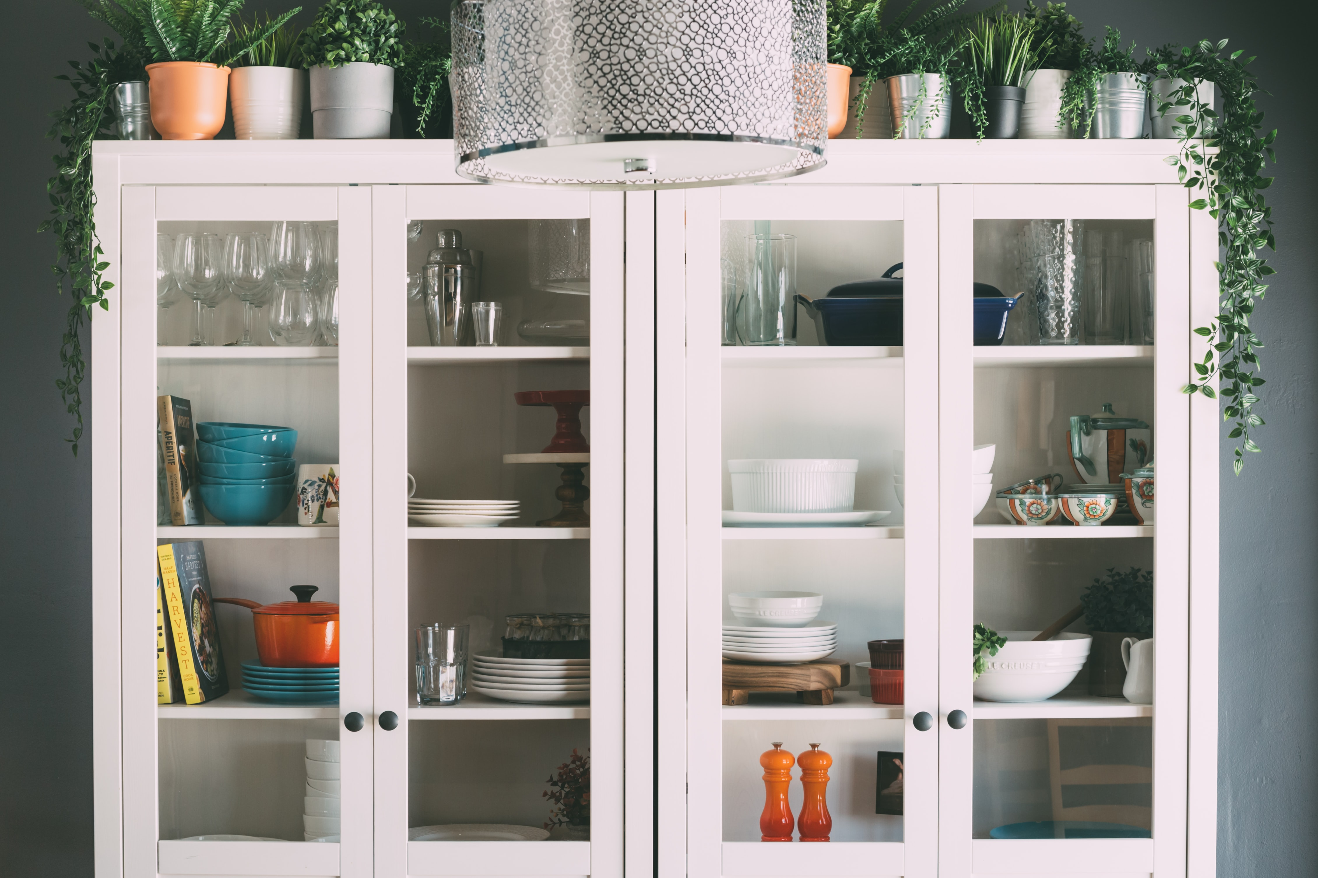
Photo by Le Creuset on Unsplash
CHECK

Slide 75
alacena

Slide 76
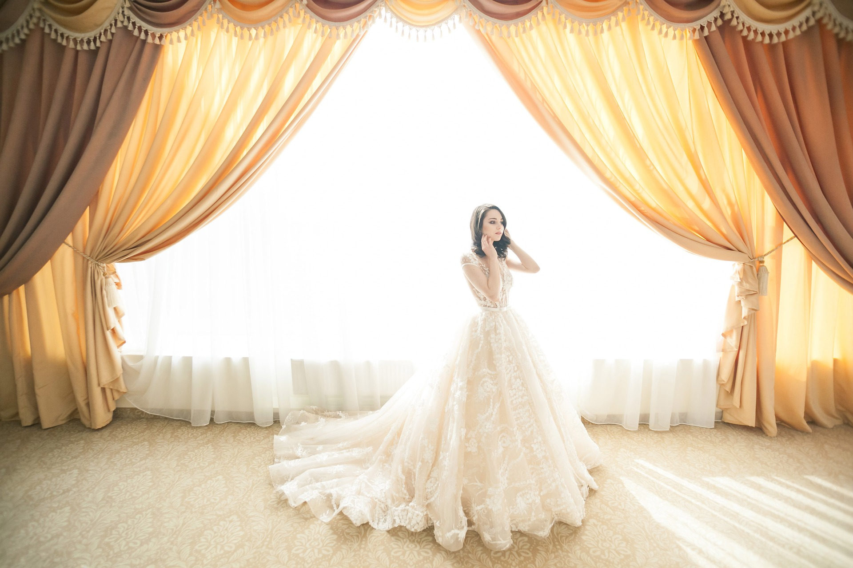
CHECK
Imagen de StockSnap en Pixabay

Slide 77
cortina

Slide 78
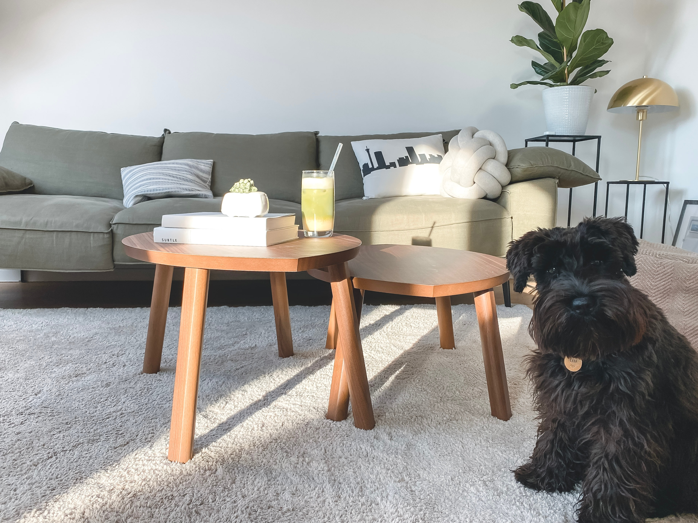
Photo by Katja Rooke on Unsplash
CHECK

Slide 79
alfombra

Slide 80
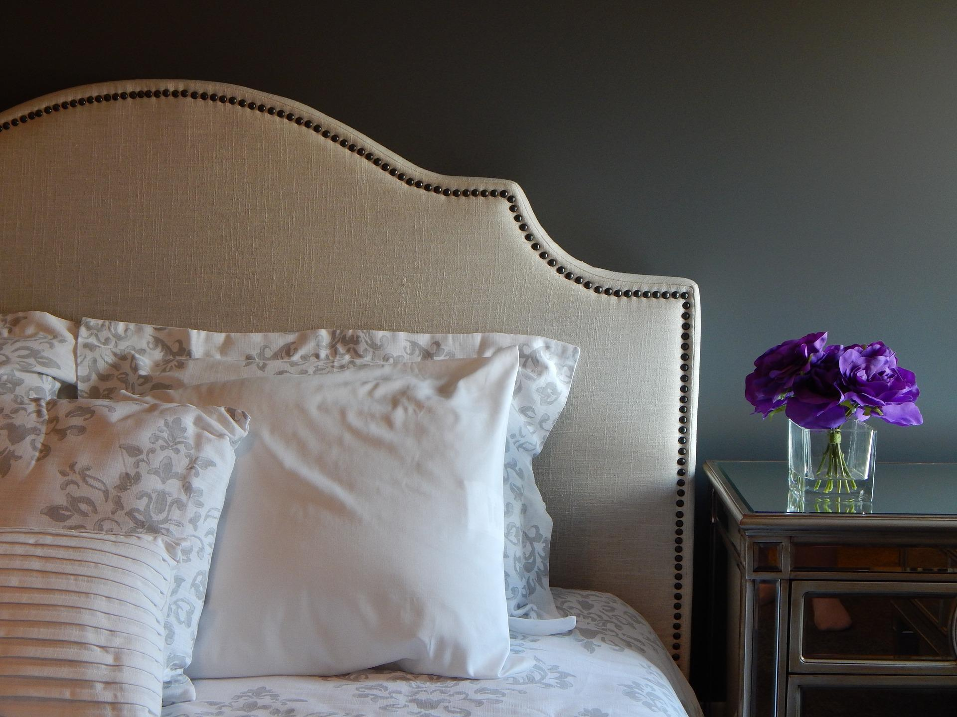
Imagen de ErikaWittlieb en Pixabay
CHECK

Slide 81
almohada

Slide 82
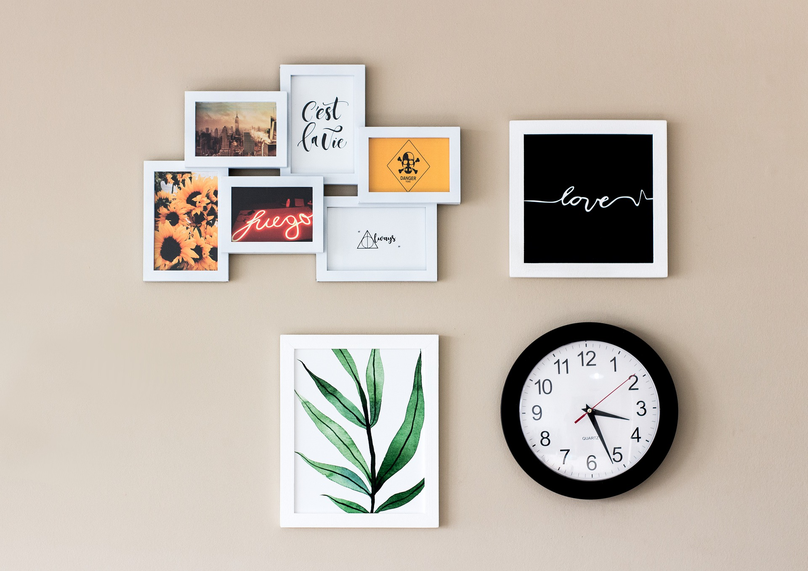
Imagen de Domenico Cervini en Pixabay
CHECK

Slide 83
cuadros

Slide 84
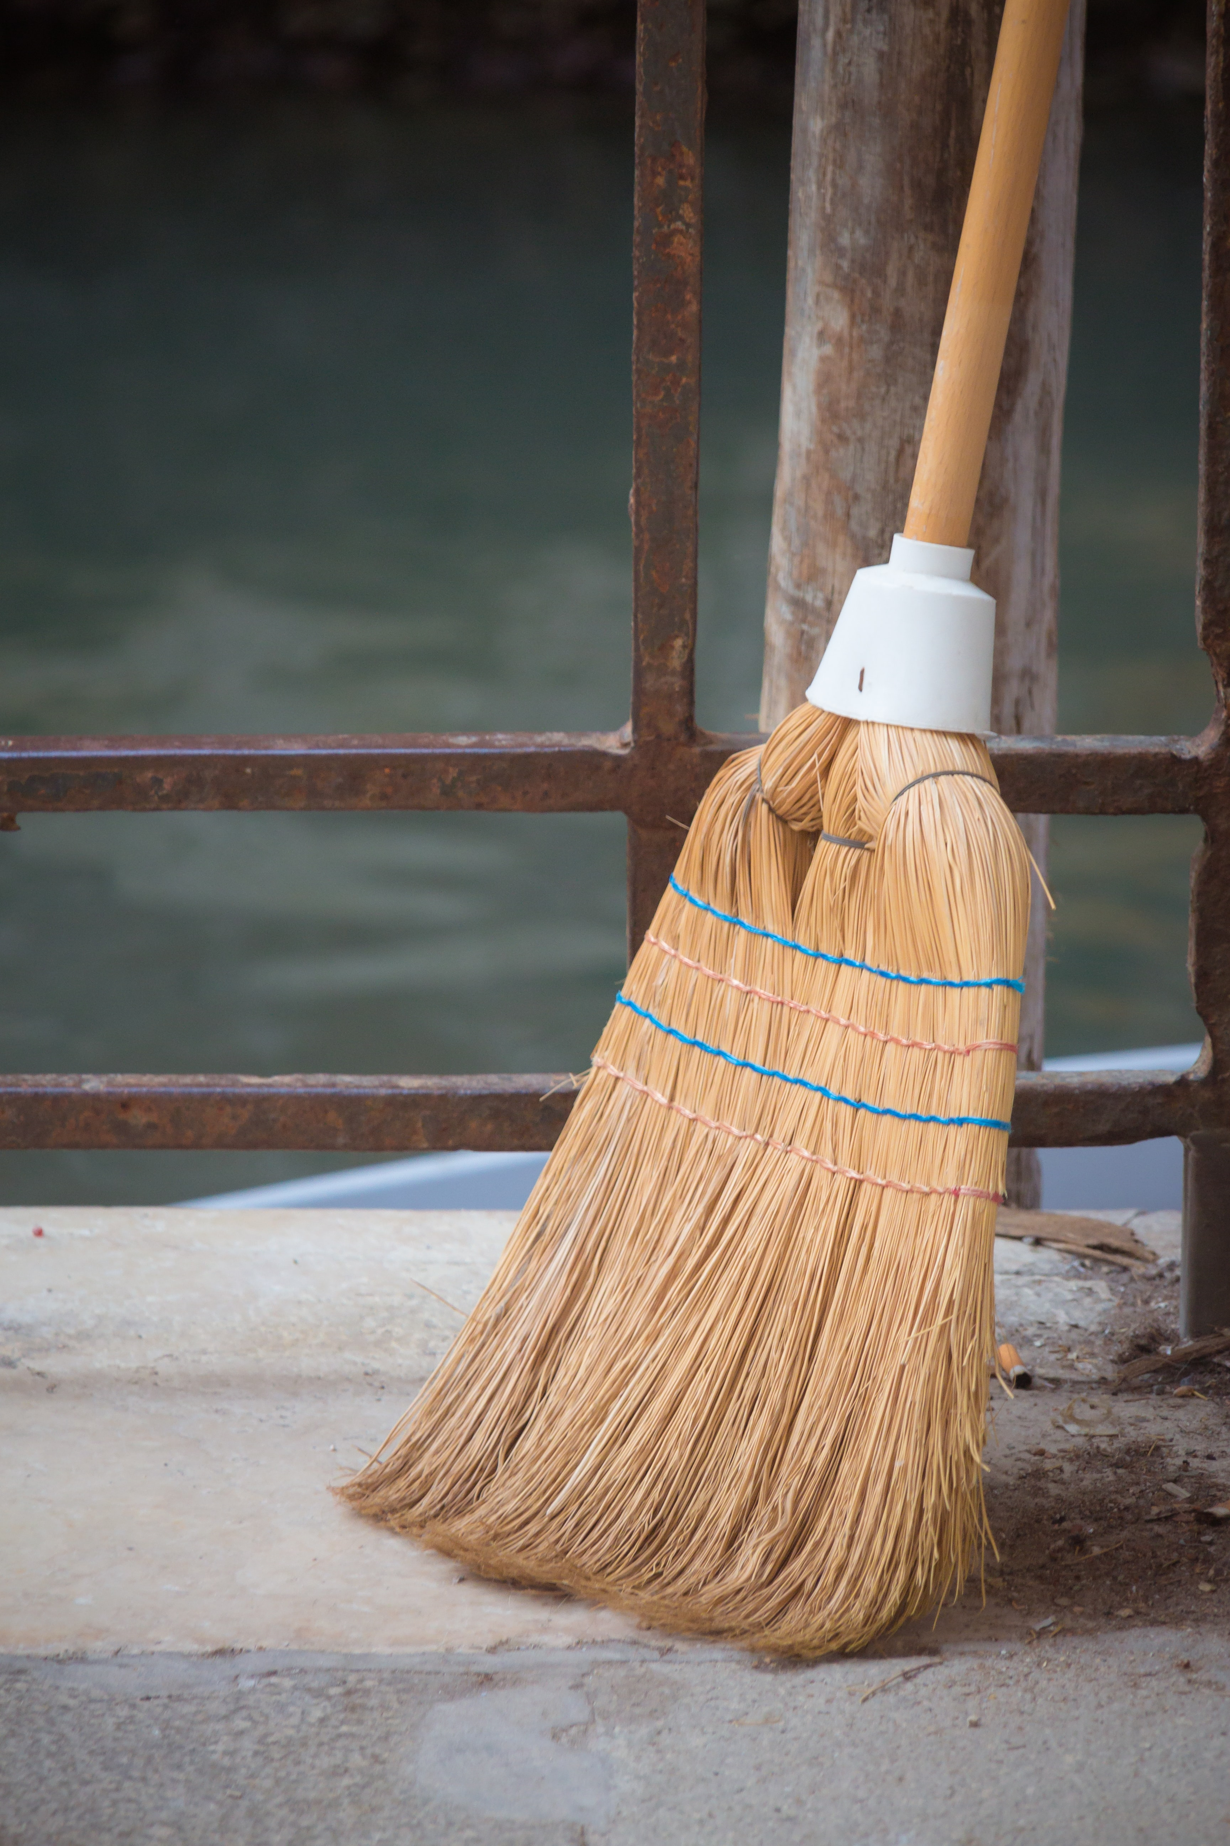
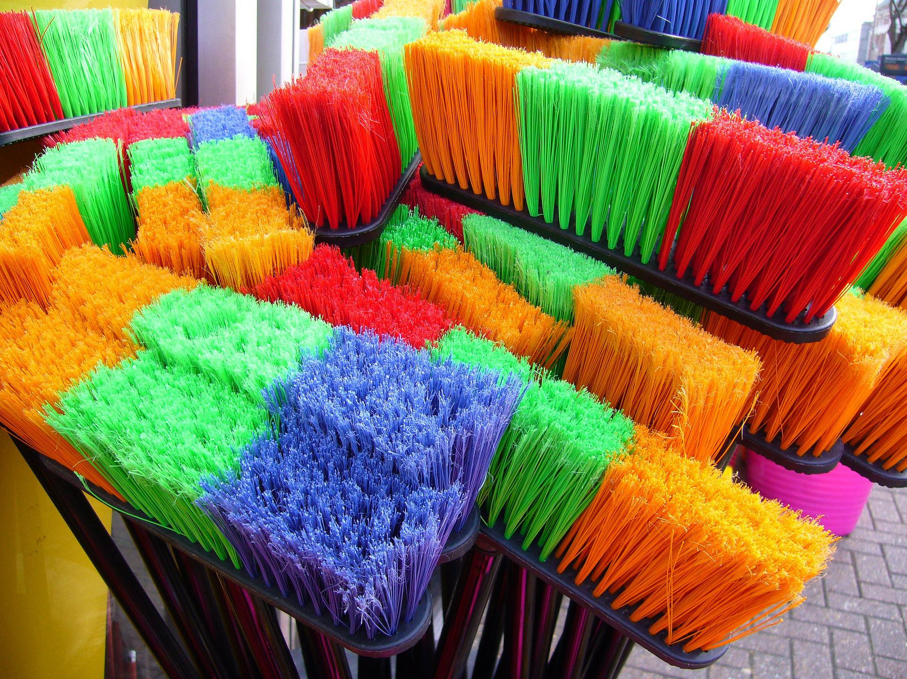
Imagen de Shirley Hirst en Pixabay
Photo by Magnus S on Unsplash
CHECK

Slide 85
escobas

Slide 86
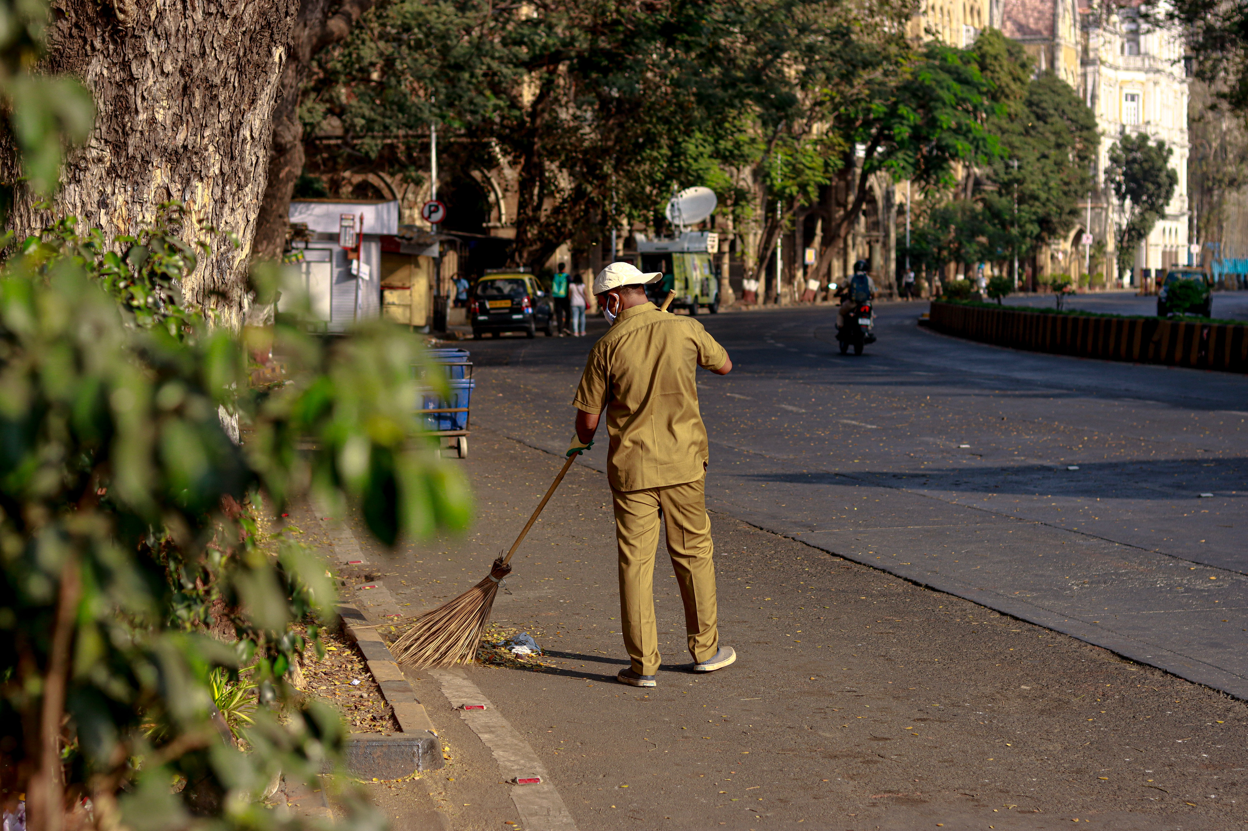
Photo by Tushar Gidwani on Unsplash
CHECK

Slide 87
El hombre barrió la calle.

Slide 88
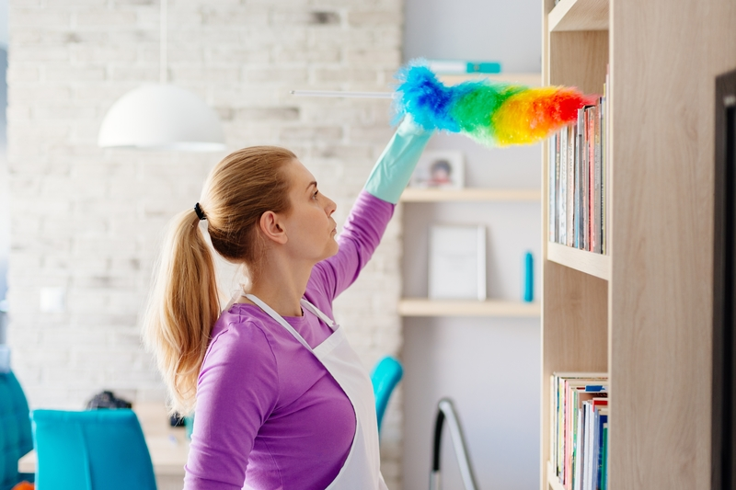
Image from Zanjani Cleaning Service
CHECK

Slide 89
La señora desempolvó el estante de libros.

Slide 90
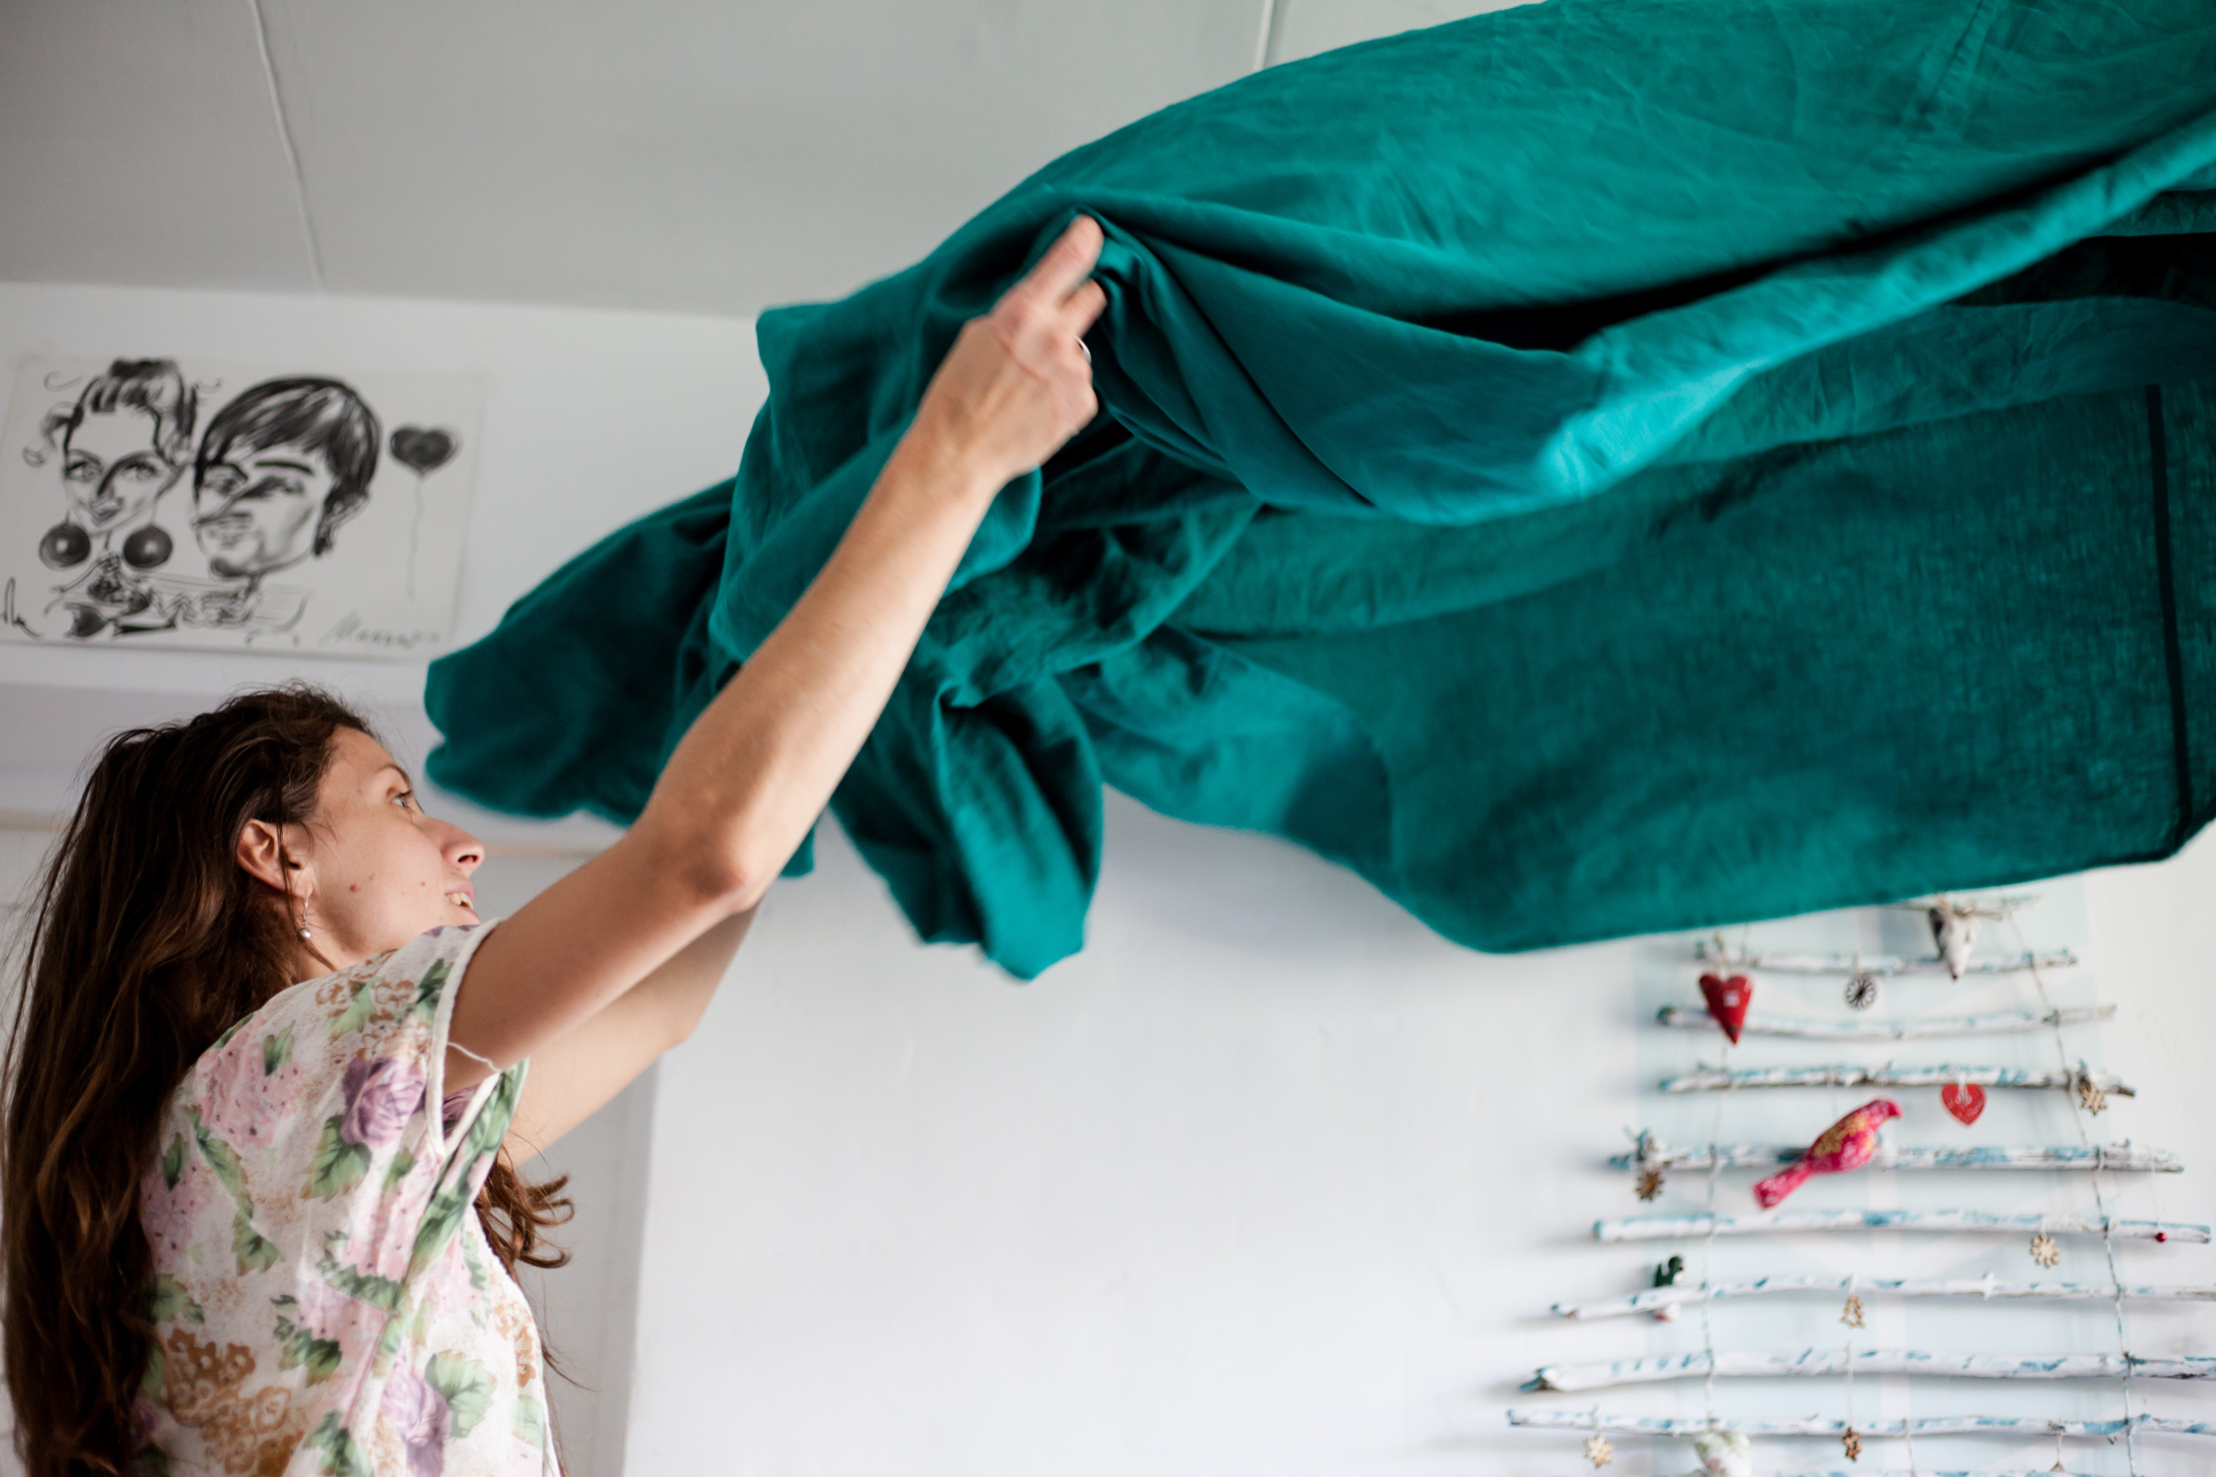
CHECK
Photo by Volha Flaxeco on Unsplash

Slide 91
La mamá tendió la cama.

Slide 92

CHECK
Image from Me Lo Dijo Pérez

Slide 93
La señora regó las plantas.

Slide 94
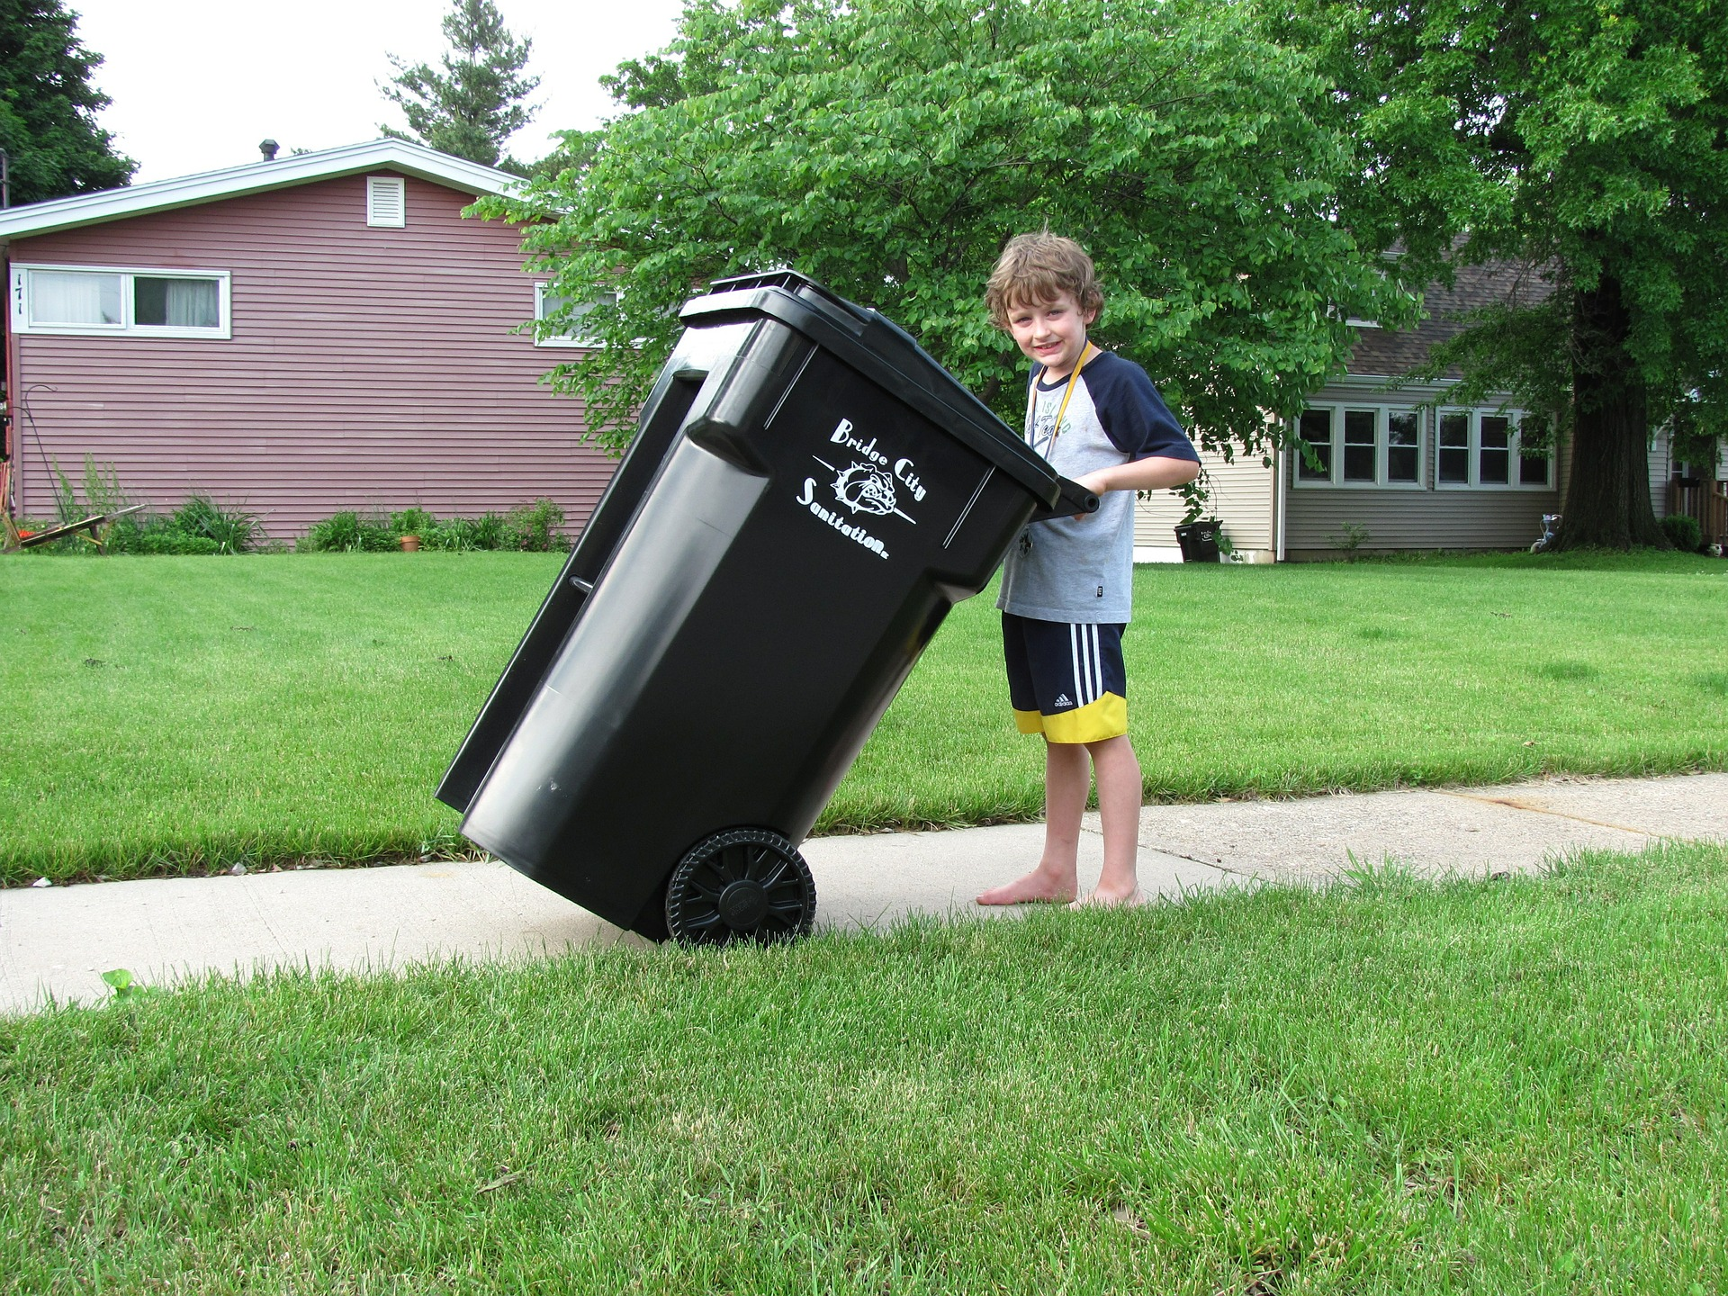
CHECK
Imagen de Jarrod Blamey en Pixabay

Slide 95
El niño sacó la basura.

Slide 96
Tenth Category 200
INSERT QUESTION HERE
CHECK
Notes:
You will have to move the Daily Double picture out of the way to write the question. If you do not wish to have the Daily Double in the game, delete it and the sound clip (speaker) from this slide. For a Daily Double, the contestant has to wager at least $5 and at most the highest point value of any player/team at that point in the game. It is considered a True Daily Double if they wager all of their points and go “double or nothing”.

Slide 97
Barranquilla es famosa por su ___, una fiesta que se celebra en febrero o marzo.
CHECK
Notes:
You will have to move the Daily Double picture out of the way to write the question. If you do not wish to have the Daily Double in the game, delete it and the sound clip (speaker) from this slide. For a Daily Double, the contestant has to wager at least $5 and at most the highest point value of any player/team at that point in the game. It is considered a True Daily Double if they wager all of their points and go “double or nothing”.

Slide 98
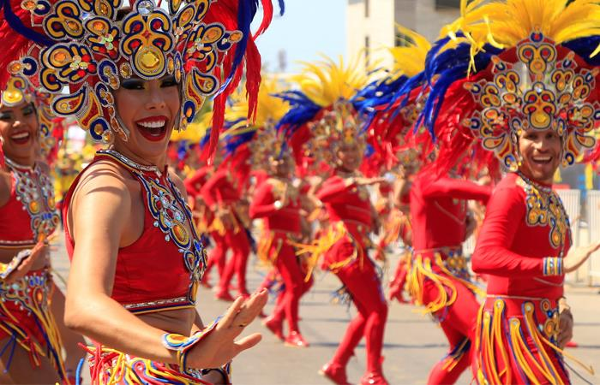
carnaval
Image from Mindomo

Slide 99
Población indígena que vive en las islas de
San Blas, Panamá.
CHECK

Slide 100
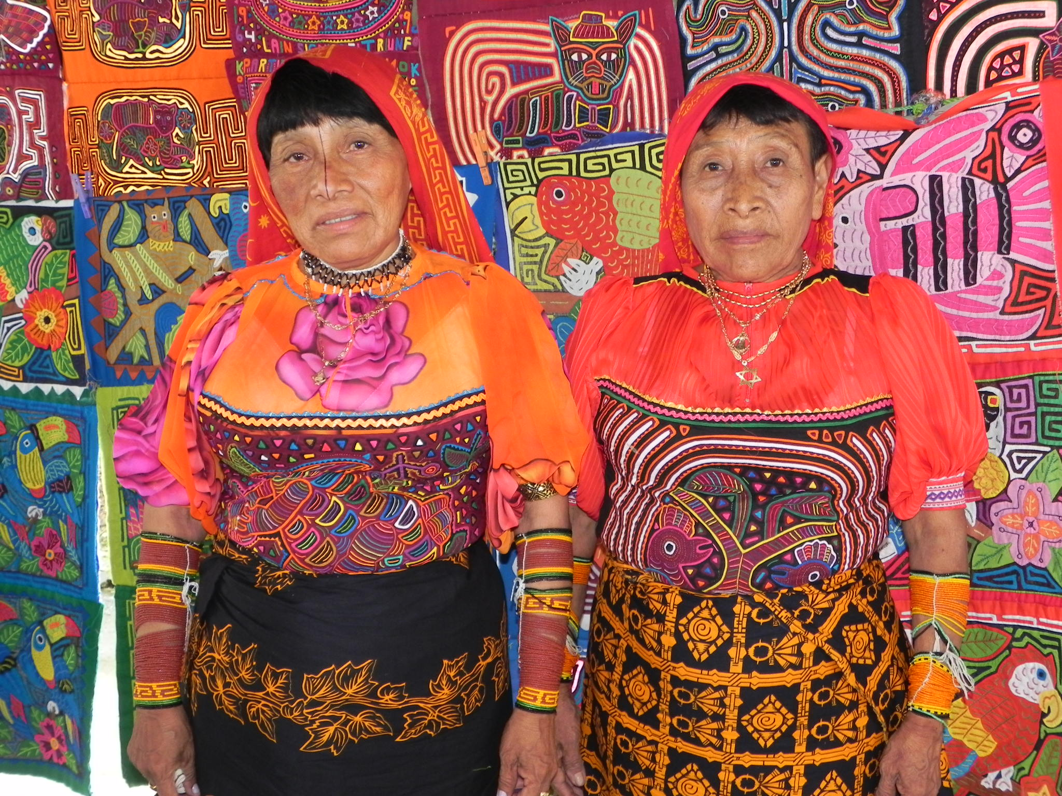
Los guna o los kunas
Foto de Beatrice Tseng

Slide 101
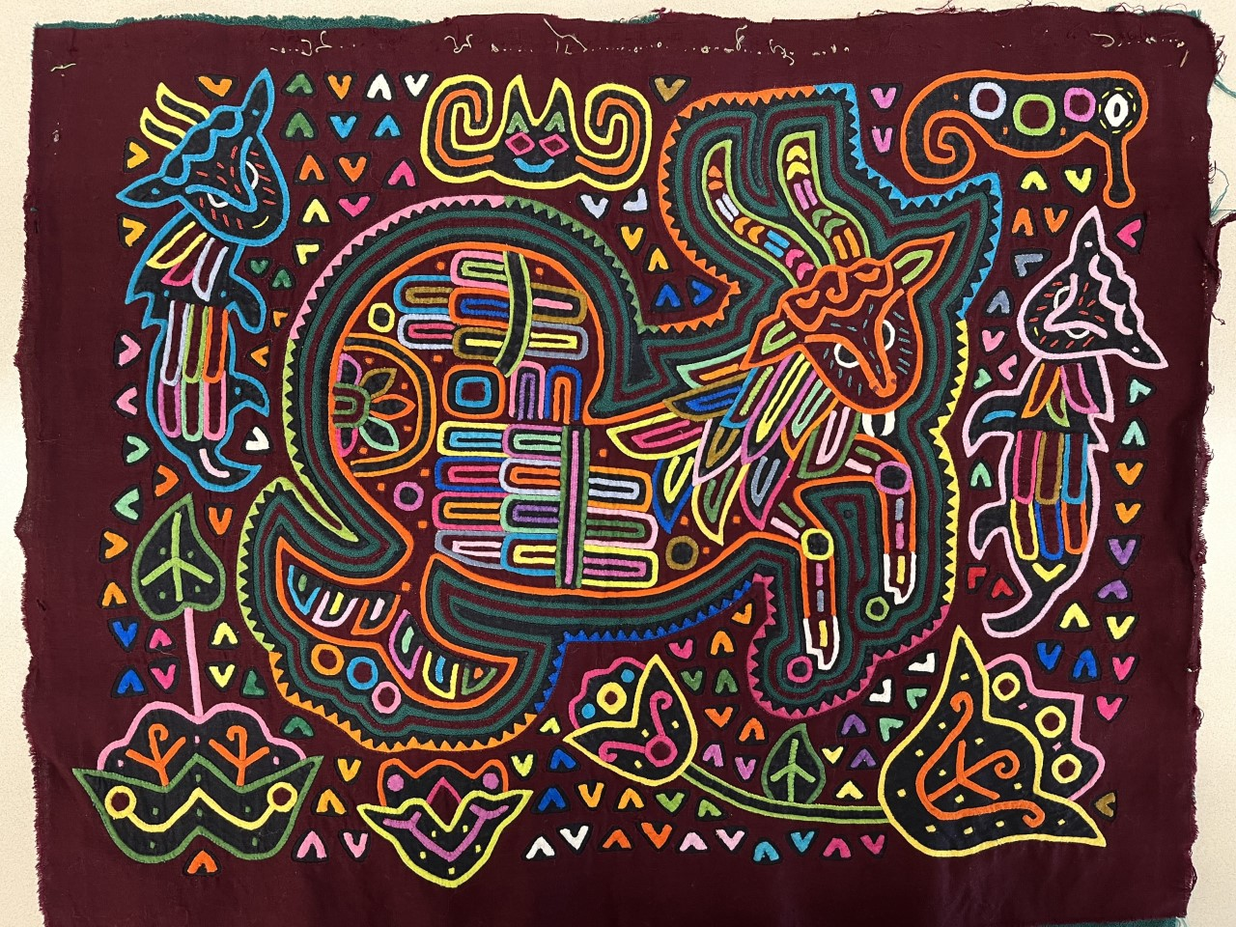
Nombre de este bordado
CHECK
Foto de Beatrice Tseng

Slide 102
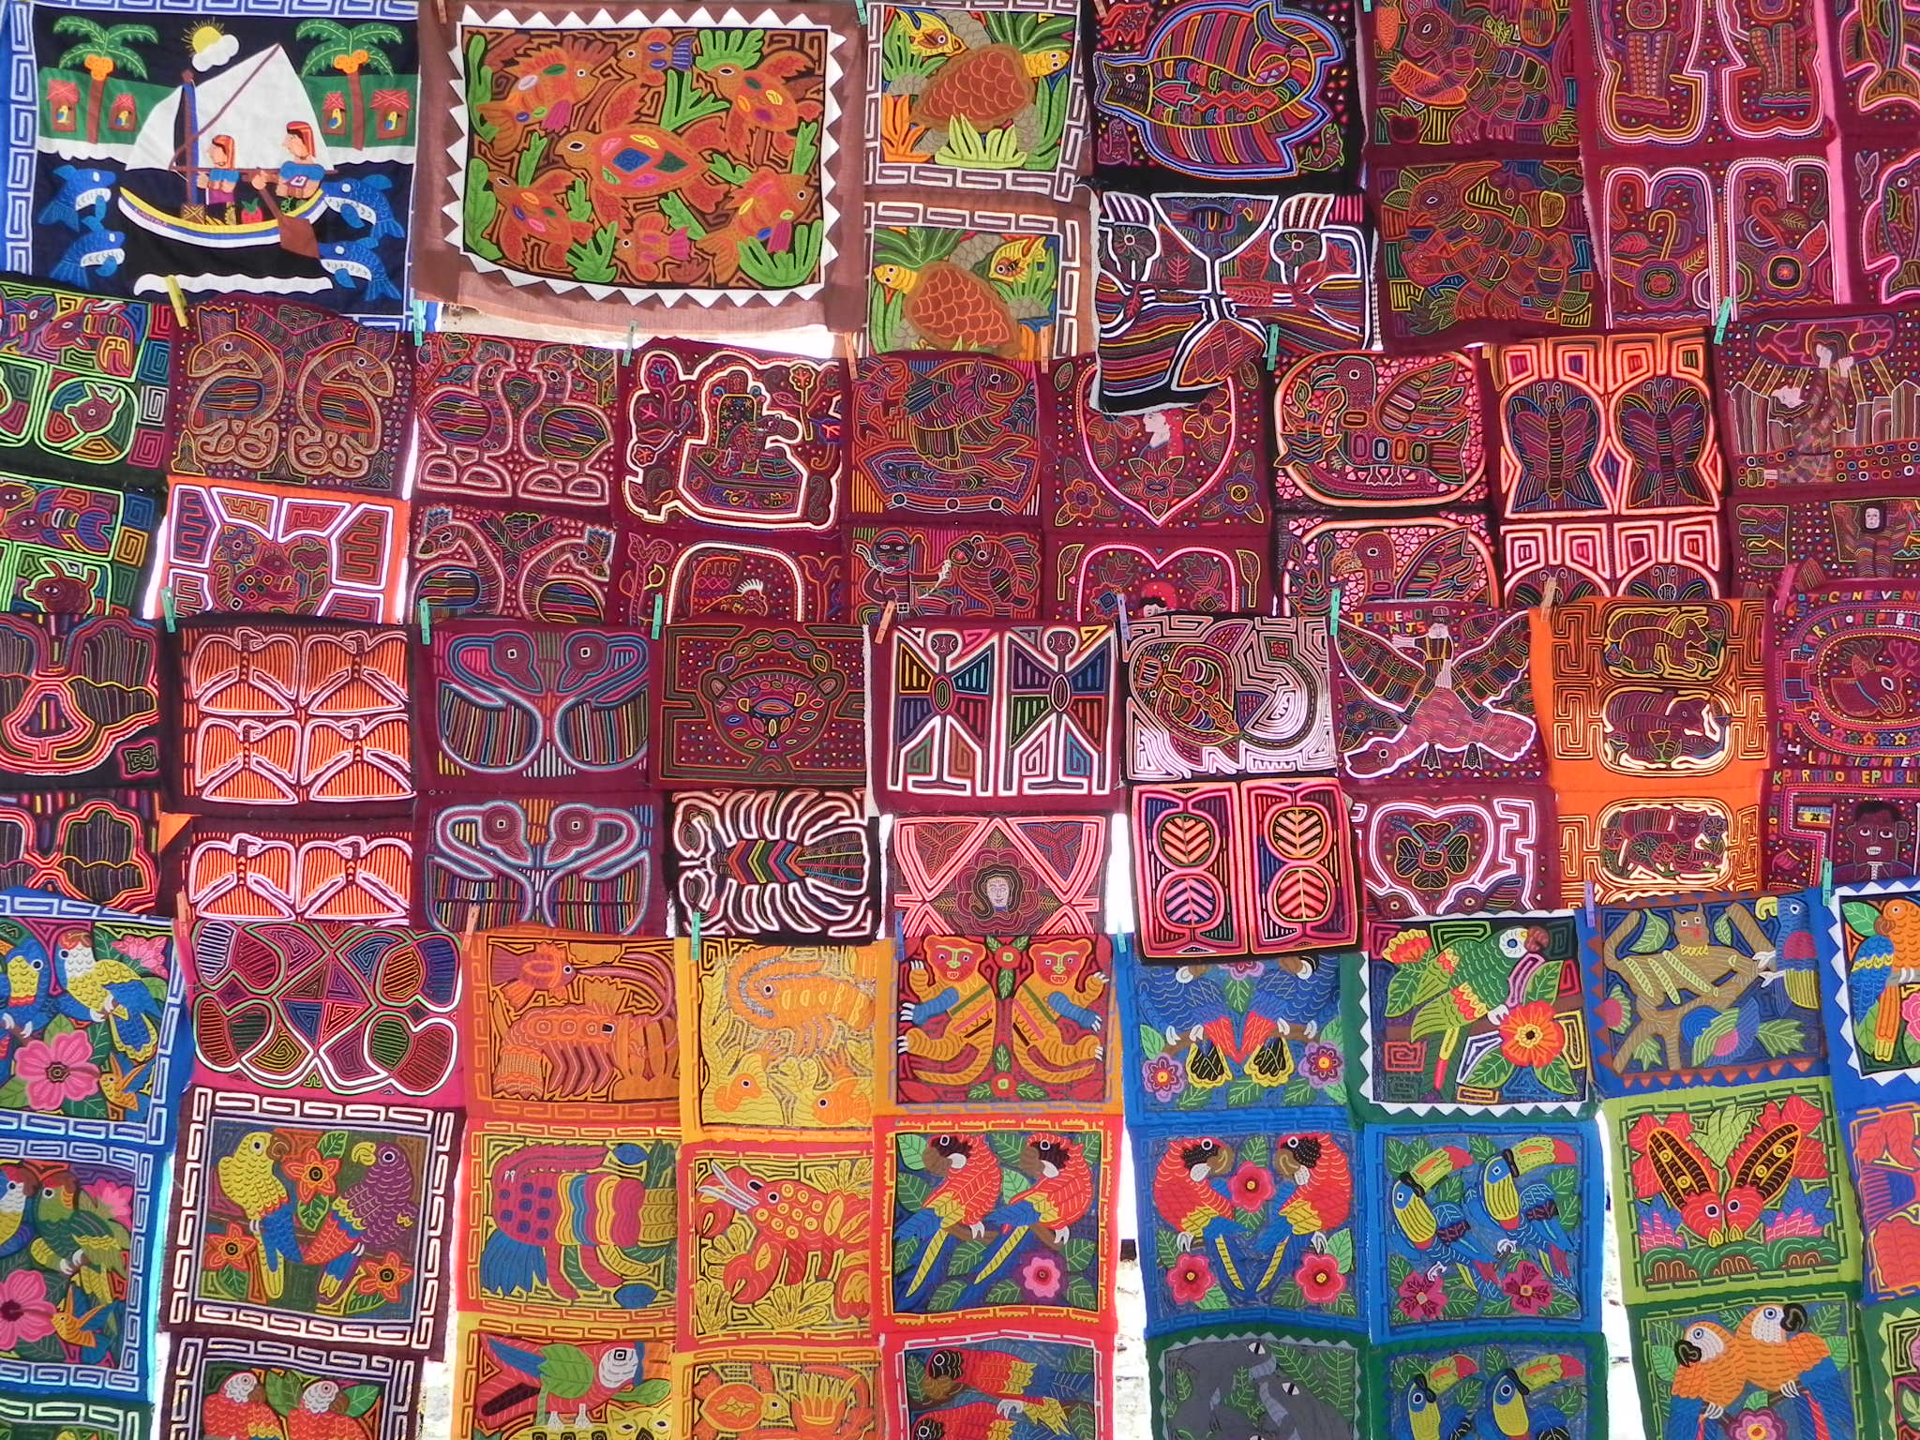
mola
Foto de Beatrice Tseng

Slide 103
Gabriel García Márquez es un famoso ___ colombiano.
(profesión)
CHECK

Slide 104
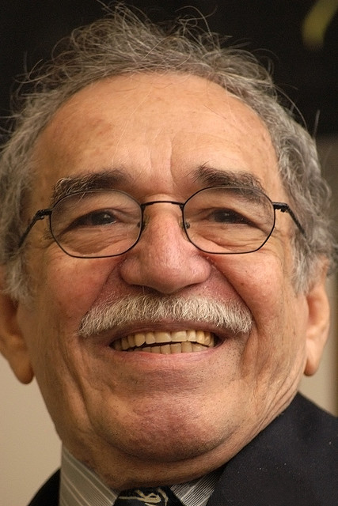
escritor
Photo from Wikimedia

Slide 105
Zona colonial en la Ciudad de Panamá con calles estrechas y plazas.
CHECK

Slide 106
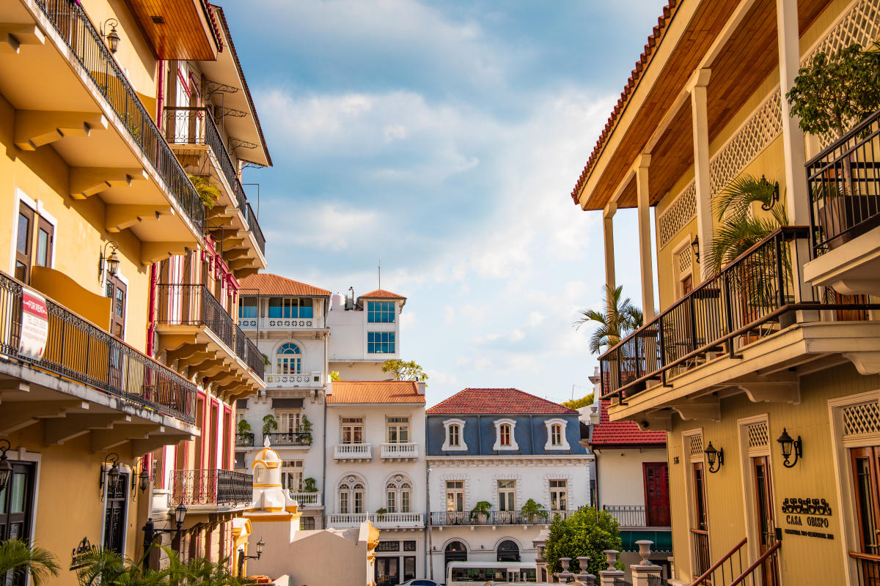
Casco Viejo
Image from Tourism Panama

Slide 107
JEOPARDY FINAL
Categoría:
Lugar
CHECK

Slide 108

En Zipaquirá hay una ___ de sal muy famosa.
CHECK

Slide 109
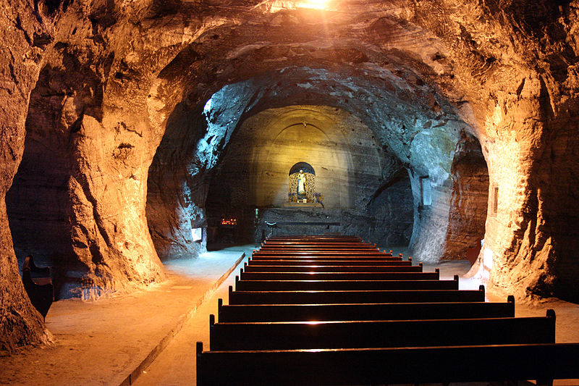
catedral de sal
Imagen de Wikimedia

