Slide 1

Capítulo 9
Template by Jared Speight
Content by Beatrice Tseng
con la Profesora Tseng

Slide 2

DESAYUNO | ALMUERZO y CENA | VERDURAS | FRUTAS | MESA y CUBIERTOS
100 | 100 | 100 | 100 | 100
200 | 200 | 200 | 200 | 200
300 | 300 | 300 | 300 | 300
400 | 400 | 400 | 400 | 400
500 | 500 | 500 | 500 | 500

Slide 3

CONDIMENTOS | MARISCOS | MEDIDAS | COCINA HISPANA | BOLIVIA y PERÚ
200 | 200 | 200 | 200 | 200
400 | 400 | 400 | 400 | 400
600 | 600 | 600 | 600 | 600
800 | 800 | 800 | 800 | 800
1000 | 1000 | 1000 | 1000 | 1000

Slide 4
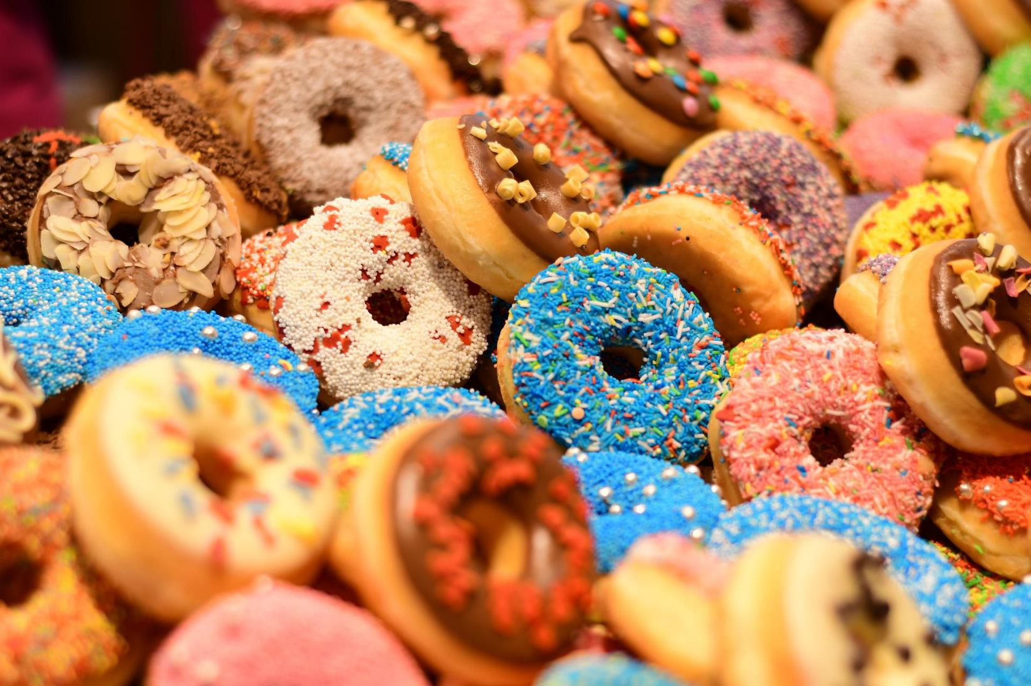
Imagen de Edward Lich en Pixabay
CHECK

Slide 5

donas

Slide 6
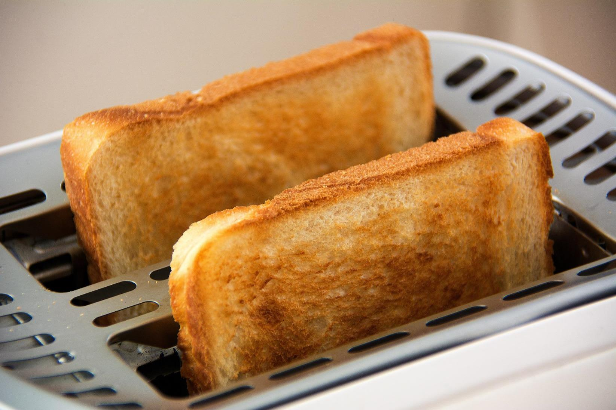
Imagen de Frank Oschatz en Pixabay
CHECK

Slide 7
pan tostado

Slide 8
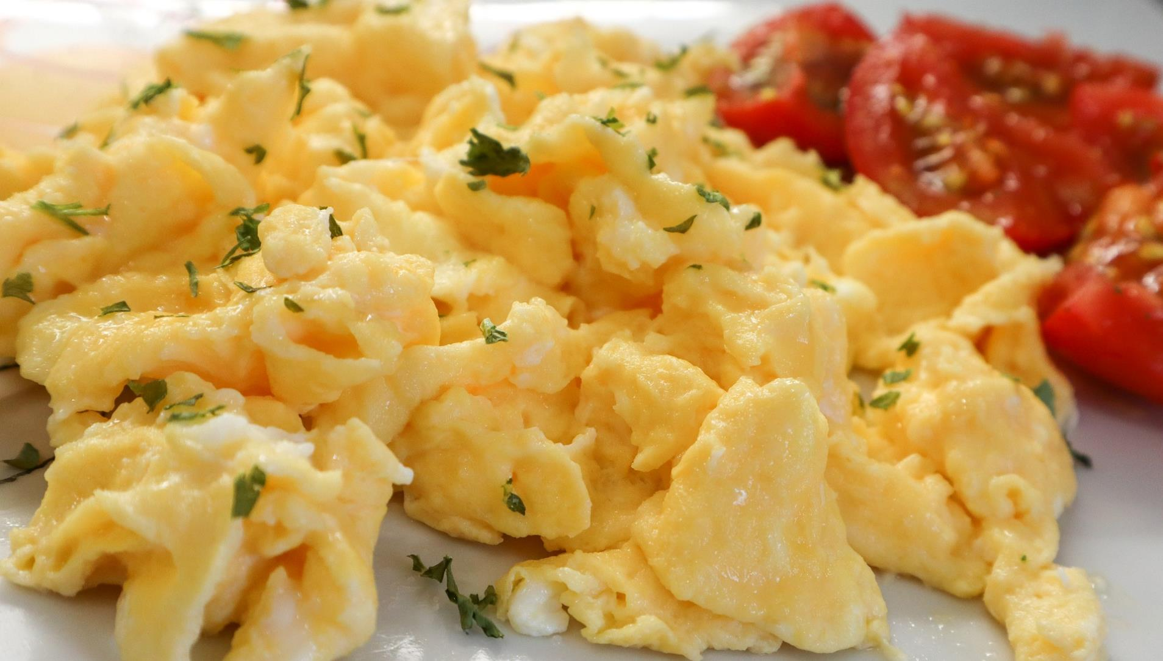
CHECK
Imagen de Mario Cvitkovic en Pixabay

Slide 9
huevos revueltos

Slide 10
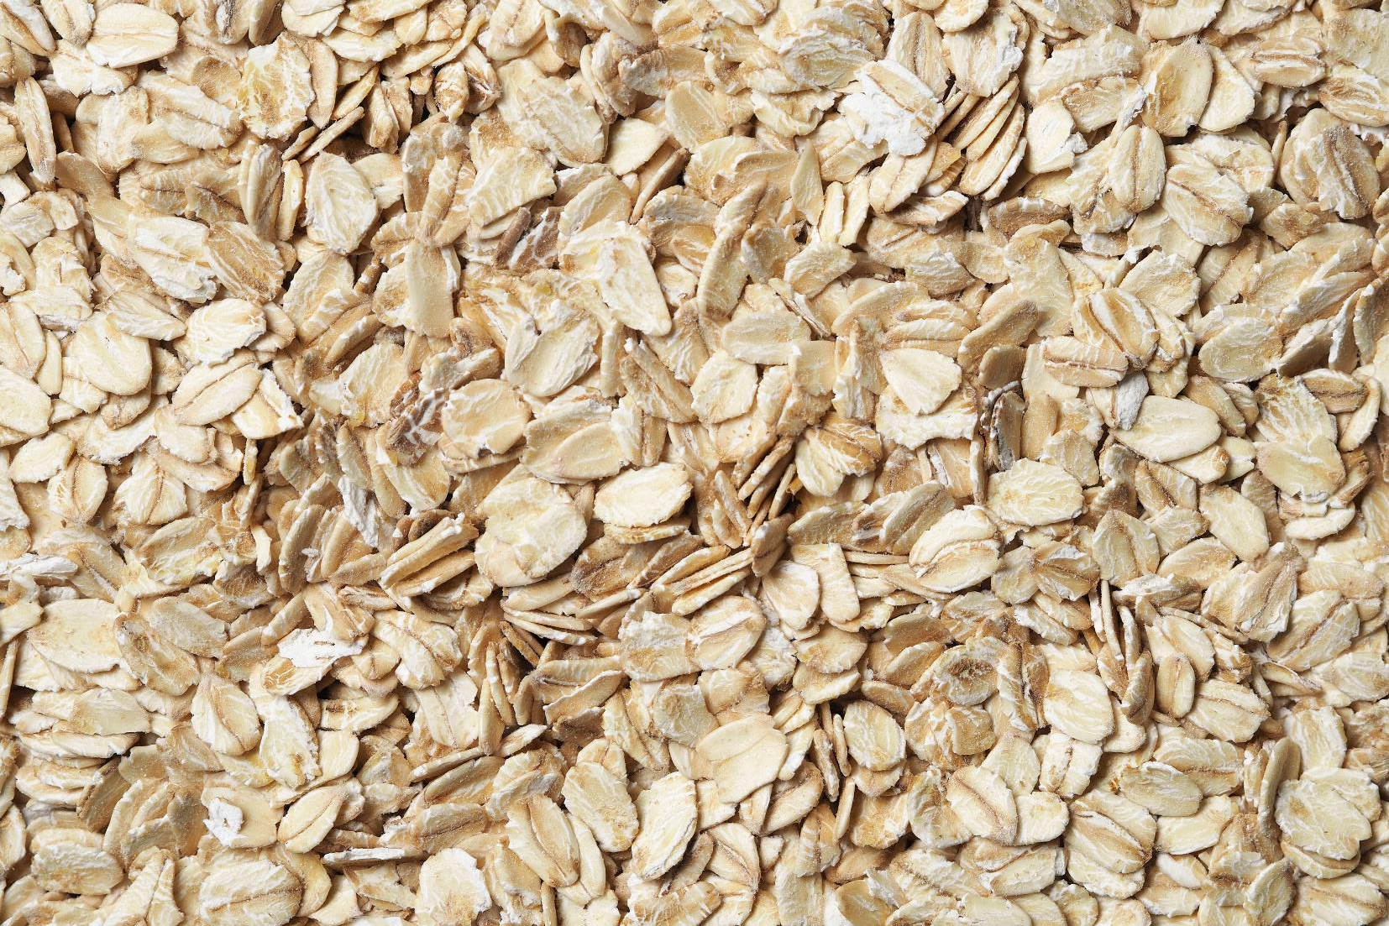
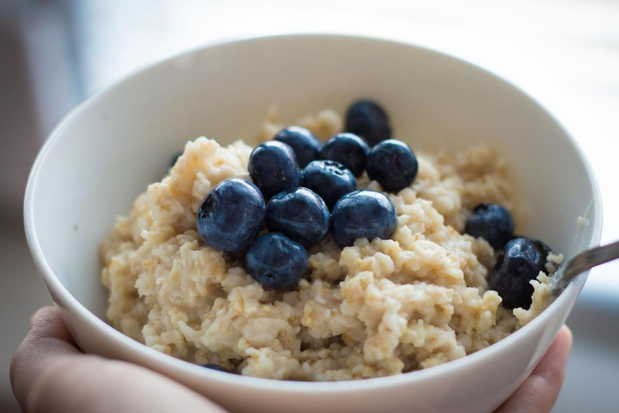
Imagen de iha31 en Pixabay
CHECK
Imagen por Łukasz Rawa en Unsplash

Slide 11
avena

Slide 12
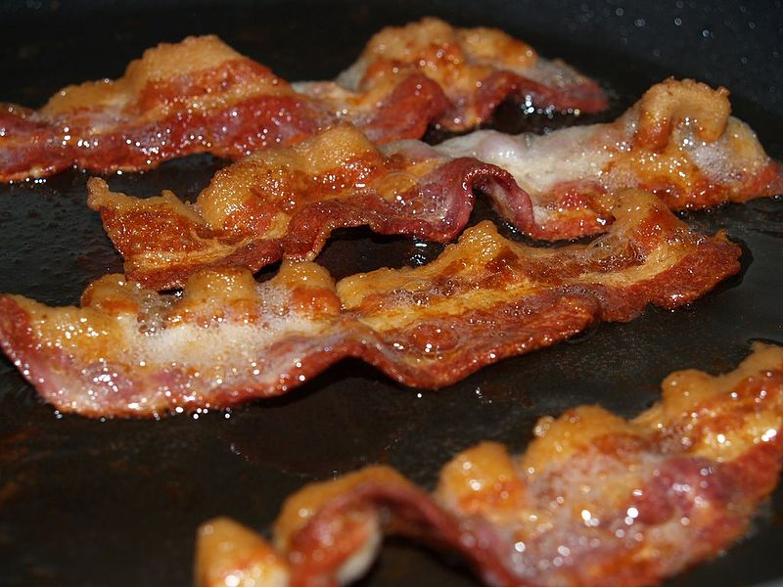
CHECK
Imagen de Wikimedia

Slide 13
tocino

Slide 14
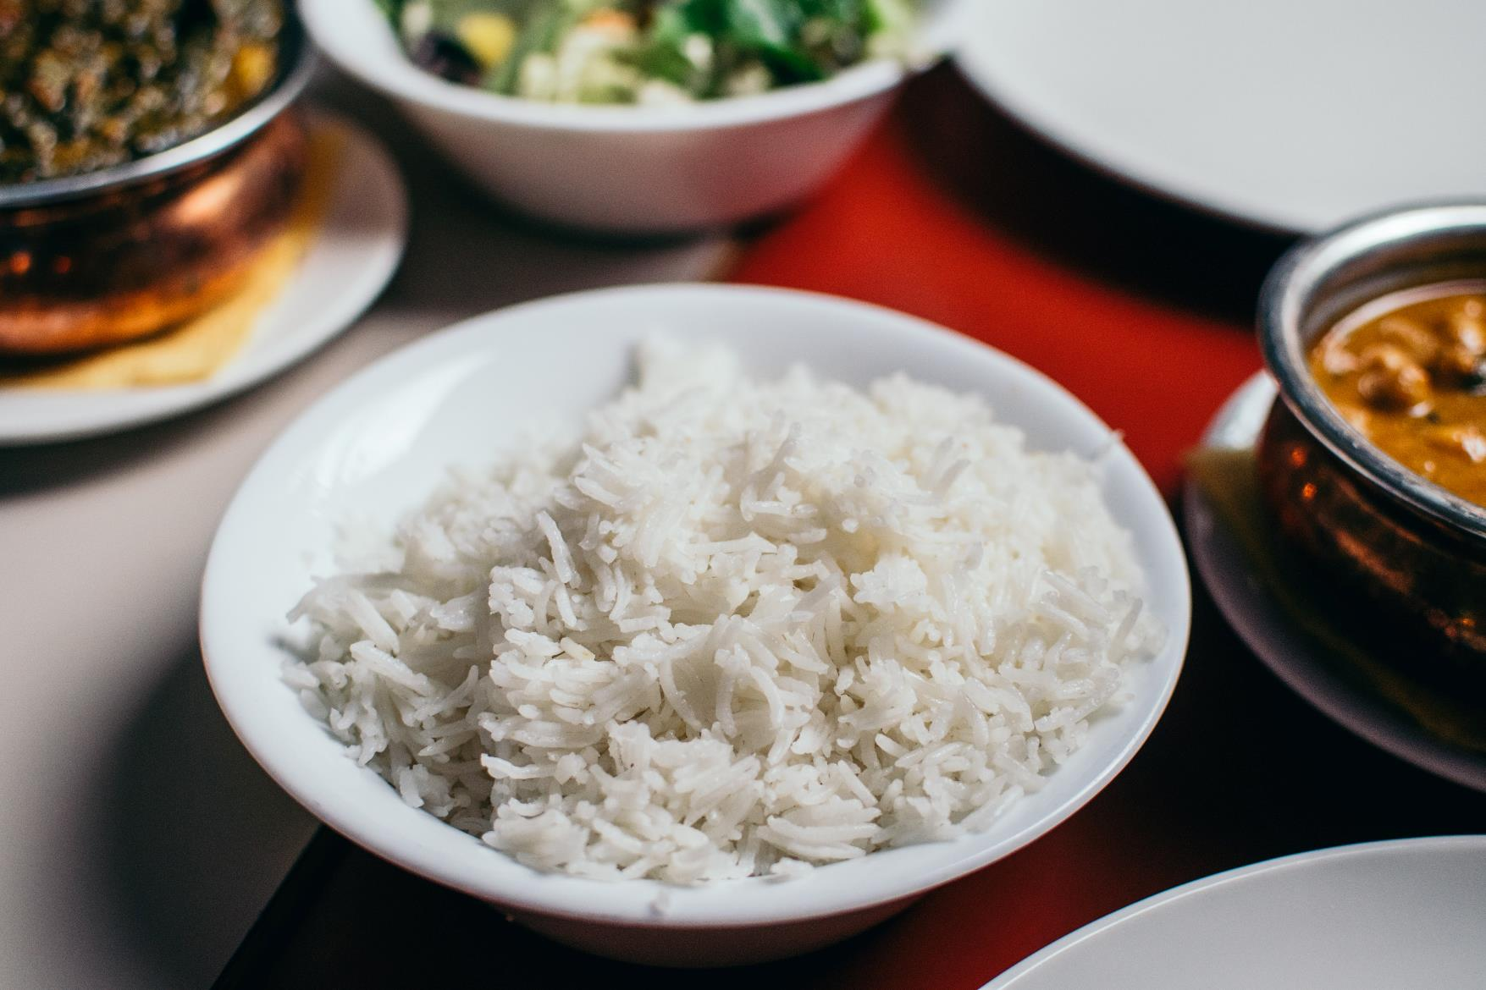
CHECK
Photo by Pille R. Priske on Unsplash

Slide 15
arroz

Slide 16
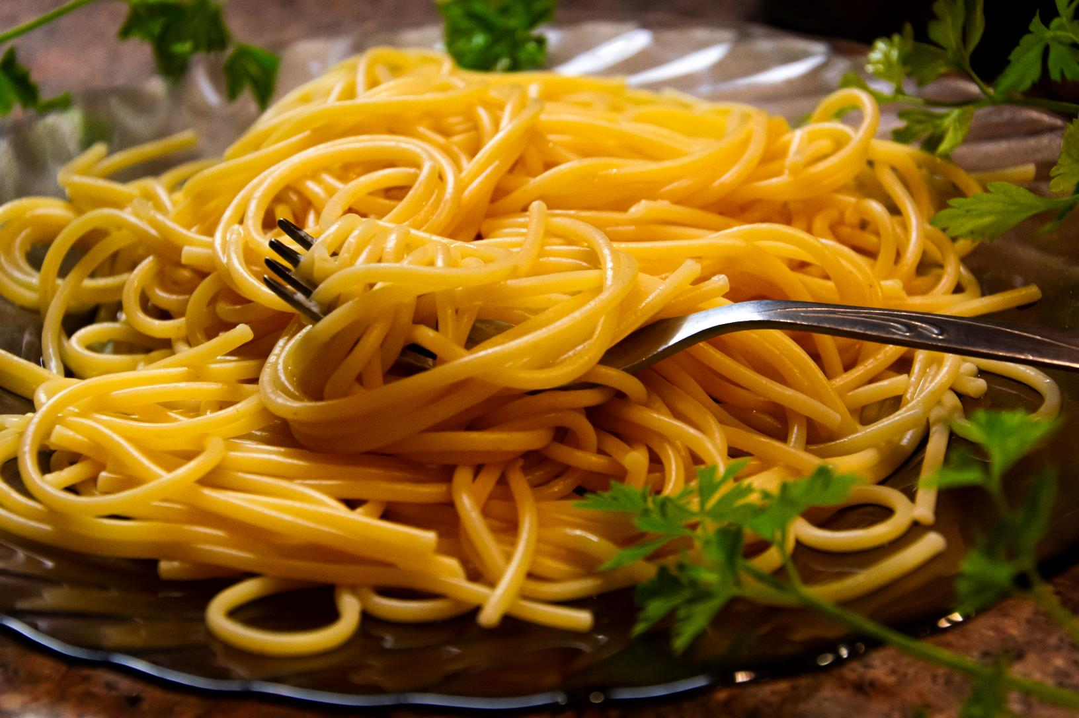
CHECK
Photo by Christine Sandu on Unsplash

Slide 17
fideos

Slide 18
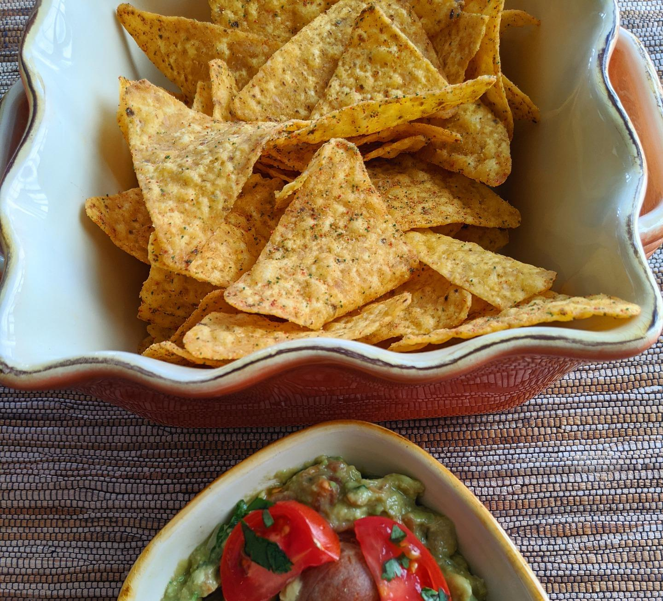
CHECK
Imagen de catceeq en Pixabay

Slide 19
totopos

Slide 20
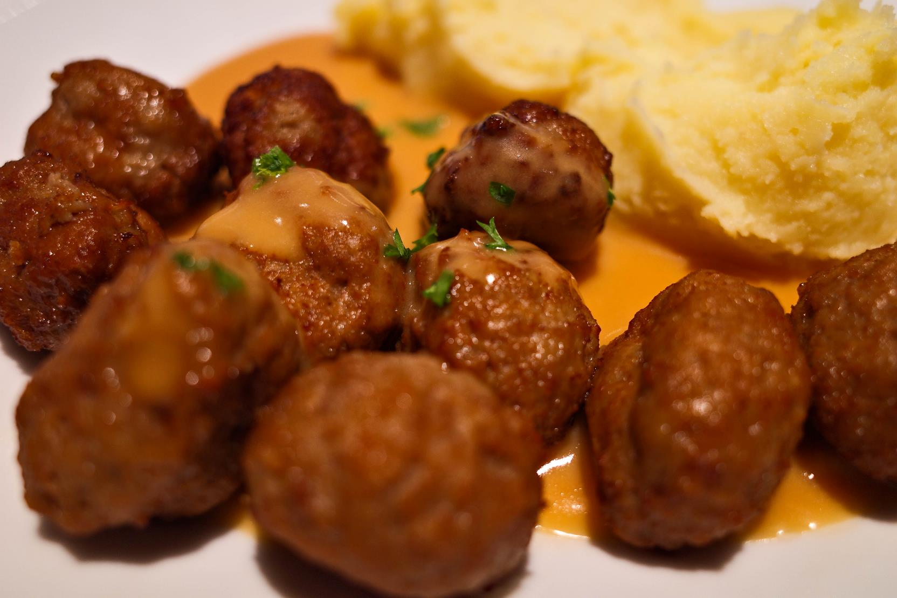
CHECK
Photo by Kina on Unsplash

Slide 21
albóndigas

Slide 22
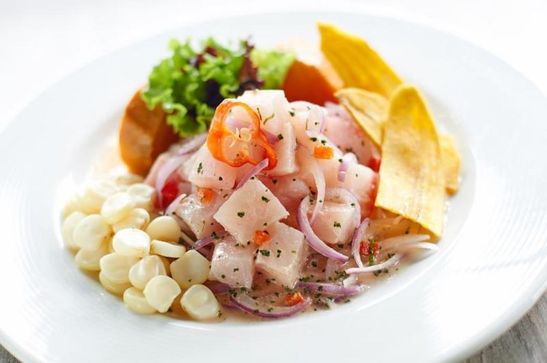
CHECK
Imagen de PeruNorth

Slide 23
ceviche

Slide 24
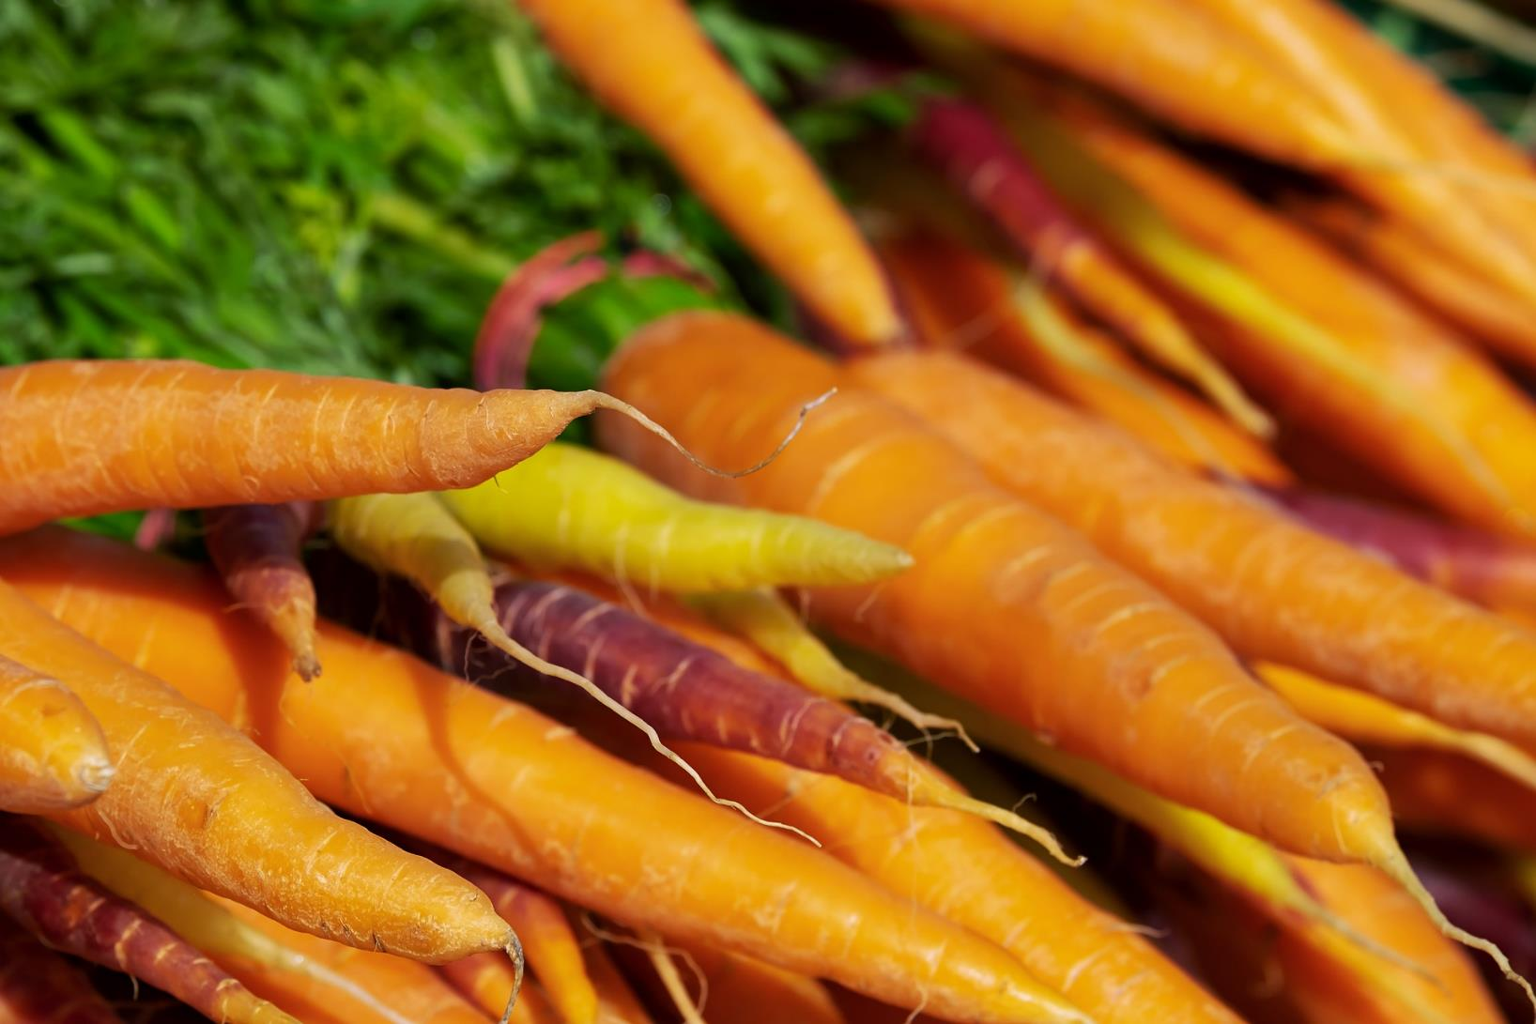
Imagen de Couleur en Pixabay
CHECK

Slide 25
zanahorias

Slide 26
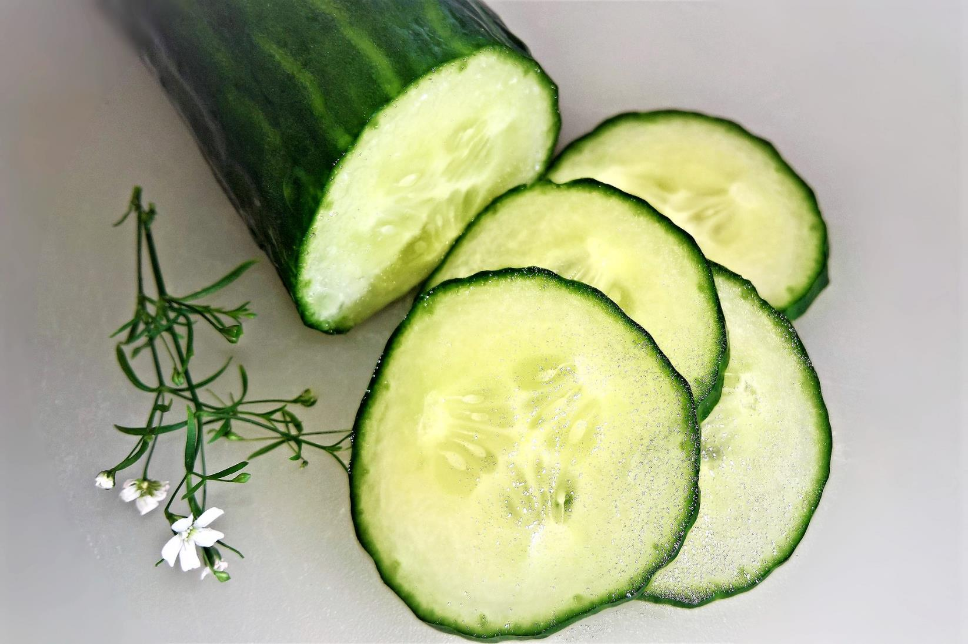
Imagen de Monika Schröder en Pixabay
CHECK

Slide 27
pepino

Slide 28
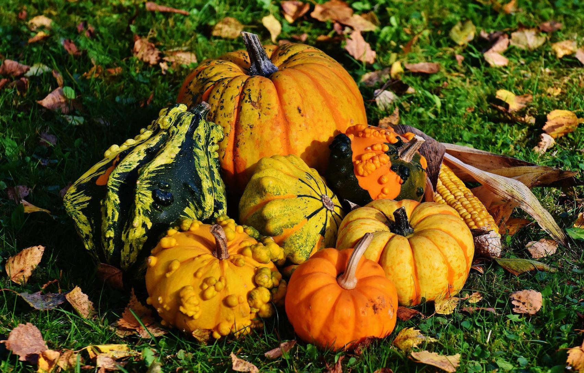
Imagen de Alexas_Fotos en Pixabay
CHECK

Slide 29
calabazas

Slide 30


Third Category - 400
INSERT QUESTION HERE
CHECK
Notes:
You will have to move the Daily Double picture out of the way to write the question. If you do not wish to have the Daily Double in the game, delete it and the sound clip (speaker) from this slide. For a Daily Double, the contestant has to wager at least $5 and at most the highest point value of any player/team at that point in the game. It is considered a True Daily Double if they wager all of their points and go “double or nothing”.

Slide 31
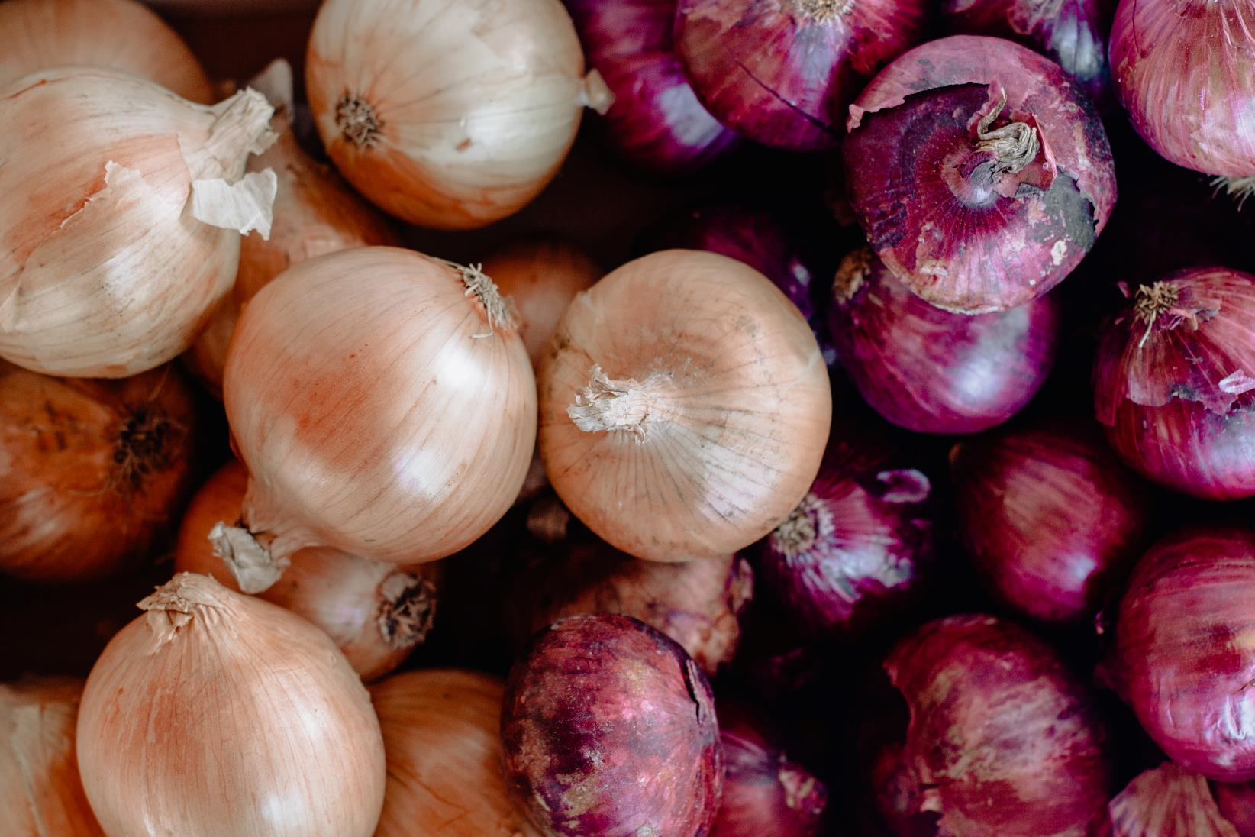
CHECK
Photo by Sincerely Media on Unsplash
Notes:
You will have to move the Daily Double picture out of the way to write the question. If you do not wish to have the Daily Double in the game, delete it and the sound clip (speaker) from this slide. For a Daily Double, the contestant has to wager at least $5 and at most the highest point value of any player/team at that point in the game. It is considered a True Daily Double if they wager all of their points and go “double or nothing”.

Slide 32
cebollas

Slide 33
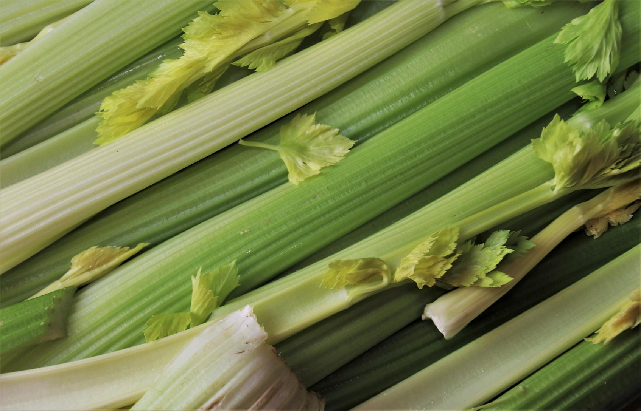
Imagen de pasja1000 en Pixabay
CHECK

Slide 34
apios

Slide 35
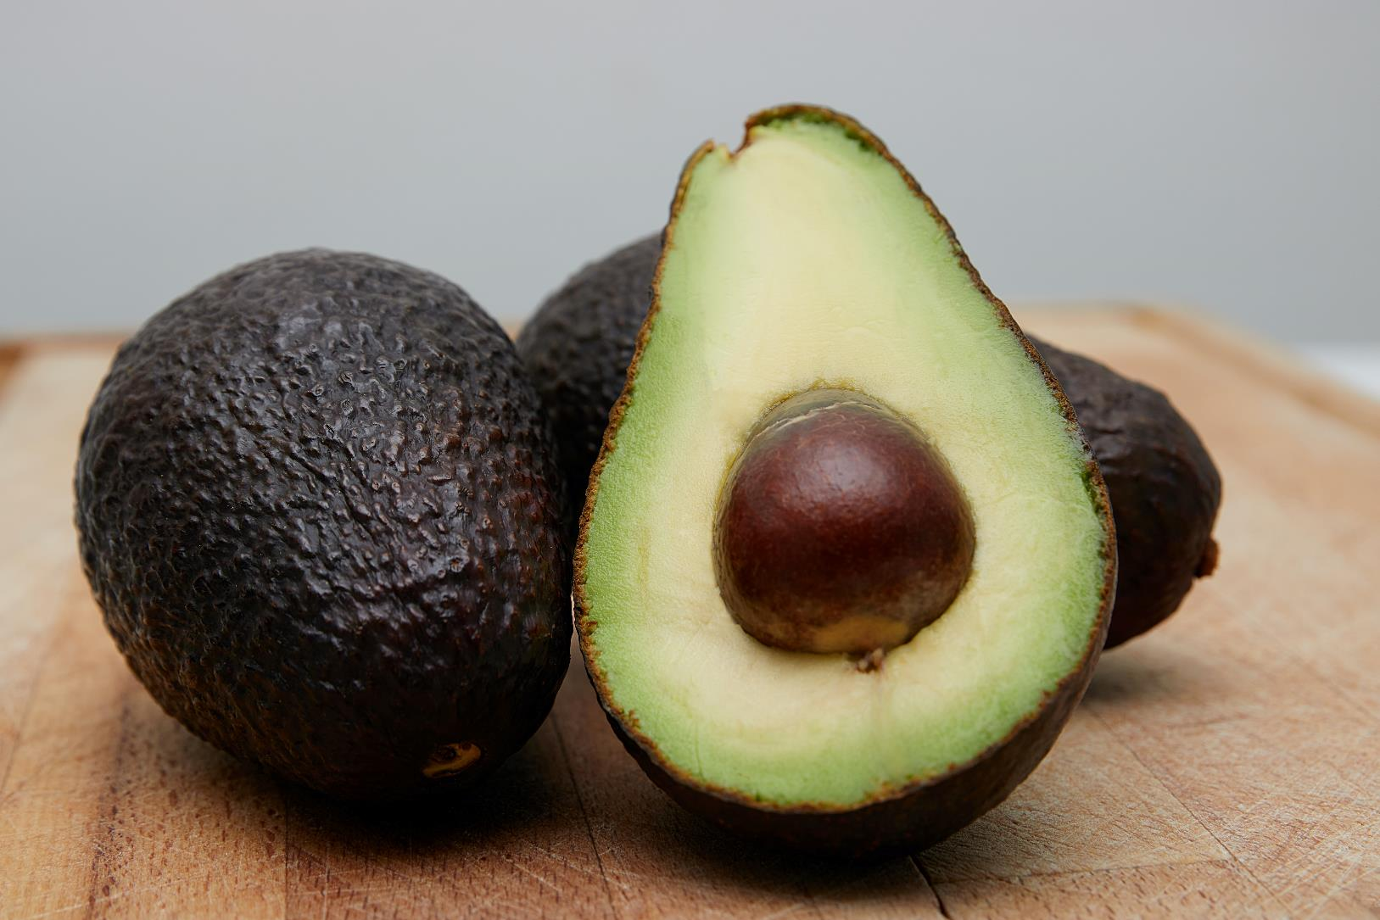
Photo by Gil Ndjouwou on Unsplash
CHECK

Slide 36
aguacate

Slide 37
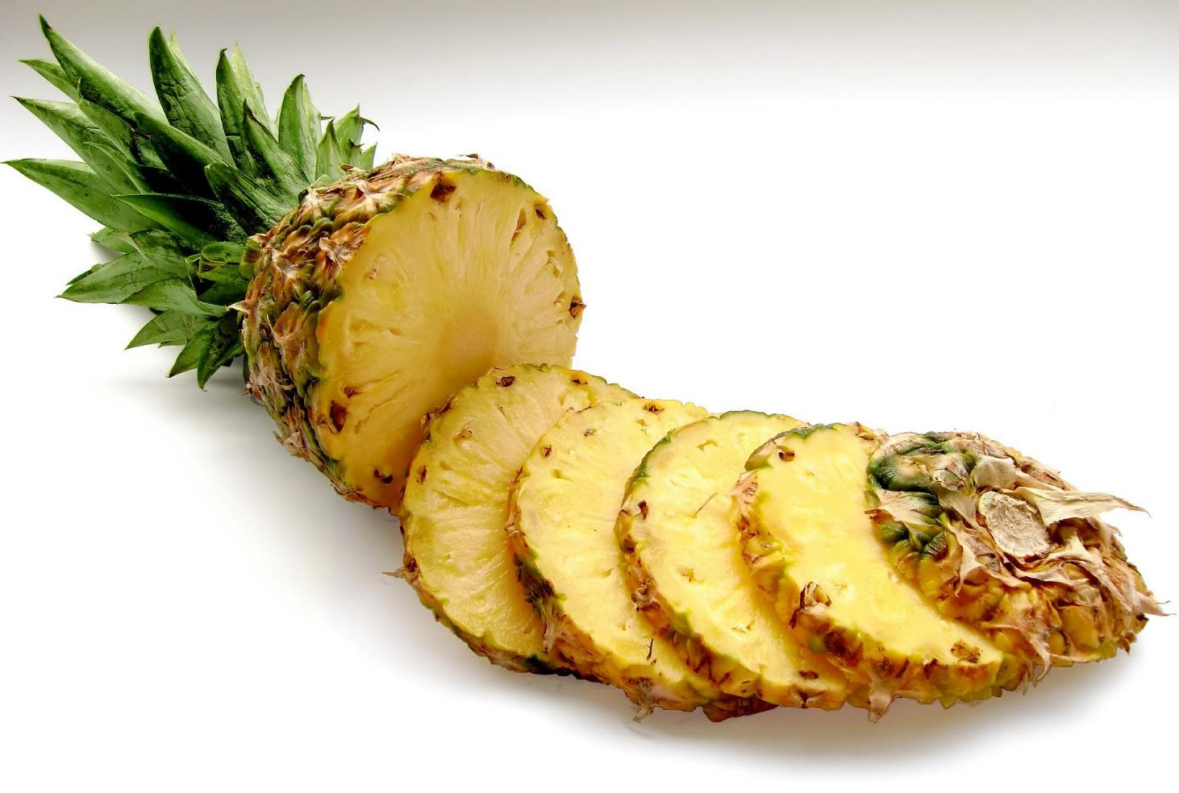
CHECK
Imagen de Security en Pixabay

Slide 38
piña

Slide 39
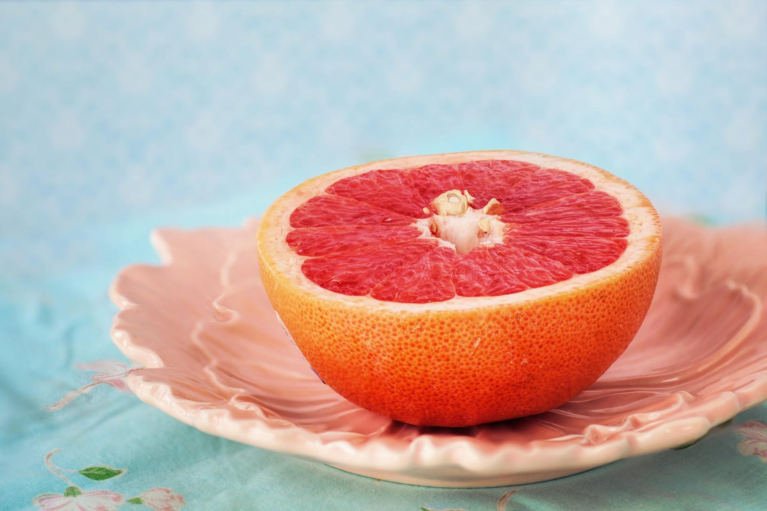
Imagen de Jill Wellington en Pixabay
CHECK

Slide 40
toronja

Slide 41
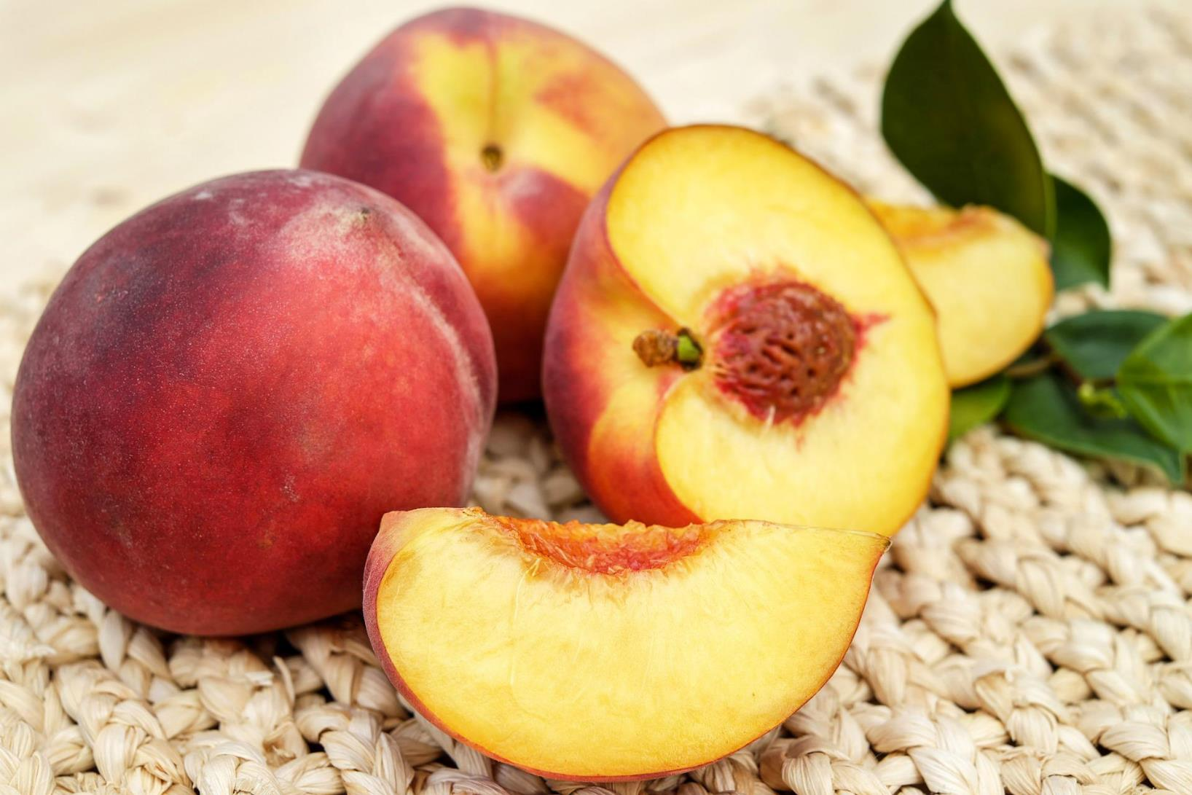
Imagen de Couleur en Pixabay
CHECK

Slide 42
durazno

Slide 43
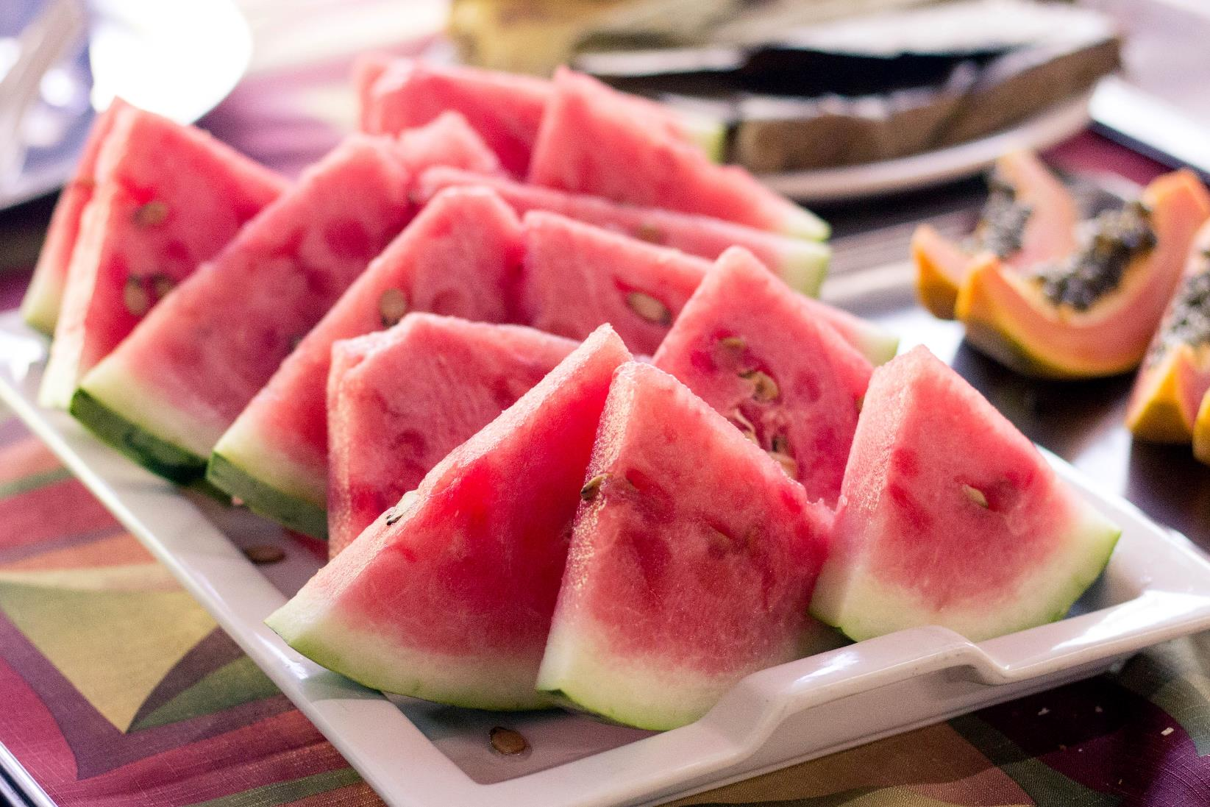
CHECK
Photo by Amanda Lins on Unsplash

Slide 44
sandía

Slide 45
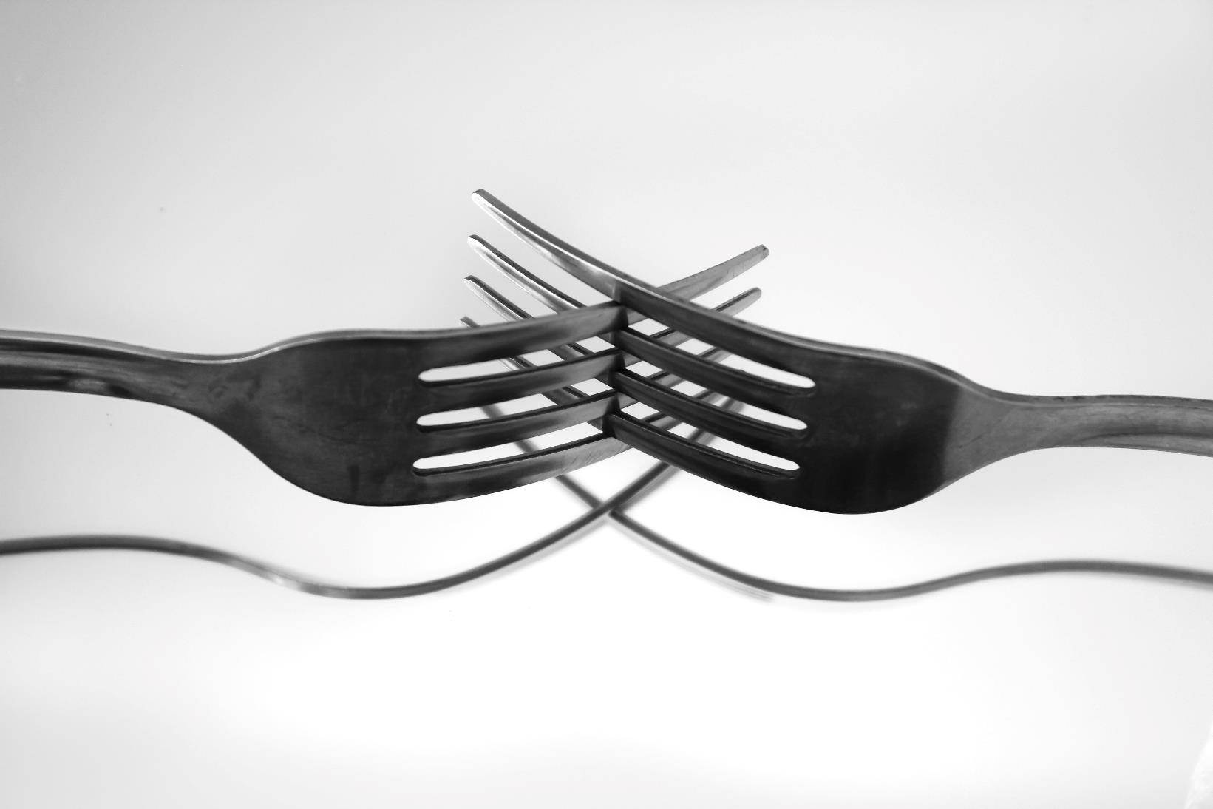
CHECK
Photo by MacDonald Almeida on Unsplash

Slide 46
tenedor(es)

Slide 47
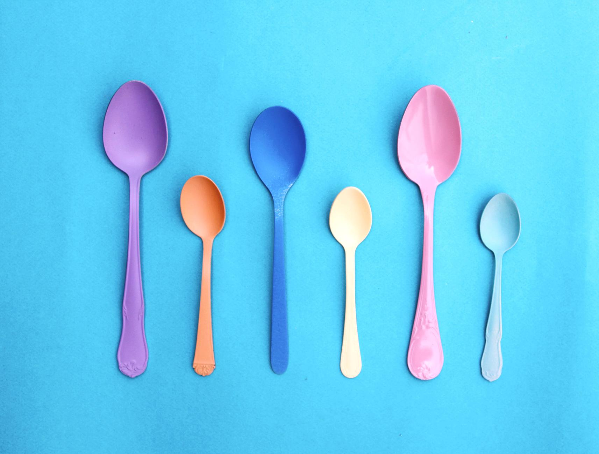
CHECK
Photo by Dstudio Bcn on Unsplash

Slide 48
cucharas

Slide 49
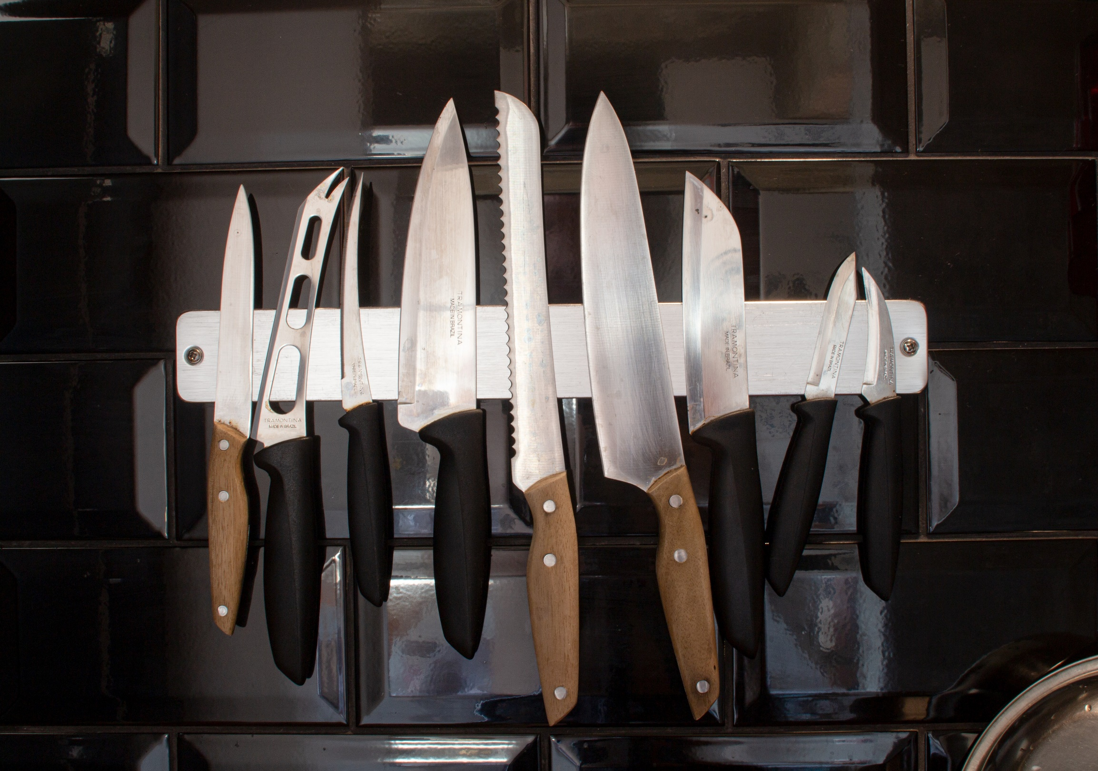
Photo by Danilo Rios on Unsplash
CHECK

Slide 50
cuchillos

Slide 51
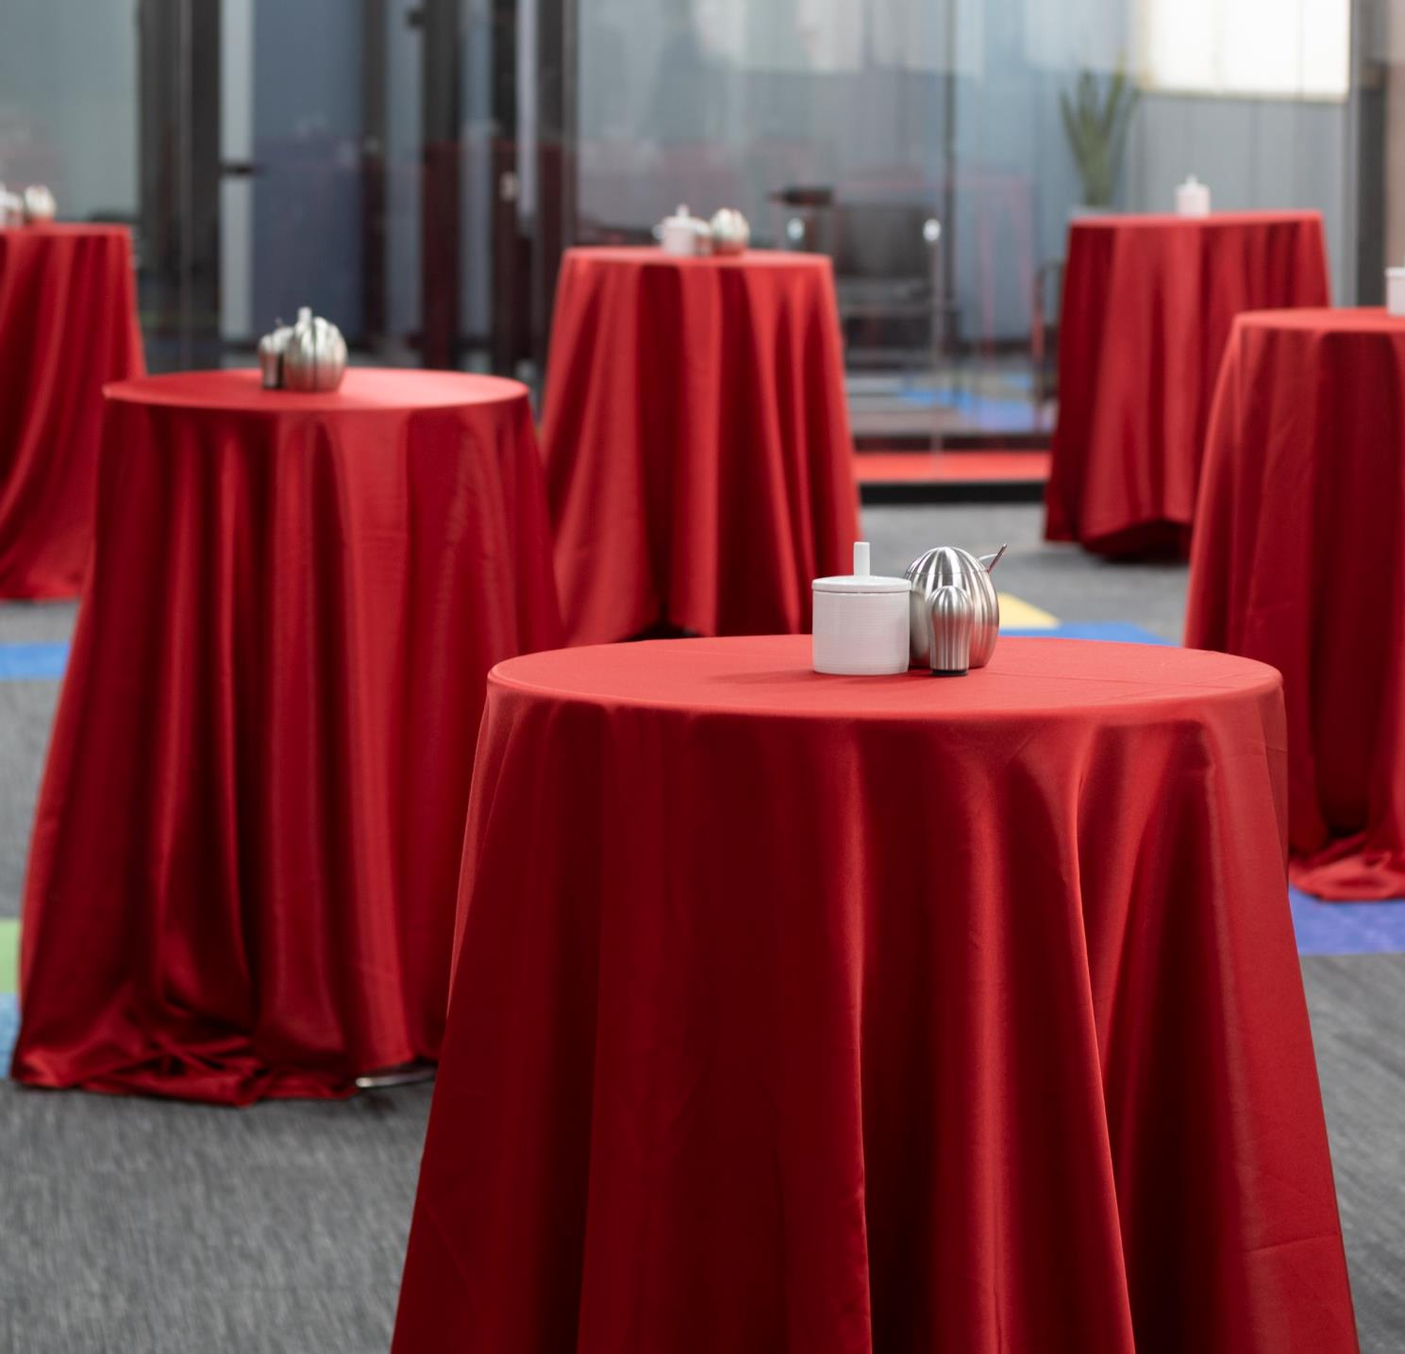
HECK
Photo by Amirhossein Soltani on Unsplash

Slide 52
mantel(es)

Slide 53
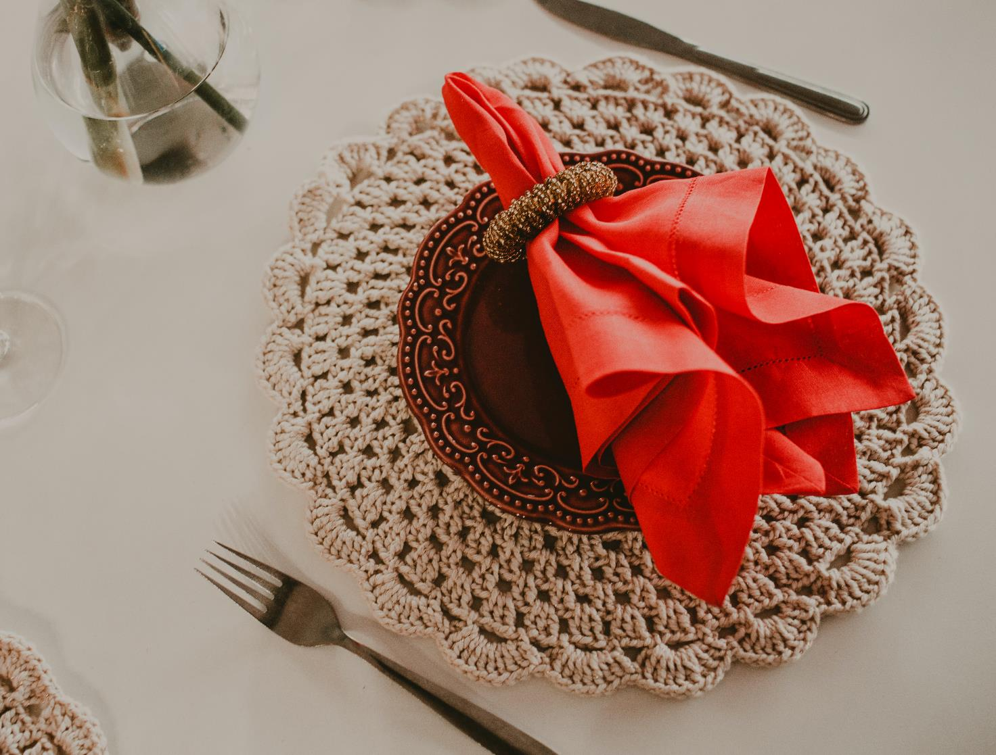
CHECK
Photo by Jonathan Borba on Unsplash

Slide 54
servilleta

Slide 55
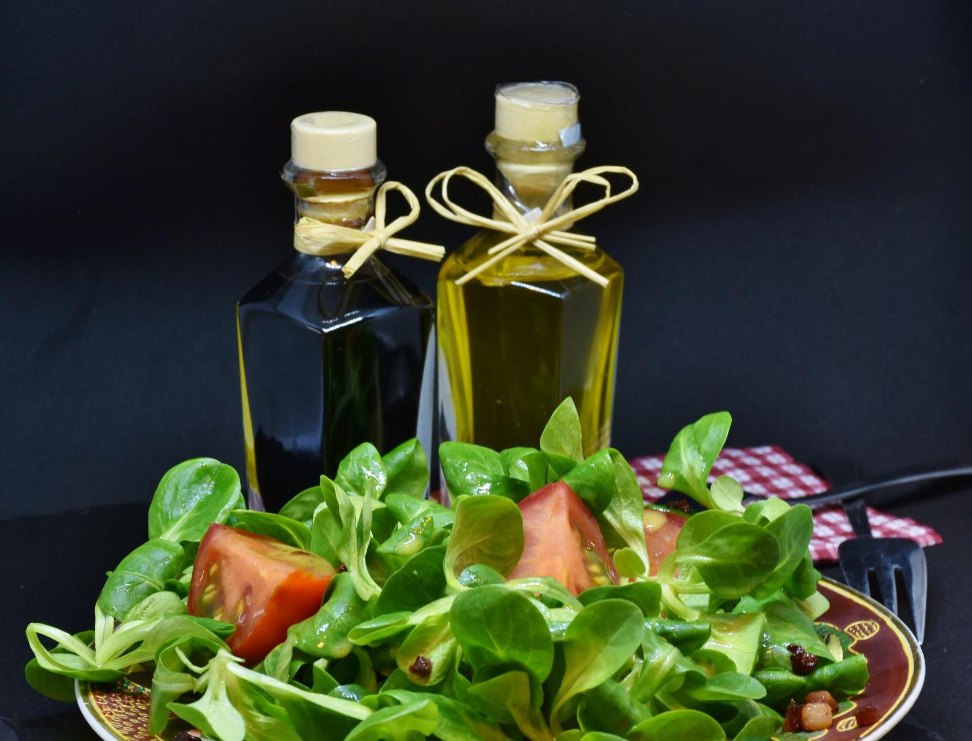
Imagen de RitaE en Pixabay
CHECK

Slide 56
aceite

Slide 57
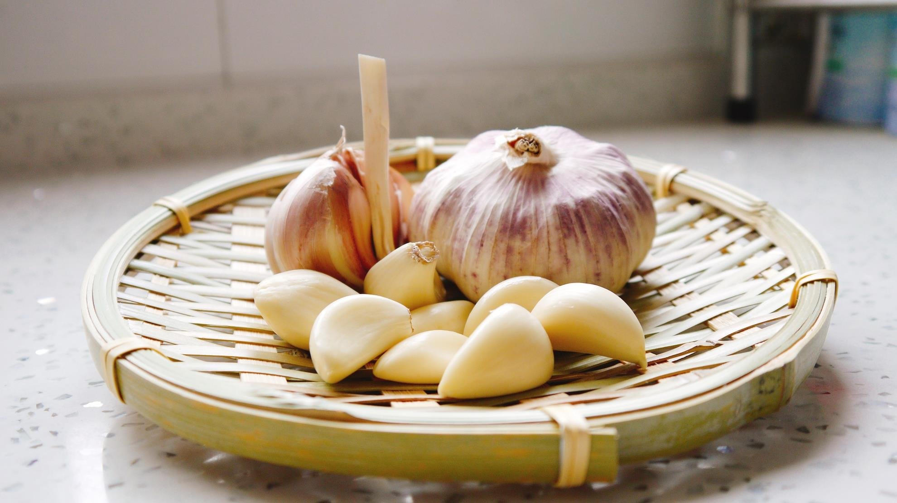
Photo by ji jiali on Unsplash
CHECK

Slide 58
ajo

Slide 59
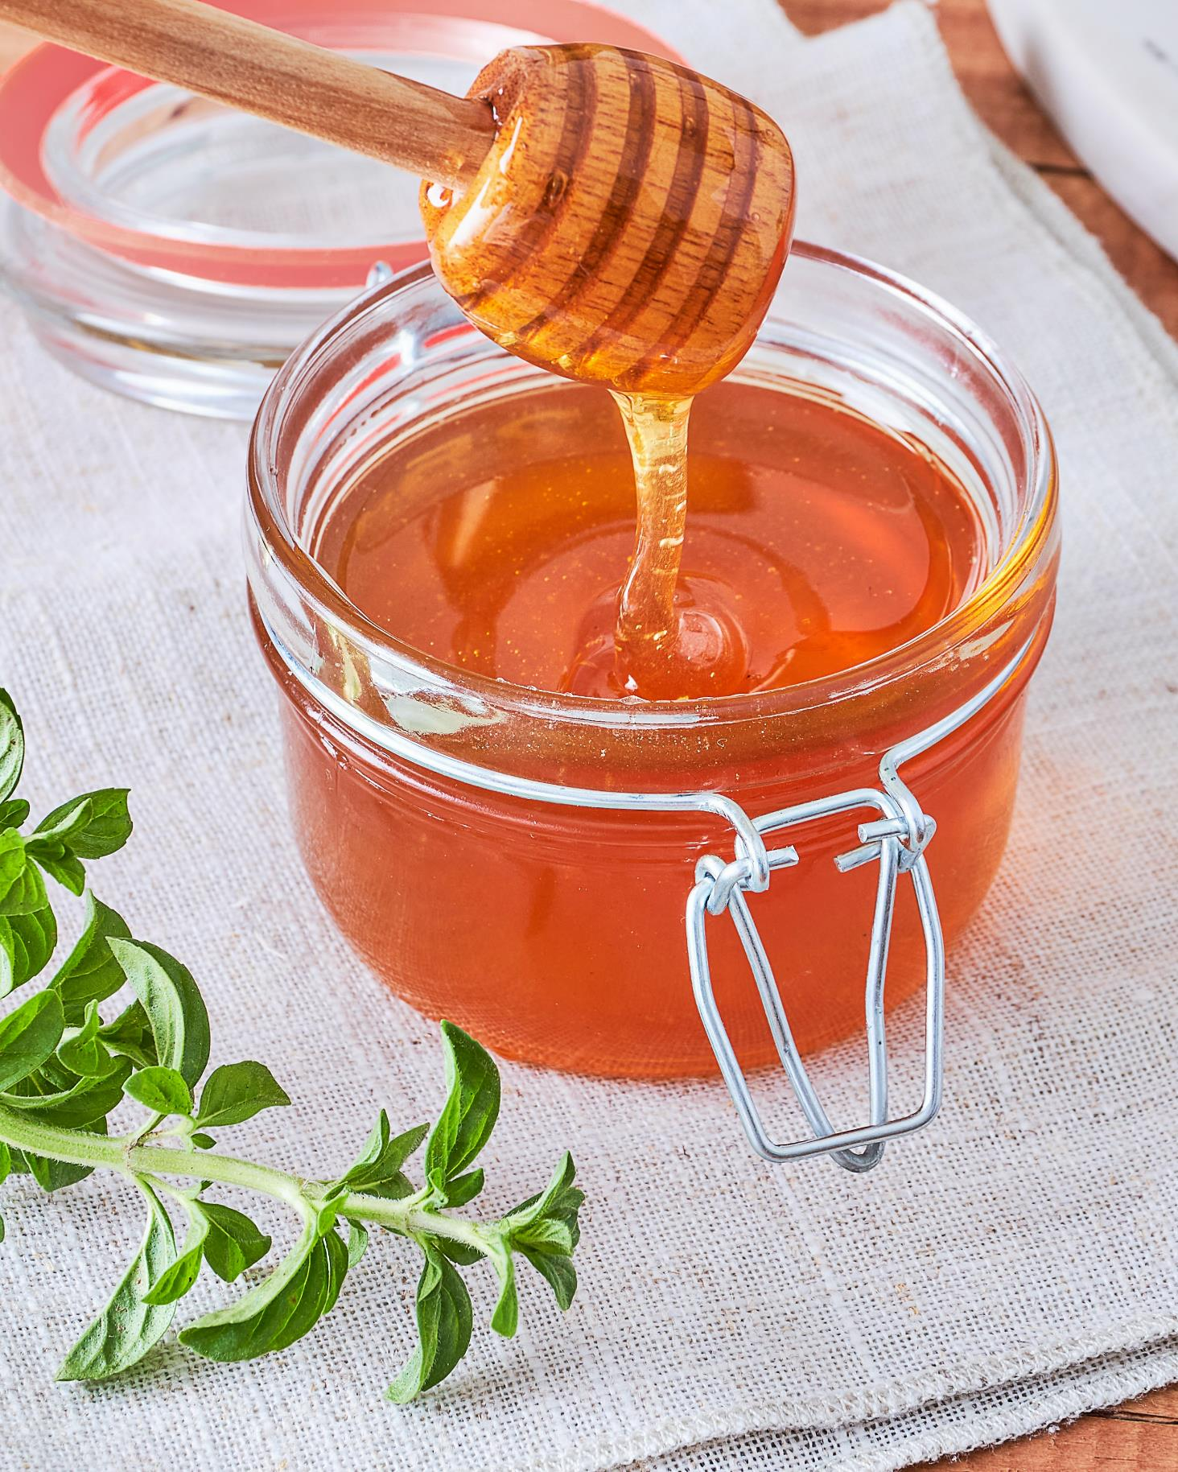
Photo by Mariana Ibanez on Unsplash
CHECK

Slide 60
miel

Slide 61
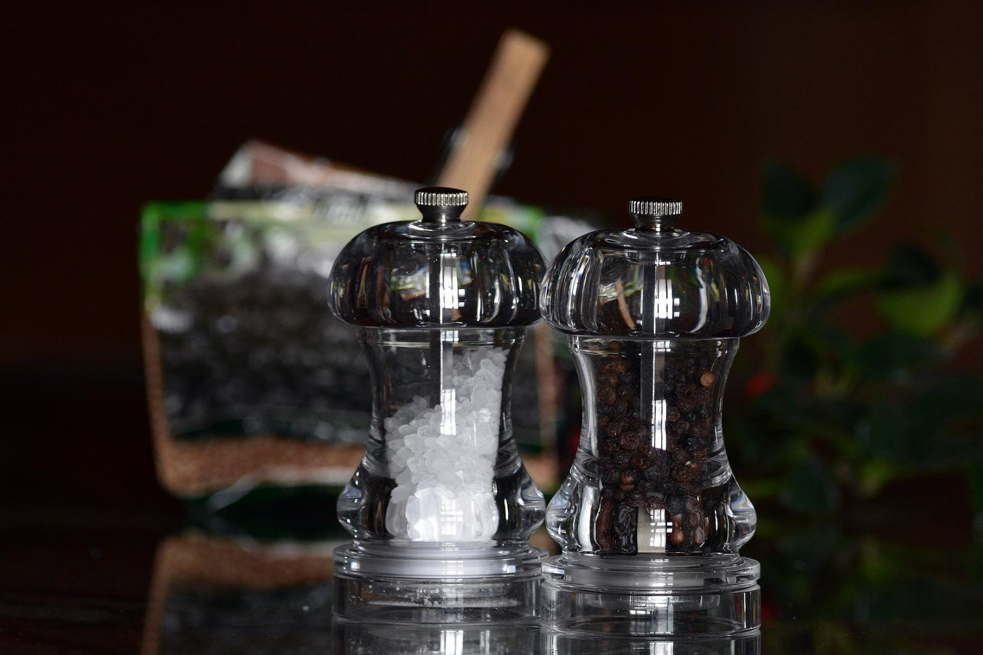
Imagen de Artur Pawlak en Pixabay
CHECK

Slide 62
pimienta

Slide 63
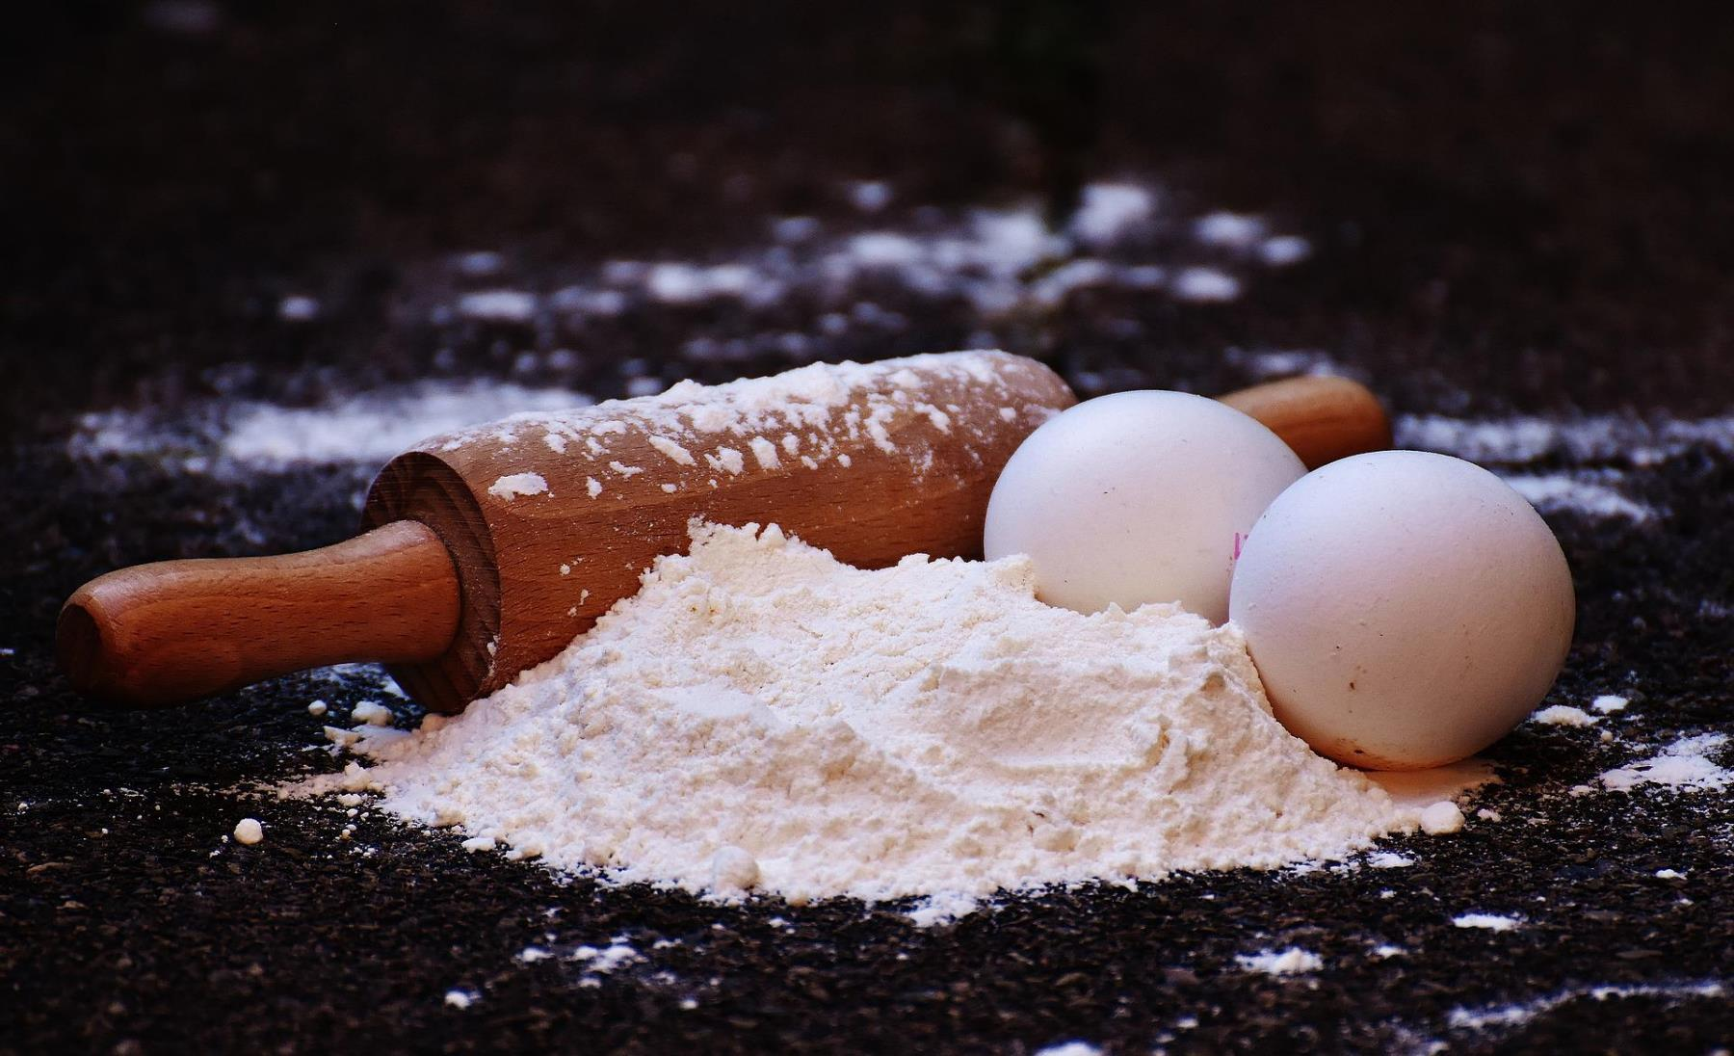
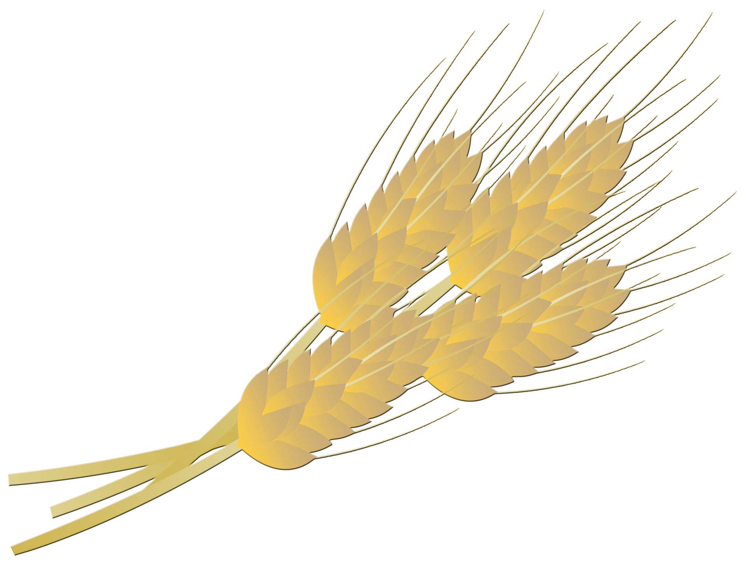
CHECK
Imagen de Alexas_Fotos en Pixabay

Slide 64
harina

Slide 65
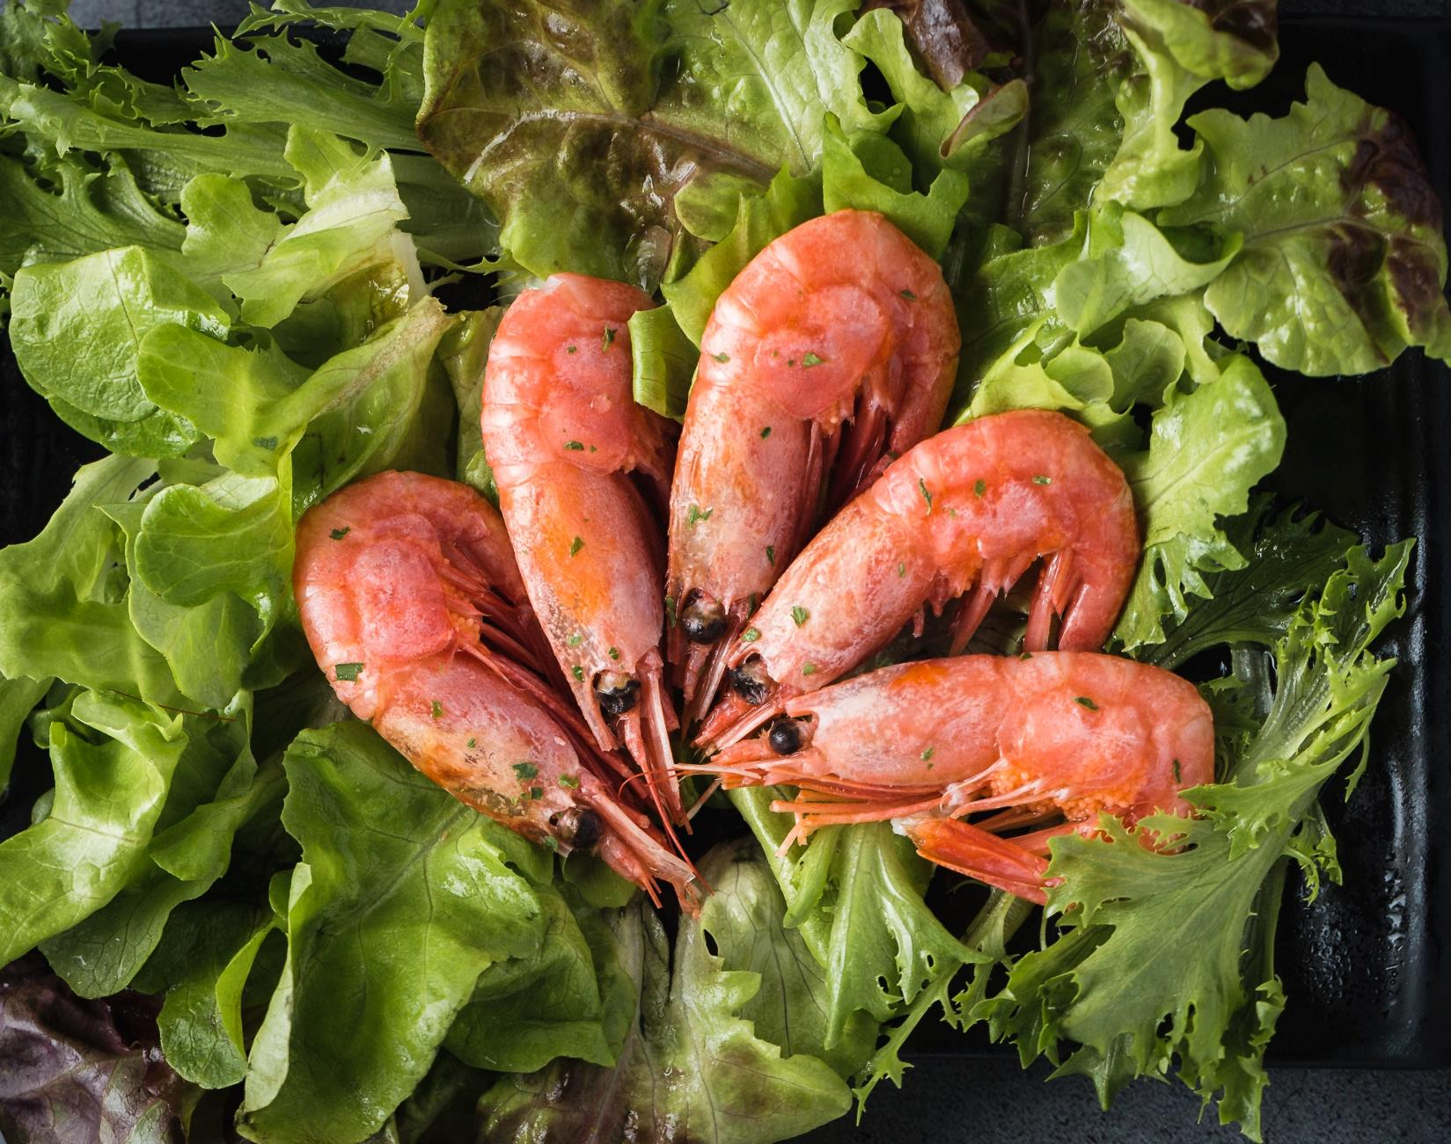
CHECK
Photo by Mae Mu on Unsplash

Slide 66
camarones

Slide 67
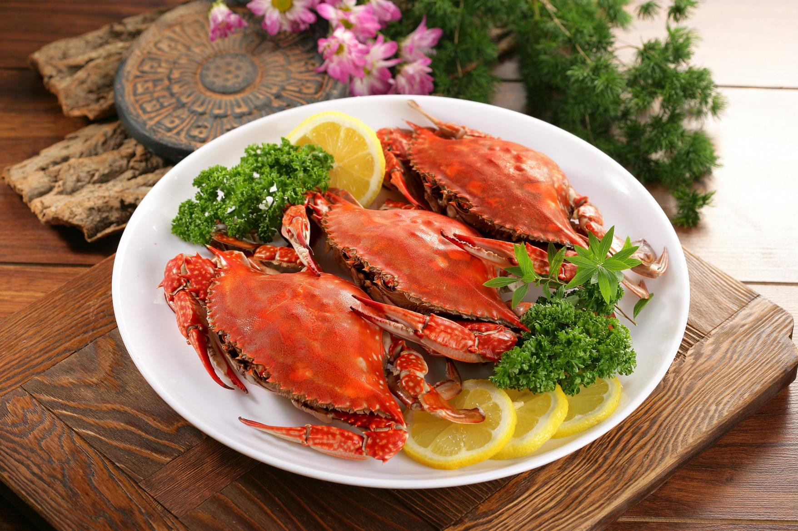
CHECK
Imagen de sintec en Pixabay

Slide 68
cangrejos

Slide 69
SEVENTH Category - 600
INSERT QUESTION HERE
CHECK
Notes:
You will have to move the Daily Double picture out of the way to write the question. If you do not wish to have the Daily Double in the game, delete it and the sound clip (speaker) from this slide. For a Daily Double, the contestant has to wager at least $5 and at most the highest point value of any player/team at that point in the game. It is considered a True Daily Double if they wager all of their points and go “double or nothing”.

Slide 70
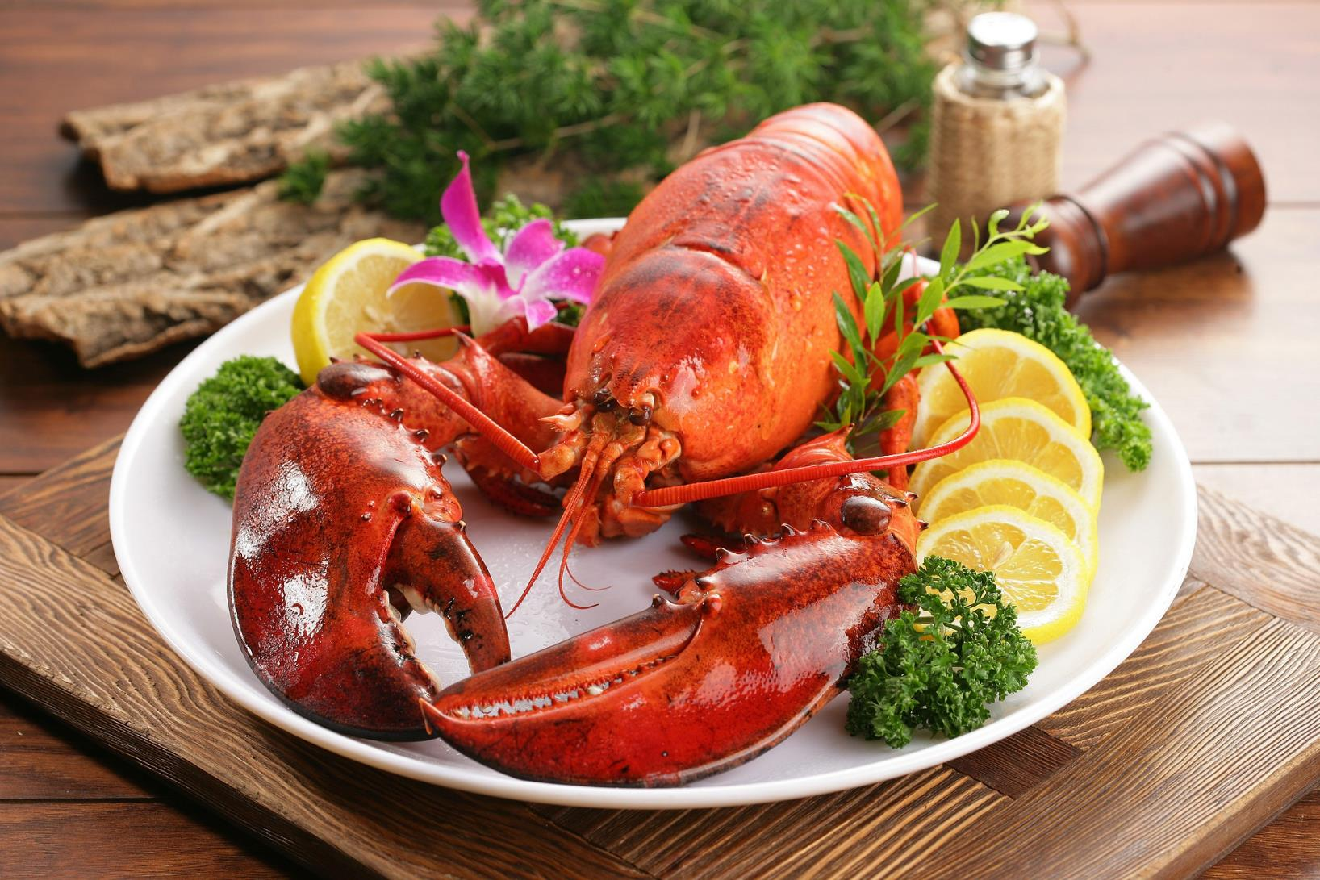
CHECK
Imagen de sintec en Pixabay
Notes:
You will have to move the Daily Double picture out of the way to write the question. If you do not wish to have the Daily Double in the game, delete it and the sound clip (speaker) from this slide. For a Daily Double, the contestant has to wager at least $5 and at most the highest point value of any player/team at that point in the game. It is considered a True Daily Double if they wager all of their points and go “double or nothing”.

Slide 71
langosta

Slide 72
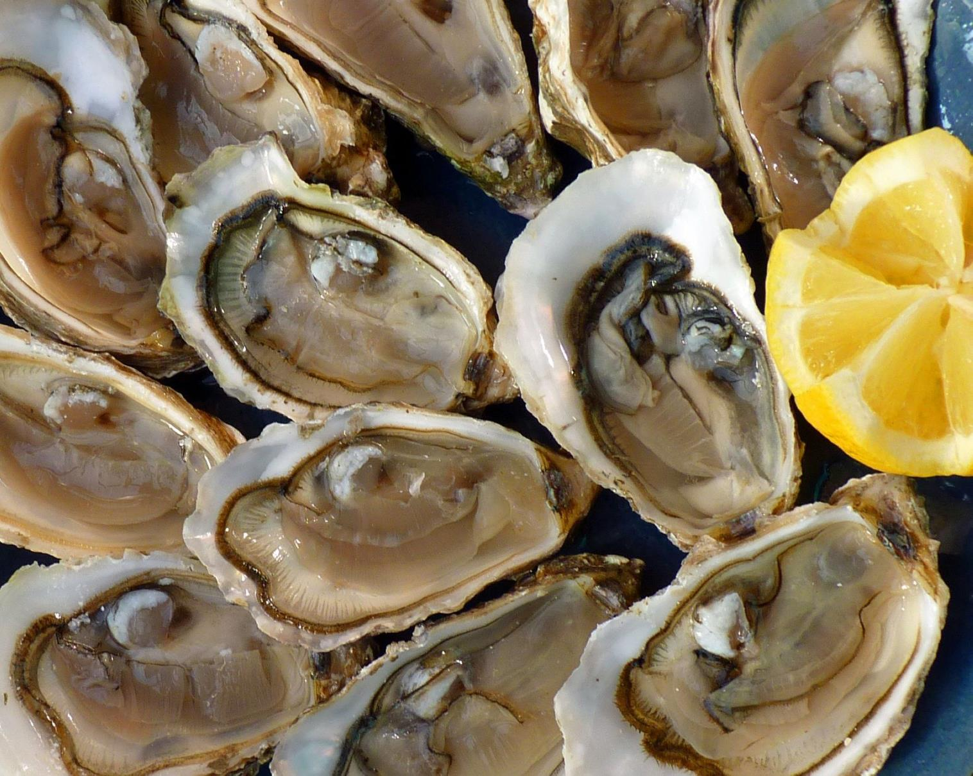
CHECK
Imagen de Jean Louis Tosque en Pixabay

Slide 73
ostras

Slide 74
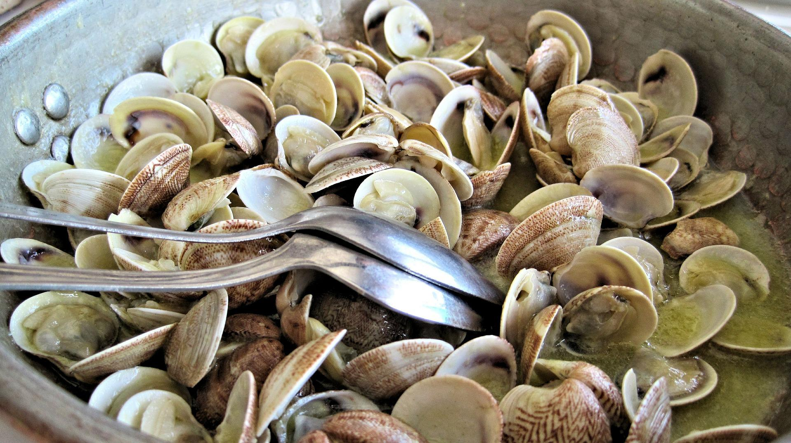
Imagen de pixel1 en Pixabay
CHECK

Slide 75
almejas

Slide 76
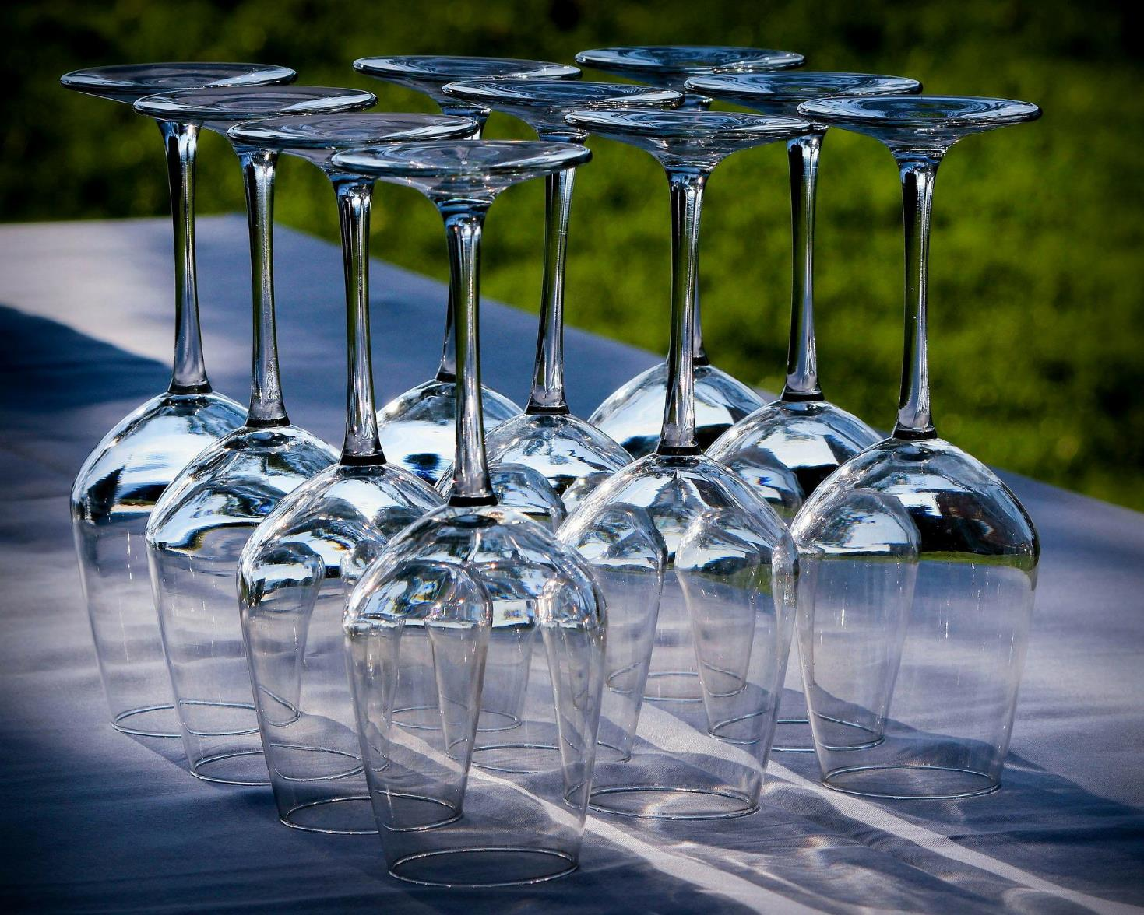
CHECK
Imagen de JamesDeMers en Pixabay

Slide 77
copas

Slide 78
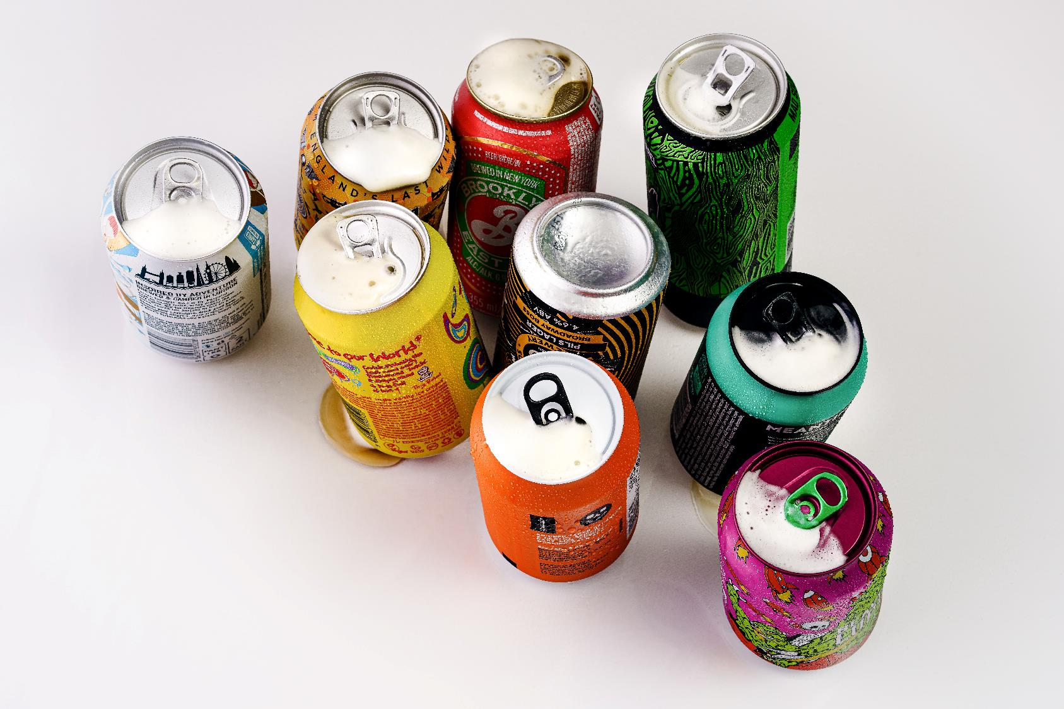
CHECK
Photo by Sebastian Coman Photography on Unsplash

Slide 79
latas

Slide 80
Photo by Bianca Ackermann on Unsplash
CHECK

Slide 81
rebanadas

Slide 82

Imagen de Libertad en Pixabay
CHECK

Slide 83
taza

Slide 84
“lb.” es abreviación para ___.
CHECK

Slide 85
libra

Slide 86
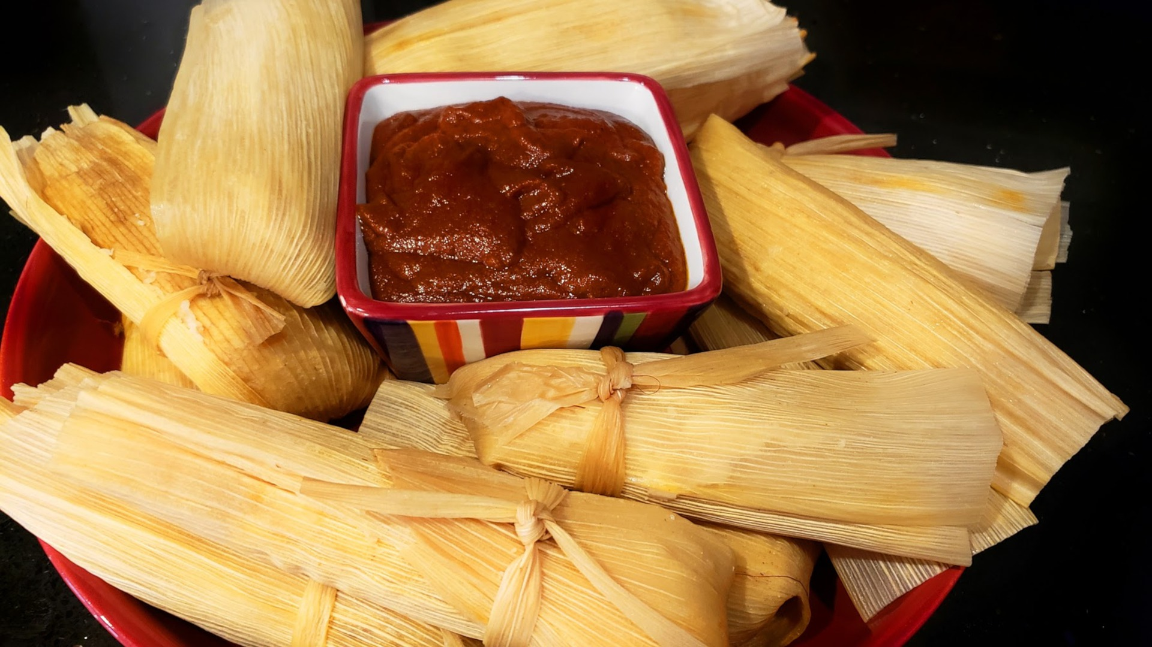
CHECK
Imagen de Lawrence Montoya en Pixabay

Slide 87
tamales

Slide 88
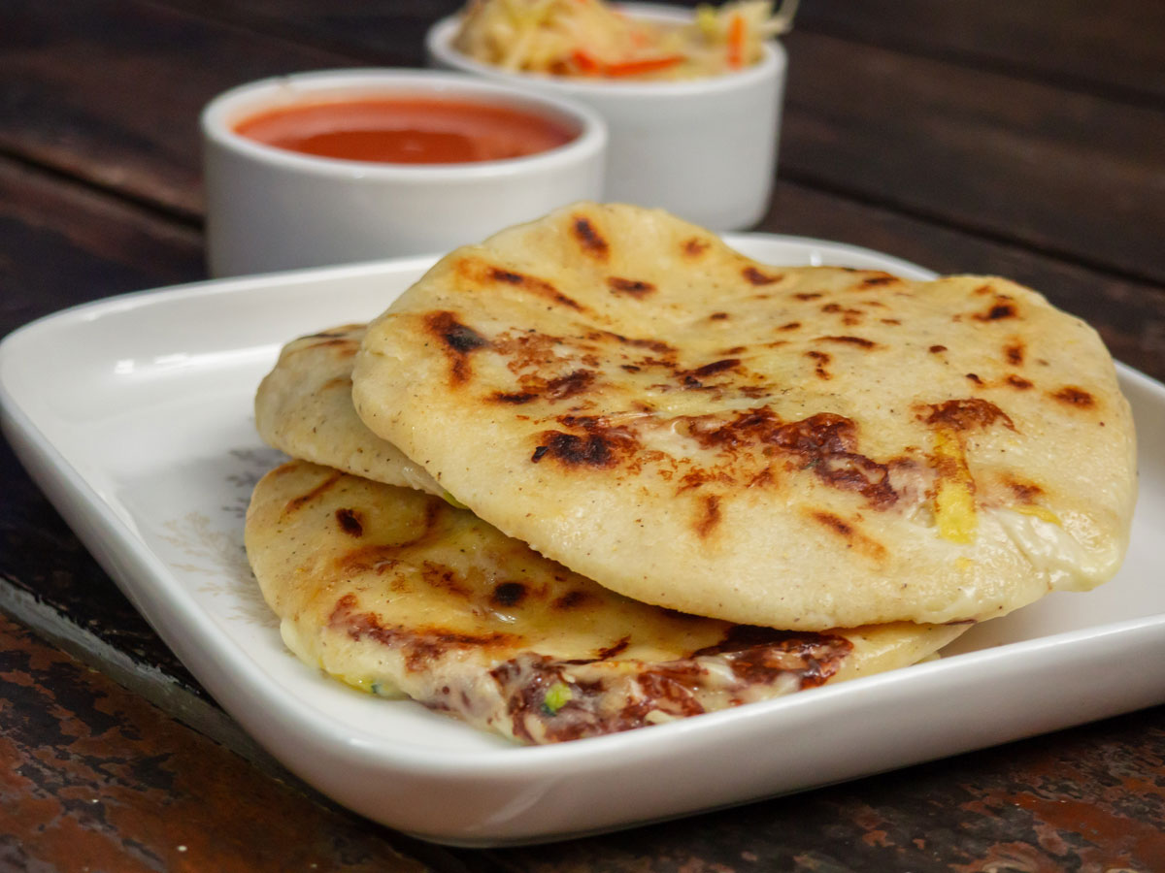
Imagen de Amigo Foods
CHECK

Slide 89
pupusas salvadoreñas

Slide 90
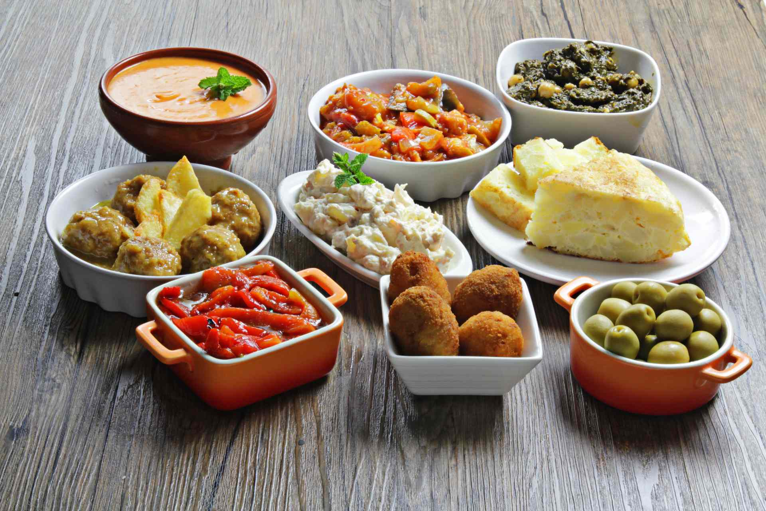
CHECK
Imagen de Koch Schule

Slide 91
tapas españolas

Slide 92
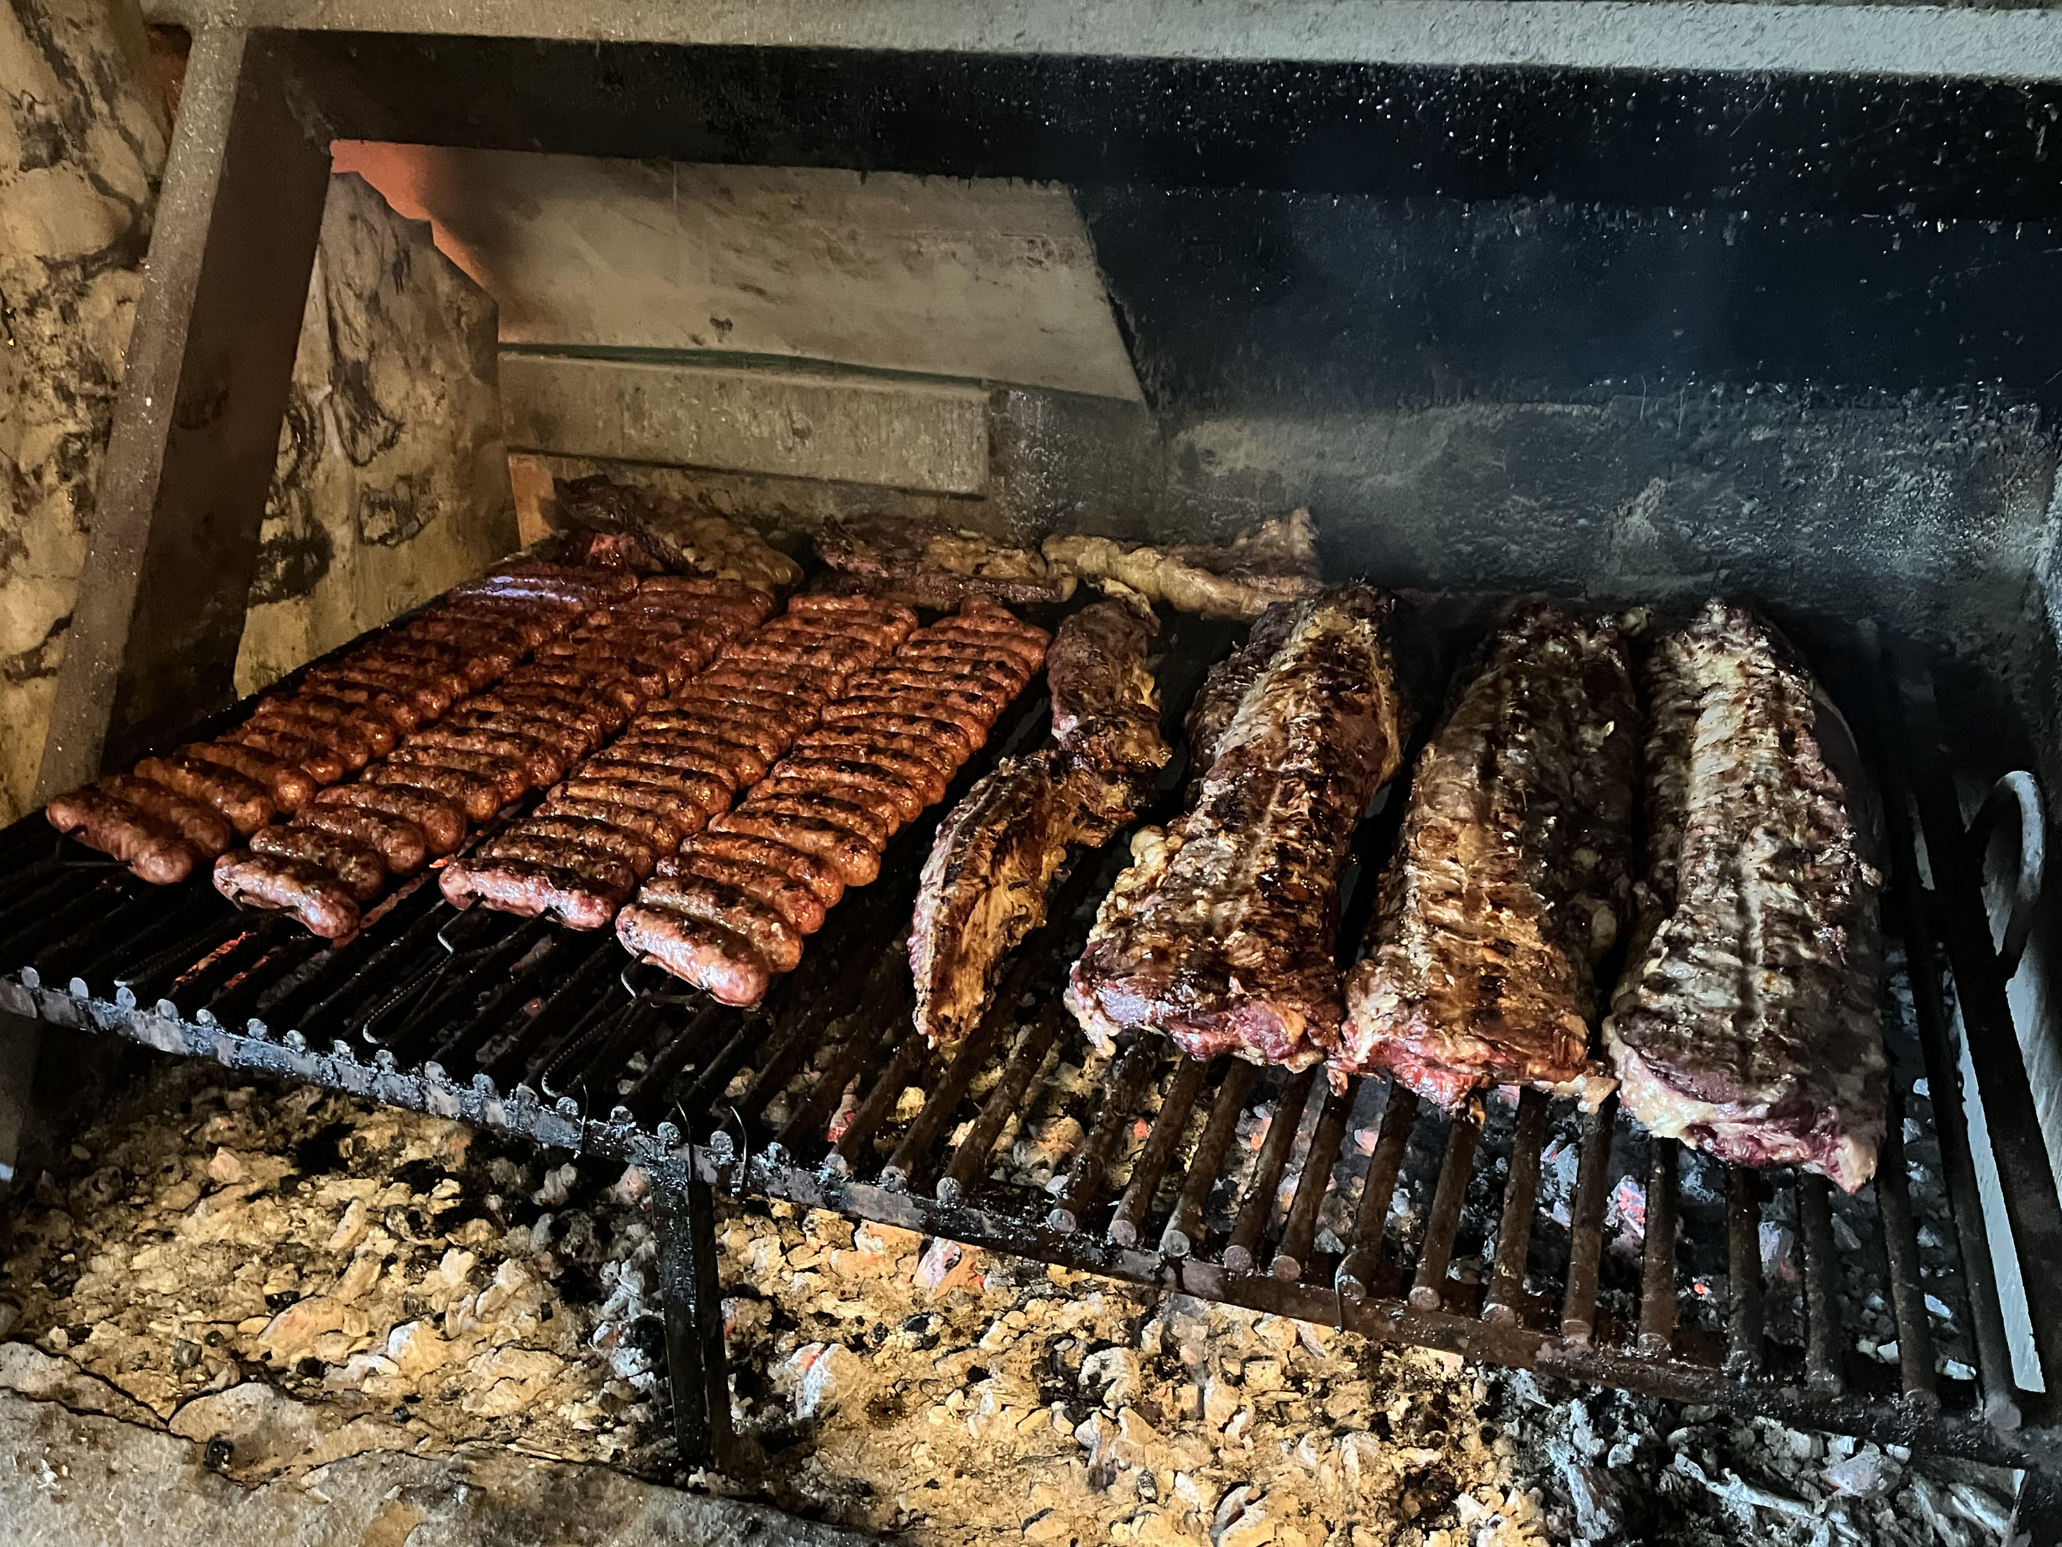
Imagen de Beatrice Tseng
CHECK

Slide 93
parrillada argentina

Slide 94
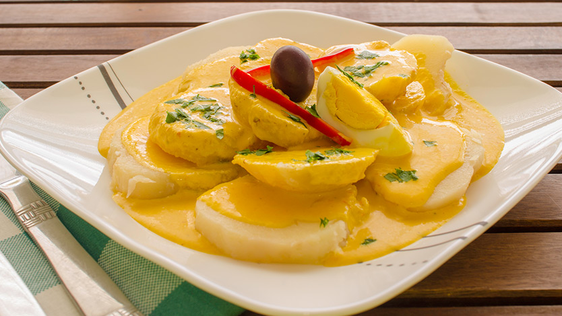
Imagen de Duman
CHECK

Slide 95
papas a la huancaína

Slide 96
Tenth Category 200
INSERT QUESTION HERE
CHECK
Notes:
You will have to move the Daily Double picture out of the way to write the question. If you do not wish to have the Daily Double in the game, delete it and the sound clip (speaker) from this slide. For a Daily Double, the contestant has to wager at least $5 and at most the highest point value of any player/team at that point in the game. It is considered a True Daily Double if they wager all of their points and go “double or nothing”.

Slide 97
El festival más famoso de
Bolivia celebrado en febrero
CHECK
Notes:
You will have to move the Daily Double picture out of the way to write the question. If you do not wish to have the Daily Double in the game, delete it and the sound clip (speaker) from this slide. For a Daily Double, the contestant has to wager at least $5 and at most the highest point value of any player/team at that point in the game. It is considered a True Daily Double if they wager all of their points and go “double or nothing”.

Slide 98
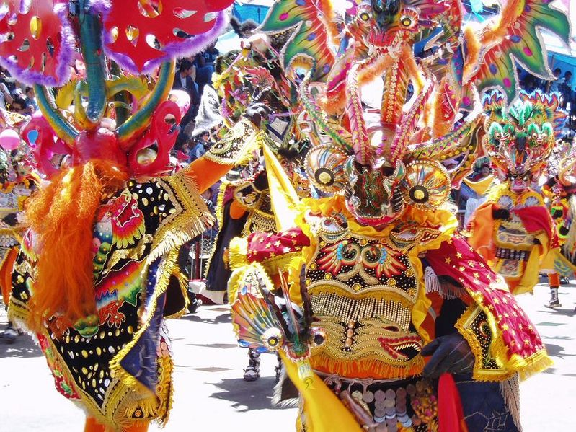
Diablada de Oruro
Imagen de Wikipedia

Slide 99
El templo inca Coricancha honra a ___, el dios del sol.
CHECK

Slide 100
Inti

Slide 101
Mujeres indígenas de
Bolivia que llevan un bombín en la cabeza.
CHECK

Slide 102
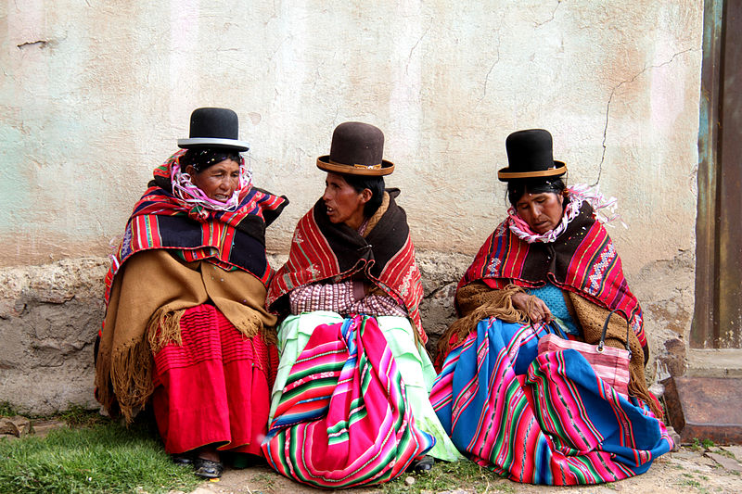
cholas
Imagen de Wikimedia

Slide 103
Lago navegable más alto del mundo
CHECK

Slide 104
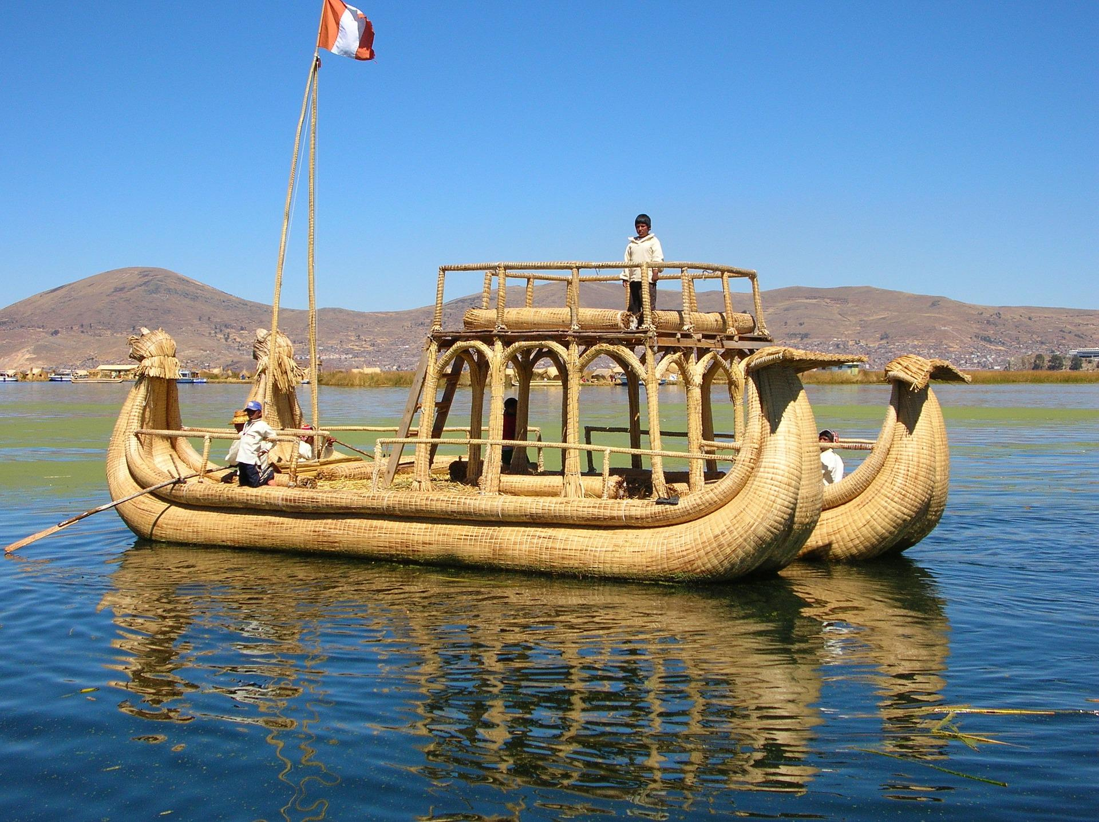
Lago Titicaca
Imagen de Francois Haefeli en Pixabay

Slide 105
Desierto de sal más alto y más grande del mundo
CHECK

Slide 106
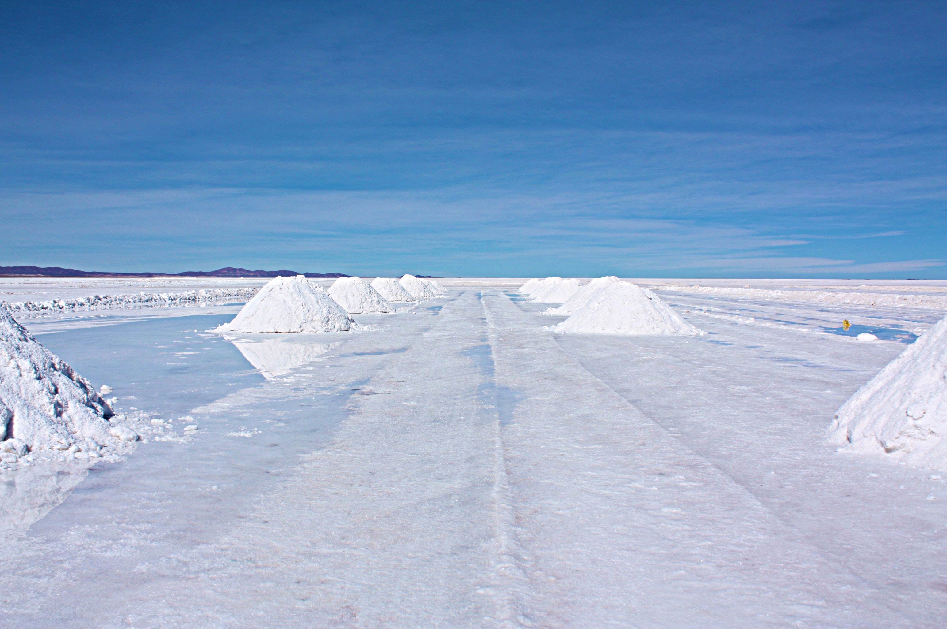
Salar de Uyuni
Photo by Julie Ricard on Unsplash

Slide 107
JEOPARDY FINAL
Categoría:
Lugar
CHECK

Slide 108

Ciudad peruana descubierta por el prof. Hiram Bingham en 1911.
CHECK

Slide 109
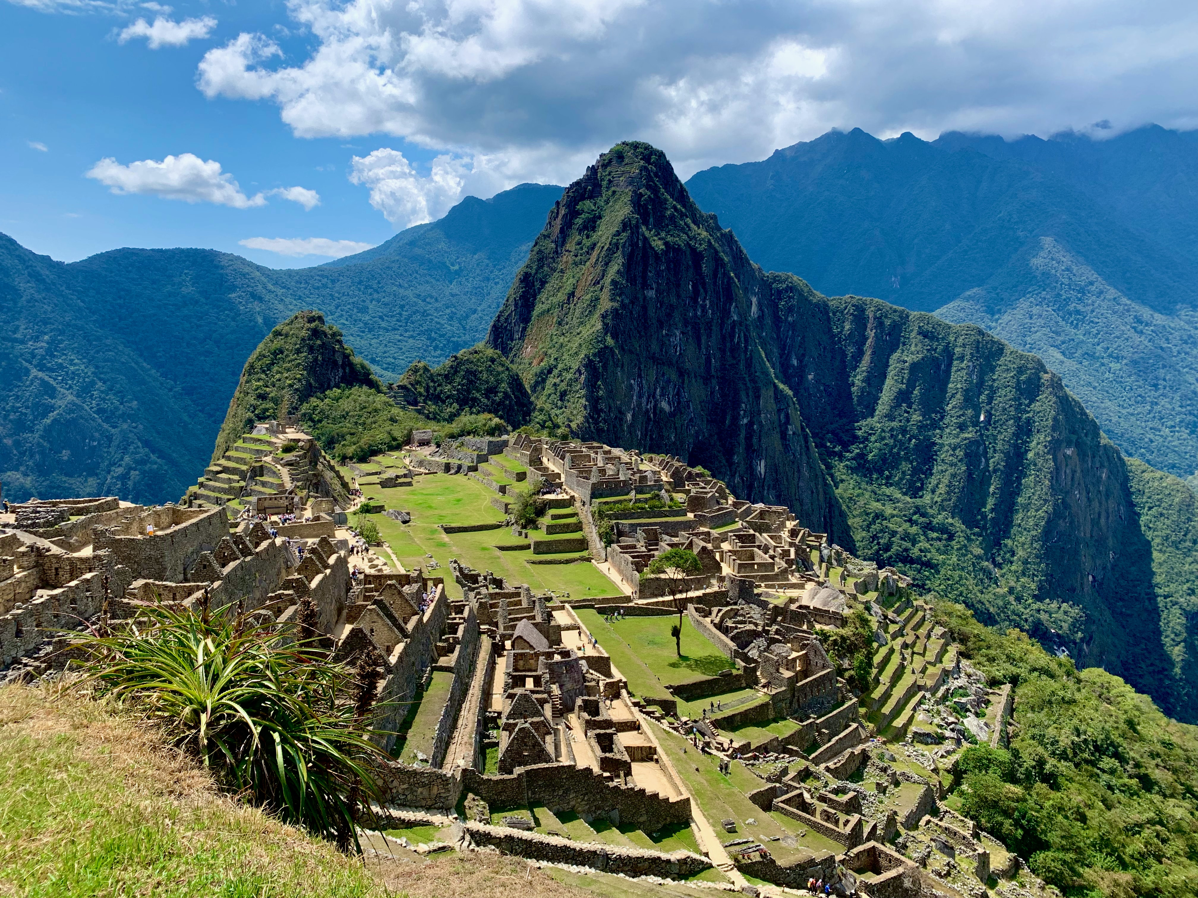
Machu Picchu
Photo by Agnieszka Mordaunt on Unsplash

