Slide 1

Capítulo 11
Template by Jared Speight
Content by Beatrice Tseng
con la Profesora Tseng

Slide 2

GEOGRAFÍA | CLIMA | MANDATOS FORMALES | AUTOMÓVIL | ESPAÑA (ciudades)
100 | 100 | 100 | 100 | 100
200 | 200 | 200 | 200 | 200
300 | 300 | 300 | 300 | 300
400 | 400 | 400 | 400 | 400
500 | 500 | 500 | 500 | 500

Slide 3

MEDIOS de TRANSPORTE | HOTEL | VIAJES/ AEROPUERTO | VERBOS | ESPAÑA
200 | 200 | 200 | 200 | 200
400 | 400 | 400 | 400 | 400
600 | 600 | 600 | 600 | 600
800 | 800 | 800 | 800 | 800
1000 | 1000 | 1000 | 1000 | 1000

Slide 4
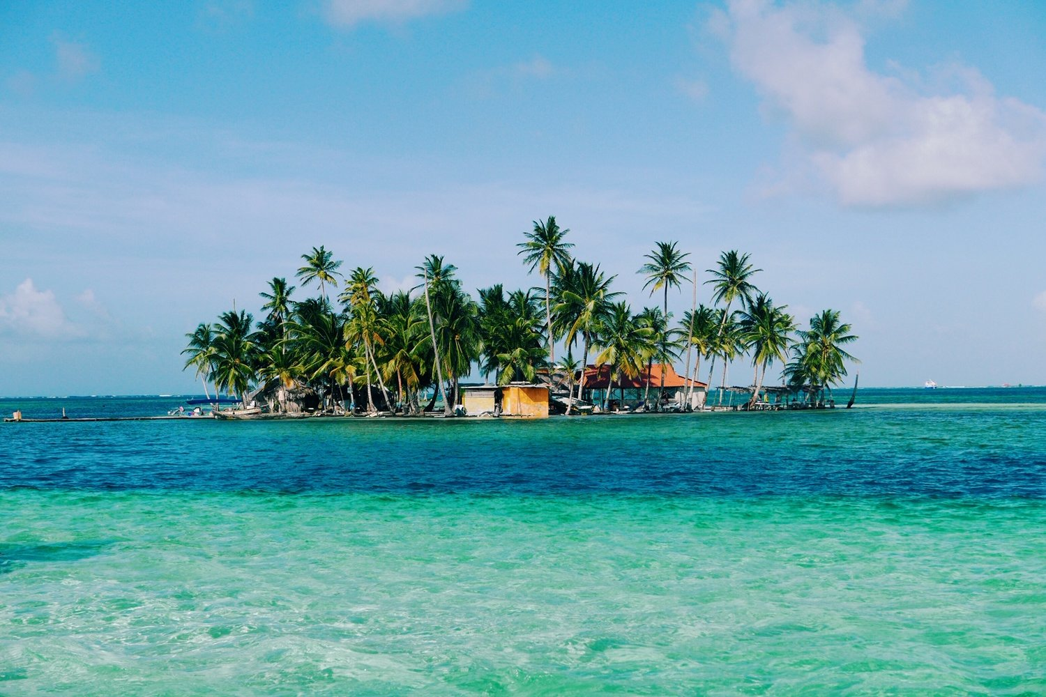
San Blas, Panamá
CHECK
Imagen de The Curious Travel

Slide 5

isla

Slide 6
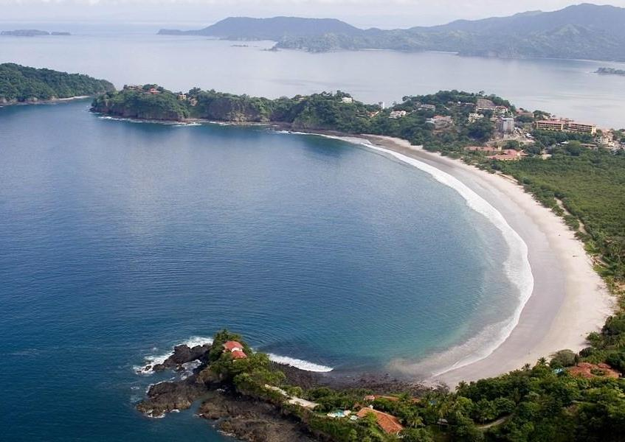
Culebra, Costa Rica
CHECK
Imagen de Cruise Mapper

Slide 7
bahía

Slide 8
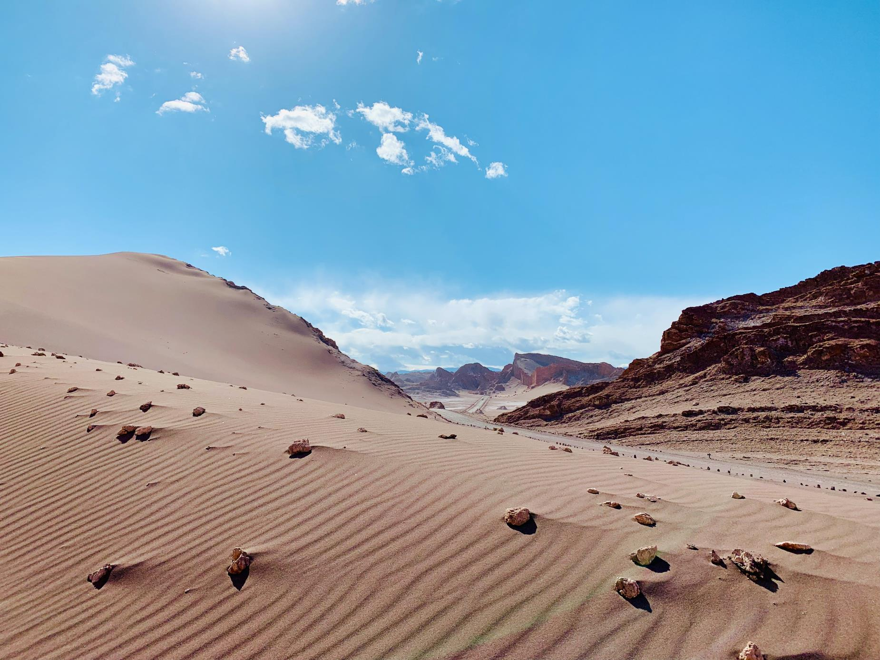
Atacama, Chile
CHECK
Photo by Agnieszka Mordaunt on Unsplash

Slide 9
desierto

Slide 10
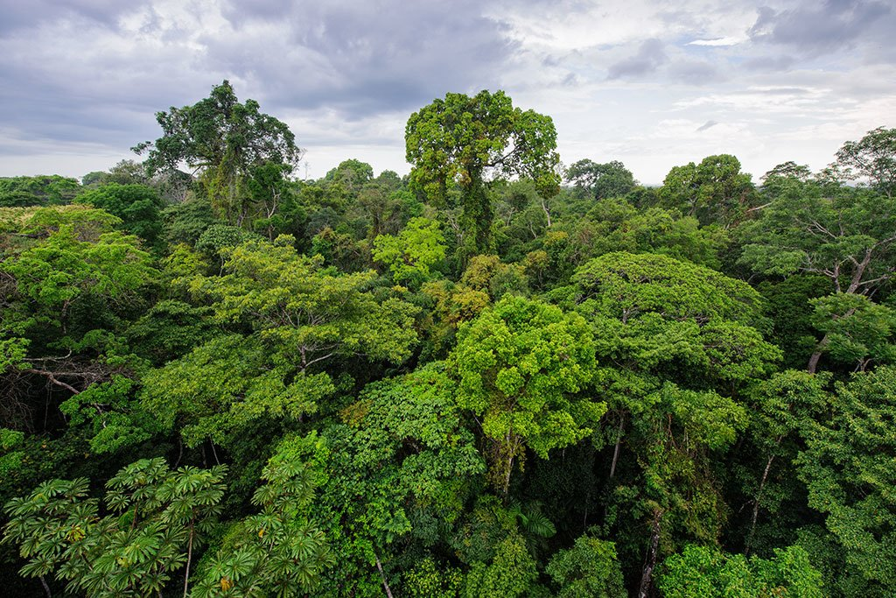
Amazonía, Perú
CHECK
Imagen de KimKim

Slide 11
bosque

Slide 12
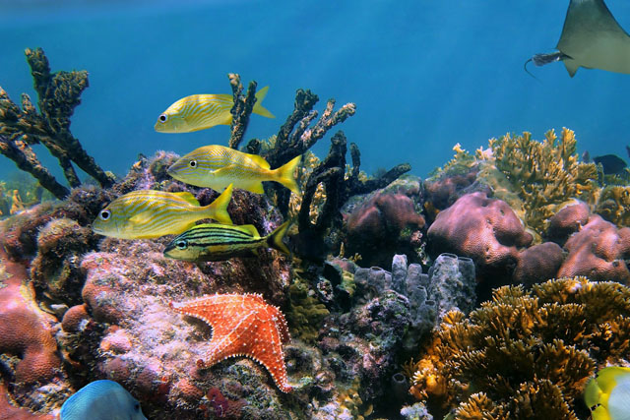
Cancún, México
CHECK
Imagen de Destinos Fun

Slide 13
arrecife

Slide 14
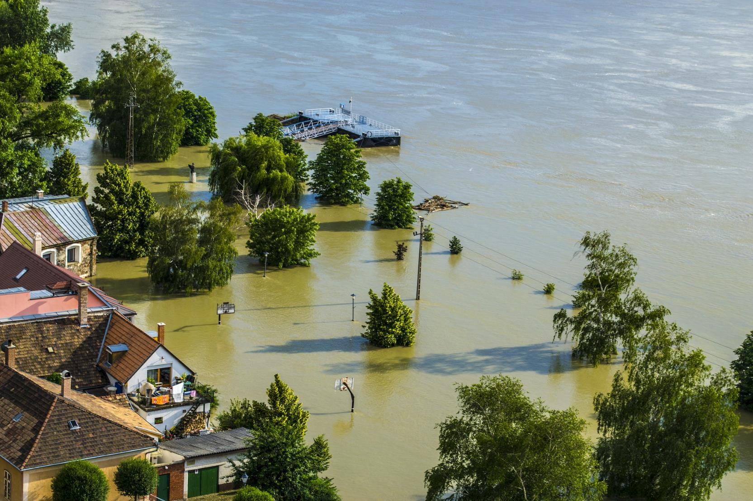
Imagen de lmaresz en Pixabay
Río Danubio
CHECK

Slide 15
inundación

Slide 16
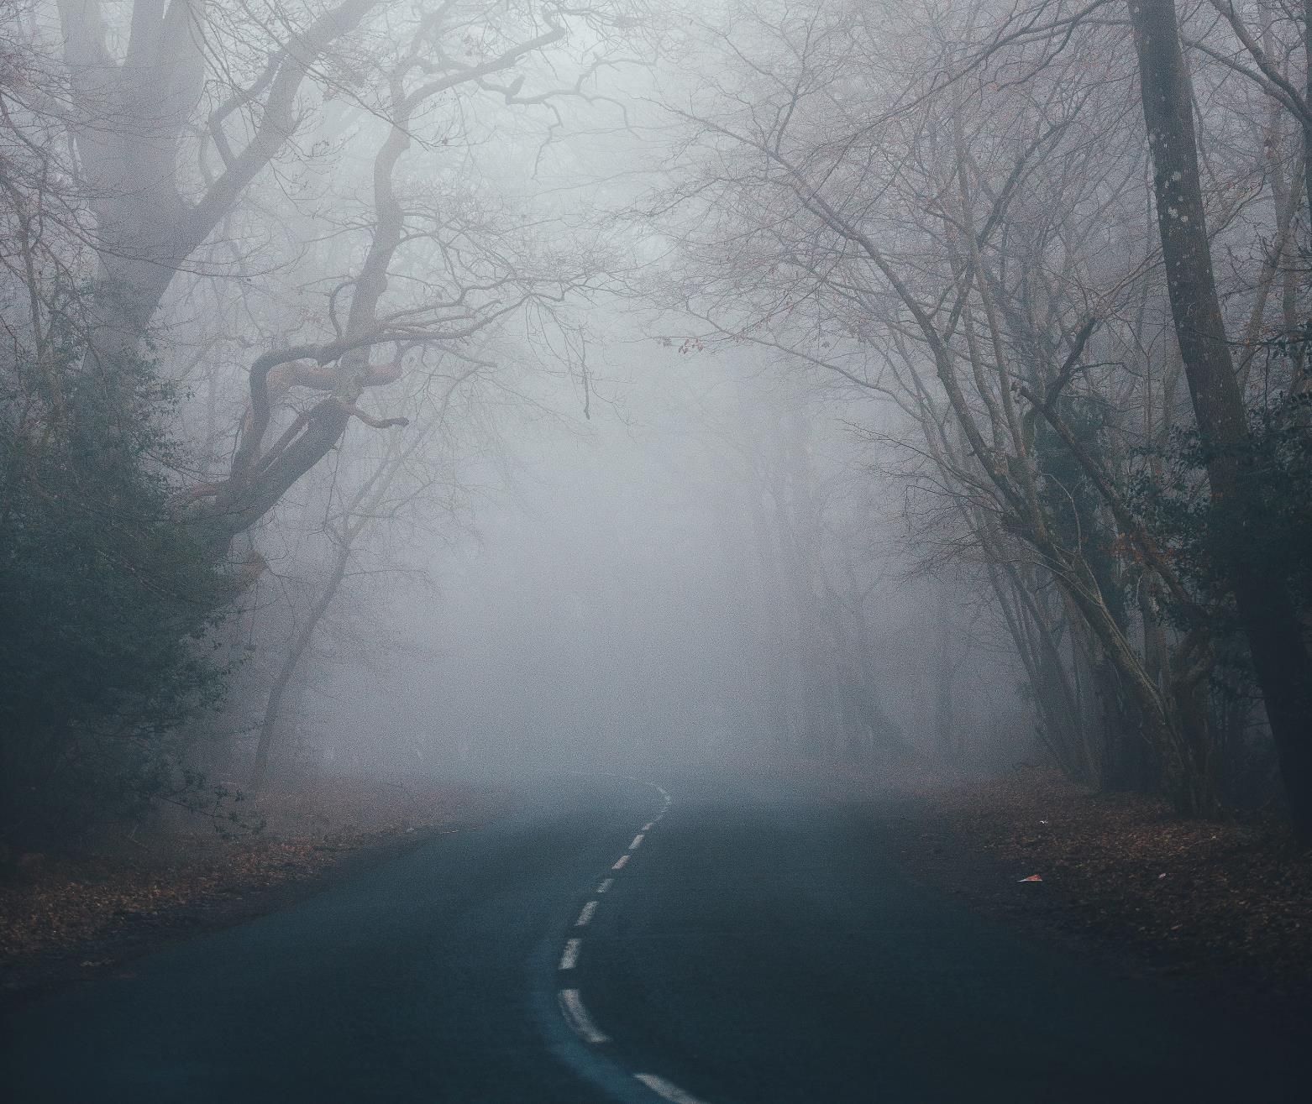
CHECK
Photo by Annie Spratt on Unsplash

Slide 17
neblina

Slide 18
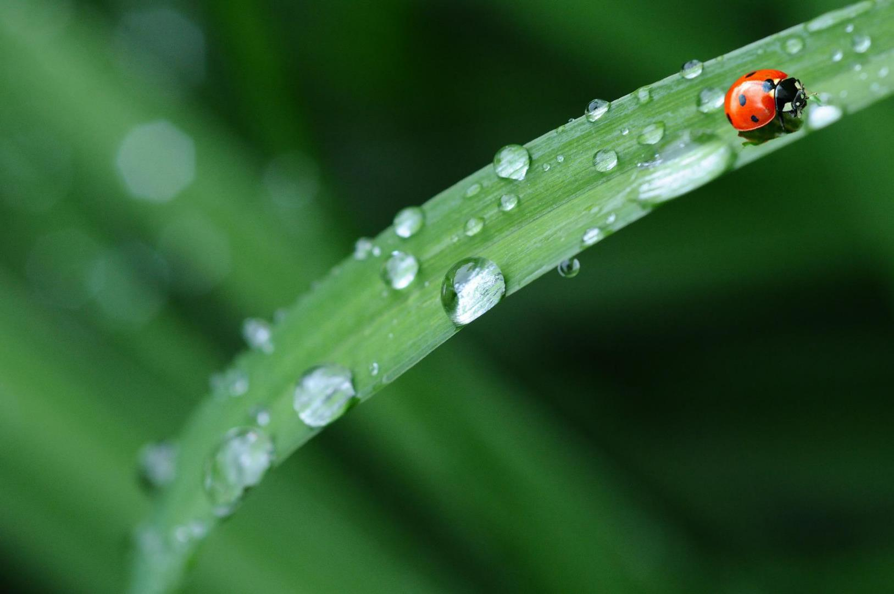
CHECK
Imagen de Denis Doukhan en Pixabay

Slide 19
rocío

Slide 20
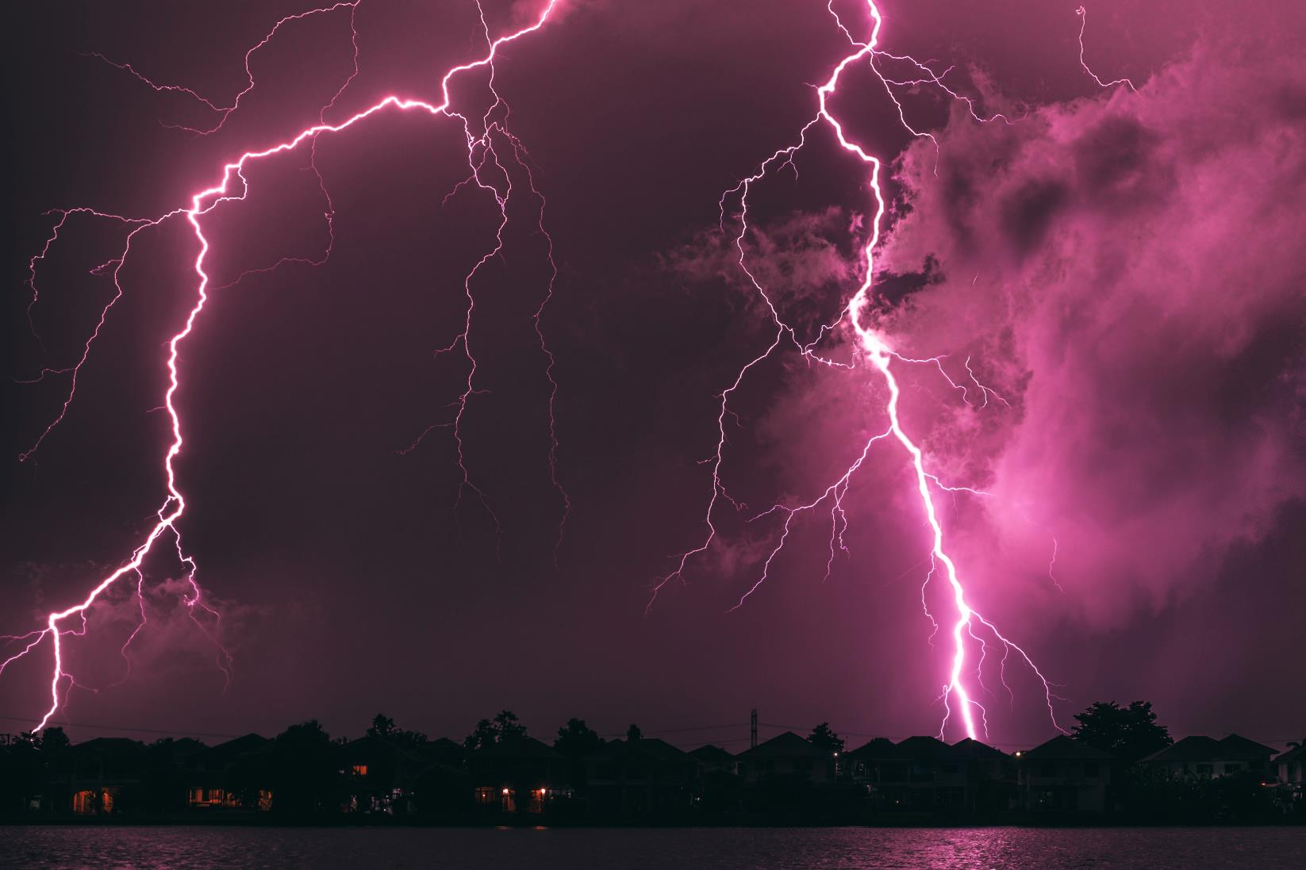
CHECK
Photo by chutipon Pattanatitinon on Unsplash

Slide 21
relámpagos

Slide 22
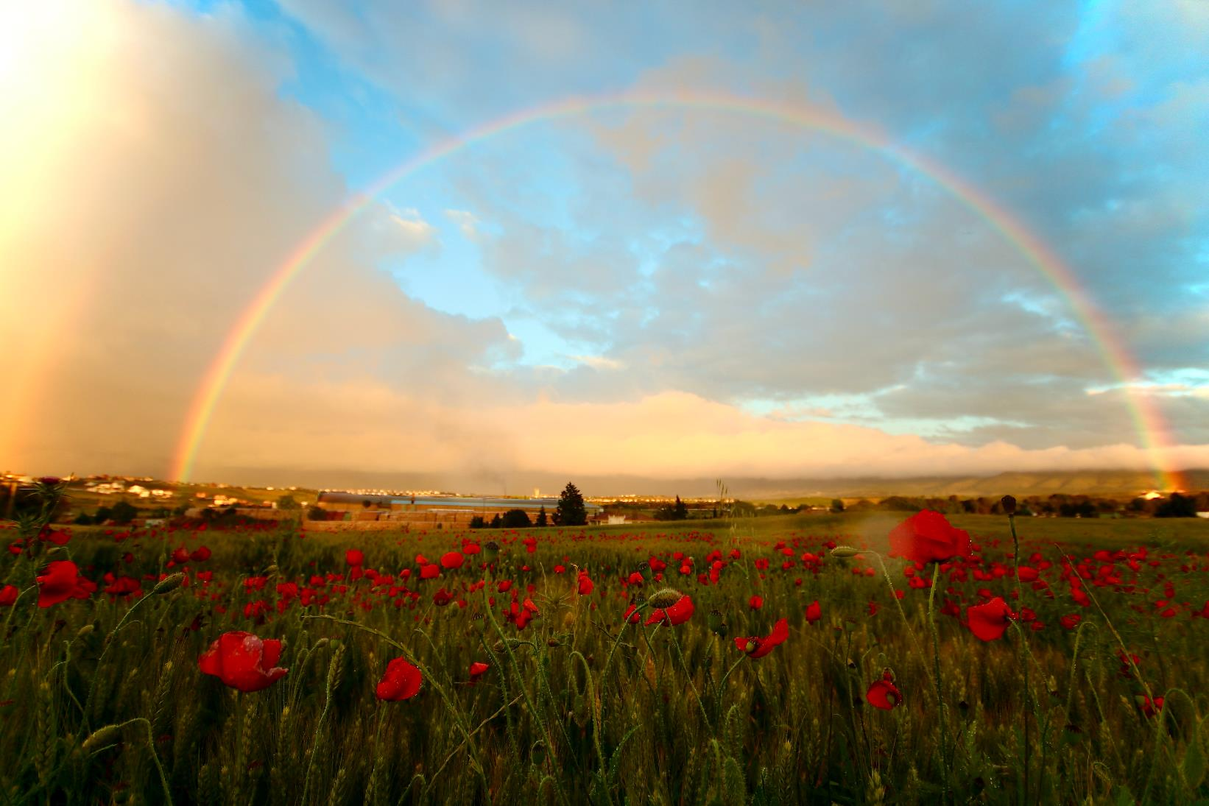
CHECK
Photo by Jorge Fernández Salas on Unsplash

Slide 23
arcoiris

Slide 24
La madre a sus hijos y a su esposo:
“___ (bajar) a comer”.
CHECK

Slide 25
Bajen a comer.

Slide 26
El joven al motorista:
“No ___ (doblar) a la derecha;
___ (seguir) derecho”.
CHECK

Slide 27
No doble a la derecha; siga derecho.

Slide 28
La dependienta al cliente:
“___ (comprar) este anillo; le queda muy bonito”.
CHECK

Slide 29
Compre este anillo.

Slide 30


Third Category - 400
INSERT QUESTION HERE
CHECK
Notes:
You will have to move the Daily Double picture out of the way to write the question. If you do not wish to have the Daily Double in the game, delete it and the sound clip (speaker) from this slide. For a Daily Double, the contestant has to wager at least $5 and at most the highest point value of any player/team at that point in the game. It is considered a True Daily Double if they wager all of their points and go “double or nothing”.

Slide 31
La profesora a los estudiantes:
“___ (sacar) un lápiz y un papel”.
CHECK
Notes:
You will have to move the Daily Double picture out of the way to write the question. If you do not wish to have the Daily Double in the game, delete it and the sound clip (speaker) from this slide. For a Daily Double, the contestant has to wager at least $5 and at most the highest point value of any player/team at that point in the game. It is considered a True Daily Double if they wager all of their points and go “double or nothing”.

Slide 32
Saquen un lápiz.

Slide 33
El policía a los peatones:
“No ___ (correr) y
___ (cruzar) la calle con cuidado”.
CHECK

Slide 34
No corran y crucen con cuidado.

Slide 35
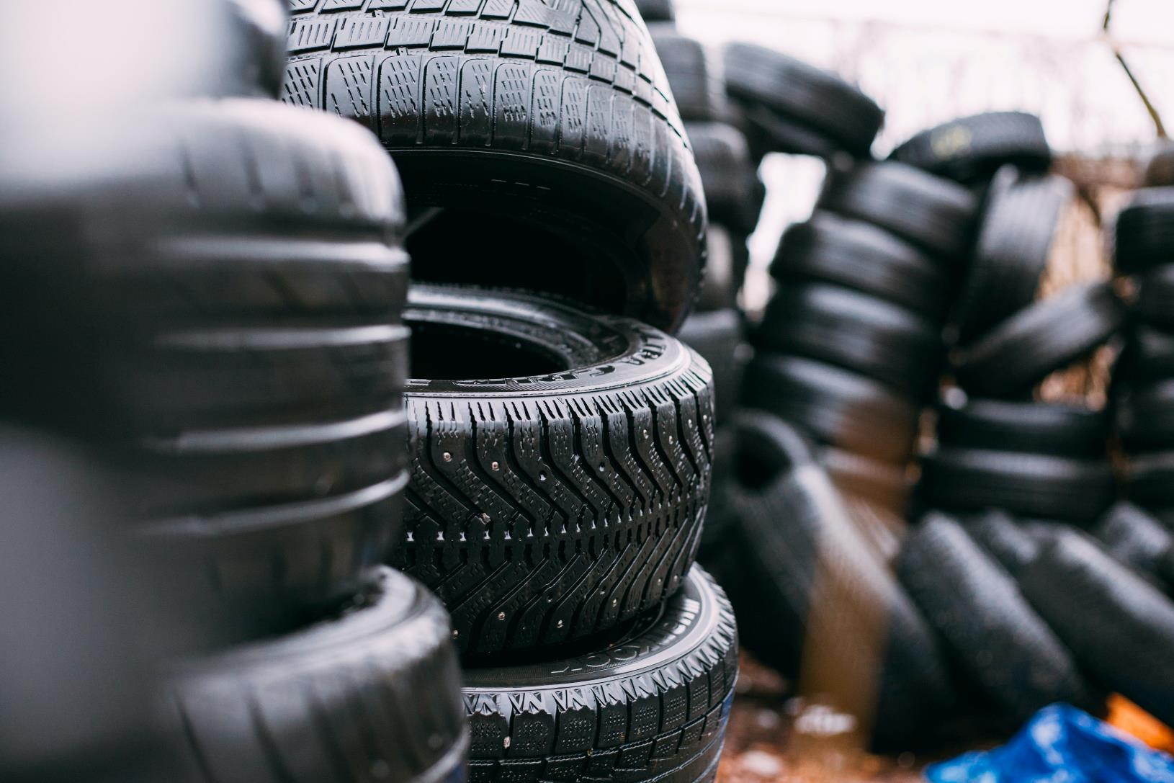
CHECK
Photo by Robert Laursoo on Unsplash

Slide 36
llantas

Slide 37
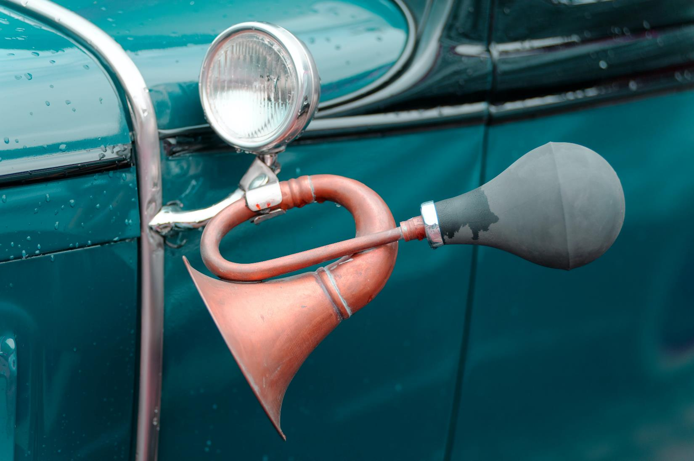
Photo by Milivoj Kuhar on Unsplash
CHECK

Slide 38
bocina

Slide 39
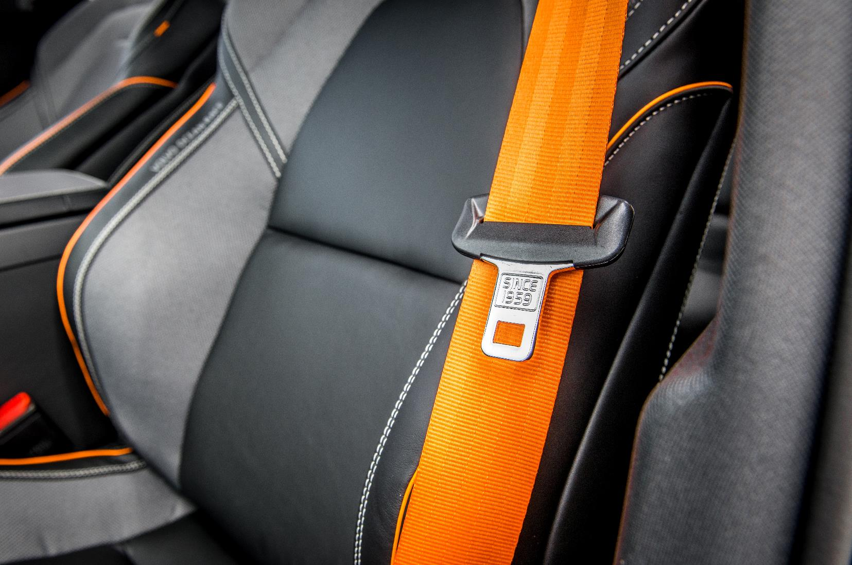
CHECK
Photo by Remy Lovesy on Unsplash

Slide 40
cinturón de seguridad

Slide 41
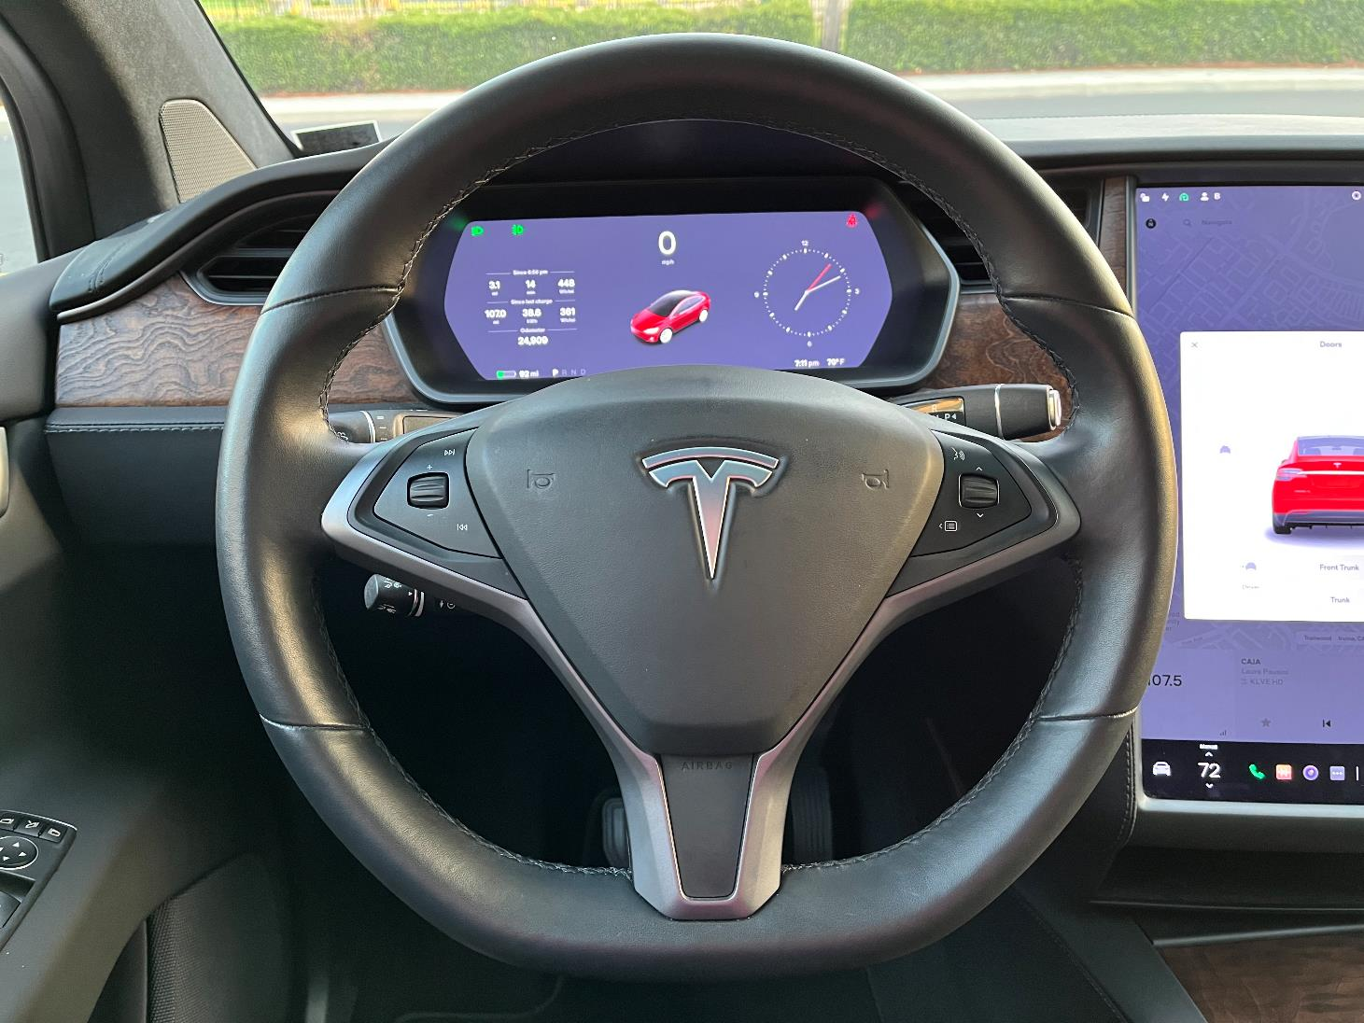
Foto de Beatrice Tseng
CHECK

Slide 42
volante

Slide 43
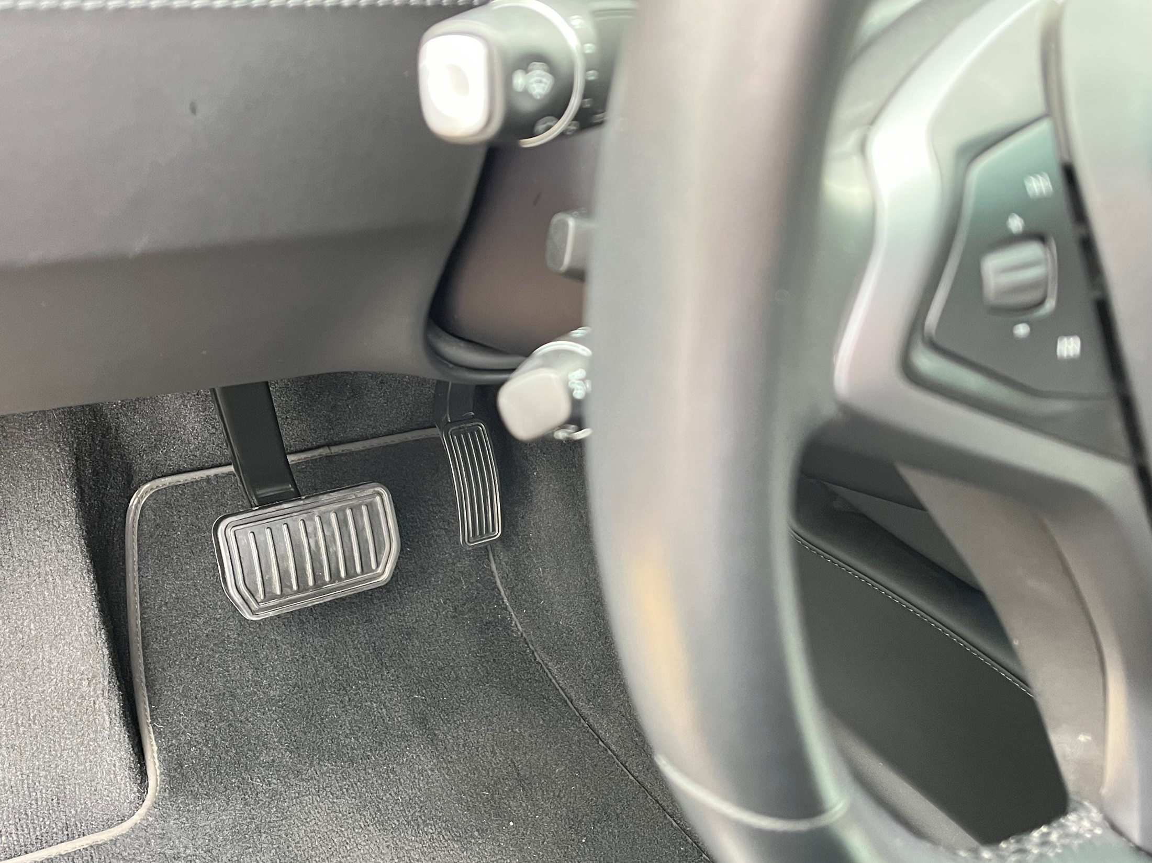
Photo by Beatrice Tseng
CHECK
CHECK

Slide 44
frenos

Slide 45
Las Ramblas y la Iglesia de la Sagrada Familia están en ____.
CHECK

Slide 46
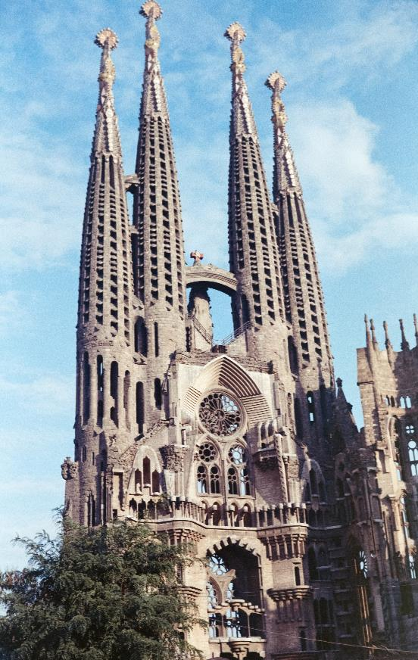
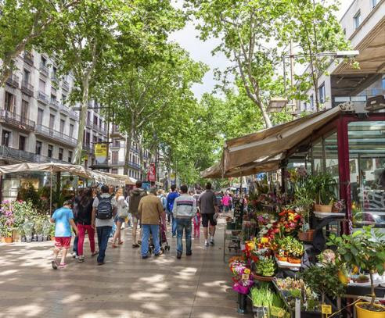
Barcelona
Photo by Annie Spratt on Unsplash
Imagen de Mercer Hoteles

Slide 47
El Museo del Prado está en ____.
CHECK

Slide 48
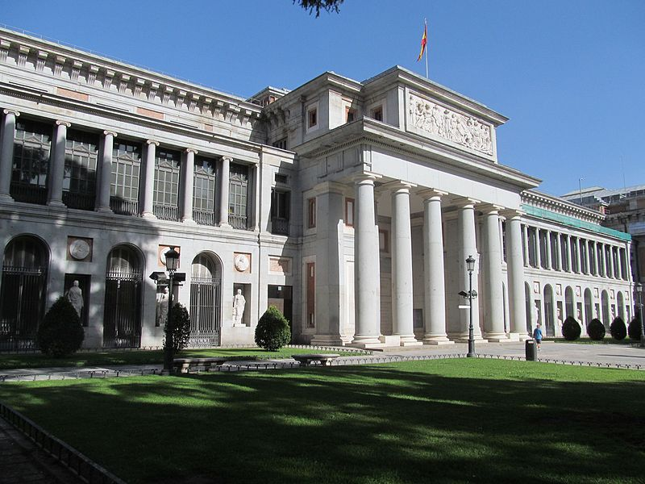
Madrid
Imagen de Wikimedia

Slide 49
La Alhambra está en ___.
CHECK

Slide 50
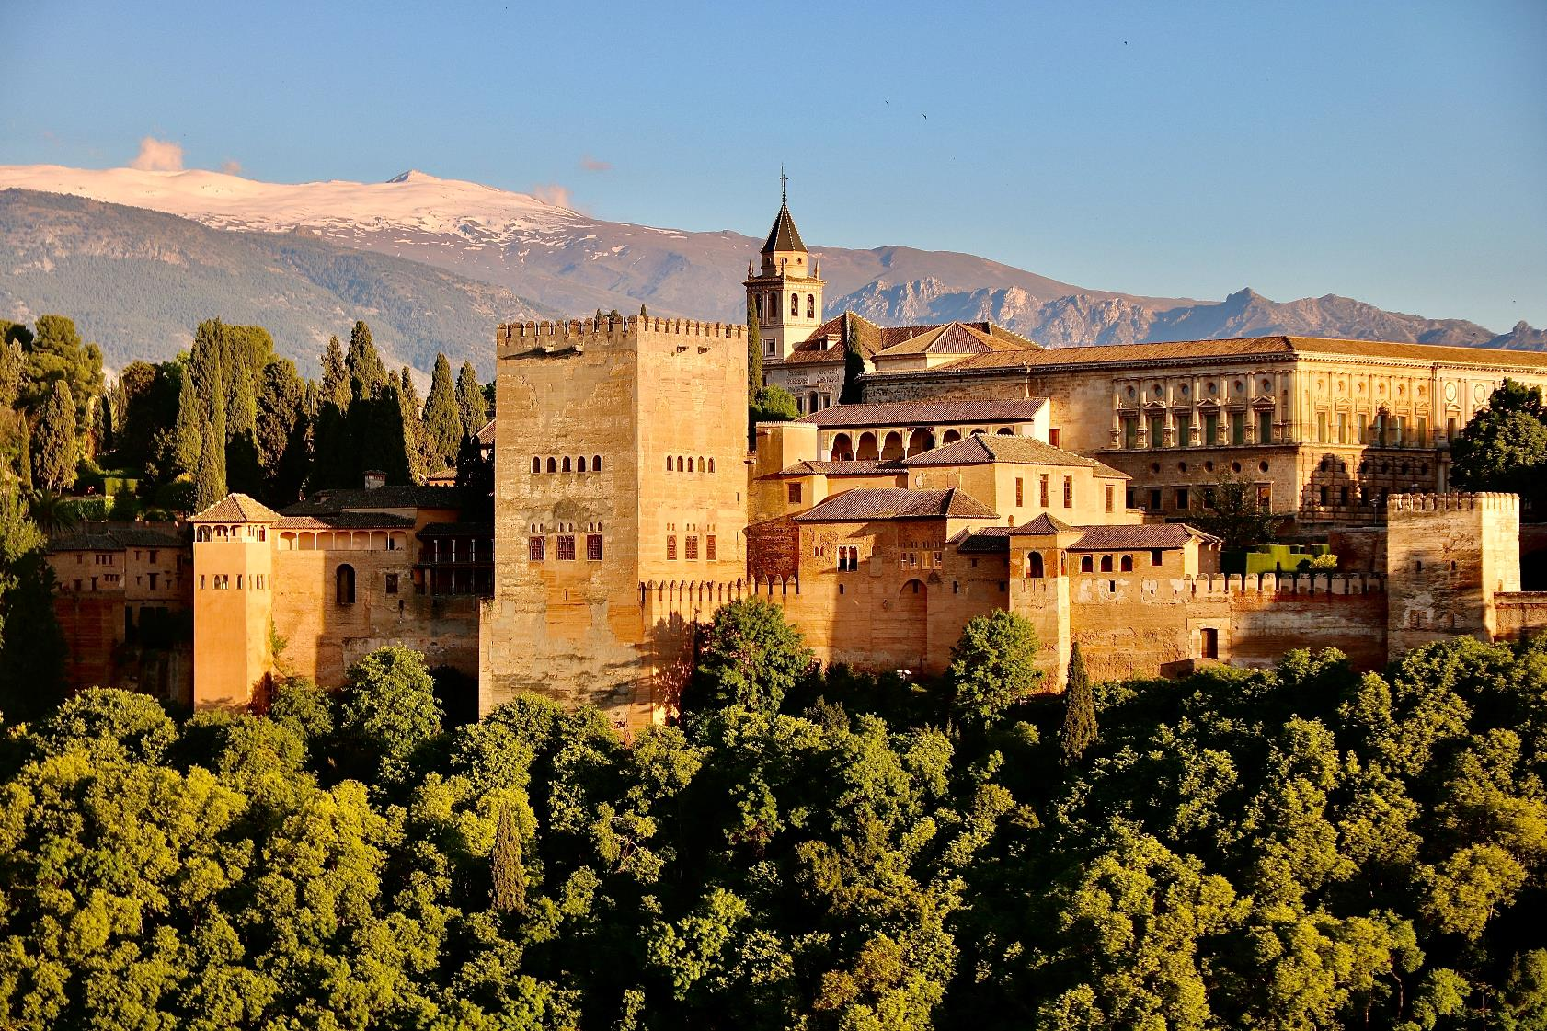
Granada
Photo by Jorge Fernández Salas on Unsplash

Slide 51
El Alcázar y la torre de
Giralda están en ___.
CHECK

Slide 52
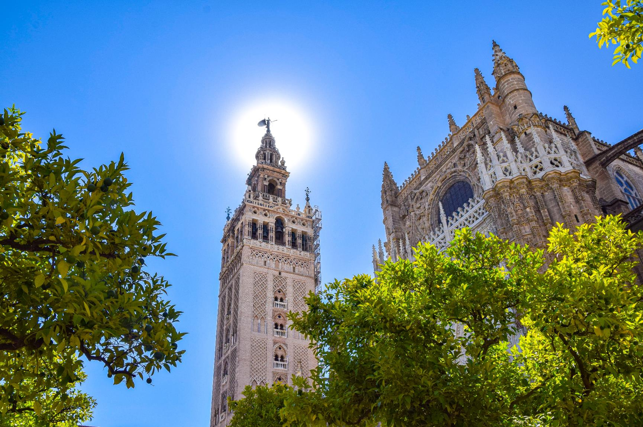
Sevilla
Photo by Tom Podmore on Unsplash

Slide 53
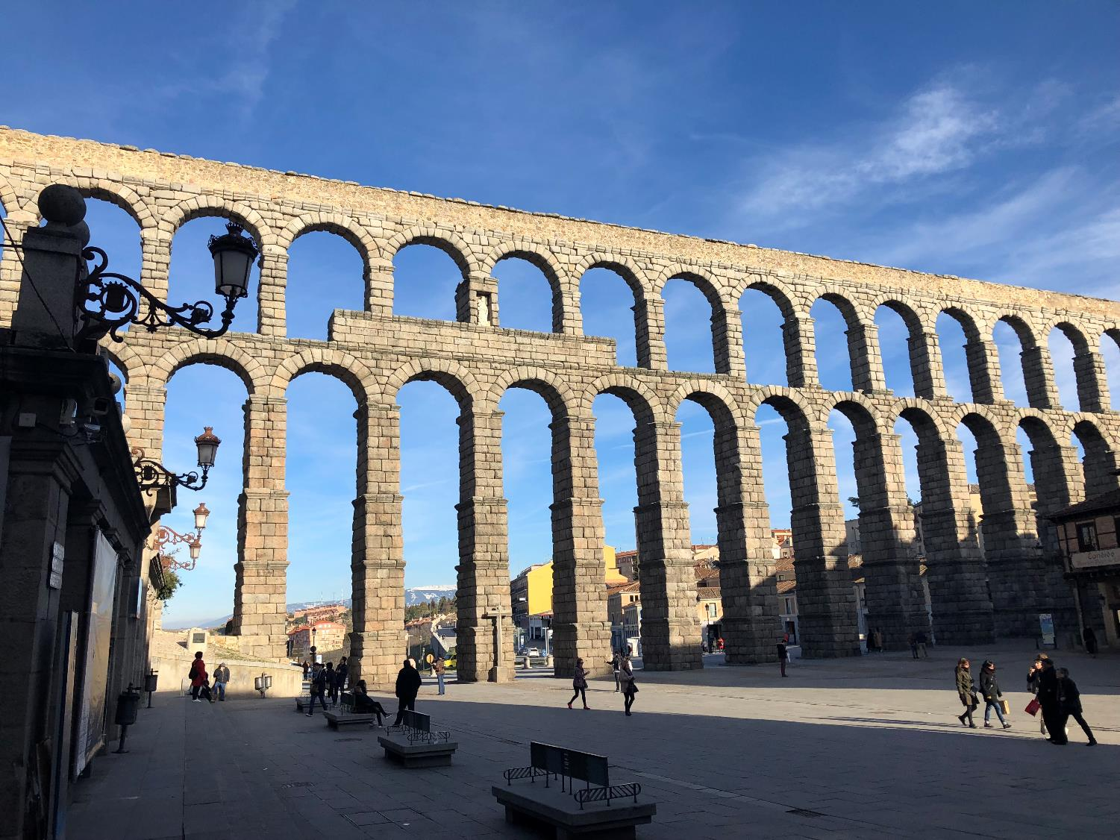
Este acueducto romano está en ___.
CHECK
Foto de Beatrice Tseng

Slide 54
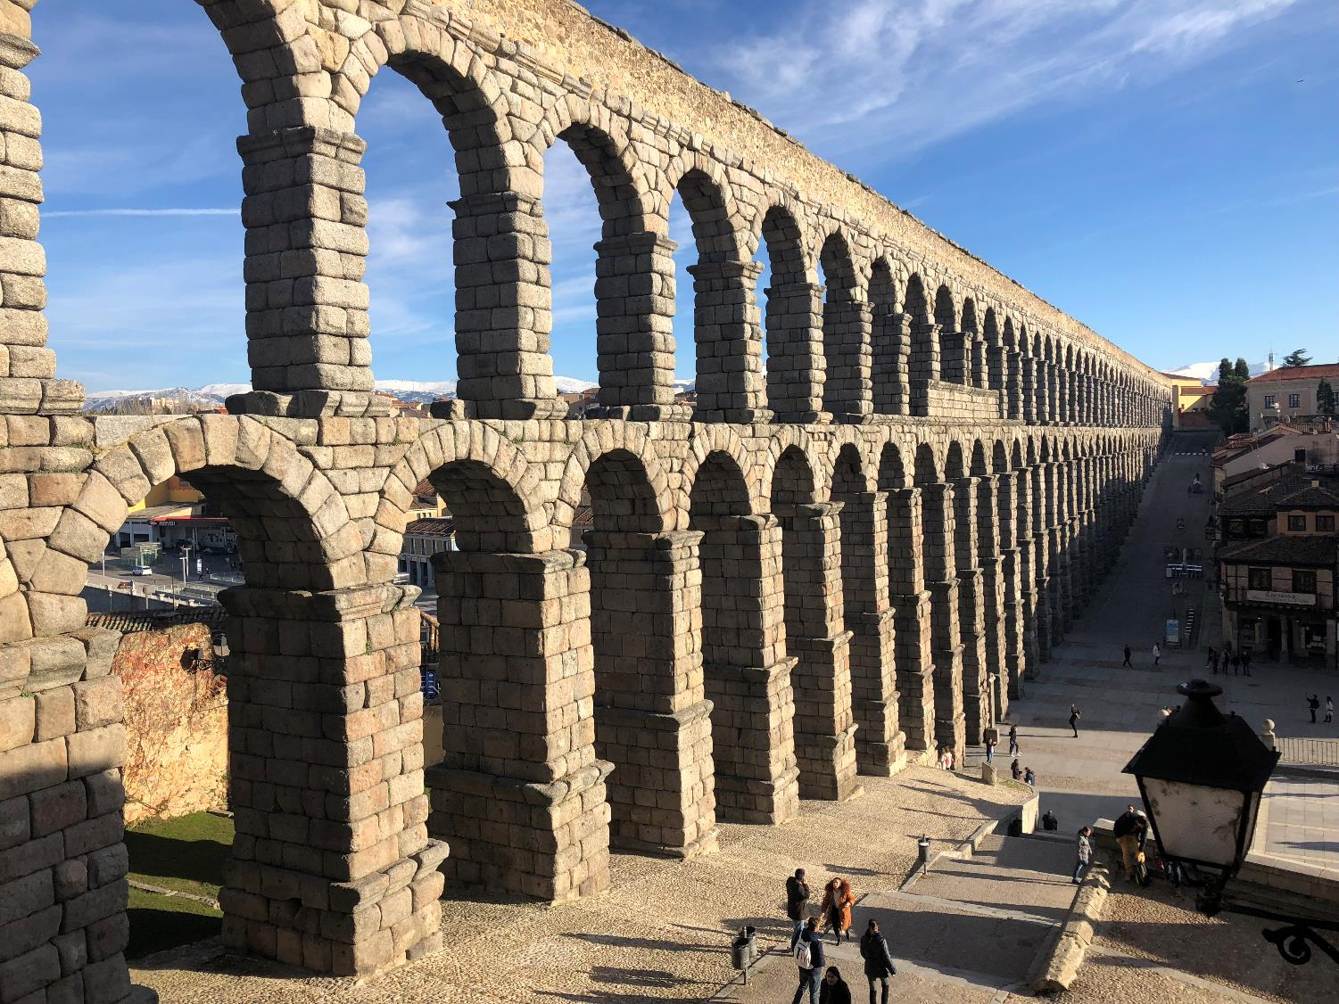
Segovia
Foto de Beatrice Tseng

Slide 55
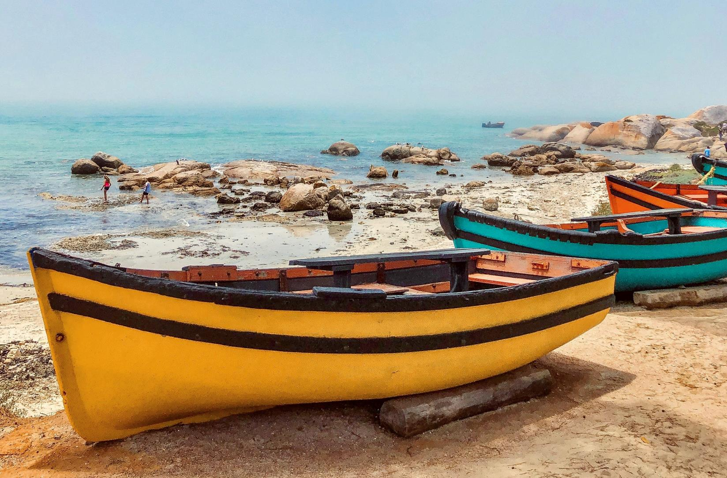
CHECK
Photo by Ian Badenhorst on Unsplash

Slide 56
bote

Slide 57
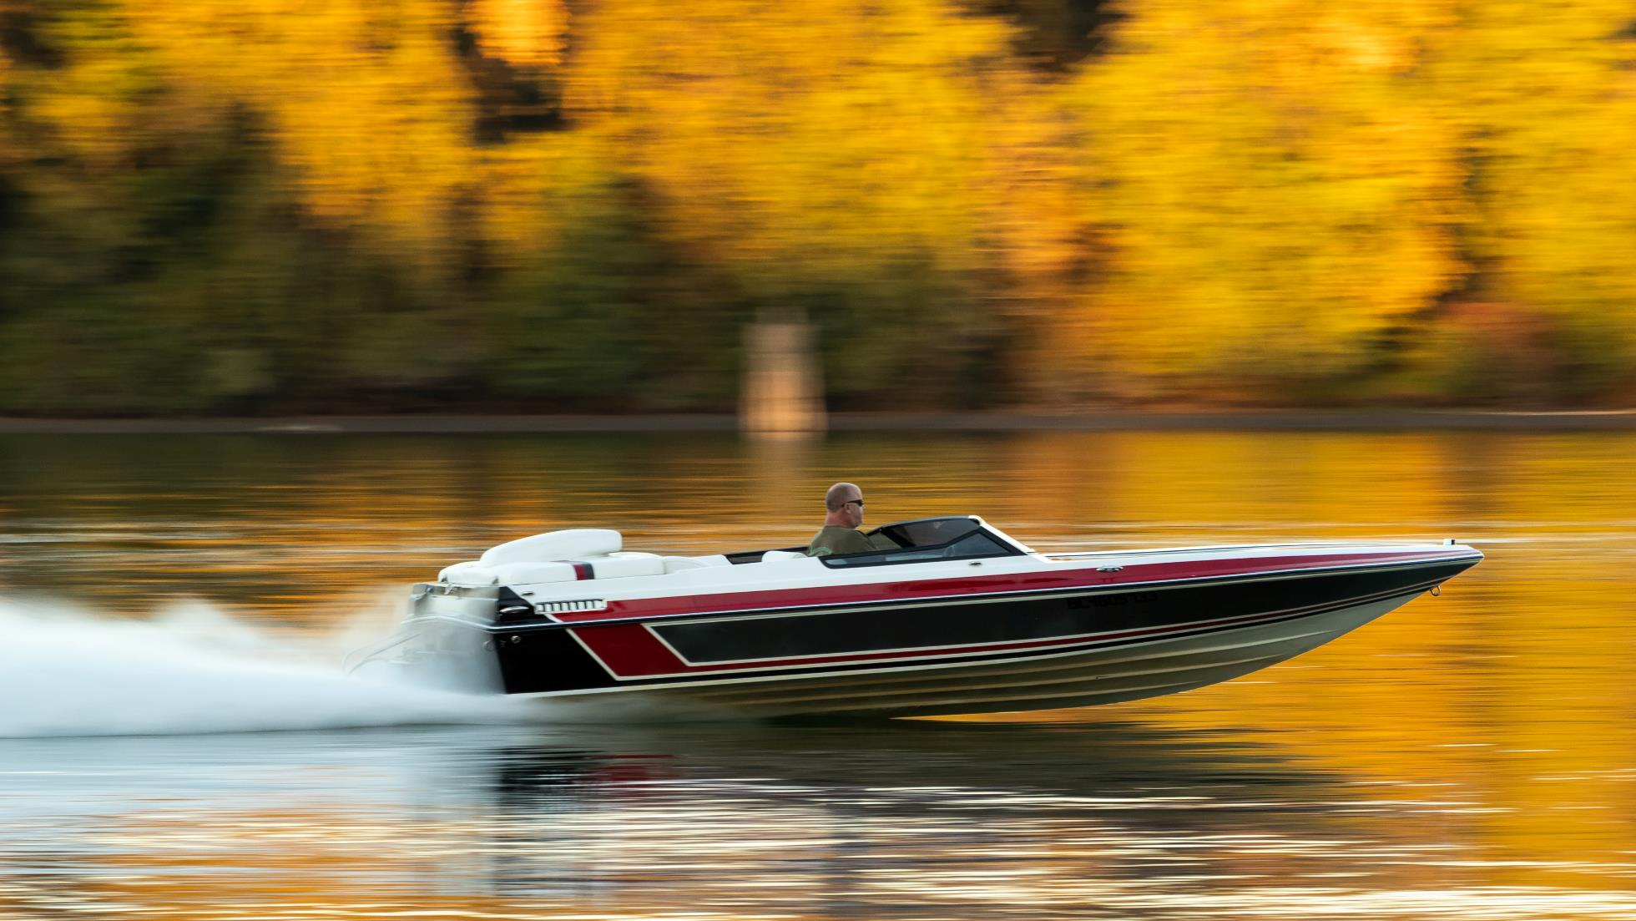
Photo by Greg Rosenke on Unsplash
CHECK

Slide 58
lancha

Slide 59
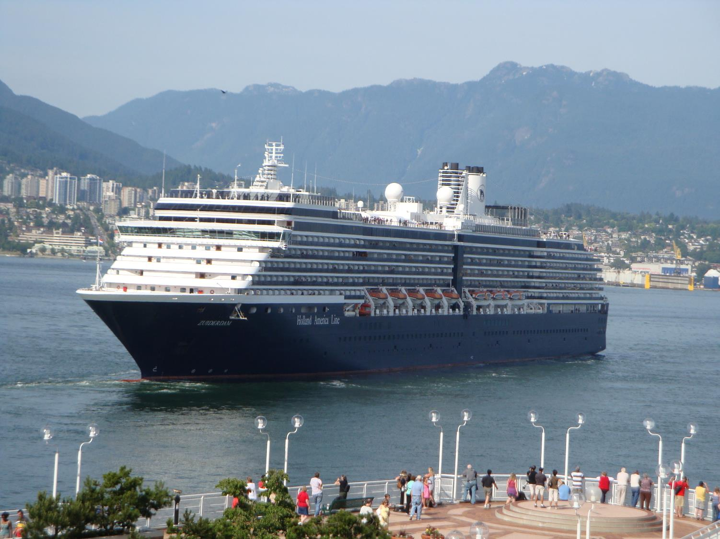
Foto de Beatrice Tseng
CHECK

Slide 60
crucero

Slide 61
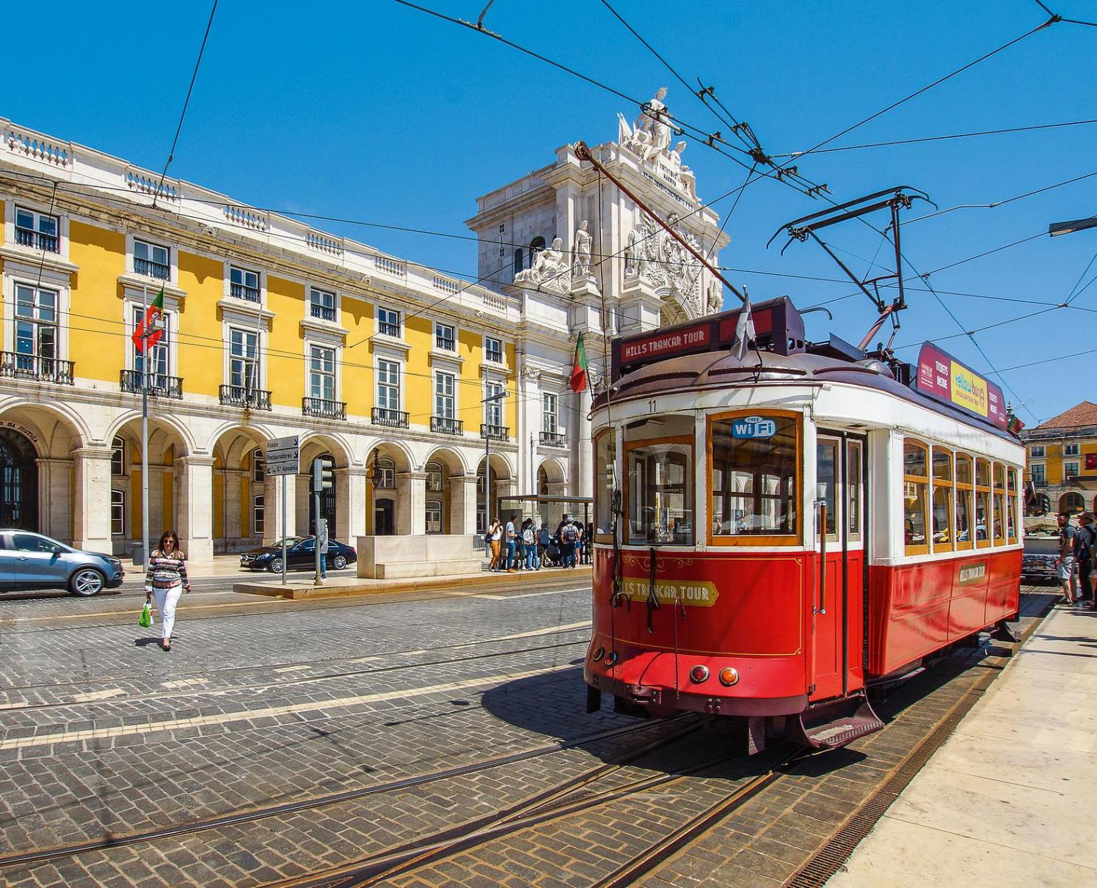
CHECK
Imagen de Frank Nürnberger en Pixabay

Slide 62
tranvía

Slide 63
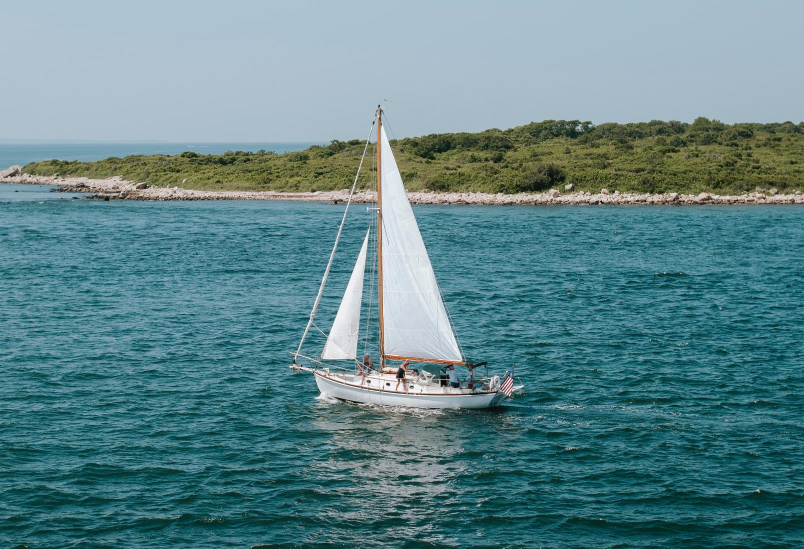
CHECK
Photo by Aubrey Odom-Mabey on Unsplash

Slide 64
velero

Slide 65
Persona que lleva las maletas a su habitación.
CHECK

Slide 66
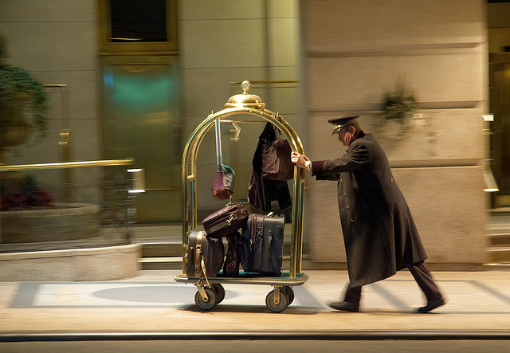
botones
Imagen de Jason Kuffer en Flickr

Slide 67
Persona que arregla su habitación.
CHECK

Slide 68
camarera

Slide 69
SEVENTH Category - 600
INSERT QUESTION HERE
CHECK
Notes:
You will have to move the Daily Double picture out of the way to write the question. If you do not wish to have the Daily Double in the game, delete it and the sound clip (speaker) from this slide. For a Daily Double, the contestant has to wager at least $5 and at most the highest point value of any player/team at that point in the game. It is considered a True Daily Double if they wager all of their points and go “double or nothing”.

Slide 70
Conjunto de ropas y cosas que llevamos de viaje.
CHECK
Notes:
You will have to move the Daily Double picture out of the way to write the question. If you do not wish to have the Daily Double in the game, delete it and the sound clip (speaker) from this slide. For a Daily Double, the contestant has to wager at least $5 and at most the highest point value of any player/team at that point in the game. It is considered a True Daily Double if they wager all of their points and go “double or nothing”.

Slide 71
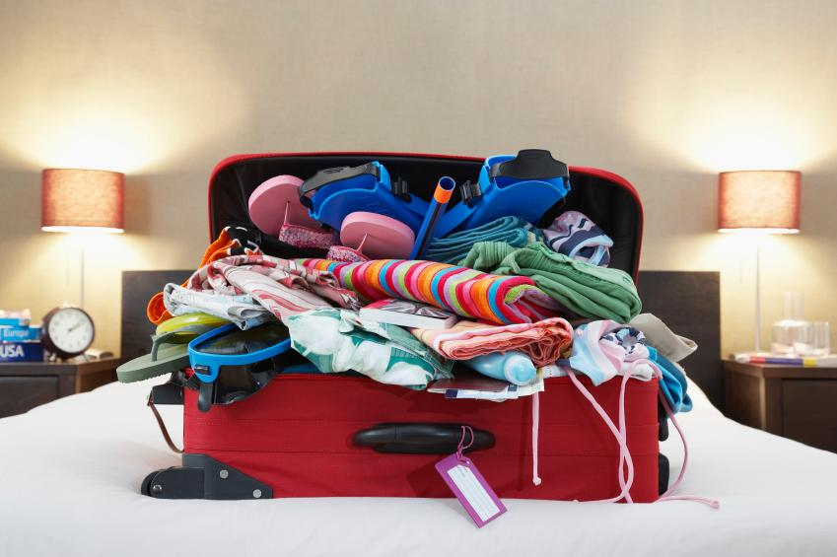
equipaje
Imagen de Mundo Deportivo

Slide 72
Lugar donde los clientes se registran y reciben información.
CHECK

Slide 73
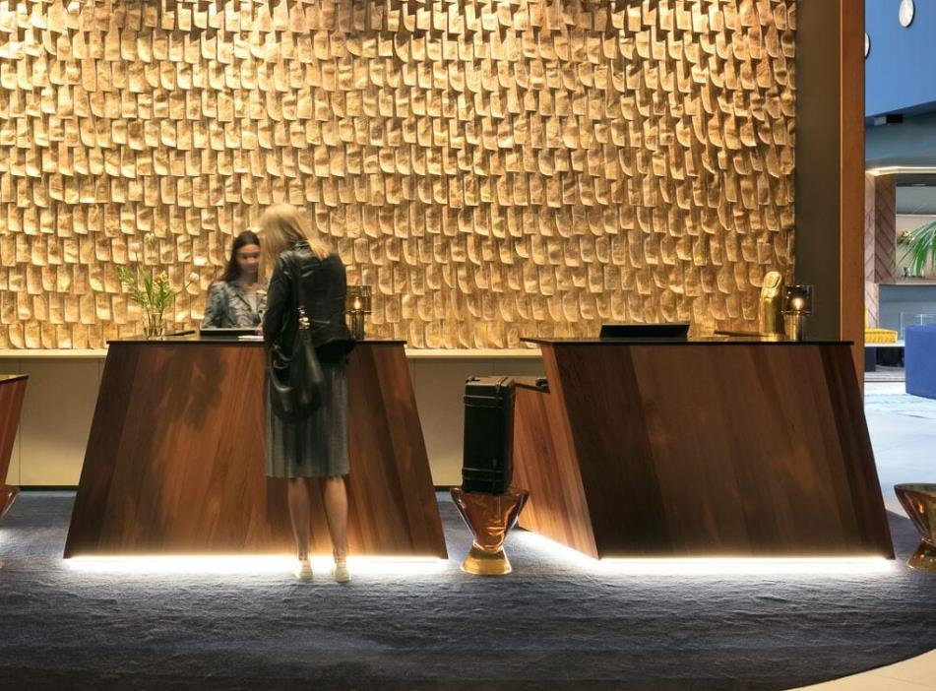
recepción/mostrador
Imagen de Skift

Slide 74
Lugar donde una persona se hospeda.
CHECK

Slide 75
alojamiento

Slide 76
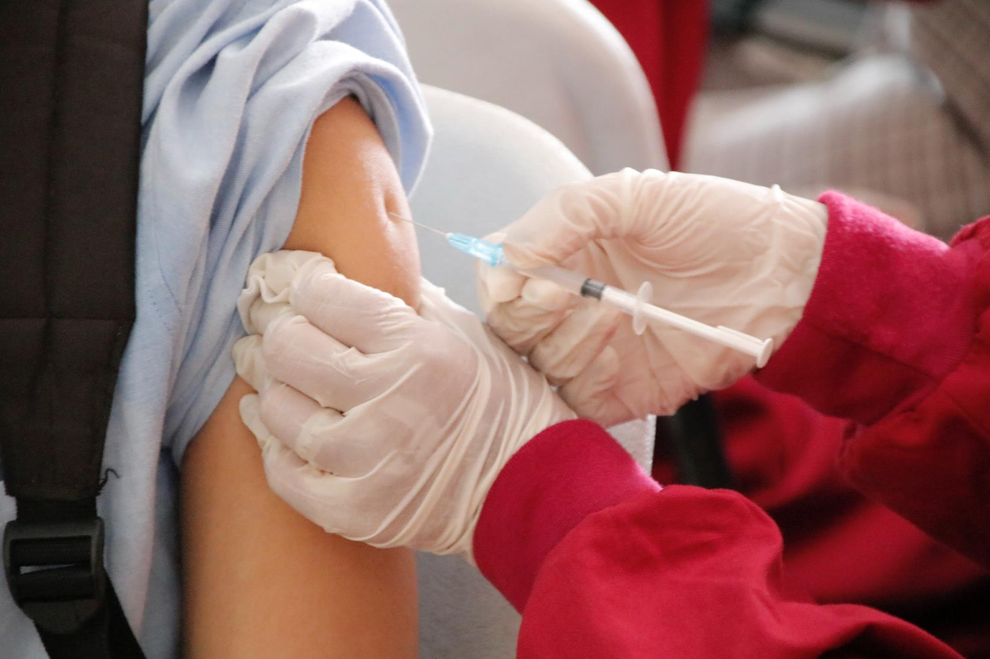
CHECK
Photo by Ed Us on Unsplash

Slide 77
vacuna

Slide 78
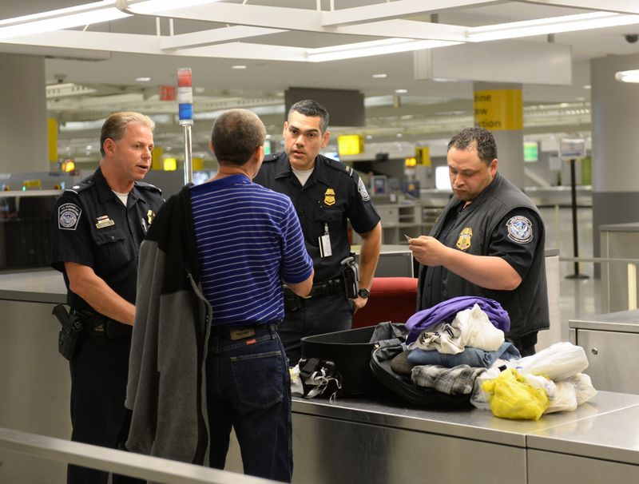
CHECK
Imagen de David Handschuh en el New York Daily News

Slide 79
aduana

Slide 80
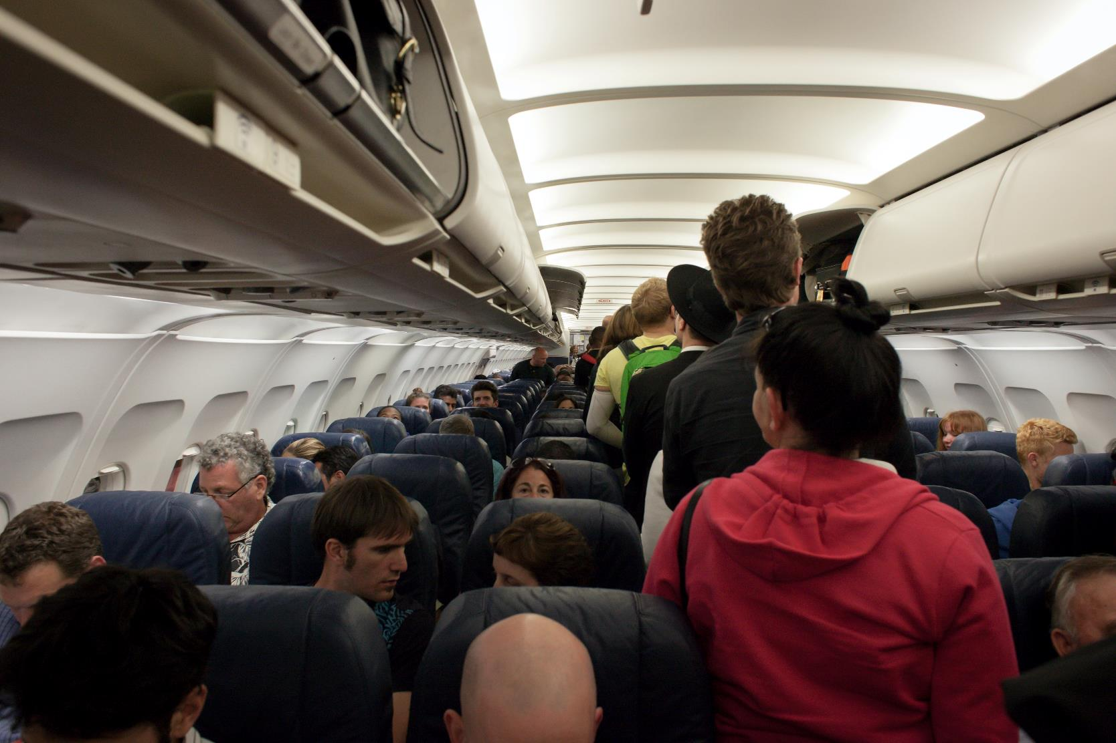
Todas estas personas son ___.
CHECK
Photo by Chris Brignola on Unsplash

Slide 81
pasajeros

Slide 82
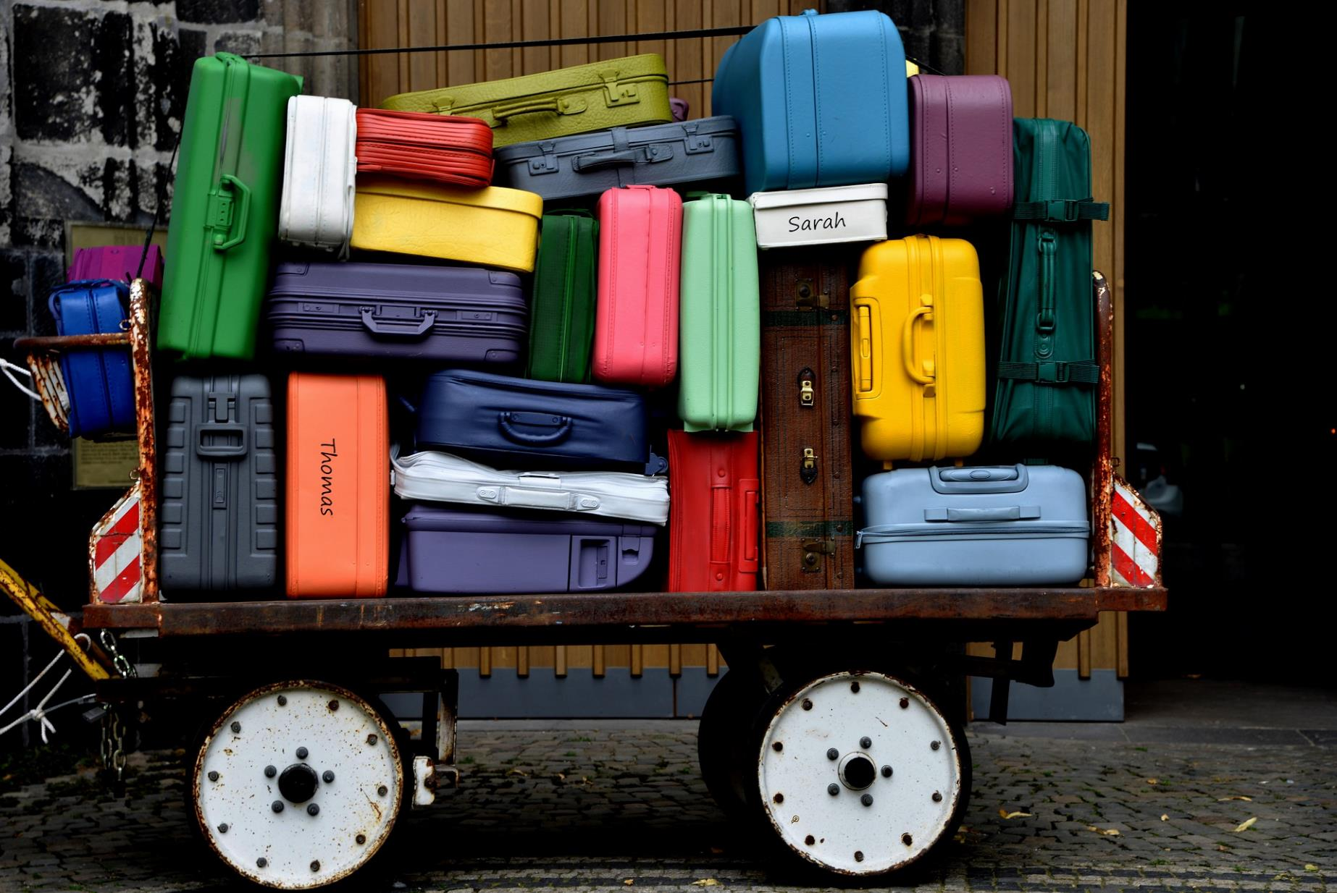
CHECK
Imagen de G37G en Pixabay

Slide 83
maletas

Slide 84
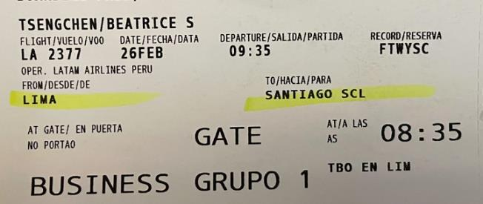
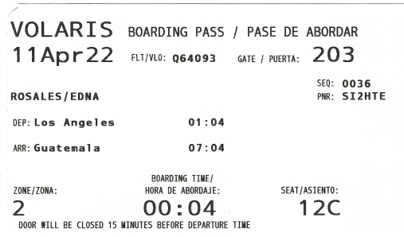
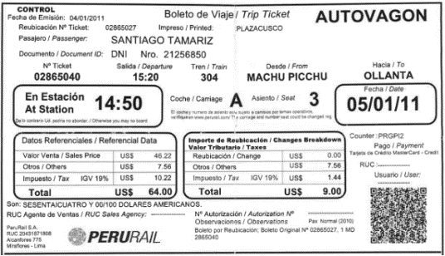
CHECK

Slide 85
pases de abordar

Slide 86
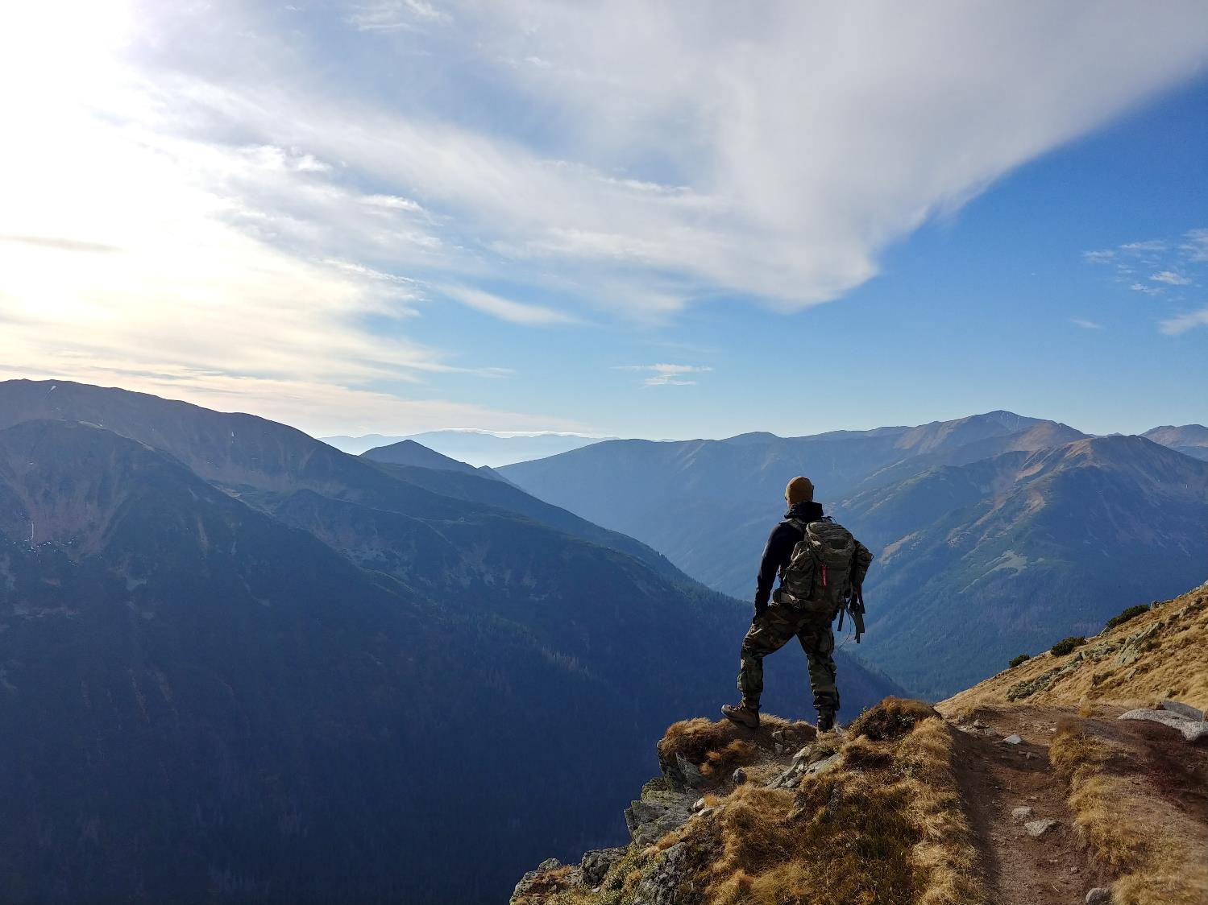
A este joven le gusta
___ montañas.
CHECK
Photo by Wojciech Then on Unsplash

Slide 87
escalar

Slide 88
En Granada, quiero
___ (pasar la noche) en el Parador San Francisco.
CHECK

Slide 89
hospedarme

Slide 90
Es común ___ un itinerario antes de viajar para saber dónde vamos a visitar.
CHECK

Slide 91
planificar

Slide 92
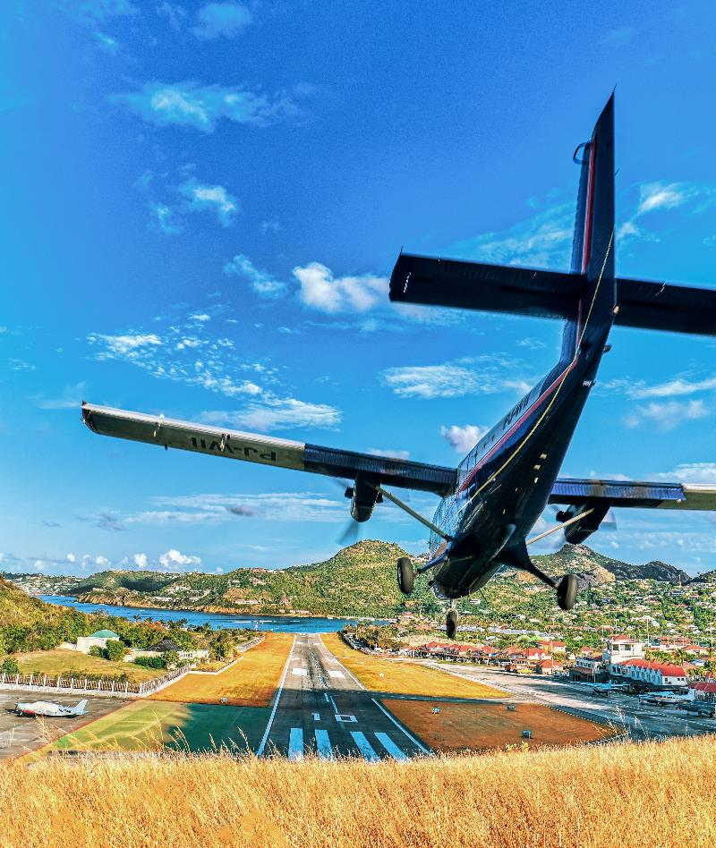
El avión ha llegado a su destino; pronto va a ____.
Photo by Vladi Malchevskiy on Unsplash
CHECK

Slide 93
aterrizar

Slide 94
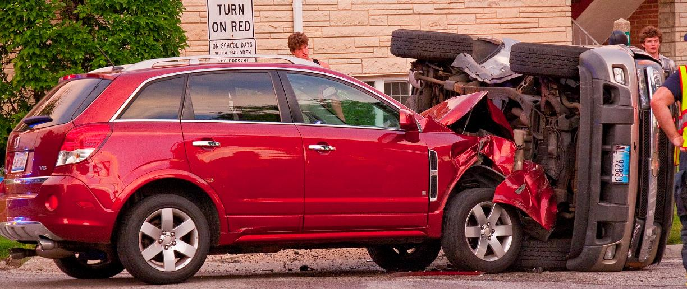
El carro rojo no pudo evitar (avoid) ____ contra el coche negro.
CHECK
Imagen de Wikimedia

Slide 95
chocarse

Slide 96
Tenth Category 200
INSERT QUESTION HERE
CHECK
Notes:
You will have to move the Daily Double picture out of the way to write the question. If you do not wish to have the Daily Double in the game, delete it and the sound clip (speaker) from this slide. For a Daily Double, the contestant has to wager at least $5 and at most the highest point value of any player/team at that point in the game. It is considered a True Daily Double if they wager all of their points and go “double or nothing”.

Slide 97
Región donde surgió la música flamenca.
CHECK
Notes:
You will have to move the Daily Double picture out of the way to write the question. If you do not wish to have the Daily Double in the game, delete it and the sound clip (speaker) from this slide. For a Daily Double, the contestant has to wager at least $5 and at most the highest point value of any player/team at that point in the game. It is considered a True Daily Double if they wager all of their points and go “double or nothing”.

Slide 98
Andalucía

Slide 99
Los gitanos de España son originalmente de este país.
CHECK

Slide 100
India

Slide 101
Los paradores son ____ de lujo administrados por el gobierno español.
CHECK

Slide 102
hoteles

Slide 103
Este mercado al aire libre en Madrid es muy popular los fines de semana.
CHECK

Slide 104
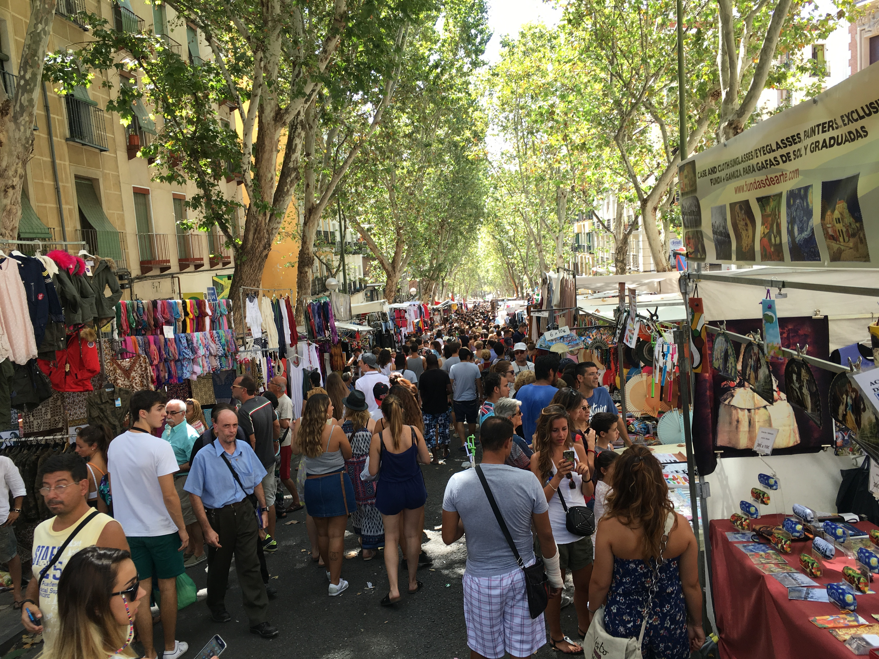
El Rastro
Imagen de Victor Grigas en Wikimedia

Slide 105
¿Qué tipo de transporte es el AVE?
CHECK

Slide 106
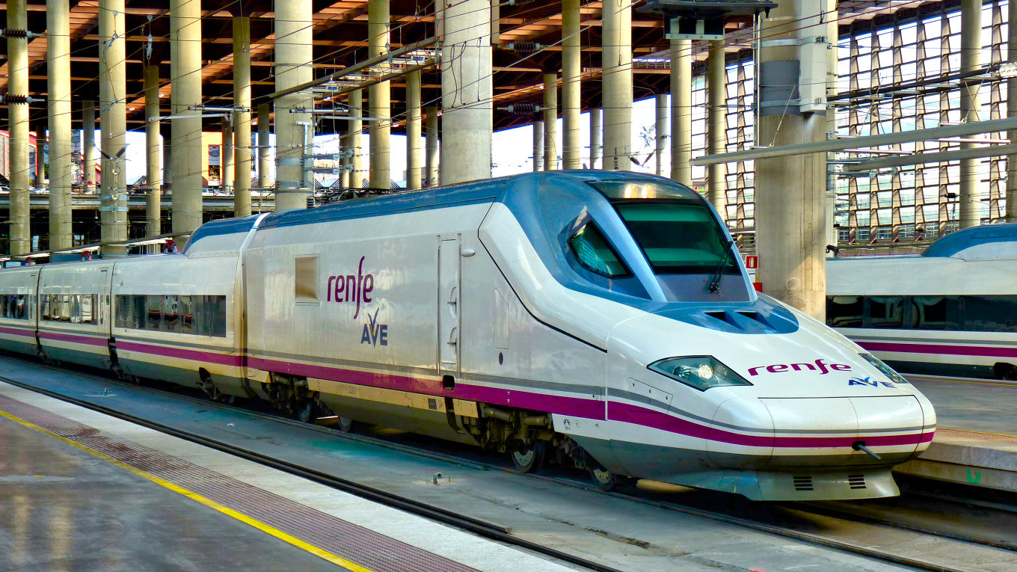
Tren (AVE = Alta Velocidad Española)
Imagen de Juan Enrique Gilardi en Flickr

Slide 107
JEOPARDY FINAL
Categoría:
Persona
CHECK

Slide 108
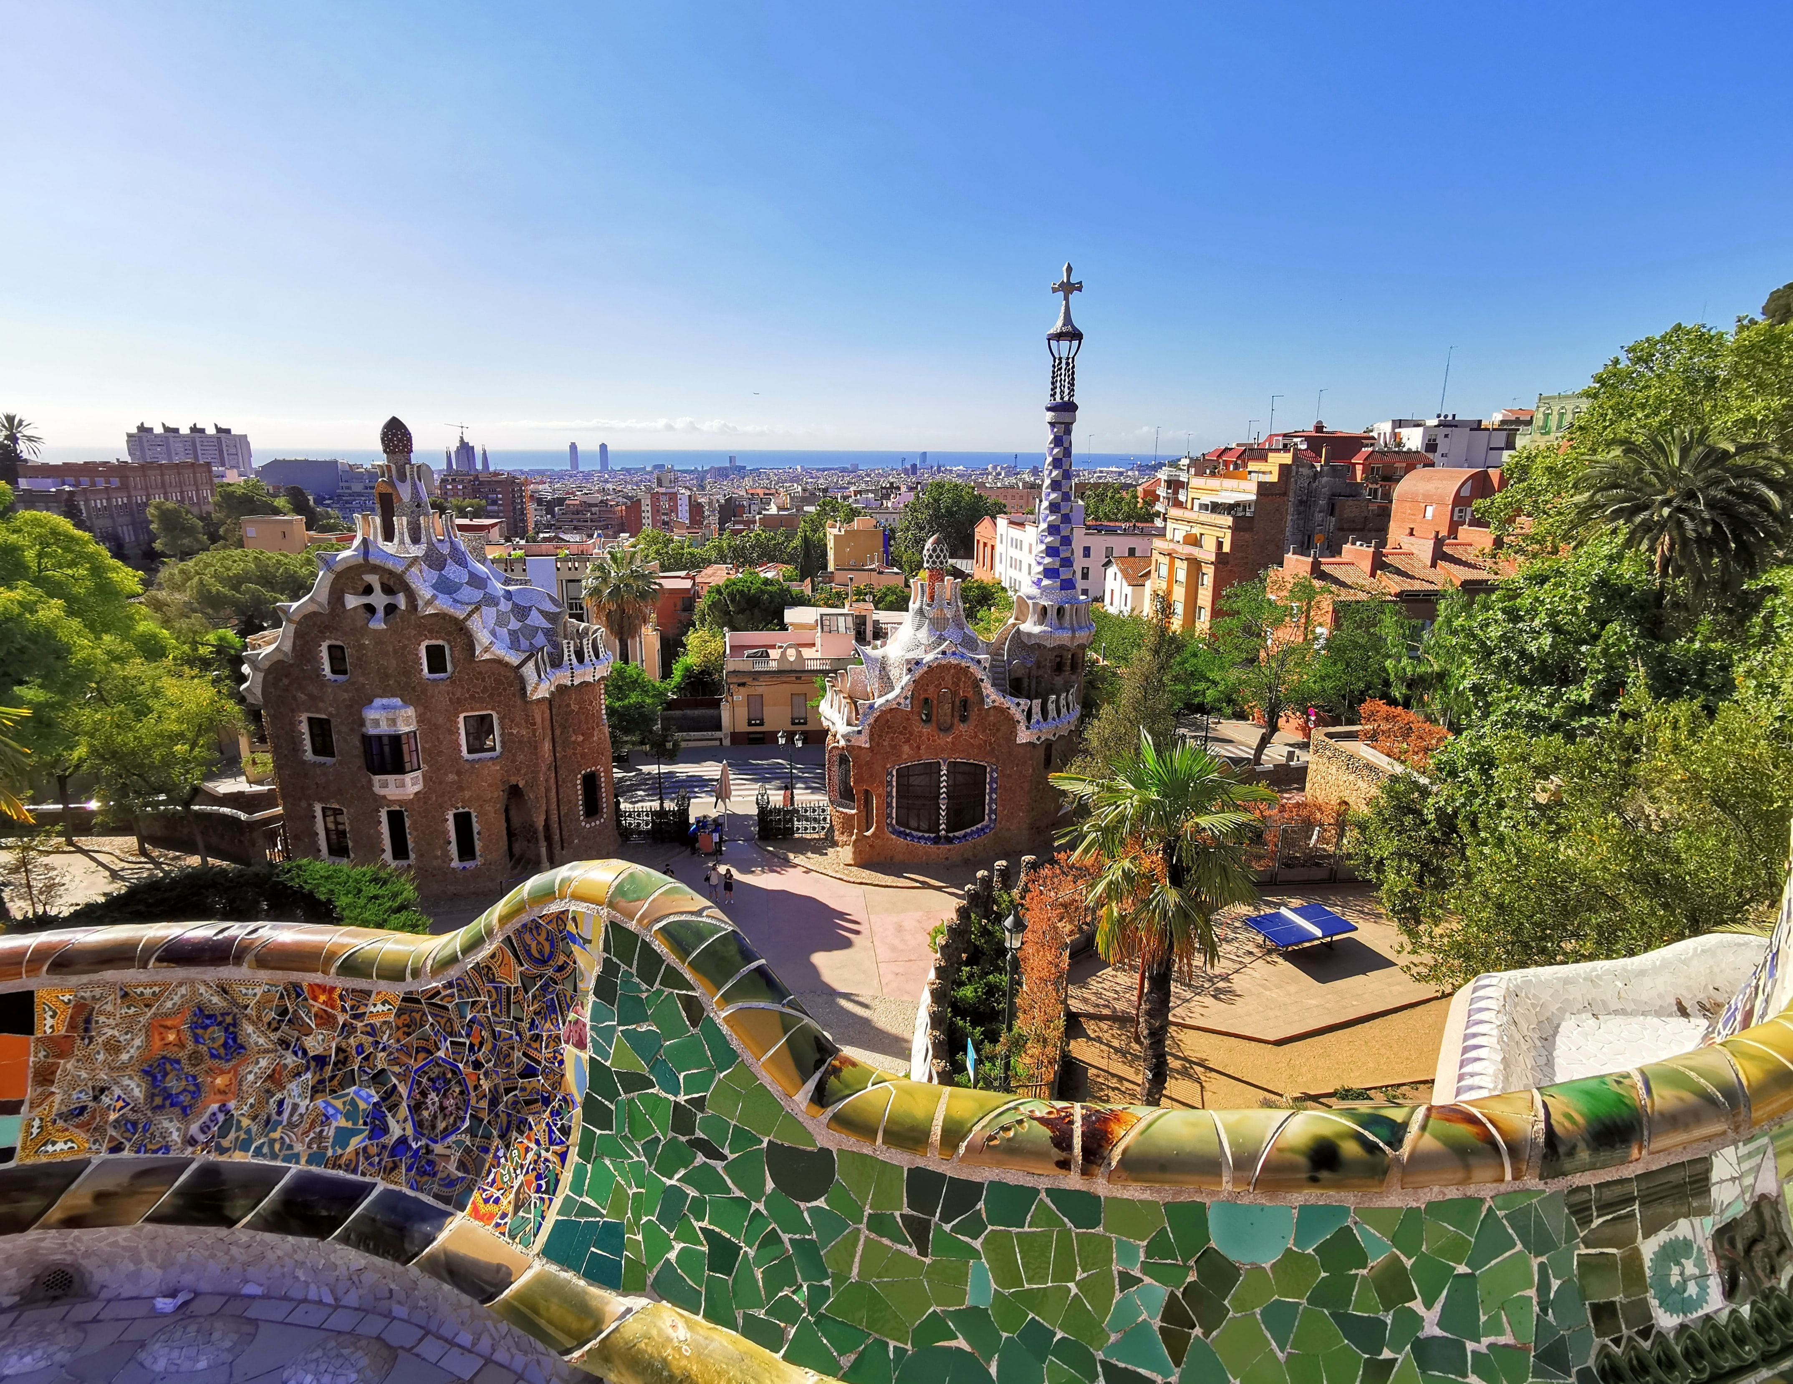

Nombre del arquitecto del Parque Güell
CHECK
Photo by Dorian D1 on Unsplash

Slide 109
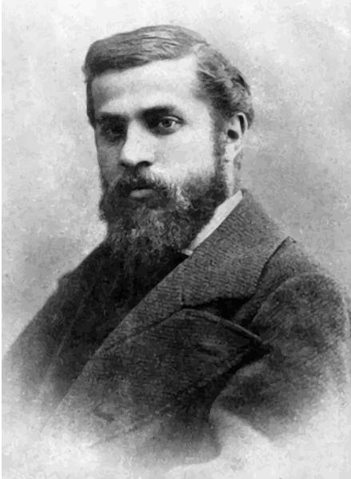
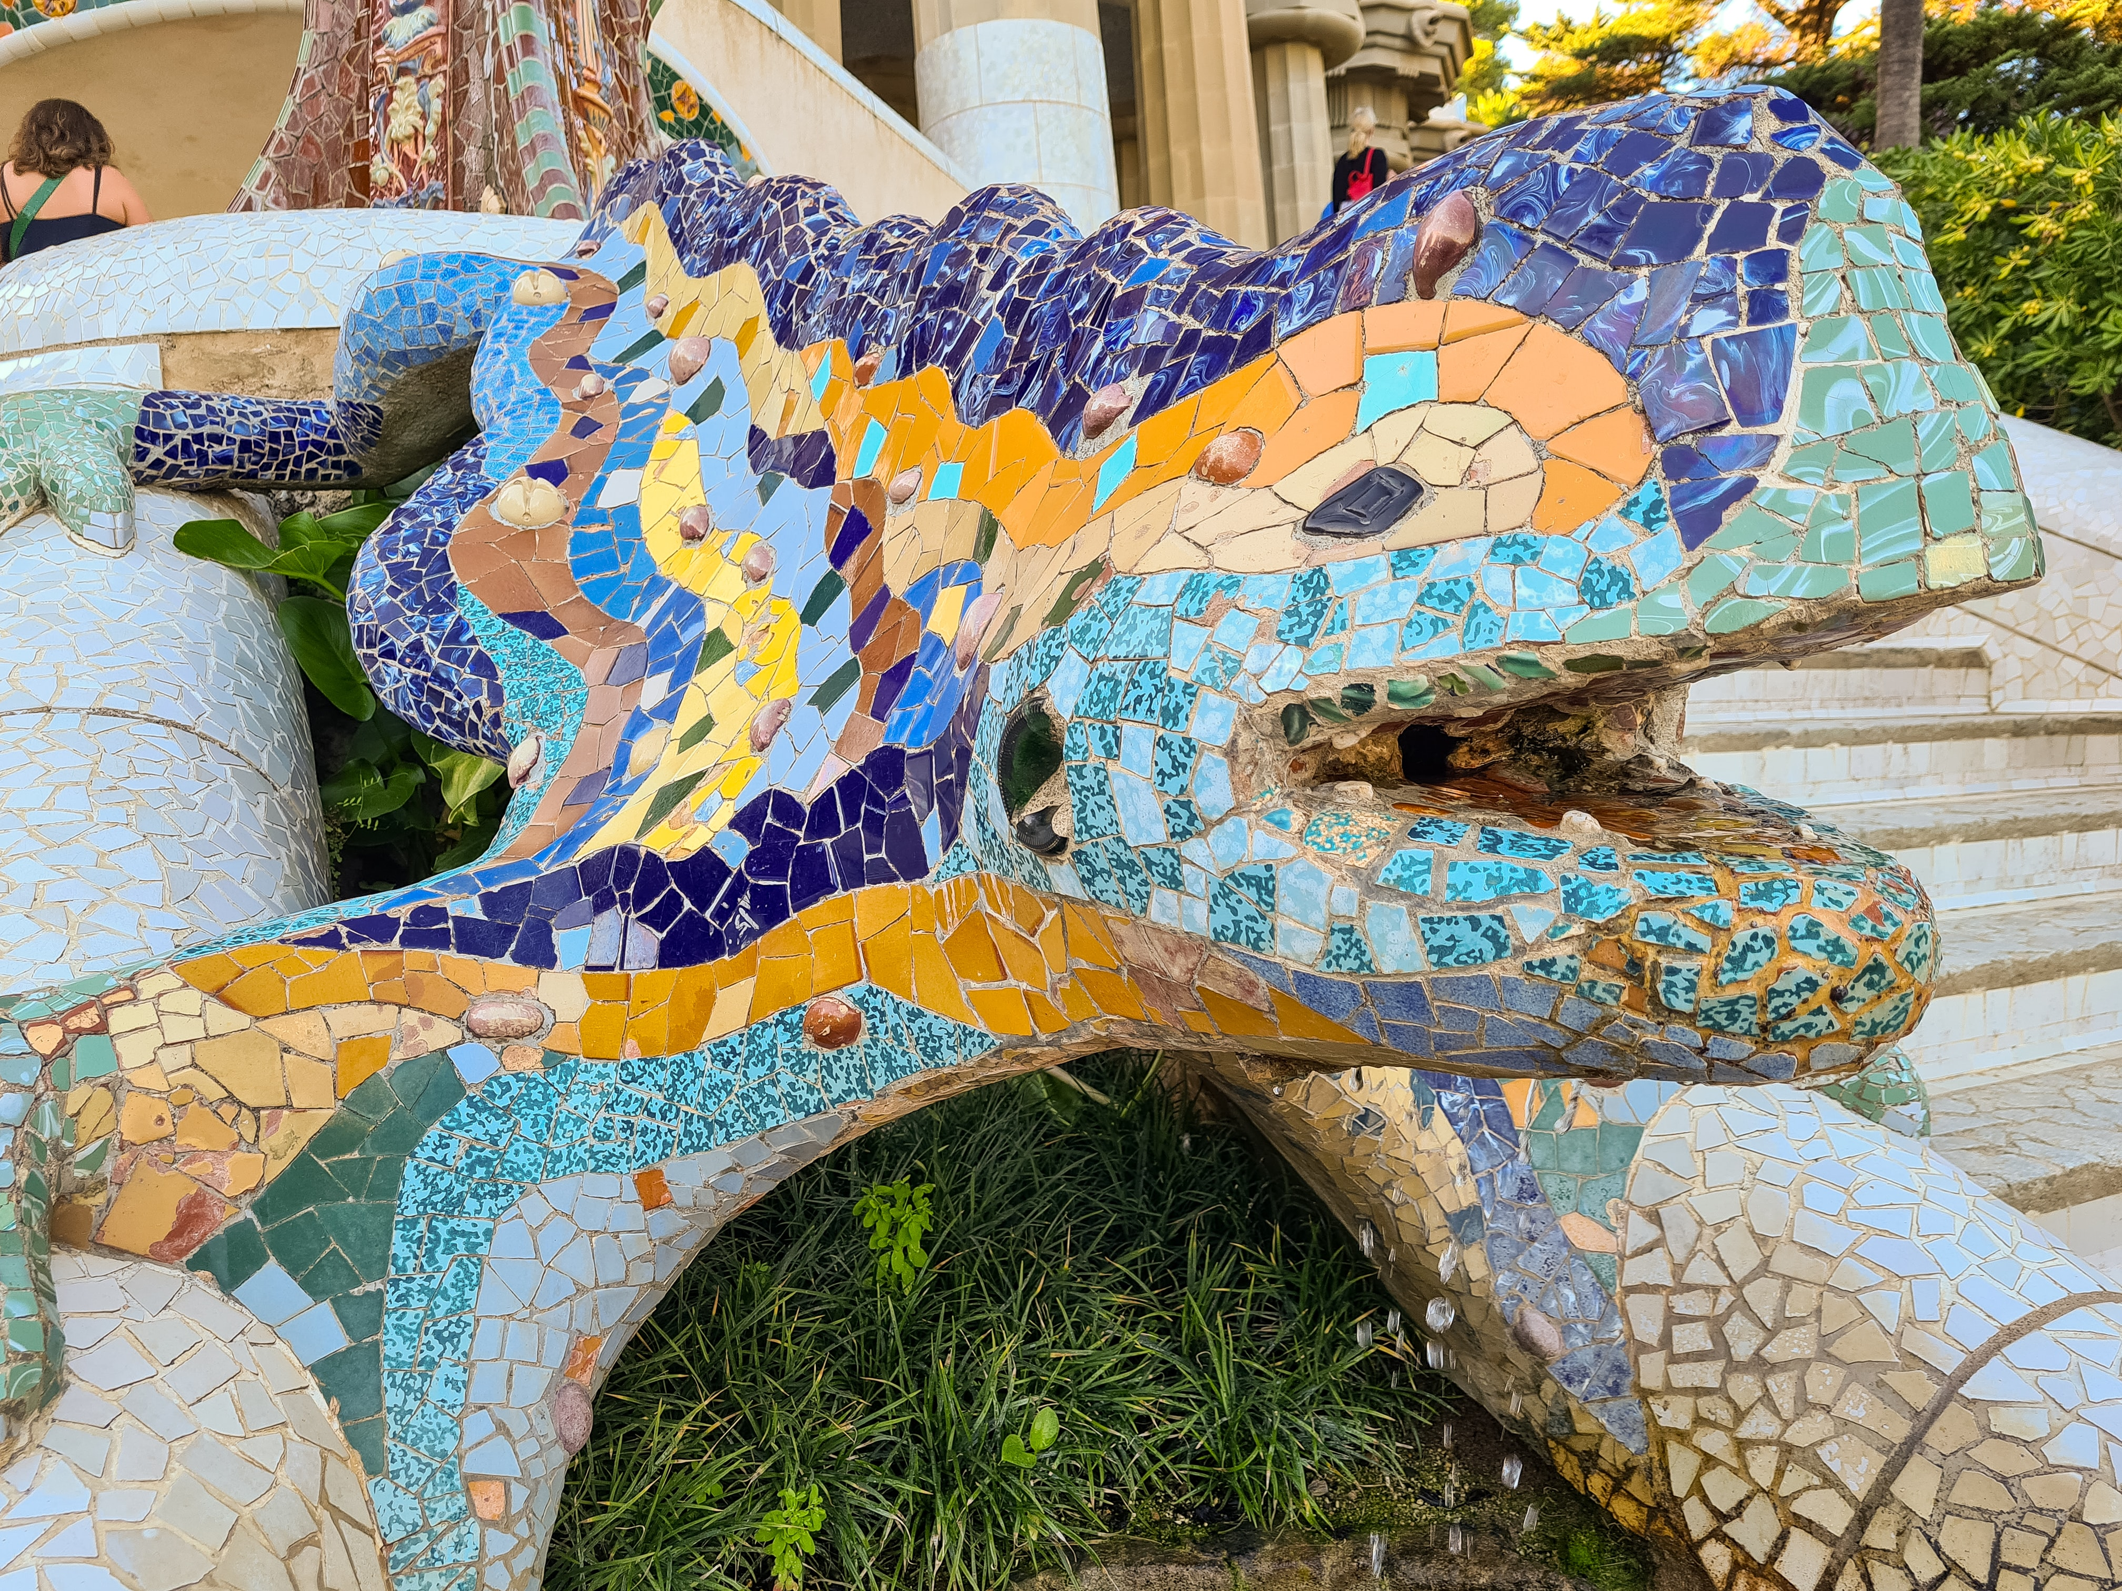
Antoní Gaudí
Photo by Martijn Vonk on Unsplash

