Slide 1
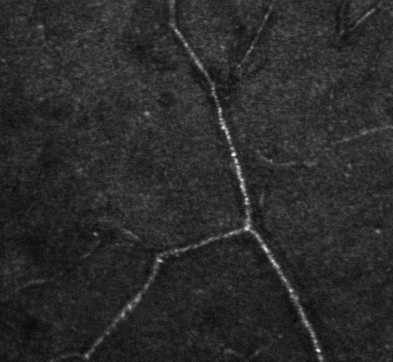
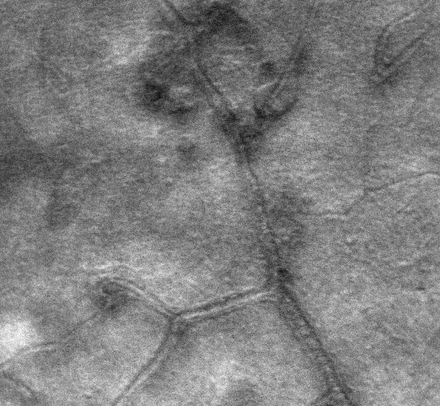
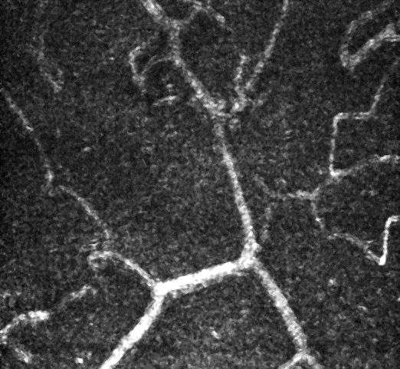
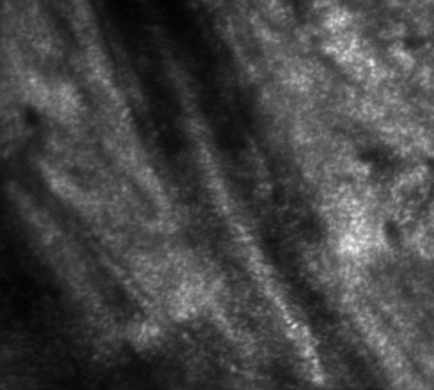
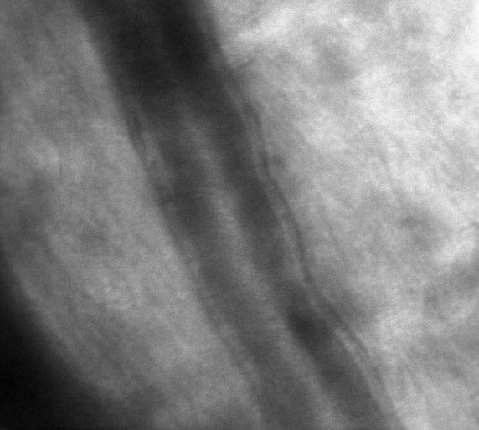
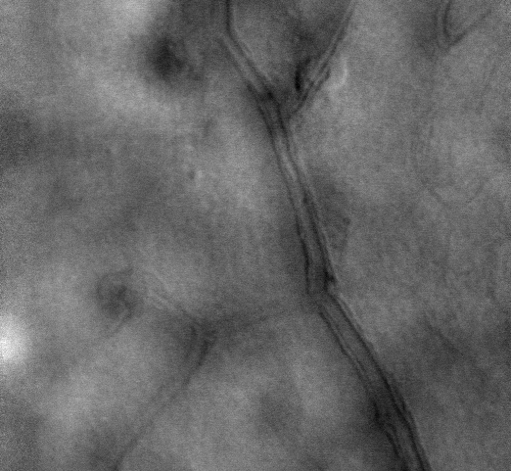
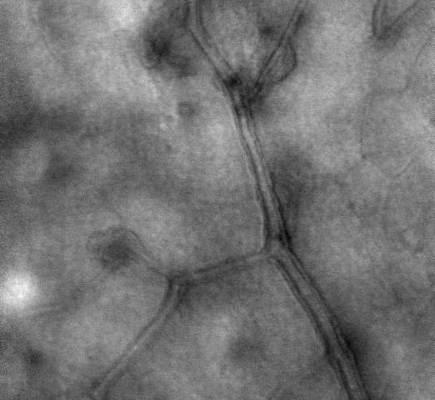
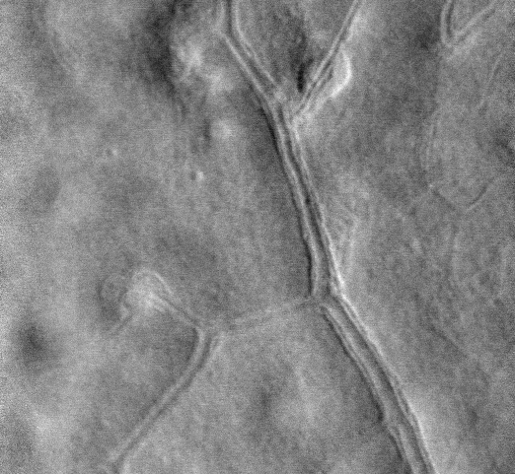
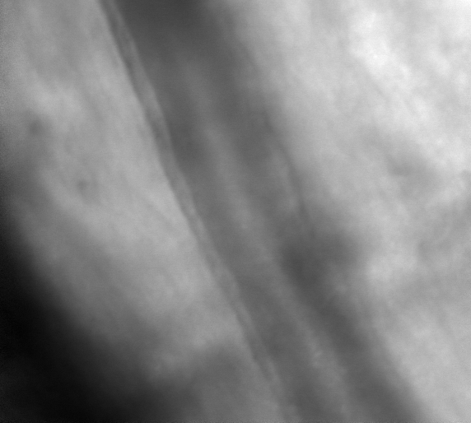
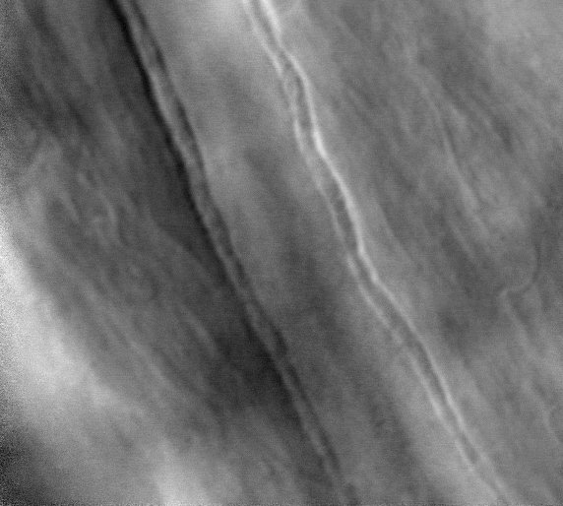
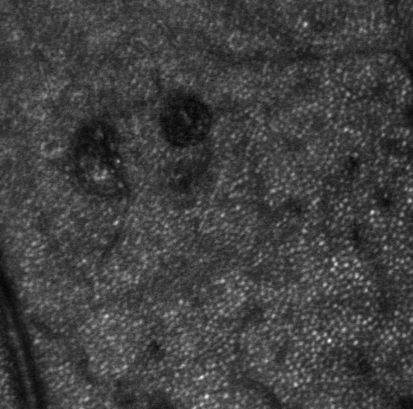
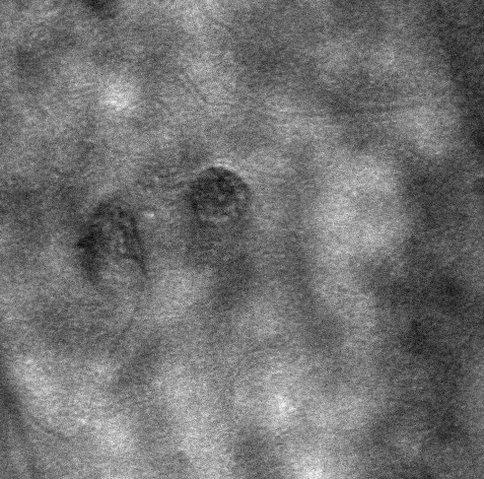
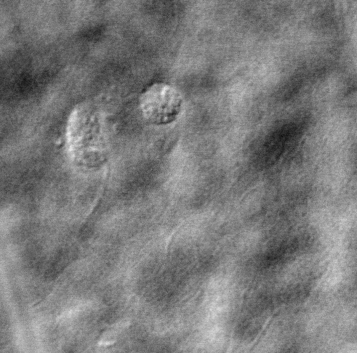
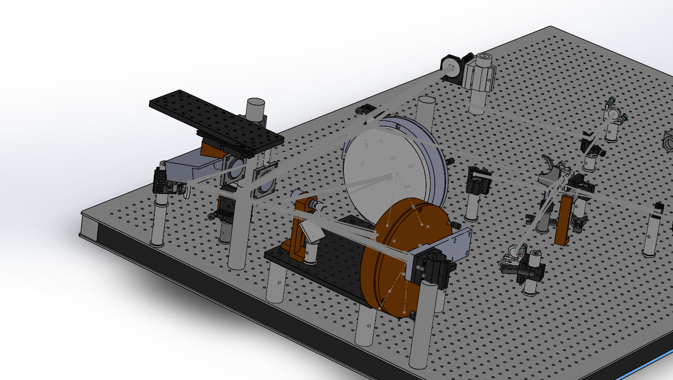
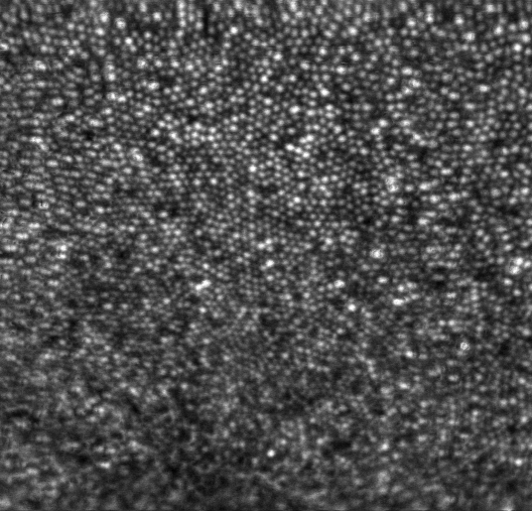
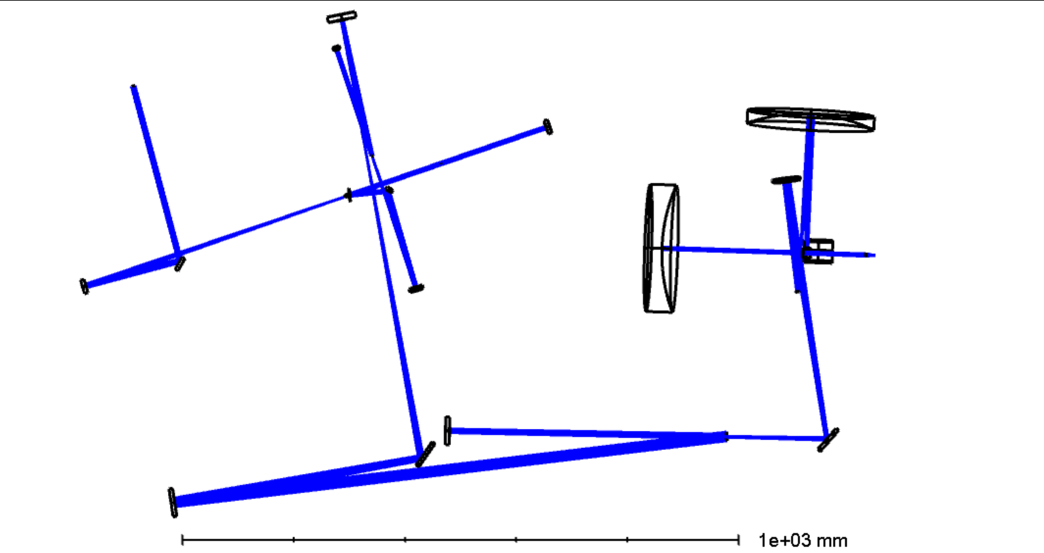
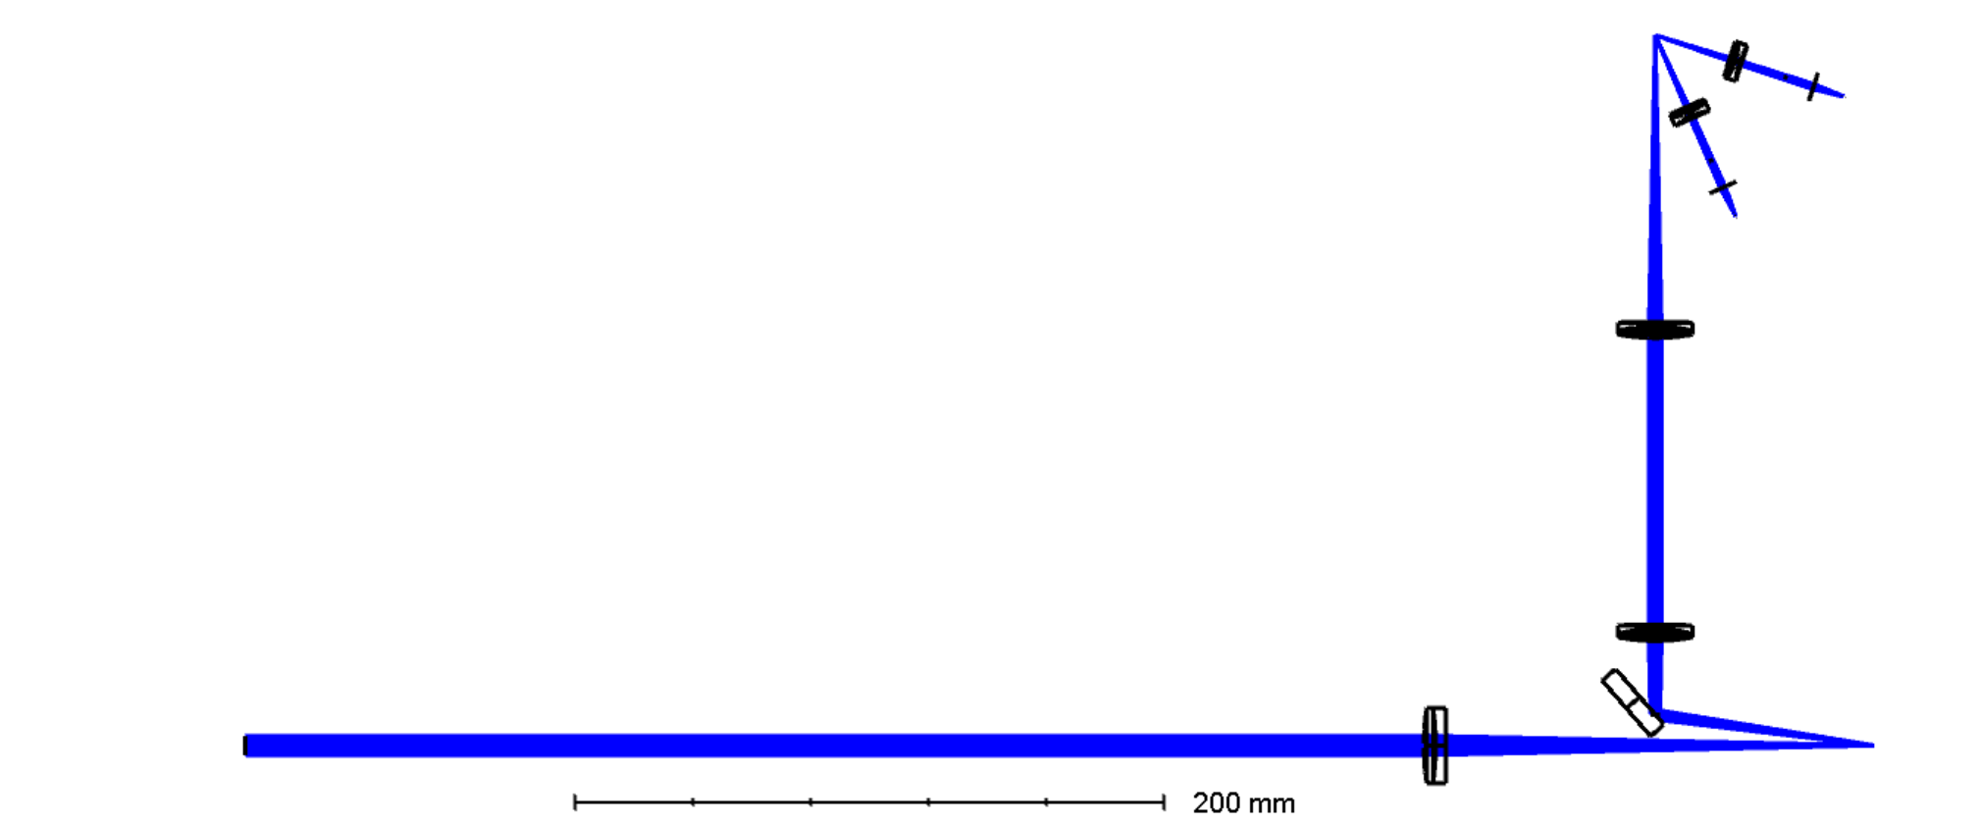
Design of a Steerable, Configurable Detection, Adaptive Optics Scanning Laser Ophthalmoscope with Integrated Fixation and Stimulation
S.A. Burns, A. de Castro, L. Sawides. T. Luo, K. Sapoznik, R. L. Warner, Indiana University School of Optometry, 800 E. Atwater, Bloomington, IN, staburns@indiana.edu
Introduction
Methods
Results
We designed, built and tested a near IR Adaptive Optics Scanning Laser Ophthalmoscope system.
Goals for clinical Imaging:
image multiple retinal regions spanning up to 30 degrees with of minimal distortion or skew (montaging and eye tracking accuracy)
Provide flexibility in imaging using both directly backscattered and multiply scattered light image
Be able to measure blood flow based on motion of individual red blood cells.
Provide a fixation channel that can provide visual stimuli and visual stimulation.
The system was designed in ZEMAX, then moved to Solidworks for mechanical modeling and finally implemented
Included a steerable system [1,2] for active retinal tracking of more than small eye movements with a large isoplanatic angle to minimize system aberrations when the eye moves.
Flexible detection modalities, including confocal and a Programmable Aperture system to detect multiply scattered [3] light, enhance the visibility of other retinal features.
Dual Offset Imaging to allow precise measurements of temporally varying events.
Imaging performance was superb. Multiply scattered light images and confocal images could all be simultaneously collected, with the second optical channel providing offset imaging on a second channel
System Implementation
APD
APD
APD
SH Sensor
APD
Discussion
We designed, built and tested a near IR Adaptive Optics Scanning Laser Ophthalmoscope system. The system performed well in practice, providing superb, flexible imaging and allowing high quality retinal imaging in normal and patients
References
Stephen A. Burns, R. Tumbar, AE Elsner, D Ferguson, & D.X. Hammer Large-field-of-view, modular, stabilized, adaptive-optics-based scanning laser ophthalmoscope. JOSA A, 24 (5), 1313-1326 (2007).
Weyao Zou, X Qi, S.A. Burns, Woofer-tweeter adaptive optics scanning laser ophthalmoscopic imaging based on Lagrange-multiplier damped least-squares algorithm, Biomedical Optics Express, 1986-2004, (2011)

Slide 2
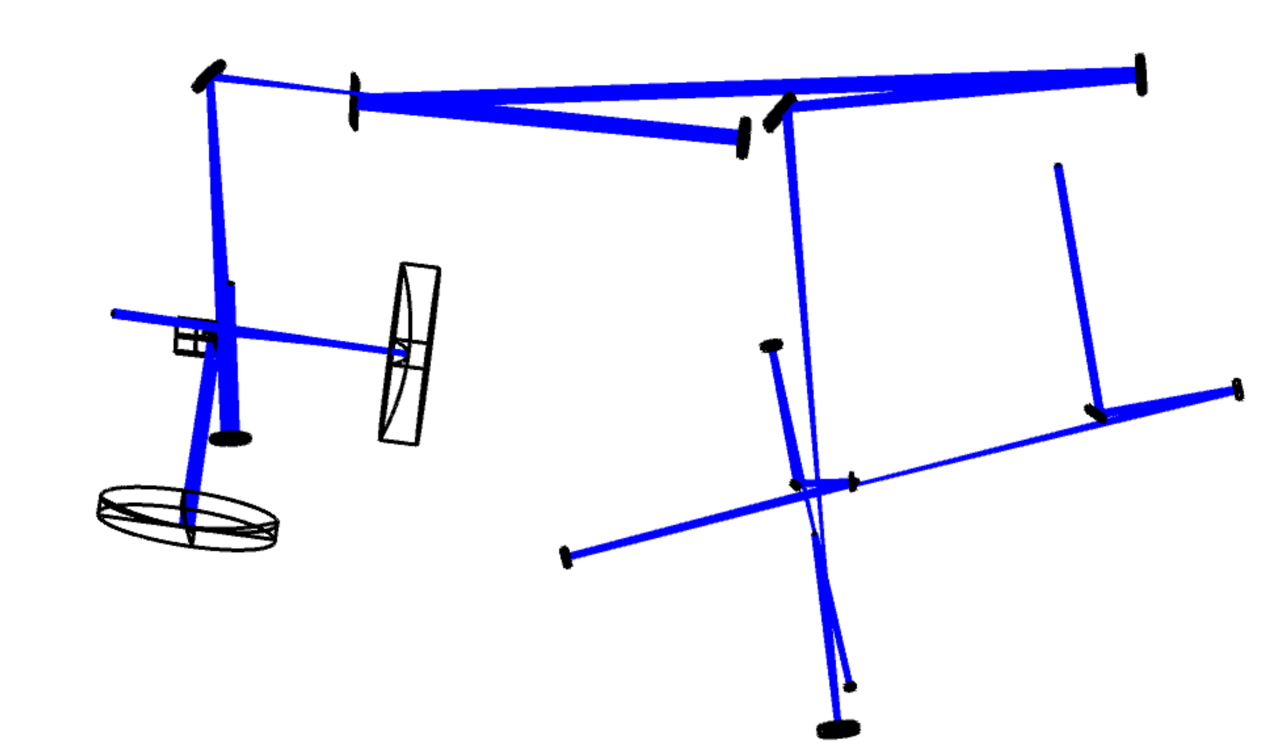
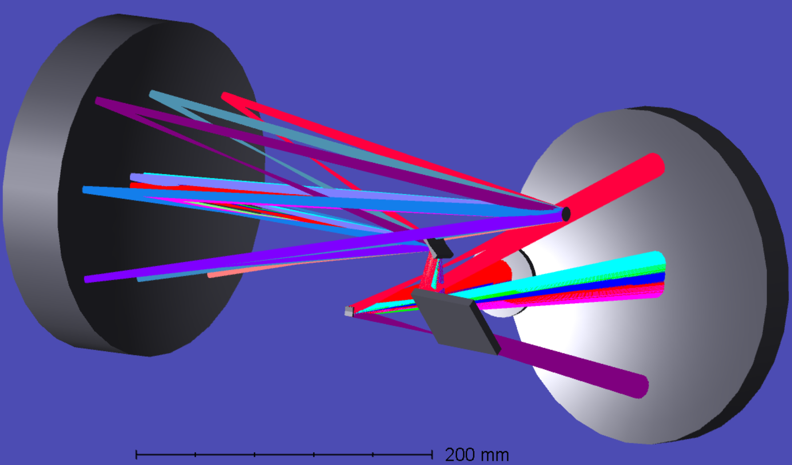
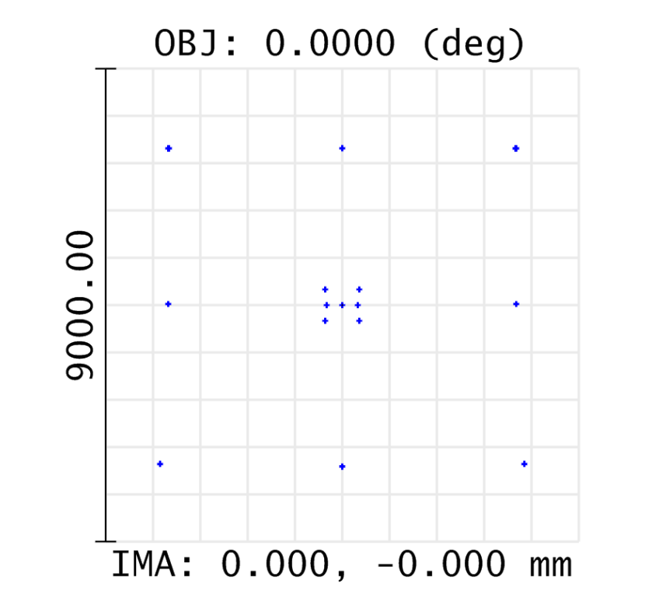
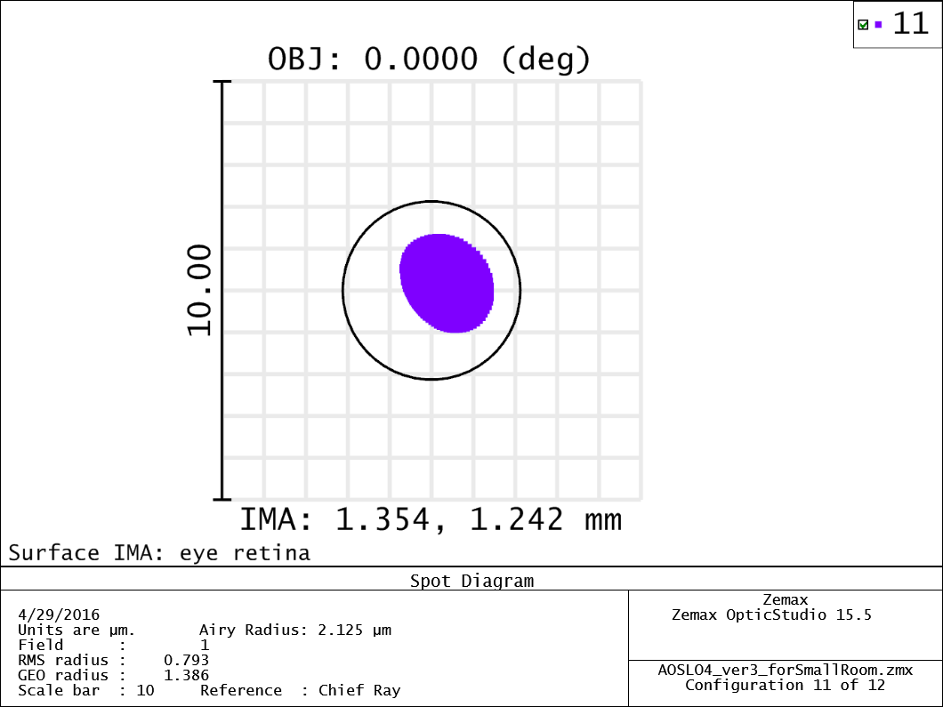
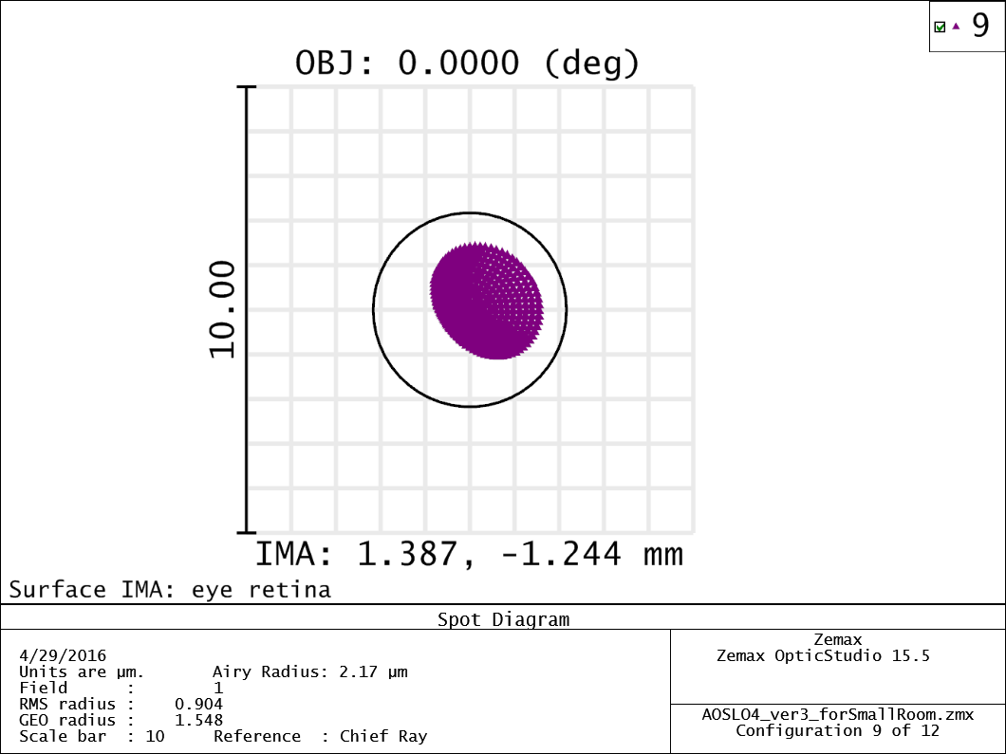
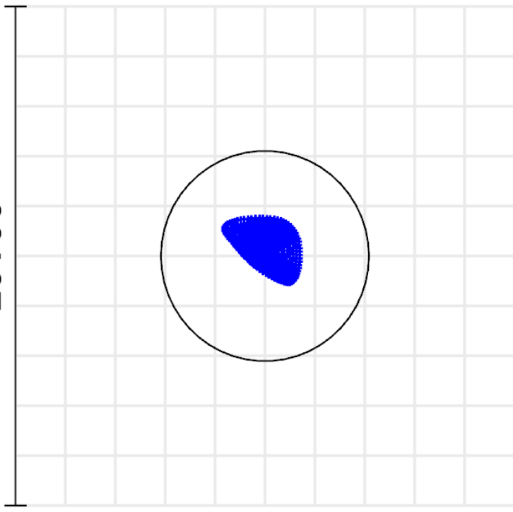
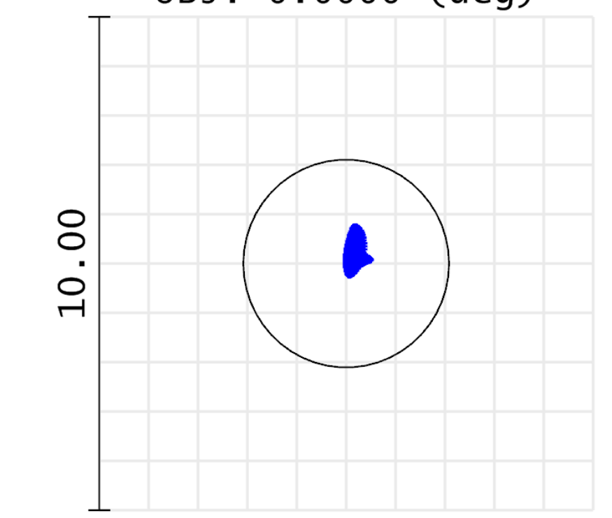
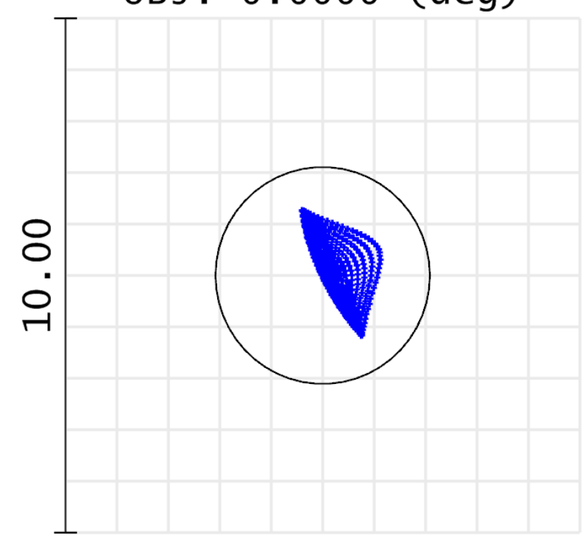
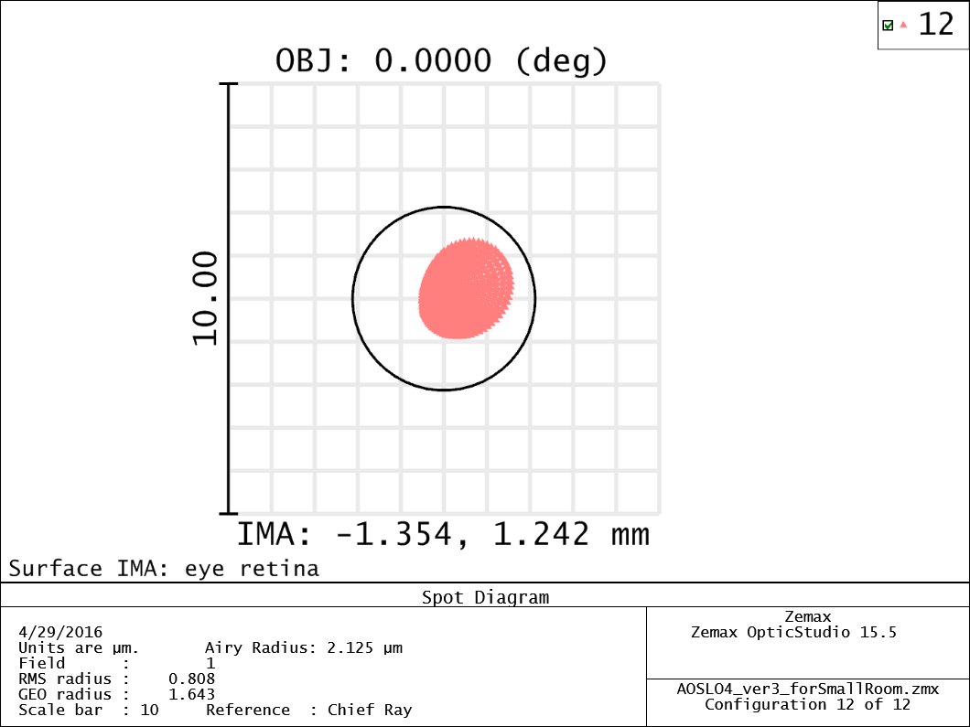
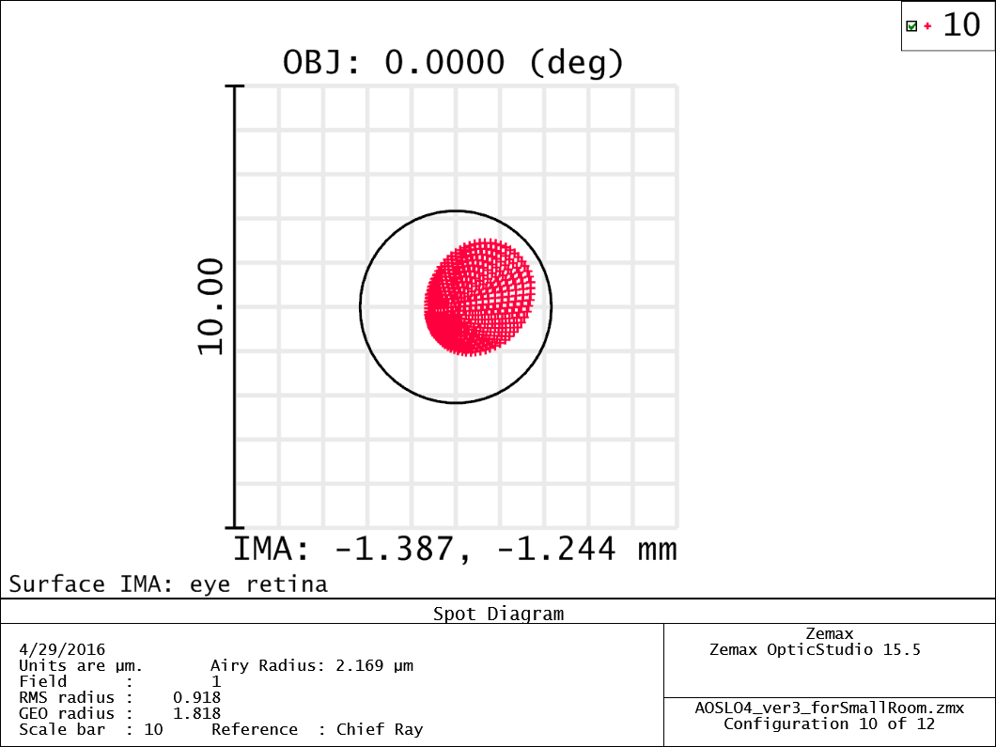
Design of a Steerable, Configurable Detection, Adaptive Optics Scanning Laser Ophthalmoscope with Integrated Fixation and Stimulation
S.A. Burns, A. de Castro, L. Sawides. T. Luo, K. Sapoznik, R. L. Warner, Indiana University School of Optometry, 800 E. Atwater, Bloomington, IN, staburns@indiana.edu
The system provides steering over 30 degrees. At the design defocus (-2.5D) the isoplanatic angle was greater than 8 degrees. Angular rotation across the field was approximately 3 degrees (along the axis of maximum distortion). This could be compensated by driving both steering mirrors for the slow scan (not implemented).
Optics- illumination and steering
Back
DM 2
Vertical Position
Slow Scan
Galvo 2
Vertical Position
Slow Scan
Galvo 1 Horizontal Position
Eye
DM 1
Light Source Supercontinuum Laser
SH Sensor- 30 Hz
Fast Scan 15.8 KHz
Visual Stimulus- TI 4600 display
Horizontal Position
Fast Scan
Detection System
Optical Design Field Positioning
Optical Design: performance
Outer boxes- effect of steering to corners of 10 degree field
Center the variation of point spread function for 3 degree scan, which goes through more optics
APD
APD
APD
SH Sensor
APD
+3 Degrees via Fast Scan
+10 Degree
System corrected for
2.5 diopter Myope at deformable mirror 2.
Back
R.Daniel. Ferguson, Z. Zhong, D.X. Hammer, M. Mujat AH Patel. C. Deng, W. Zou, W, S.A. Burns, "Adaptive optics SLO with integrated wide-field retinal imaging and tracking" JOSA A 27, 265-277 (2010)

Slide 3
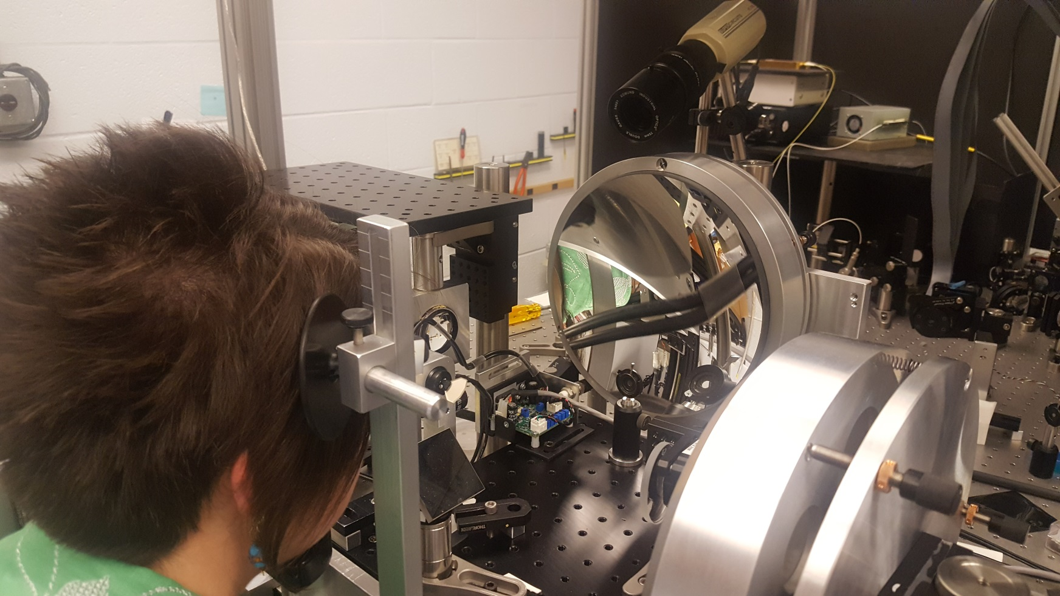
Design of a Steerable, Configurable Detection, Adaptive Optics Scanning Laser Ophthalmoscope with Integrated Fixation and Stimulation
S.A. Burns, A. de Castro, L. Sawides. T. Luo, K. Sapoznik, R. L. Warner, Indiana University School of Optometry, 800 E. Atwater, Bloomington, IN, staburns@indiana.edu
The system provides steering over 30 degrees. At the design defocus (-2.5D) the isoplanatic angle was greater than 8 degrees. Angular rotation across the field was approximately 3 degrees (along the axis of maximum distortion). This could be compensated by driving both steering mirrors for the slow scan (not implemented).
Optical Design: Implementation
Back
Optical Implementation
Display System
APD
APD
APD
SH Sensor
APD
Back

Slide 4
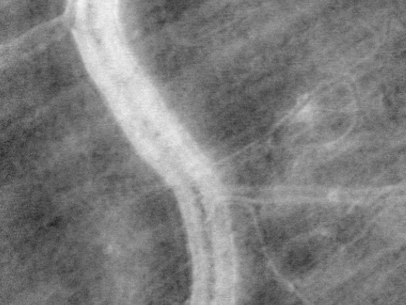
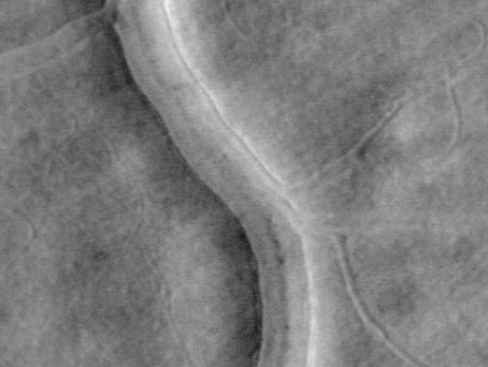
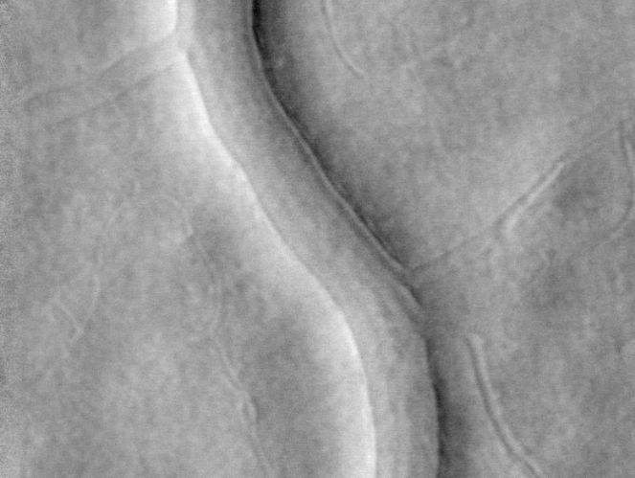
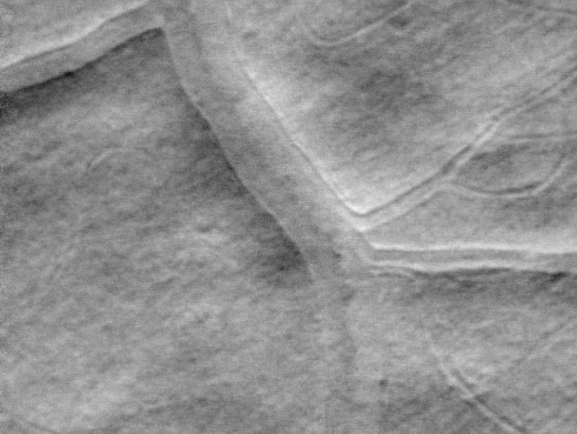
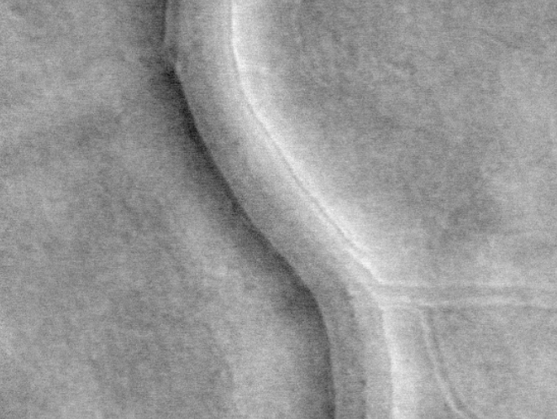
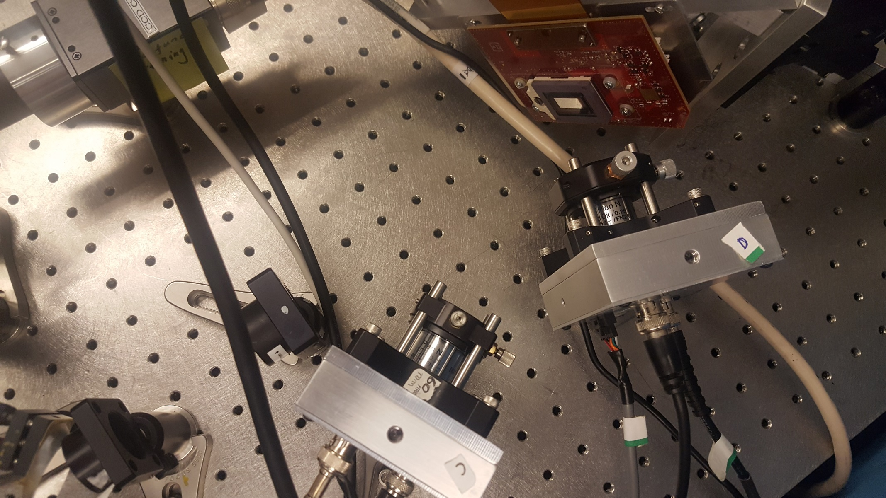
Design of a Steerable, Configurable Detection, Adaptive Optics Scanning Laser Ophthalmoscope with Integrated Fixation and Stimulation
S.A. Burns, A. de Castro, L. Sawides. T. Luo, K. Sapoznik, R. L. Warner, Indiana University School of Optometry, 800 E. Atwater, Bloomington, IN, staburns@indiana.edu
Programmable Array Detection
Multiply Scattered Light in the retina returns from secondary scatterers after first being refracted and diffracted from retinal structures. Because the actual retinal structure controls the direction of scattering as well as the angle, it is useful to be able to capture different aspects of that scattered light
Back
Detector 2
Detector 3
Light From Retina
ON
Ratio images of the same vessel with different DMD aperture configurations
Confocal Pinhole
OFF
Detector 1
DMD
Schematic of Channel 1 Detection Scheme
A single beam from the retina is sent to three detectors simultaneously. The psf is separated into directly backscattered light by a pinhole at the conjugate plane. The surrounds of the psf (multiply scattered light) is re-imaged onto a DLP, which diverts it to one of two detectors
APD
APD
APD
SH Sensor
100 μm
APD
The computed contrast between the “on” and “off” states for the same retinal blood vessel, using different spatial masks. Note that the edges of the vessels are differentially emphasized with mask size and orientation
Back
Toco Y.P. Chui, D.A. VanNasdale and S.A. Burns The use of forward scatter to improve retinal vascular imaging with an adaptive optics scanning laser ophthalmoscope. Biomed. Opt. Express 3(10): 2537-2549. (2012).

Slide 5
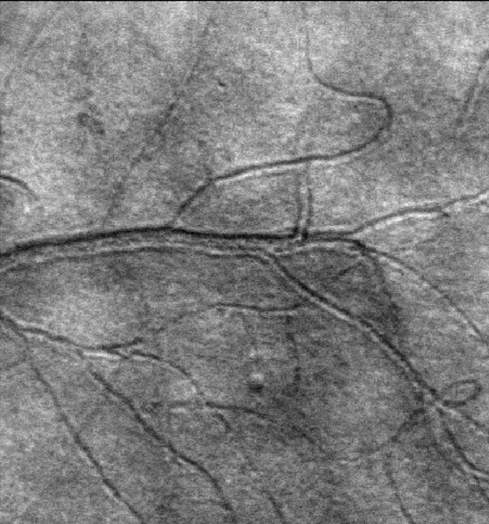
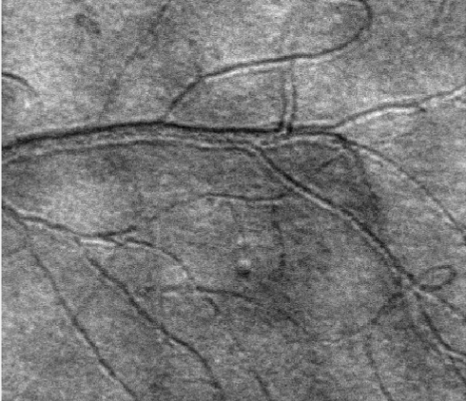
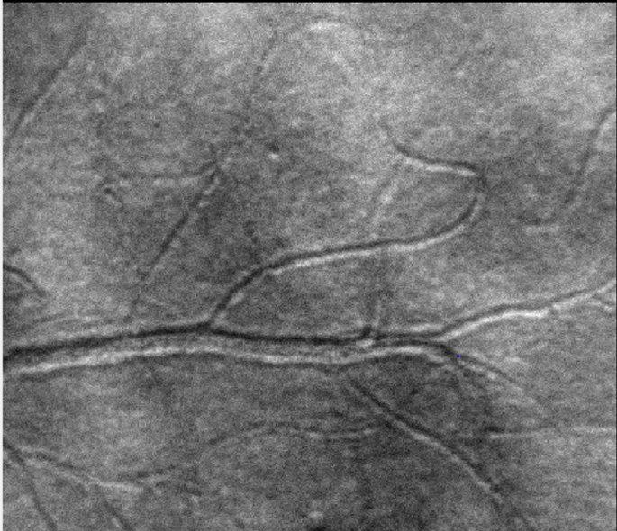
Design of a Steerable, Configurable Detection, Adaptive Optics Scanning Laser Ophthalmoscope with Integrated Fixation and Stimulation
S.A. Burns, A. de Castro, L. Sawides. T. Luo, K. Sapoznik, R. L. Warner, Indiana University School of Optometry, 800 E. Atwater, Bloomington, IN, staburns@indiana.edu
Channel 1 is set to use as large displaced aperture identically to channel 2. The two channels enter the pupil at slightly different angles, which produces a displacement. Thus a feature scanned in A at time t, is scanned in channel 2 later (time t+d)
Back
1. Introduction
We designed a near IR Adaptive Optics Scanning Laser Ophthalmoscope system with the goal of meeting several requirement for clinical retinal imaging.
the need to image multiple retinal regions spanning up to 30 degrees with of minimal distortion or skew for montaging or eye tracking
A steerable system [1,2] for active retinal tracking of more than small eye movements with a large isoplanatic angle to minimize system aberrations when the eye moves.
Flexible detection modalities, including confocal and a Programmable Aperture system to detect multiply scattered [3] light, enhance the visibility of other retinal features.
Dual Offset Imaging to allow precise measurements of temporally varying events.
Channels are then processed to show only the change over time for each pixel
δ
Channel 1
Channel 2
And pixels exceeding a given z-score in a given capillary are used to detect erythrocytes.
The regions around detected cells are then average in each channel. For the detection channel, this means there is always an RBC in the center
APD
APD
APD
SH Sensor
APD
The regions around detected cells are then average in each channel. For the other channel the RBC is not in the center due to blood flow during the time interval. This distance changes with the heartbeat.
Average Velocity: 2.0043
Back
de Castro A, Huang G, Sawides L, Luo T, Burns SA. Rapid high resolution imaging with a dual-channel scanning technique. Optics Letters 2016;41:1881-1884.

Slide 6
Design of a Steerable, Configurable Detection, Adaptive Optics Scanning Laser Ophthalmoscope with Integrated Fixation and Stimulation
S.A. Burns, A. de Castro, L. Sawides. T. Luo, K. Sapoznik, R. L. Warner, Indiana University School of Optometry, 800 E. Atwater, Bloomington, IN, staburns@indiana.edu
X
1. Introduction
2. System
Montages could be made without the need for adding a skew to the positioning system (frame edges are parallel)
.
Confocal image of cone mosaic. Not cones down to the central fovea are visible.
Scale bar 50 μm.
Gathered in 10 minutes subject time.
APD
APD
APD
SH Sensor
APD
Back

Slide 7
Design of a Steerable, Configurable Detection, Adaptive Optics Scanning Laser Ophthalmoscope with Integrated Fixation and Stimulation
S.A. Burns, A. de Castro, L. Sawides. T. Luo, K. Sapoznik, R. L. Warner, Indiana University School of Optometry, 800 E. Atwater, Bloomington, IN, staburns@indiana.edu
X
Example of a blood vessel image- showing all images extracted from a single 100 frame acquisition. (videos not shown)
.
Simultaneously collected Image types.
A: Confocal image.
B: Offset Aperture Image from Channel 2
C: Flow map from variance of offset image
D: Image obtained with a Half annular aperture.
E: complement (rest of light) that is not directed to
F: Contrast between D and E (D-E)/(D+E)
Scale bar 100 μm.
A
B
C
D
E
F
Back

Slide 8
Design of a Steerable, Configurable Detection, Adaptive Optics Scanning Laser Ophthalmoscope with Integrated Fixation and Stimulation
S.A. Burns, A. de Castro, L. Sawides. T. Luo, K. Sapoznik, R. L. Warner, Indiana University School of Optometry, 800 E. Atwater, Bloomington, IN, staburns@indiana.edu
X
Simultaneously collected Image of Blood vessel showing the ability to enhance visibility of the vascular walls with a half annular aperture
.
Simultaneously collected Image types.
A: Confocal image.
B: Offset Aperture Image from Channel 2
D: Image obtained with a Half annular aperture.
E: complement (rest of light) that is not directed to
F: Contrast between D and E (D-E)/(D+E)
Scale bar 100 μm.
A
B
D
A
B
C
E
D
D
E
E
F
F
Back

Slide 9
Design of a Steerable, Configurable Detection, Adaptive Optics Scanning Laser Ophthalmoscope with Integrated Fixation and Stimulation
S.A. Burns, A. de Castro, L. Sawides. T. Luo, K. Sapoznik, R. L. Warner, Indiana University School of Optometry, 800 E. Atwater, Bloomington, IN, staburns@indiana.edu
X
A
B
C
Small Microaneurysm in diabetic, showing confocal (A), offset aperture multiply scattered light(B) and programmable aperture contrast images where presumed endothelials cells in the superficial wall are readily seen ( C)
Confocal foveal cone images (D), simultaneously collected multiply scattered light images showing RPE cells (C ), and shaped aperture images showing that there is a mix of cone and RPE cell contributions at short scattering distances.
Scale bar 100 μm.
D
E
F
Back

