Slide 1
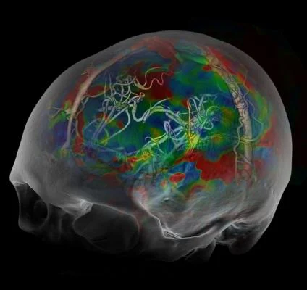
Wellness
Brain health

Slide 2
Terms you know
Burnout
Wellness
Mental Illness
Mental Health
How about → Brain Health?

Slide 3

About me: Ian Rutkofsky, MD
1. Medical Director, Psychiatrist, at Covenant Psychiatric and Mental Health Services,
2. Psychiatrist, Neuroscientist, at Amen Clinics
3. Faculty, California Institute of Behavioral Neurosciences & Psychology
4. Ann Kwon’s Husband, AKA The Most Important Job!!

Slide 4
Get your Brain Right and Your Mind Will Follow!
BRAIN HEALTH!!
Amen Clinics
https://www.youtube.com/watch?v=eEsE8dimhw0

Slide 5

What if we used the term Brain Health instead of mental illness ?

Slide 6
What If you could see your brain, would you take better care of it???

Slide 7
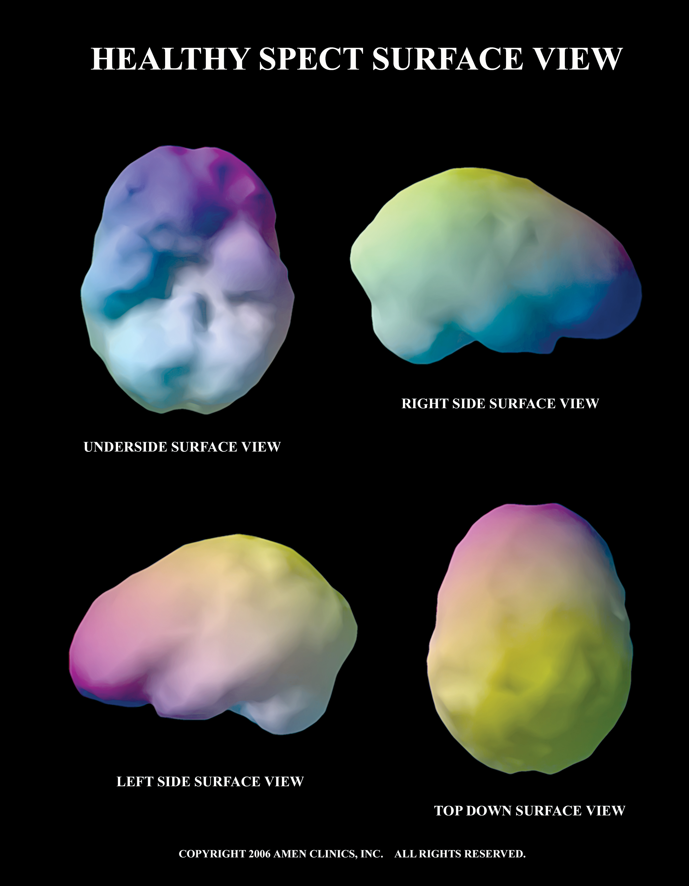
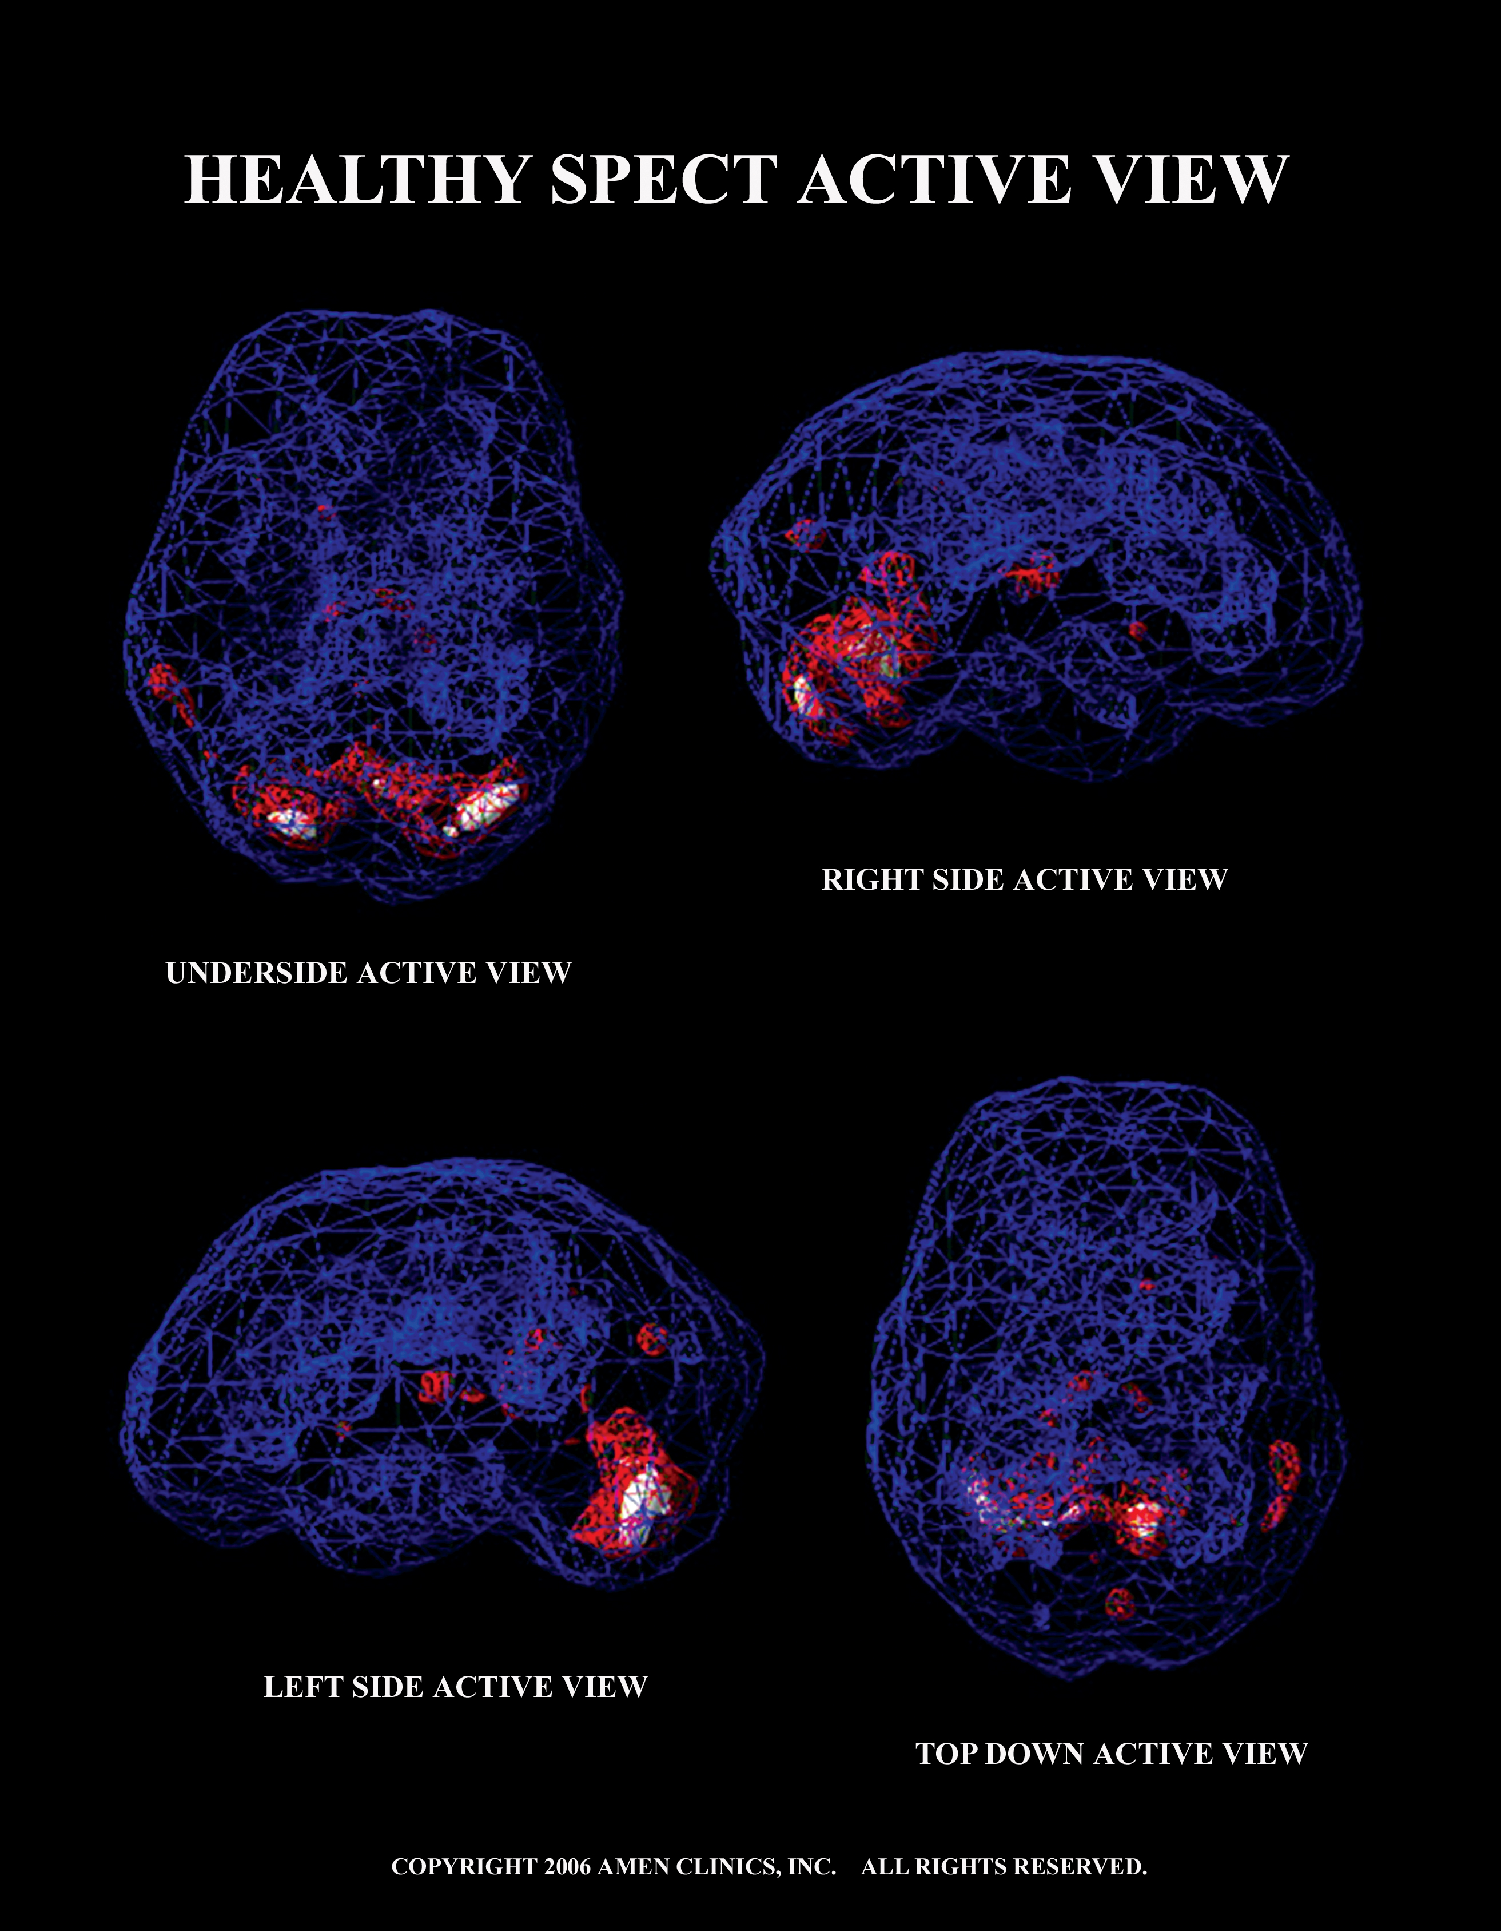
HEALTHY BRAIN IMAGES

Slide 8
As psychiatrists brain scans allow us to ask better questions

Slide 9
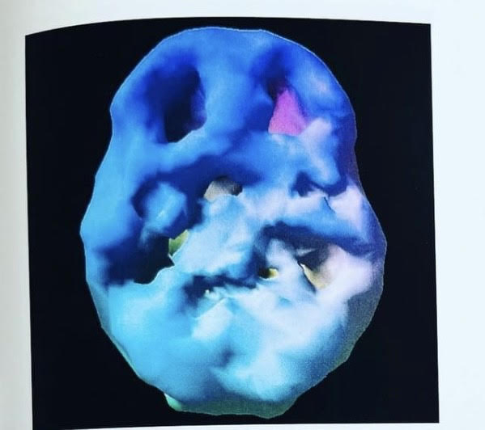
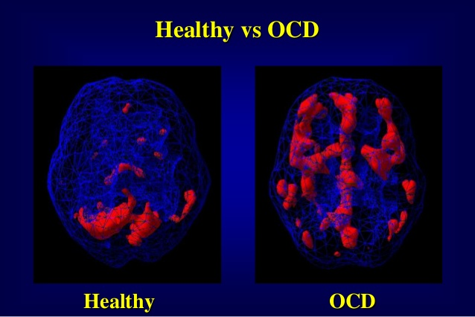

Slide 10
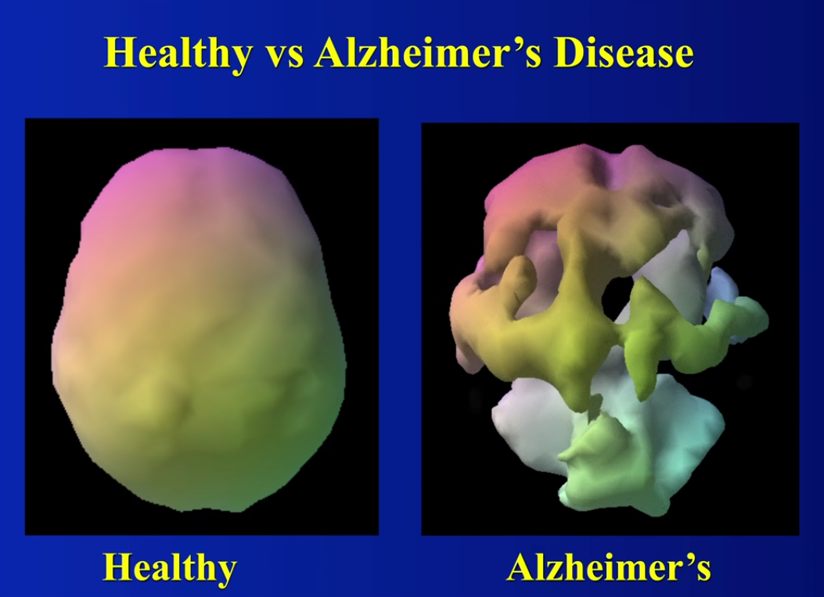

Slide 11
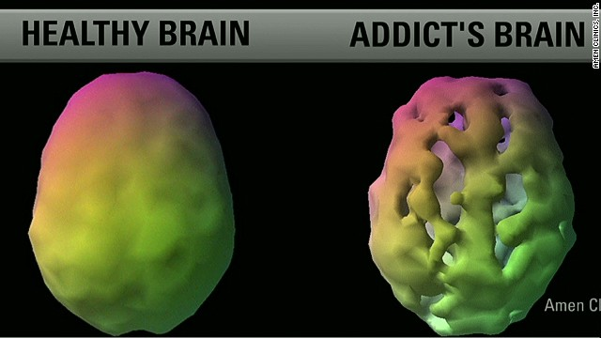

Slide 12
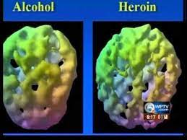

Slide 13
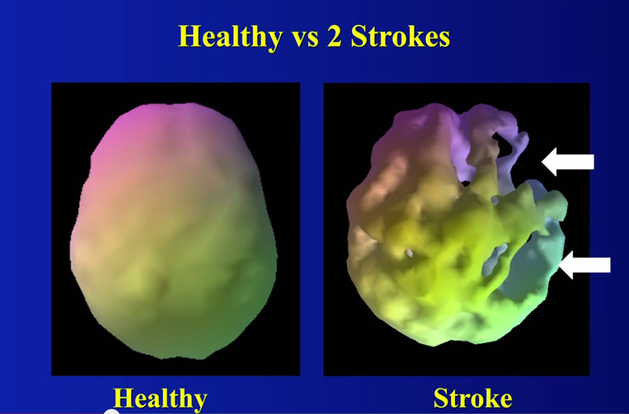
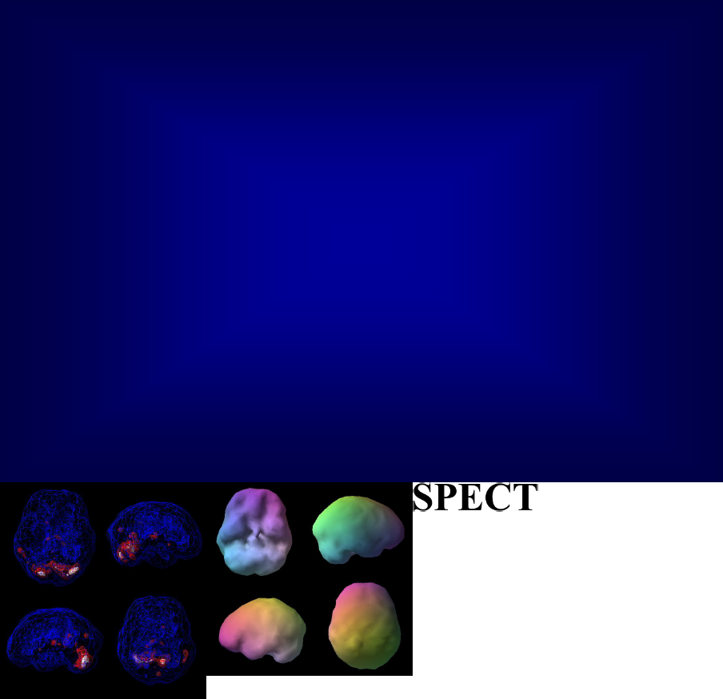
nd activity

Shows 3 things:

good activity

too little

too much
SPECT
Healthy surface viewHealthy active view

Slide 14

Notes:
Americans’ stress levels are going up. A 2019 Gallup Poll found that people living in the U.S. reported the highest levels of stress, worry, and anger in the past 10 years. When asked how they felt the previous day, about 55% of adults said they felt stress during “a lot of the day,” 45% felt a lot of worry, and 22% felt anger. Problems with stress hit all age groups. Children, teens, adults, and seniors are all vulnerable to the effects of this all-too-common problem.

Slide 15
Stress levels are going up!!!!!!
More people living in the U.S. are reporting the highest levels of stress, worry, and anger over the past 10 years.
When asked how they felt the previous day, 55% of adults said they felt stressed out ,past of the day,
45% felt too much worry and anxiety
22% felt anger
2019 Gallup pole prior to COVID-19

Slide 16
Stress is not only impacting the USA! Stress levels are increasing everyplace!!

Slide 17



Slide 18
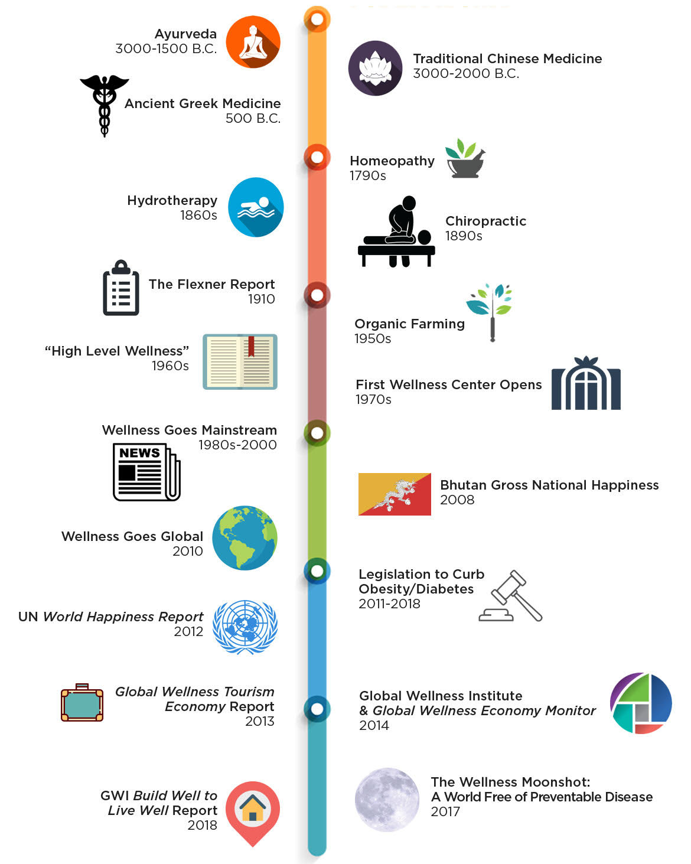

Slide 19
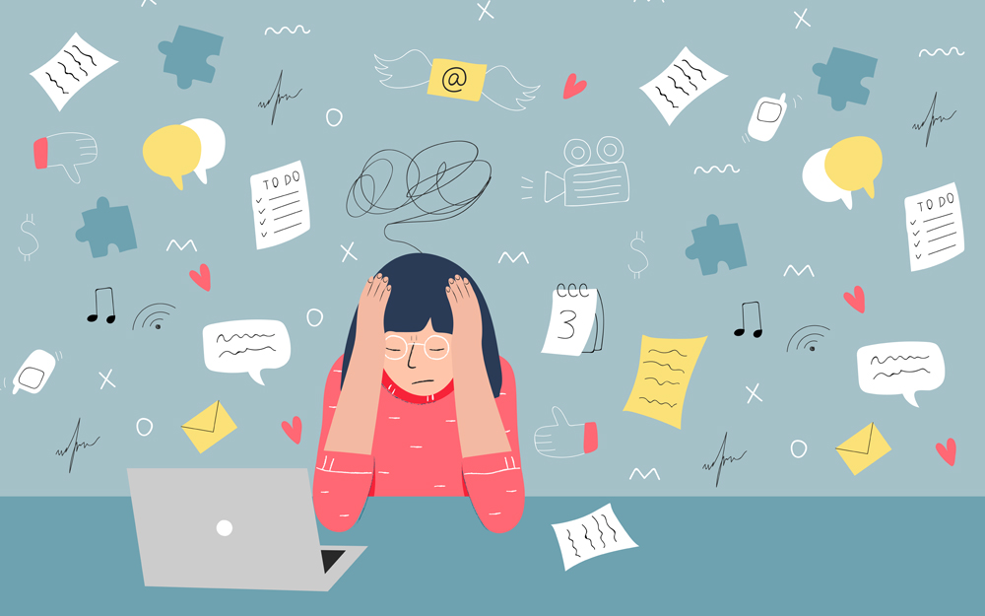
Stress can cause a number of physical, psychological, cognitive, and behavioral symptoms.
PSYCHOLOGICAL
COGNITIVE
PHYSICAL
BEHAVIORAL
Notes:
Stress can cause a number of physical, psychological, cognitive, and behavioral symptoms. Being aware of the most common signs of stress and taking note of how many of them are affecting you can help you understand if you need to seek help

Slide 20
Stress
PHYSICAL | Psychological | Cognitive | Behavioral
Headaches Muscle tension Trembling Dry eyes, mouth Cold hands and feet Rapid breathing Increase blood sugar Increased BP, HR Digestive issue | Anxious thoughts Depressed mood Negative bias Depersonalization Loss of hope Anger Irritability Lack of empathy | Inability to focus Poor judgment Memory loss Executive Forgetfulness | Social isolation Avoidance Sleep disturbance Changes in appetite Drug/toxins Lack of empathy Depersonalization
Being aware of the most common signs of stress and taking note of how many of them are affecting you can help you understand if you need to seek help!
Notes:
The fight-or-flight response is triggered by: (1) the amygdala, an almond-shaped structure in the temporal lobes that is part of the limbic or emotional brain, which sends a signal to… (2) the hypothalamus and pituitary gland to secrete adrenocorticotropic hormone (ACTH), which signals… (3) the adrenal glands, located on the top of the kidneys, to flood the body with cortisol, adrenalin, and other chemicals to rocket you into action.

Slide 21
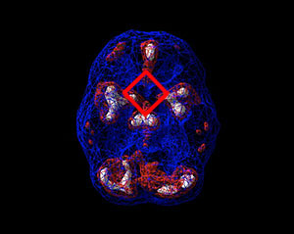
Stress Vs Healthy

Slide 22
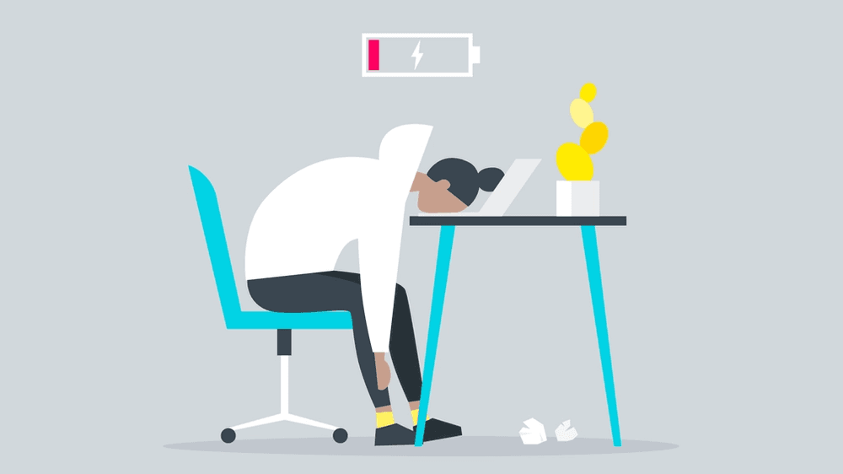
Recognizing “Burn Out”
Notes:
Job burnout is a special type of work-related stress — a state of physical or emotional exhaustion that also involves a sense of reduced accomplishment and loss of personal identity. "Burnout" isn't a medical diagnosis

Slide 23
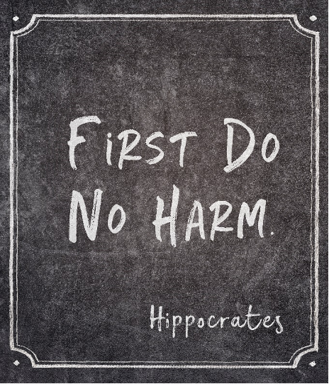
What does that mean to us?
Notes:
inability focus and memory impairs , increase in anxiety and decrease work efficient, lack of empathy and caring less for the work executive functioning planning = poor patient care,
Social and work interpersonal relationship
psychiatric = depression, suicide

Slide 24
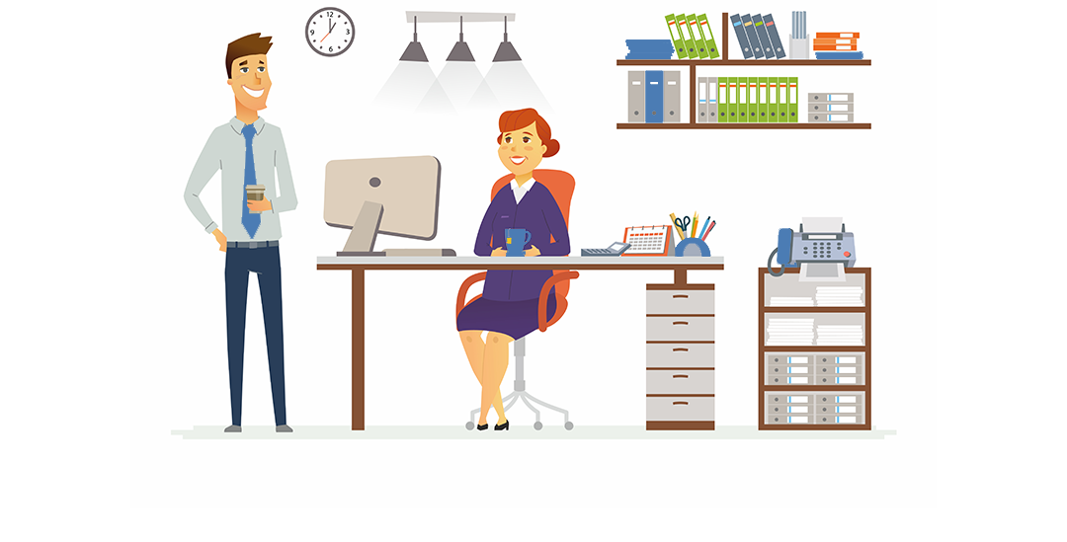
Handling of Burn Out
Notes:
Handling job burnout
Try to take action. To get started:
• Evaluate your options. Discuss specific concerns with your supervisor. Maybe you can work together to change expectations or reach compromises or solutions. Try to set goals for what must get done and what can wait.
•

Slide 25

Handling of Burn Out
Notes:
Seek support. Whether you reach out to co-workers, friends or loved ones, support and collaboration might help you cope. If you have access to an employee assistance program, take advantage of relevant services.
•

Slide 26


Handling of Burn Out
Notes:
Try a relaxing activity. Explore programs that can help with stress such as yoga, meditation or tai chi.
• Get some exercise. Regular physical activity can help you to better deal with stress. It can also take your mind off work
If you’re prone to anxiety and depression, exercise is one of the best natural treatments that exists—and it’s free! Exercise activates the same pathways in the brain as morphine and increases the release of endorphins, your natural feel-good neurotransmitters.
A depression study compared the benefits of exercise to those of the prescription drug, Zoloft. After 12 weeks, the exercise proved equally effective as Zoloft in curbing depression. And after 10 months, exercise surpassed the effects of the drug with zero negative side effects! Exercise is not only a fountain of youth but also the closest thing to a happy pill that you will ever find.
Exercise improves telomere maintenance by increasing the activity of the enzyme telomerase that builds and repairs telomeres.

Slide 27
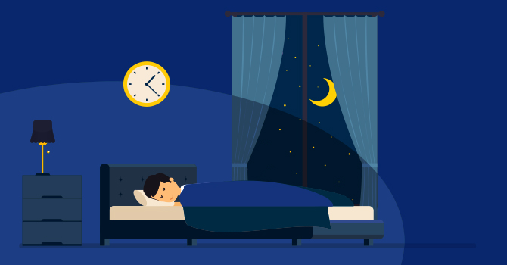
Handling of Burn Out
Notes:
Get some sleep. Sleep restores well-being and helps protect your health.
•

Slide 28
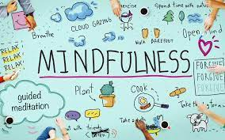
Mindfulness
Notes:
Mindfulness. Mindfulness is the act of focusing on your breath .. and being intensely aware of what you're sensing and feeling …, without interpretation or judgment. In a job setting, this practice involves facing situations with openness and patience, and without judgment.

Slide 29


Supplements for Stress

Slide 30


Supplements for Depression

Slide 31
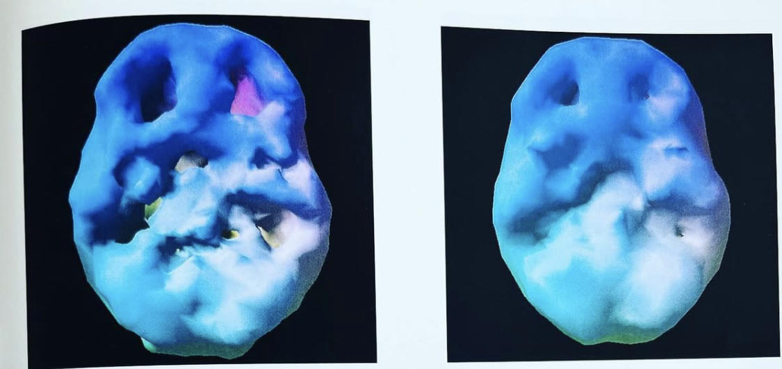
ADHD before and after treatment

Slide 32
You can literally change people’s brains, and when you do, you change people’s life!
Thank you

