Slide 1
Wellness in residency
Byoung Uk Park​
KOPANA 2022 Virtual FALL SPECIAL SEMINAR
November 12, 2022

Slide 2
AGENDA
Wellness in healthcare
ACGME accreditation and Wellness
Wellness related resources and activities during my residency training

Slide 3
Wellness?

Slide 4
Wellness is the active pursuit of activities, choices and lifestyles that lead to a state of holistic health.
“
”
- Global Wellness Institute
https://globalwellnessinstitute.org/what-is-wellness/

Slide 5
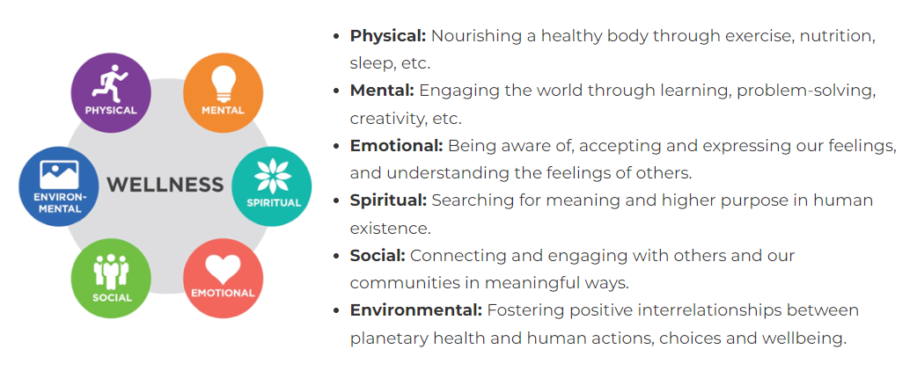
Multidimensional
https://globalwellnessinstitute.org/what-is-wellness/

Slide 6
Wellness in Healthcare?

Slide 7
Wellness in healthcare
Per, a systematic review, the definition in the health community varied extensively:
  Mental
  Physical
  Burnout*
  Depression*
Brady, K.J.S., Trockel, M.T., Khan, C.T. et al. What Do We Mean by Physician Wellness? A Systematic Review of Its Definition and Measurement. Acad Psychiatry 42, 94–108 (2018).

Slide 8
Wellness in healthcare - its importance
Patient care ⁽¹⁾
Medical errors ⁽²⁾
Patient outcome ⁽³⁾
Poor physician wellness
-> compromises the quality, safety, and efficiency of medical care for patients
Unwell (e.g., “burned out,” depressed) physicians
-> more likely to order unnecessary care, commit a medical error, and leave the medical profession early
Patients of burned-out physicians may suffer from an
-> increased risk of patient mortality and longer post-discharge recovery times
Williams ES, Manwell LB, Konrad TR, Linzer M. The relationship of organizational culture, stress, satisfaction, and burnout with physician-reported error and suboptimal patient care: results from the MEMO study. Health Care Manag Rev. 2007;32(3):203–12
Fahrenkopf AM, Sectish TC, Barger LK, et al. Rates of medication errors among depressed and burnt out residents: prospective cohort study. BMJ. 2008;336(7642):488–91.
Halbesleben JRB, Rathert C. Linking physician burnout and patient outcomes: exploring the dyadic relationship between physicians and patients. Health Care Manag Rev. 2008;33(1):29–39.

Slide 9
Wellness in healthcare - its importance
Patient care ⁽¹⁾
Medical errors ⁽²⁾
Patient outcome ⁽³⁾
Poor physician wellness
-> compromises the quality, safety, and efficiency of medical care for patients
Unwell (e.g., “burned out,” depressed) physicians
-> more likely to order unnecessary care, commit a medical error, and leave the medical profession early
Patients of burned-out physicians may suffer from an
-> increased risk of patient mortality and longer post-discharge recovery times
Williams ES, Manwell LB, Konrad TR, Linzer M. The relationship of organizational culture, stress, satisfaction, and burnout with physician-reported error and suboptimal patient care: results from the MEMO study. Health Care Manag Rev. 2007;32(3):203–12
Fahrenkopf AM, Sectish TC, Barger LK, et al. Rates of medication errors among depressed and burnt out residents: prospective cohort study. BMJ. 2008;336(7642):488–91.
Halbesleben JRB, Rathert C. Linking physician burnout and patient outcomes: exploring the dyadic relationship between physicians and patients. Health Care Manag Rev. 2008;33(1):29–39.

Slide 10
Wellness and ACGME Accreditation

Slide 11
ACGME*
*Accreditation Council for Graduate Medical Education
Independent & not-for-profit
Sets and monitors professional educational standard
  preparing physicians to deliver safe, high-quality medical care
Accreditation provides assurance that the program met the quality standards when preparing/training graduates
https://www.acgme.org/about-us/overview/

Slide 12
ACGME Changes in 2017
Revised the COMMON PROGRAM REQUIREMENT to address wellness
emphasized that psychological, emotional and physical well-being are:
    critical in the development of the competent, caring, and resilient physician
    crucial to physicians’ ability to deliver the safest, best possible care to patients
https://www.acgme.org/about-us/overview/

Slide 13
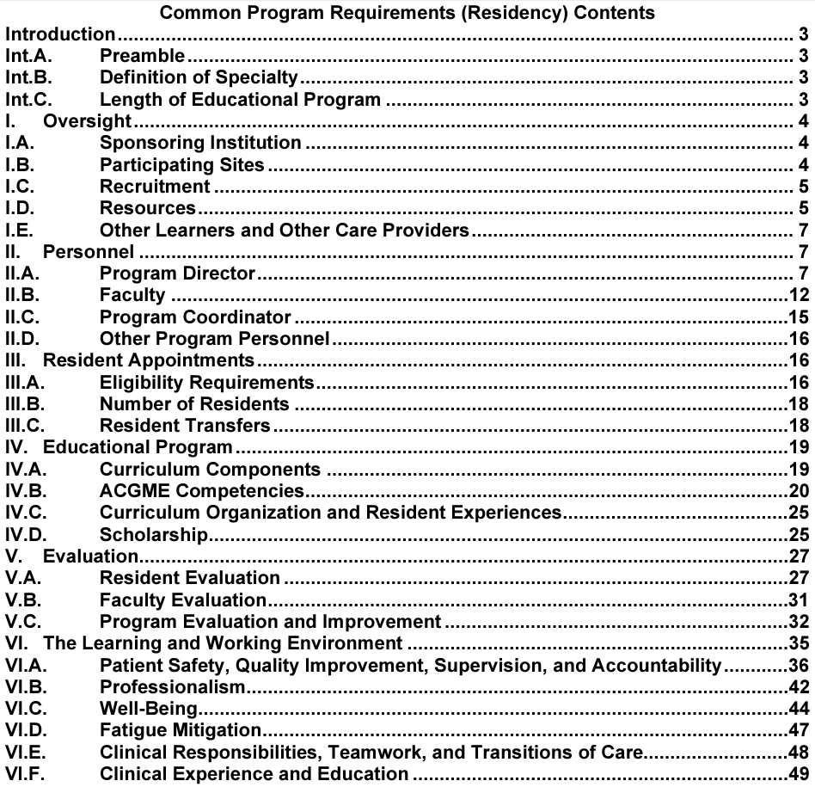
https://www.acgme.org/what-we-do/accreditation/common-program-requirements/

Slide 14
Wellness - ACGME common program requirement -
Requires mechanisms and policies to:
minimize non-physician obligations
promote autonomy/flexibility
workplace safety
given opportunity to attend medical appointments
coverage policies without fear of negative consequences
educate symptoms of burnout, depression and substance abuse
tools for self-screening
provide accessible affordable mental health assessment, counseling, and treatment
https://www.acgme.org/globalassets/pfassets/programrequirements/cprresidency_2022v3.pdf

Slide 15
Wellness related Resources & activities during my residency training

Slide 16
DEPARTMENTAL
Wellness resources and activities
during my residency training
Policies to be compliant with ACGME requirements
Sick leaves
Coverage policies
Gradual responsibility to promote autonomy
Annual educational videos on burnout, depression and substance

Slide 17
DEPARTMENTAL
Wellness resources and activities
during my residency training
Policies to be compliant with ACGME requirements

Slide 18
DEPARTMENTAL
Wellness resources and activities
during my residency training
Policies to be compliant with ACGME requirements
Concerned and committed department leadership
Wellness Director
Wellness Sessions
Food
Feedback Fridays
Stipends / Funds / Reimbursement
Social Events

Slide 19
DEPARTMENTAL
Wellness resources and activities
during my residency training
Policies to be compliant with ACGME requirements
Concerned and committed department leadership
Wellness Director
Wellness Sessions
Food
Feedback Fridays
Stipends / Funds / Reimbursement
Social Events

Slide 20
DEPARTMENTAL
Wellness resources and activities
during my residency training
Concerned and committed department leadership
Friendly work environment – Family like
Open door policies
Mutual respect

Slide 21
DEPARTMENTAL
Wellness resources and activities
during my residency training
Policies to be compliant with ACGME requirements
Concerned and committed department leadership
Wellness Director
Wellness Sessions
Food
Feedback Fridays
Stipends / Funds / Reimbursement
Social Events

Slide 22
DEPARTMENTAL
Wellness resources and activities
during my residency training
Policies to be compliant with ACGME requirements
Concerned and committed department leadership
Wellness Director
Wellness Sessions
Food
Feedback Fridays
Stipends / Funds / Reimbursement
Social Events

Slide 23
DEPARTMENTAL
Wellness resources and activities
during my residency training
Wellness Director
1-year appointment
Junior resident
Promote and organize wellness-related activities

Slide 24
DEPARTMENTAL
Wellness resources and activities
during my residency training
Policies to be compliant with ACGME requirements
Concerned and committed department leadership
Wellness Director
Wellness Sessions
Food
Feedback Fridays
Stipends / Funds / Reimbursement
Social Events

Slide 25
DEPARTMENTAL
Wellness resources and activities
during my residency training
Policies to be compliant with ACGME requirements
Concerned and committed department leadership
Wellness Director
Wellness Sessions
Food
Feedback Fridays
Stipends / Funds / Reimbursement
Social Events

Slide 26
DEPARTMENTAL
Wellness resources and activities
during my residency training
Wellness Sessions
1-hour / month; 2nd Friday; 12 to 1 PM
Protected time
Group activities
pumpkin carving, painting, baking, competitive team games, seasonal activities (Secret Santa Christmas gift exchange)

Slide 27
DEPARTMENTAL
Wellness resources and activities
during my residency training
Wellness Sessions
1-hour / month; 2nd Friday; 12 to 1 PM
Protected time
Group activities

Slide 28
DEPARTMENTAL
Wellness resources and activities
during my residency training
Policies to be compliant with ACGME requirements
Concerned and committed department leadership
Wellness Director
Wellness Sessions
Food
Feedback Fridays
Stipends / Funds / Reimbursement
Social Events

Slide 29
DEPARTMENTAL
Wellness resources and activities
during my residency training
Policies to be compliant with ACGME requirements
Concerned and committed department leadership
Wellness Director
Wellness Sessions
FOOD!
Feedback Fridays
Stipends / Funds / Reimbursement
Social Events

Slide 30
DEPARTMENTAL
Wellness resources and activities
during my residency training
Monday Breakfast
Friday Lunch
Many more….
FOOD!

Slide 31
DEPARTMENTAL
Wellness resources and activities
during my residency training
Policies to be compliant with ACGME requirements
Concerned and committed department leadership
Wellness Director
Wellness Sessions
Food
Feedback Fridays
Stipends / Funds / Reimbursement
Social Events

Slide 32
DEPARTMENTAL
Wellness resources and activities
during my residency training
Policies to be compliant with ACGME requirements
Concerned and committed department leadership
Wellness Director
Wellness Sessions
Food
Feedback Fridays
Stipends / Funds / Reimbursement
Social Events

Slide 33
DEPARTMENTAL
Wellness resources and activities
during my residency training
1-hour / month; 1st Friday; 12 to 1 PM
Protected time
Safe and Private environment
Concerns / Stressors in the program
Communicated to leaderships in anonymous manner
Feedback Fridays

Slide 34
DEPARTMENTAL
Wellness resources and activities
during my residency training
Policies to be compliant with ACGME requirements
Concerned and committed department leadership
Wellness Director
Wellness Sessions
Food
Feedback Fridays
Stipends / Funds / Reimbursement
Social Events

Slide 35
DEPARTMENTAL
Wellness resources and activities
during my residency training
Policies to be compliant with ACGME requirements
Concerned and committed department leadership
Wellness Director
Wellness Sessions
Food
Feedback Fridays
Stipends / Funds / Reimbursement
Social Events

Slide 36
DEPARTMENTAL
Wellness resources and activities
during my residency training
Educational fund
Research funds
Registration fees
Travel expenses
Stipends / Funds / Reimbursement
Departmental
Out-side of work

Slide 37
DEPARTMENTAL
Wellness resources and activities
during my residency training
Policies to be compliant with ACGME requirements
Concerned and committed department leadership
Wellness Director
Wellness Sessions
Food
Feedback Fridays
Stipends / Funds / Reimbursement
Social Events

Slide 38
DEPARTMENTAL
Wellness resources and activities
during my residency training
Celebrations (Birthdays, Baby Showers, Bachelor’s party, graduations, etc.)
Happy hours / seasonal parties
Social Events

Slide 39
DEPARTMENTAL
Wellness resources and activities
during my residency training
Celebrations
Happy hours
Social Events

Slide 40
DEPARTMENTAL
Wellness resources and activities
during my residency training
Policies to be compliant with ACGME requirements
Concerned and committed department leadership
Wellness Director
Wellness Sessions
Food
Feedback Fridays
Stipends / Funds / Reimbursement
Social Events

Slide 41
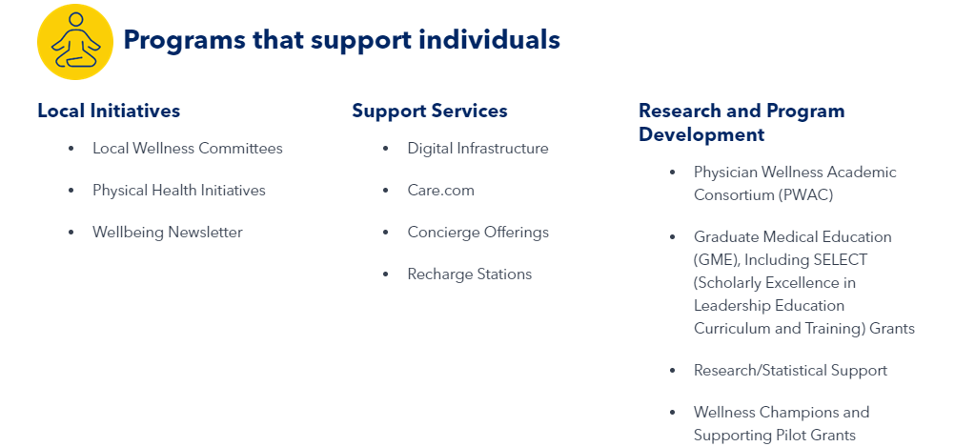
Institutional
Wellness resources and activities
during my residency training
https://www.medstarhealth.org/innovation-and-research/medstar-institute-for-innovation/about-us/medstar-health-center-for-wellbeing

Slide 42
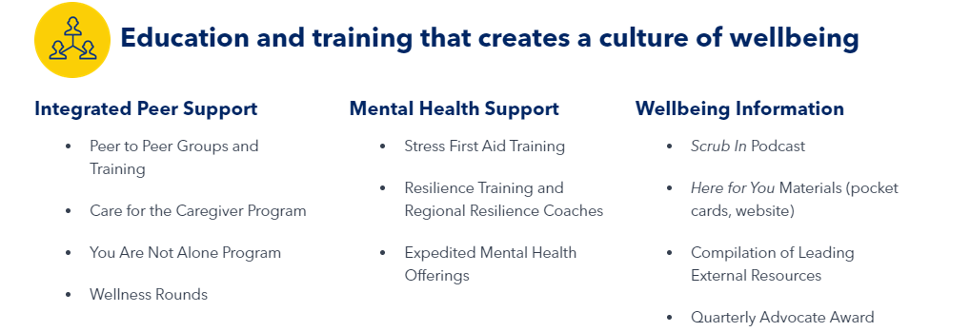
Institutional
Wellness resources and activities
during my residency training
https://www.medstarhealth.org/innovation-and-research/medstar-institute-for-innovation/about-us/medstar-health-center-for-wellbeing

Slide 43
SUMMARY
Growing evidence of the importance and ongoing efforts to ensure physician well-being.
Absence of standardized “curriculum” for wellness in residency.
Resources and activities that may seem insignificant may have a huge impact.

Slide 44
THANK YOU
Byoung Uk Park​
bpark8@stanford.edu

