Slide 1
Seeking Wellness for Young Pathologists
KOPANA 2022 Virtual Fall Special Seminar
Jiwon Koh
Clinical Assistant Professor
Department of Pathology
Seoul National University Hospital

Slide 2
Contents
Part One: 2022 survey in Korea
Part Two: People are the cure – my story
Part Three: Other possible resolutions

Slide 3
2022 Survey in Korea
1. Overview
65 responders (response rate of 40%)
Practicing
Pathologists
40%
7.7%
92.3%
44.6%
55.4%
Residents
60%
Courtesy of Dr. Yoon Jung Hwang @SNUH
Notes:
설문조사에는 총 65명이 참여하여 약 40%의 응답률을 보였습니다.
응답률이 높은 편은 아니었지만 응답해주신 선생님들께서 좋은 의견을 많이 주셨고, 답변해 주셔서 감사드립니다.
응답자의 분포를 보시면 전공의가 60%, 신입전문의가 40%를 차지하고 있습니다.
90% 이상이 대학병원에서 근무하고 있었으며, 서울에 소재하는 기관에 근무하는 경우가 55.4%였습니다.
종합병원 2
검사센터 1
개원의 1
군의관 1

Slide 4
2022 Survey in Korea
2. Work hours
Weekdays
Those who work more than 12 hours per day…
12 hours
8 am to 9 pm
Working >80 hours/week
3.1%
Courtesy of Dr. Yoon Jung Hwang @SNUH
Notes:
근무 시간에 대해 조사한 결과를 보시겠습니다.
평일 평균 근무 시간을 조사한 문항에서는 10-12시간 근무하는 경우가 32.3%로 가장 많았으며,
평균적으로 약 12시간 정도 근무하는 것으로 확인되었습니다.
오전 8시부터 근무한다고 하면 평균적으로 저녁 9시 정도까지 근무한다고 보시면 되겠습니다.
평일 평균 16시간 이상 근무하여 주 80시간 이상 근무할 것으로 생각되는 비율은 3.1% 정도였습니다.
평일 평균 근무시간인 12시간을 기준으로 그 이상 근무하는 전공의의 비율은 비교해보았습니다.
서울과 비서울 소재지의 전공의들 간에 비교를 해보았을 때는 서울 소재의 기관이 39%, 비서울 소재의 기관이 38%로 차이를 보이지 않았습니다.
연차별로 비교를 해보았을 때는 평일 평균 12시간 이상 근무하는 비율이 1년차 9.1% 에서 4년차가 되면 62.5%로 연차가 올라감에 따라 증가하는 경향을 확인할 수 있었습니다.
8-5
8-7
8-9
8-11
8시부터 근무한다고 했을 때, 평일 평균 8시까지 근무, 10시 이상까지 근무하는 비율 16.9%

Slide 5
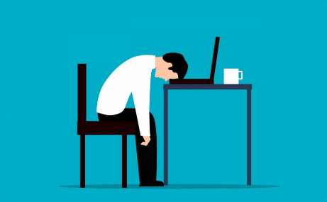
2022 Survey in Korea
3. Burn-out syndrome
Q. Have you experienced signs or symptoms of burn-out syndrome during the last one year?
Q. How many days during the last year did you find it very difficult to start your work day?
NO
YES
Courtesy of Dr. Yoon Jung Hwang @SNUH
Notes:
소진도와 관련된 질문에 대한 결과를 보시면,
전공의 수련기간 혹은 지난 1년간 만성 피로나 소진증후군의 증상을 경험한 적이 있냐는 질문에 그렇다고 대답한 경우가 63.1%였습니다.
아침에 일어나서 출근하기 힘들다고 느낀 적이 한 달 평균 몇 일이냐고 묻는 질문에는 1-5일이라고 응답한 경우가 41.6%로 가장 많았으며,
16일 이상이라고 응답한 경우도 21.5%였습니다.

Slide 6
2022 Survey in Korea
4. Satisfaction Survey
Are you happy with your training?
YES! I am satisfied and happy!
Courtesy of Dr. Yoon Jung Hwang @SNUH

Slide 7


2022 Survey in Korea
4. Satisfaction Survey
Dislike!
Like!
Courtesy of Dr. Yoon Jung Hwang @SNUH
Notes:
병리과 수련 환경에 만족하는 이유로는 업무 패턴이 규칙적이고 시간을 탄력적으로 운용할 수 있다는 점이 88.9%로 가장 많았고, 응급이 없기 때문이라는 언급도 많았습니다.
다음으로 73.8%가 업무가 적성에 맞아 만족스럽다고 대답하였고, 배운 것을 바로 적용할 수 있어 성장하는 느낌이 든다는 의견이 있었습니다.
또한 환자를 직접 보지 않아 환자 대면에 대한 스트레스가 적으며 질병에 대해 가장 잘 알고 환자 진료에 결정적인 역할을 한다는 점에서 뿌듯함을 느낀다는 의견도 많았습니다.
만족하지 않는 이유로는 많은 업무량에 비해 급여가 적다는 점이 72.4%로 가장 많았고,
주로 전공의 수 부족과 같은 인력 부족으로 인한 업무 과중으로 인해 전공의 교육이 비효율적으로 이루어지고 있다는 의견이 많았습니다.
또한 진로에 대한 정보가 부족하다는 응답도 많았습니다.

Slide 8
2022 Survey in Korea
4. Satisfaction Survey
Dislike!
Like!
Courtesy of Dr. Yoon Jung Hwang @SNUH
Notes:
병리과 수련 환경에 만족하는 이유로는 업무 패턴이 규칙적이고 시간을 탄력적으로 운용할 수 있다는 점이 88.9%로 가장 많았고, 응급이 없기 때문이라는 언급도 많았습니다.
다음으로 73.8%가 업무가 적성에 맞아 만족스럽다고 대답하였고, 배운 것을 바로 적용할 수 있어 성장하는 느낌이 든다는 의견이 있었습니다.
또한 환자를 직접 보지 않아 환자 대면에 대한 스트레스가 적으며 질병에 대해 가장 잘 알고 환자 진료에 결정적인 역할을 한다는 점에서 뿌듯함을 느낀다는 의견도 많았습니다.
만족하지 않는 이유로는 많은 업무량에 비해 급여가 적다는 점이 72.4%로 가장 많았고,
주로 전공의 수 부족과 같은 인력 부족으로 인한 업무 과중으로 인해 전공의 교육이 비효율적으로 이루어지고 있다는 의견이 많았습니다.
또한 진로에 대한 정보가 부족하다는 응답도 많았습니다.

Slide 9
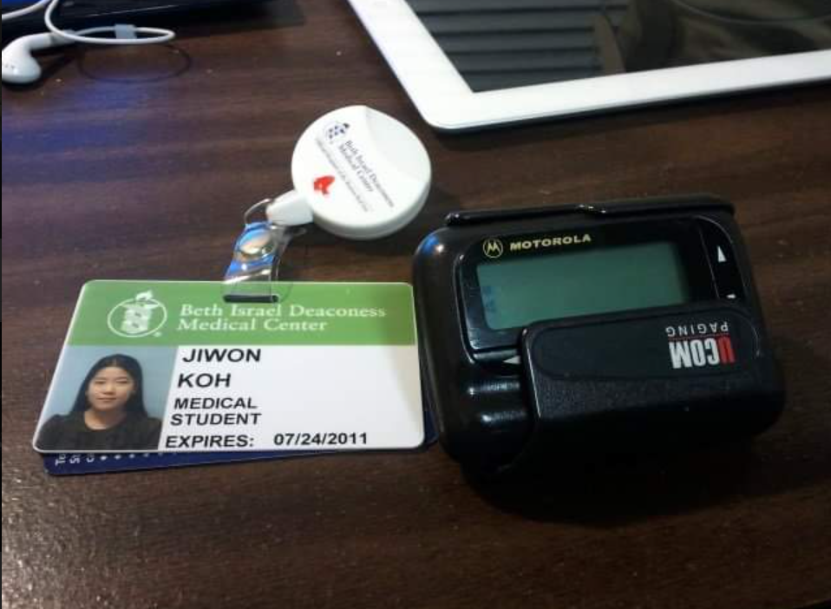
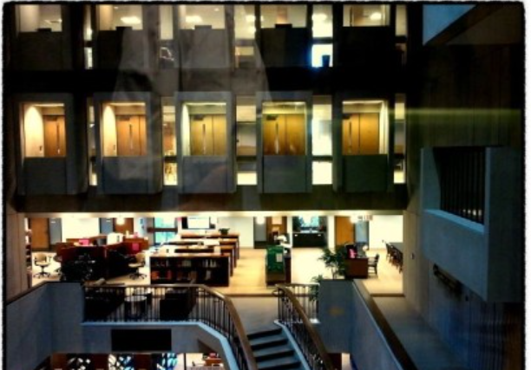
People are the cure – my story
July, 2011
Boston, MA, USA

Slide 10
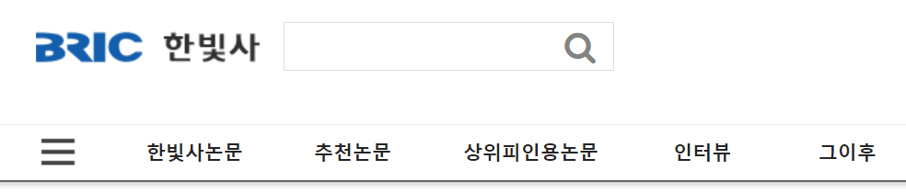
People are the cure – my story
January, 2016
Seoul, Korea
January, 2016
Boston, MA, USA

Slide 11


People are the cure – my story
January, 2016
Seoul, Korea
January, 2016
Boston, MA, USA
You might not remember me; we've run into each other at Countway Library.
…
and more importantly, I've became a pathology resident in Korea.
…
Thank you for your help back at year 2011, and thank you again for all the motivation you gave me by your work.

Slide 12
People are the cure – my story
January, 2016
Seoul, Korea
January, 2016
Boston, MA, USA
Of course I remember you! I too have been wondering about you, and it is so great to hear that you are doing well.
I am so happy that you have chosen pathology. An excellent choice!
I know that you have great potentials and bright career ahead of you.
I have no doubt that you will achieve many things way beyond mine.

Slide 13
People are the cure – my story
January, 2016
Seoul, Korea
January, 2016
Boston, MA, USA
I don't know for sure right now which subspecialty to follow, but my primary goal during this residency program is becoming a fine general pathologist. :)
Since the reason for choosing pathology was my consistent interest in oncology, I want to be in the academic position.
Due to various reasons such as longstanding economic depression in South Korea, it is not so easy to get jobs even for doctors.
It is getting more and more competitive but I will do my best. :)

Slide 14
People are the cure – my story
January, 2016
Seoul, Korea
January, 2016
Boston, MA, USA
As far as frustration part goes, I went through a very similar experience too, especially during my third and early fourth year ( I did AP/CP).
I always felt like I should know more and be better, but I always felt like I was inadequate.

Slide 15
People are the cure – my story
January, 2016
Seoul, Korea
January, 2016
Boston, MA, USA
I tried to figure out what was wrong with me. What I did not know was that I was burnt out from chronic fatigue.
It’s an odd thing, but when you are really burnt out, you don’t even realize that you are burnt out. When you are burnt out, you get very pessimistic about yourself and doubt your abilities and potentials.
I am not sure, if this may be the case for you, but if this may be, then seriously, find time to take care of yourself.
The fact of the matter is, you are probably doing very well. It is very likely that you are really tired and stressed out from residency training.

Slide 16
People are the cure – my story
January, 2016
Seoul, Korea
January, 2016
Boston, MA, USA
Also, during your third year, things will start clicking together and start making sense. You will recognize things you had not before.
Studying for the boards will also help. It will help with organizing your thoughts and reinforcing the knowledge you already have retained.
I think “frustration” is not necessarily a bad thing, because it will make you try harder and better.
At the same time, don’t push yourself too hard.
Take a break, treat yourself with a relaxing vacation, and take care of yourself.
You are not alone in this.
Many residents at USA go through similar phases too.
We all struggle with similar things.
Even experienced attendings and practicing pathologists make mistakes and have different opinions on cases.

Slide 17
People are the cure – my story
January, 2016
Seoul, Korea
January, 2016
Boston, MA, USA
So this is me speaking.
You are not alone in this.
“Your attending” went through similar phases too.
We all struggle with similar things.
I got this from my friend who was thousand miles away.
Imagine what I can get you right here.
Please reach out. Please do not suffer alone.
Also, during your third year, things will start clicking together and start making sense. You will recognize things you had not before.
Studying for the boards will also help. It will help with organizing your thoughts and reinforcing the knowledge you already have retained.
I think “frustration” is not necessarily a bad thing, because it will make you try harder and better.
At the same time, don’t push yourself too hard.
Take a break, treat yourself with a relaxing vacation, and take care of yourself.
You are not alone in this.
Many residents at USA go through similar phases too.
We all struggle with similar things.
Even experienced attendings and practicing pathologists make mistakes and have different opinions on cases.

Slide 18
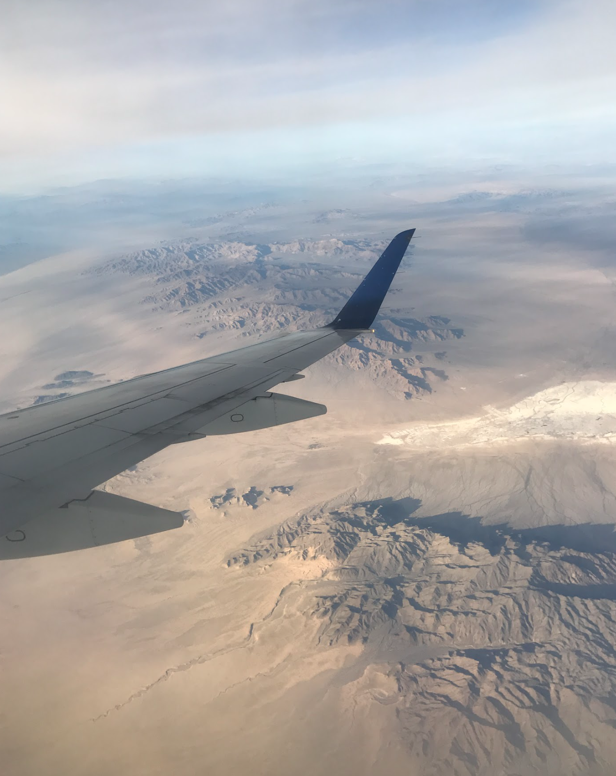
Other possible resolutions
We travel
Not to escape life
But for life not to escape us

Slide 19
Epilogue
So this is me speaking, again and again.
You are not alone in this.
“Your attending” went through similar phases too.
We all struggle with similar things.
I got this from my friend who was thousand miles away.
Imagine what I can get you right here.
Please reach out. Please do not suffer alone.

