Slide 1

Social Equity Caucus
:an Inclusive Learning Community
”New member orientation”

Slide 2
Social Equity Caucus (SEC)
Acknowledgment of Unceded Abenaki Territory
Some indigenous people would suggest it should be a white person who most directly benefited from the settlement of unceded territory that does the acknowledgement. There are also evolving land acknowledgements that honor the uncompensated and exploited labor of slaves and migrant farmworkers. Here is a draft we can review together and modify when necessary, and the acknowledgement would rotate among those who feel moved to speak:
  The Social Equity Caucus of the Vermont Legislature acknowledges the Abenaki people as the traditional land caretakers of Ndakinna (En-DAH-kee-nah), which includes parts of Vermont, New England, and Quebec. As elected officials on the unceded territory of the Abenaki people, we pay our respects to their ancestors, elders, and relations past, present and emerging. We also acknowledge that our state has benefited from the uncompensated and exploited labor represented in the legacy of slavery and the present-day reality of migrant farmworkers.

Slide 3
Social Equity Caucus (SEC)
Dec 2, New Member Orientation, 8-9 am
8 am: Arrival
8:05: Welcome from Coach & Identification of Leadership Team
8:10: Random Triad Breakouts - Introductions & Question (What made you want to join this caucus?)
8:15: Overview of Mission, Vision & Structure - Coach
8:25: Past & Present Legislative Work - John, Marybeth, Mike & Martin
8:35: Role of the Executive Director of Racial Equity - Anne & Xusana
8:45‪: SEC Work Group & Looking Ahead - Hal, Lucy & Emilie
8:50: Q&A
9:00: Adjourn

Slide 4
Social Equity Caucus (SEC)
Leadership Team
MaryBeth Redmond | Brian Cina | Becca Balint | Anne Donahue
Sara Coffey | Emilie Kornheiser | Hal Colston | Alison Clarkson
Lucy Rogers | Martin LaLonde | Mike Morwicki | John Gannon
Kevin Coach Christie | Kesha Ram |  | Will Notte

Slide 5
Social Equity Caucus (SEC)
Mission
The mission of the Social Equity Caucus is to focus deliberately on improving outcomes for marginalized peoples and create a vehicle for Vermonters to access their representation, leadership and community. It is not enough to get rid of institutionalized inequality—we aim to institutionalize equity and inclusivity.

Slide 6
Founding Members
08/24/2019
Hal Colston
Randy Brock
Brian Cina
Becca Balint
Diana Gonzalez
Brian Campion
Nader Hashim
Debbie Ingram
Bill Lippert
Lucy Rogers
John Killacky
Emily Kornheiser
Matt Trieber
Kathleen James
Avram Patt
Mari Cordes
Maxine Grad
Barb Rachelson
(Mike Mrowicki)
Kevin Coach Christie

Slide 7
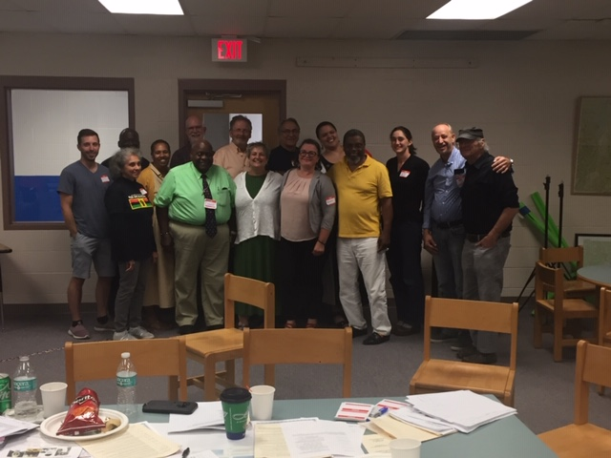
Social Equity Caucus
:an Inclusive Learning Community
Rev. Thomas
Xusana Davis
Malcom Green
Lucy Rogers
Mari Cordes
Angie Christie
Dick McCormick
Alice Nitka
Curtis Reed
John Moody
Wafic Faour
Rachael Siegal
Mike Morwicki
Bill Lippert
Avram Patt
Debbie Ann Paige
Jill Michaels
Coach
Our first “UNITY SUMMIT” 8/24/19

Slide 8
Social Equity Caucus (SEC)
Membership History
The SEC started (8/24/19) with a core group of about 20 Legislators and a hand full of Community members and Organizations. Almost a year later our Legislative membership is over 86 and our community, individual and group membership is over 118. (Now 204)

Slide 9
Social Equity Caucus (SEC)
Our Work
In addition to our numerous activities, weekly meetings and panels, this Session, S.219, S.338 (Sec.19), Joint Legislative Hearings, a Statewide Survey, S.124, S.119 and S.24., SEC is empaneling “SEC Work Group” charged with the development of a policy recommendations that will address short-term legislation, mid-term and long-term legislation. The most unique nature of the “SEC Work Group” is a paradigm shift. The “SEC Work Group” will be comprised of diverse, emerging voices, multi-talented, marginalized members from our Vermont communities. The “SEC Work Group” will be comprised of 18-20 members: four - six legislative members with two members representing the Senate, House Government Operations Committee, House Judiciary Committee and others; and 14 members of the communities of color and mental health advocates as well as other marginalized groups. The “SEC Work Group” will be Co-Chaired by a Community Member and a Legislator.

Slide 10
Social Equity Caucus
:an Inclusive Learning Community
        ”This is who we are!”

