Slide 1

MCI Treatment Tag Review
Why
When
How

Slide 2
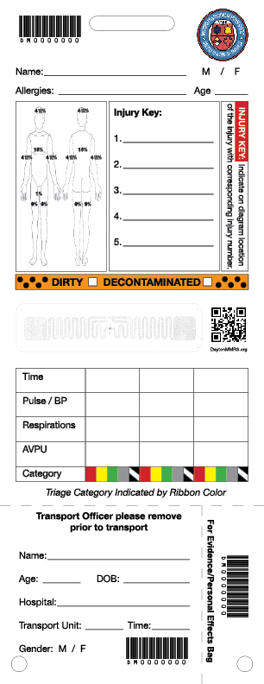
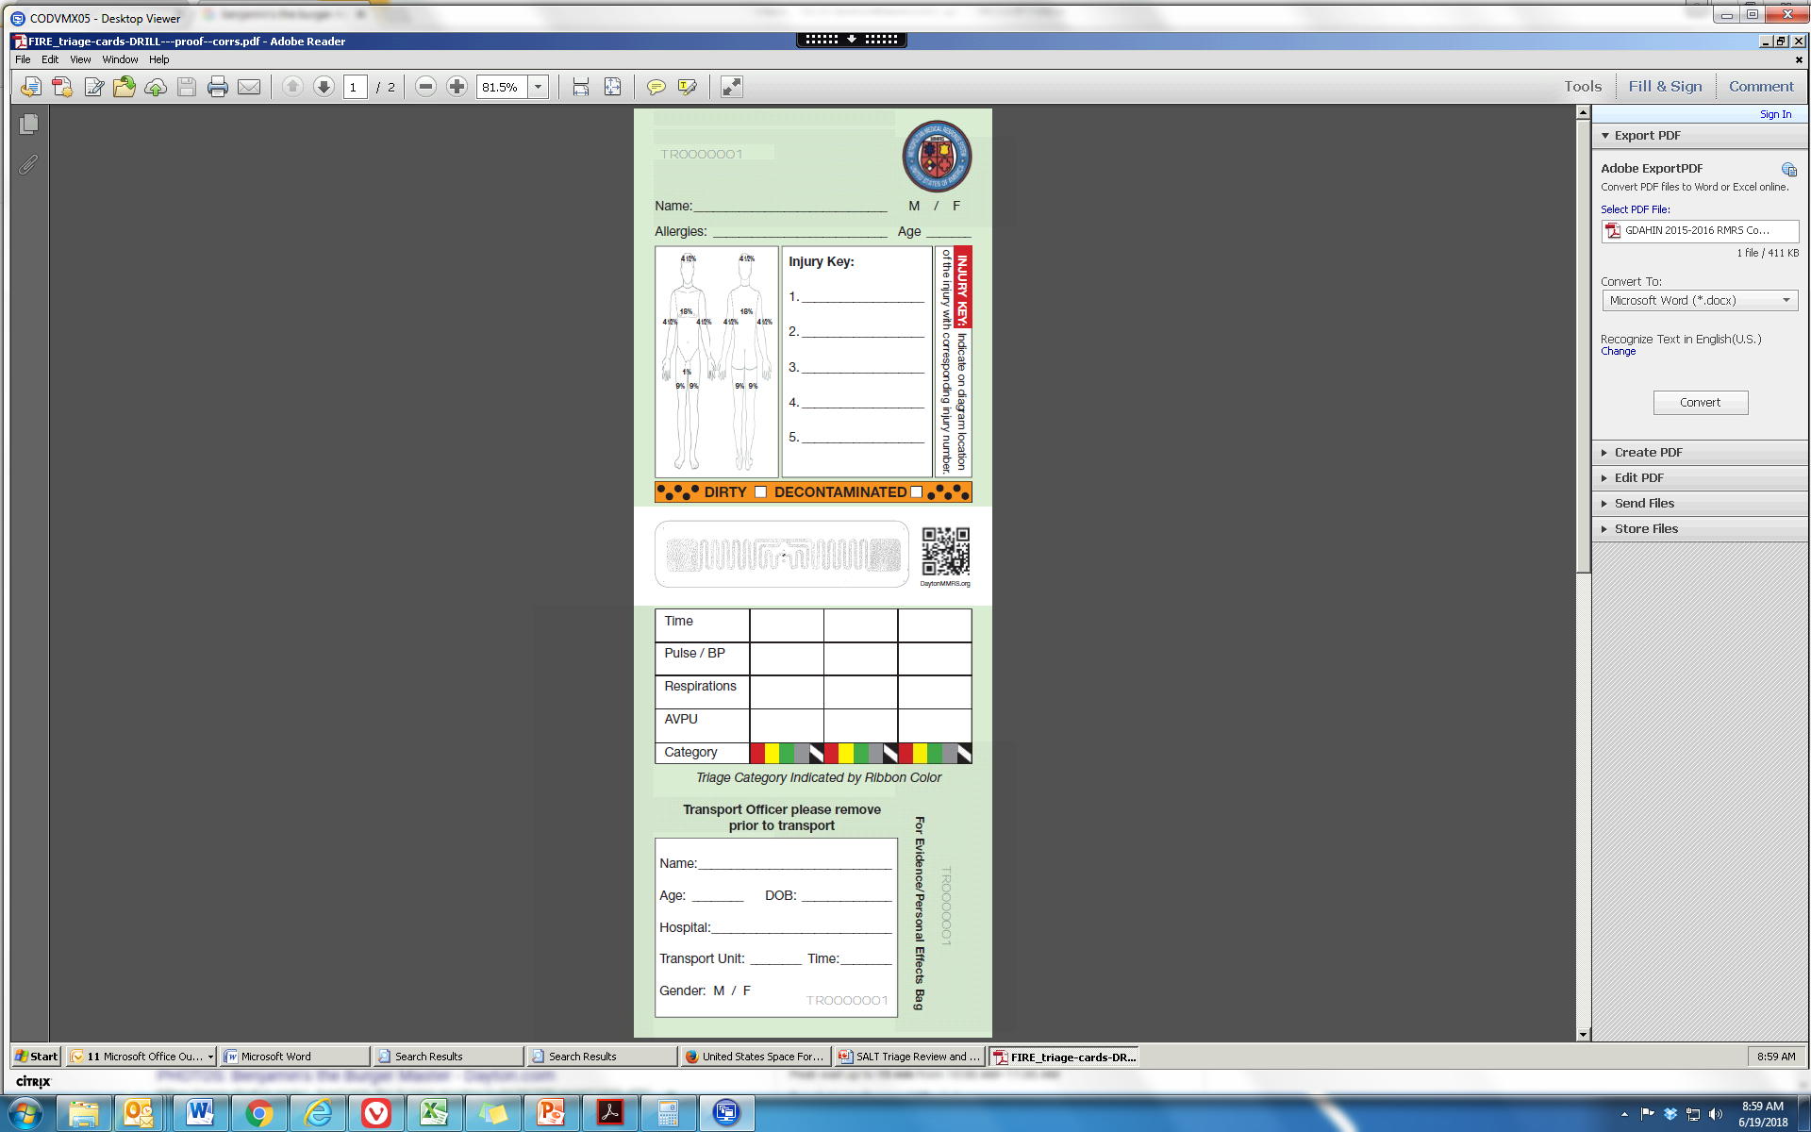
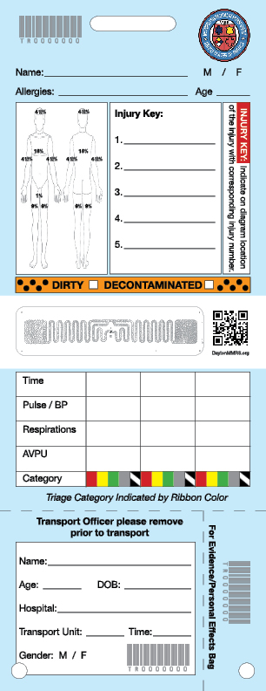
Overview
  There are 3 types of tags
    White
    Green
    Blue
  Differences
    White: Unique barcodes and RFIDs
    Green: Unique barcodes
    Blue: Barcodes all same
  Uses
    White: Real Life Events
    Green: Exercises and Drills (QTD)
    Blue: Training

Slide 3
Why/When
  Treatment tags are often the only documentation of patient care in an MCI
  Provides information to other EMS personnel and the ED
  Makes it easier to track patient through transport and in the hospital
  Allows for efficient patient care, documentation, and consistency (in major MCI, probably the only EMS documentation)
  Helps with identification and family reunification
  Treatment tags should be tied on to patient with their triage ribbon after patients enter CCP or in the Transport Area if patient is bypassing the Treatment Area
    Tags can be filled out in the CCP or during transport
    Every patient should leave the scene with a Treatment Tag or have one applied in transport
    Can scan tags into EMTrack
  If condition changes, change ribbon but keep the same tag

Slide 4
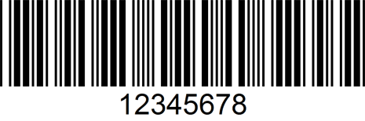
Front
1
2
3
Barcode – on tag three times; is unique to each individual tag; can be scanned into Juvare
Basic ID – Name, sex, allergies, age/DOB
Injury – indicates where patient is injured (mark # on diagram)
Hazardous Material – if patient is contaminated then decontaminated
RFID – hospitals can use RFID instead of barcode; when scanning in tags, be careful that you scan the barcode not the QR code
Vitals and Triage Category – document time/vitals/triage category and changes over time
Tear-off – this section remains with the Transport Officer to keep track of who was on scene and who left
4
5
6
7
8

Slide 5
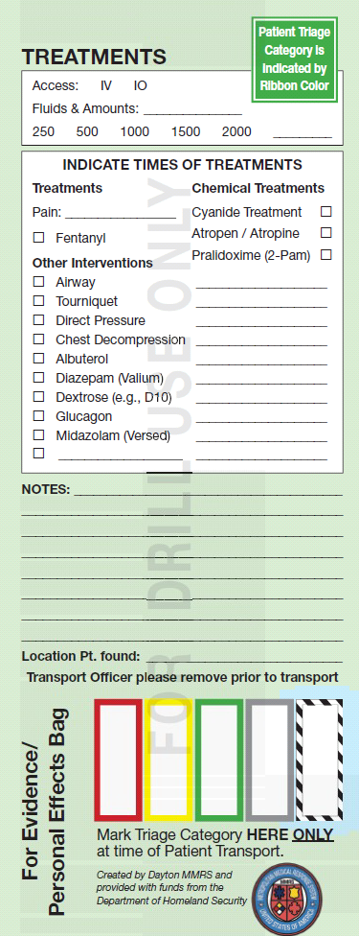
Back (Treatments)
9
Second Tear-Off – For any belongings or evidence left on scene, allows it to be connected to the patient once scanned into EMTrack
Access and Fluids – if patient was given fluids indicate what fluids, the amount, and the route
Treatments and Interventions – document treatments/interventions
Notes –pertinent information about patient and situation (e.g., medical conditions, language barriers, contaminant information, etc.)
Location PT. found – if pertinent, include where/when/how patient was found
Tear-off – document triage category at time of patient transport
10
11
    12
13
8

