Slide 1

Regional Hospital Notification System
How
Why
When

Slide 2
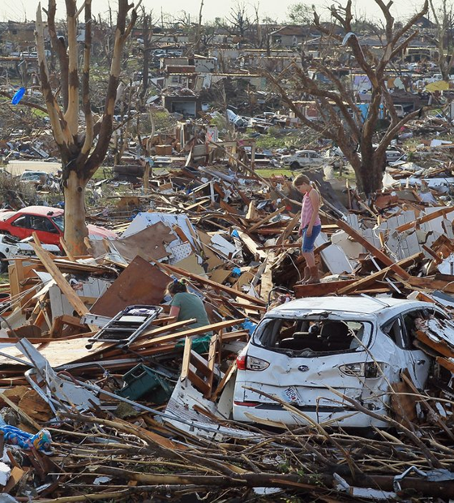
Overview
  Activation number for EMS, Hospitals, and EMAs to call
  Rapid, simultaneous notifications during MCI or other major emergency
  Use whenever an incident could potentially involve a significant number of region’s hospitals
    EMAs can use for events spanning multiple jurisdictions (e.g., tornadoes)
    Use to alert hospitals that patients will need decon
    Also use to indicate no need for action and other major events
  Montgomery County Regional Dispatch Center (RDC) puts out computerized message

Slide 3
Hospitals
  Numbers called at each hospital were chosen by that hospital
    Emergency messages on cell phones should get both text and voice (if one system down, other may go through)
  RHNS Messages
    All EDs in our region (and some outside our region)
    Alerts hospitals plus Regional Coordinators, EMAs, etc.
    RHNS is tested monthly and during most area exercises

Slide 4
RHNS
  RHNS is a critical system. Both EMS and hospitals should give high priority to activating it.
    Triggers hospitals to be ready and clarifies what they might have heard on media/social media
    Triggers EDs to start considering which patients in their EDs could be discharged
    Triggers EDs to start monitoring the MCI Radio Talks Groups (which do not have alerts)

Slide 5
Activation
  EMS, fire, hospitals, EMAs, and Dispatch Centers
  To activate RHNS call 937-333-USAR (8727)
  The agency calling must ask for a Dispatch Supervisor, request a “Regional Hospital Notification”, and use the phrase “Mass Casualty Page Hospitals”. Then provide the following:
    Name of agency
    Nature and locationof emergency
    General statement on severity, such as approximate number of victims
    Any other information to be conveyed
  RDC will immediately put out an RHNS message with the information provided

Slide 6
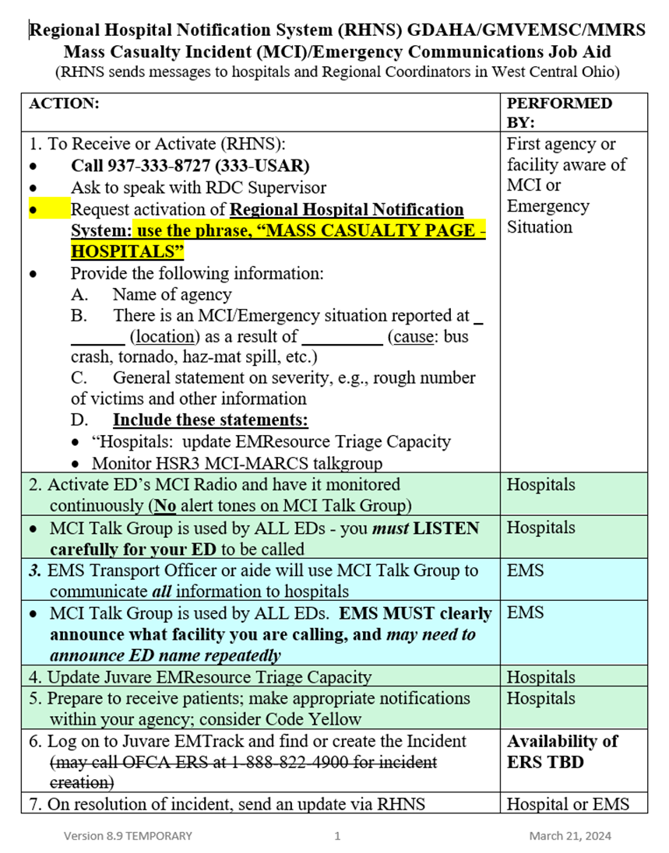
Job Aid
  Sent to all hospitals, EMS, and dispatch agencies in region
  Transport Officer clipboard on each apparatus should have a copy of the Job Aid
  Every ED and EMA should have the Job Aid posted
  Provides personnel with everything needed to activate RHNS
  On both GDAHA & Dayton MMRS websites

