Slide 1
Guidelines for Mass Casualty Triage
Developed by:
David N Gerstner, EMT-P
MMRS Regional Coordinator
Dayton Fire Department
- - - - - - - - - - - - - - - - - - - - - - - - - - - - - - - - - - - - - - - - - - - - - - - - - - - - - - - - - - -
Matt Clark, EMS-I
EMS Education Coordinator
Premier Health Miami Valley Hospital
- - - - - - - - - - - - - - - - - - - - - - - - - - - - - - - - - - - - - - - - - - - - - -
James E Brown, MD MMM EMT-P
Chairman
Department of Emergency Medicine
Wright State University

Slide 2
collaborative PLANNING for MCI Training
DMMRS
Public Health
Fire, EMS, Law Enforcement, EMAs
Hospitals (GDAHA)

Slide 3
Triage Process
Section 1

Slide 4
Objectives
Be able to apply SALT Triage methods on real or simulated victims
Be familiar with the Regional MCI Communications Plan and able to use all appropriate components of that plan
Be able to quickly and effectively use Dayton MMRS SALT Triage Materials utilized in our region
“Live” Triage Treatment Tags
Training or Drill Treatment Tags
Triage Ribbon Kits
Transport Log
Transport Worksheet

Slide 5
SALT
Acronym for:
Sort
Assess
Life Saving Interventions (LSI)
Treatment/Transport
CDC sponsored the project to develop a national standard for mass casualty triage
Developed SALT Triage Guideline using best of all known triage systems
Based on best evidence available
Concept endorsed by: ACEP, ACS-COT, ATS, NAEMSP, NDLSEC, STIPDA, FICEMS
SALT is fastest!

Slide 6
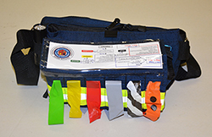
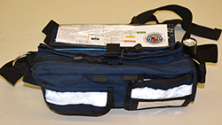
SALT Triage
Used whenever number of patients exceeds immediate treatment or transport resources
Same process for adult and peds, except for one LSI step…
Notes:
SALT triage is designed to be a national triage guideline. It is simple to use and easy to remember. It instructs providers to quickly group patients by their ability to follow commands and then to individual assess patients applying life saving interventions rapidly and then assigning each person a treatment or transport priority.

Slide 7
SALT/MCI General Principles
Move as quickly as possible
Begin transports of RED patients as soon as feasible!
Don’t neglect processes (triage, allocation of patients to hospitals, command, etc.)
Triage Ribbons 1st
Then Tags at Casualty Collection Point (CCP),Transport Area, or during transport
Over-triage can be as harmful as under-triage

Slide 8
TRANSPORT Group/Unit
Crucial to overall success in MCI
Use Regional Hospital Notification System
RHNS
Ensure secondary triage prior to transport
Ensure triage treatment tag application prior to or during transport
Responsible (with Treatment Group) for assigning priorities for transport

Slide 9
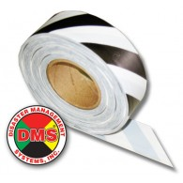
Triage Categories ID-MED
Immediate
Delayed
Minimal
Expectant
Dead
(Ribbon/Tag zebra-striped)
Notes:
The answers to these questions will allow you to place the patient in one of the 5 categories shown here. Each category is given a color code so that they can be recognized quickly.

Slide 10
STEP 1: Global Sorting
Notes:
The goal of Global sorting is to quickly prioritize patients for individual assessment. This will allow you to go first to those patients who are most likely to need immediate life saving interventions such as bleeding control.

Slide 11
Global Sorting: Action 1
Action:
“Everyone who can hear me please move to [designated area] and we will help you”
Goal:
Group ambulatory victims using voice commands
Result:
Those who follow this command - last priority for individual assessment
Notes:
As you approach a scene with multiple patients your first step will be to give them a voice command. “Everyone who can hear me and needs help, move to some designated area” Those who are able to move are then grouped and will be the last priority for individual assessment.

Slide 12
Global Sorting: Action 2
Action:
“If you need help, wave your arm or move your leg and we will be there to help you in a few minutes”
Goal:
Identify non-ambulatory patients who can follow commands or make purposeful movements
Result:
Those who follow this command - second priority for individual assessment
Notes:
Next you will want to identify non-ambulatory patients who can follow commands or are making purposeful movements. By saying “If you need help, wave your arm or move your leg and we will be there to help you in a few minutes” Those who are moving purposefully are prioritized second for individual assessment.

Slide 13
Global Sorting Result
Casualties are now prioritized for individual assessment
Priority 1: Still, and those with obvious life threat
Priority 2: Waving/purposeful movements
Priority 3: Walking
2
1
3

Slide 14
Global Sorting – misleading Result?
Many possibilities could impact response to Global Sorts:
A mom could walk, but with an unconscious child
Husband who’s uninjured may refuse to leave wife’s side
Patient with AMI may walk
Global Sort is merely first step
ALL must be individually assessed as soon as possible

Slide 15
Global Sorting Result
Next step:
Assess all non-ambulatory victims where they lie and provide the four LSI’s as needed
Only if within your Scope of Practice, training, and authorization
Only if you have the equipment readily available
(e.g., do not return to the rig to get an NPA)
Triage as quickly as possible!

Slide 17
Step 2: Individual Assessment - Lifesaving Interventions
Provide Lifesaving Interventions
Control major hemorrhage
Open airway if not breathing
If child, consider giving 2 ventilations
Chest needle decompression
Auto injector antidotes

Slide 18
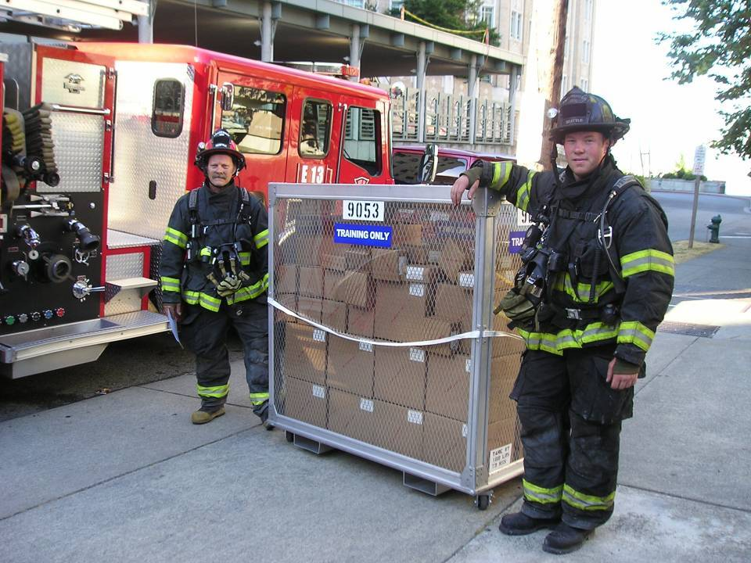
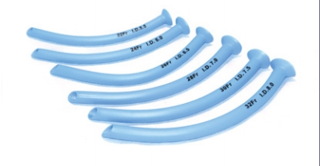
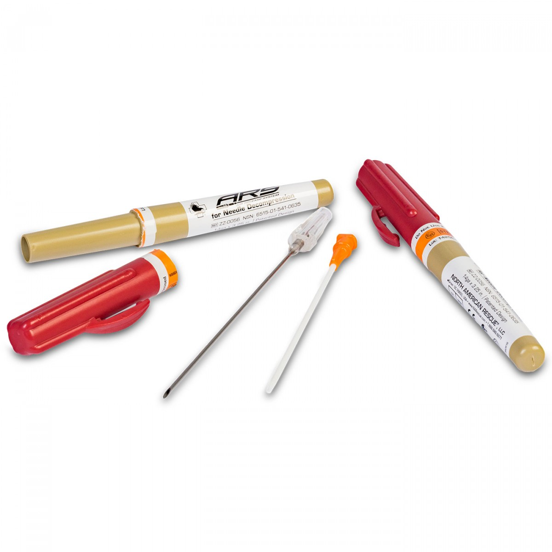
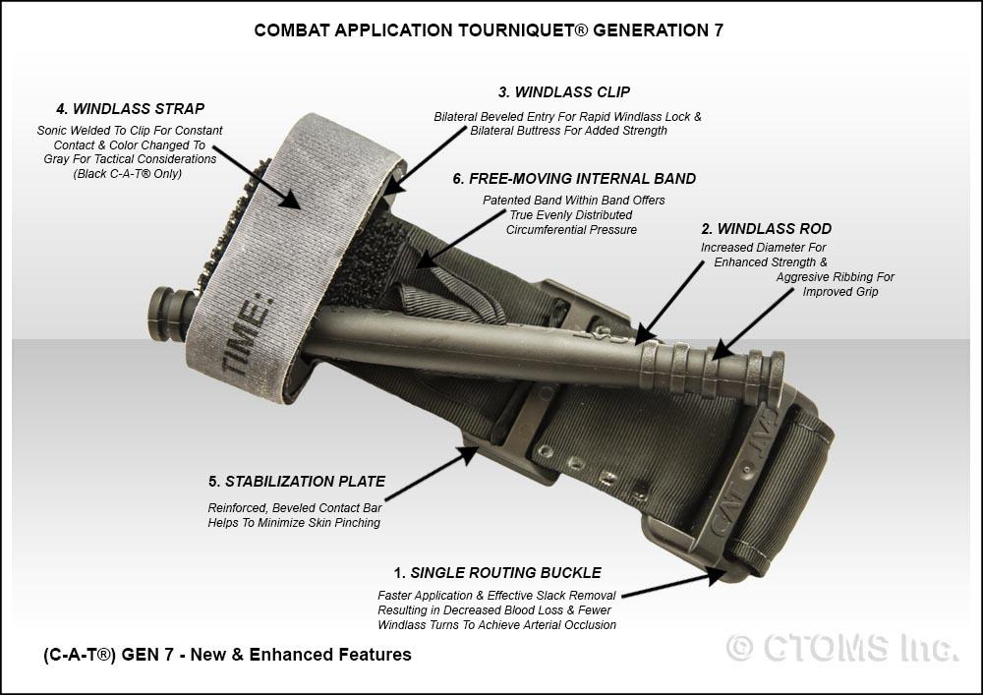
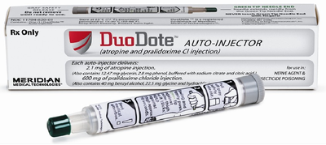
Life-Saving Interventions
Only CORRECT life-threatening problems found during triage
Control major hemorrhage
Open airway
Needle chest decompression
Auto injector antidotes
Pre-positioned for an event?
CHEMPACKS will arrive within 60 minutes of request

Slide 20
Individual Assessment - Assign Category
Triage Categories:
Immediate
Delayed
Minimal
Expectant
Dead

Slide 21
A - Assess
Is the patient breathing?
If not, open airway
If still not breathing, triage to BLACK
If breathing, conduct next assessment

Slide 22
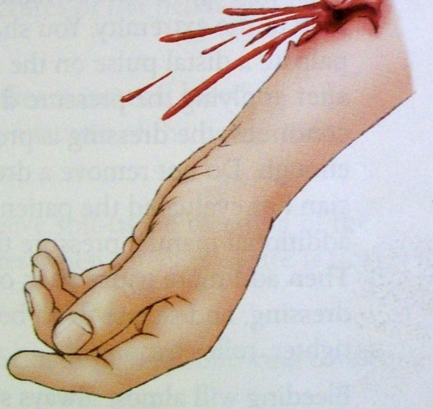
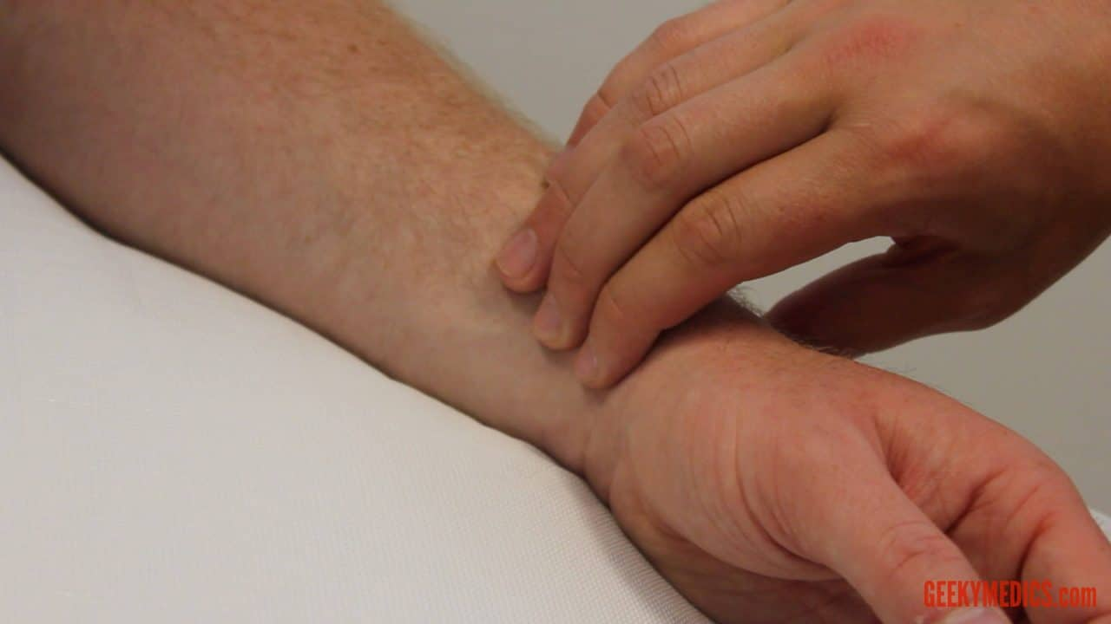
Assess for the following:
Able to follow commands or make purposeful movements?
Respiratory distress?
Uncontrolled hemorrhage?
Palpable peripheral pulse?

Slide 23
Dead
Patient not breathing after opening airway
In Children, consider 2 rescue breaths… (How?)
If still not breathing mark as Dead
Ribbon Dead patients to prevent re-triage
If breathing conduct the next assessment

Slide 24
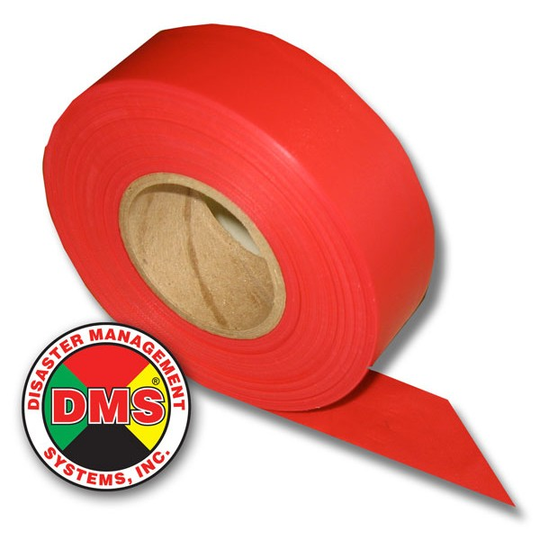
Mnemonics for Assess questions
C – Follows Commands/purposeful?
R – No Respiratory Distress?
A – No (uncontrolled) Arterial bleeding?
P – Peripheral Pulse Present?
“Bad” answer to any one or more?
Pt. is either RED or GRAY

Slide 25
Can usually assess 3 of 4 before even touching patient!
C – Commands /Purposeful movements?
R – Respiratory Distress?
A – Uncontrolled (Arterial) bleeding?
P – Peripheral Pulse Present?

Slide 26
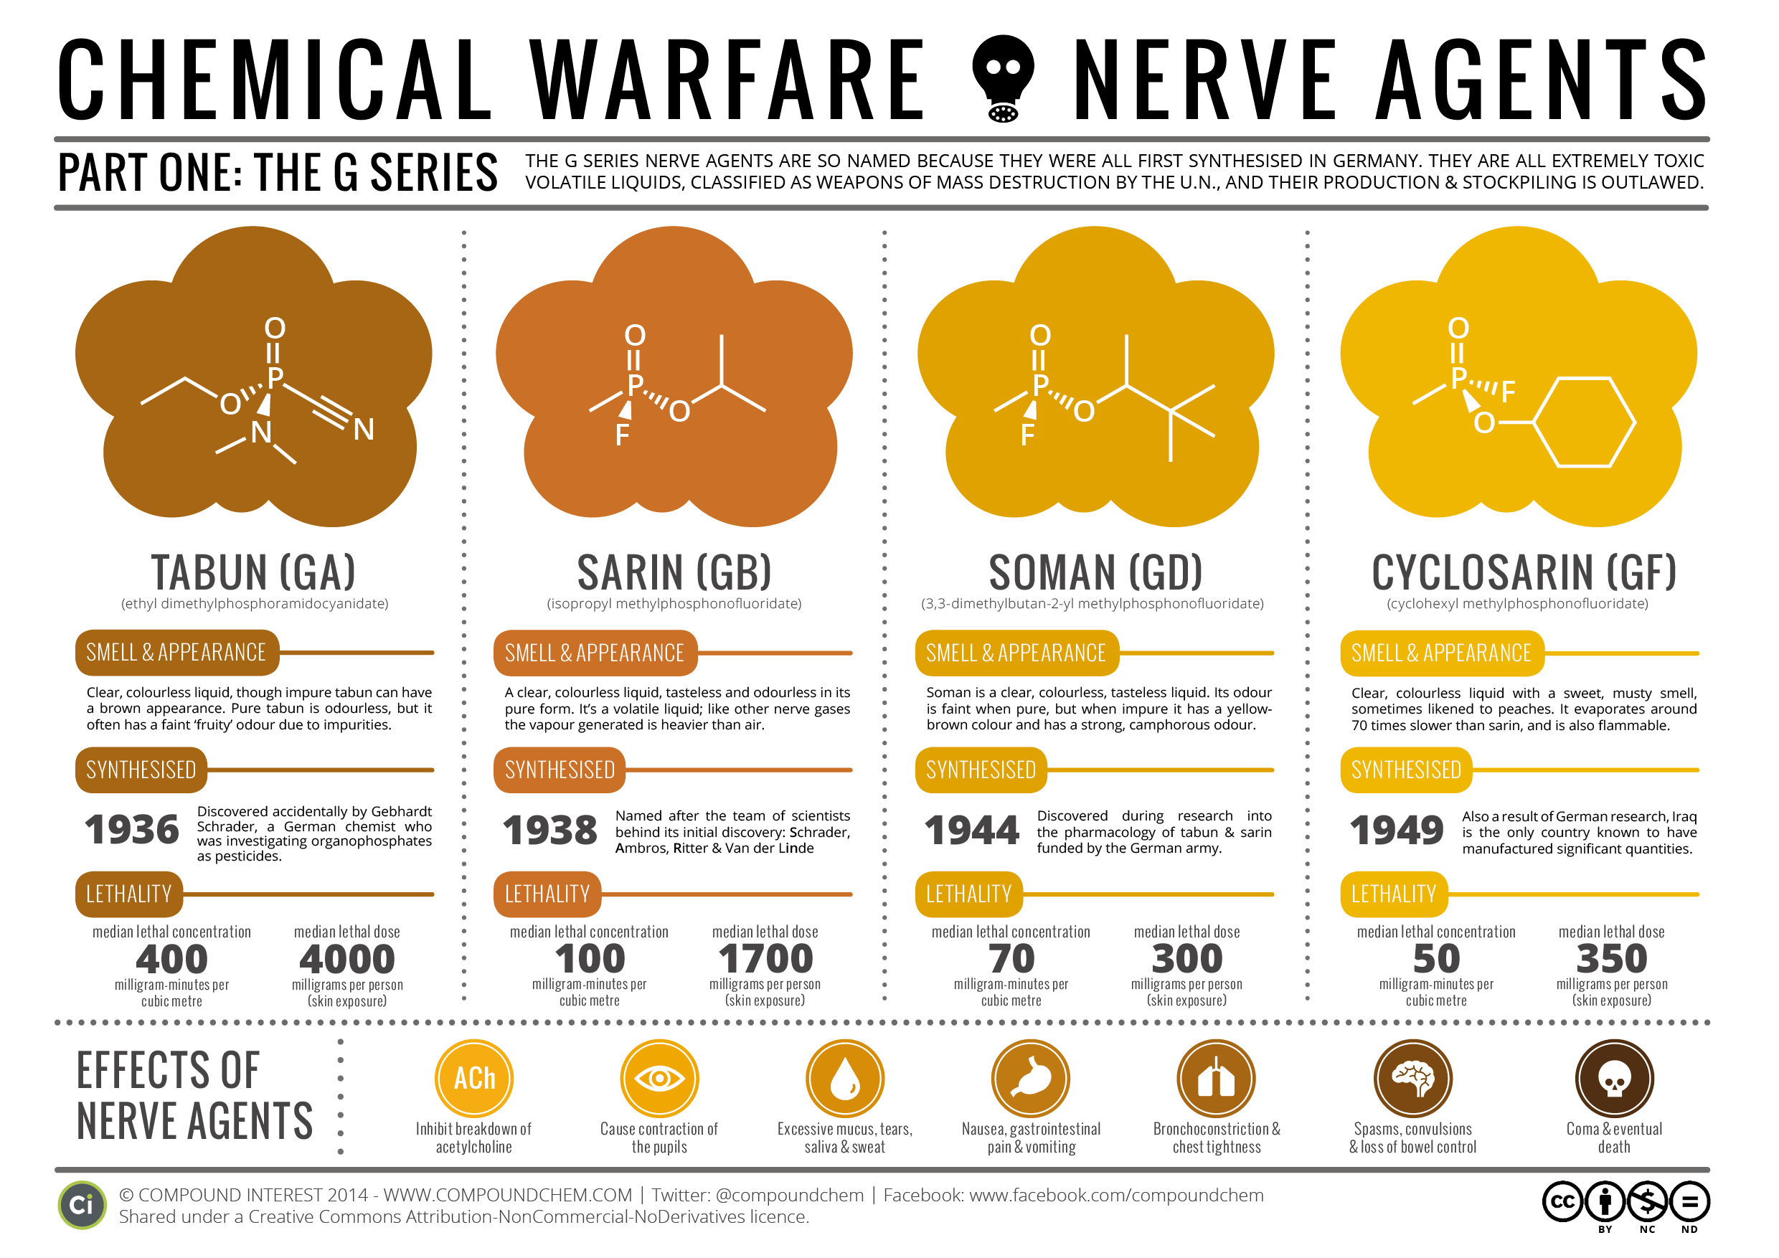
Immediate
Serious injuries
Immediately life threatening problems
High potential for survivability
Examples
Tension pneumothorax
Exposure to nerve agent
Severe shortness of breath or seizures
Photo Source: www.swsahs.nsw.gov.au Public Domain

Slide 27
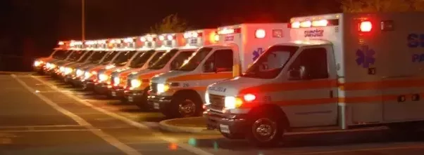
Immediate
“Bad” answer to any of the following:
C – Follows Commands/Purposeful moves?
R – Respiratory Distress?
A – Uncontrolled (Arterial) bleeding?
P – Peripheral Pulse Present?
AND likely to survive given available resources

Slide 28
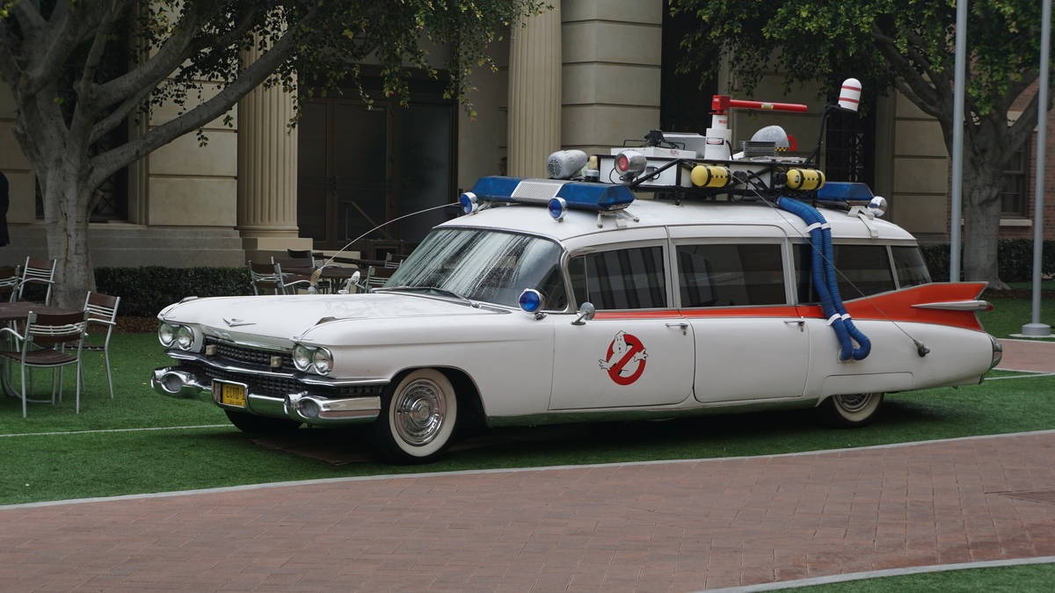
Expectant
“Bad” answer to any of the following:
C – Follows Commands/Purposeful moves?
R – Respiratory Distress?
A – Uncontrolled (Arterial) bleeding?
P – Peripheral Pulse Present?
And UNlikely to survive given available resources

Slide 29
Expectant
Way to preserve resources by taking care of those who are more likely to survive
Extreme injuries or…
Extreme shortage of resources
Poor survivability even with maximal care in hospital or pre-hospital setting
Many of these patients unlikely to survive in best of circumstances
Examples:
90% BSA Burns
Multi-trauma pt. with brain matter extruding

Slide 30
Expectant
DOES NOT MEAN Dead
Means the patient is unlikely to survive given current resources
Important for preservation of resources
Delay treatment and transport until more resources, field or hospital, are available
If delays in the field, consider requesting orders for palliative care
e.g., pain medications, if time and resources allow

Slide 31
Delayed
Serious injuries
Require care but management can be delayed without increasing morbidity or mortality
Examples
Long bone fractures
40% BSA exposure to Mustard gas
Photo Source: Phillip L. Coule, MD

Slide 32
Delayed
Important for preservation of resources
Not “Bad” to all of the following:
C – Follows Commands/Purposeful moves?
R – Respiratory Distress?
A – Uncontrolled (Arterial) bleeding?
P – Peripheral Pulse Present?
Injuries are not Minor and need care

Slide 33
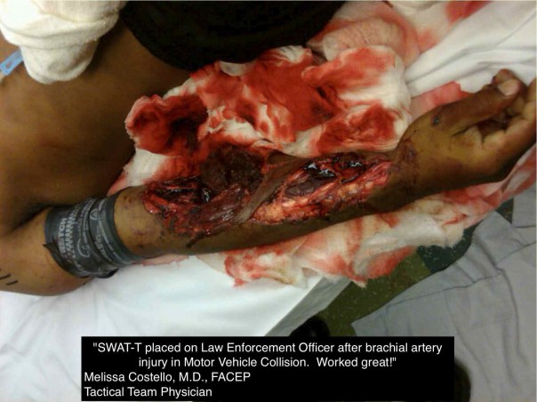
Delayed
On secondary triage, some of these patients will be higher priorities for transport than others:
MI with no dyspnea over long-bone fracture with good distal PMS
Pt. with TK over pt. with minor bleeding

Slide 34
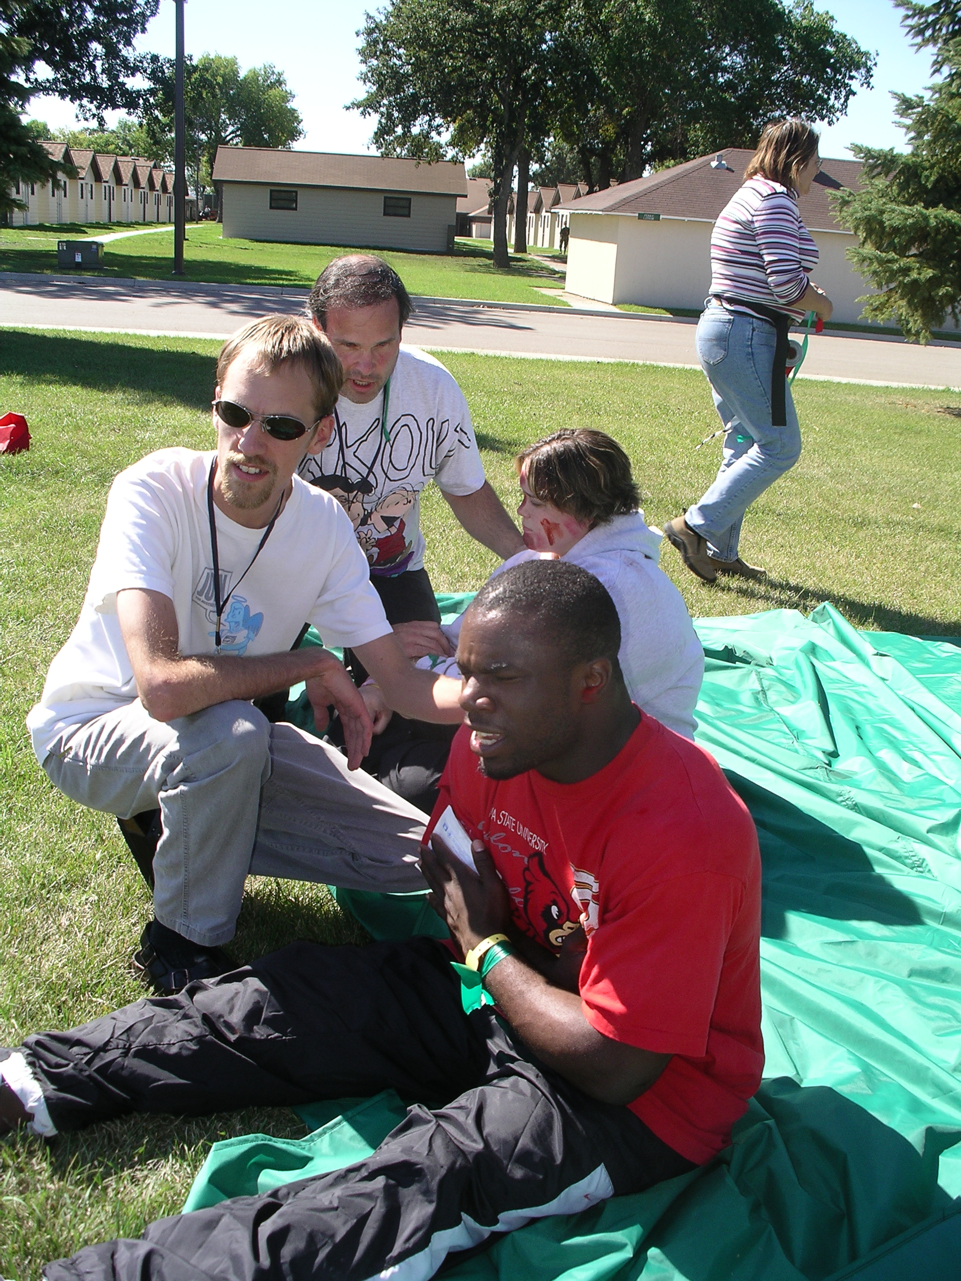
Minimal
“Good” answer to all of the following:
C – Follows Commands/Purposeful moves?
R – Respiratory Distress?
A – Uncontrolled (Arterial) bleeding?
P – Peripheral Pulse Present?
Injuries are Minor
Require minor care or no care
Examples
Abrasions
Minor lacerations
Nerve agent exposure with mild runny nose
Photo source: Phillip L. Coule, MD

Slide 35
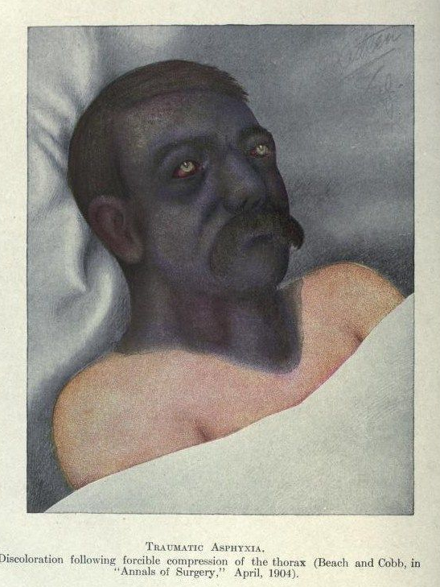
SALT is a clinical guideline, NOT an absolute!
Every MCI is extraordinary – use your clinical judgement
Patients with traumatic asphyxia may start breathing after a few ventilations
In such a situation, e.g., Houston Astroworld Fest, attempt a few ventilations during the LSI step, even in adults
In MCIs due to lightning strikes, pathology can be complex
Consider attempting ventilation or defibrillation, depending on resources and the conditions of other victims

Slide 36
After Patients are Categorized
Prioritization process is dynamic!
Patient conditions change
Correct misses
Resources change
After care/transport has been given to immediate patients
Re-assess expectant, delayed, or minimal patients
Some patients will improve and others will decompensate

Slide 37
Treatment/Transport Priority
In general, treat/transport immediate patients first
Then delayed
Then minimal
Treat/transport expectant patients as resources permit/as pt. condition warrants
In other words, your priority should be to:
“Get the Reds out!”

Slide 38
Treatment/Transport Priority
Efficient use of transport assets may include mixing categories of patients or alternate forms of transport
GREENS with REDS? Empty front seat? Empty seats in the box?
Buses? Other?
However, don’t relocate the disaster to the hospital
GREENS can go to freestanding EDs or distant hospitals
GET ALL TRANSPORTED ASAP!

