Slide 1
Drills and Resources
Section 5

Slide 2
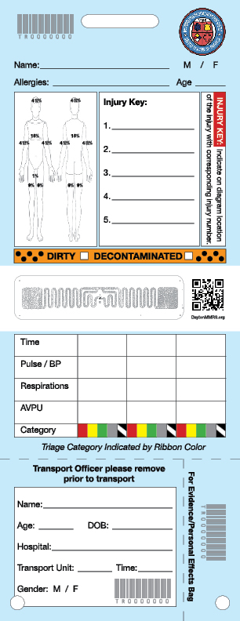
Training – Use Blue Tags, but Real Ribbons!

Slide 3
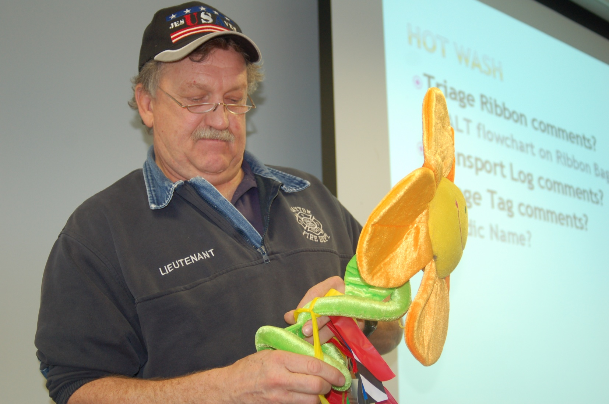
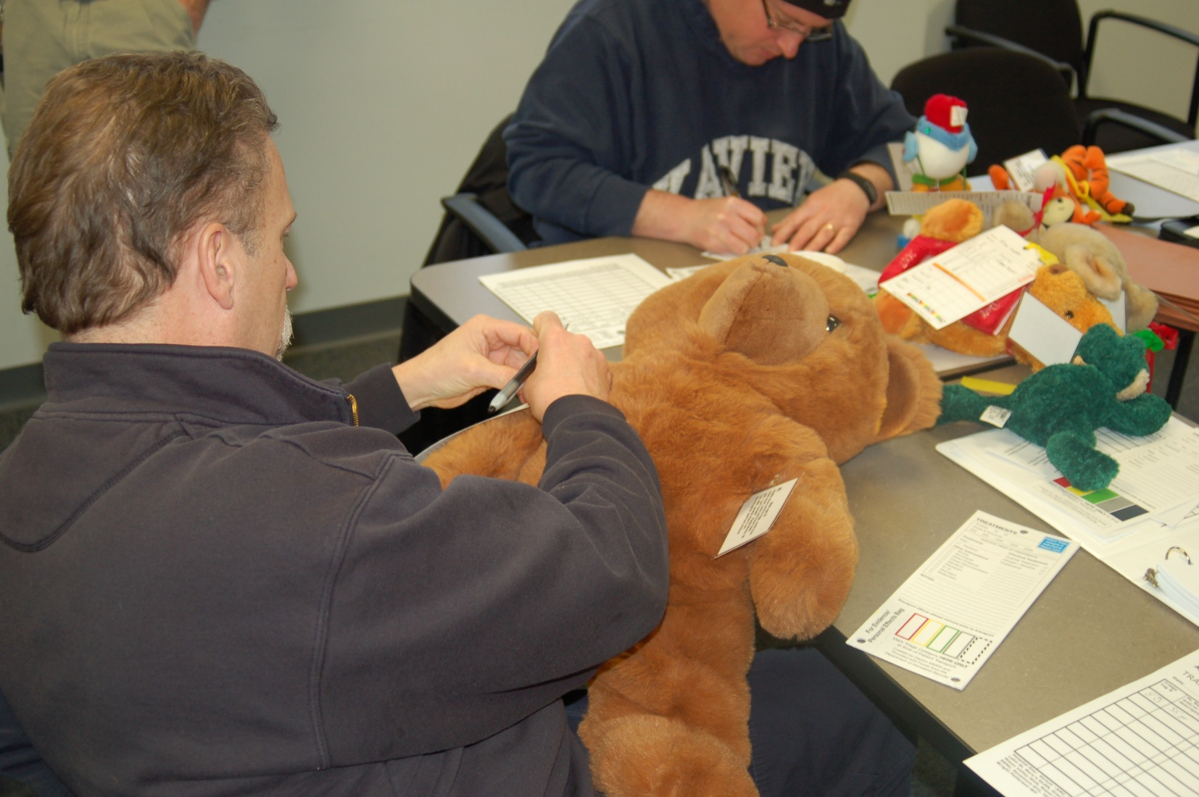
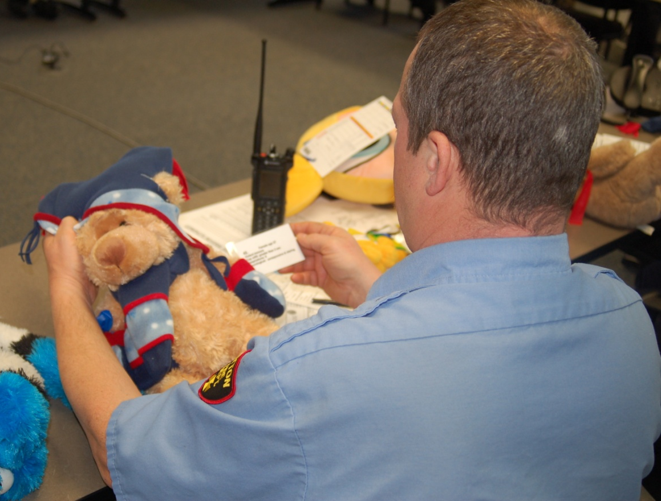

Slide 4
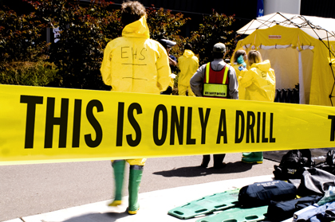
drill Models
“Flashcard” Drill
“Triage & Transport” Drill

Slide 5
First drill
Pair up
Flashcards
Divide up equally
Student A shows scenario side of card to Student B
Student B assigns a category
Student A provides feedback from “Hidden Side”
Room for judgment on some
When complete, rotate cards clockwise and repeat until all cards have been seen by each group.

Slide 6
Second drill: “Triage & Transport”
Artificialities
Use BLUE Training Triage Treatment Tags
Barcodes & Numbers are all the same
Patients are stuffed humanoids!
Expectant?
Consider resources to be somewhat limited

Slide 7
Second drill
Half participants are Triage Officers
Triage one ‘patient’ at a time
Assign a category, and place a triage ribbon
Deliver patient to Treatment Officer
Get another ‘patient’ until half are gone
Half participants are Treatment Officers
For each patient received, the Treatment Officer will:
Apply and complete a Treatment Tag
Assign them to Treatment Areas
RED / YELLOW / GREEN / BLACK (ORANGE?)
Then repeat drill, with reversed roles
Once complete? Hold a short “Hot Wash”

Slide 8
But WAIT, there's more! Treatment/Transport/Aide
Student pairs:
Treatment Officer & Transport Officer (and Aide?)
Using all of the ‘humanoids’ you both previously collected…
First step:
Quickly complete your Transport Log (Facilitator will read them off one-by-one)
Tear off bottom of tag and give to facilitator
Once complete?
Second step:
Using your Transport Log assign all 36 victims to 18 on-scene ambulances and 4 on-scene helicopters
Allocate these ambulances to HOSPITALS based on SURGENET data on the NEXT SLIDE.

Slide 9
FAC | Receiving Capacity |  |  |  |  | Patients Received? |  |  |  |  | Capability? |  |  | Last Update?
 | R | Y | G | B |  | R | Y | G | B |  | OB | PEDS | DECON
Atrium | 2 | 4 | 6 | 3 |  | 0 | 0 | 0 | 0 |  | Y | Y | Y | 9/14/2022 4:42 PM
DCH | 2 | 9 | 23 | 1 |  | 0 | 5 | 21 | 1 |  | N | Y | Y | 9/14/2022 4:42 PM
GView | 4 | 4 | 3 | 36 |  | 0 | 2 | 9 | 0 |  | N | N | Y | 9/14/2022 4:42 PM
Greene | 2 | 6 | 12 | 2 |  | 0 | 0 | 0 | 0 |  | N | N | Y | 9/14/2022 4:42 PM
Soin | 2 | 5 | 8 | 2 |  | 0 | 1 | 4 | 0 |  | Y | N | Y | 9/14/2022 4:42 PM
JTDMH | 2 | 8 | 10 | 2 |  | 0 | 0 | 0 | 0 |  | Y | Y | Y | 9/14/2022 4:42 PM
KMC | 6 | 8 | 0 | 10 |  | 0 | 6 | 23 | 0 |  | Y | N | Y | 9/14/2022 4:42 PM
MM-Urb | 2 | 6 | 12 | 2 |  | 0 | 0 | 0 | 0 |  | Y | N | Y | 9/14/2022 4:42 PM
MVH | 18 | 4 | 0 | 10 |  | 0 | 6 | 37 | 0 |  | Y | N | Y | 9/14/2022 4:42 PM
MVH-N | 4 | 6 | 5 | 6 |  | 0 | 2 | 7 | 0 |  | N | N | Y | 9/14/2022 4:42 PM
MVH-S | 4 | 5 | 10 | 6 |  | 0 | 3 | 2 | 0 |  | Y | N | Y | 9/14/2022 4:42 PM
SView | 4 | 10 | 15 | 10 |  | 0 | 0 | 0 | 0 |  | Y | N | Y | 9/14/2022 4:42 PM
SRMC | 2 | 8 | 20 | 6 |  | 0 | 0 | 0 | 0 |  | Y | Y | Y | 9/14/2022 4:42 PM
Sycam | 2 | 6 | 12 | 2 |  | 0 | 0 | 0 | 0 |  | N | N | Y | 9/14/2022 4:42 PM
UVMC | 4 | 8 | 12 | 10 |  | 0 | 0 | 0 | 0 |  | Y | N | Y | 9/14/2022 4:42 PM
Wayne | 2 | 4 | 10 | 2 |  | 0 | 0 | 0 | 0 |  | N | N | Y | 9/14/2022 4:42 PM
Wilson | 0 | 4 | 8 | 2 |  | 0 | 0 | 0 | 0 |  | Y | Y | N | 9/14/2022 4:42 PM
WPAFB | 2 | 4 | 6 | 2 |  | 0 | 0 | 0 | 0 |  | Y | N | Y | 9/14/2022 4:42 PM

Slide 10
MCI Communications Quarterly Triage Day Drills
Agreed on by GDAHA Domestic Preparedness Coalition, GMVEMSC, MVFEA, GMCFCA, et al
24 hours each quarter
Day of week different each quarter so all ED & EMS personnel have opportunities to participate
Day selected each quarter by GDAHA Communications Committee
Communicated to all hospitals and EMS agencies
Includes Ribbons, “Treatment” Tags, MCI Radio Talk Groups, Surgenet MCI webpage, OHTrac
OPPORTUNITY FOR US ALL TO WORK TOGETHER

Slide 11
Today’s Drill
Final hot wash
THANK YOU FOR PARTICIPATING!!

Slide 12
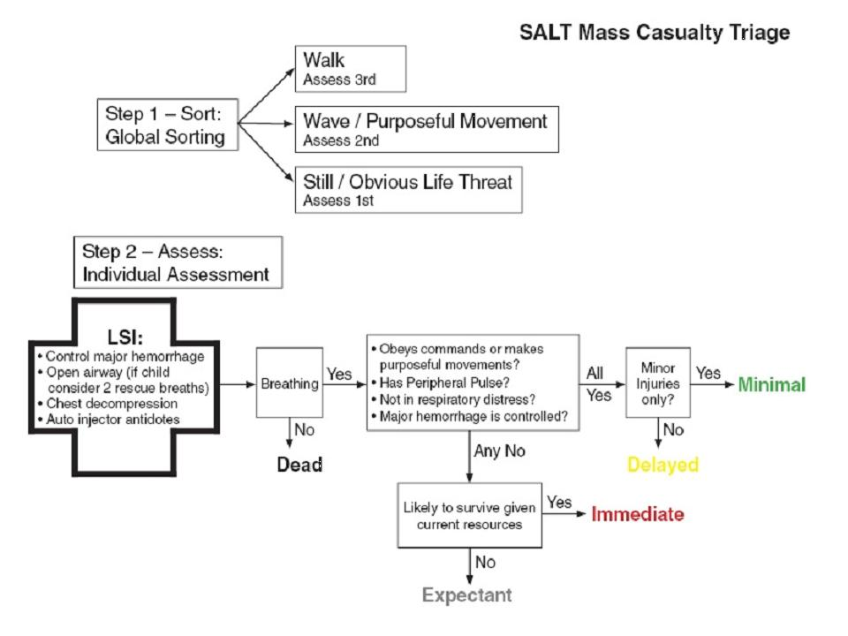
Questions?
Notes:
be prepared to respond on lightning strikes and cyanide.

