Slide 1

MCI SALT Triage/Ribbon Review
Why
When
how
Notes:
Hello. This presentation is an overview/review of how and when to use triage ribbons as well as MCI SALT Triage.

Slide 2
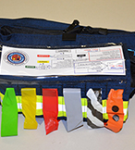
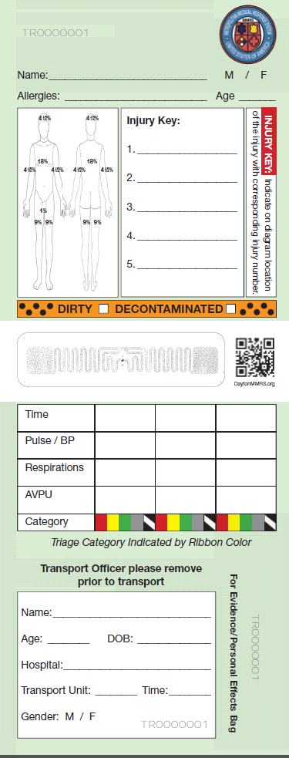
Overview
Green (minimal) – “walking wounded”
Yellow (delayed) – expected to survive until definitive care can be rendered later
Red (immediate) – critically injured and require immediate intervention to sustain viability
Grey (expectant) – expected to not survive given current circumstances
Zebra (deceased)
Orange Spotted (contaminated) – use in addition to another color to indicate contamination with hazardous material
Sort, Assess, Life-saving interventions, Treatment/Transport (SALT)
Notes:
Let’s start with an overview of the triage categories. First you have your greens, the minimally injured. Next are the yellows who are expected to survive but need to receive definitive care eventually. Next are the reds, these patients are your critically injured and require immediate intervention. The grey category is for patients who are not expected to survive given current circumstances. The zebra striped ribbons are for your deceased patients in the black triage category. And finally, the orange spotted ribbon is for your contaminated patients. This ribbon is used with another ribbon to indicate contamination with hazardous material. And then of course, the triage system we use is SALT which stands for Sort, Assess, Life-Saving interventions, Treatment/Transport.

Slide 3
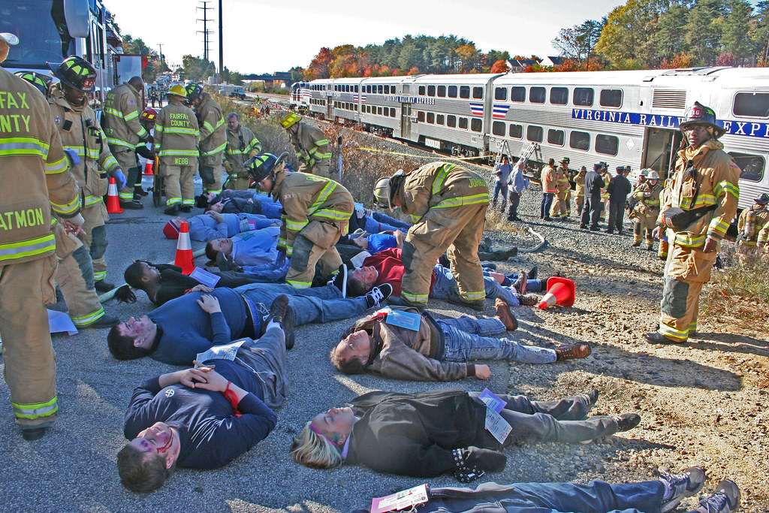
Why
  Severity
  Organize transport priority
  Black ribbons important so no time is wasted by other crews on patients beyond help
Notes:
Why do we use ribbons? The ribbons help indicate which patients have been primarily assessed, help organize patients based on severity, and help organize transport priority. The black ribbons are important so that no time is wasted on patients beyond help.

Slide 4
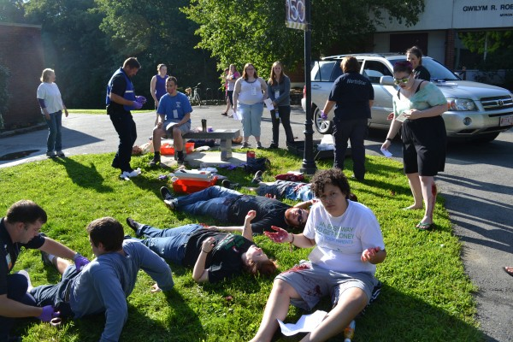
When
  In an MCI initial triage is vital to operational organization and patient care
    Move as quickly and safely as possible
    Re-triage patients; revise triage category as indicated
    Over-triage can be as harmful as under-triage
    Triage should not delay treatment/transport, especially of red patients
Notes:
When do we use triage ribbons? During MCIs it’s vital to operational organization to use the ribbons.
If you mark too many patients red that might actually be yellow or green, you will delay care for the actual red patients.
Triage should not delay treatment/transport.

Slide 5
When Continued
  Ribbons are put on every patient during the initial triage
    Tie triage ribbon to an upper extremity (right wrist if possible)
    Change ribbon color if/when patient condition changes (e.g., yellow to red) but keep the same tag
  Secondary triage should occur often, including when patients are moved into CCP or Treatment Area and prior to transport
    Treatment tags should be applied after patients enter CCP or in the Transport Area or during Transport

Slide 6
How (Global Sorting)
  Walk - “If you can hear me, move to [designated area] and we will help you”
    Must be re-triaged ASAP
    Assess this group third
    Moves ambulatory patients into a group quickly
    Assign someone to keep them together and notify IC or EMS Group/Branch of # and location
  Wave - “If you need help, wave. We will come help as soon as possible”
    Assess this group second
  Still - Anyone who didn’t walk/wave or has an obvious life threat is assessed first

Slide 7
How (Assessment)
  Is the patient breathing? If yes…
  Assess for the following (CRAP Questions)
    Commands – Can the patient obey commands or make purposeful movements?
    Respiratory – Is the patient not in respiratory distress?
    Arterial – Is all major hemorrhage controlled?
    Pulse – Does the patient have a peripheral pulse?
  If no to any of those questions (or bad), patient is either red, grey, or black
  If yes to all those questions, patient is either yellow or green
Notes:
Really your first observations are the start of your assessment. Is there any major hemorrhage, does the patient have an open airway, etc?

Slide 8
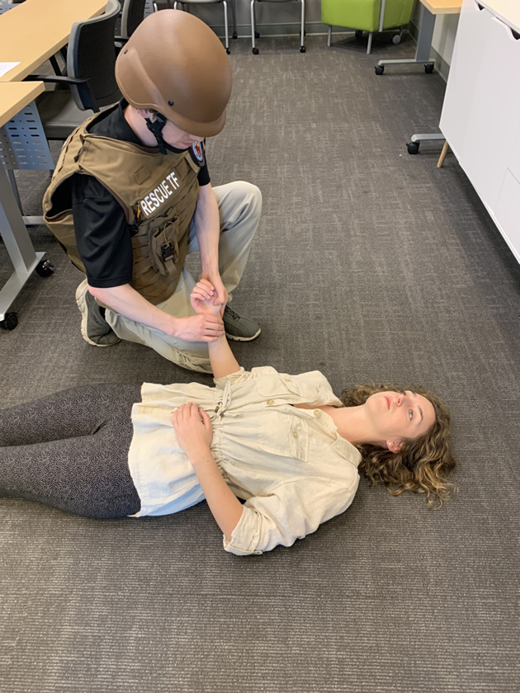
CRAP
Can usually assess 3 of 4 before even touching patient!
7-8 seconds:
C – Commands/Purposeful movements?
R – Respiratory Distress?
A – Uncontrolled (Arterial) Bleeding?
P – Peripheral Pulse Present?
“Bad” answer to any and patient is likely to survive given available resources -> RED

Slide 9
How (LSI)
  Life Saving Interventions (LSIs) are the things providers can do immediately to help patients survive
  LSIs should not delay triage and are the only interventions that should be done during triage
  Control major hemorrhage
    Direct pressure, tourniquet, etc.
  Open airway
    If child, consider 2 rescue breaths
  Needle chest decompression
  Auto injector antidotes

Slide 10
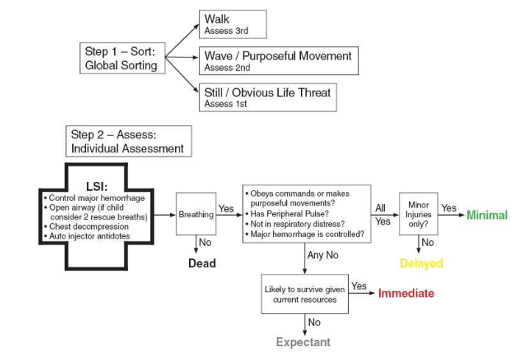

Slide 11
How (Treatment/Transport)
  Treatment Area or Transport Group personnel determine transport priority
  DO NOT overload any one hospital
    Consider using Juvare EMResource to monitor hospital triage capabilities
  Transport priority is (typically) given in order of survivability/severity:
    RED (Immediate)
    YELLOW (Delayed)
    GREEN (Minimal)
    GREY (Expectant)
  Transport priority can depend on # of patients, amount of resources, and other factors
  MCIs are never normal events, always use your best clinical judgement

