Slide 1
MCI Communications Between EMS and Hospitals
Radio Channels

Slide 2
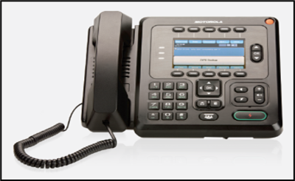
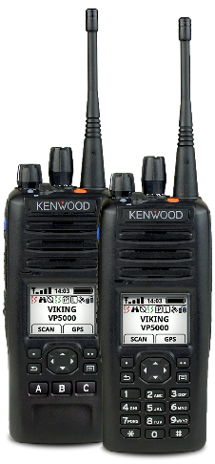
Radios
During an incident, hospitals turn on and monitor MCI talkgroup (TG)
MCI MARCS - additional hospital ED radio to be used solely in an MCI
HSR3-MCI (Dayton Region) and HSR6-MCI (Cincinnati Region) MARCS Radio Talk Groups in your radio template
KNOW WHERE TO FIND IT
The two talkgroups can be patched together by Dispatch Centers

Slide 3
Radio Reports
During an MCI, Medic Units DO NOT “CALL-IN” to ED with REPORT!
ONLY the TRANSPORT Officer/Aide does this
For QTD we ask medic crews to make MCI reports, so everyone understands what is expected during an MCI
(there are exceptions)

Slide 4
Radio Reports Continued
MCI Reports by Transport Officer or Transport Comm Aide
Short, sweet, to the point
>95% of EMS communication during MCIs should come from Transport Officer or Transport Comm Aide
Ex) “St. Medicine ED there is a red patient with a GSW to the abdomen arriving at your ED in approx. 10 minutes.”

Slide 5
HSR3-MCI & HSR6-MCI Benefits & Use
Notify each hospital of patients they will receive
Provide ALL hospitals with a “common operating picture”- simultaneously
Hospitals can ask questions about incident over HSR3 Radio Talk Group
No alerts on MCI Talk Groups! Use RHNS!
MCI Communications Job Aid

Slide 6
