Slide 1
Eclipse Planning
Monday, April 8, 2024
MMRS 8/30/23

Slide 2
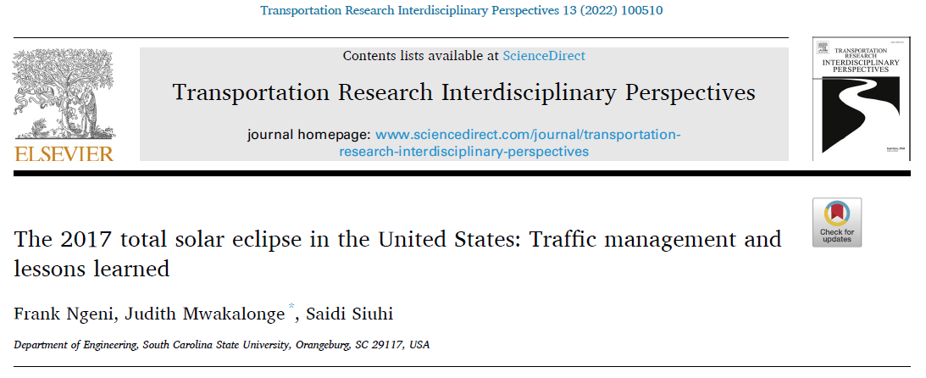
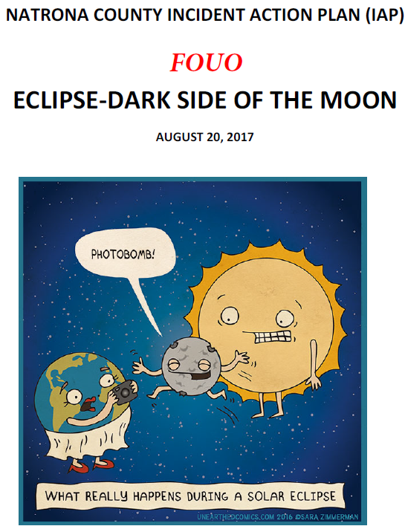
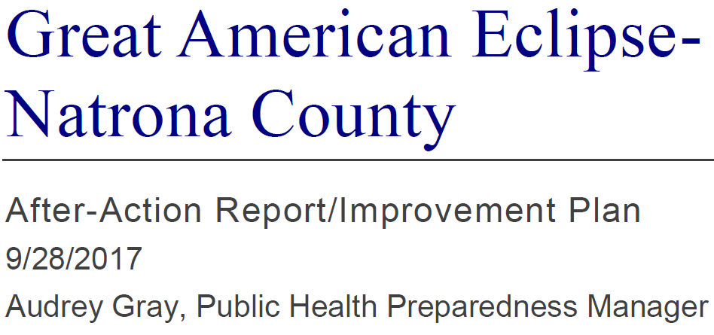

Slide 3
Arrive Early,
Stay Late

Slide 4
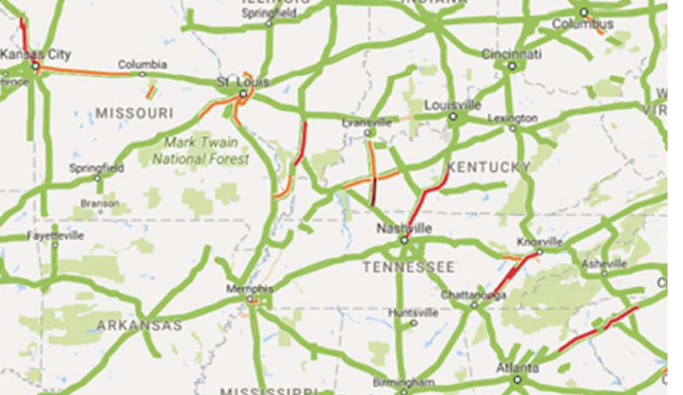
3:30 pm, 45 minutes after totality

Slide 5
Traffic Flow
Eclipse began at 10:21 am.
Screenline, Wyoming Aug 21-22, 2017

Slide 6
Traffic Flow
Some interstates had traffic congestion / slow speeds up to 13 hours after totality.
Rural, non-freeway routes also experienced significant traffic congestion.
INRIX showed 4 of top 5 bottleneck locations measured by duration & length of queue were non-freeway routes.
These 4 had congestion 7 – 15.5 hours, and max queue lengths at 3 locations ranged from 45 – 70 miles.

Slide 7
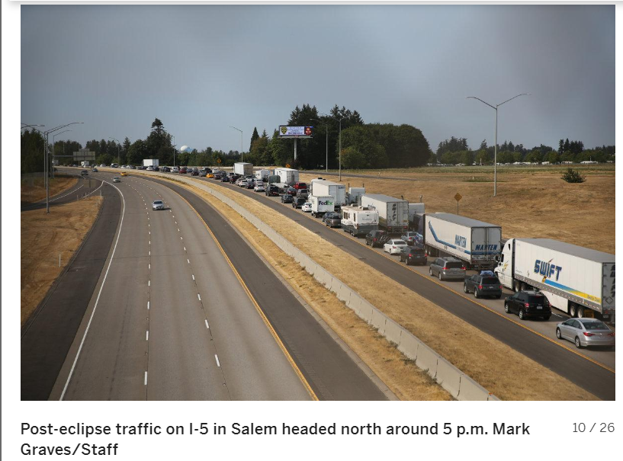

Slide 8
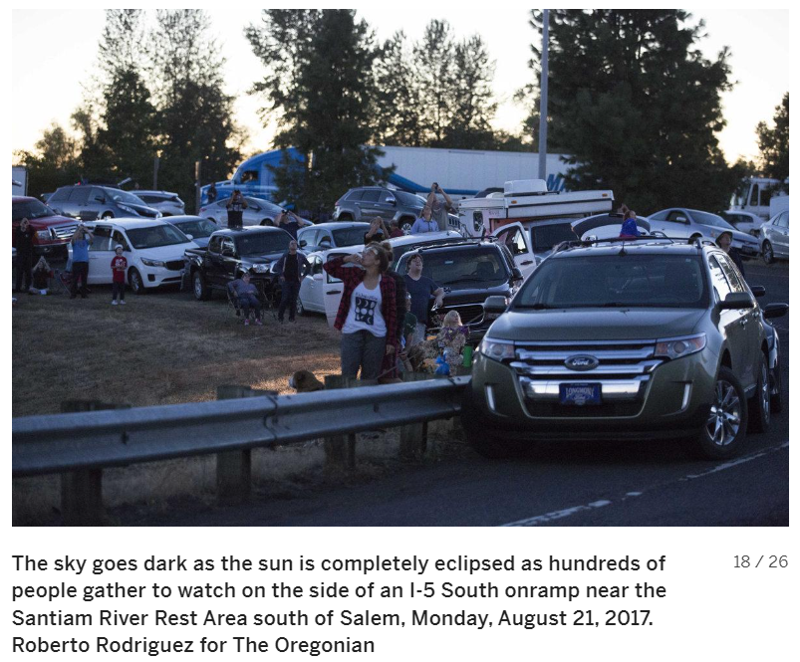

Slide 9
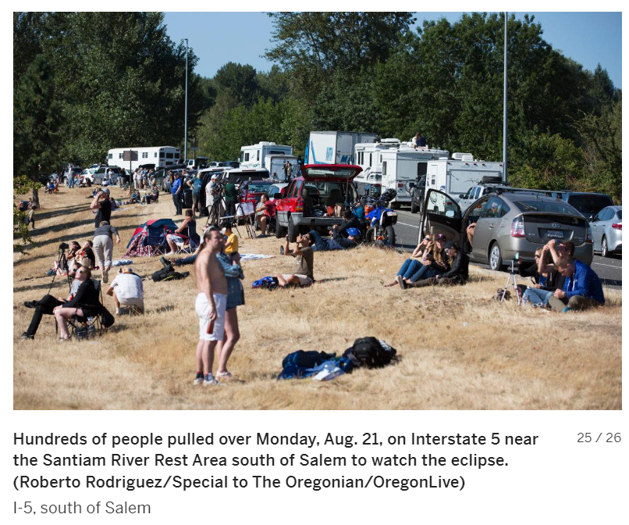

Slide 10
First Responder Impacts
Extended travel times for emergency response
Callers not knowing where they are
Possible temporary campground not well organized, and no signs…
Incident at a temporary campground, 75 yards off road, with no “road” to get back there
“Stage” equipment around jurisdiction?
Limited mutual aid from other counties, and within the county

Slide 11
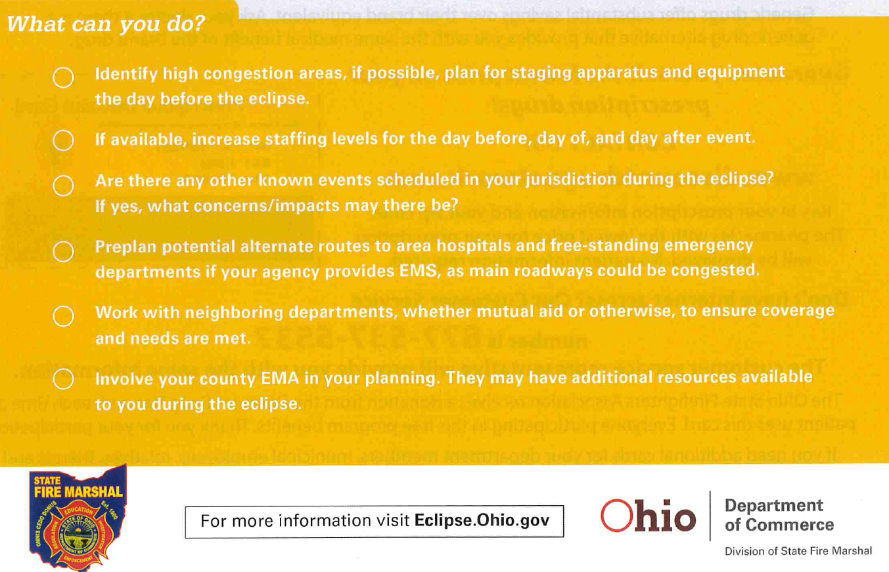
Fire Marshal’s Office

Slide 12
Communication
Possibility for Cell Phones & Wi-Fi to be significantly impacted
Ability for public to place 911 calls could be impacted
Ability to use mapping apps
Promote having a hard copy map
People getting lost, we want them to exit as quick as possible
Ability to use credit cards or features like Apple Pay
Or may just operate very slowly
Have cash, ATMs may be an issue, businesses have extra change

Slide 13
Communication – Radio Specific
State will have an ICS-205 Comm Plan
Have / SHARE Local ICS-205 Comm Plan
Tower loading an issue, especially if ambulances can’t “call” hospitals, moves more traffic to MARCS
Promote agencies acquire GETS/WPS cards if they don’t already have them, to assist with load reduction on system
Make sure phones are in WPS
Review FirstNet & Verizon Frontline setup
Amateur Radio involvement
Frequent reporting of traffic status

Slide 14
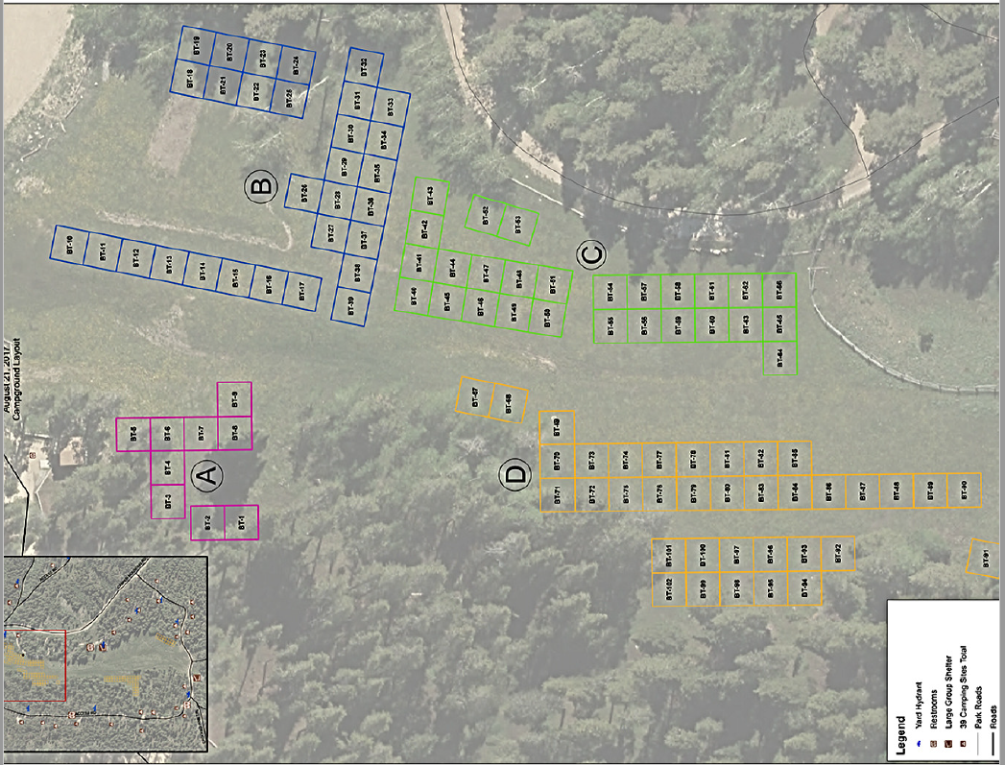
Temporary Campground Example

Slide 15
Health Dept Concerns
Temporary Camp Sites
Permits so we know how many, and where campers will be
Potable Water
Restrooms
Trash
Could have significant amount of
Temporary Food Permits / Registration
Food Service Operation Inspections (Food Trucks, Mobiles)

Slide 16
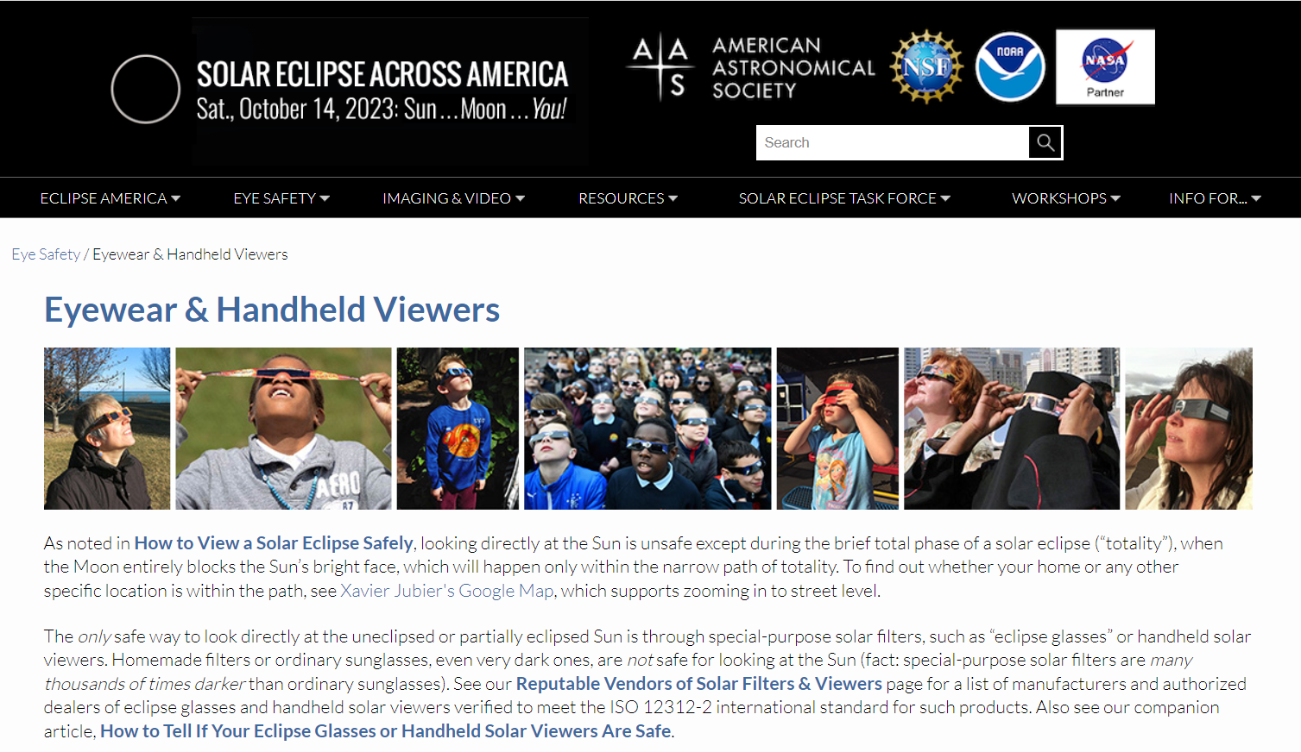
https://eclipse.aas.org/eye-safety/eyewear-viewers
Do not use old glasses / viewers, as lens may have deteriorated

Slide 17
