Slide 1
Regional Hospital Notification System
How
Why
When

Slide 2
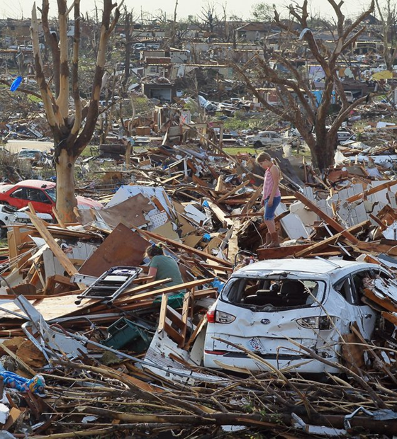
Overview
Activation number for EMS, Hospitals, and EMAs to call
Rapid, simultaneous notifications during MCI or other major emergency
Use whenever an incident could potentially involve a significant number of region’s hospitals
EMAs can use for events spanning multiple jurisdictions (e.g., tornadoes)
Use to alert hospitals that patients will need decon
Also use to indicate no need for action and other major events
Montgomery County Regional Dispatch Center (RDC) puts out computerized message

Slide 3
Hospitals
Numbers called at each hospital were chosen by that hospital
Emergency messages on cell phones should get both text and voice (if one system down, other may go through)
RHNS Messages
All EDs in our region (and some outside our region)
Alerts hospitals plus Regional Coordinators, EMAs, etc.
RHNS is tested monthly and during most area exercises

Slide 4
RHNS
RHNS is a critical system. Both EMS and hospitals should give high priority to activating it.
Triggers hospitals to be ready and clarifies what they might have heard on media/social media
Triggers EDs to start considering which patients in their EDs could be discharged
Triggers EDs to start monitoring the MCI Radio Talks Groups (which do not have alerts)

Slide 5
Activation
EMS, fire, hospitals, EMAs, and Dispatch Centers
To activate RHNS call 937-333-USAR (8727)
The agency calling must ask for a Dispatch Supervisor, request a “Regional Hospital Notification”, and use the phrase “Mass Casualty Page Hospitals”. Then provide the following:
Name of agency
Nature and locationof emergency
General statement on severity, such as approximate number of victims
Any other information to be conveyed
RDC will immediately put out an RHNS message with the information provided

Slide 6
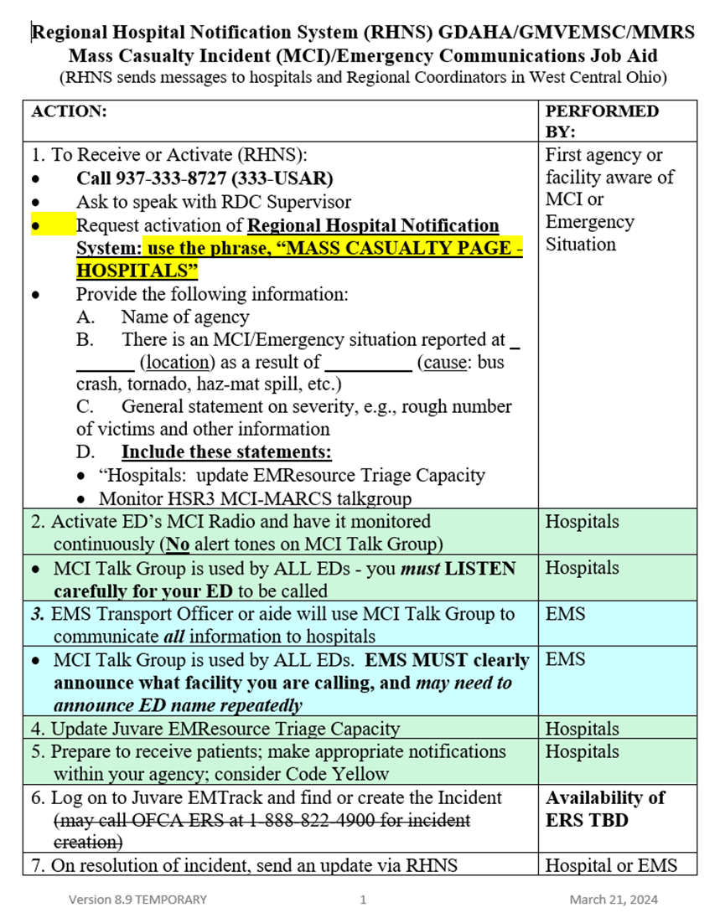
Job Aid
Sent to all hospitals, EMS, and dispatch agencies in region
Transport Officer clipboard on each apparatus should have a copy of the Job Aid
Every ED and EMA should have the Job Aid posted
Provides personnel with everything needed to activate RHNS
On both GDAHA & Dayton MMRS websites

