Slide 1
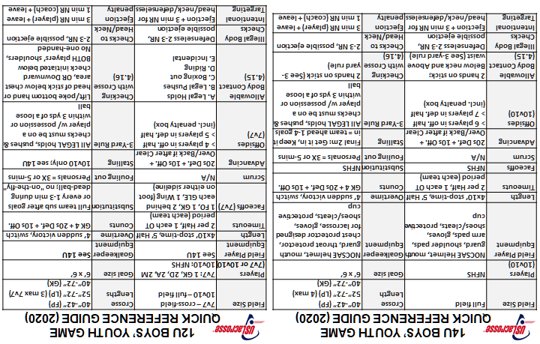

10U BOYS’ YOUTH GAME
QUICK REFERENCE GUIDE (2020)
8U BOYS’ YOUTH GAME
QUICK REFERENCE GUIDE (2020)
Field Size | L: 60-70 yds W: 35-45 yds (Cross-Field) | Crosse Lengths | (FP) 37”-42” (GK) 37”-54” (LP) 47”-54” (3 max)
Players (6v6 or 7v7) | 1 GK, 5 or 6 field players | Goal size | 6’ x 6’
Field Player Equipment | See 14U | Goalkeeper Equipment | See 14U
Length | 4x10’ Running, 5’ Half | Overtime | None
Timeouts | None. Officials only | Counts | 4-sec GK only; no advance
Faceoffs | 1 FO, 1 GK, 2 behind each GLE, 7v7 adds 1 Wing (foot on either SL) | Substitution | Full team sub after goals or every 1-3 min during dead-ball; no "on-the-fly"
Scrum | Extended w/3 or more players, use A/P | Fouling out | Personals = 3X or 5-mins
Advancing | Not used | Stalling | Not used
Offsides | 6v6 – none 7v7 – yes, >4 on offense, or >5 on defense (incl. penalty box) | 3-Yard Rule | All LEGAL holds, pushes & checks must be on a player w/ possession or within 3 yds of a loose ball
Allowable Body Contact (4.15) | A. Legal Holds B. Legal Pushes C. Boxing out D. Riding E. Incidental | Checking with Crosse (4.16) | Lift/poke bottom hand or head of stick below chest area, OR Downward check initiated below BOTH players’ shoulders, No one-handed
Illegal Body Checks | Defenseless 2-3 NR, possible ejection | Checks to Head/Neck | 2-3 NR, possible ejection
Intentional Targeting | Ejection + 3 min NR for head/neck/defenseless | Ejection penalty | 3 min NR (player) + leave 1 min NR (coach) + leave
Field Size | L: 60-70 yds W: 35-45 yds (Cross-Field) | Crosse Length | (FP) 37”-42” (GK) 37”-54” (LP) None
Players (4v4) | 1 GK, 3 field players | Goal size | 3’ x 3’ (preferred) 6’ x 6” (allowable)
Field Player Equipment | See 14U | Goalkeeper Equipment | See 14U
Length | 2x12’ Running, 4’ Half | Overtime | None
Timeouts | None. Officials only | Counts | 4-sec GK only; no advance
Faceoffs | No FO; Coin flip winner Center-X. Others on own def. half >5 yds from each other. Other team ball start 2nd half. | Substitution | Full team sub after goals or every 1-3 min during dead-ball; no "on-the-fly"
Scrum | Extended w/3 or more players, use A/P | Fouling out | Personals = 3X or 5-mins
Advancing | Not used | Stalling | Not used
Offsides | None | 3-Yard Rule | All LEGAL holds, pushes & checks on a player w/ possession or within 3 yds of a loose ball
Allowable Body Contact (4.15) | A. Legal Holds B. Legal Pushes C. Boxing out D. Riding E. Incidental | Checking with Crosse (4.16) | Lift/poke bottom hand or head of stick below chest area, OR Downward check initiated below BOTH players’ shoulders, No one-handed
Illegal Body Checks | Defenseless 2-3 NR, possible ejection | Checks to Head/Neck | 2-3 NR, possible ejection
Intentional Targeting | Ejection + 3 min NR for head/neck/defenseless | Ejection penalty | 3 min NR (player) + leave 1 min NR (coach) + leave

Slide 2
Instructions for creating the Quick Reference Guide for boys’ youth lacrosse:
Open PowerPoint.
Open the file containing the QRC.
Print slide 1 of the file onto standard-sized 8.5x11’ paper.
Fold the page along the short dotted line to create two halves of the paper.
Fold the page again along the other dotted line to create a book.
Trim the excess paper on the sides and bottom of the book (leave the top edge untrimmed or the QRC will fall apart), which will produce a card that is approximately 3.75” wide and 4.75” tall.
You are done.
Note: You might want to laminate the card, if you want to protect it from rain or sweat. The QRC fits nicely into a front shirt pocket or the back pocket of pants/shorts.

Slide 3
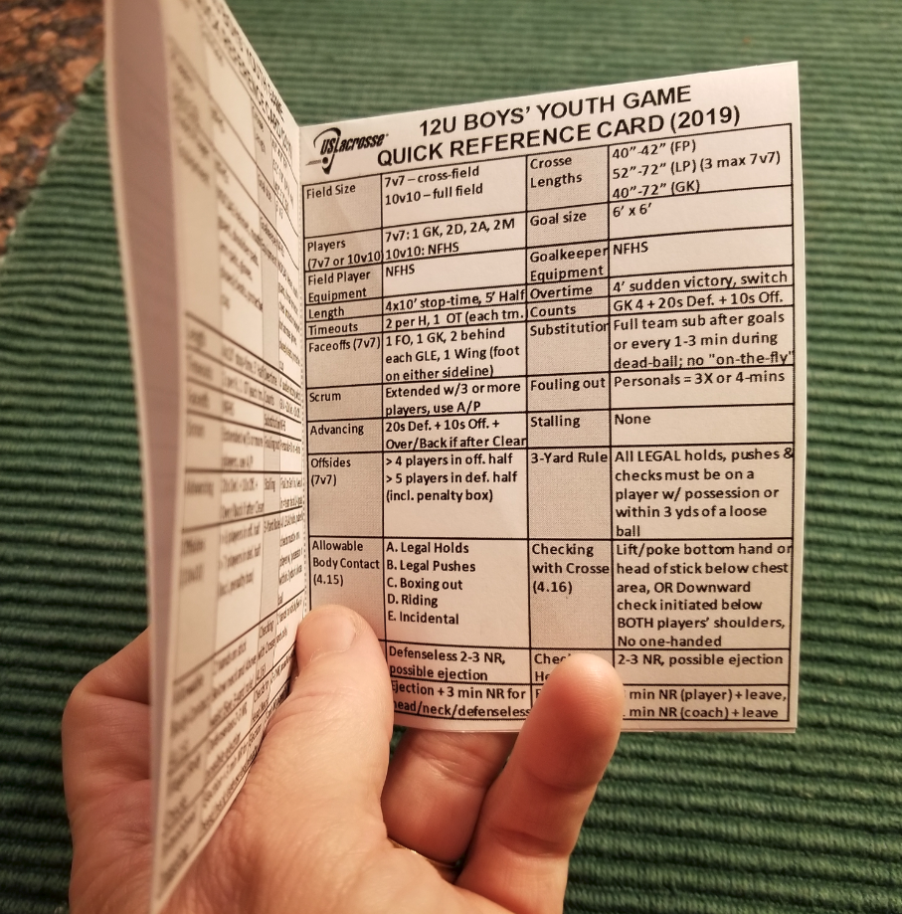
QRC folds twice for a nice front-and-back book-style design

Slide 4
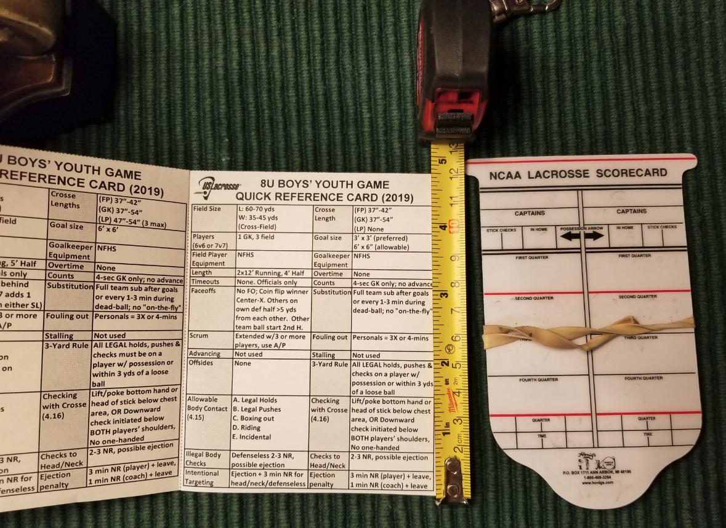
QRC (at 4.75” tall) is shorter than an NCAA scorecard

Slide 5
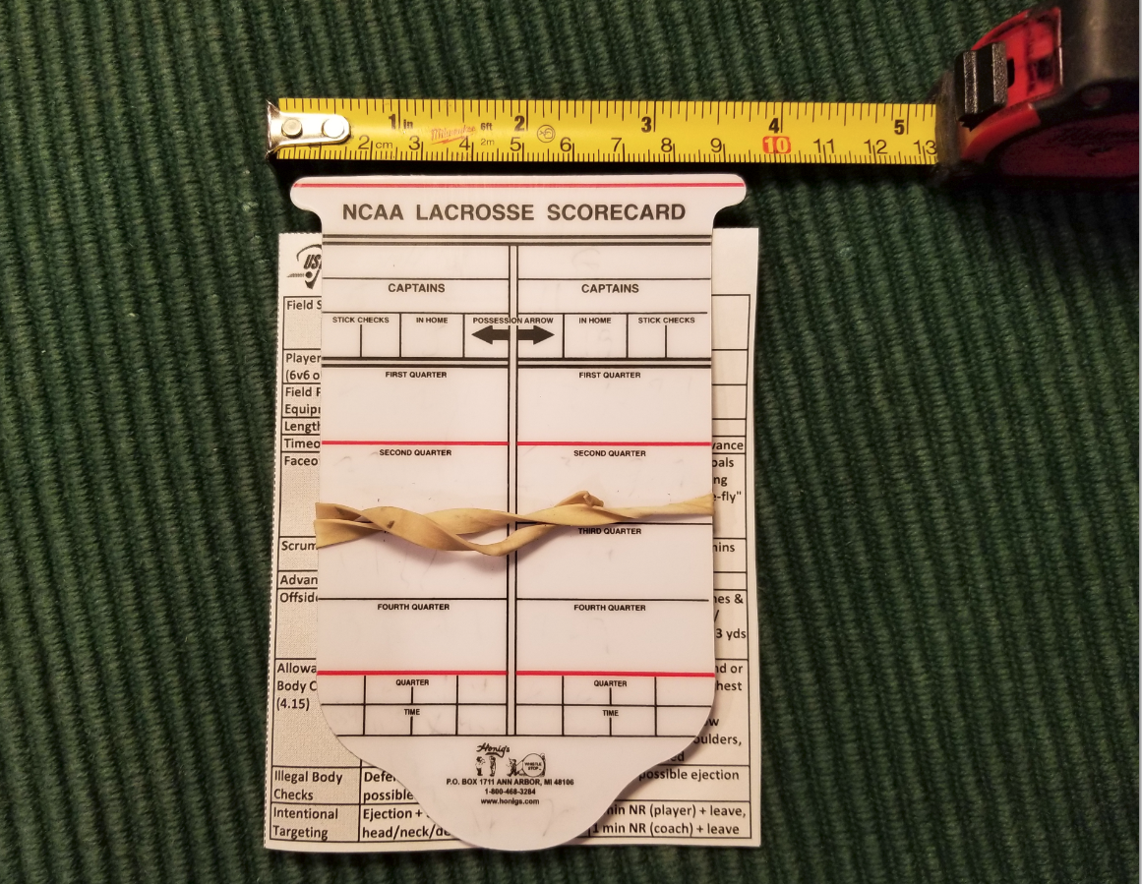
QRC (at 3.75” wide) is similar to an NCAA scorecard

Slide 6
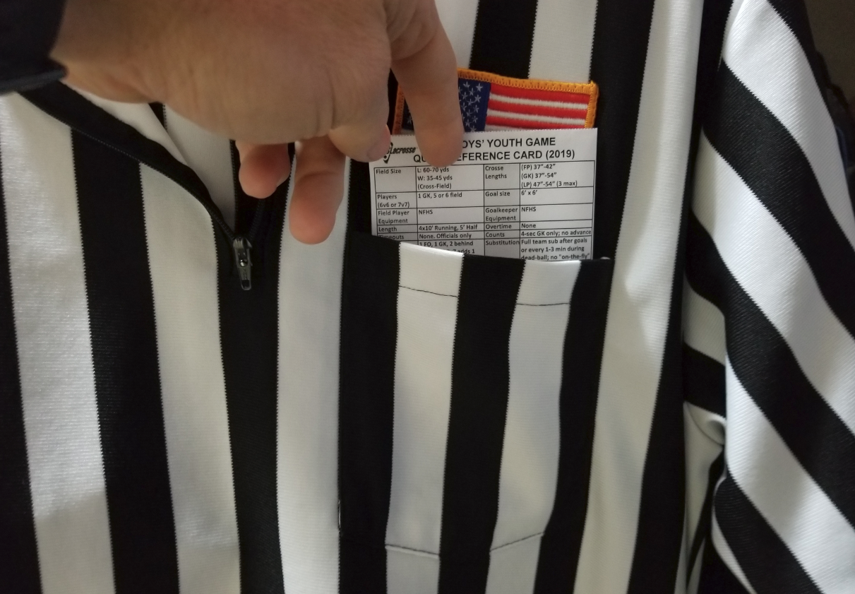
QRC fits easily inside a lacrosse official’s shirt pocket

Slide 7
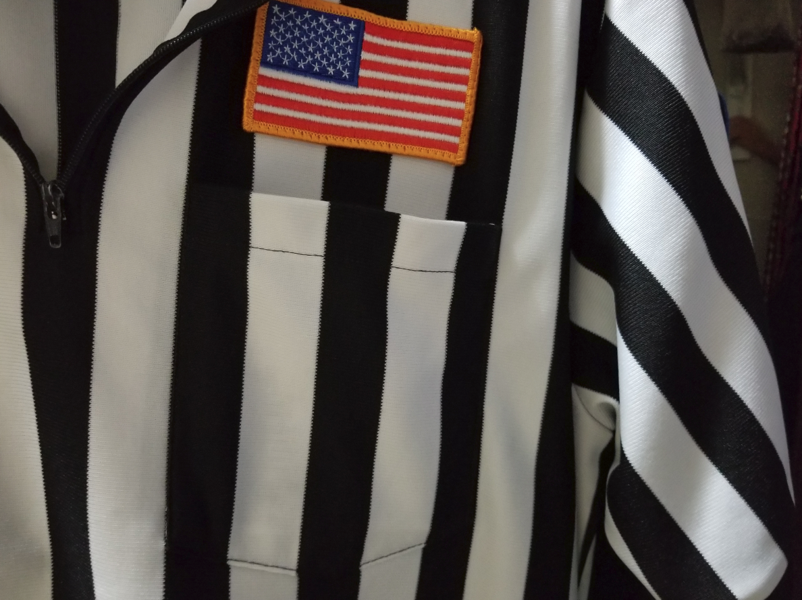
QRC fits completely inside and is hidden from view

Slide 8
14U BOYS’ YOUTH GAME
QUICK REFERENCE GUIDE (2020)
12U BOYS’ YOUTH GAME
QUICK REFERENCE GUIDE (2020)
Field Size | Full field | Crosse Length | 40”-42” (FP) 52”-72” (LP) (4 max) 40”-72” (GK)
Players (10v10) | NFHS | Goal size | 6’ x 6’
Field Player Equipment | NOCSAE Helmet, mouth guard, shoulder pads, arm pads, gloves, shoes/cleats, protective cup | Goalkeeper Equipment | NOCSAE helmet, mouth guard, throat protector, chest protector designed for lacrosse, gloves, shoes/cleats, protective cup
Length | 4x10’ stop-time, 5’ Half | Overtime | 4’ sudden victory, switch
Timeouts | 2 per Half, 1 each OT period (each team) | Counts | GK 4 + 20s Def. + 10s Off.
Faceoffs | NFHS | Substitution | NFHS
Scrum | N/A | Fouling out | Personals = 3X or 5-mins
Advancing | 20s Def. + 10s Off. + Over/Back if after Clear | Stalling | Final 2m: Get it in, Keep it in = team ahead 1-4 goals
Offsides (10v10) | > 6 players in off. half > 7 players in def. half (incl. penalty box) | 3-Yard Rule | All LEGAL holds, pushes & checks must be on a player w/ possession or within 3 yds of a loose ball
Allowable Body Contact (4.15) | 2 hands on stick; Below neck and Above waist (See 3-yard rule) | Checking with Crosse (4.16) | 2 hands on stick (See 3-yard rule)
Illegal Body Checks | Defenseless 2-3 NR, possible ejection | Checks to Head/Neck | 2-3 NR, possible ejection
Intentional Targeting | Ejection + 3 min NR for head/neck/defenseless | Ejection penalty | 3 min NR (player) + leave 1 min NR (coach) + leave
Field Size | 7v7 – cross-field 10v10 – full field | Crosse Lengths | 40”-42” (FP) 52”-72” (LP) (3 max 7v7) 40”-72” (GK)
Players (7v7 or 10v10) | 7v7: 1 GK, 2D, 2A, 2M 10v10: NFHS | Goal size | 6’ x 6’
Field Player Equipment | See 14U | Goalkeeper Equipment | See 14U
Length | 4x10’ stop-time, 5’ Half | Overtime | 4’ sudden victory, switch
Timeouts | 2 per Half, 1 each OT period (each team) | Counts | GK 4 + 20s Def. + 10s Off.
Faceoffs (7v7) | 1 FO, 1 GK, 2 behind each GLE, 1 Wing (foot on either sideline) | Substitution | Full team sub after goals or every 1-3 min during dead-ball; no "on-the-fly"
Scrum | N/A | Fouling out | Personals = 3X or 5-mins
Advancing | 20s Def. + 10s Off. + Over/Back if after Clear | Stalling | 10v10 only; see 14U
Offsides (7v7) | > 4 players in off. half > 5 players in def. half (incl. penalty box) | 3-Yard Rule | All LEGAL holds, pushes & checks must be on a player w/ possession or within 3 yds of a loose ball
Allowable Body Contact (4.15) | A. Legal Holds B. Legal Pushes C. Boxing out D. Riding E. Incidental | Checking with Crosse (4.16) | Lift/poke bottom hand or head of stick below chest area, OR Downward check initiated below BOTH players’ shoulders, No one-handed
Illegal Body Checks | Defenseless 2-3 NR, possible ejection | Checks to Head/Neck | 2-3 NR, possible ejection
Intentional Targeting | Ejection + 3 min NR for head/neck/defenseless | Ejection penalty | 3 min NR (player) + leave 1 min NR (coach) + leave
This is the master slide for the QRC
Make changes here
Then paste 14U/12U as bitmap picture on slide 1 (rotate top half); send to back so dotted lines are in front
Paste 10U/8U as actual; sent to back so dotted lines are in front
10U BOYS’ YOUTH GAME
QUICK REFERENCE GUIDE (2020)
8U BOYS’ YOUTH GAME
QUICK REFERENCE GUIDE (2020)
Field Size | L: 60-70 yds W: 35-45 yds (Cross-Field) | Crosse Lengths | (FP) 37”-42” (GK) 37”-54” (LP) 47”-54” (3 max)
Players (6v6 or 7v7) | 1 GK, 5 or 6 field players | Goal size | 6’ x 6’
Field Player Equipment | See 14U | Goalkeeper Equipment | See 14U
Length | 4x10’ Running, 5’ Half | Overtime | None
Timeouts | None. Officials only | Counts | 4-sec GK only; no advance
Faceoffs | 1 FO, 1 GK, 2 behind each GLE, 7v7 adds 1 Wing (foot on either SL) | Substitution | Full team sub after goals or every 1-3 min during dead-ball; no "on-the-fly"
Scrum | Extended w/3 or more players, use A/P | Fouling out | Personals = 3X or 5-mins
Advancing | Not used | Stalling | Not used
Offsides | 6v6 – none 7v7 – yes, >4 on offense, or >5 on defense (incl. penalty box) | 3-Yard Rule | All LEGAL holds, pushes & checks must be on a player w/ possession or within 3 yds of a loose ball
Allowable Body Contact (4.15) | A. Legal Holds B. Legal Pushes C. Boxing out D. Riding E. Incidental | Checking with Crosse (4.16) | Lift/poke bottom hand or head of stick below chest area, OR Downward check initiated below BOTH players’ shoulders, No one-handed
Illegal Body Checks | Defenseless 2-3 NR, possible ejection | Checks to Head/Neck | 2-3 NR, possible ejection
Intentional Targeting | Ejection + 3 min NR for head/neck/defenseless | Ejection penalty | 3 min NR (player) + leave 1 min NR (coach) + leave
Field Size | L: 60-70 yds W: 35-45 yds (Cross-Field) | Crosse Length | (FP) 37”-42” (GK) 37”-54” (LP) None
Players (4v4) | 1 GK, 3 field players | Goal size | 3’ x 3’ (preferred) 6’ x 6” (allowable)
Field Player Equipment | See 14U | Goalkeeper Equipment | See 14U
Length | 2x12’ Running, 4’ Half | Overtime | None
Timeouts | None. Officials only | Counts | 4-sec GK only; no advance
Faceoffs | No FO; Coin flip winner Center-X. Others on own def. half >5 yds from each other. Other team ball start 2nd half. | Substitution | Full team sub after goals or every 1-3 min during dead-ball; no "on-the-fly"
Scrum | Extended w/3 or more players, use A/P | Fouling out | Personals = 3X or 5-mins
Advancing | Not used | Stalling | Not used
Offsides | None | 3-Yard Rule | All LEGAL holds, pushes & checks on a player w/ possession or within 3 yds of a loose ball
Allowable Body Contact (4.15) | A. Legal Holds B. Legal Pushes C. Boxing out D. Riding E. Incidental | Checking with Crosse (4.16) | Lift/poke bottom hand or head of stick below chest area, OR Downward check initiated below BOTH players’ shoulders, No one-handed
Illegal Body Checks | Defenseless 2-3 NR, possible ejection | Checks to Head/Neck | 2-3 NR, possible ejection
Intentional Targeting | Ejection + 3 min NR for head/neck/defenseless | Ejection penalty | 3 min NR (player) + leave 1 min NR (coach) + leave

