Slide 1
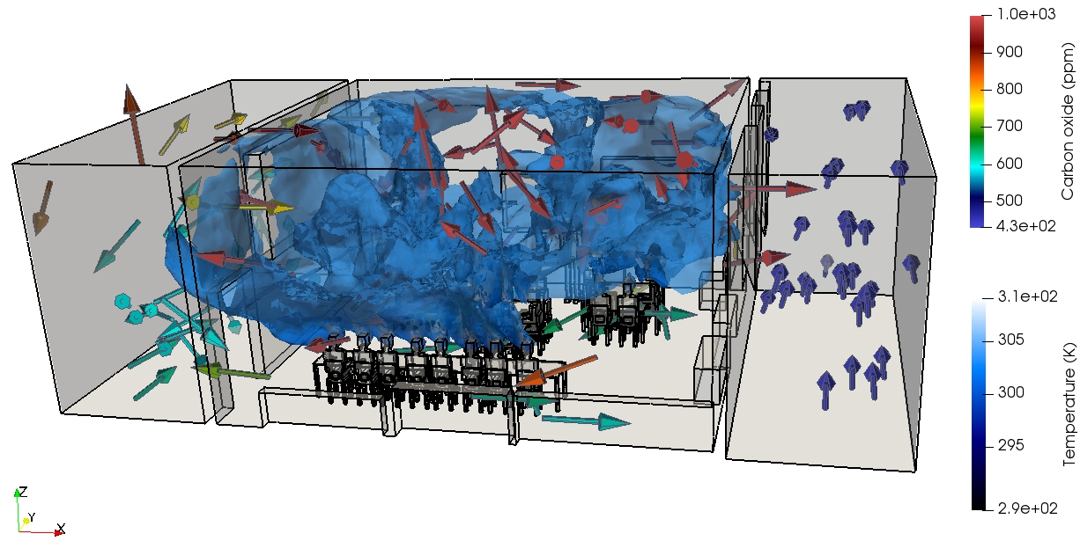
Work Package 1.3
Intelligent ventilation control
Guo et al (2023) Controlling ventilation for Comfort, Energy minimization and Infection Risk Mitigation in Enclosed Spaces using Adversarial Neural Networks Energy and Buildings (Submitted in Feb 2023)
People movement in the classroom
CFD Simulation of indoor ventilation in a classroom

Slide 2
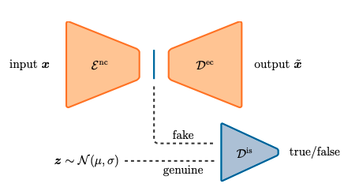
Heaney et al (2023) Data Assimilation with Machine Learning for Dynamical Systems: Modelling Indoor Ventilation Physica A: Statistical Mechanics and its Applications (Submitted in Dec 2022)
Work Package 1.3
Temperature, humidity and CO2
Fluidity data
AI predictive data
Experimental data
AI-based data assimilation

Slide 3
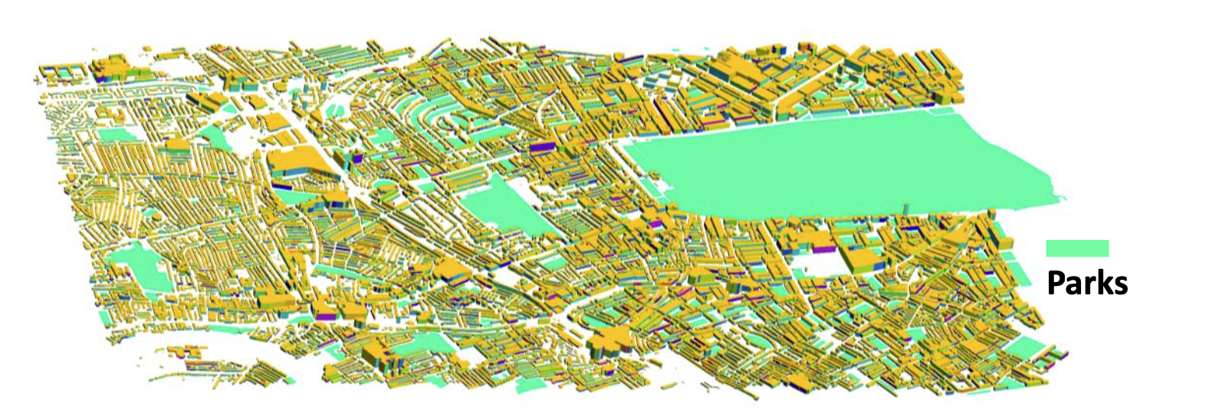
A novel CFD approach using AI libraries for indoor ventilation
Chen et al (2023) Using AI libraries for Incompressible Computational Fluid Dynamics (Submitted in Feb 2023)
Chen et al (2023) Artificial Intelligent for Computational Fluid Dynamics Applied to Urban Flows (In preparation)
Chen et al (2023) Using Graph Neural Networks for Incompressible CFD on Unstructured Meshes (In preparation)
Work Package 1.3
Velocity magnitude
A neighborhood in central London
1024m x 1024m x 128m
134M nodes (1m grid size)
1 hr ctime takes 10 hrs

Slide 4
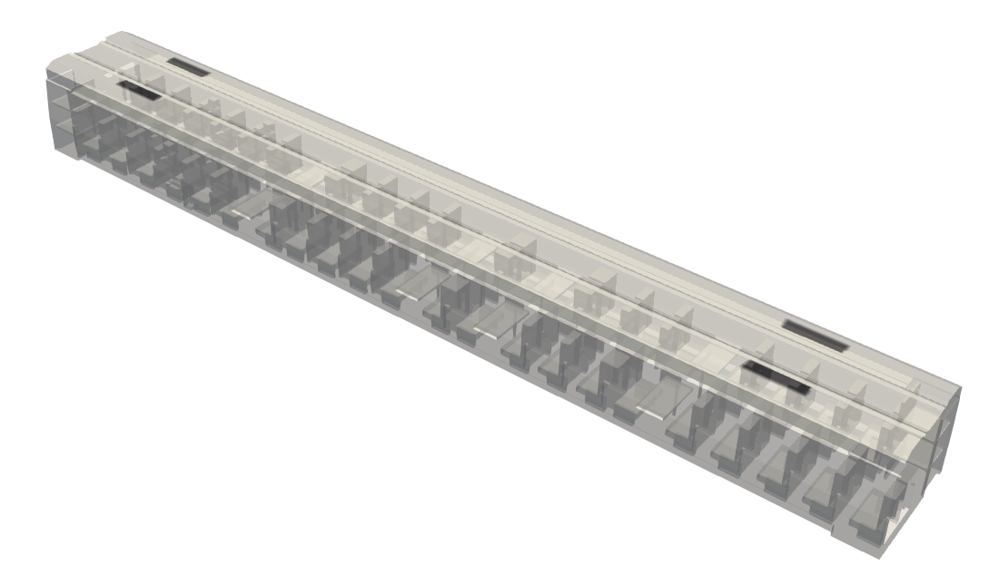
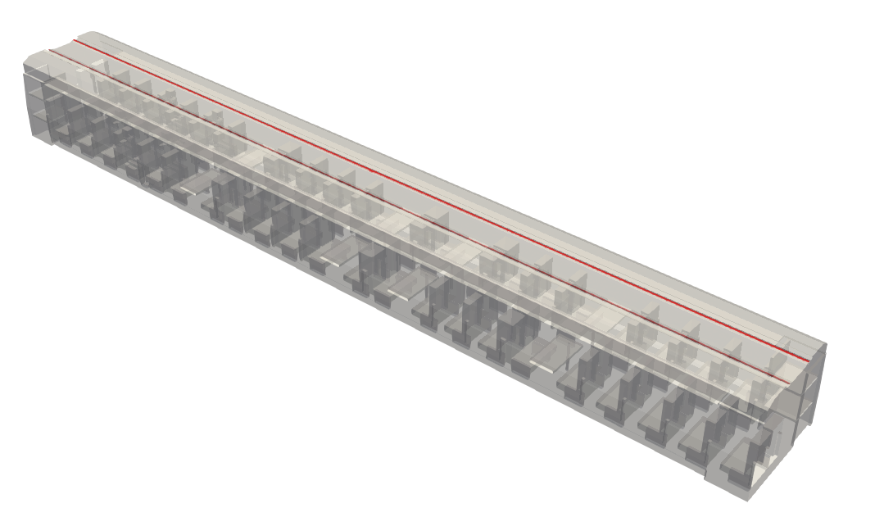
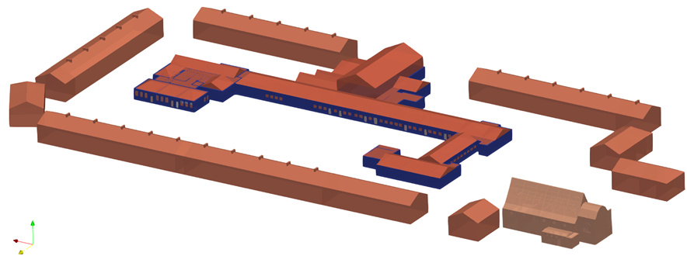
Work Package 1.3
Outlet
A novel CFD approach using AI libraries for indoor ventilation
1024m x 1024m x 128m
134M nodes (1cm grid size)
1 hr ctime takes 10 hrs
Inlet
Applied to indoor ventilation in school
Real-scale simulation of air exchange between indoor and outdoor
Simulation of the entire school involved with several classrooms
Assimilate the new database into the experimental measurements

