Slide 1
Work Package 2.2
The CO-TRACE work published on the seasonal variation of airborne infection risk in schools evidenced the dramatic variation in potential risk, not just between schools, but also between classrooms in the same school.
This was the case even when the classrooms were provided with hybrid ventilation systems and hence had some degree of automation in the control of ventilation.
Hence, no simple classification based on school type or classroom ventilation design was expected.
CO-TRACE members were aware that their modelling work to quantify transmission risk was being extended under the NCS programme PROTECT programme to include epidemiological models and stochasticity.
As such, CO-TRACE resources were deployed to other priorities.

Slide 2
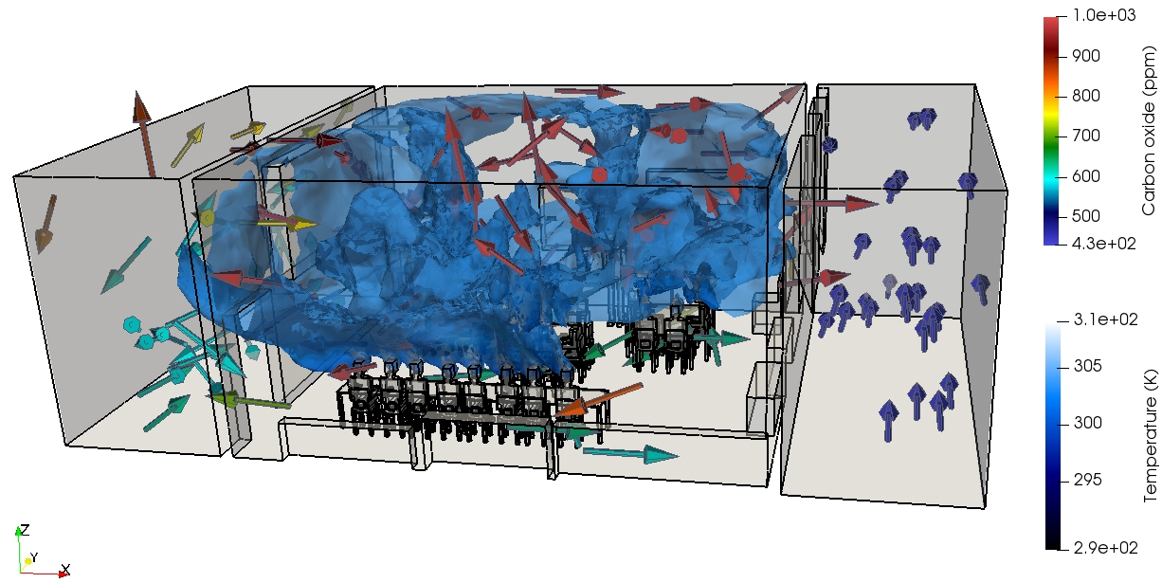
Work Package 2.2
Intelligent ventilation control
Guo et al (2023) Controlling ventilation for Comfort, Energy minimization and Infection Risk Mitigation in Enclosed Spaces using Adversarial Neural Networks Energy and Buildings (Submitted in Feb 2023)
People movement in the classroom
CFD Simulation of indoor ventilation in a classroom

Slide 3
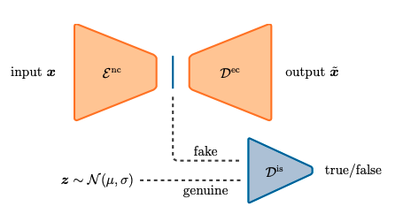
Heaney et al (2023) Data Assimilation with Machine Learning for Dynamical Systems: Modelling Indoor Ventilation Physica A: Statistical Mechanics and its Applications (Submitted in Dec 2022)
Work Package 2.2
Temperature, humidity and CO2
Fluidity data
AI predictive data
Experimental data
AI-based data assimilation

