Slide 1
Glen Lake Septic Systems and Water Sampling
Glen Lake Protective Association,
Membership Meeting July 14, 2025
Information from 2025 Glen Lake Watershed Management Plan [GLWMP]

Slide 2
Near Shore Septic Systems
There are approximately 266 homes on the lake with additional near shore lots with some form of access to the lake. All homes rely on on-site subsurface sewage disposal/treatment. The efficacy of conventional on-site wastewater treatment systems (OWTS) is highly variable depending on system maintenance, design, and local environmental factors such as soil type and proximity to groundwater or vadose zone depth. The risk of groundwater contamination from onsite disposal of domestic sanitary waste is largely dependent on system size, soil composition, and vadose zone depth or a system’s proximity to shallow groundwater (Chazen 2020).
The life expectancy of a properly sited and constructed septic system is approximately 30 years. Systems may continue to function properly, but their overall effectiveness diminishes with age. (GLWMP, page 21)

Slide 3
Glen Lake Septic System Inventory
In 2023, an inventory of the Glen Lake’s septic systems was undertaken in an effort to identify antiquated septic systems with the theory that these represent the greatest potential for failure and therefore release of phosphorus (and other constituents) into the Lake. The septic system inventory occurred in phases and included a review of the Town’s building permit data, a homeowner survey, and compilation of inspection data compiled by the Town’s Building Department. It was noted previously that the average life of septic systems is 30 years, and this was used in the evaluation. (GLWMP, page 22)

Slide 4
Table 5.1: Age of Septic Systems on Glen Lake (GLWMP, page 23)
Age (Years) | Number of systems
<10 | 50
10-20 | 28
20-30 | 26
>30 | 166
Based on this evaluation just over 60% of all septic systems are in excess of 30 years old or exceeding their typical life expectancy.

Slide 5
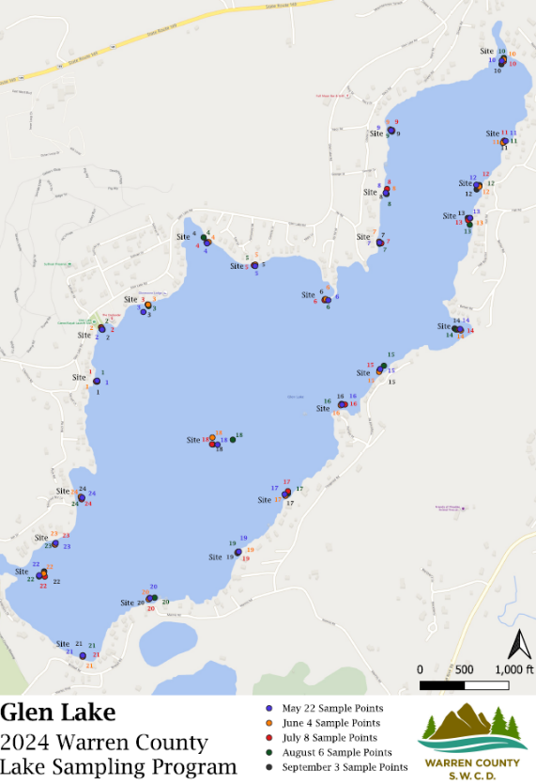
SUNY Adirondack Water Quality Monitoring
Since 2015, the Environmental Studies Collaborative (ESC) at SUNY Adirondack has collaborated with the Warren County Soil and Water Conservation District (WCSWCD) in the collection of water quality samples on Glen Lake to detect septic system-derived non-point source pollution (NPSP). Water quality samples were taken at 23 locations adjacent to the shoreline, as well as a 'control' sample located in the middle of the lake (No.: 18). Three additional sampling locations were taken in the fen. Samples were taken four to five times, May through September, and during the peak periods in the summer season. (GLWMP, pages 28-29).

Slide 6
Poop & Bleach
Water samples were tested for E. Coli (poop, which would come from humans or animals – geese, beavers, etc.) and free chlorine (bleach) that is used in most of our cleaning products and is not present in nature, which shows human activity. A positive sample (A Hit!) is when BOTH E Coli and free chlorine are found in the same sample, which strongly suggests pollution (leaching) from septic systems.
The precise source of the septic pollution is not determined, but the general area of the Hits (pollution source) is shown.

Slide 7
E. Coli and free chlorine FINDINGS
In 2024, 11 of the 24 lake testing sites were positive for NPSP indicators (both E. Coli and free chlorine) at least once. Site 9 was NPSP positive 3 of the 5 testing dates. Site 18 (the control site located at the center of the lake) was negative across all testing dates. (GLWMP page 29).
A review of SUNY ADK’s NPS sampling for the years 2019 - 2022 nearly all sampling locations reported E. Coli and free chlorine detections during those years. Sampling locations 8 and 11 reported detections over 50% of the sampling events and locations 2 and 9 approximately 40% of the events. No detection were reported for sampling location 18. (GLWMP page 30).

Slide 8
E. Coli and free chlorine FINDINGS
In 2024, 11 of the 24 lake testing sites were positive for NPSP indicators (both E. Coli and free chlorine) at least once. Site 9 was NPSP positive 3 of the 5 testing dates. Site 18 (the control site located at the center of the lake) was negative across all testing dates. (GLWMP page 29).
A review of SUNY ADK’s NPS sampling for the years 2019 - 2022 nearly all sampling locations reported E. Coli and free chlorine detections during those years. Sampling locations 8 and 11 reported detections over 50% of the sampling events and locations 2 and 9 approximately 40% of the events. No detection were reported for sampling location 18. (GLWMP page 30).

Slide 9
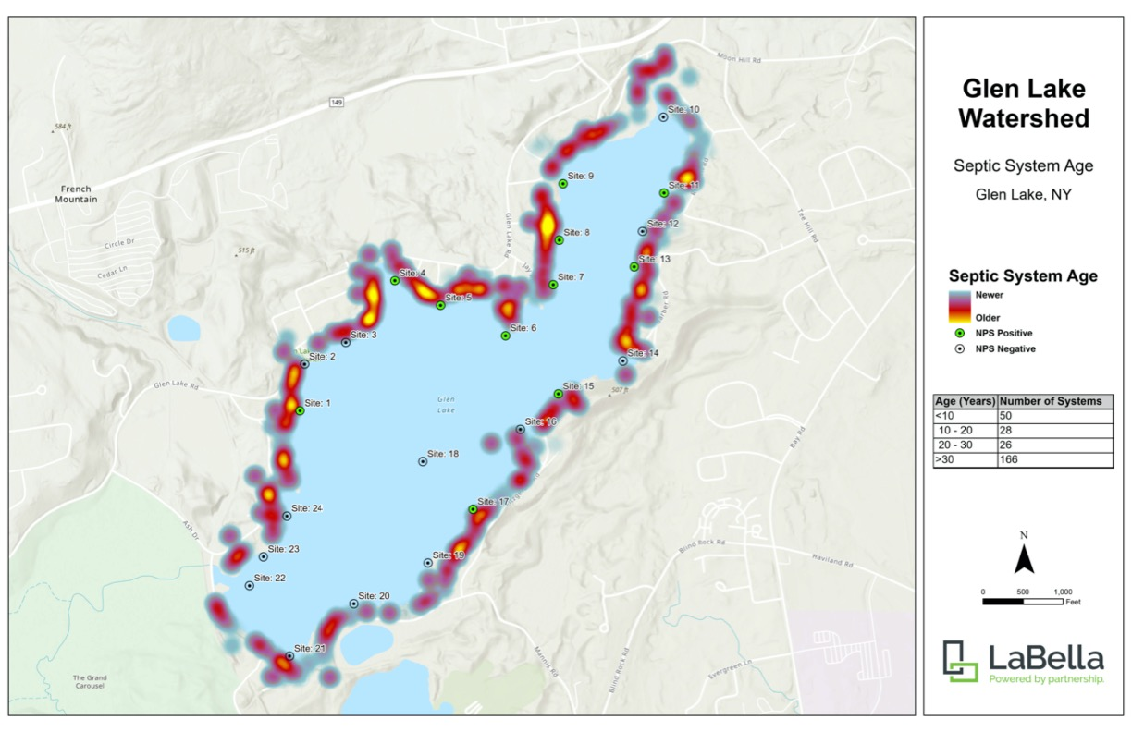
Heat Map shows age of septic systems and positive hits for both E. Coli and free Chlorine

Slide 12
Conclusion: Most of our septic systems are old, and there is some septic leaching into Glen Lake.

Slide 13
NYSDEC Septic Replacement Grants
July 2, 2025
RE: Request for Inclusion of Glen Lake, Warren County in the NYSDEC Septic System Replacement Program
To Whom It May Concern:
On behalf of the Glen Lake Protective Association (GLPA), and in partnership with Warren County and the Town of Queensbury, we respectfully request that Glen Lake be considered for inclusion in the NYSDEC Septic System Replacement Program. Glen Lake, located in the Town of Queensbury, Warren County, is experiencing septic-related water quality concerns that are well-documented and align closely with the conditions used to designate other waterbodies for program eligibility.

