Slide 1
A CRITIQUE OF AQUIFER STORAGE AND RECOVERY WELLS [ASR’S] vs.
ALTERNATE FLOW THROUGH MARSH ADDED TO THE SOUTHERN RESERVOIR
AS
A COMPONENT OF THE COMPREHENSIVE EVERGLADES RESTORATION PLAN [CERP]
BY Joseph L. Gilio, Professional Wetland Scientist Emeritus
August 4, 2018
DRAFT

Slide 2
BRIEF HISTORY OF EVERGLADES RESTORATION AND EXECUTIVE SUMMARY to .07.2018
SFWMD AND USACE HAVE DEVELOPED CERP [COMPHREHENSIVE EVERGLADES RESTORATION PLAN] APPROVED BY CONGRESS AND STATE OF FLORIDA.
MANY COMPONENTS OF CERP IN VARIOUS STAGES OF COMPLETION, CONSTRUCTION AND PLANNING EXIST.
LATEST CERP COMPONENT, COMPONENT G IS THE SOUTHERN RESERVOIR AT 240,000 ACRE FEET STORAGE [78 BILLION GAL. AND 360,000 ACRE FEET [ 117 BILLION GAL.] WATER QUALITY IMPROVEMENT TREATMENT TO 10 PPB TP [TOTAL PHOSPHORUS] FOR FLOW SOUTH INTO EVERGLADES.
SUM TOTAL OF ALL COMPLETED CERP AND COMPONENT G IS EXPECTED TO REDUCE DISCHARGES TO THE CALOOSAHATCHEE AND ST. LUCIE RIVERS AND ESTUARIES EACH BY 55%. TOTAL CUMULATIVE COST ~ $18-20 BILLION.
THE ASR WELL CONCEPT AT FULL UTILIZATION IS INTENDED TO REDUCE DISCHARGE VOLUME TO THESE RIVER/ESTUARIES BY ABOUT AN ADDITIONAL 20 %. TOTAL LAKE OKEECHOBEE DISCHARGE COULD BE 75% REDUCTION. COST ~ $1.5 Billion.
AN ALTERNATIVE TOTAL 75% REDUCTION IS AN ADD-ON TO THE SOUTHERN RESERVOIR. O’LAUGHLIN & GILIO, 2018 HAVE PROPOSED USING THE STATE OWNED HOLEY LAND TRUST’S 35,000 ACRES AS A FURTHER WATER QUALITY TREATMENT AREA TO INCREASE STORAGE VOLUME BY 52,300 AF AND TREATED FLOW SOUTH BY 0.628 MAF [204 billion gallons]. COST ~ $1 BILLION.
DIFFERENCE IS ASR’S UNCERTAIN, EXPENSIVE HARD ENGINEERING TECHNOLOGY FOR ASR’S VS. PROVEN SOFT MAN-MADE WETLAND WATER QUALITY TREATMENT ON STATE OF FLORIDA OWNED LAND TRUST SITUATED ADJACENT TO SOUTHERN RESERVOIR AND TRUST MANAGEMENT PLAN CONFORMITY.
DRAFT

Slide 3
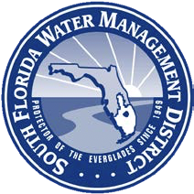

15
ASR concept extensively researched and modelled a tenuous concept:
The ASR Issue Team → series of report 1999-2002
-National Research Council’s Committee on Restoration of the Greater Everglades Ecosystem (CROGEE)→ report → series of reports 1999-2002
Led to concerns→ more studies and models
-→ASR Regional Study →CERP ASR Pilot Projects at Kissimmee River and Hillsboro Canal ---→ technical data report published previously (USACE and SFWMD, 2013) → Led to
FINAL TECHNICAL DATA REPORT
AQUIFER STORAGE AND RECOVERY REGIONAL STUDY MAY 20, 2015
DRAFT

Slide 4
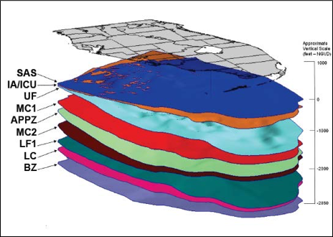
ASR HYDROGEOLOGY
DRAFT
A CROSS SECTION OF THE ROCK LAYERS
THAT COMPRISE SOUTH FLORIDA
SAS -SURFICIAL AQUIFER SYSTEM
IA/ICU INTERMEDIATE AQUIFER / CONFINING LAYER
UF UPPER FLORIDIAN AQUIFER
MC1 MIDDLE CONFINING LAYER UPPER
APPZ AVON PARK PERMEABLE ZONE
MC2 MIDDLE CONFINING LAYER LOWER
LF1 LOWER FLORIDIAN AQUIFER
LC LOWER CONFINING ZONE
BZ BOULDER ZONE
TEST ASR WELL RECOVERED ~ FROM 95 TO <50% INJECTED WATER VOLUME
EXERPTED FROM PUBLIC DOMAIN OF FINAL TECHNICALL DATA REPORT FLORIDA AQUAFER AND RECOVERY REGIONAL STUDY, MAY 20, 2015

Slide 5
DRAFT
SURFACE WATER CLEANED CHEMICALLY, PUMPED DOWN,
SPREADS UP,DOWN AND SIDEWAYS, REPUMPED UP WITH UP TO ~ 50% LOSS OF VOLUME RETURNED.
ARSENIC IN PUMPED DOWN WATER
TRAPPED IN FLORIDIAN AQUIFER
EXERPTED FROM PUBLIC DOMAIN OF FINAL
TECHNICALL DATA REPORT FLORIDA AQUAFER
AND RECOVERY REGIONAL STUDY, MAY 20, 2015

Slide 6
ESSENTIAL FINDINGS : FINAL TECHNICALL DATA REPORT FLORIDA AQUAFER AND RECOVERY REGIONAL STUDY, MAY 20, 2015
1.Large capacity ASR systems can be built and operated in south Florida. Variability in aquifer characteristics will result in varying well performances. Exploratory program reduced number from 333 to 131 a 61% reduction and some SITE re-locations.
2. To date, no "fatal flaws" have been uncovered that might hinder the implementation of CERP ASR BUT BEWARE OF MURPHEY’S LAW.
3. Potential for rock fracturing and land subsidence resulting from ASR is very low, provided that the wells are spaced at safe distances from each other and that pumping pressures are kept below their permitted levels. THERE’S MURPHY’S LAW AGAIN.
4. surface water in south Florida presents some challenges to conventional disinfection technologies. Also, arsenic mobilization occurs during early cycle testing, but attenuates over time as the storage zone is conditioned. HARD TO CLEAN SURFACE WATERS [KISSIMMEE RIVER] . ARSENIC TRAPPED IN AQUAFER.
5. Water recovered from the ASR pilot projects did not result in any persistent acute or chronic toxicological effects on test species. However, there were a few instances when reproduction of a cladoceran (a test organism) was inhibited. This occurred when the percent volume of water recovered was between 50 and 75 percent, and the cause of this effect was never determined. MAJOR RIVER AND LAKE ZOOPLANKTON [CLADOCERAN ] ADVERSELY AFFECTED ON ASR RECOVERED WATER ADDED BACK TO RIVER AND LAKE OKEECHOBEE.
6. Mussels and periphytometers deployed in the recovery stream at the Kissimmee River ASR did not exhibit significant negative bioaccumulation affects or shifts in community composition. THESE ARE DOMINANT BOTTOM DWELLING ANIMALS AND PLANTS THAT CLEAN RIVER AND LAKE WATER.
7.The potential for mercury methylation during storage and recovery of water from within the FAS has generally been determined to be very low. However, groundwater from the FAS has sulfate concentrations that are higher than those in surface water. Since sulfate has been linked to mercury methylation, discharge may need to be monitored in locations where mixing of recovered water and ambient surface waters is incomplete. HIGHER SULFATE IN RETURNED WATER COULD LEAD TO INCREASE IN SULFATE REDUCING BACTERIA THAT THEN INCREASE CONVERSION OF MERCURY INTO METHYL MERCURY THAT IS MORE ABLE TO ENTER FOOD CHAIN.
8. Some reduction in phosphorus concentration was observed during ASR storage. ASR’S WILL NOT REDUCE PHOSPHORUS SIGNIFICANTLY.
9. It would be most prudent that any further implementation of CERP ASR proceed as a phased approach, which would include expansion and continued testing of pilot facilities and construction of new ASR systems at environmental restoration projects where environmental benefits can be optimized by underground water storage, treatment, and recovery. IN OTHER WORDS THESE ENGINEERS AND SCIENTISTS ARE NOT SURE HOW WELL ASR’S WILL WORK.
DIRECT COMMENTS FROM REPORT EDITED [SHORTENED] IN BLACK GILIO COMMENTS IN RED
DRAFT

Slide 7
WHERE DOES USACE AND SFWMD WANT TO USE ASR’S?
DRAFT
KEY
CLUMPS OF 80 PROPOSED ASR’S
MAXIMUM STORED VOLUME
0.446 M ACRE-FEET/YR.
[146 BILLION GALLONS]
Cost. ~$1.5 Billion

Slide 8
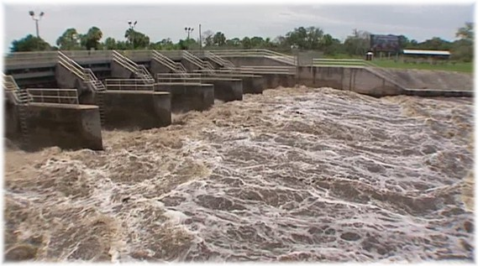
THE ALTERNATIVE OPTIONS
TO PREVENT FUTURE LOST SUMMERS AND RESULTING TOXIC ALGAE BLOOMS
DRAFT
Repurpose Holey land back to its original form and function as a free flowing Everglades wetland

Slide 9
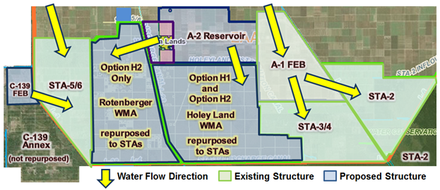
Hybrid R240H1 and Hybrid R240H2
Restoring Rotenberger and Holey Land
Wildlife Management Areas (WMAs)
DRAFT
Lake Okeechobee input
Southern reservoir [hatched]
Modified From O’Laughlin & Gilio, 2018.

Slide 10
Option 1.Holey Land as additional water quality treatment area from weir overflow from top of southern reservoir
increases lake Okeechobee water storage south of reservoir by 52,500 AF,
increased water treatment pass through of this volume by 12/ yr. X 0.0525MAF or
0.628 MAF [204 billion gallon] more of lake Okeechobee water south not into
Caloosahatchee and St. Lucie Rivers and estuaries.
reduces total river discharges from 55% to 75% with all CERP complete,
restores Everglades wetland function in conformity with
the trust management plan,
increases wetland habitat for birds, bass and ducks,
increases public use –hunting fishing, birding,
increases employment for local townspeople to grow, install, maintain new treatment wetland
uses reliable proven wetland technology
DRAFT

Slide 11
OPTION 2. Adding Rotenberger* tract to Holey Land as additional reservoir water treatment storage and treatment:
increases lake Okeechobee water storage south of reservoir by 37,500 AF,
increased water treatment pass through of this volume by 12/yr. X 0.03650MAF or
0.438 MAF [143 billion gallons more of lake Okeechobee water south not into
Caloosahatchee and St. Lucie Rivers and estuaries.
Combined decrease total discharges to rivers by 95% with all CERP, southern
Reservoir, Holey Land and 25,000 acres of Rotenberger trust used as water treatment areas at 30 day flow through time.
95% OF LAKE OKEECHOBEE DISCHARGE REDUCTION
IS CRITICAL PRECONDITION FOR RIVER AND ESTUARY RECOVERY.
ROTHENBERGER TRACT HAS ~ 4000 ACRES IN ~ 40 PRIVATE OWNERSHIP WITHIN 29,000 ACRES.
DRAFT

Slide 12
OPTION # 3
IF LIMITED PRIVATE OWNERSHIP IN ROTENBERGER DELAYS OR PREVENTS ITS USE,
THEN USE HOLEY LAND AND , IF NEEDED, ASR, TO THE EXTENT AND TIMING THAT IT WILL PRODUCE 95%
REDUCTION OF LAKE OKEECHOBEE AT ANY GIVEN TIME.
DRAFT

Slide 13
Select References
http://www.saj.usace.army.mil/LOWRP/
This reference downloads the final Lake Okeechobee Water Resources Plan with all information on engineering , cost, public use, etc. and was used extensively in this analysis for the ASR evaluation.
Note that the LOWRP also involves wetland restoration and surface water storage units just north of Lake Okeechobee that the author approves.
2. O’Lauglin, J. Ph.D. and Gilio, J. PWS Emeritus “Out of the Box “ Options for the EAA Reservoir/STA Project, Jan. 22,2018 as found in www.joegilio.com
DRAFT

