Slide 1
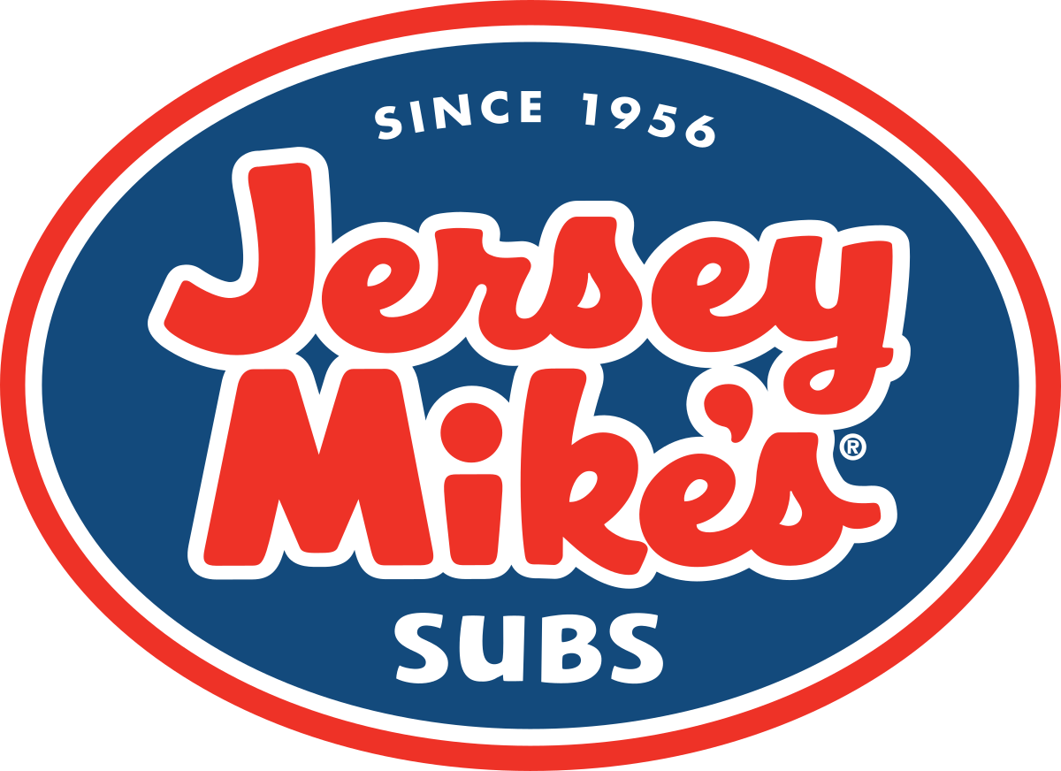
Jersey Mike’s Subs of West Windsor, New Jersey
Rachael Ennis, Jessica Gushnay, Preet Rathi, Leo Lin, and Madeleine Wakefield

Slide 2
Agenda
Introduction to Business
Target Market Analysis
Core Competencies & Major Challenges
Strategies of Business Resilience
Summary

Slide 3
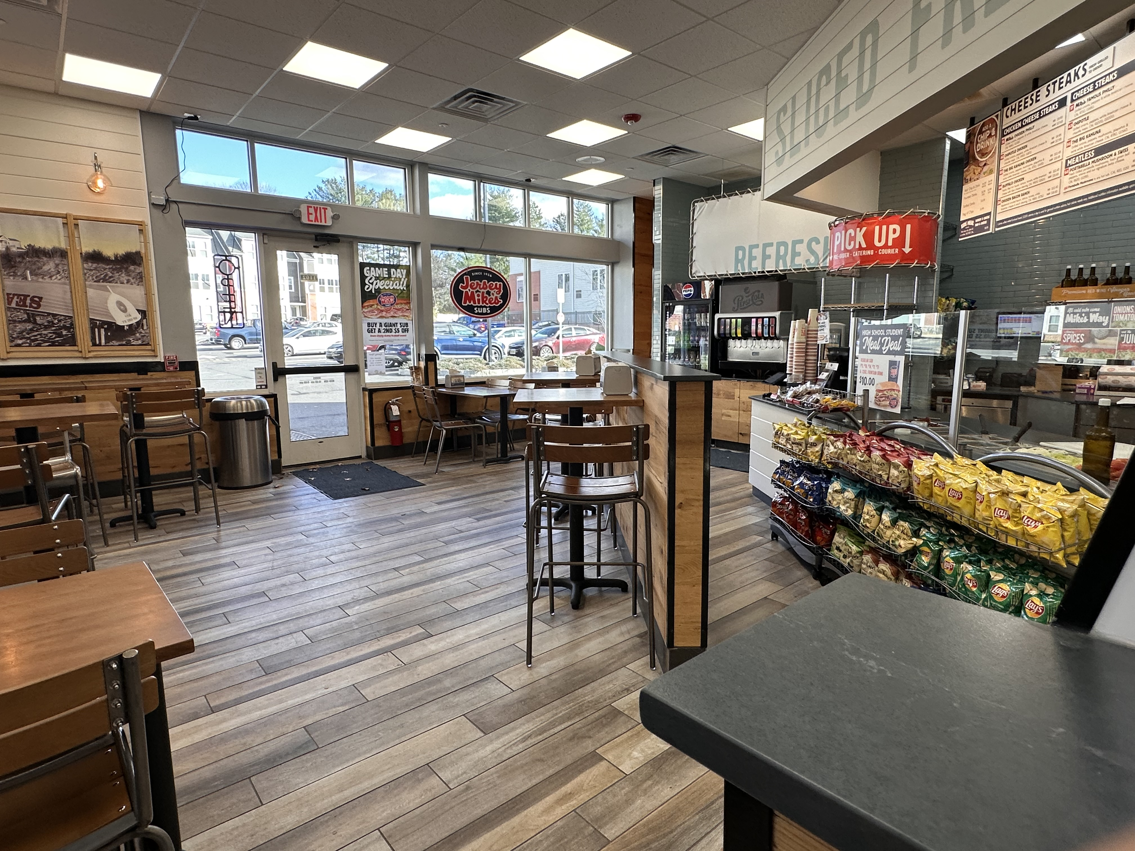
Introduction to Jersey Mike's Subs
Founded in 1956 in Point Pleasant, NJ originally known as Mike's Subs.
Fast casual sandwich chain.
Known for high-quality, made-to-order subs featuring freshly baked bread and sliced meats.
Over 2,000 locations nationwide and various locations in Canada and the United Kingdom.
West Windsor, NJ Location
Opened on November 29, 2023
Offers full range of services: dine-in, takeout, catering, and delivery through third-party apps.
Location is within residential homes and close to Princeton University, Princeton-Junction Train Station, and corporate offices.
Has partnerships with nearby high schools and organizations, as well as local charities.
3

Slide 4
Target Market Analysis
Students & Staff
Families & Residents
Health-Conscious Consumers
Corporate Clients & Professionals
Heavily based on their location: "… strategically targeting suburban areas with education, middle-plus-income population" (Anderson, 2024).
4
Notes:
https://startupsofa.com/growing-a-business/from-deli-to-franchise-jersey-mikes-journey/

Slide 5
Core Competencies
High Quality and Freshness - Jersey Mike’s emphasizes fresh ingredients, including high-quality meats, cheeses, and freshly baked bread. The brand prides itself on offering subs made with premium, sliced-to-order meats and fresh produce.
Authenticity - The company is known for using a variety of traditional methods, including hand-slicing meats and cheeses, which enhances the quality and taste of their products.
Customer Service - Employees prepare subs while engaging the customers in a personalized and tailored experience, asking them how they would like for their sandwich to be made.
Franchise Model – The brand has grown quickly through franchising, allowing it to expand nationwide while maintaining operational efficiency and authenticity.
Consumer Loyalty - Jersey Mike’s benefits from positive word-of-mouth due to the quality of the products and customer service .
Healthy Options - Jersey Mike's offers a variety of healthier choices, such as subs with whole-wheat bread, low-calorie options, and items with fresh ingredients.

Slide 6
Challenges
Brand Differentiation - Jersey Mike's faces the challenge of differentiating itself in a crowded sandwich market.
Marketing - Competitors like Subway and Jimmy John’s have significant marketing budgets, which is something that Jersey Mike's needs to work on using digital platforms.
Staffing - Like many in the restaurant industry, Jersey Mike’s faces difficulties in recruiting and retaining skilled staff, especially during peak hours or in competitive labor markets. There is also issues related to scheduling due to the number of part time workers.
Dietary Restrictions - The menu has very limited options for people with dietary restrictions which is something the company needs to work on.
Competition – The company faces a lot direct competition in the market with other sandwich chains like Subway, Firehouse Subs, Jimmy John’s, and Quiznos that have a strong market presence. There is also the challenge of competing with local shops and regional players that gain loyal customer bases in their respective regions.

Slide 7
Menu Analysis
7
Notes:
This menu board design is fairly standard for a fast food establishment, but also has some of the same flaws that are often present. The menu itself is well structured, split into two sections, with cheese steaks being hot menu items and submarines being cold menu items. The pricing psychology used of ending many prices in .95 is in line with Jersey Mike's brand image as being inexpensive. The placement of the adding of a chip and drink on the left may initially seem like poor design, but customers enter the store to the right on this menu, naturally making their eyes move that direction. The items offered are comparable to similar restaurants, featuring classic sandwiches, while also including items unique to the chain. The menu design still has room for improvement, however. Some of the font sizes used on this menu board could be difficult for some people read at this distance, especially the text underneath the sandwich names. The caloric information is given in the same font as the sandwich descriptions, making it difficult to understand at a glance. This could be better served by displaying in some way next to the sandwich prices, which are already separated by size like the caloric information. There is also a takeout menu available, that also serves as the catering menu, but lacks a lot of utility by not including any menu pricing, including for their catering options, which could discourage potential customers by adding an additional hurdle in comparing prices to other caterers.

Slide 8
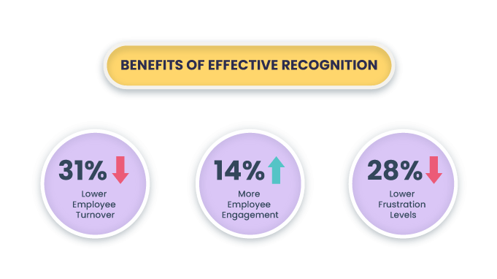
Employee Management Strategies
Challenges in Staffing:
Hiring and Managing Minors:
Mandatory breaks and restrictions (e.g., cannot close the store) complicate scheduling
Flexible Scheduling Demands:
Managing overlapping time-off requests creates coverage gaps.
Reliance on inter-store support is not sustainable long-term.
Lack of Employee Recognition:
No formal programs to acknowledge employee contributions
Missed opportunities to improve morale and retention
Proposed Solutions:
Streamline Scheduling:
Maintain a rotation system for weekend and evening shifts to balance workloads
Introduce a preference submission process for employees to indicate availability in advance
Implement Employee Recognition Programs:
Start an “Employee of the Month” initiative with small prizes like gift cards, free meals, or recognition plaques
Engage Employees Through Feedback:
Regular check-ins with staff to discuss scheduling challenges and gather ideas for improvements
8
Notes:
https://startupsofa.com/growing-a-business/from-deli-to-franchise-jersey-mikes-journey/

Slide 9
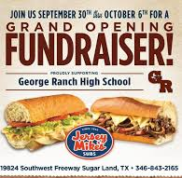
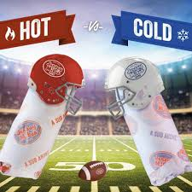
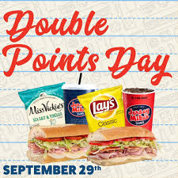
Current Marketing Strategies
Community Engagement
Discount Promotions:
Loyalty Program
Collaborations with nearby schools, sports teams, and community organizations
Donations to local causes
Best Buddies 4.3M
Consumers are 4–6 times more likely to trust, purchase from, and recommend companies that give back
Football season offers bundle deals for catering packages (e.g., "Buy 4 Subs, Get 1 Free").
Aimed at groups and families hosting Superbowl parties
Jersey Mikes also offers daily and weekly deals on their app
84% of consumers are influenced by promotions
Customers earn Shore Points which can be redeemed for free menu items or discounts
Rewards members receive early access to promotions, special deals, and bonus point days
Triple Points Saturdays to address low weekend sales
Selling to an existing customer is up to 14 times higher than the probability of selling to a new customer
9
Notes:
https://startupsofa.com/growing-a-business/from-deli-to-franchise-jersey-mikes-journey/

Slide 10
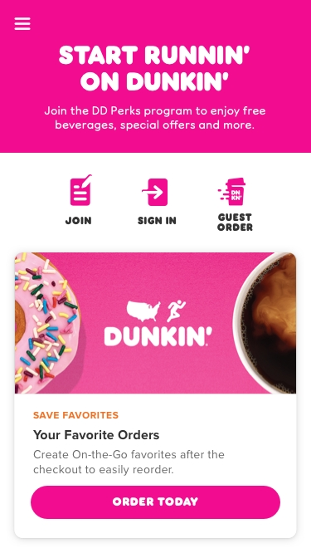
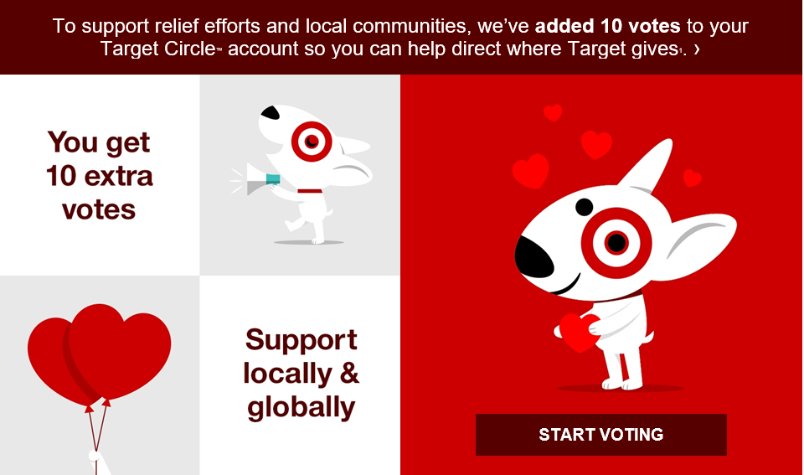
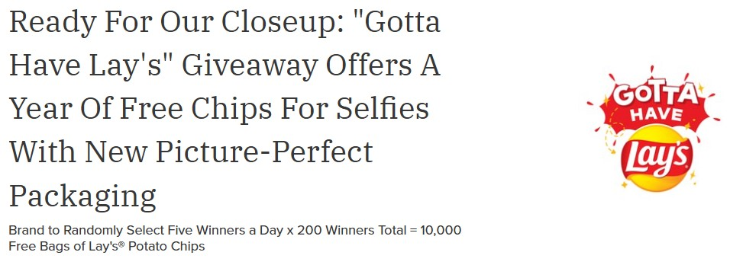
New Strategies
Customer Voting Feature
Promotions
Personalized Customer Engagement:​
Allow customers to vote for the next charity Jersey Mike’s will support through app or purchase-based votes
Example: Target’s "Circle Giving" program fosters goodwill by letting customers allocate their votes to local nonprofits
Showcase impact stories via social media and newsletters to strengthen emotional connections and loyalty
Add football-themed decor encouraging foot traffic and advertise the football bundle
Encourage customers to share their photos at the store and their Superbowl spreads at home on social media with a hashtag
Create a prize for a random winner who uses the Hashtag to win
Example: Lay’s “Gotta Have Lay’s” Superbowl campaign saw a 40% increase in social mentions through user-generated content.
Use customer data to create tailored discounts on most-ordered items.
Example: Dunkin’ Donuts uses app data to send personalized deals, resulting in a 19% increase in app usage.

Slide 11
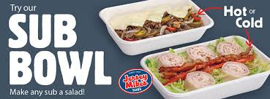
Marketing Problem
Jersey Mike’s wraps, which offer a healthier and customizable alternative to subs, are currently under-promoted.
Despite their potential appeal to health-conscious consumers, they are often overshadowed by subs in marketing materials and promotions
missed opportunities to capture a broader customer base
Subway’s promotion of low-carb protein bowls led to a 25% increase in health-conscious customer visits
Proposed Solution:
Awareness Campaign
Highlight bowls and wraps in advertisements with messaging like "Same Great Subs, Just the Way You Want Them."
Staff Training
Encourage staff to recommend bowls and wraps during orders
Increases Customer awareness and driving sales
Double Points Promotion:
Offer double loyalty points for purchases of bowls and wraps to incentivize customers to try these options
11
Notes:
https://startupsofa.com/growing-a-business/from-deli-to-franchise-jersey-mikes-journey/

Slide 12
Summary
12

Slide 13
Thank you
Group 6
Food & Beverage Management

