Slide 1
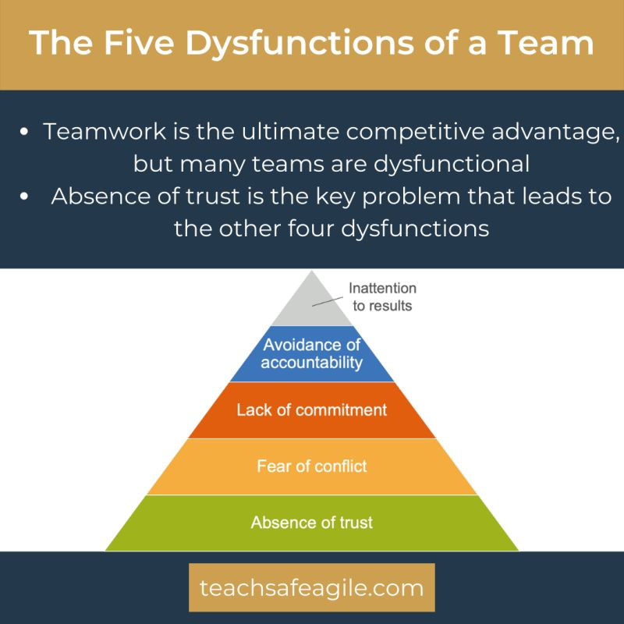
The Five Dysfunctions of a Team
DYSFUNCTION #1: ABSENCE OF TRUST
The fear of being vulnerable prevents team members from building trust with each other.
DYSFUNCTION #2: FEAR OF CONFLICT
The desire to preserve artificial harmony stifles productive ideological conflict within the team.
DYSFUNCTION #3: LACK OF COMMITMENT
The lack of clarity and/or buy-in prevents team members from making decisions they stick to.
DYSFUNCTION #4: AVOIDANCE OF ACCOUNTABILITY
The need to avoid interpersonal discomfort prevents team members from holding each other accountable for their behaviors and performance.
DYSFUNCTION #5: INATTENTION TO RESULTS
The pursuit of individual goals and personal status erodes the team's focus on collective success.
Notes:
Trainer Guidance:
Reference:
The Five Dysfunctions of a Team, Patrick Lencioni, https://www.tablegroup.com/books/dysfunctions/
Teamwork is the ultimate competitive advantage, but many teams are dysfunctional
Absence of trust is the key problem that leads to the other four dysfunctions

