Slide 1
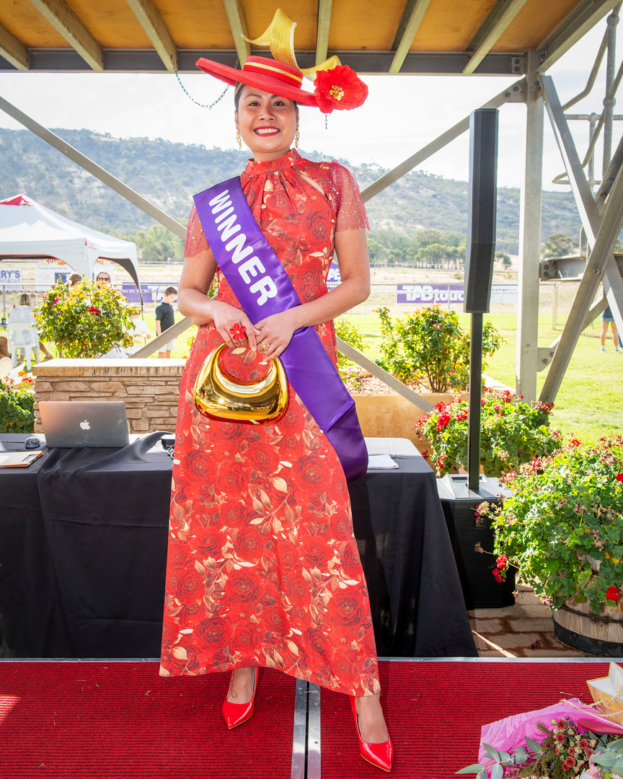
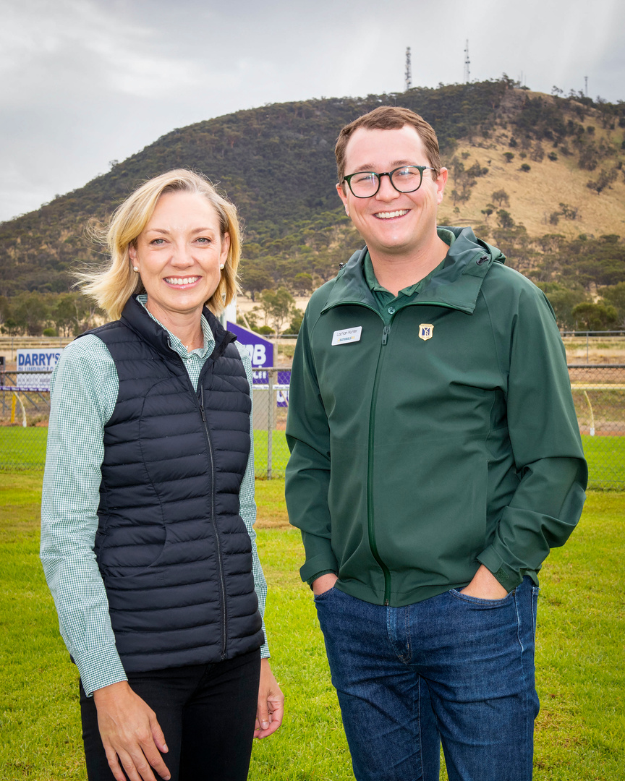

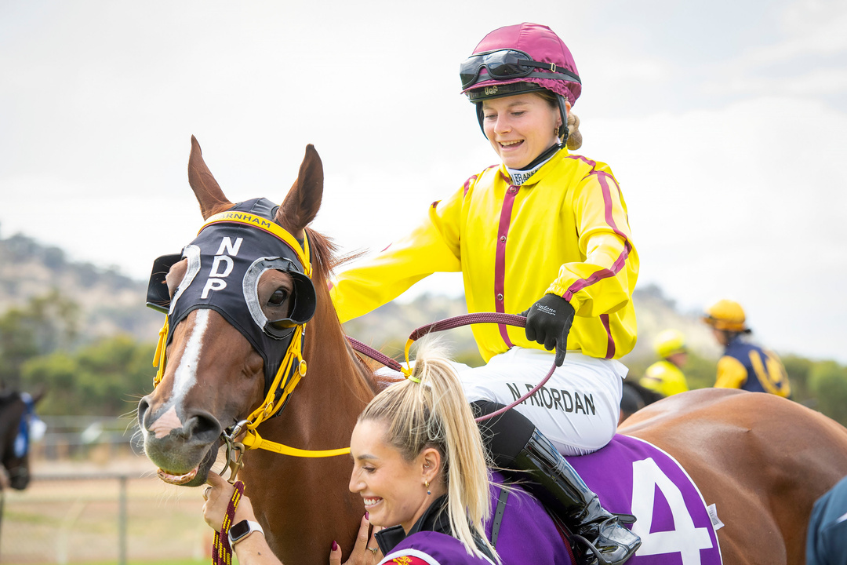
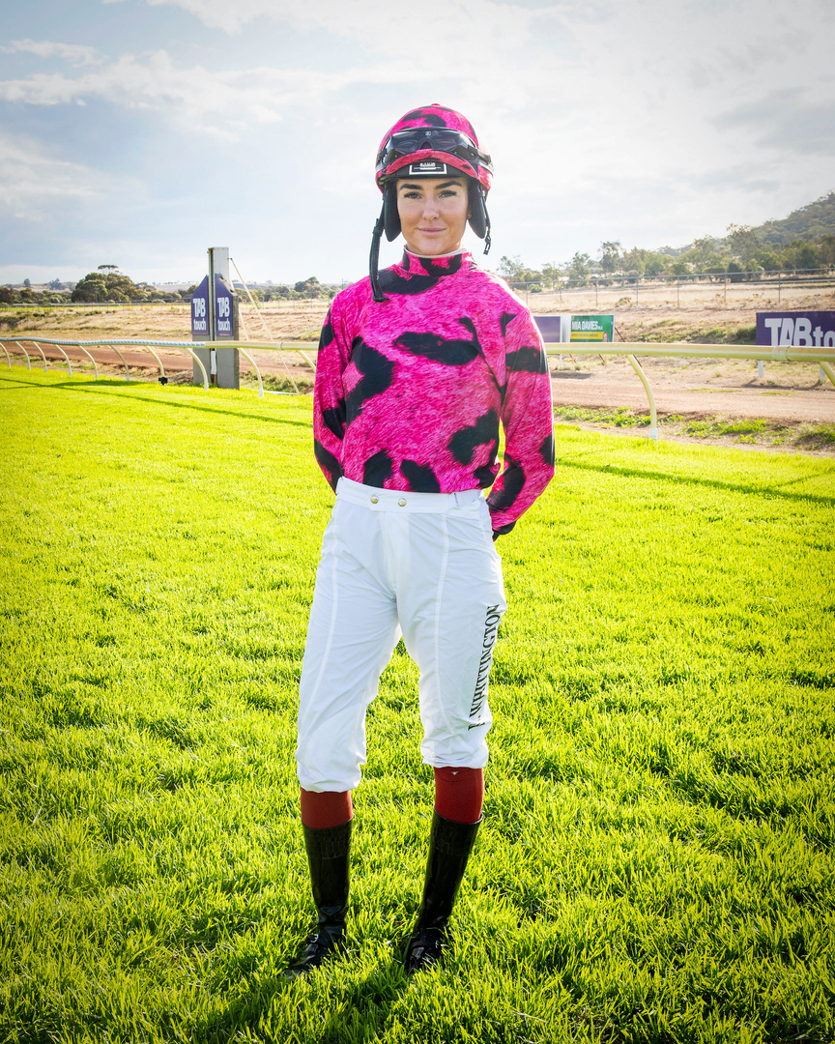

Australia's First Provincial Racecourse
FY25
CHAIRSREPORT

Slide 2


YORK RACING INC.
ANNUAL REPORT
CHAIRS INTRODUCTION
NATASHA ATKINSON
CHAIR
A Year of Renewal & Momentum
  Appointed Chair in January 2025 — my first Annual Report in this role
  Proud custodians of Australia’s oldest provincial racecourse (est. 1843)
  Focus: honouring our heritage while building a sustainable, future-ready organisation
Over the past 12 months, we have:
  Strengthened governance and management team
  Investigated in bore and irrigation solutions
  Invested in track, facilities and member experience
  Expanded the use of the Racecourse through new events and partnerships
Despite challenges, including the loss of two race meets and a damaged track, we adapted, diversified and moved forward with purpose.
Our priority is clear:
To ensure York Racecourse remains relevant, resilient and a place our community is proud to gather.

Slide 3
YORK RACING INC.
ANNUAL REPORT
STREGTHENING THE COMMITTEE
York Racing Inc. has a highly capable and aligned committee. We would like to acknowledge and thank;
Treasurer - Guy Lehmann
Secretary & Club Manager - Shelly Turner
Committee Members
David McAuliffe, Paul Tester, Maryanne White & Robin Bell
Collective focus in 2025:
Strengthening governance and financial oversight
Stabilising operations following early-year disruptions
Diversifying income through events and venue activation
Investing in infrastructure to support racing, equestrian and event use
Positioning York Racecourse for long-term sustainability
The Committee extends sincere thanks to all volunteers, staff and supporters who contribute to the success of York Racing Inc.

Slide 4



OUR TEAM
ANNUAL REPORT
Our dedicated team — Shelly and Trevor — bring passion, expertise, and heart to York Racing Inc., ensuring smooth operations, welcoming members, and keeping the spirit of country racing alive.
York Racing Inc
Committee
Shelly Turner
Club Manager
Day-to-Day Operations
Staff & Contractor Management
Race Day & Event Delivery
Facilities & Asset Oversight
Compliance & Risk Management
Stakeholder & Tenant Liaison
Reporting & Administration
Trevor Ness
Track Manager
Track Preparation & Presentaion
Grounds & Turf Management
Maintenace Panning & Logs
Machinery & Equipment Oversights
Race Day Readines
Safety Compliance & Risk
Advisory Role to Committee
Race Day, Event & Bar Staff
Contract Gardeners/Cleaners
Track & Grounds Volunteers/Contractors

Slide 5
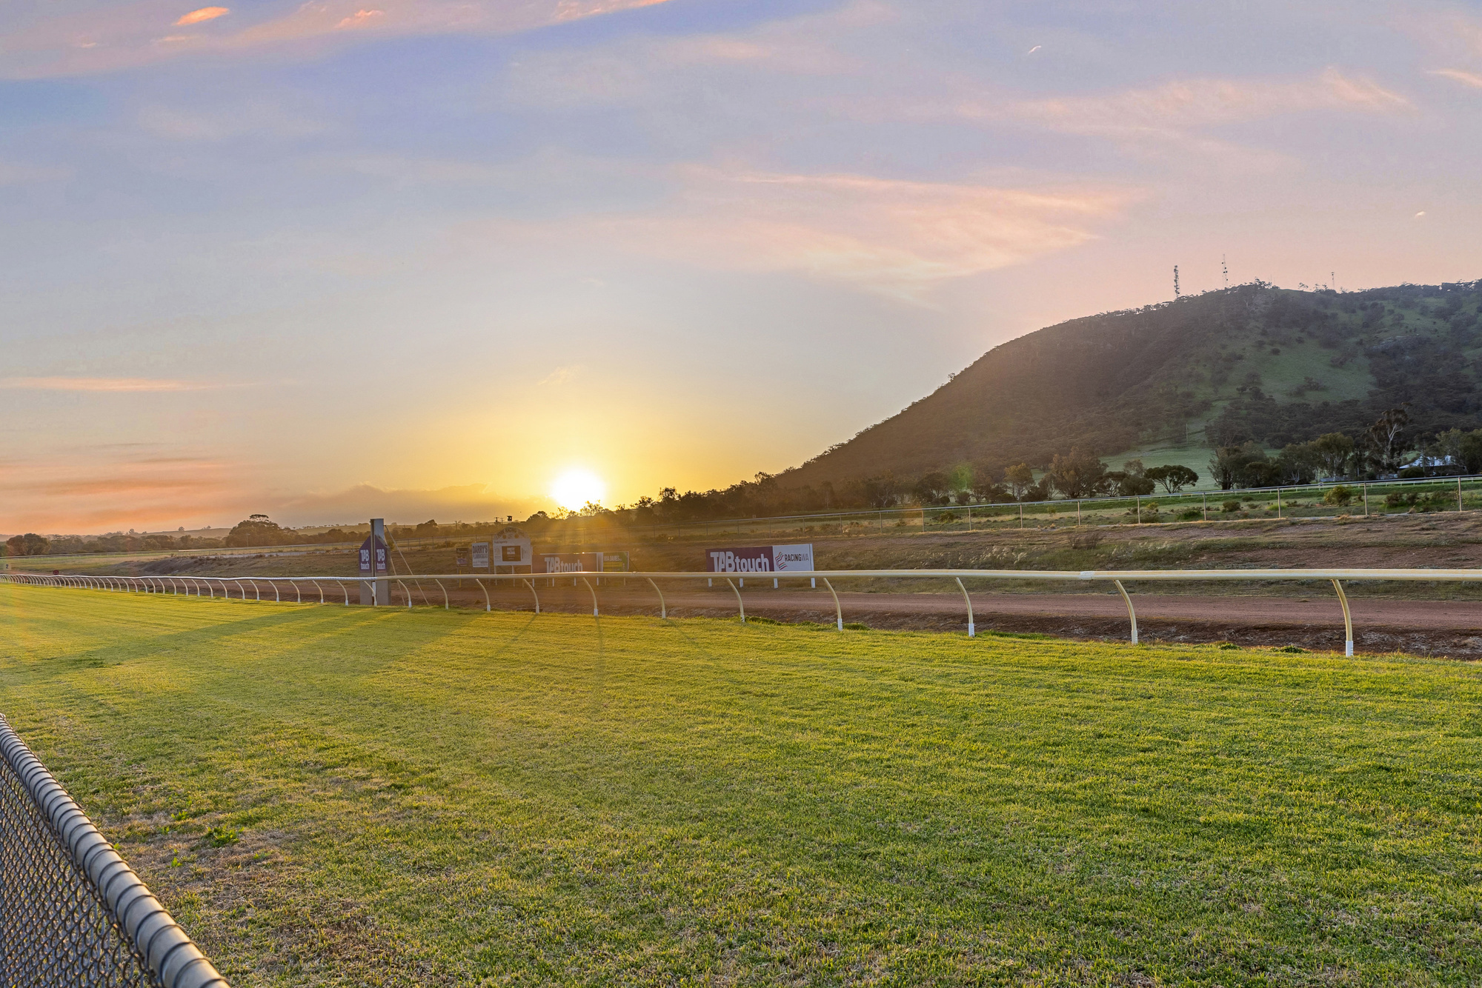

YORK RACING INC.
ANNUAL REPORT PRESENTATION
KEY POINTS
  Last 12 months - Good and Bad
  Looking forward - Next 12 months
  Bore & Irrigation
  Vision for the future

Slide 6
YORK RACING INC.
ANNUAL REPORT PRESENTATION
LAST 12 MONTHS - THE GOOD & THE BAD
The Bad
  Early-year setback: damaged track resulting in the loss of two race meets
  Significant unplanned costs to repair the track and damaged machinery
  Resulting financial and operational pressure on the Club
  Long-standing water, bore and irrigation challenges
  Inherited operational and governance gaps, including water infrastructure constraints, asset management systems, and the absence of formal HR frameworks.
The Good
In addition to what you already have, I’d include:
  Stabilisation of the racetrack following the appointment of Trevor Ness as Track Curator
  Strengthened governance and financial oversight with the appointment of Guy Lehmann as Treasurer
  Improved financial oversight, budgeting discipline and reporting transparency.
  Formal recognition of leadership and continuity through the appointment of Shelly Turner as Club Manager
  Upgrade from Country to Provincial Racecourse status — a major milestone
  Diversification of income through concerts and non-race events
  Significant investment in the racetrack, harness track and broader grounds
  Strategic leasing of 42 acres to the Wheatbelt Regional Carriage Driving Club, expanding the equine precinct
  Commencement of a staged, long-term solution to bore and water security
  Official host location for the Lexus Melbourne Cup
  Appointment of Lachlan Hunter, MP as Patron

Slide 7
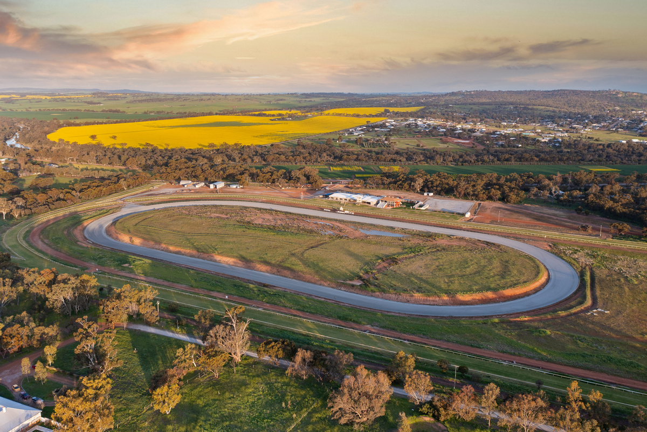
YORK RACING INC.
ANNUAL REPORT PRESENTATION
LOOKING AHEAD | NEXT 12 MONTHS
  Strategic Plan (2025–26):
Finalise and implement a clear Strategic & Operational Plan to guide investment, governance and growth.
  Revenue Diversification:
Expand non-race revenue through events, concerts, venue hire, equine leasing and tourism-led initiatives.
  Asset & Maintenance Management:
Introduce formal asset registers, maintenance plans and logging systems to protect infrastructure and support long-term sustainability.
  Water Security – Stage 1:
Deliver Stage 1 of the bore and water solution to address long-standing irrigation and track reliability issues.
  Equine Precinct Development:
Establish an Equine Working Group to masterplan and progress a multi-user equine precinct in partnership with key stakeholders.
  Governance & Operations:
Continue strengthening governance frameworks, contracts, policies and operational systems.
  Community & Stakeholder Engagement:
Build deeper partnerships across racing, equestrian, tourism and the wider Wheatbelt community.

Slide 8
YORK RACING INC.
ANNUAL REPORT PRESENTATION
BORE & IRRIGATION
  The existing bore is over 45 years old and has experienced declining reliability and performance over time.
  Independent investigations and testing confirmed the bore cannot meet peak irrigation demand during the full season without intervention.
  Water quality presents challenges for turf management, requiring careful management and treatment.
  A staged solution has been adopted to reduce risk and spread cost.
  Stage 1 focuses on improving reliability through water storage, upgraded pumping, filtration and controls.
  Grant funding will be sought however, we can not rely on funding, we need to budget for stages.
  Long-term planning continues for supplementary water sources to secure the racecourse’s future.
  This staged approach allows the Club to manage risk, cash flow and operational continuity responsibly.

Slide 9
YORK RACING INC.
ANNUAL REPORT PRESENTATION
WESTERN IRRIGATION REPORT 2022
Way Forward:
As the yield from the bore is inadequate to directly supply the existing irrigation system in the latter
part of the watering season, it will be necessary to construct a storage facility and booster pump unit
for transfer of water from the storage facility to the irrigation system.
This would enable pumping from the bore over a longer period of time each day to fill the tanks,
while water could also be pumped from the tanks into the irrigation system at the rate required for
effective watering. Note that lining of the existing bore wont be possible

Slide 10
YORK RACING INC.
ANNUAL REPORT PRESENTATION
WESTERN IRRIGATION CONT....
The following works are recommended in order to provide a viable water supply for the irrigation system on the site:
1. Construct a water storage facility comprising 2 of 200kL storage tanks, linked by a balance pipe.
Storage facility to include infill point for fill from current bore as well as a) potential future additional bore, and b) potential future scheme water fill point.
2. Replace the existing 11kW bore pump unit with a new 7.5kW Grundfos unit installed deeper in the bore (to capture more of the available water resource). Pump to be installed on new 80mm PVC column, submersible pump cable, low level probes and conduit, and bore to be fitted with new bore headworks, mete and automatic backflushing filter. Undertake a down-hole video inspection of the bore at the time the existing pump unit is removed.
3. Existing pump starting arrangements to be replaced with new pump cubicle, containing new pump starting and protection equipment. Include auto fill controls for storage tank
4. 90mm MDPE pipeline from borehead works to new storage tanks.
5. 11kW Grundfos booster pump (with ventilated aluminium checkerplate cover) to deliver water from the storage facility back into the existing irrigation system, via a 110mm PN12.5 MDPE pipeline.
6. Include an antisyphon assembly to prevent accidental drainage of tank in the event of a faulty solenoid valve.
7. Starting and protection controls for transfer pump to be in new aluminium cubicle.
8. Test and commission new water supply into the existing irrigation system.

Slide 11
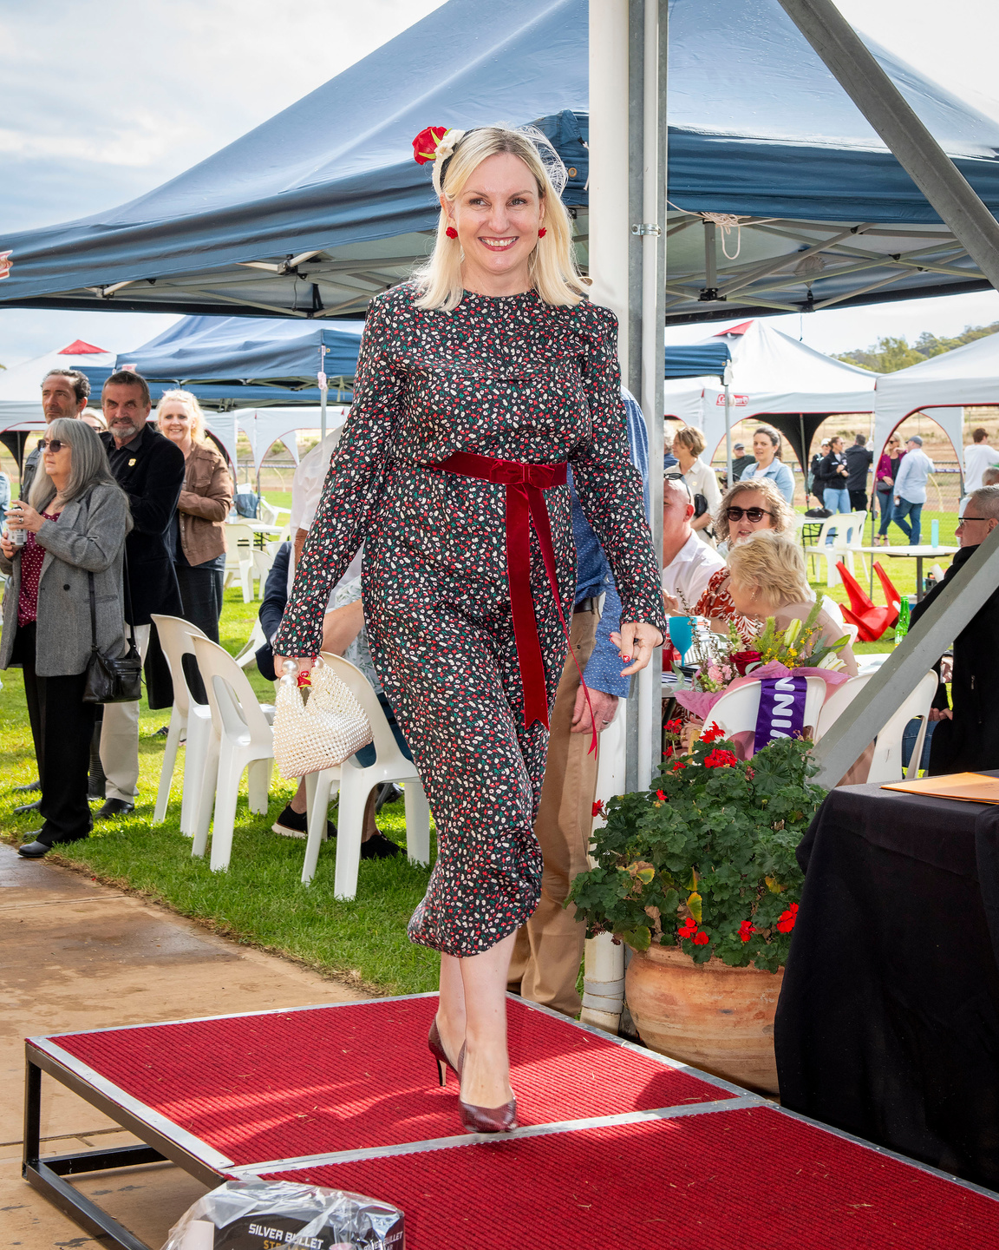
YORK RACING INC.
ANNUAL REPORT PRESENTATION
OUR VISION
To honour York’s proud racing heritage while shaping a vibrant future.
We strive to:
  Preserve tradition – safeguarding York Racecourse as Australia’s oldest provincial track.
  Deliver unforgettable experiences – hosting race days and events that bring people together.
  Drive regional growth – positioning York as a leading tourism and equine destination.
  Foster community – creating a welcoming space for members, volunteers, and visitors.
  Innovate with purpose – evolving our facilities to ensure long-term sustainability.
  This racecourse belongs to the community — our role is to leave it stronger than we found it.
York Racing Inc. exists to keep the spirit of country racing alive — celebrating history while creating opportunities for generations to come.

Slide 12

YORK RACING INC.
ANNUAL REPORT
FY26 STRATEGIC GOALS
  Deliver the 2025–26 Strategic & Operational Plan
  Finalise and implement a clear plan to guide governance, investment, maintenance and growth.
  Strengthen Financial Sustainability
  Diversify revenue through race days, events, venue hire, equine leasing and new commercial opportunities.
  Improve Water Security & Track Reliability
  Complete Stage 1 of the bore solution and continue staged improvements to irrigation and track infrastructure.
  Establish an Equine Precinct & Working Group
  Progress masterplanning and partnerships to develop York Racecourse as a multi-use equine precinct.
  Protect & Maintain Club Assets
  Implement asset registers, maintenance schedules and logging systems to support long-term asset management.
  Enhance Governance, Capability & Community Engagement
  Strengthen policies, contracts and committee capability while deepening engagement with members, volunteers and the Wheatbelt community.

Slide 13
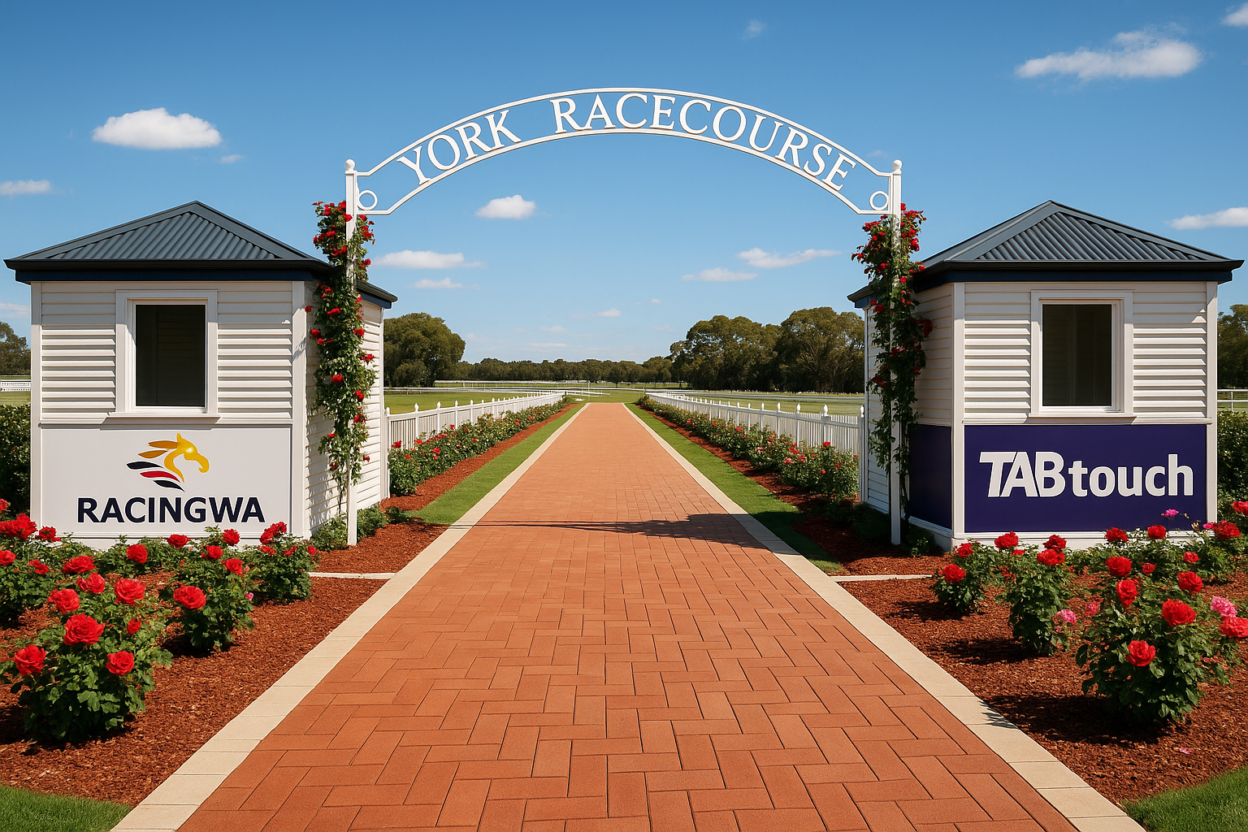
YORK RACING INC.
ANNUAL REPORT PRESENTATION
LOOKING AHEAD
Stronger. Smarter. Sustainable.
  We faced one of the most challenging years in the Club’s history — and we stood up.
  We stabilised, invested and strengthened our foundations.
  We are financially more resilient and strategically aligned.
  We are committed to growing income so we can reinvest in racing, equestrian facilities and the future of this site.
Our goal is clear:
To honour our history while building a racecourse that is sustainable, profitable and proudly community-focused.
Not just Australia’s Oldest Provincial Racecourse — but the best.

Slide 14
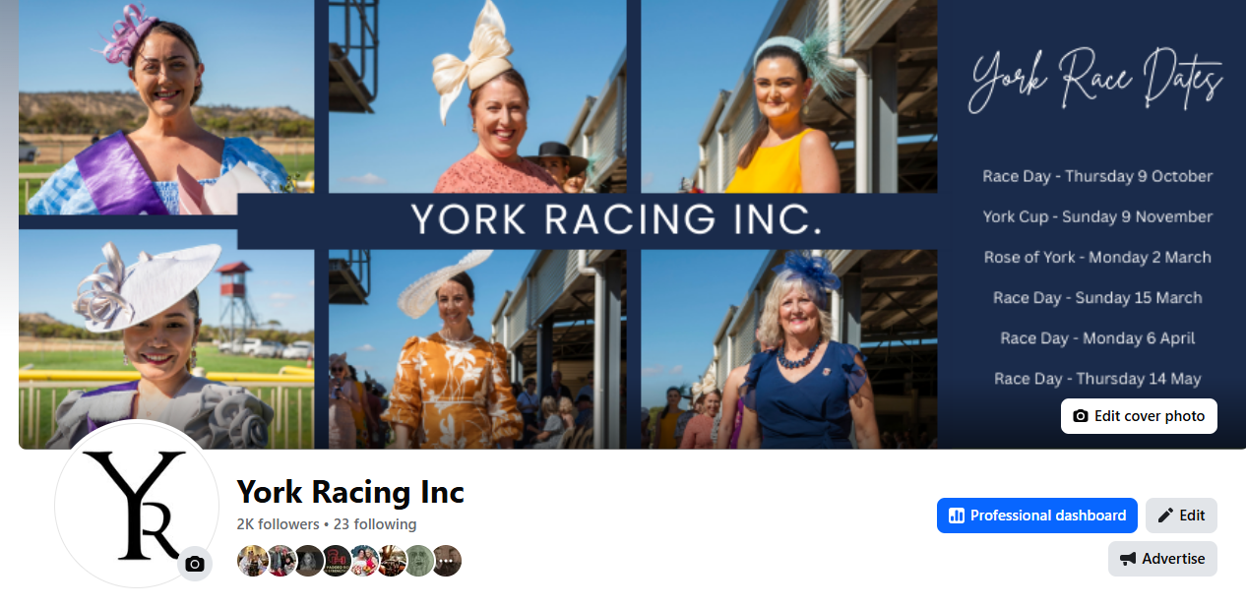
YORK RACING INC.
ANNUAL REPORT PRESENTATION
FACEBOOK STATS
2042 FOLLOWERS
+11.6% FROM PREVIOUS 365 DAYS
192,807 VIEWS ON OUR PAGE
2,463 INTERACTIONS
+65.7% FROM PREVIOUS 365 DAYS

Slide 15
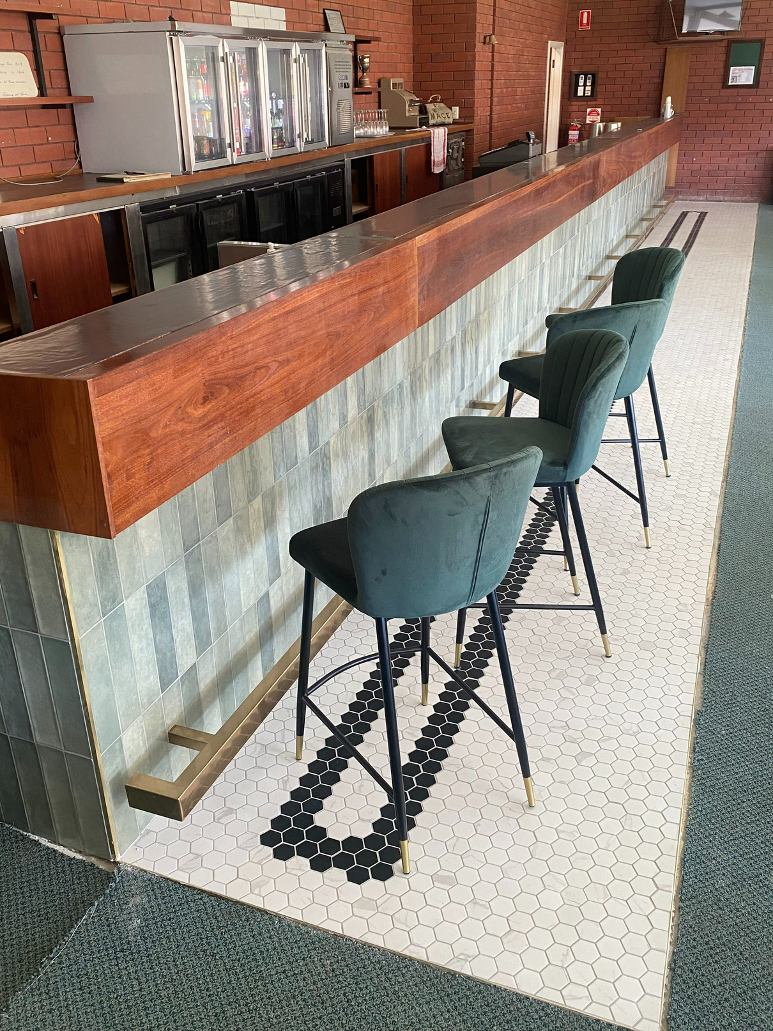
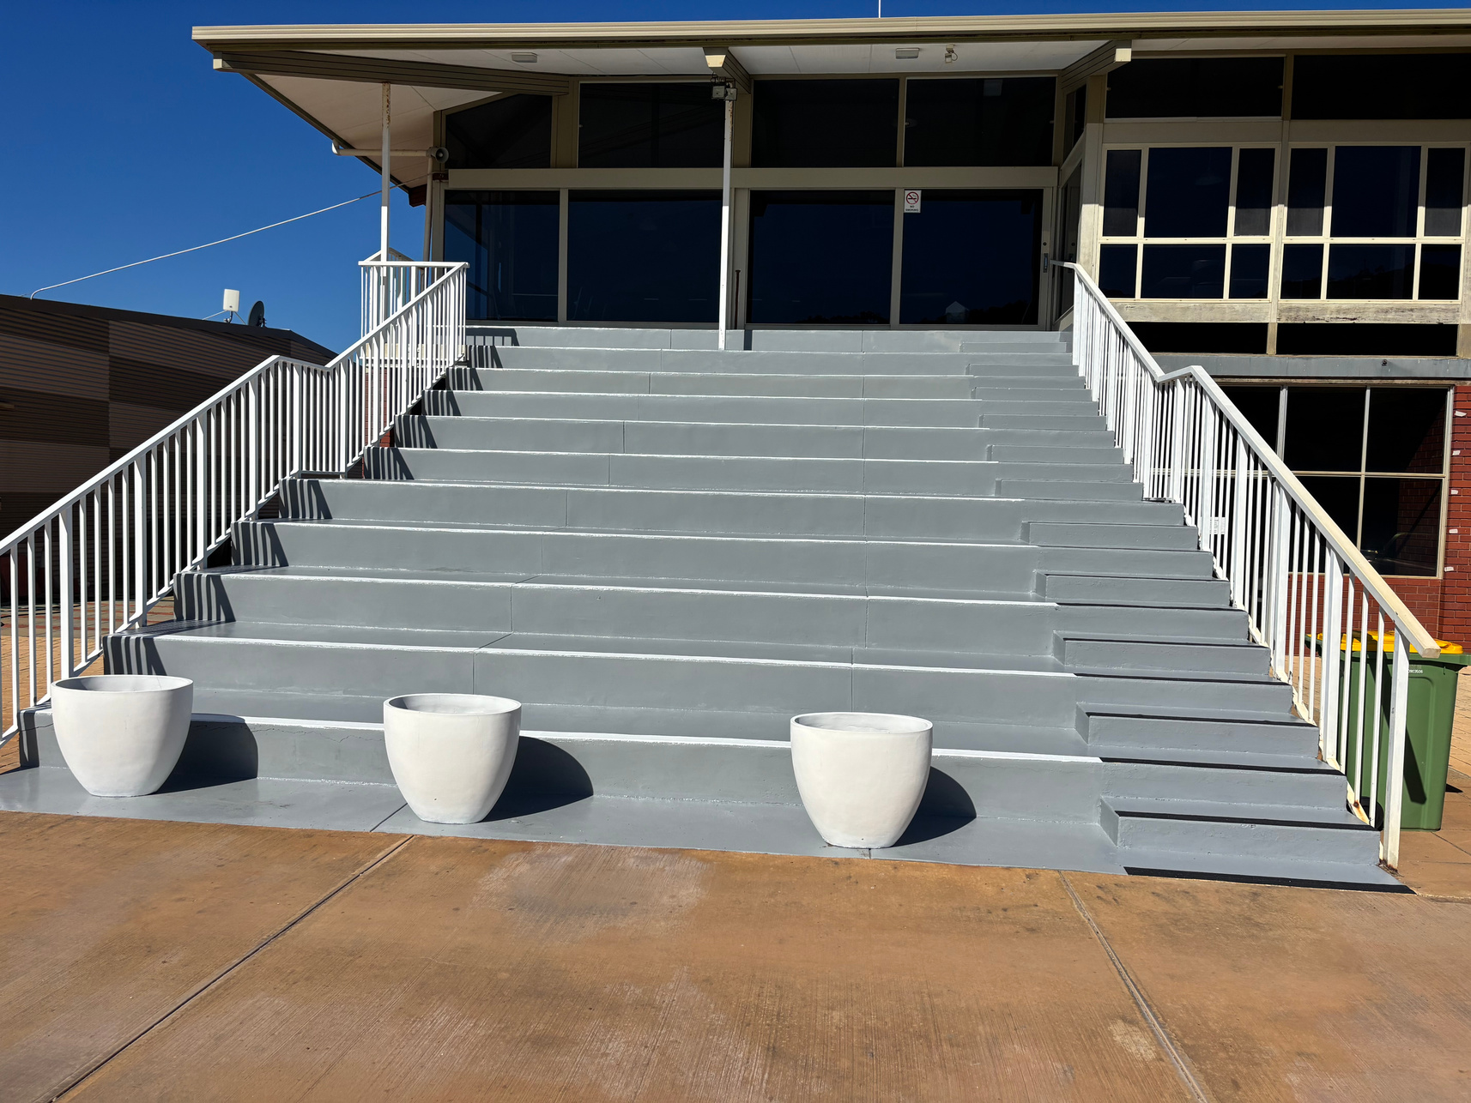

YORK RACING INC.
ANNUAL REPORT
IMPROVEMENTS IN FY25
TILING MEMBERS BAR & FLOOR
REPAINTING MEMBERS GRANDSTAND
This year we invested in key improvements across York Racecourse, including tiling to the Members Lounge bar, creating a more polished and welcoming space. These upgrades, alongside ongoing maintenance, enhance comfort, functionality and presentation, ensuring our facilities reflect the pride and heritage of Australia’s oldest provincial racecourse.
This year, Kim and Shelly repainted the grandstand, improving both presentation and safety. Their efforts ensure the structure remains welcoming, well-maintained, and reflective of the pride of York Racecourse.

Slide 16
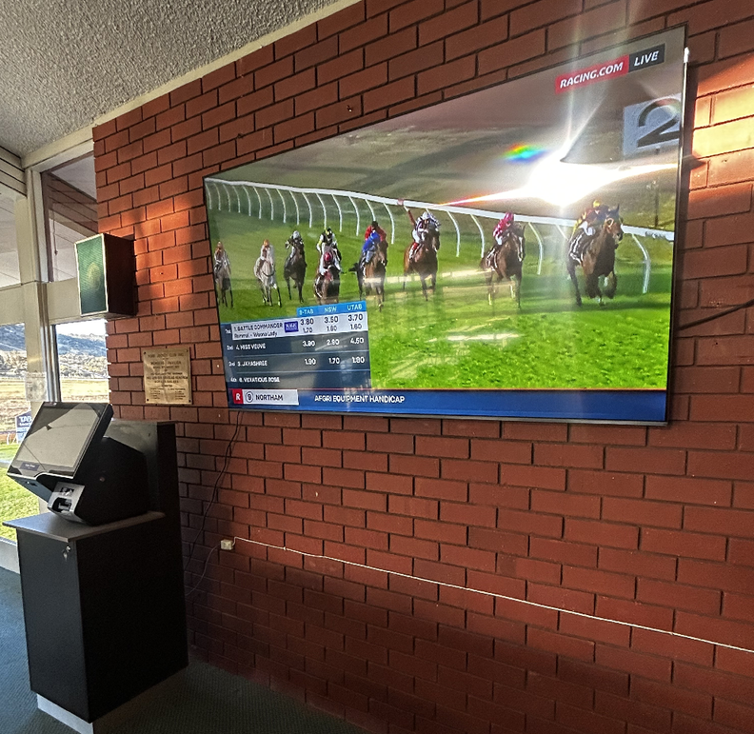
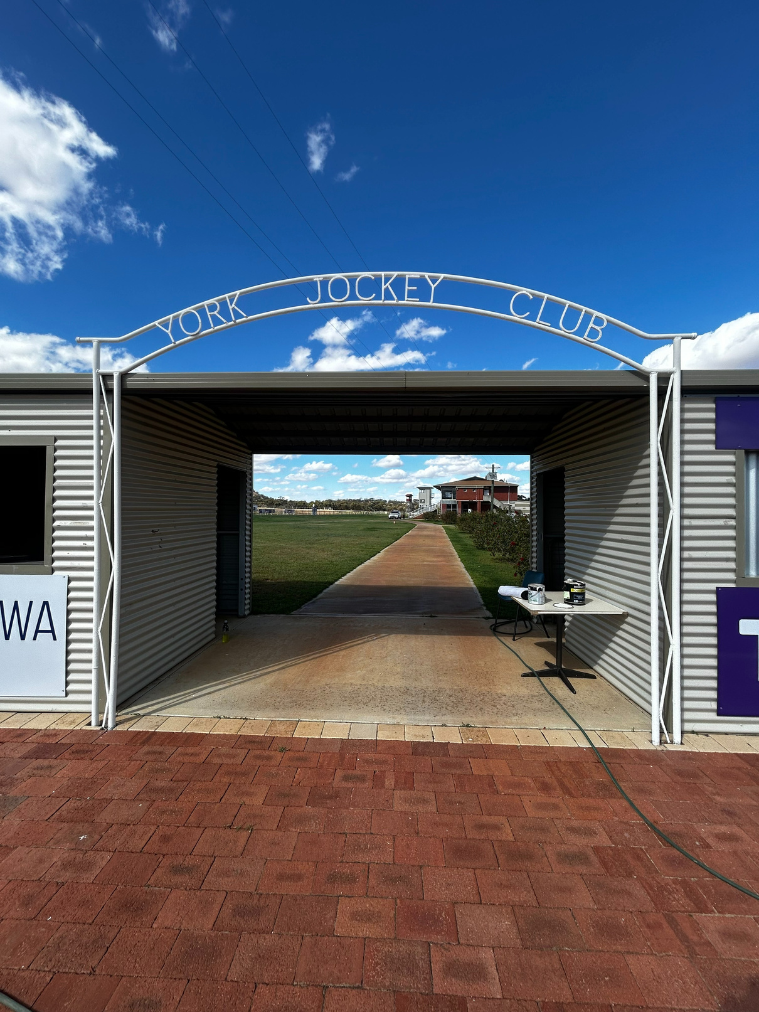
YORK RACING INC.
ANNUAL REPORT
IMPROVEMENTS IN FY25
MEMBERS LOUNGE LARGE SCREEN
REPAINTING ENTRACE & PLANTING CLIMBING ROSES
Large screen TV purchased and installed in Members Lounge to ensure you don’t miss any of the action!
We had a busy bee to repaint the entrance from the car park back to white. We have also planted climbing roses along the fence line so we hope to have an abundance of roses for you to arrive to in the future.

Slide 17








YORK RACING INC.
ANNUAL REPORT
OUR SPONSORS
MAJOR SPONSORS
SILVER SPONSORS
GOLD SPONSOR
BRONZE SPONSORS
Thank you to our sponsors for your invaluable support. Your contributions help us deliver great race days, maintain our facilities, and strengthen our community.

Slide 18
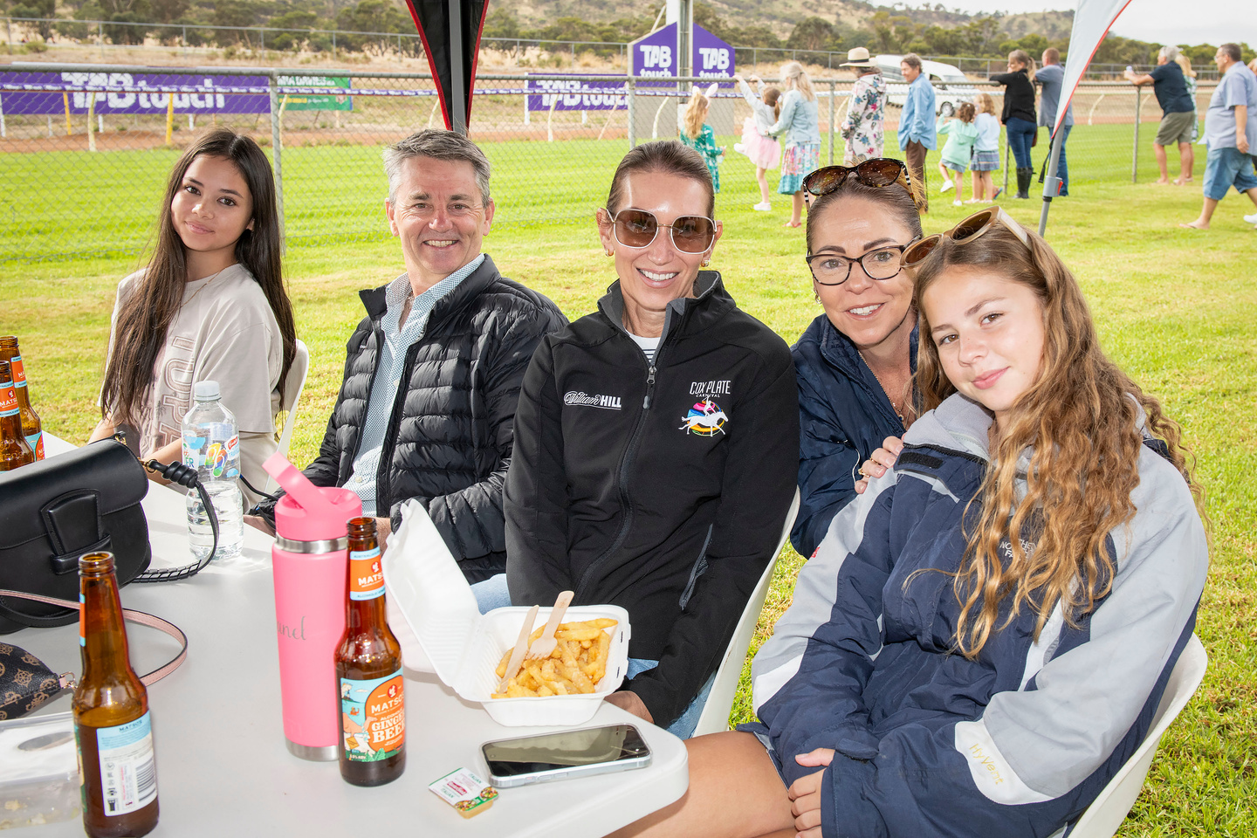
JOIN US!
YORK RACING INC.
ANNUAL REPORT PRESENTATION
York Racing Inc. is built on the strength of its members, volunteers, sponsors, and supporters. As a not-for-profit community organisation, everything we achieve – from delivering memorable race days to maintaining our historic facilities – is only possible through the dedication of people who care about the future of York Racecourse.
There are many ways to get involved:
  Membership – enjoy exclusive access to member facilities, discounted entry, and the pride of supporting Australia’s oldest provincial racecourse.
  Volunteering – lend a hand on race days or in the lead-up, whether it’s helping with grounds, hospitality, or events. Every contribution makes a difference.
  Sponsorship – partner with us to promote your business to thousands of visitors while supporting the growth and sustainability of York Racecourse.
  Committee and Subcommittees – join us in shaping the future of racing and equestrian activities in York by contributing your skills and insights.
We invite everyone with a love of racing, community, and regional tourism to be part of our journey. Together, we can preserve our heritage while building an exciting future for York Racecourse.

Slide 19

YORK RACING INC.
THANK YOU FOR
YOUR SUPPORT!
WWW.YORKRACECOURSE.COM.AU
YORKRACING@BIGPOND.COM

