Slide 1
Hidden CI/KR Systems and Social Media
Detecting hidden CI/KR system events using social media
Notes:
This is a discussion of an event that revealed a hidden critical infrastructure / key resource, and the means to discover “surprise events.”

Slide 2

















Critical Infrastructure Sectors
Chemical
Dams
Financial Services
Information
Technology
Commercial Facilities
Defense Industry
Food and Agriculture
Nuclear Reactors
Material/Waste
Communications
Emergency Services
Government
Facilities
Transportation
Critical Manufacturing
Energy
Healthcare
Public Health
Water
Wastewater
Notes:
DHS groups CI/KR into 16 major sectors.

Slide 3







Critical Infrastructure Responsibilities
Chemical
Dams
Financial Services
Information
Technology
Commercial Facilities
Defense Industry
Food and Agriculture
Nuclear Reactors
Material/Waste
Communications
Emergency Services
Government
Facilities
Transportation
Critical Manufacturing
Energy
Healthcare
Public Health
Water
Wastewater
Notes:
The responsibility for those sectors is divided among 7 federal departments with DHS responsible for 9 of the 16.

Slide 4
CARVER / CARVER + Shock / ASCOPE
C.A.R.V.E.R. – Special Operations Forces, Department of Energy, Department of State, and Department of Homeland Security
Criticality - measure of public health and economic impacts of an attack
Accessibility - ability to physically access and egress from target
Recuperability - ability of system to recover from an attack
Vulnerability - ease of accomplishing attack
Effect - amount of direct loss from an attack as measured by loss in production
Recognizability - ease of identifying target
C.A.R.V.E.R. + Shock – Department of Agriculture
Shock – impact on food supply using Risk = Exposure x Hazard
ASCOPE – Department of Defense
Area – addresses terrain analysis from a civilian perspective
Structures – structures include traditional high-payoff targets, protected cultural sites, and facilities with practical applications
Capabilities – assess capabilities in terms of those required to save, sustain, or enhance life, in that order
Organizations - consider all nonmilitary groups or institutions in the AO (area of operations)
People - people is a general term describing all nonmilitary personnel whom military forces encounter in the AO
Events - events are routine, cyclical, planned, or spontaneous activities that significantly affect organizations, people, and military operations, such as seasons, festivals, holidays, funerals, political rallies, and agricultural crop/livestock and market cycles and paydays
Notes:
There are several schools of assessment for CI/KR including the CARVER, CARVER + shock, and ASCOPE. The assessments form the basis for the identification of CI/KR.

Slide 5
Risk Formulas
Risk = (Vulnerability * Threat * Impact)
Risk = ((Vulnerability * Threat * Impact) * Commonality))
Risk = (((Vulnerability * Threat * Impact) * Commonality)) / Environment)
Vulnerability = ((location * accessibility * site visibility)/hardness)
Threat = ((notifications * bulletins * precedents * calendar * weather) * (ability * intent * opportunity))
Impact = (criticality * dependencies * visibility * symbolism * bodies * VIPs)
Commonality = (ethnicity * age * facility type * agency/organization * availability * method)
Environment = (date <>/= calendar date) / (time from incident) / (distance from incident)
This relatively simple risk formula has 27 variables, with 4 dynamic variables subject to constant change.
Notes:
Once the CI/KRs are identified, a formula can be used to calculate potential risk to the asset. The basic R=V*T*I, can also be evaluated for commonality, the environment, and the changes in the environment. It can get very complex very quickly.

Slide 6
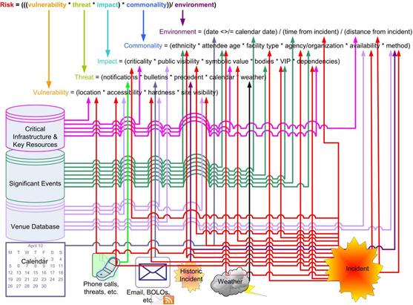
Risk Formulas “Simplified”
Notes:
The possible questions for immediate analysis and decisions include (Italicized text are examples of possible questions.):
Time of the incident – How long ago did this happen, and are there more attacks on the way? Are we running the risk of a subsequent bomb endangering other first responders?
Distance from other potential targets – How close are other similar targets? This is the third nursing home fire tonight in that part of town. Where are the other nursing homes near these locations?
Ethnicity of the target – What element could link this incident to other targets? The poisoned hand soap has been delivered to only Synagogues, should we release a statement to that effect?
Age of the attendees or victims – Is the age of the victims the deciding factor? The shootings have been confined to high schools, should we include the middle schools in our immediate response?
Facility type – Does the facility matter? Is every major grain silo in the county at risk?
Agency or organization – Is this agency or organization specific? Is this an attack on the IRS or did they just happen to be in the building?
Availability – How important was the availability of the site to the attack? Was the firebombing of one church and not another next door simply a matter of one being occupied?
Method – Will subsequent attacks be limited to this method? Do we have to defend against just Molotovs or any kind of arson?
Criticality of the target – Was the attack attempting to target more than just that site? What do we need to protect first, the refineries or the storage facilities?
Public visibility – Was the attack on that building because of its visibility? Are all our historic landmarks at risk?
Symbolic value – Was the motive of the attack symbolic? Is it just historic cemeteries, or any cemeteries?
Bodies – Was the point of the attack simply how many people would die? Is it just flea markets or any gathering of large numbers?
VIP – Was the attack against specific people-targets or the site? Was this an attack against the Governor or the Mansion?
Dependencies – What are the consequences of this attack and does it point to a subsequent attack? Were the power substations fired upon deliberately, or is it just deer season?
Location – How important was the location to the attacker? Are they just burning rural churches because they can’t be caught?

Slide 7
A Hidden CI/KR System failure…
No warning
Within 6 hours resulted in threats of arson, assault, and riots
In at least 2 cases resulting in police action
Touched 17 states and 1 out of every 7 people in those states
Could happen again in the next minute
Notes:
In 2013 we encountered a hidden CI/KR. It was an out-of-the-blue surprise. If it was not on anyone’s radar, it was not discussed with any degree of urgency.

Slide 8

Critical Infrastructure Sectors
Chemical
Dams
Financial Services
Information
Technology
Commercial Facilities
Defense Industry
Food and Agriculture
Nuclear Reactors
Material/Waste
Communications
Emergency Services
Government
Facilities
Transportation
Critical Manufacturing
Energy
Healthcare
Public Health
Water
Wastewater
Notes:
This “hidden” CI/KR system touched 4 critical infrastructure sectors and three federal departments.

Slide 9
CARVER / CARVER + Shock / ASCOPE
C.A.R.V.E.R. – Special Operations Forces, Department of Energy, Department of State, and Department of Homeland Security
Criticality - measure of public health and economic impacts of an attack
Accessibility - ability to physically access and egress from target
Recuperability - ability of system to recover from an attack
Vulnerability - ease of accomplishing attack
Effect - amount of direct loss from an attack as measured by loss in production
Recognizability - ease of identifying target
C.A.R.V.E.R. + Shock – Department of Agriculture
Shock – impact on food supply using Risk = Exposure X Hazard
ASCOPE – Department of Defense
Area – addresses terrain analysis from a civilian perspective
Structures – structures include traditional high-payoff targets, protected cultural sites, and facilities with practical applications
Capabilities – assess capabilities in terms of those required to save, sustain, or enhance life, in that order
Organizations - consider all nonmilitary groups or institutions in the AO (area of operations)
People - people is a general term describing all nonmilitary personnel whom military forces encounter in the AO
Events - events are routine, cyclical, planned, or spontaneous activities that significantly affect organizations, people, and military operations, such as seasons, festivals, holidays, funerals, political rallies, and agricultural crop/livestock and market cycles and paydays
Notes:
In terms of Carver or ASCOPE it was critical in impact, and addressed an unrealized vulnerability with significant effects.

Slide 10
Risk Formulas
Risk = (Vulnerability * Threat * Impact)
Risk = ((Vulnerability * Threat * Impact) * Commonality))
Risk = (((Vulnerability * Threat * Impact) * Commonality)) / Environment)
Vulnerability = ((location * accessibility * site visibility)/hardness)
Threat = ((notifications * bulletins * precedents * calendar * weather) * (ability * intent * opportunity))
Impact = (criticality * dependencies * visibility * symbolism * bodies * VIPs)
Commonality = (ethnicity * age * facility type * agency/organization * availability * method)
Environment = (date <>/= calendar date) / (time from incident) / (distance from incident)
Notes:
In the context of risk assessment it was across multiple locations, readily accessed vulnerabilities, was highly visible to the public, was of critical impact, with subsequent dependencies. It was bad, and could have been terrible.

Slide 11
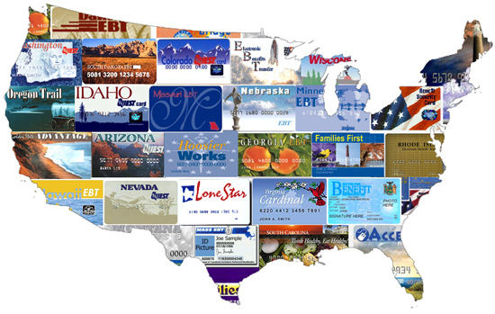
EBT event
On the 11th of October, 2013 a test of the Xerox backup software for the electronic balance transfer (EBT) card system shut down the EBT service for 17 states for a period of 9 hours.
In at least two states (FL and GA), within 6 hours the failure of the EBT system resulted in threats of violence and confrontations between store personnel and EBT users.
Notes:
This was a tiny blip on the news. It happened on a Friday and Saturday, and the focus of the nation was on the government shutdown. In fact, some initial reactions blamed the government shutdown.

Slide 12
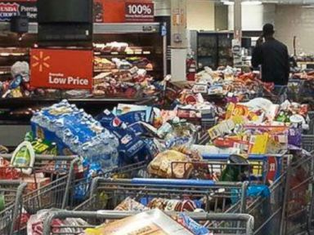
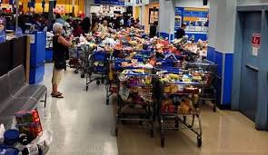
EBT event
In two Louisiana Wal-Marts, when the cards showed no limit on charges, managers at the Wal-Marts allowed customers to purchase groceries. This triggered a run on the stores with EBT card users purchasing massive amounts of groceries, electronics, and other goods. Police had to be called to manage the situation.
Notes:
…this happened in just 6 hours.

Slide 13
A hidden CI/KR with SCADA-like effect
Many EBT/food stamp recipients have no financial resources and no alternatives – they are vulnerable
The EBT failure was caused by the failure of a single server group – a single point of failure
The failure of the EBT system triggered crime and threats of violence within 6 hours
Social support systems represent a hidden and vulnerable critical infrastructure/key resource system. This is a direct cyber to real world impact with SCADA-like effect.
Notes:
Conventional cyber attacks in which data is stolen or IDs are compromised represent an initial attack with subsequent criminal exploitation. SCADA attacks have potential immediate impact. Power shuts down, trains are rerouted or derailed, centrifuges spin out of control, etc. This failure is more like a SCADA attack. Within 6 hours there were significant events triggered by the loss of EBT accessibility.

Slide 14
Scale and Scope of EBT/Food stamps
More than 46 million Americans (approximately 1 in 7) are on food stamps
In fiscal year 2012, more than 70 billion dollars in benefits were paid out
In at least 3 states (TN, MS, and NM) over 20% of the population received food stamps
The immediate effect combined with a scale impacting over 14% of the population in 17 states potentially put every food vendor or restaurant accepting EBT cards at risk.
Notes:
…not only did it have an immediate SCADA-like effect, the effect impacted approximately one out of every seven people in seventeen states.

Slide 15
Why we didn’t see it coming…
Black swans – the world is not more unpredictable than we think, it is more unpredictable than we can think
Bak’s sand pile model – self organizing states of criticality/instability
  Once the sand pile model reaches its critical state, there is no correlation between the system's response to a perturbation and the details of a perturbation. Generally this means that dropping another grain of sand onto the pile may cause nothing to happen, or it may cause the entire pile to collapse in a massive slide
  Efficiency – pushes against redundancy, serves the majority, and pushes to a critical state
  Cost – pushes against redundancy, does not reward in-depth resources, and pushes to a critical state
So how do we detect what is critical but we don’t know and may not be able to know?
Notes:
Nassim Nicholas Taleb - Black Swan theory: "we humans, facing limits of knowledge, and things we do not observe, the unseen and the unknown, resolve the tension by squeezing life and the world into crisp commoditized ideas".
Bak, Tang, and Wiesenfeld’s 1987 paper of the Abelian sand pile model argues that things push to a point of criticality – and then anything can happen.
It is more efficient to deliver EBT resources via an electronic format – it doesn’t need to be sent by snail mail. Most people prefer using a credit card-like device.
The more efficient a system is, the less likely it will have an equivalent reliable alternative – at some point the “inherent depth” of a solution may not be deep enough for a recovery.

Slide 16
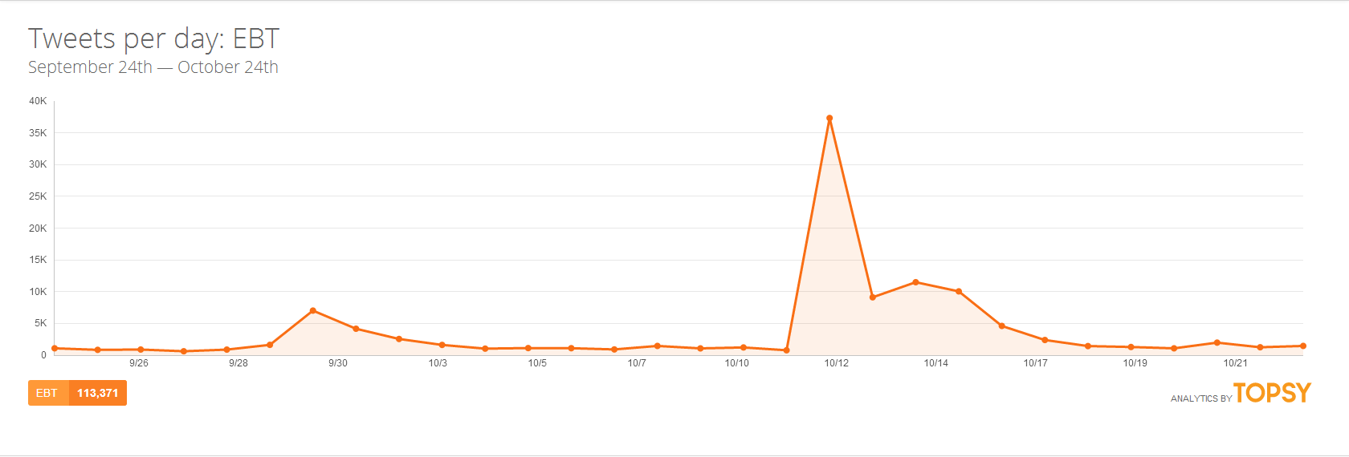
At first by accident…
Twitter traffic about EBT cards made a sudden spike late on the night of the 10th and peaked on the 12th with over 25,000 tweets dealing with the failure of the EBT system.
Notes:
While examining a new tool (Topsy) about a week after the Oct 11th event, we examined the tweets regarding the EBT. Predictably, we saw a spike in the tweets about EBT.

Slide 17
Volume and volume change
The volume of traffic reflects the level of interest. The amount of increase in a period of time reflects the degree of surprise. The sharper the angle, the higher the degree of surprise.
Notes:
We did not really know what we were looking at when we first saw it. We just saw a spike, but then we dug a little deeper.

Slide 18
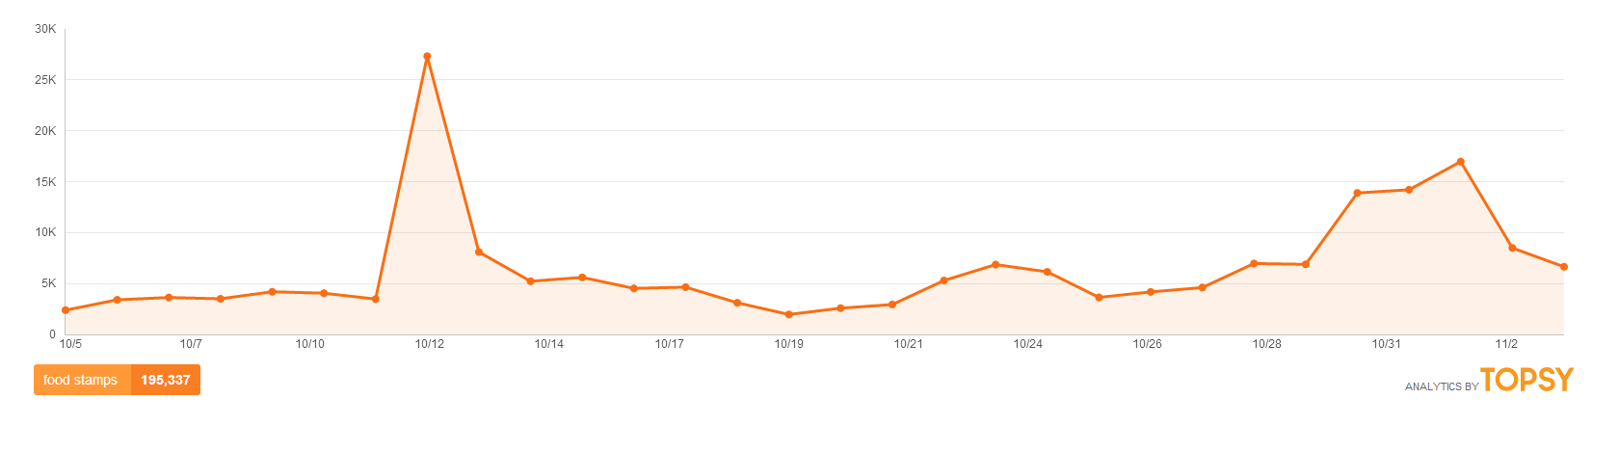

Traffic volume change
The social media traffic volume change on Oct 11th reflects an unanticipated event with a sudden and wide-spread response.
On the basis of the end of the supplemental stimulus package, EBT/food stamp/SNAP benefits were reduced on November 1^{st..}
The Nov 1st social media traffic volume change reflects a growing awareness of an anticipated event.
The differences in the volume change indicates that an algorithm to detect sudden and wide spread responses should be possible.
Notes:
We were provided an excellent means to compare the surprise factor by the Oct 11th event being followed by a change to EBT funding on Nov 1st. That is a short enough time span, and tweets dealing the same subject to make reasonable comparison. To understand the power of the rate of change to indicate the level of surprise, the event on the 11th was not expected. The event on November 1st was expected. Both events deal with the same topic and probably are closely paralleled in the tweeting population.

Slide 19
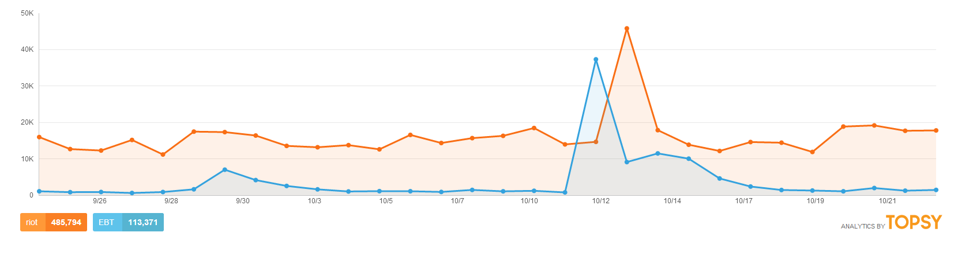
Linking words – detecting patterns
Patterns of word use in tweets confirms the relationship of the event to social media traffic. In this example, EBT is closely mirrored by riot in both traffic volume and volume change.
Notes:
When we began to examine other words closely associated with the word “EBT” such as riot, we noticed a sharp parallel in the angles of the words, and that pointed to an idea. BTW, the unexpected volume of the word “riot” was due to a Russian all-female, topless rock group with the word “riot” in their name.

Slide 20
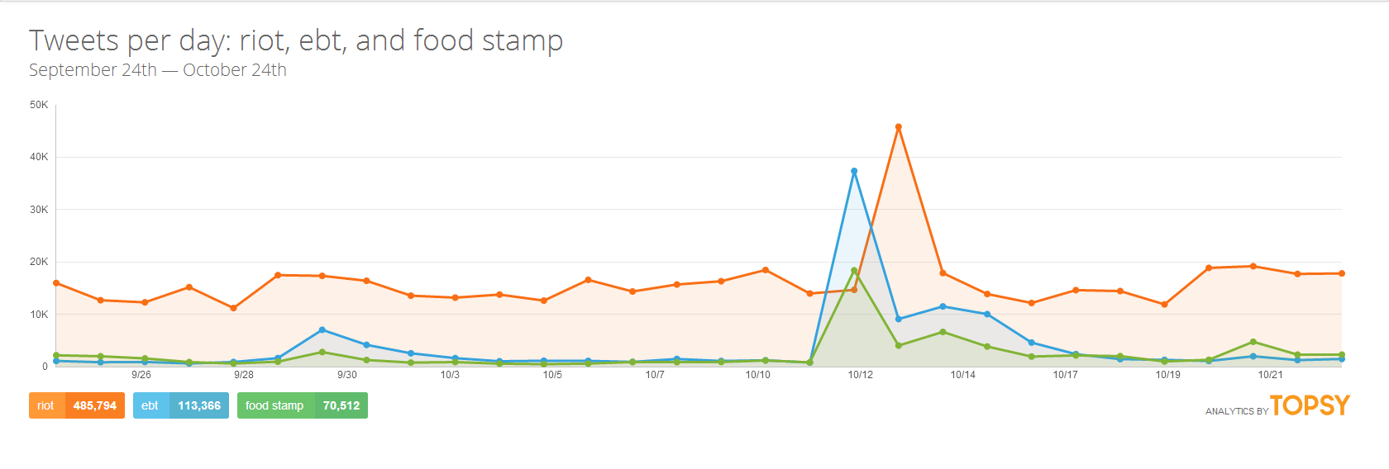
Deeper lexicon = more accurate detection of the pattern
The more words available for comparison, the more accurate the detection. – Adding food stamp to EBT and riot confirms the pattern.
Notes:
As we added words to the lexicon we clarified the nature of the angle. As an example, the words “food stamp” are relatively old-fashioned, and that was reflected in both the scale of the response and the angle of the slope. Had we a means to read the phone use of the words “food stamp” it might have reflected the same change.

Slide 21
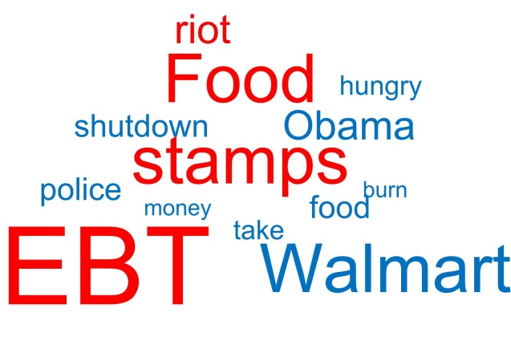
Mining a lexicon for detection
By scanning tweets for key words, a word cloud could be created that would be sensitive to sudden shifts in both the volume and the change in volume of the key words¹. Monitoring the word cloud would provide an early detection/warning system.
1.
https://sites.google.com/site/miningtwitter/questions/talking-about/wordclouds/wordcloud
Notes:
Using a word cloud means you don’t have to read every tweet or email, but only watch the ebb and flow of words. The larger the word, the higher the volume of use, the brighter the word, the more recent.

Slide 22
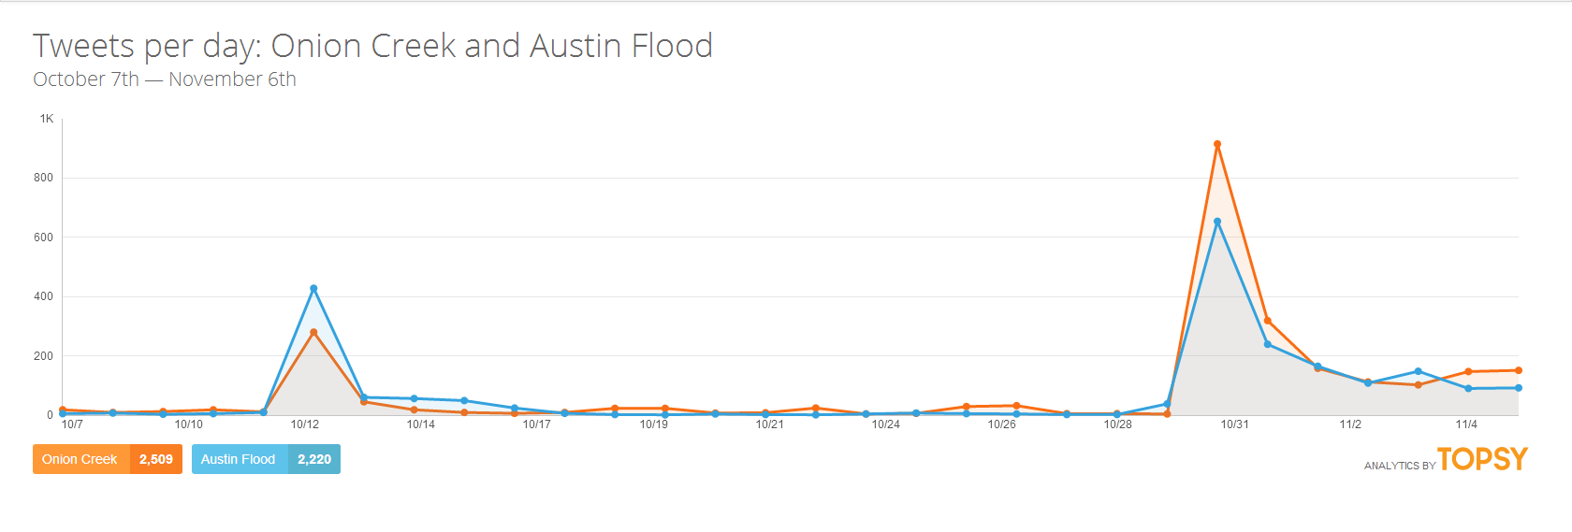
Volume change in the Onion Creek flood
The combination of volume and the rate of volume change function as a reliable indicator of an event of concern to the public. This is the response to the flooding in Austin and on Onion Creek.
Notes:
These are the tweets dealing with the Onion Creek flood on Halloween night. The angle clearly shows the degree of surprise at the event.

Slide 23
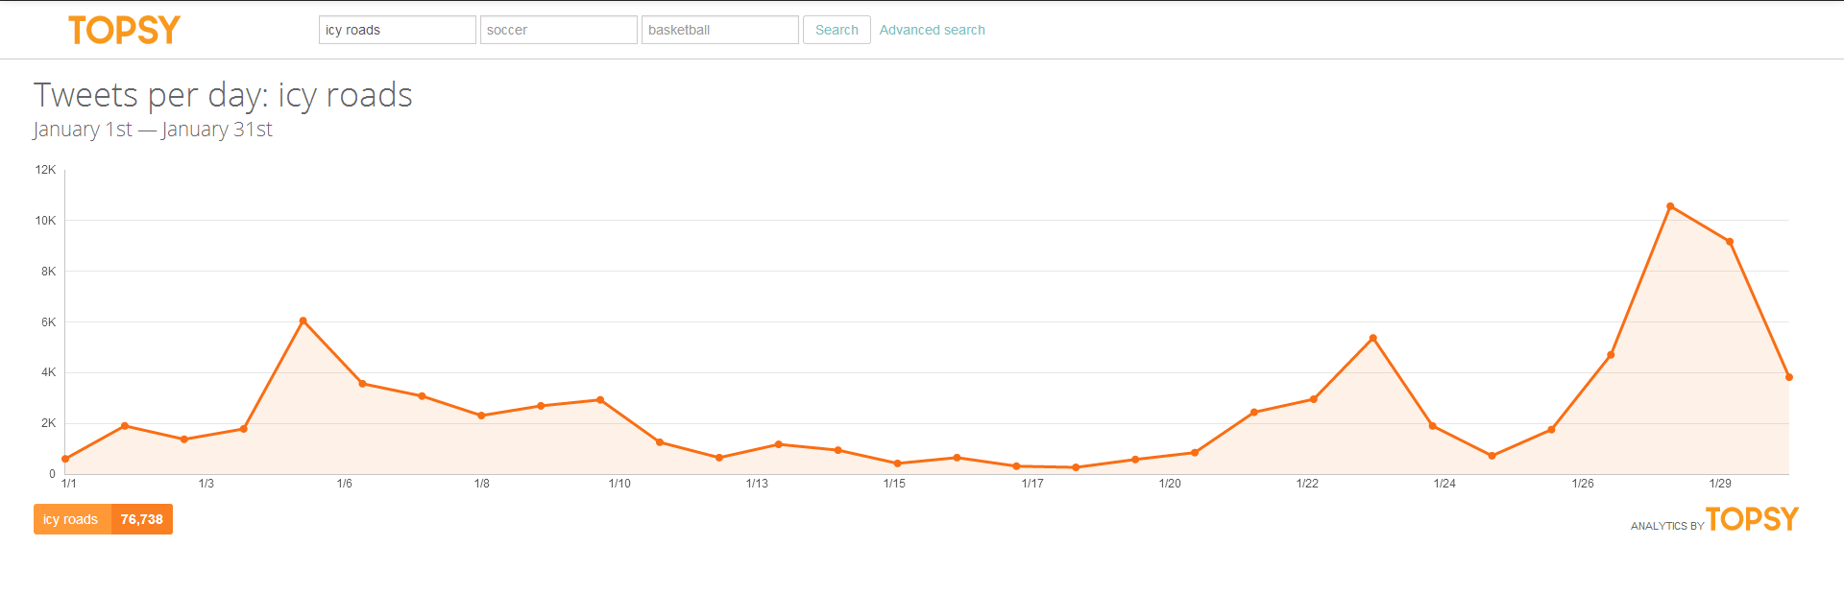
Atlanta – icy roads
These are the tweets regarding the words “icy roads.” Can you spot the surprise events in this chart?
Notes:
These tweets reflect two distinct “surprise” events.

Slide 24

Atlanta – icy roads
The events of January 3rd were anticipated to an extent, but the events of the 27th and 28th were a surprise.
Notes:
The events on the 3rd of January were discussed in the news and weather reports in advance, so the slope reflects less surprise. The events on the 27th and 28th were the surprise events that paralyzed the city.

Slide 25
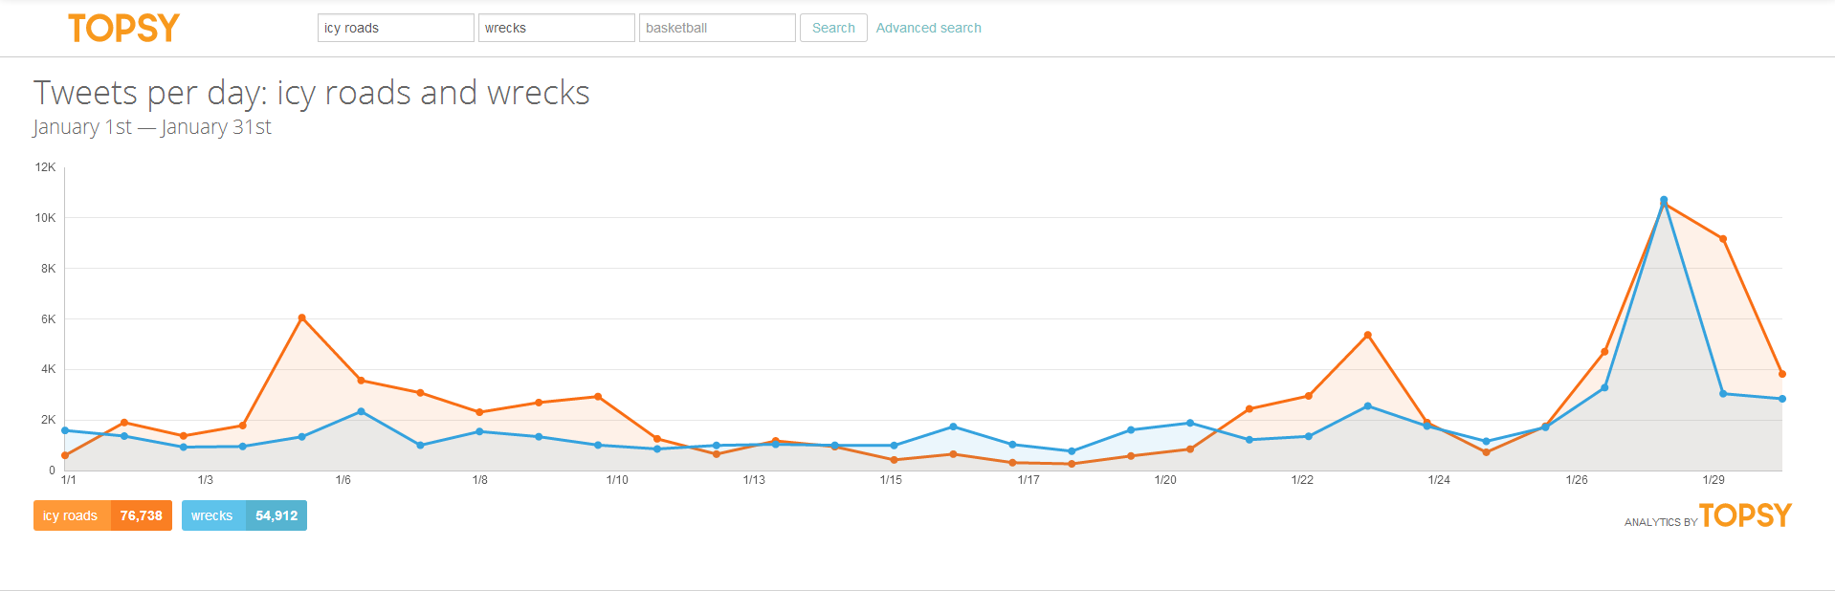
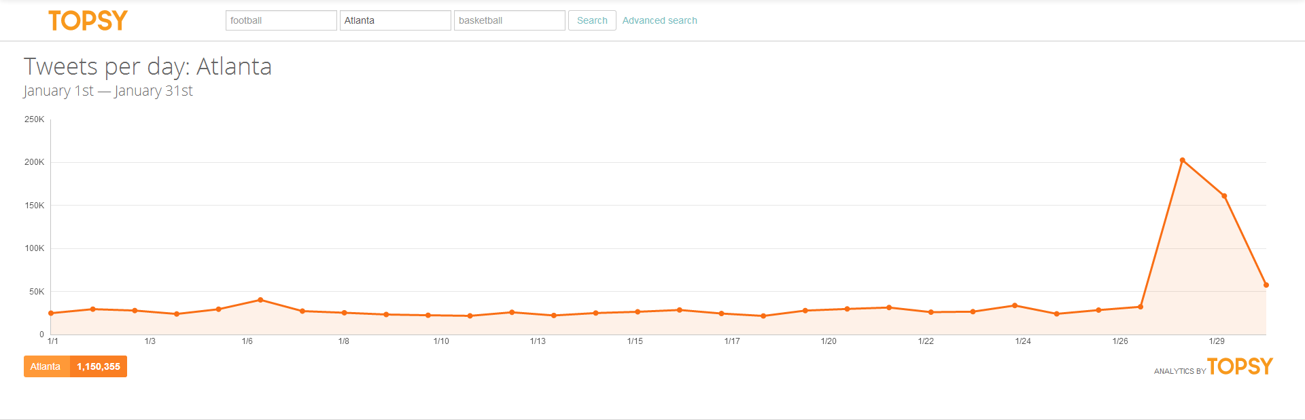
The word Atlanta
This is just the tweets that contain the word “Atlanta,” but it reflects the level of surprise surrounding the winter storm event in Atlanta. The sudden change in volume dealing with a word can reveal location.
Notes:
This points to the possibility of using the content of the tweets or other social media to determine the geospatial location of events.

Slide 26
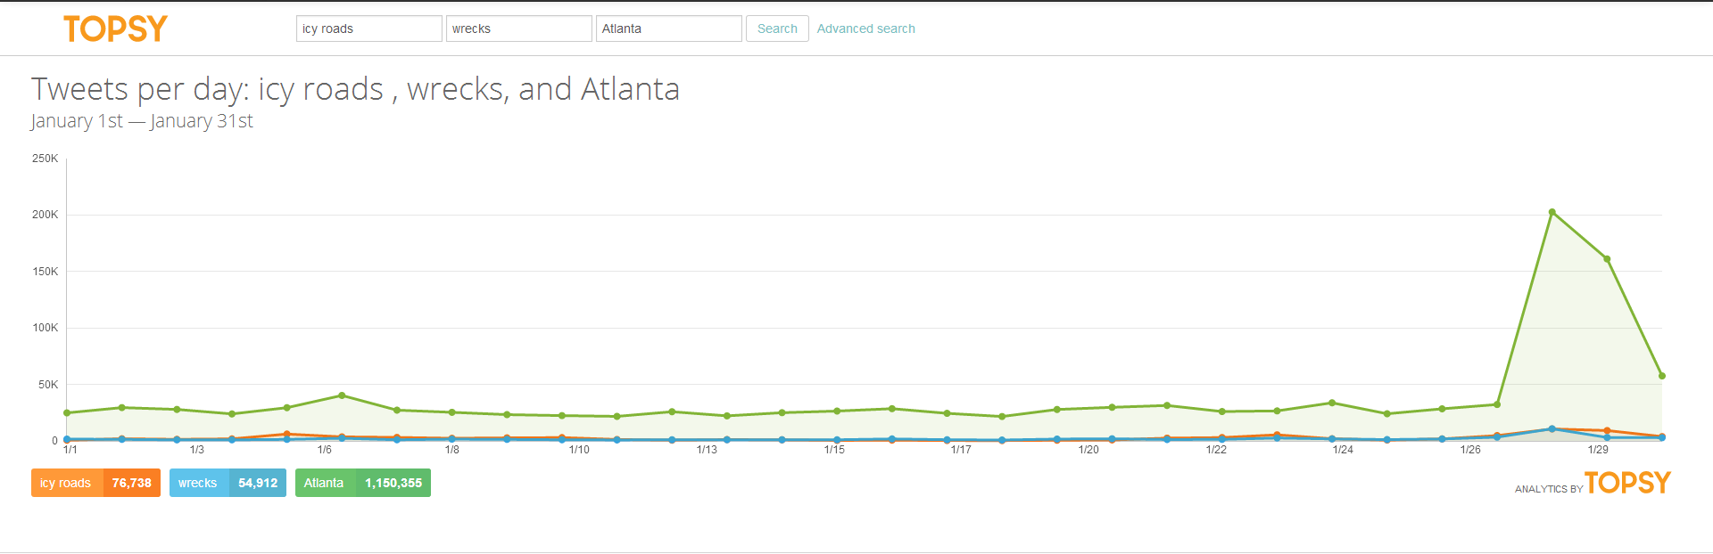
Icy roads, wrecks, Atlanta
“Icy road” is in orange, “wrecks” is in blue, and “Atlanta” is green. Notice the dominance of the word “Atlanta.”
Notes:
Even compared against “icy road and “wrecks” the word “Atlanta” stuck out.

Slide 27
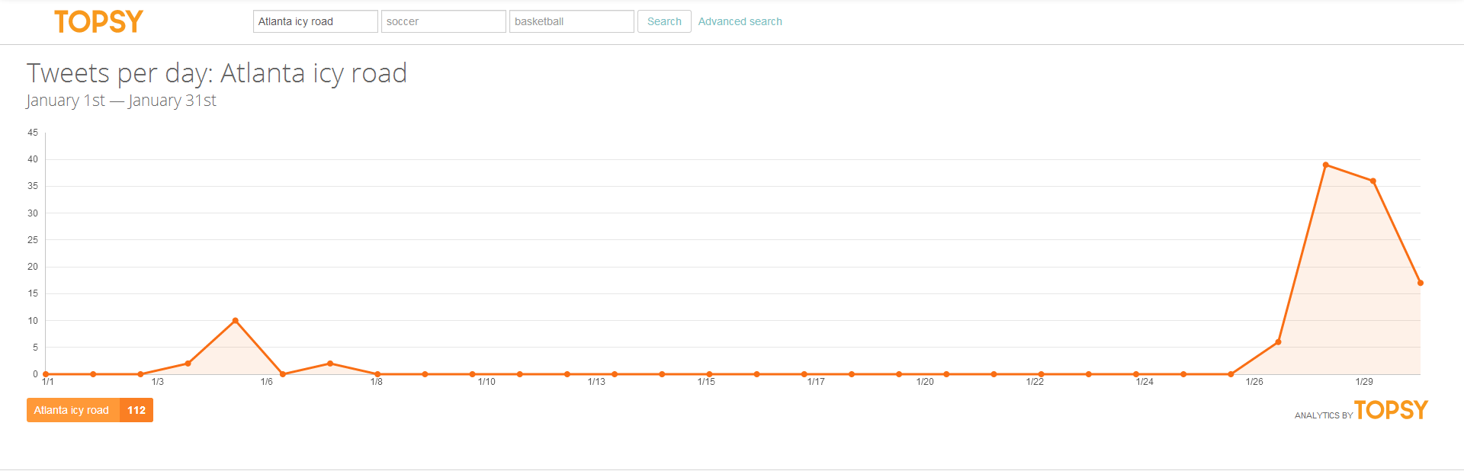
“Atlanta icy road” vs. “Atlanta”
Notes:
Note that the close parallel of the angles indicated surprise.

Slide 28
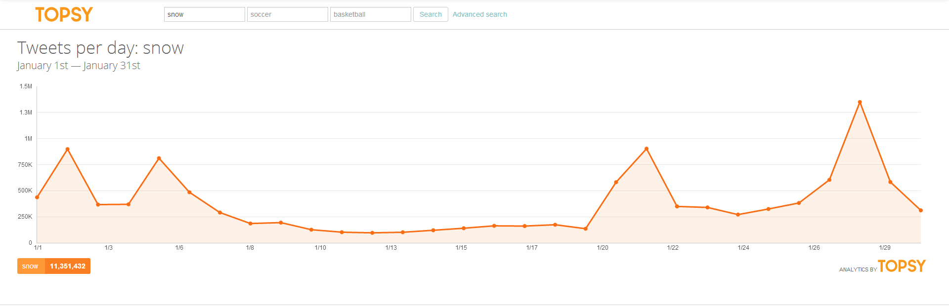
The word “snow”
This is the word “snow” and it reflects several snow events with varying degrees of surprise.
Notes:
This shows the reflection of various snow events as reflected in social media. Only one event, the Atlanta winter snow, showed a degree of surprise.

Slide 29
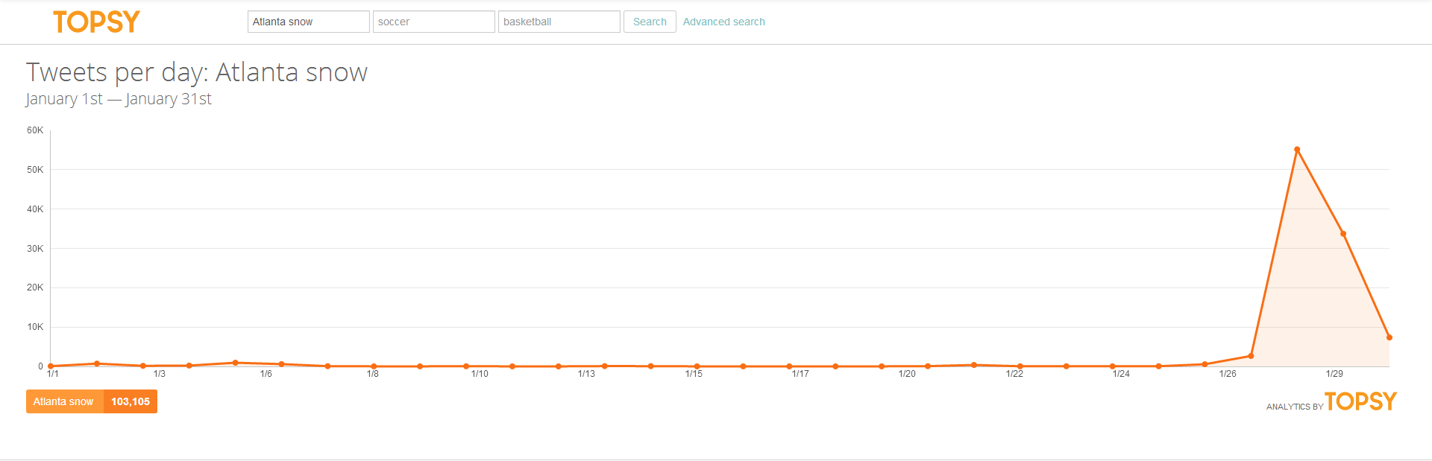
“Atlanta snow”
These are the tweets including the words “Atlanta snow” and they reflect a significant degree of surprise.
Notes:
This reflects both the surprise and the geospatial nature of the event.

Slide 30
…and then what?
Risk = (Vulnerability * Threat * Impact)
We focus on reducing vulnerability
We focus on detecting threat
We believe with these two we can eliminate/mitigate impact
“Hidden” CI/KR systems do not provide us those luxuries, but social media may provide us the means to detect hidden CI/KR system events.
Notes:
Addressing risk is most often done by reversing the risk formula. What is the worst thing that could happen? How do we reduce our vulnerability to that, and then how do we detect the threat? …this works for identified CI/KRs, but not for hidden CI/KRs. We can’t see the vulnerability or understand the threat if we don’t recognize the CI/KR systems. … but by the nature of social media, we may be able to detect that which we do not know.

Slide 31
Next steps
Collect lexicon of early indicator words
  Social & physical infrastructure: roads, water, electricity, food stamps, welfare checks, etc.
  Events: marches, rallies, concerts, parades, etc.
  Threats: bomb, active shooter, gas, etc.
Research the importance of “outlier” words
Research the use of amplifier words such as “OMG” and “WTF”
Establish a dedicated Twitter word cloud monitoring computer
Display the word cloud in the watch center
Train the watch center staff in the monitoring of the word cloud
Notes:
The outlier words from the Boston bombing were “limbs, bodies, and blood.”
The amplifier words of OMG and WTF in combination with select lexicons point to the potential to tap these words to further refine the detection process.

Slide 32
Questions?

