Slide 1
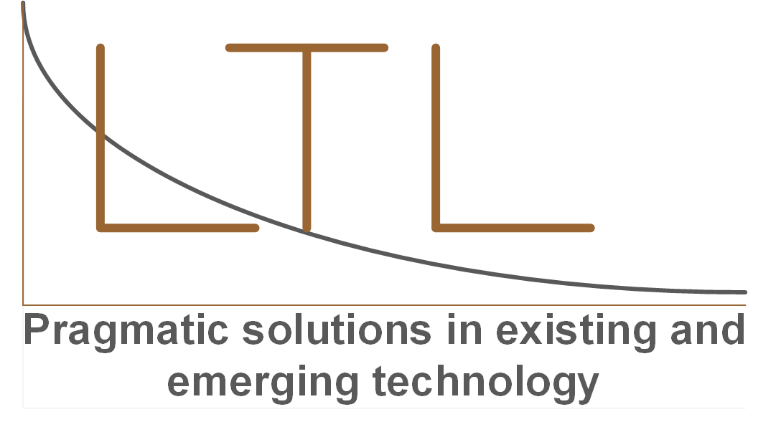
The border crisis
Local/State/Federal/Commercial solutions

Slide 2
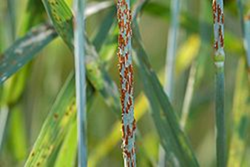
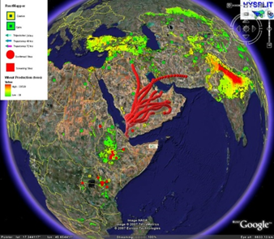
A nightmare - Ug99
Ug99
95% of the wheat commercially grown in the world is vulnerable to Ug99
As a result of the “green revolution” we have a relatively small gene pool for wheat
Spores do not recognize borders
It is in Western Kazakhstan
It is in China
It takes 7 to 12 years for a new wheat strain to migrate from research to the farm.
20% of the calories consumed by humans come from wheat
http://www.wheatworld.org/wp-content/uploads/Wheat-101.pdf

Slide 3
Nightmare - Sewbot
Sewbot
Chemical treatment renders material into a “tin-like” state, then cuts, seams, and completes the garment.
Warm water removes the conditioning material returning it to soft cloth state.
Produces a t-shirt or smock every 7 seconds or the equivalent of approximately 75+ workers.
With Asian wages, ROI is less than 18 months.
About 137 million workers or 56% of the salaried workforce from Cambodia, Indonesia, the Philippines, Thailand and Vietnam, fall under the high-risk “replaced by automation” category.
For Mexico/Central America it is 20-40%.
https://roboticsandautomationnews.com/2016/10/01/sewbots-prepare-to-take-millions-of-jobs-off-humans-in-clothes-manufacturing-sector/7566/

Slide 4
Nightmare – Chinese-sourced fentanyl for profit and world dominance
Poorly regulated labs in China produce both finished synthetic opioids and precursors.
The material is shipped to Canada, Mexico, and directly to the US.
It is not in the economic interest or political interest of the Chinese government to stop the flow.
It is not in the financial interest or political interest of many US politicians to address the issue.
News.yahoo.com

Slide 5
Reality check
The volume and tempo of illegal immigration and drugs will increase
What happens to the flow of illegal immigration when the world loses 20% of all available calories?
What happens to the flow of illegal immigration when 56% of the jobs in Asia and 40% of the jobs in Mexico and Central America cease to exist?
With legalization of marijuana, cartels’ profit centers have shifted to human trafficking and Chinese-sourced fentanyl. What possible incentive can offset the money from the cartels and influence of China?
The current leadership of the federal government will not act to effectively slow or stop illegal immigration – it is not in their interest.
The current leadership of the federal government will not act on fentanyl in a way to antagonize China – it is not in their interest.
Federal/state/county law enforcement resources are finite, and the current political climate is not promising for more resources.
The use of illegal immigrant labor continues to be profitable for agriculture, construction, and landscaping. They fund politicians.

Slide 6
What can be done - local
Increase ranch-to-ranch communication/cooperation
Immediately share security events and share notification architecture
Increase ranch-based security and law enforcement cooperation
Leverage smart technology for security
Ranch-based rest centers / satellite law enforcement facilities
County-funded remote fuel depots
Parking and staging facilities
Access to ranch Wi-Fi
Make counties retired law enforcement friendly
Sheriff-determined immediate deputization
County-supported low/no-interest loans for home/land purchase
County-based exemptions for property tax
Make counties cartel drug/human trafficking hostile
Publish drug and human traffickers’ IDs and photos in local papers and social media
Publish “found bodies” images in local papers and in social media
Drive home the humanitarian cost of human trafficking
Provide the numbers and images of “found bodies” to state and national media, and social media
Drive home the humanitarian cost of human trafficking
Feed information to state and national media, social media, and politicians
Provide data and images from illegal immigration and human trafficking events

Slide 7
What can be done - state
Attack cartel vulnerabilities
Use drug, money, guns, and human trafficking seizure data to identify businesses facilitating cartel activities
Seize their assets
For car dealerships – use national license plate readers service to track the vehicles to safe houses and stash houses
Audit their taxes
Publish their identities in state and national media, and social media
Mandate maximum legal sentencing for all cartel-related crime
Elect border security politicians – because of the economic advantage of illegal immigrant labor agriculture, construction, and landscaping firms contribute big money to politicians. This must be countered.
Mandate E-Verify for all employment - Increase fines to $1,000 per day per employee
Make all border and near-border counties retired law enforcement friendly
State-supported low/no-interest loans for land purchase
State-based exemptions for property tax
Publish “found bodies” numbers and images as ads in Mexican and Central American papers
Their clothing may help families identify the lost loved ones
It will drive home the risk of illegal immigration
It will drive home the high humanitarian cost of illegal immigration

Slide 8
What can be done – the federal “stick”
Elect border security politicians - because of the economic advantage of illegal immigrant labor agriculture, construction, and landscaping firms contribute big money to politicians. This must be countered – everything else is dependent on it.
Mandate E-Verify for all employment - Increase fines to $1,000 per day per employee
Declare cartels terrorist organizations
Any nation not actively countering cartel activity must be declared a sponsor of terrorism
Make the U.S. an illegal immigration hostile government and environment
Any nation not restricting illegal immigration forfeits all U.S. aid, and any city or state offering illegal sanctuary forfeits all federal aid
Immediate deportation of any illegal immigrant with cost of deportation taken from the U.S. aid of their nation of origin – remove/lessen the remittance incentive for nations
100% tax on all remittance funds going to nations identified as supporting illegal immigration
Finish the wall
On federal land between the wall and the border, declare the area a nature preserve subject to federal parks and wildlife laws and on private land between the wall and the border, pay owners a “lie-fallow fee” and declare the area a nature preserve subject to federal parks and wildlife laws.
Cyber letters of Marque – license cyber professionals to conduct cyber raids on cartel financial resources with a percentage of the captured funds going to the cyber professionals.

Slide 9
What can be done –the federal “carrot”
Establish a “carrot” border employment program
Corporate federal tax exemption for all businesses in border counties –border counties currently take more from the federal government than they produce. This will reduce the lure of jobs farther from the border while providing a means for businesses to leverage an available workforce.
Mandatory sponsorship of schools and clinics in the border counties and 50 miles into the Mexican border states by the businesses receiving the federal tax exemption – this would relieve the crushing burden being borne by the border counties from cross-border medical/education traffic and would improve the standard of living in the regions of Mexico directly adjacent to the border counties. This provides an improved standard of living within an hour’s bus ride of the border.
Border county-specific green cards that provide exemption from immigration enforcement in those counties – you can live, work, attend school, save money, and live legally in the U.S. without fear. Outside of the border counties you cannot receive state or federal benefits, you cannot enroll in school, you cannot get a driver’s license, and you cannot purchase land or register a vehicle.
Personal federal income tax exemption for all retirement income in the border counties – the U.S. has a growing aged population and there are critical shortages in the staff needed for nursing homes and retirement living support. The border counties have some of the most senior citizen hospitable climates in the U.S., and the tax exemption would ease the financial crisis facing many senior citizens. This provides the impetus for infrastructure and broader employment base in border counties.
If properly developed, it is conceivable that a golf cart path might stretch from Brownsville, TX, to San Diego, CA, and in a decade, and a person might make the border-length pilgrimage without being out of sight of a Sun City, Denny’s, Cracker Barrel, or Walmart.

Slide 10
What can be done – Commercial/Federal
Destroy the economic incentive of cheap illegal labor
Establish a Manhattan scope/scale, warp-speed tempo federal award program for agricultural, construction, and landscape training in community colleges and vo-tech schools
In parallel, establish infrastructure programs that cancel student debt within a fixed number of years in the programs
Establish a Manhattan scope/scale, warp-speed tempo federal award program for agricultural, construction, and landscape robotics – for reasons of an aging and limited work force and xenophobia, Japan is already pursuing this solution
In parallel, provide incentives for the migration robot/human workforces, and full robot workforces

Slide 11
Cartels are the single greatest threat to Texas
The cartels have a budget in excess of 70 billion.
The cartels have a nearly unlimited personnel pool.
The cartels have superior on-the-ground intelligence.
The cartels are not limited by bureaucratic strictures.
It is not a question of whether a cartel will rule Mexico, but which cartel will rule Mexico.
Any U.S. resources provided to the government of Mexico will simply strengthen the ruling cartel.
The financial advantage of drug trade and expatriate remittance is of such a scale that it deters Mexico from any effective border security effort.
Given a realistic assessment of Mexico, policing or arresting the cartels out of existence may not be possible.

Slide 12
Cartel functionality
Cartels are vertically integrated organizations – the legalization-driven shift from marijuana to meth, heroin, and cocaine is testimony to the agile business model of the cartels.

Slide 13
Cartel vulnerabilities
Although the majority of the cartels’ criminal enterprise is beyond the reach of Texas enforcement, there are areas of vulnerability:
Mules and vehicles from the river
Stash houses
Safe vehicles
Mules and vehicles flanking checkpoints
Mules and vehicles after checkpoints
Safe vehicles in country
Southbound cash and cards
Taking away or denying these elements will disrupt the vertical structure of the cartels’ efforts.

Slide 14
The cartels can be beaten by hitting their critical infrastructure and key resources (CI/KR)
By a deliberate policy that targets the accessible critical infrastructure and key resource (CI/KR) elements of the cartels, their criminal enterprises can be disrupted.
Regardless of how well other elements of their efforts may work, if one or more CI/KR elements are denied to the cartels, they will be forced into a reactive posture to compensate for the loss of the CI/KR.
Forcing them into a reactive posture provides the opportunity to move inside their decision cycle and further disrupt their efforts. For example, if we take away their access to safe overland transport, we should be prepared for a shift to water and/or air transport, before they perfect their methodology.

Slide 15
Material
This presentation, the Rural security document, the Church security document, and the ASP instruction document are all available at:
https://leantaillabs.com/

