Slide 1



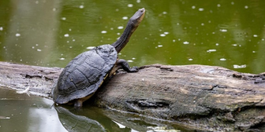
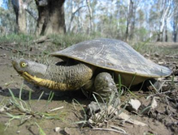
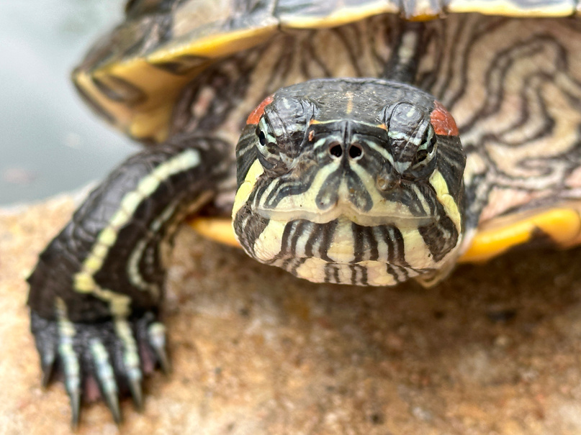
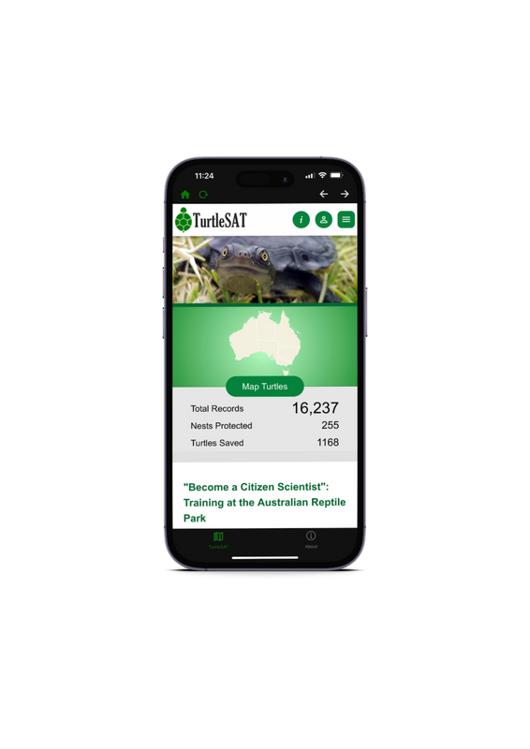
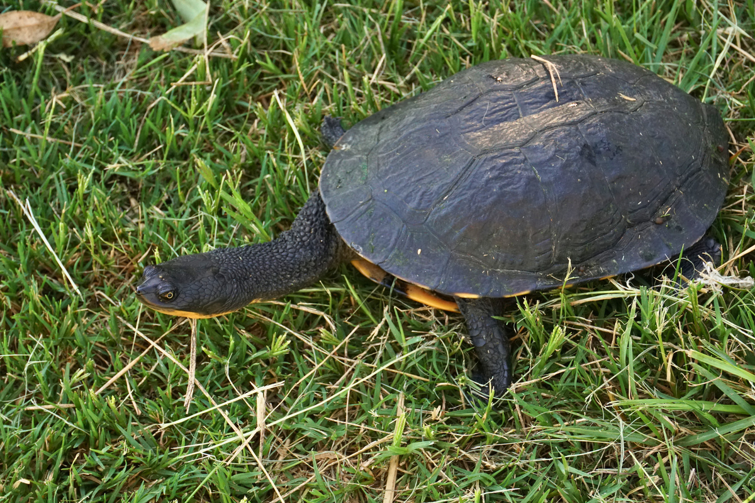
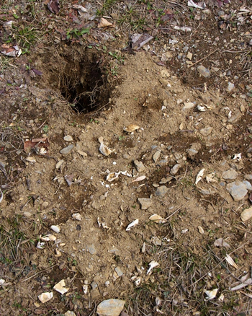



Freshwater Turtles in [insert location]
Turtles You May See
Seen a turtle or spotted
a dug up nest? Make an impact by reporting it to TurtleSAT
Types of sightings you can report to TurtleSAT
  Turtles basking on logs or rocks
  Red-Sliders
  Turtles found dead, e.g. along roads
  Turtles found crossing or walking along roads
  Dug up turtle nests
  Turtles nesting or intact turtle nest
Eastern Long-necked Turtle
Murray Short-necked Turtle
Red-eared Slider
Chelodina longicollis
Emydura macquarii
Trachemys scripta elegans
Size: 20cm
Found: eastern Australia
Unique features:
A long neck and releases pungent smell when threatened
Size: 30cm
Found: Murray-Darling
Unique features:
A short neck and can be often seen basking on rocks and logs on land
Size: 20cm
Found: In Australia due to released pets
Unique feature:
Distinct red or orange marking behind eye
More About Turtles
Basking
Nesting
Dug Up Turtle Nests
Scan to learn more about the
1 Million Turtles Program
Scan to learn more or download
TurtleSAT
Turtles need external sources to remain warm and can often be seen basking in the sunlight on rocks and logs during warmer months
Female turtles emerge from the water during the nesting season and walk for some distance to find a spot. Once found, they will use their back legs to dig a hole.
You may come across a dug up hole on the ground with egg shells around it. A fox (or other feral species) may have dug up the turtle’s nest and consumed the eggs.
Insert your logo

