Slide 1
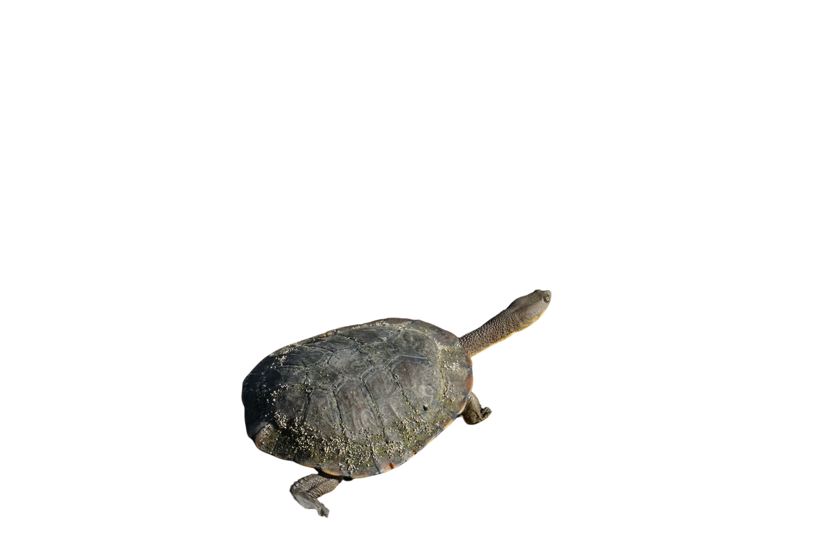






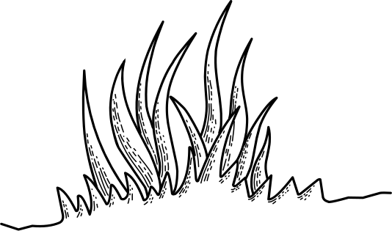
Turtle Month
is here!
Nov 2023
Scan to learn about
1 Million Turtles
Are you ready to give our turtles a helping hand?
Join our
Turtle Month
Call-to-Action
1 Million Turtles

Slide 2

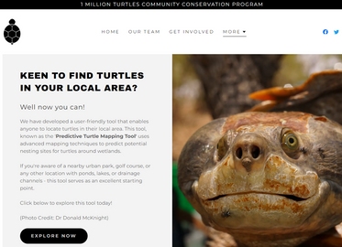
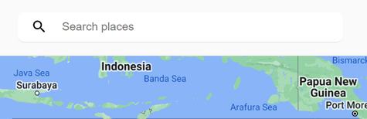
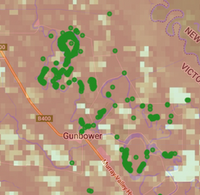








Turtle Month 2023
GET YOUR STEPS IN & SCIENCE ON
THIS TURTLE MONTH
1
2
3
4
Head to our Turtle Nest Predictor (TNP) site and click ‘Explore Now’
(QR code below)
Enter an address or location in the search bar of the nest predictor tool
Note locations of turtle nesting hotspots and head out with your phone
Take photos of surroundings and submit your data and photos to TurtleSAT
Visit 1millionturtles.com
This turtle month, we invite you to help us make the Turtle Nest Predictor tool even better. This tool enables you to identify potential or existing nesting sites of freshwater turtles in Australia. Your help to ground truth these locations will enhance the tool’s accuracy, increasing the accuracy of turtle nesting sites.
Scan here to visit the Turtle Nest Predictor Tool
Ensure that you have TurtleSAT installed on your phone and you have registered for an account before heading out.

Slide 3
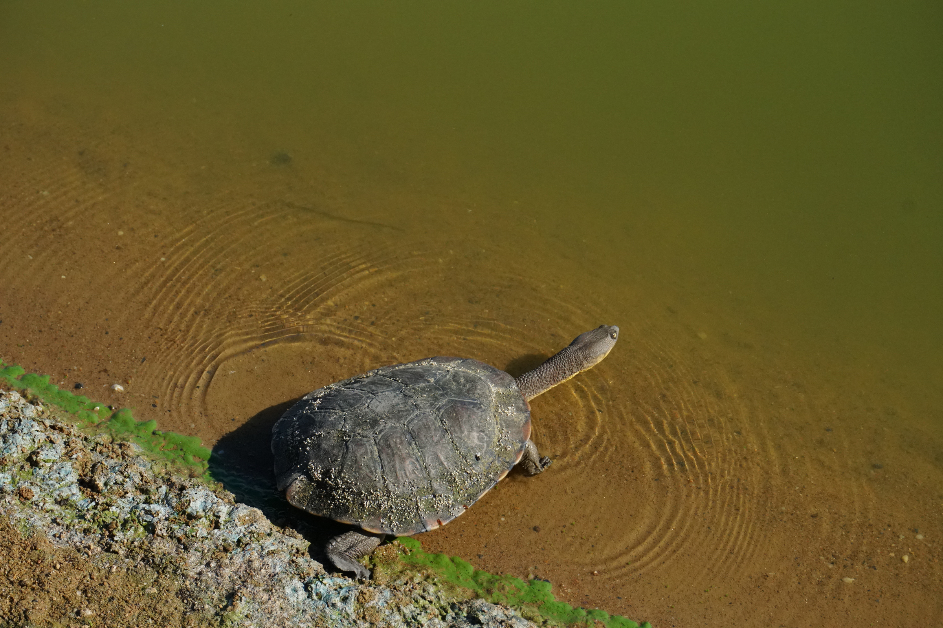



Turtle Month
is here!
1 Million Turtles
Nov 2023
Scan to learn about
1 Million Turtles
Are you ready to give our turtles a helping hand?
Join our
Turtle Month
Call-to-Action

Slide 4
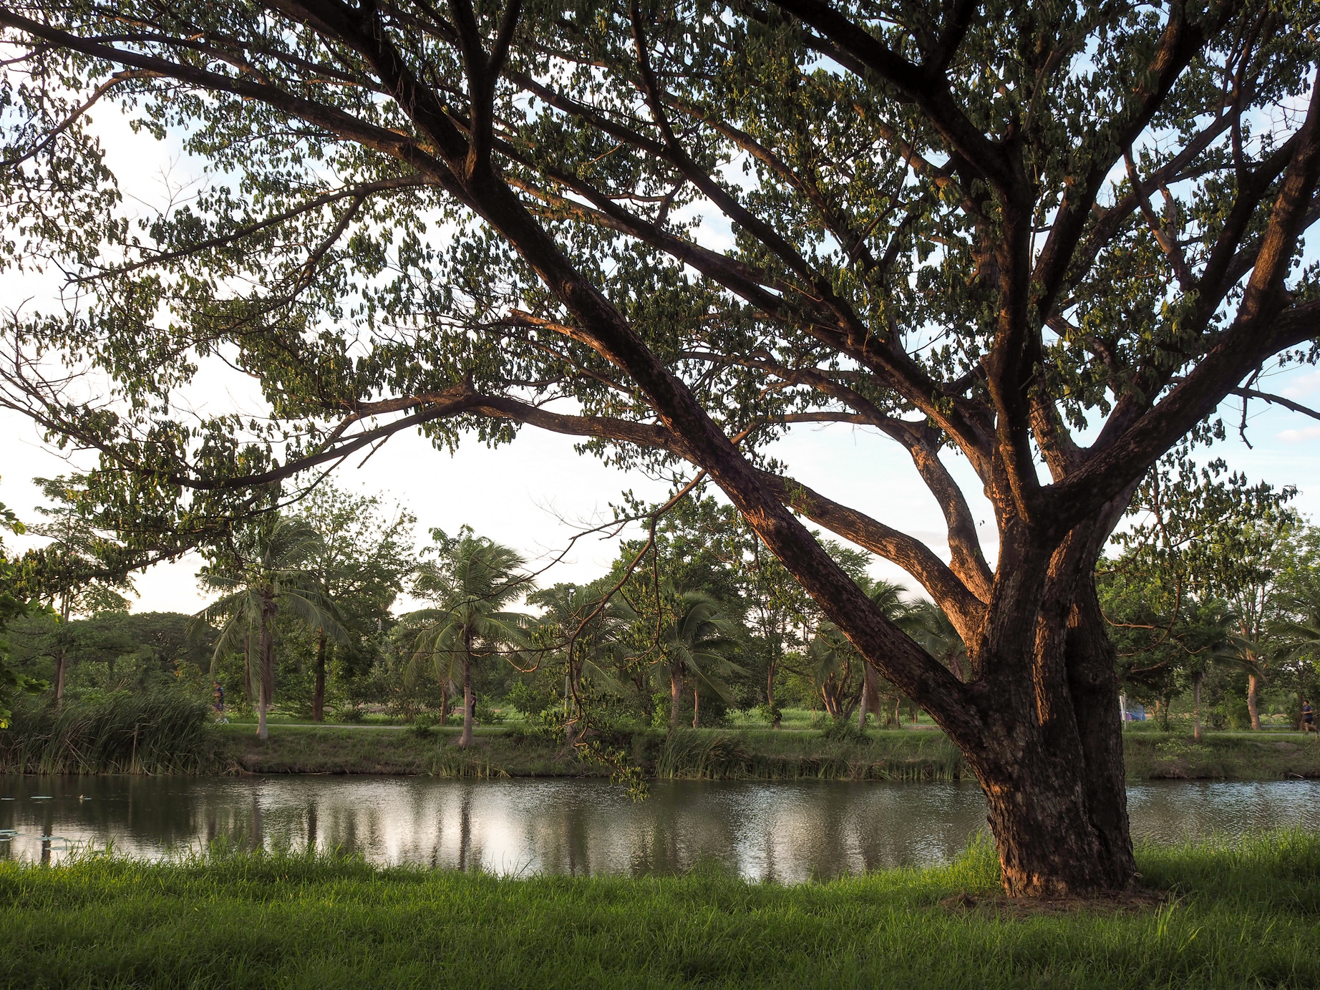
Turtle Month 2023
GET YOUR STEPS IN & SCIENCE ON
THIS TURTLE MONTH
1
2
3
4
Head to our Turtle Nest Predictor (TNP) site and click ‘Explore Now’
(QR code below)
Enter an address or location in the search bar of the nest predictor tool
Note location of turtle nesting hotspots and head out with your phone
Take photos of surroundings and submit your data and photos to TurtleSAT
Visit 1millionturtles.com
This turtle month, we invite you to help us make the Turtle Nest Predictor tool even better. This tool enables you to identify potential or existing nesting sites of freshwater turtles in Australia. Your help to ground truth these locations will enhance the tool’s accuracy, increasing the accuracy of turtle nesting sites.
Scan here to visit the Turtle Nest Predictor Tool
Ensure that you have TurtleSAT installed on your phone and you have registered for an account before heading out.

