Slide 1
1MT Turtle Tour Template - BLUE
Please read the following.
There are five different signage designs included in this template. Please feel free to make the necessary modifications to any element included in this template to better fit your context, needs and branding guidelines. You may choose to use this template as is with minor edits or simply use this as a guide to design something different.
While using this template, please note the following:
Green text – highlights words that need to be personalized or edited – e.g., the name of the lake, wetland or other water body where you will be setting up this turtle tour.
Remove any guidance text or notes denoted in blue, including any arrows.
Remove the rectangles where it says – ‘Insert your logo here’.
The slides have been resized to A3 (29.7cm X 42cm) instead of the usual 16:9.
If you do not have any Red-eared sliders in your local area – remember to include a sentence about this in ‘Signage 5’.
Check all QR codes.
We hope that this template helps and if you have any questions or need any assistance, please contact the 1 Million Turtles Program Team at 1millionturtles@1millionturtles.com
For more information about setting up a turtle tour and using this template, please refer to Attachment A.

Slide 2
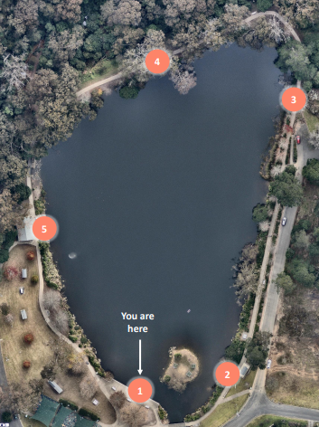
[Insert Name of Place] Turtle Tour
p
t
o
r
S
u
o
1
What is the Turtle Tour about?
T
e
l
t
r
u
The Turtle Tour is a self-paced initiative by the 1 Million Turtles Community Conservation Program and [your Local Council's name]. It provides information about turtles and promotes citizen science. Turtles are vital for waterways and wetlands, but their populations are declining due to predation and habitat loss. By becoming a citizen scientist, you can contribute to turtle research and conservation efforts. To get involved:
T
Insert your turtle tour map here, like the example here.
Download the TurtleSAT app.
Register an account.
Visit Turtle Tour Stops to learn about freshwater turtles and record your observations.
To download TurtleSAT
SCAN HERE
Apple & Android
As you walk around the [lake/wetland/river], keep an eye out for signs and QR codes. At each of these locations, you will learn more about freshwater turtles and their behaviour. See map for Turtle Tour stops around the lake.
Insert your logo here

Slide 3
Turtle Nesting
p
t
o
r
S
u
o
2
T
e
l
1. Leaving the lake
Female turtles leave the lake to find an open space for nest construction.
3. Incubation
The eggs will incubate underground for 2-3 months.
t
r
u
T
Late Spring - Early
Summer
1
2
3
4
Autumn
For more information
2. Nest Building
Female turtles use their hind legs to dig a hole and lay up to 20 eggs, which are then covered with dirt.
4. Hatchlings
Hatchlings emerge in early Autumn and make their way towards the lake.
SCAN HERE
Update QR code once your webpage is set up
The island provides an ideal nesting location for turtles, protected from fox predation. Keep an eye out for turtles constructing nests during late spring and early summer.
Please do not disturb turtles building nests or handle hatchlings.
Insert your logo here

Slide 4
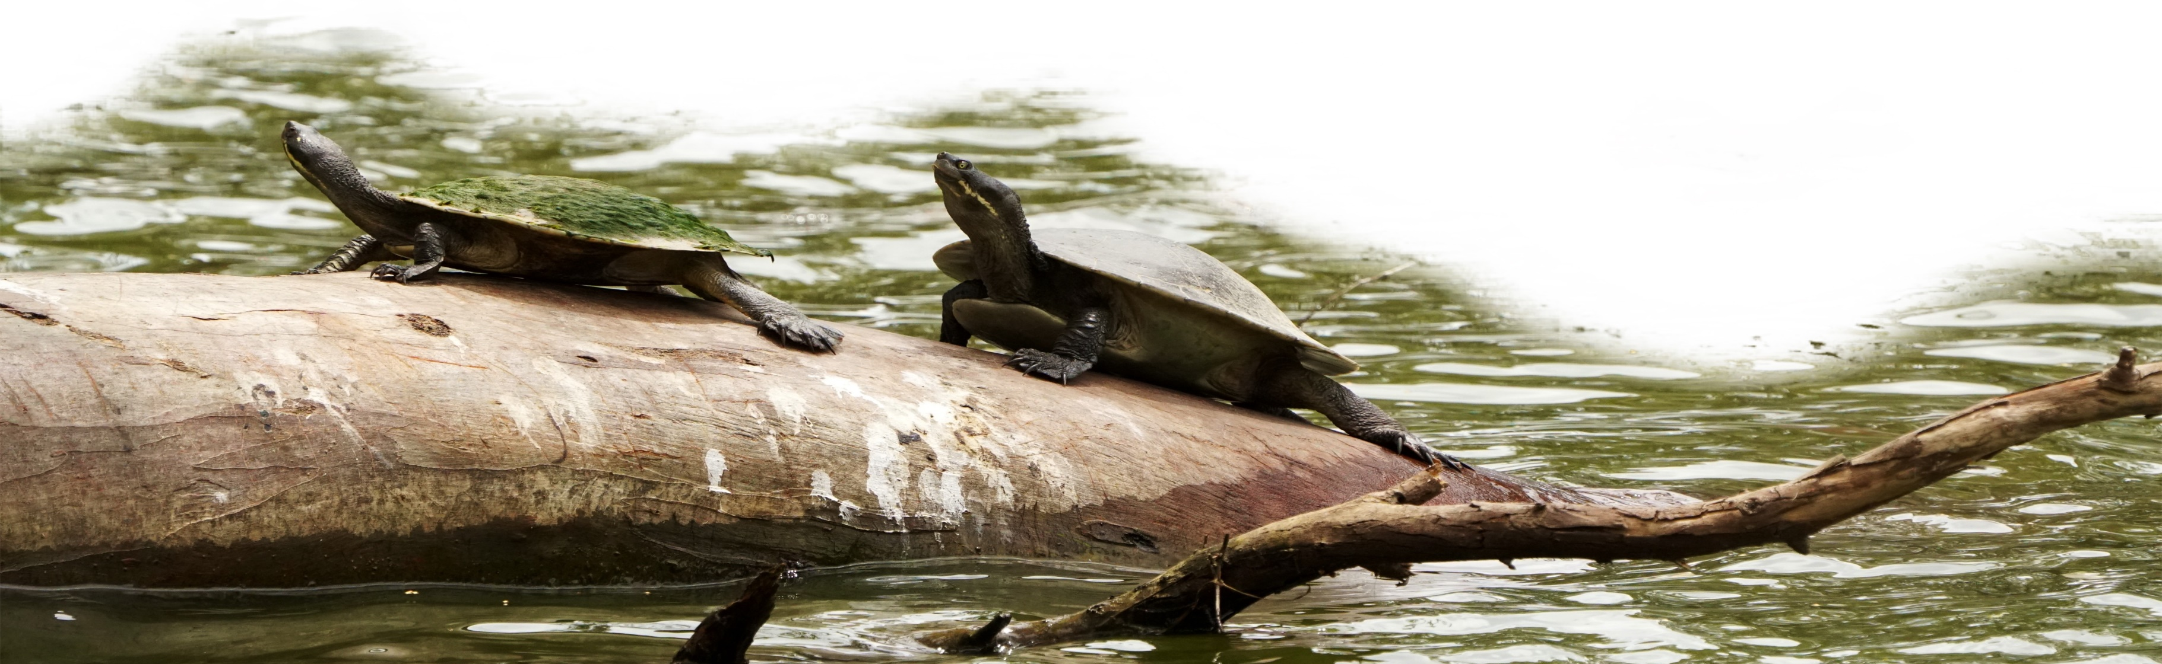
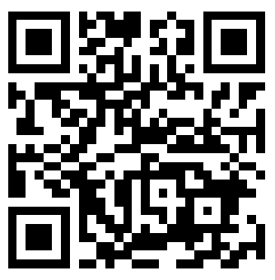
Turtle Basking
t
o
p
r
S
u
o
3
T
Turtles are ectothermic and rely on external sources for warmth. They can often be seen basking on rocks and logs, especially between September and June.
The best time to spot turtles is usually mid-morning, but during warmer months they can be seen throughout the day. Remember to report any turtle sightings on the TurtleSAT website or app.
e
l
t
r
u
T
This QR code leads to TurtleSAT website
Please feel free to replace this photo with any basking turtle photos or images you may own or have.
To record turtle sightings
SCAN HERE
While walking around the lake, check exposed rocks, branches, and logs where turtles often bask
To observe turtles, approach them slowly and quietly as they can be easily startled.
Insert your logo here

Slide 5
Turtle Spotting and Safety
t
o
p
r
S
u
o
4
[Insert name of place –lake/wetland/river] is an excellent location to observe freshwater turtles and other aquatic wildlife. When walking around the lake, keep an eye out for various turtle behaviours. Here are some tips for spotting turtles:
T
e
l
t
r
u
T
Basking: Watch for rocks, fallen trees, and branches in the lake where turtles bask. They might also bask in shallow water.
Swimming: Look out for small "pebbles" on the water's surface, as they could be a turtle's head. Turtles need to breathe air and may also bask in the warm surface water on hot Spring or Summer days.
Nesting: Turtles may travel up to 500m away from the lake to nest. Look for them in areas around the lake or even in your backyard.
Road crossings: Watch out for turtles on the roads when driving around the lake and nearby areas.
The lake provides important habitat for turtles. Make sure you report your sightings using TurtleSAT.
It is important to note that capturing and keeping turtles is illegal. If you witness any illegal activity related to turtles, please report it by calling 131 555.
Safely move turtles off the road by placing them in the direction they were heading, away from danger. Avoid returning them directly to the water.
To record turtle sightings
Insert your logo here
SCAN HERE

Slide 6
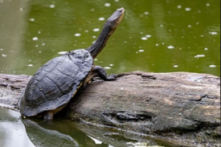
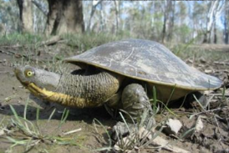
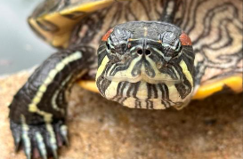
Types of Freshwater Turtles
t
o
p
r
S
Australia is home to 23 species of freshwater turtles, with 7 species found in New South Wales. These turtles can be categorized as either long-necked or short-necked. In Lake Alexandra, you can observe Eastern Long-necked turtles and Murray Short-necked turtles.
u
o
T
5
e
l
t
r
u
T
For more information
SCAN HERE
Scan Here
Eastern Long-necked Turtle
Chelodina longicollis
Murray Short-necked Turtle
Emydura macquarii
Red-eared Slider
Trachemys scripta elegans
for more information
Native Species: Yes, Size: 20cm
Found: throughout eastern Australia.
Unique features:
Pungent smell when threatened
Black markings on underside (plastron)
Native Species: Yes, Size: 30cm
Found: throughout Murray-Darling.
Unique features:
Short neck
Cream patch along jawline
Rarely seen on land except for basking on rocks and logs.
Native Species: No. Invasive and a threat to native turtles
Size: 20cm, Found: In Australia due to released pets.
Unique features:
Red or orange marking behind eye
Update QR code once your webpage is set up
Insert your logo here

