Slide 1
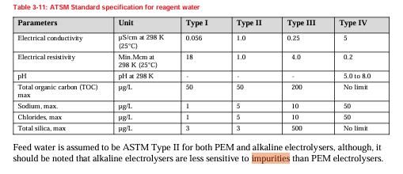
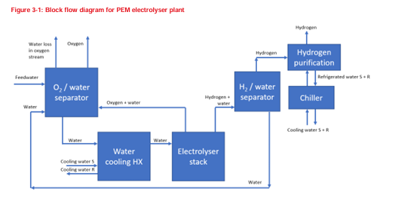
Water Purity Requirements for Green H2 production
What is the specification for the feed water used in a typical PEM electrolyser?
What is the specification for the electrolyser return water, which might be at a slightly elevated temperature when compared to the feed water?
Why is this important?
Temperature of the electrolyser return water has a major impact on the treatment step/process used for the purification of this stream, for eg if IX technology is used then TOC release from the IX resins and stability of the SBA resin component should be considered at elevated temperatures.
Pictures:
Feed Water
Electrolyser Return Water

