Slide 1

ADHD TIPS FOR MANAGING LIFE
AT WORK AND SCHOOL
Tash Hutcheson – ADHD Coach at The School Of Life
Notes:
Welcome. I am Tash. I am ADHD, with an ADHD child and an ADHD coach. Today we are talking about …

Slide 2
So what is ADHD?
Notes:
I am sure a lot of you know but for those new to our group, lets do a quick recap

Slide 3

ADHD SYMPTONS
ADHD, or Attention Deficit Hyperactivity Disorder, is a neurodevelopmental disorder that affects both children and adults.
The primary symptoms of ADHD include inattention, hyperactivity, and impulsivity.
It's worth noting that symptoms of ADHD can vary widely between individuals, and not all people with ADHD will experience all symptoms. Furthermore, the symptoms of ADHD can change over time, and may not always be present in the same way.
Inattention symptoms include:
  Difficulty paying attention to details or making careless mistakes
  Difficulty maintaining attention for an extended period of time
  Difficulty following through on instructions or completing tasks
  Difficulty organizing tasks and activities
  Avoiding tasks that require sustained mental effort
  Losing things needed for tasks or activities
  Being easily distracted
  Forgetting things frequently

Slide 4

ADHD SYMPTONS
Hyperactivity symptoms include:
  Fidgeting or squirming when seated
  Difficulty remaining seated when required
  Excessive talking
  Running or climbing in inappropriate situations
  Difficulty engaging in quiet activities or leisure activities
  Being "on the go" or acting as if "driven by a motor"
Impulsivity symptoms include:
  Blurting out answers before questions have been completed
  Difficulty waiting one's turn
  Interrupting or intruding on others
  Acting without thinking
  Being impatient
  Taking unnecessary risks
  Difficulty delaying gratification

Slide 5

How does ADHD affect adults in the workplace?

Slide 6

CHALLENGES ADULTS EXPERIENCE IN THE WORKPLACE
ADHD can present a variety of challenges for individuals in the workplace.
Some common challenges that you will find include:
Difficulty with organization and time management
Difficulty with focus and attention
Managing stress
Difficulty with social interactions
Impulsive behavior
Problem-solving
Decision-making
Communication
These challenges can make it difficult for individuals with ADHD to meet the expectations and demands of their job, leading to poor job performance, low job satisfaction, and difficulty in maintaining employment.

Slide 7

TOP 10 TIPS FOR ADHD ADULTS IN THE WORKPLACE
Prioritize tasks and make to-do lists to stay organized.
Break down larger tasks into smaller, manageable chunks.
Use a calendar or planner to schedule your time and set reminders.
Take regular breaks throughout the day to refresh your mind.
Minimize distractions by creating a designated workspace and minimizing interruptions.
6. Communicate with your employer and coworkers about your condition and how they can support you.
7. Take care of your physical and mental health by getting enough sleep, exercising, and eating well.
8. Seek support from a therapist or coach who specializes in ADHD management.
9. Use tools such as noise-canceling headphones, fidget toys, or standing desks to help with focus.
10. Allow yourself to be flexible with your work schedule.
Notes:
My experience - Make notes for a meeting so that can stay structure and focussed on the message

Slide 8

TOP 10 TIPS FOR LEADERS SUPPORTING ADHD STAFF
Clearly communicate expectation and responsibilities.
Break down tasks into smaller, manageable chunks.
Foster a positive and supportive work environment.
Encourage regular breaks and physical activity.
Use visual aids, such as calendars and checklists, to help with organization and prioritization.
Encourage the use of assistive technology, such as apps for time management and task tracking.
Provide flexibility in terms of work schedule and environment.
Set aside dedicated time for one-on-one meetings to check in and provide feedback.
Be understanding of the individual's needs and accommodations.
Regularly provide positive reinforcement and recognition for a job well done.
Notes:
My experience - Daily stand up

Slide 9
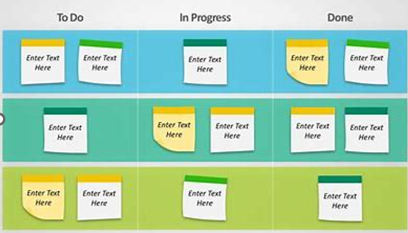
EXAMPLE OF A KANBAN BOARD
Notes:
Kanban board to visualise actions and communication, show blockers and manage capacity

Slide 10

How does ADHD affect children at school?

Slide 11

CHALLENGES CHILDREN EXPERIENCE AT SCHOOL
Children with ADHD may experience a variety of challenges that can affect a child's performance in school, their relationships with peers and family members, and their overall functioning in daily life.
Some common challenges that children with ADHD may experience include:
Difficulty paying attention in class or completing tasks
Forgetfulness or poor organizational skills
Difficulty following directions or staying on task
Impulsivity, which can lead to interrupting others or acting without thinking
Hyperactivity, which can make it hard for a child to sit still or stay in one place
Difficulty with time management or planning
Difficulty with self-regulation and emotional control
Low self-esteem or poor self-image
Difficulty making and maintaining friendships

Slide 12
TOP 10 TIPS FOR TEACHERS TEACHING ADHD CHILDREN
Create structure: Establish a clear and consistent routine for the child, including expectations for behaviour and rewards for success.
Use visual aids: Visual aids, such as charts and diagrams, can help children with ADHD understand and retain information.
Encourage movement: Allowing for breaks where the child can stretch, move, or engage in physical activity can help maintain focus and manage impulsivity.
Modify homework: Breaking down homework into smaller, manageable tasks and providing frequent positive reinforcement can help the child stay on task.
Be patient: Children with ADHD may need extra time and patience to process information and complete tasks.
Use positive reinforcement: Regularly praise and acknowledge the child's positive behaviour and effort.
Minimize distractions: Remove or reduce distractions in the classroom, such as background noise, movement, or excessive stimuli.
Provide choice: Offer choices and allow for flexible seating arrangements to increase the child's sense of control and engagement.
Foster relationships: Encourage the child to develop positive relationships with peers and build social skills through cooperative activities.
Communicate with parents: Maintaining open communication with parents can help ensure a consistent approach and provide the child with additional support at home.

Slide 13

TOP 10 TIPS FOR ADHD KIDS AT SCHOOL
Use a planner or a to-do list to stay organized and on task.
Take frequent breaks to move around and refocus attention.
Seek out extra help or tutoring if needed
Use a fidget toy to help release excess energy and stay focused.
Sit in a designated spot in the classroom, such as the front, to minimize distractions.
Use a noise-cancelling headphone or earplugs to block out background noise.
Break down long-term assignments into smaller, manageable chunks and set specific deadlines/rewards for completing each step.
8. Use visual aids, such as flashcards or diagrams, to help with learning and retention.
9. Seek out accommodations from school such as extra time on tests or permission to use a laptop.
10. Understand the strengths and weakness in learning and seek out ways to work with it.
It's important to work closely with your teachers and other professionals to develop a personalized
plan that addresses your unique needs and accommodations.
Notes:
Importance for kids to self advocate with your 100% backing

Slide 14
15 TIPS FOR PARENTS TO SUPPORT THEIR ADHD SCHOOLCHILDREN
Communicate regularly with the child's teacher to stay informed about their progress and any challenges they may be facing in the classroom.
Help your child establish a structured routine at home, including set times for homework, studying and bedtime.
Break down tasks and assignments into smaller, manageable chunks to make them less overwhelming for the child.
Encourage them to take part in extra murals that align to their strengths and interests to build their confidence
Use positive reinforcement to encourage good behavior and academic progress, big and small.
Encourage physical activity and healthy habits, such as exercise and a nutritious diet, to help the child manage their symptoms.
Encourage your child to take regular breaks and to move around to refocus.
Provide your child with a quiet space to work free of distractions.
Notes:
Locker chat

Slide 15

TIPS FOR PARENTS TO SUPPORT THEIR ADHD SCHOOLCHILDREN
Work with the school to develop an individualized education plan or a plan that addresses the child's unique needs and accommodations, if possible.
Help the child develop strategies for managing their symptoms, such as using a planner or a to-do list.
Organize social activities with children from school to help your child make friends
Help your child learn self-advocacy skills so that they can communicate their needs to their teachers and classmates
Seek out professional support, such as counseling or therapy, to help the child learn coping mechanisms and to address any related emotional or social issues
Understand your child’s timings and work with that
Be their champion!
Notes:
Morning routine for us

Slide 16
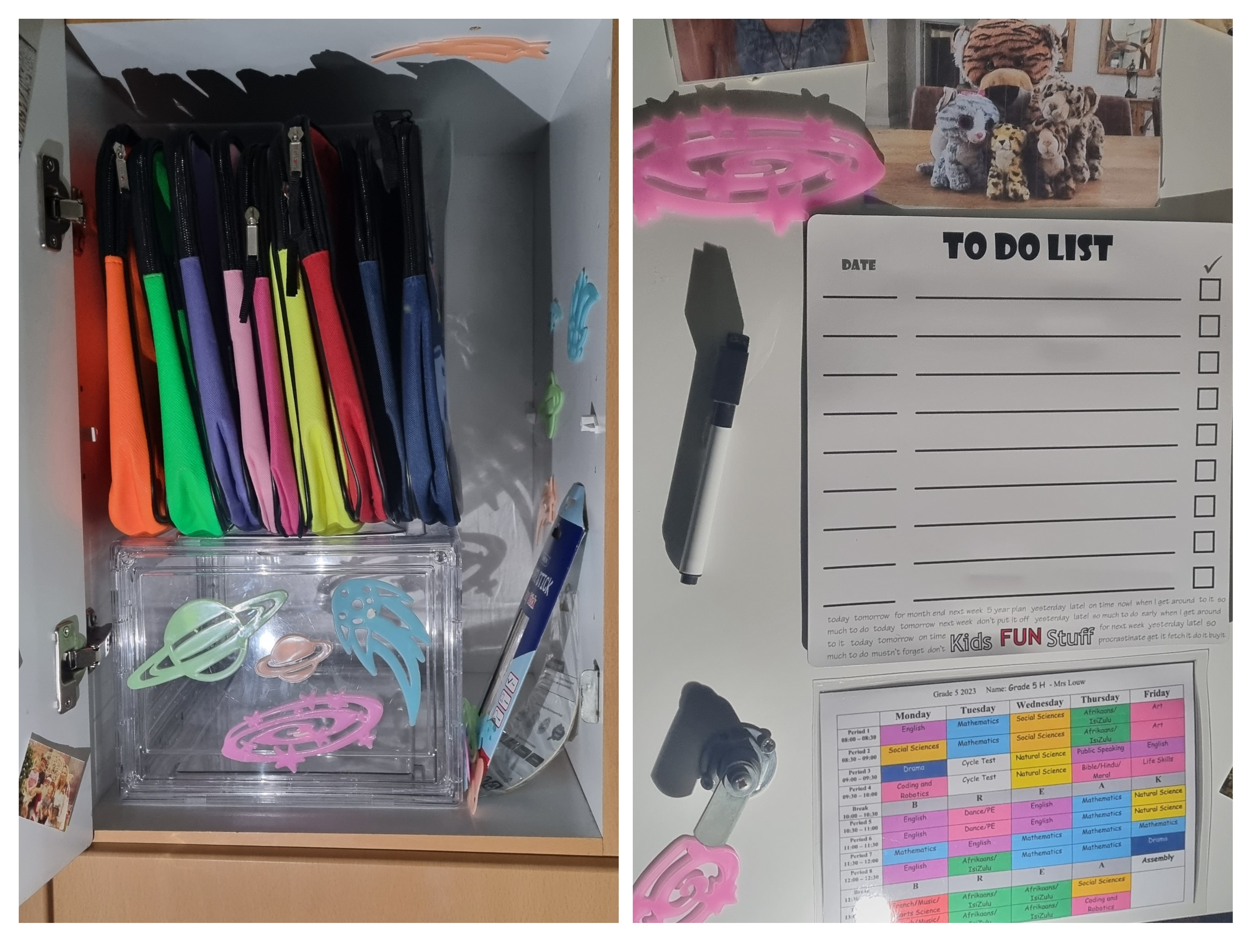
ORGANISING SCHOOL SPACE
Notes:
Morning routine for us

Slide 17
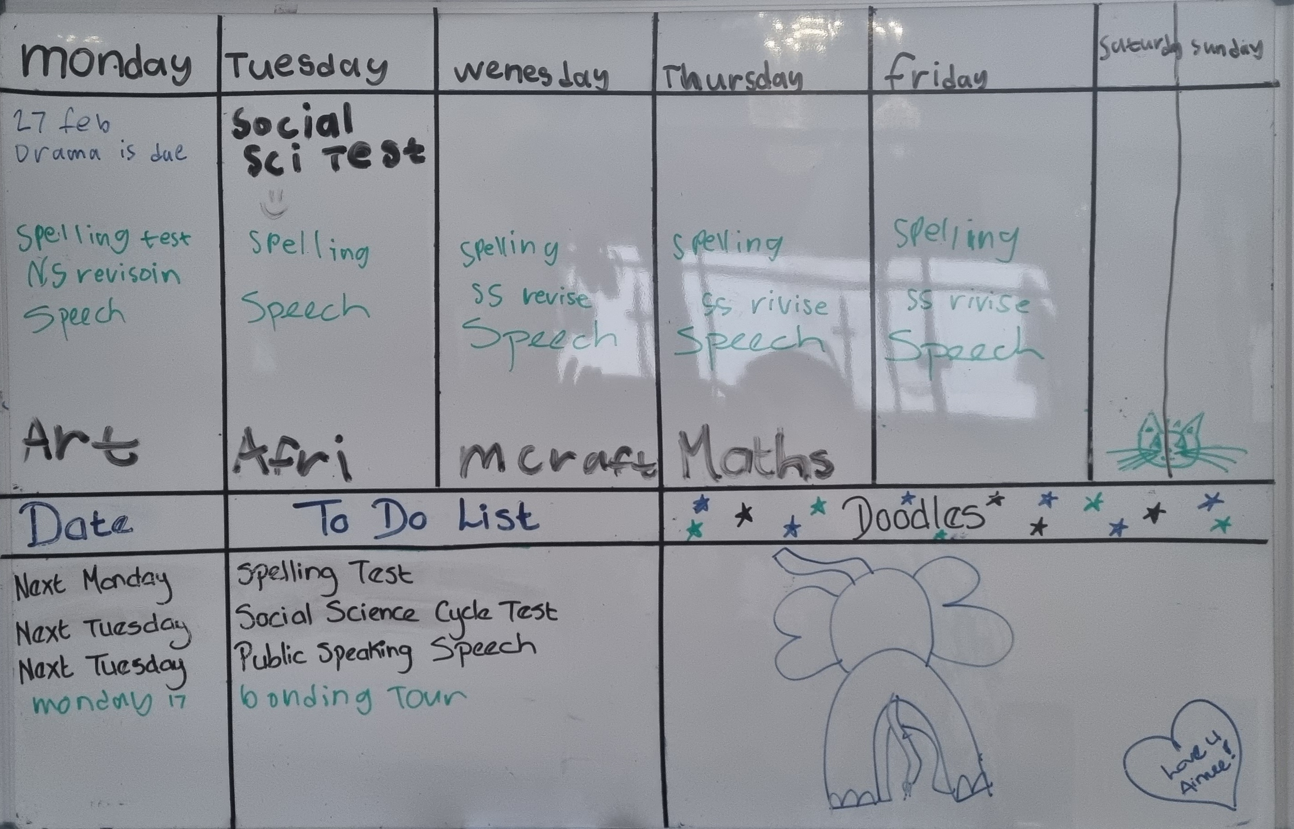
ORGANISING HOME SPACE
Notes:
Morning routine for us

Slide 18
Final thoughts …
Life with ADHD can feel complex and challenging. Coaching brings increased awareness and skills development that greatly eases ADHD challenges resulting in reduced anxiety levels and a happier life.
Thank you for joining our support group and I hope that these tips will help you navigate the complexities that ADHD can bring.

Slide 19
THE SCHOOL OF LIFE OFFERS:
Life Skills Coaching, Life Skills Coach Training Course Life Skills Workshops Presentations Counselling Trauma De-briefing | Business Coaching Corporate Workshops & Wellness Character Education Curriculum ADHD & ASD Support Group ADHD & ASD Coaching Talks
YOU CAN FIND US AT:
https://www.instagram.com/the.school.of.life/
https://www.facebook.com/theschooloflifeza
https://www.theschooloflife.org.za/

