Slide 1
Facing the World with Positivity and Courage
Dr. Janett Naylor-Tincknell
Professor of Psychology
Fort Hays State University

Slide 2
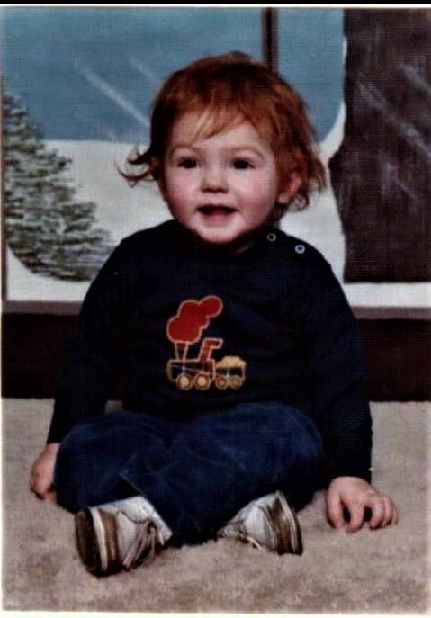
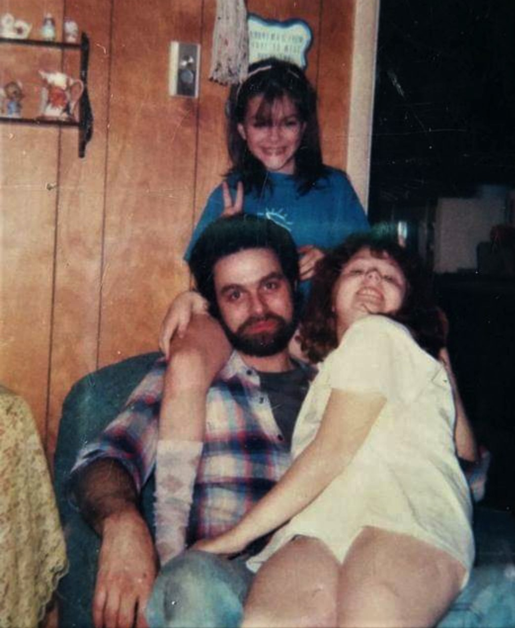
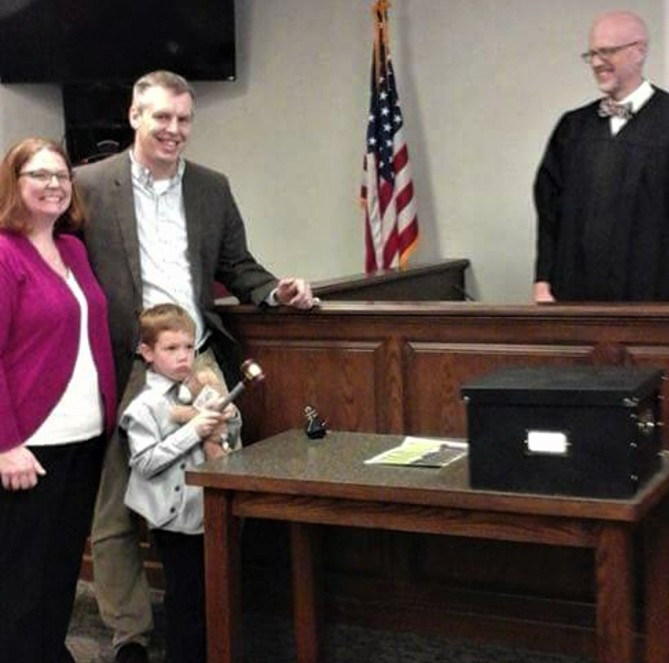
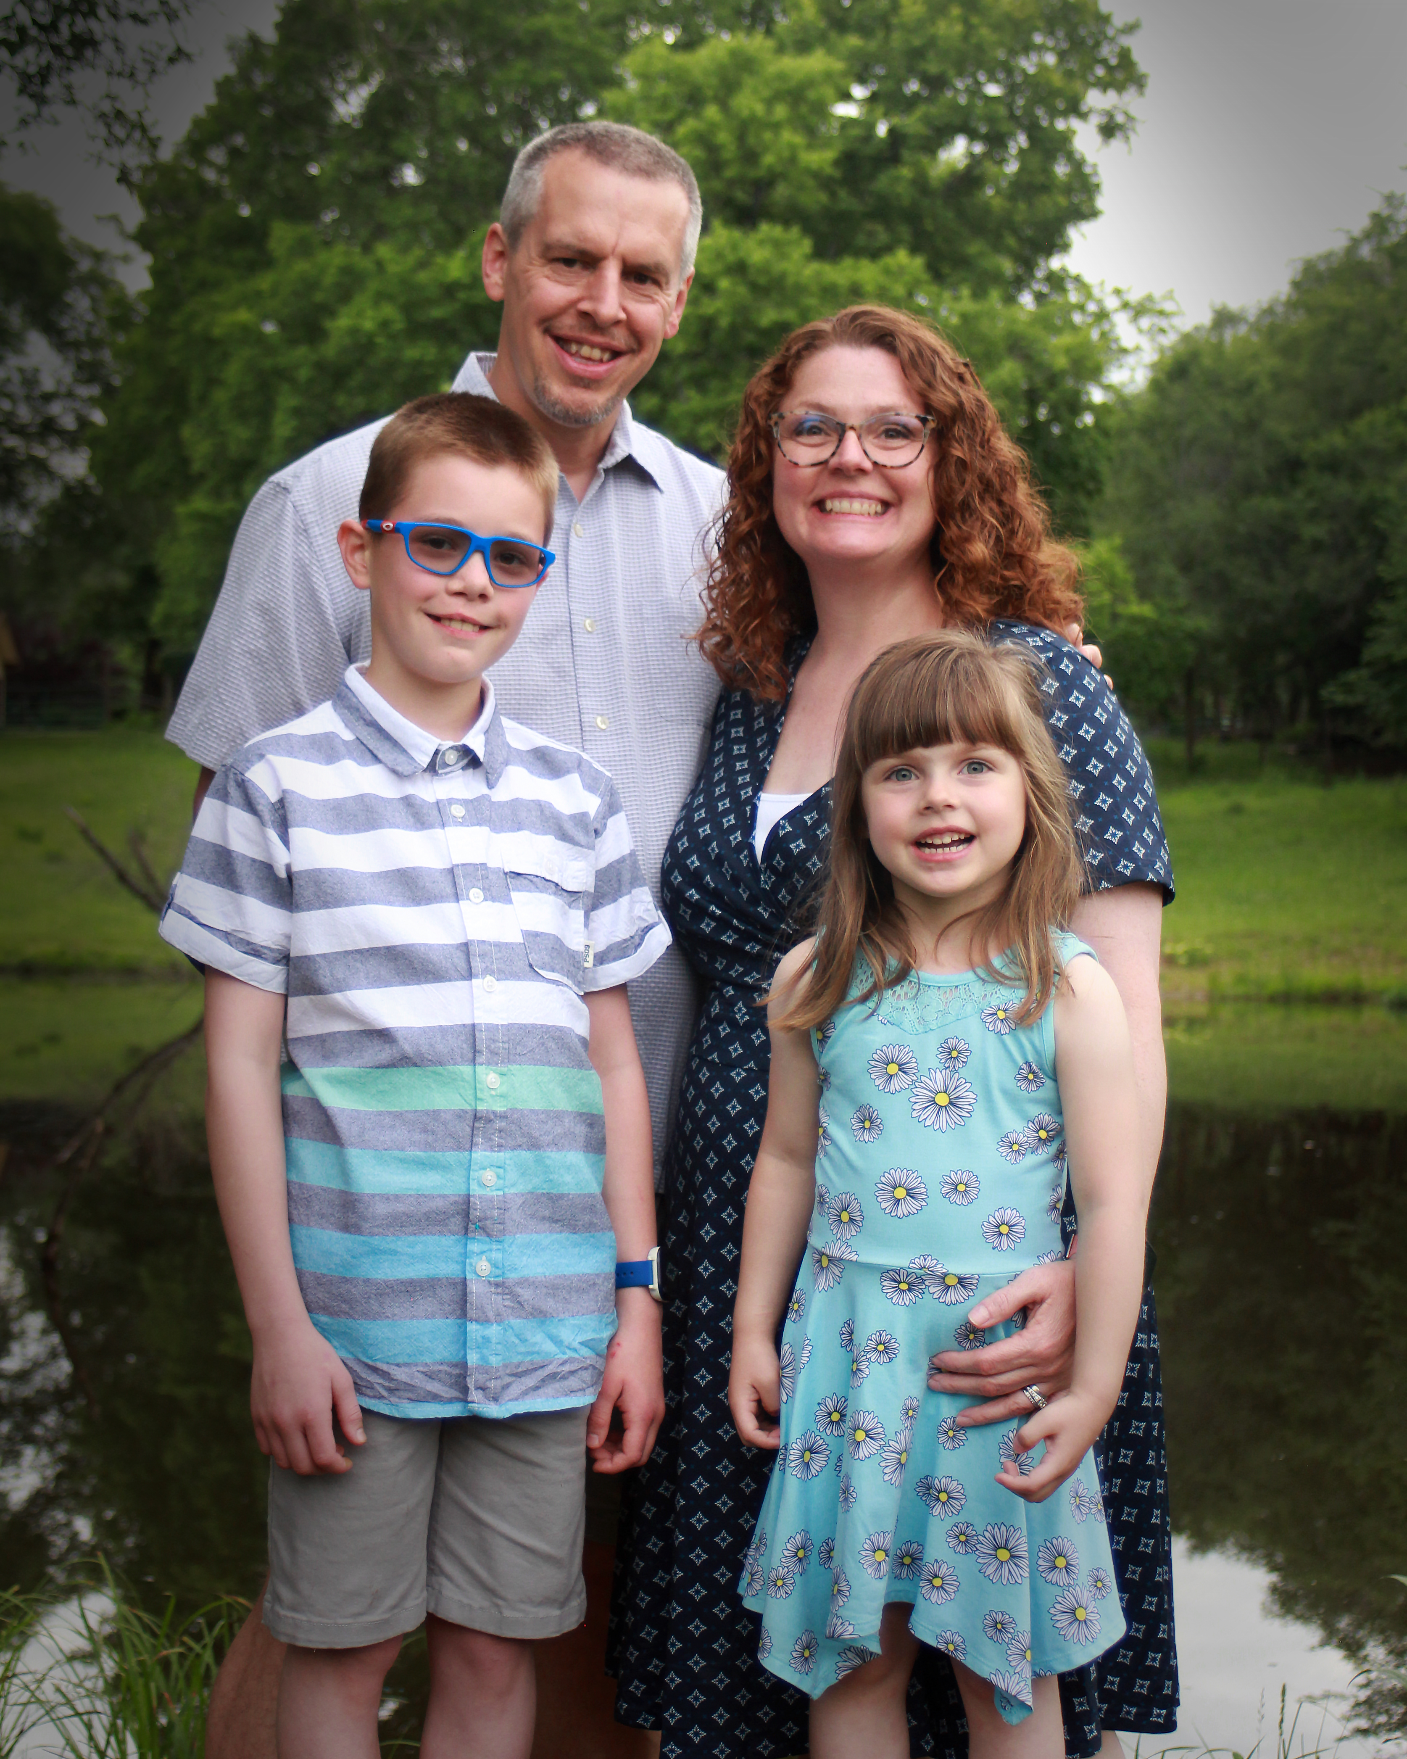
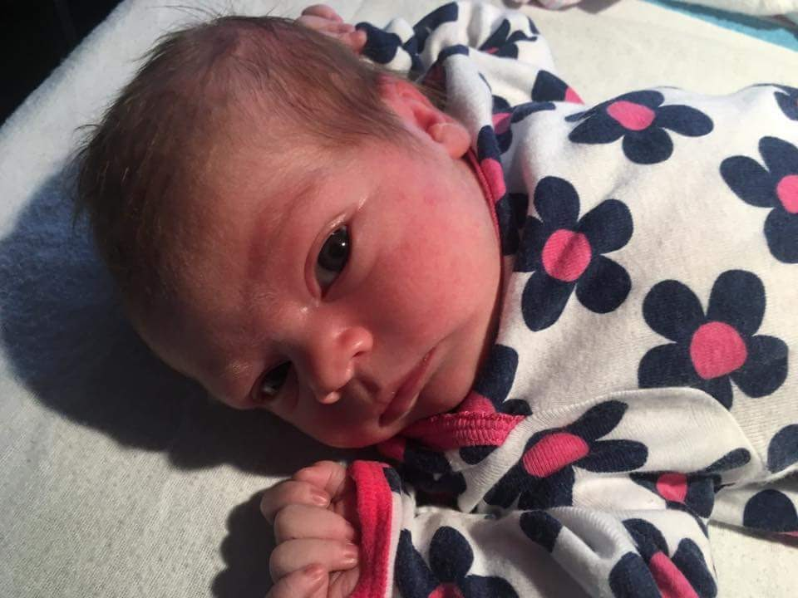
Setting the Context: A Bit about Me
Born in rural Pennsylvania
Family lived on a farm with Dad working in Steel Mills.
Lived at or below the poverty line
Moved to wealthy suburb in 10th grade
1st person in my extended family to attend college
Forced to grow up quickly. Left home for college at 17.
Strained relationships with family members.
Currently married with 2 children
Tenured, Full Professor at Fort Hays State University

Slide 3

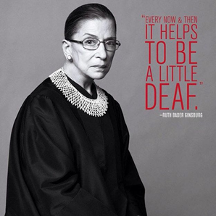
What is Self-Talk?
Self-Talk is both conscious and unconscious thoughts and biases we have our ourselves and the world around us.
Positive vs. Negative
Types of Negative Self-Talk
  Personalizing: It’s my fault…
  Magnifying: Bad things only happen to me…
  Catastrophizing: I’ll never be good enough…
  Polarizing: I’m bad at everything…

Slide 4
Breaking the Cycle
Negative Self-Talk
Self-Sabotaging Behavior
Negative Self-Talk
Self-Sabotaging Behavior
The negative cycle can end with you.
It will take work and will not happen immediately.
You have the strength to positively shape the future.

Slide 5

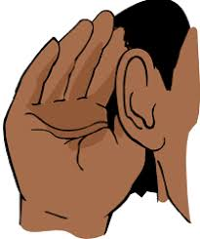
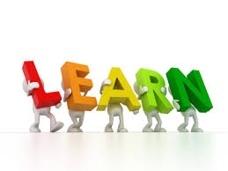
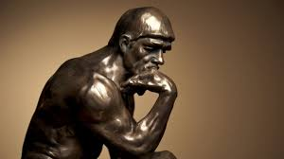
Stop and Consider Exercise 1
Step One: Listen to your Self-Talk
  If you use Negative Self-Talk, do you use a specific type?
  Is there a time of day or location that causes more Positive or Negative Self-Talk?
  What would your loved ones say if they heard your Self-Talk?
Step Two: Learn
  How would you feel if you switched Negative Self-Talk for Positive Self-Talk?
  What might you achieve if you practiced more Positive Self-Talk?
Step Three: Think it Through
  How big of a deal is this really?
  How accurate is my Negative Self-Talk?
  Whose opinions shape my Negative Self-Talk?

Slide 6




Benefits of Positive Self-Talk
Helps Boost Confidence and Resilience
Greater Life Satisfaction
Improved Physical Health (Immune system, cardiovascular, etc.)
Builds Better Relationships
Better Physical Wellbeing
Better Psychological Health
Reduced Risk of Death

Slide 7

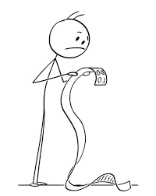

Stop and Consider Exercise 2
Make a list of the things in your life you would like to improve.
  Don’t be too hard on yourself.
  You can’t fix everything at once.
Rank those items.
Rate the items on how easy it will be to fix.
Pick a few to address first.

Slide 8
How Do We Practice Positive Self-Talk?
Identify negative self-talk traps and triggers
Check in with your feelings
Find the humor
Surround yourself with positive people (Set Boundaries)
Give yourself positive affirmations
Practice self care
Don’t fear failure
Don’t compare yourself to others (especially on social media)
Use positive words with others
Don’t dwell on the past
Visualize your success
Help others
Be physically active
Set obtainable goals

Slide 9
Stop and Consider Exercise 3
Trigger | Negative Self-Thought | Adaptive Positive Self-Thought | Behavior Plan Brainstorming
I didn’t do well on the exam. | “I am never going to be good enough.” | “I was not prepared enough for this exam. I will do better next time.” | Start studying small bits every day. Take notes on the book content. Ask the instructor clarifying questions. Study with a friend. Find tutoring resources.

Slide 10

Resources in Your Packet & Questions??
Self-Talk: Identifying, Challenging, and Changing
Getting Rid of ANTS: Automatic Negative Thoughts
15 Ways to Practice Positive Self-Talk for Success
What are Personal Boundaries?
How to Create Healthy Boundaries
Setting Boundaries
Dr. Janett Naylor-Tincknell
Fort Hays State University
jmnaylor@fhsu.edu
785.628.5857
Martin Allen Hall, Rm. 226

