Slide 1
耶穌的受苦之路
The Path of Jesus' Suffering
馬可福音14-15章
選讀 14:1-2節，10-11節，29-31節，32-34節；15:9-13節，22-24，27節，33-39節，44-46節

Slide 2
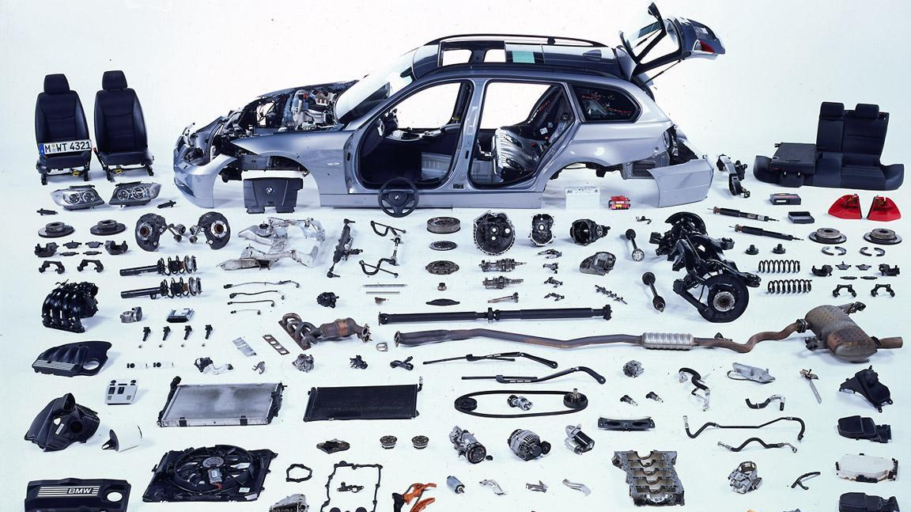
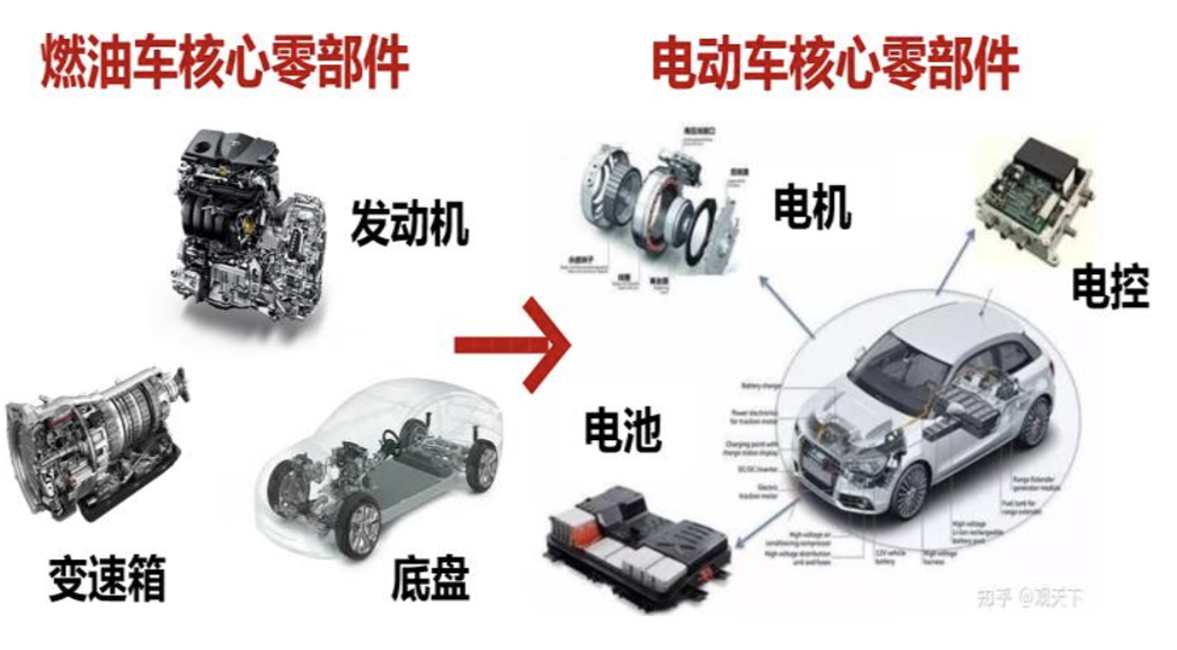

Slide 3
福音的核心是什麼？
What is the core of the Gospel?
耶穌基督的釘死（受难节）
  因為我曾定了主意，在你們中間不知道別的，只知道耶穌基督並他釘十字架。(哥林多前書 2:2)
耶穌基督的復活（复活节）
  你若口裏認耶穌為主，心裏信神叫他從死裏復活，就必得救。因為，人心裏相信就可以稱義，口裏承認就可以得救。(羅馬書 10:9-10)

Slide 4

受難節
Good Friday （April 18th）
早期在逾越节期间纪念主的复活。
公元325年，尼西亚会议确定了春分之后的第一个满月（月圆）后的第一个礼拜日就是复活节。而复活节之前的那个周五，就是受难节。
“Good Friday”的来源：
1909 年《天主教百科全书》提出“Good”（好）是从“God’s”（上帝的）转化而来的，因此“Good Friday”=“God’s Friday”。
牛津英语词典及多位语言学家认为，“Good”在古时的含义中包括了“Holy”（神圣）的意思，因此“Good Friday”=“Holy Friday”。
Notes:
每一年春分后第一个满月(Full Moon月圆）后的第一个礼拜日，就是复活节。而复活节之前的那个周五，就是受难节。
早期的基督徒开始每年在逾越节期间纪念主的复活。公元325年，尼西亚会议确定了春分之后的第一个满月（月圆）后的第一个礼拜日就是复活节。
英文名称是“Good Friday”的来源：
1909 年《天主教百科全书》中的一个条目，提出“Good”（好）这个词，是从“God’s”（上帝的）转化而来的，就是说“好周五”可以理解为“上帝的周五”。
牛津英语词典以及许多语言学家都认为，“Good”这个英文词，其古时的含义中包括了“Holy”（神圣）的意思，所以 “Good Friday”的意思就是“神圣周五”。

Slide 5
耶穌的受苦之路
The Path of Jesus' Suffering
I. He Was Framed by Religious Leaders 他被宗教領袖陷害(14:1-2)
II. He Was Betrayed by His Disciple Judas 他被門徒猶太出賣(14:10-11)
III. He Was Abandoned by All His Disciples 他的眾門徒离棄他(14:29-31)
IV. He Suffered Alone and Prayed in Agony 他在痛苦中禱告(14:32-34)
V. He Was Sentenced to Death by Pilate 他被彼拉多判死罪(15:9-13)
VI. He Was Crucified Between Criminals 他與罪犯同釘十架(15:22-24)
VII. He Died in Agony 他在痛苦中斷氣 (15:33-39)
VIII. He Was Buried in a Borrowed Tomb 他借葬於他人之墓(15:44-46)

Slide 6
I. He Was Framed by Religious Leaders
他被宗教領袖陷害
(14:1-2)
過兩天是逾越節，又是除酵節，祭司長和文士想法子怎麼用詭計捉拿耶穌，殺他。只是說：「當節的日子不可，恐怕百姓生亂。」
It was now two days before Passover and the Festival of Unleavened Bread. The leading priests and the teachers of religious law were still looking for an opportunity to capture Jesus secretly and kill him.“ But not during the Passover celebration,” they agreed, “or the people may riot.”
(Mark 14:1-2 NLT)

Slide 7
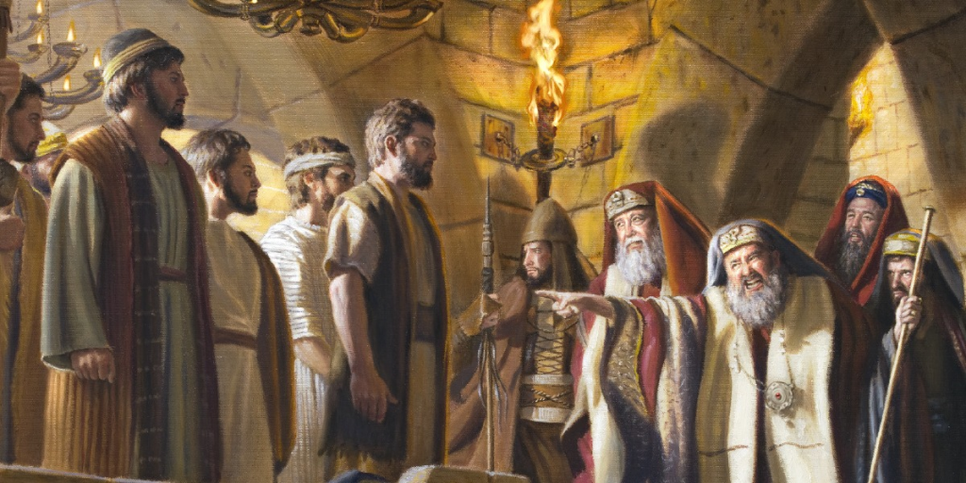
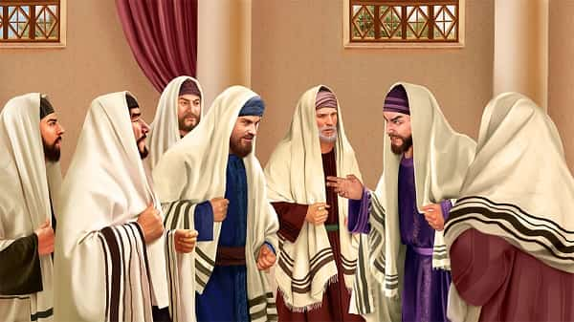
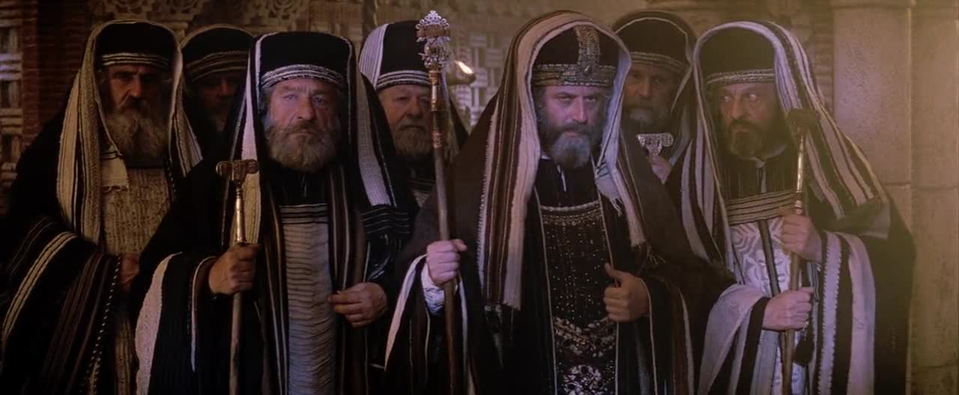

Slide 8
宗教領袖視耶穌為“眼中釘”
The religious leaders saw Jesus as a “thorn in their side”
逾越节 Passover：
宗教领袖的仇恨 Hatred of religious leaders：
宗教与政治结盟 Religion and politics were aligned：文士（法利赛人）与祭司（撒都该人）
矛盾与讽刺 Contradiction and irony：
耶稣的反应 Jesus' reaction：
Notes:
逾越节是纪念犹太人出埃及的重要节日，耶路撒冷会聚集大量朝圣者，气氛紧张，罗马当局也高度警惕任何可能引发骚乱的因素。耶稣作为一个吸引群众的人物，他的言行（如进入耶路撒冷时受到民众欢呼，约翰福音12:12-19）让法利赛人担心会引发混乱，甚至招致罗马的镇压。
逾越节 Passover：纪念神拯救的日子；朝圣者的聚集日。
宗教领袖的仇恨 Hatred of religious leaders：源于嫉妒与心硬。
宗教与政治结盟 Religion and politics were aligned：文士（法利赛人）与祭司（撒都该人）
矛盾与讽刺 Contradiction and irony：借外族势力杀害同族人；互相为敌变为朋友。
耶稣的反应 Jesus' reaction：将自己交托于神且勇于面对强权。

Slide 9
個人反思
Personal Reflection
警惕內心的“法利賽人傾向”（驕傲與嫉妒）
Be wary of the inner "Pharisee tendencies" (pride and jealousy)
Notes:
默想耶稣的牺牲与逾越节的意义：看重除酵节的属灵清洁与生命的更新。

Slide 10
祷告 Prayer
親愛的主耶穌，感謝你為我成為逾越節的羔羊，用你的寶血洗淨我的罪，賜下救贖的大愛。求你鑒察我的心，幫助我除去生命中的虛偽與驕傲，讓我的信仰不只在外表，而是在內心。在面對反對和挑戰時，求你賜我信心和順服，像你一樣依靠父神的旨意。主啊，也求你教我以愛和寬恕對待他人，即使在仇恨面前也能彰顯你的恩典。
Dear Lord Jesus, thank you for being the Passover lamb for me, cleansing me from sin with your precious blood and giving me redemption love. Search my heart, help me to remove the hypocrisy and pride of my life, and let my faith not be just outwardly but inwardly. In the face of opposition and challenges, please give me faith and obedience, relying on the will of God the Father as you do. Lord, teach me to treat others with love and forgiveness, and to show your grace even in the face of hatred.
Notes:
默想耶稣的牺牲与逾越节的意义：看重除酵节的属灵清洁与生命的更新。

Slide 11
II. He Was Betrayed by His Disciple Judas
他被門徒猶大出賣
(14:10-11)
十二門徒之中，有一個加略人猶大去見祭司長，要把耶穌交給他們。他們聽見就歡喜，又應許給他銀子；他就尋思如何得便把耶穌交給他們。
Then Judas Iscariot, one of the twelve disciples, went to the leading priests to arrange to betray Jesus to them. They were delighted when they heard why he had come, and they promised to give him money. So he began looking for an opportunity to betray Jesus.(Mark 14:10-11 NLT)

Slide 12
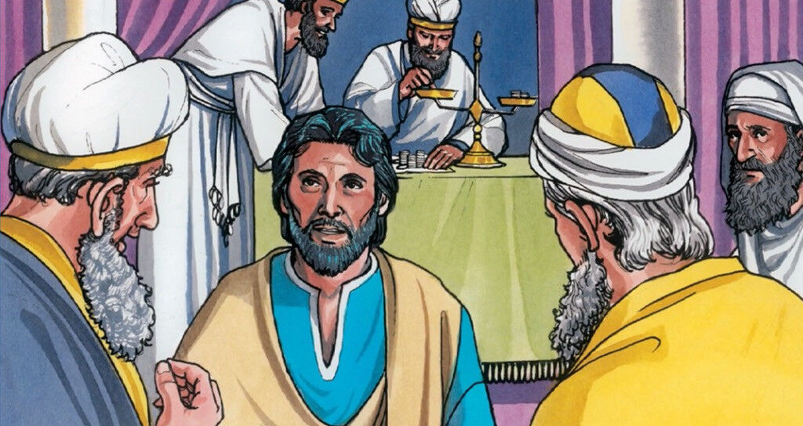
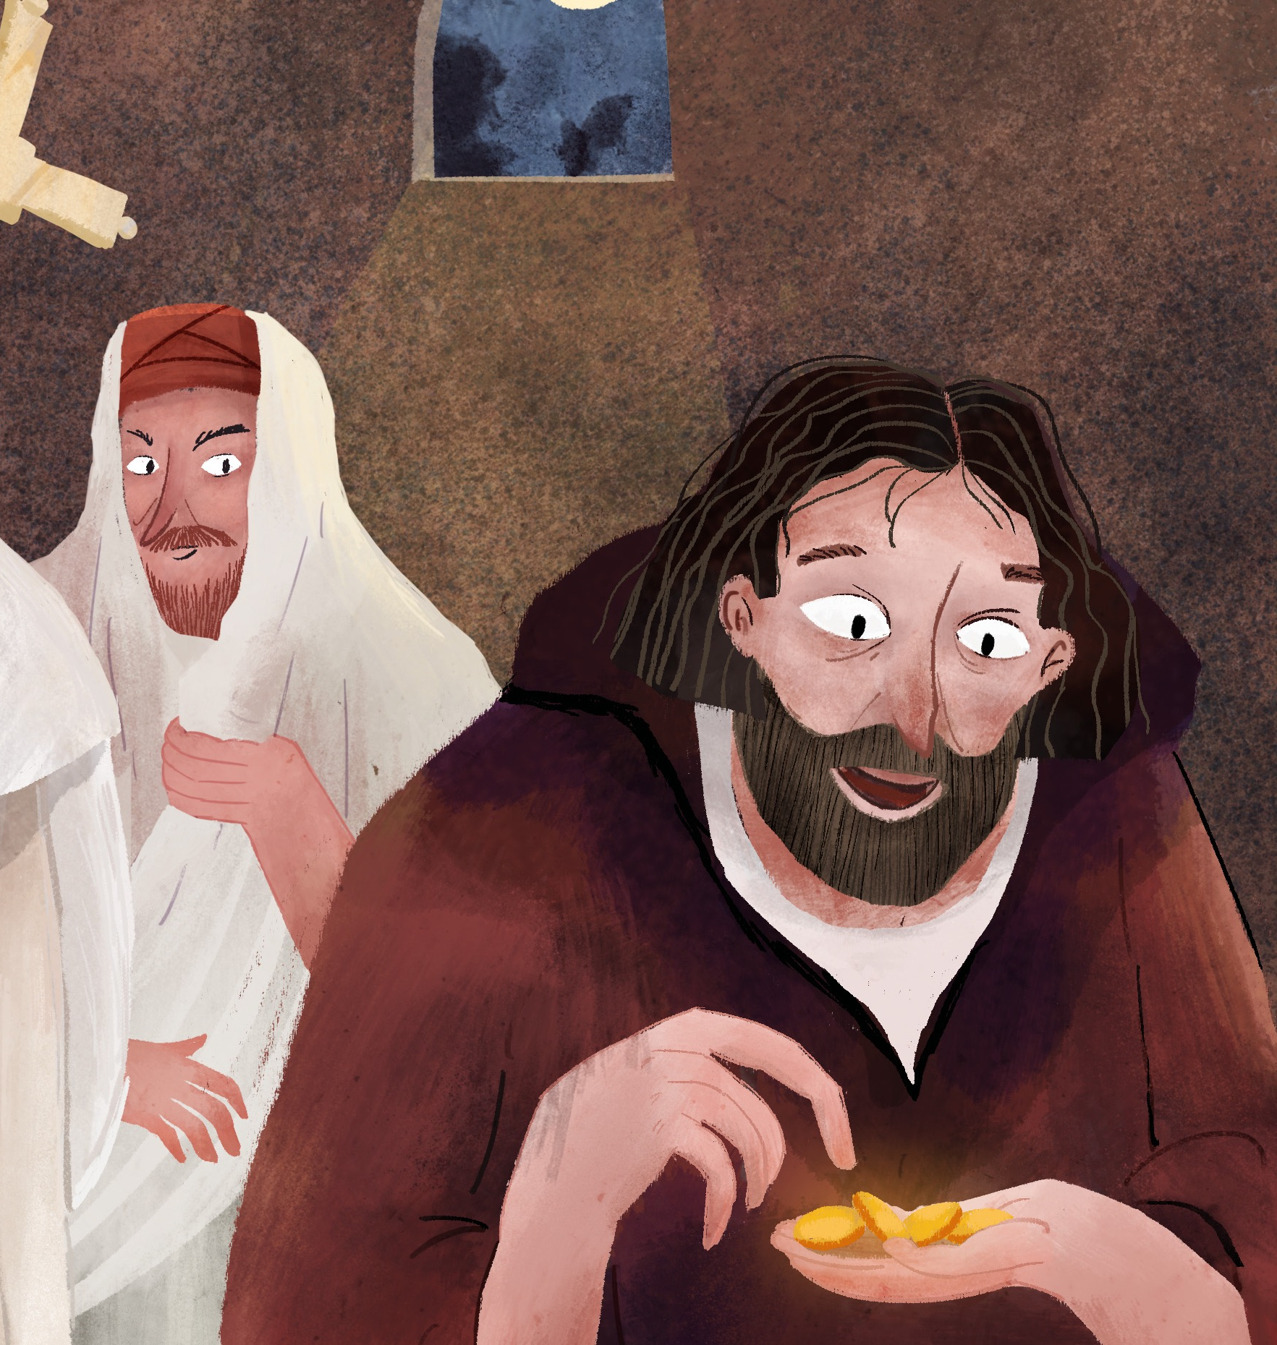
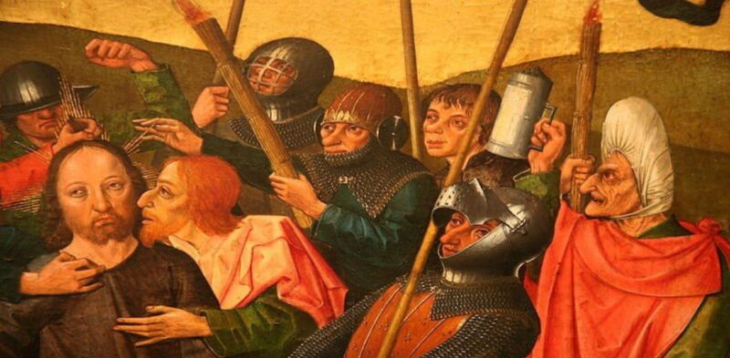

Slide 13
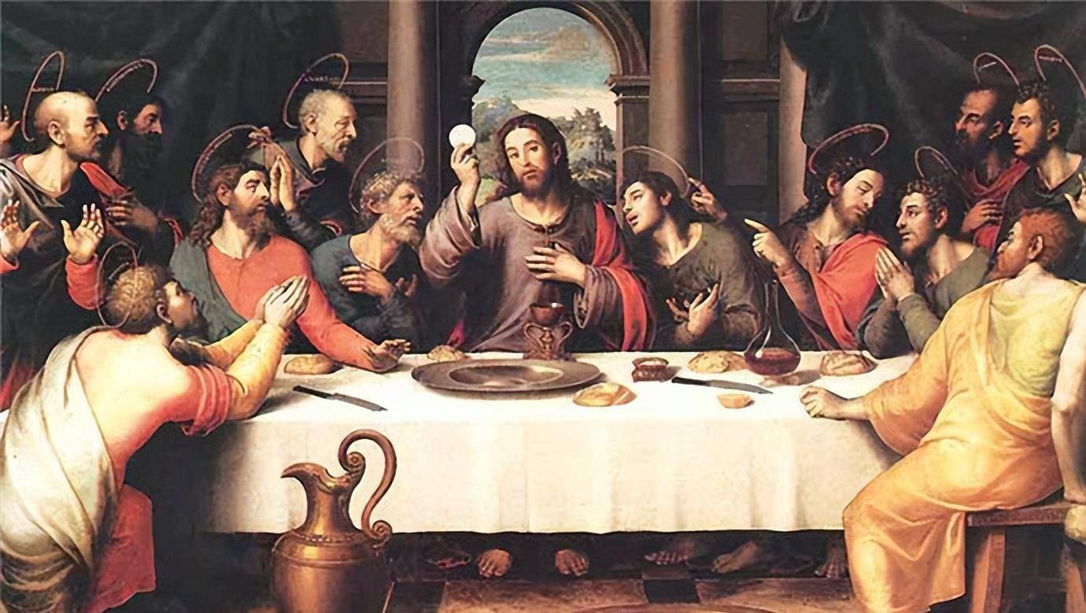
哪個人是賣耶穌的猶大？
Which man is Judas the betrayer of Jesus?

Slide 14
耶穌被猶大視為“搖錢樹”
Judas saw Jesus as a money-making opportunity.
親密的同工 Close Co-Workers
貪財的本性 The nature of greed for money
自愿背叛耶穌 Voluntary Betrayal of Jesus
獲得三十塊錢 Get Thirty pieces of silver
耶穌的回應 Jesus' Response
Notes:
约13:11.耶稣愿知道谁要卖他。
亲密的同工：被耶稣赏识且管理钱财。
贪财的本性：心术不正且财迷心窍。
主动出卖耶稣：向法利赛人汇报并讨价。
获得三十块钱：成年人一年的收入；名利双收。
耶稣的回应：多次提醒他；为犹大洗脚；留给最后的机会。

Slide 15
個人反思
Personal Reflection
誰是“利己主義”的猶大？誰是靠近耶穌，卻離真理最遠的人？
Who is the "egoistic" Judas? Who is the one who is closest to Jesus, but furthest from the truth?
Notes:
因贪财而堕落，被金钱蒙蔽心灵：他出卖耶稣，仅为“三十块钱”，显示他已经完全被物质利益控制了判断力和道德感。

Slide 16
禱告 Prayer
主啊，求你憐憫我，不讓猶大的悲劇重演在我生命中。賜我一顆清潔的心、正直的靈，讓我渴慕你勝過渴慕金錢，讓我忠於你勝過忠於自己。讓我時常思想：你是那無價之寶，世界上一切都不能與你相比。讓我在每一個小決定中，都選擇忠誠。謝謝你仍然愛我，仍然給我悔改的機會。幫助我天天背起十字架，跟隨你，直到見你面的那日。
Lord, have mercy on me and prevent the tragedy of Judah from repeating itself in my life. Give me a clean heart, a spirit of integrity, that I will desire you more than money, that I will be faithful to you more than to myself. Let me think often: you are priceless, and nothing in the world can compare to you. Let me choose loyalty in every small decision. Thank you for still loving me and still giving me a chance to repent. Help me to take up my cross daily and follow you until the day I see you.
Notes:
因贪财而堕落，被金钱蒙蔽心灵：他出卖耶稣，仅为“三十块钱”，显示他已经完全被物质利益控制了判断力和道德感。

Slide 17
III. He Was Abandoned by All His Disciples
他的眾門徒离棄他
(14:27-31)
耶穌對他們說：「你們都要跌倒了，因為經上記著說：我要擊打牧人，羊就分散了。但我復活以後，要在你們以先往加利利去。」彼得說：「眾人雖然跌倒，我總不能。」耶穌對他說：「我實在告訴你，就在今天夜裏，雞叫兩遍以先，你要三次不認我。」彼得卻極力地說：「我就是必須和你同死，也總不能不認你。」眾門徒都是這樣說。
On the way, Jesus told them, “All of you will desert me. For the Scriptures say, ‘ God will strike the Shepherd, and the sheep will be scattered.’ But after I am raised from the dead, I will go ahead of you to Galilee and meet you there. Peter said to him, “Even if everyone else deserts you, I never will.” Jesus replied, “I tell you the truth, Peter—this very night, before the rooster crows twice, you will deny three times that you even know me.” “No!” Peter declared emphatically. “Even if I have to die with you, I will never deny you!” And all the others vowed the same.(Mark 14:27-31 NLT)

Slide 18
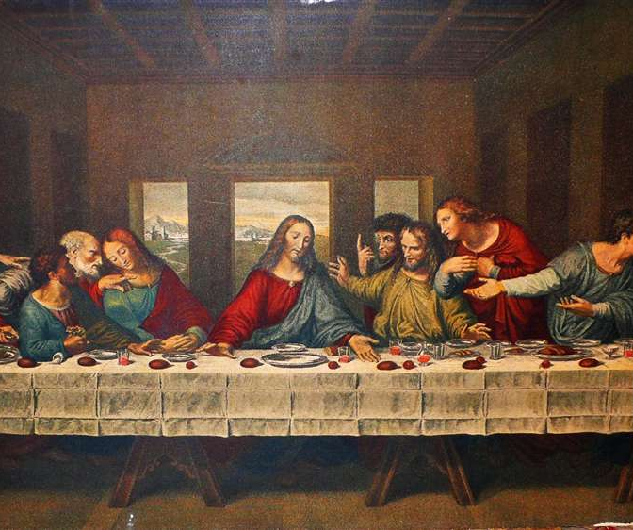
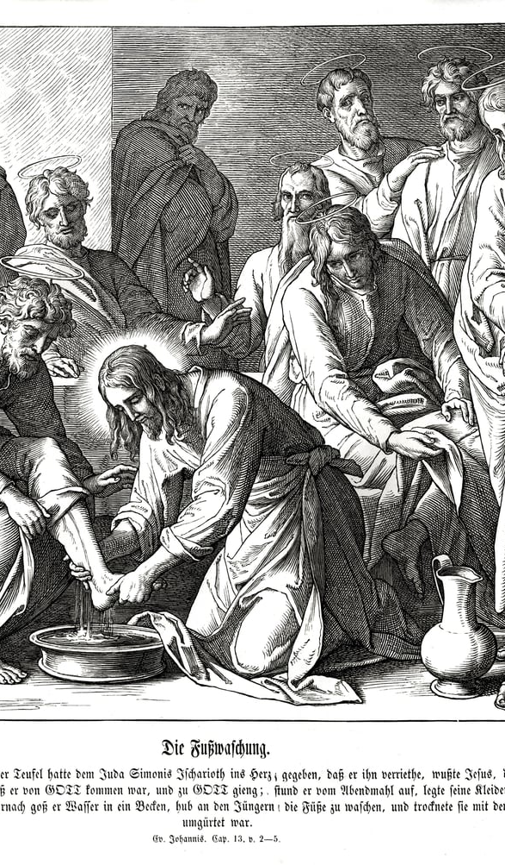

Slide 19
門徒不認識自己的“情緒化忠誠”
The disciples did not recognize their own "emotional loyalty"
耶稣预言中的怜悯 Jesus' Prophecy in Mercy
彼得：真诚但自信过度 Peter: Sincere, but overconfident
众门徒：缺乏属灵警醒与预备 The Disciples: Lack of spiritual vigilance and preparation
理想与现实的巨大落差 The huge gap between ideal and reality
耶稣给出盼望之言 Jesus gave the word of hope
Notes:
彼得的表态——“我總不能跌倒”、“我就是必須和你同死，也總不能不認你”——反映出他对主的忠心与爱是发自内心的。他并非说谎，而是真心认为自己会坚守到底。
虽然他们愿意为主而死，但他们并没有进入祷告、警醒、属灵预备的状态。很快他们就在客西马尼园睡着了，面对捉拿耶稣的兵丁时也四散奔逃。
慈爱的预告：耶稣告诉彼得他将三次不认主，目的是叫彼得警醒，而不是羞辱他。
耶稣预言中的怜悯： Jesus' Prophecy in Mercy:目的是警告而非羞辱
彼得：真诚但自信过度
众门徒：缺乏属灵警醒与预备
理想与现实的落差
耶稣给出盼望之言：为他们的跌倒留了复合的余地，预备了重聚的应许。

Slide 20
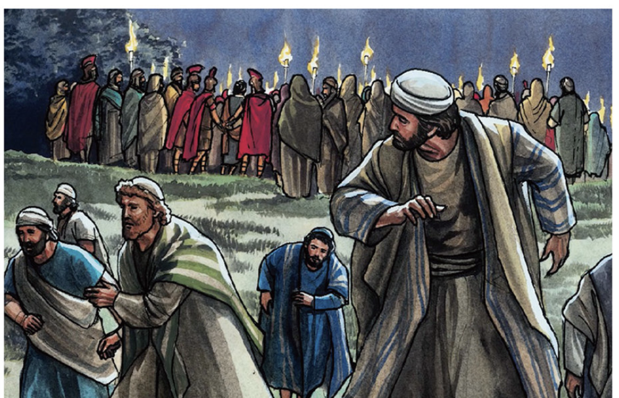
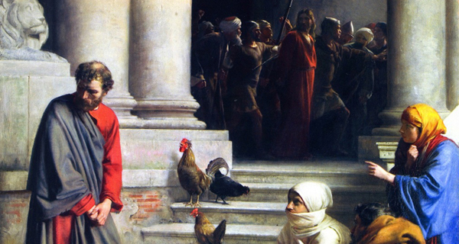

Slide 21
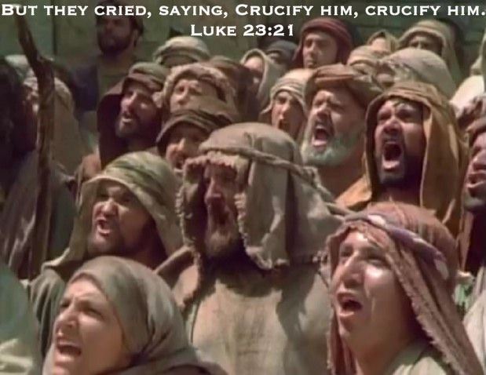
個人反思
Personal Reflection
是否高估自己的屬靈狀態？是否有跟風/從眾心理？
Have I overestimated my spiritual condition? Am I simply following the crowd?

Slide 22
禱告 Prayer
主啊，賜我一個謙卑的心，不以自己為剛強，不倚靠情緒的熱情，而是天天倚靠聖靈的能力，警醒禱告，警惕自己的驕傲。當我跌倒時，求你用復活的大能再次扶起我；當我退後時，求你用你不變的愛吸引我。讓我不只是說“我愛你”，更讓我在風雨中站穩腳步，忠心到底。
Lord, grant me a humble heart that does not rely on the strength of myself, not in the passion of the emotions, but in the power of the Holy Spirit daily, watchful in prayer and on the watchful eye for pride. When I fall, lift me up again with the power of the resurrection. As I step back, draw me in with your unchanging love. Let me not only say “I love you”, but also let me stand firm in the wind and rain and be faithful to the end.

Slide 23
IV. He Suffered Alone and Prayed in Agony
他獨自痛苦並禱告
(14:32-34)
他們來到一個地方，名叫客西馬尼。耶穌對門徒說：「你們坐在這裏，等我禱告。」於是帶著彼得、雅各、約翰同去，就驚恐起來，極其難過，對他們說：「我心裏甚是憂傷，幾乎要死；你們在這裏等候，警醒。」
They went to the olive grove called Gethsemane, and Jesus said, “Sit here while I go and pray.” He took Peter, James, and John with him, and he became deeply troubled and distressed. He told them, “My soul is crushed with grief to the point of death. Stay here and keep watch with me.”(Mark 14:32-34 NLT)

Slide 24
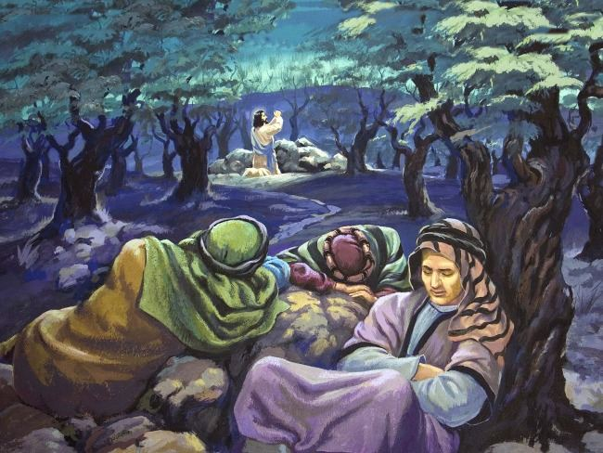
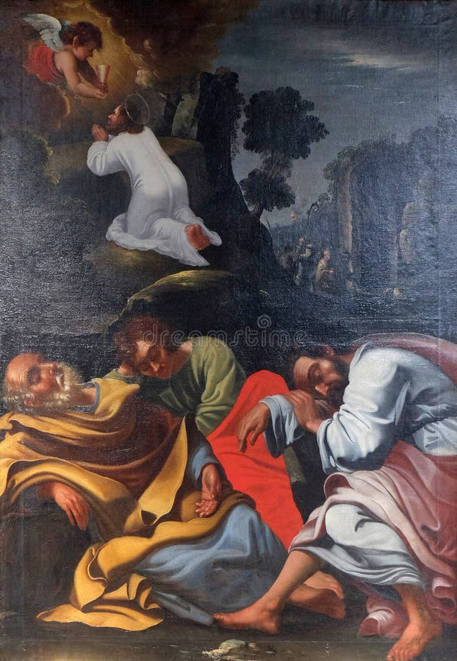
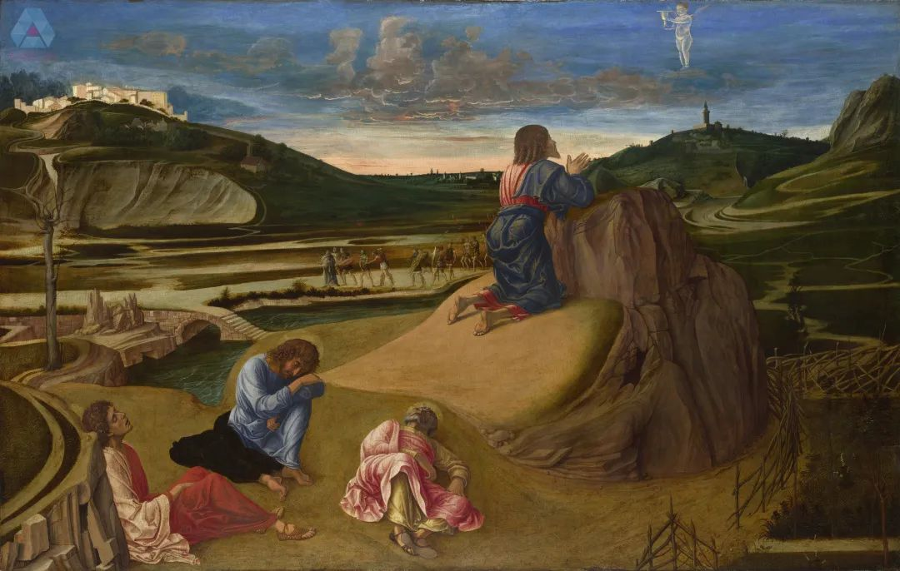

Slide 25
耶穌成為“孤勇者”
Jesus became the “Lone Ranger”
耶穌極其痛苦 Jesus was in great pain ：幾乎要死
耶穌發出請求 Jesus made a request
門徒有心無力 They want to, but they are not able
耶穌孤身奮戰 Jesus fought alone ：三次禱告。
Notes:
门徒不理解耶稣的忧伤，仍沉浸在自己的思绪中

Slide 26
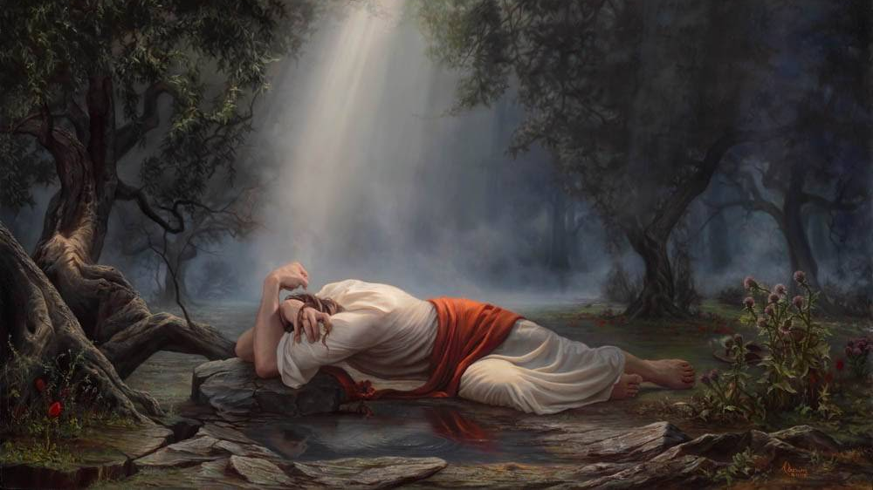

Slide 27

個人反思
Personal Reflection
是否能體貼主的心腸？是否僅僅向主索求而不懂得回報於他？
Are you considerate of the heart of the Lord? Do you just ask the Lord and not know how to reciprocate it?

Slide 28
V. He Was Sentenced to Death by Pilate
他被彼拉多判死罪(15:9-13)
彼拉多說：「你們要我釋放猶太人的王給你們嗎？」他原曉得，祭司長是因為嫉妒才把耶穌解了來。只是祭司長挑唆眾人，寧可釋放巴拉巴給他們。彼拉多又說：「那麼樣，你們所稱為猶太人的王，我怎麼辦他呢？」他們又喊著說：「把他釘十字架！」
“Would you like me to release to you this ‘King of the Jews’?” Pilate asked.(For he realized by now that the leading priests had arrested Jesus out of envy.)But at this point the leading priests stirred up the crowd to demand the release of Barabbas instead of Jesus. Pilate asked them, “Then what should I do with this man you call the king of the Jews?” They shouted back, “Crucify him!”(Mark 15:9-13 NLT)

Slide 29
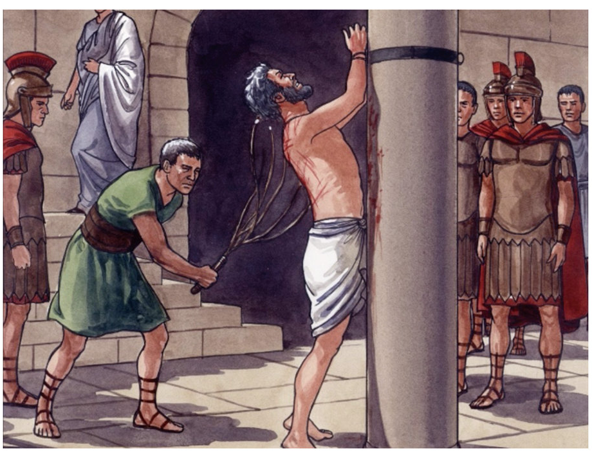
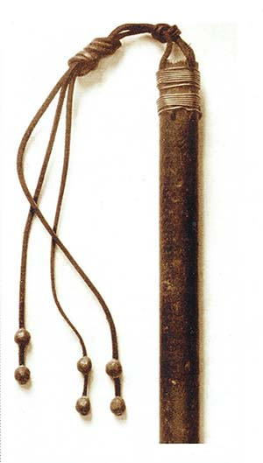
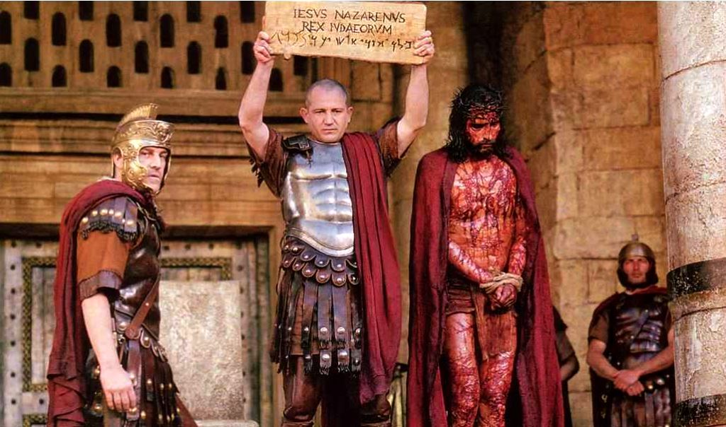

Slide 30
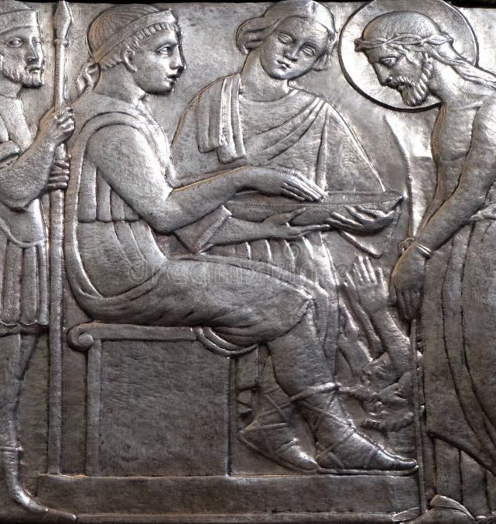
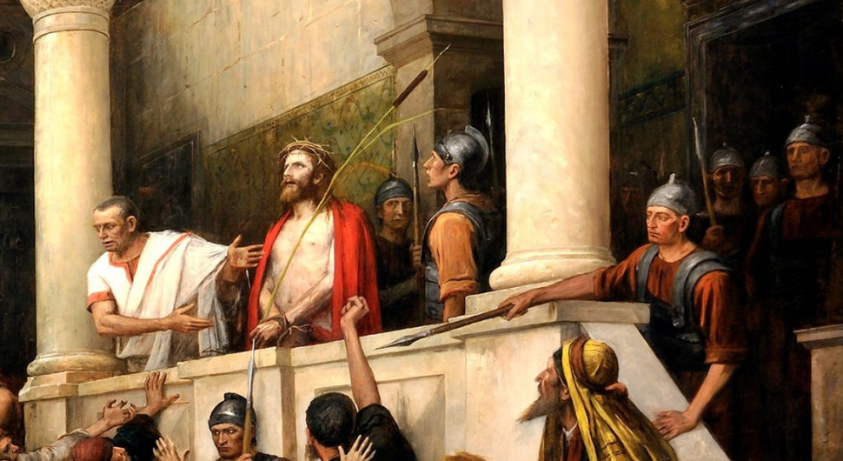
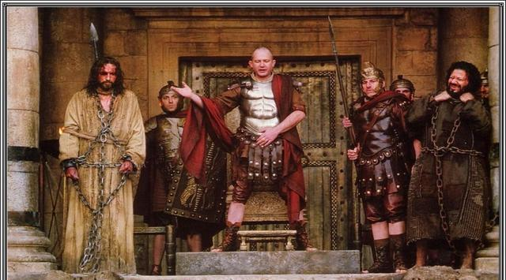

Slide 31
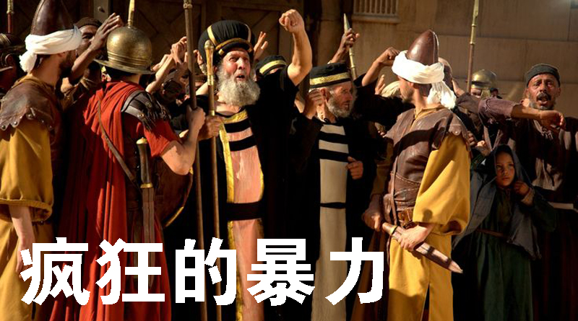

Slide 32
耶穌成為政教聯合下的“犧牲品”
Jesus became a “victim” of the union of religion and politics
彼拉多的困惑与妥协：政治的游戏
Pilate's confusion and compromise: The Game of Politics
祭司长的嫉妒与恶意：宗教的迫害
Jealousy and malice of the chief priests: The Radicalization of Religion
群众的盲从与情绪化：民心被蛊惑
The Blindness and Emotionalism of the Crowd: The People's Heart was Compelled
耶稣彻底被拒绝：选择暴徒弃绝救主
Jesus' Total Rejection: Chose the Mob but Abandoned the Savior

Slide 33
個人反思
Personal Reflection
在我的生活中，我是否曾因壓力、恐懼或利益而妥協，未能堅持神的公義？我如何能在群體的影響下，保持理智和獨立思考，始終保持忠於神的真理？
Have I ever compromised in my life because of pressure, fear, or profit and failed to stand up for God's justice? How can I remain rational and independent in the face of the community, and remain faithful to God's truth?

Slide 34
禱告 prayer
主啊，求你幫助我，在面對生活中的挑戰和選擇時，能夠堅定站立在你的真理和公義上，而不是受外界壓力的影響。賜給我一顆警醒的心，使我不会盲目跟隨群體的意見。主啊，求你在我軟弱的時候給我力量，在我迷茫的時候給我智慧，在我需要作出決策時，幫助我憑信心依靠你。願我不只是口頭上承認你是王，而是在生活的每一處都活出順服與感恩的心。
Lord, pray to help me stand firm in the truth and righteousness of prayer in the face of life‘s challenges and choices, rather than being influenced by outside pressures. Lord, pray to give me strength when I am weak, wisdom when I am confused, and help me to rely on prayer in faith when I need to make decisions. May I not just pay lip service to prayer as king, but live with obedience and gratitude everywhere in my life.

Slide 35
VI. He Was Crucified Between Criminals
他與罪犯同釘十架
(15:22-24, 27)
他們帶耶穌到了各各他地方，拿沒藥調和的酒給耶穌，他卻不受。於是將他釘在十字架上，拈鬮分他的衣服，看是誰得甚麼。他們又把兩個強盜和他同釘十字架，一個在右邊，一個在左邊。
And they brought Jesus to a place called Golgotha. They offered him wine drugged with myrrh, but he refused it. Then the soldiers nailed him to the cross. They divided his clothes and threw dice to decide who would get each piece. Two revolutionaries were crucified with him, one on his right and one on his left.(Mark 15:22-24,27 NLT)

Slide 36
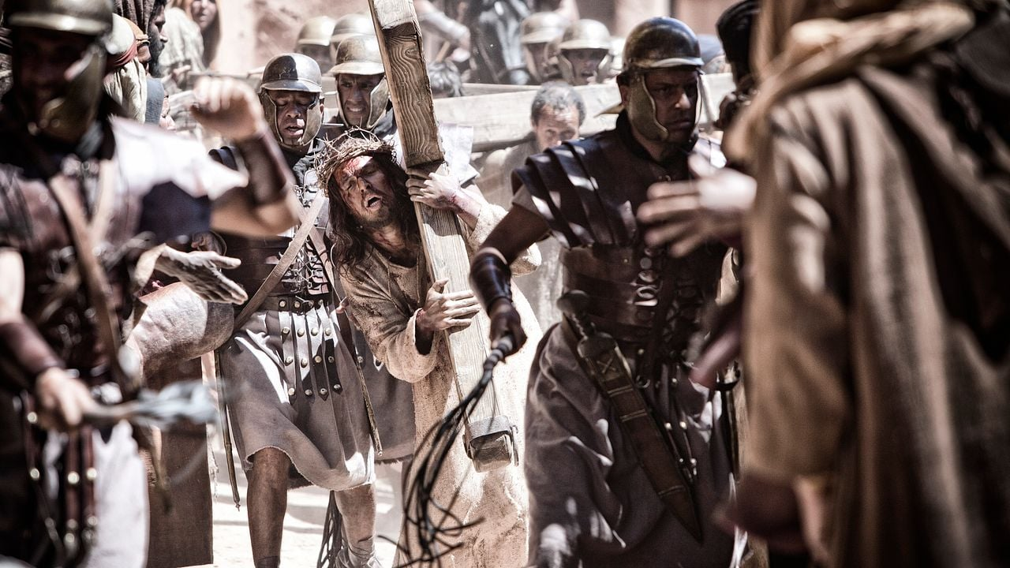
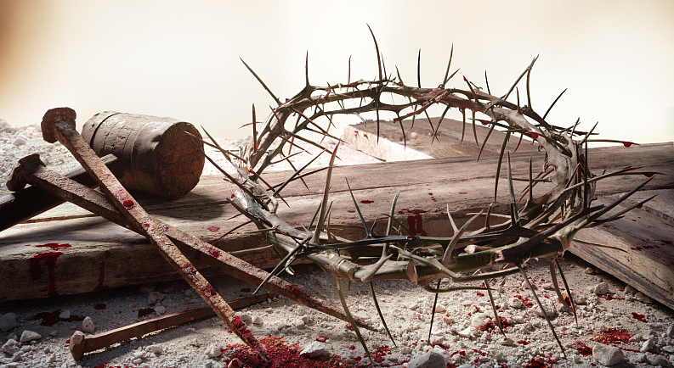
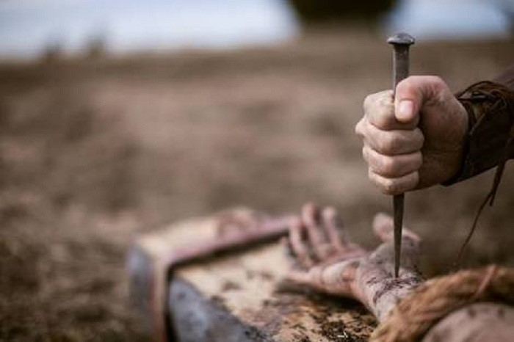

Slide 37
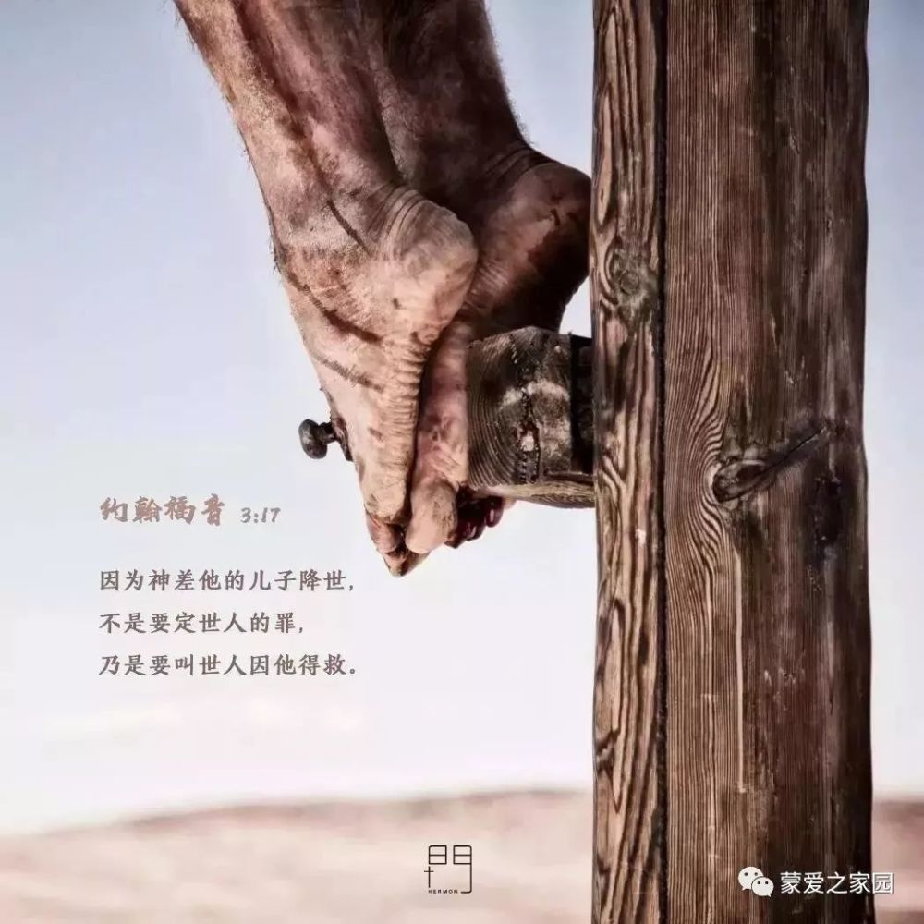
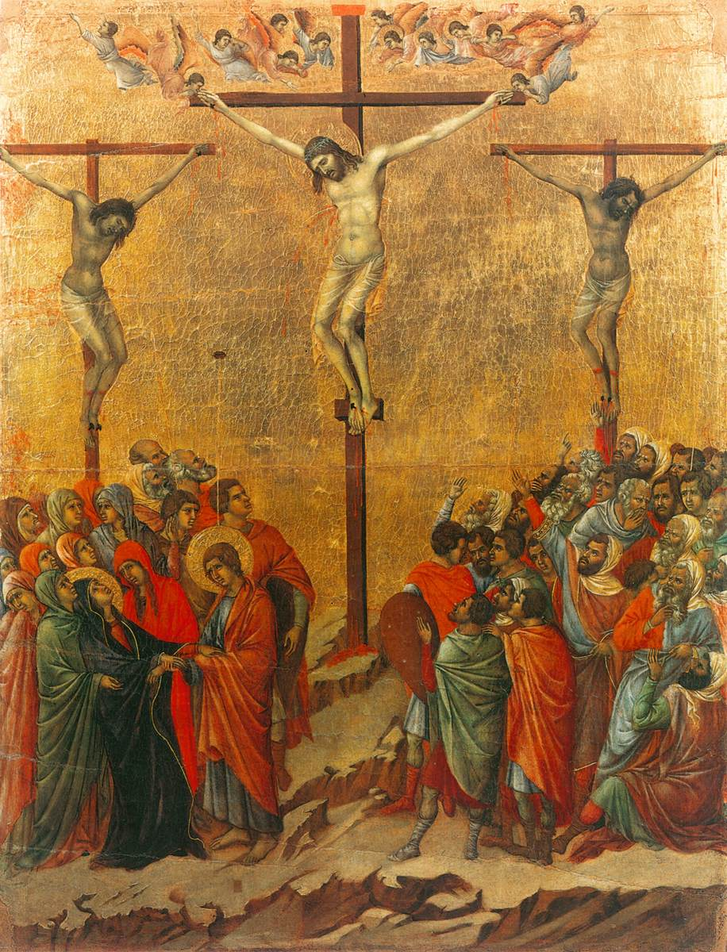

Slide 38
耶稣被视为罪犯的“头目”
Jesus was seen as the "ringleader" of criminals
耶稣被列在罪犯中 Jesus was listed among the criminals
耶稣被钉十字架 Jesus was crucified：十字架是当时最为残酷的刑罚，象征着羞辱、痛苦和死刑。肉体折磨与精神羞辱并存。The cross was the most brutal punishment of the time, symbolizing humiliation, suffering, and the death penalty. Physical torture and mental humiliation coexist.
Notes:
被钉十字架的人通常是被视为最卑贱、十恶不赦的罪犯。

Slide 39
個人反思
Personal Reflection
是否接受被定罪的耶穌就是為我贖罪的救主呢？Do you accept that the condemned Jesus is the Savior who atoned for my sins?
我是否能夠寬恕那些傷害過我、冒犯過我的人？Will I be able to forgive those who have hurt me or offended me？

Slide 40
禱告 Prayer
亲爱的耶稣，感谢祢为我所做的一切，感谢祢在十字架上为我展现的无条件的爱。祢为了我的罪与痛苦，不惜付出自己的生命，忍受极大的苦难，为了救我成为“罪犯”。祢的爱如此深沉，超过我的理解。主啊，求祢帮助我，让我真正体会你的爱，也能活出你的爱。
Dear Jesus, thank You for all that You have done for me and for the unconditional love You showed me on the cross. You have given your life and endured great suffering for my sins and pains, in order to save me from becoming a “criminal.” Your love is so deep that it is beyond my comprehension. Lord, help me to truly appreciate your love， and I can live your love too.

Slide 41
VII. He Died in Agony
他在痛苦中斷氣
(15:33-39)
從午正到申初，遍地都黑暗了。……耶穌大聲喊叫，氣就斷了。殿裏的幔子從上到下裂為兩半。對面站著的百夫長看見耶穌這樣喊叫斷氣，就說：「這人真是神的兒子！」
At noon, darkness fell across the whole land until three o’clock. ……And the curtain in the sanctuary of the Temple was torn in two, from top to bottom. When the Roman officer who stood facing him saw how he had died, he exclaimed, “This man truly was the Son of God!” (Mark 15:33-34,38-39 NLT)

Slide 42
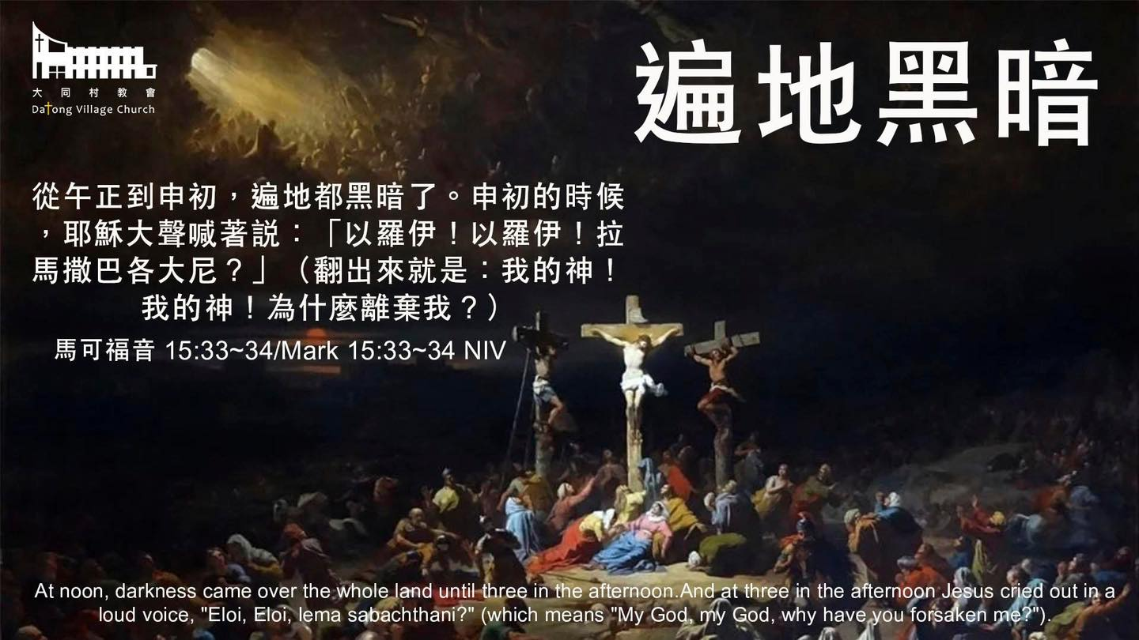

Slide 43
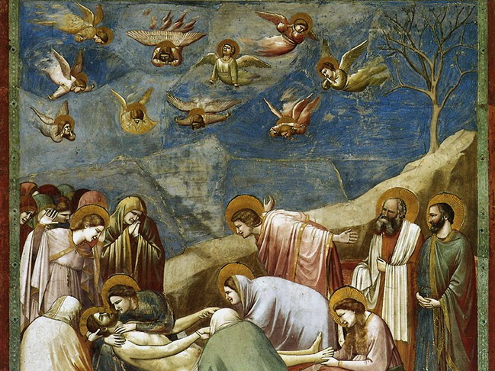
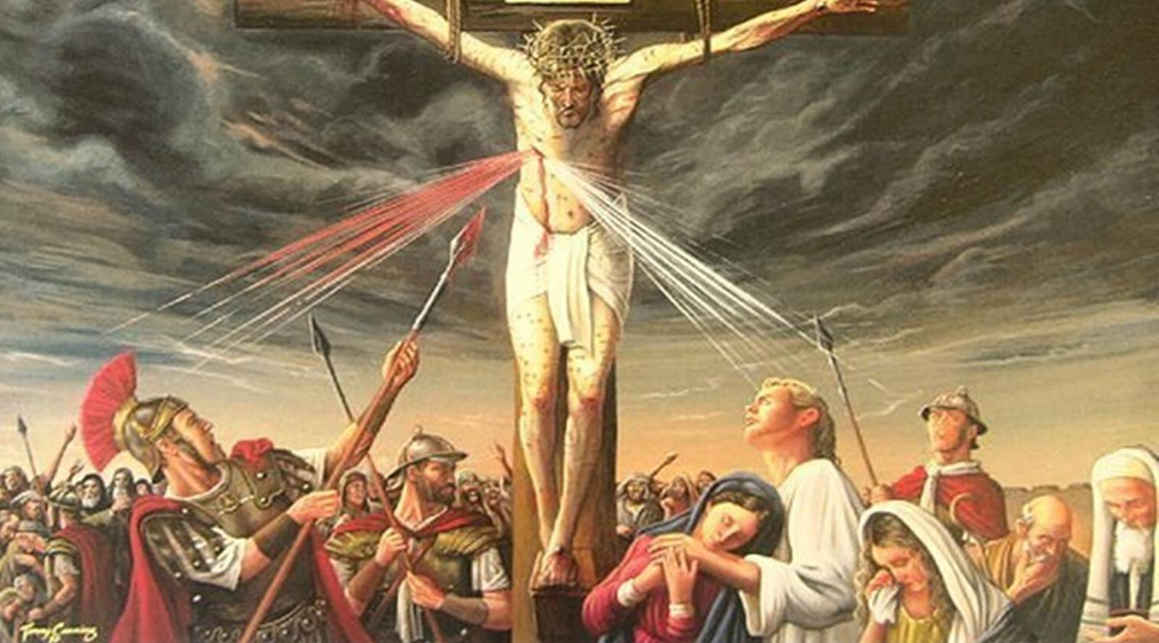
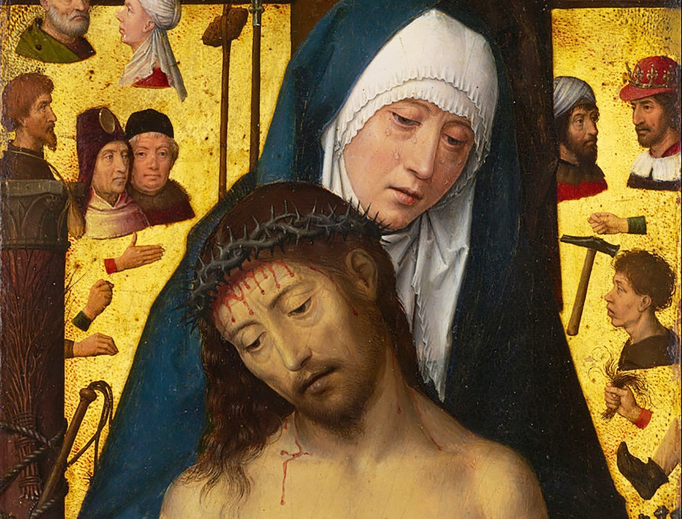

Slide 44
耶穌成為代罪的“羔羊”
Jesus became the “Lamb” of Atonement
日正中天卻遍地黑暗 The sky was full of darkness：代表罪的力量和耶穌所經歷的最深痛苦。
耶穌斷氣 Jesus' Death：受苦的最高峰。
殿里的幔子裂為兩半 The curtain in the temple was torn in two：神與人的障礙清除。
百夫長的宣告 The Roman officer‘s proclamation ：耶穌是神的兒子
Notes:
日正中天卻遍地黑暗：代表了罪的力量和耶穌所經歷的最深痛苦。
耶穌斷氣：受苦的最高峰。
殿里的幔子從上到下裂為兩半：神與人的障礙清除。
百夫長的宣告：耶穌是神的兒子

Slide 45
禱告 Prayer
親愛的耶穌，感謝你在十字架上為我承受的痛苦和犧牲。你為我承擔了所有的罪使我可以與神和好，得以親近神。主啊，幫助我更加明白你在十字架上的犧牲，懂得感恩和回應。最重要的事是願我像百夫長一樣，真誠地相信你是神的兒子，是我的救主。
Dear Jesus, thank you for the pain and sacrifice you endured for me on the cross. You bore all your sins for me so that we could be reconciled to God and draw near to Him. Lord, help me to be more aware of your sacrifice on the cross, to be thankful and to respond. The most important thing is that I may be like a centurion and sincerely confess that you are the Son of God and my Savior.

Slide 46
VIII. He Was Buried in a Borrowed Tomb
他借埋於他人之墓
(15:44-46)
彼拉多詫異耶穌已經死了，便叫百夫長來，問他耶穌死了久不久。既從百夫長得知實情，就把耶穌的屍首賜給約瑟。約瑟買了細麻布，把耶穌取下來，用細麻布裹好，安放在磐石中鑿出來的墳墓裏，又滾過一塊石頭來擋住墓門。
Pilate couldn’t believe that Jesus was already dead, so he called for the Roman officer and asked if he had died yet. The officer confirmed that Jesus was dead, so Pilate told Joseph he could have the body. Joseph bought a long sheet of linen cloth. Then he took Jesus’ body down from the cross, wrapped it in the cloth, and laid it in a tomb that had been carved out of the rock. Then he rolled a stone in front of the entrance.(Mark 15:44-46 NLT)

Slide 47
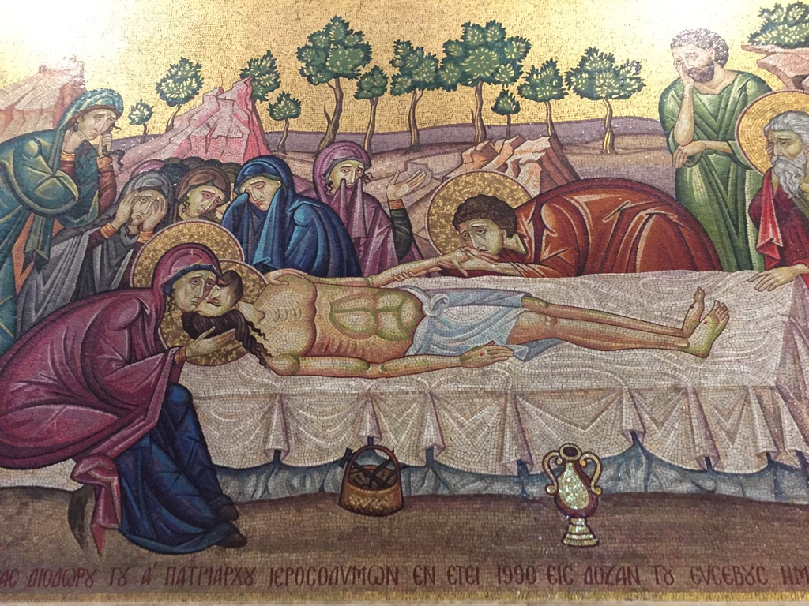
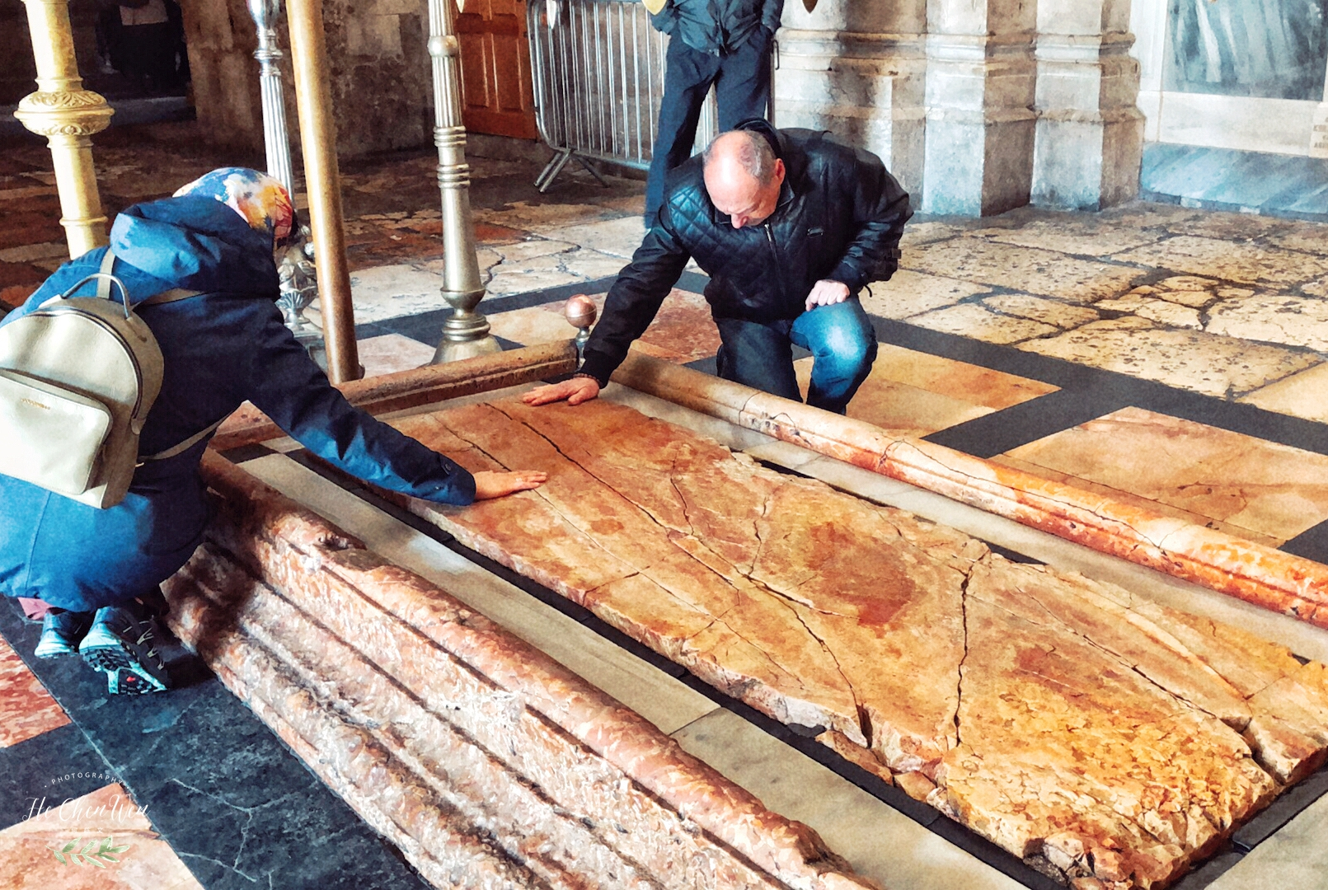

Slide 48
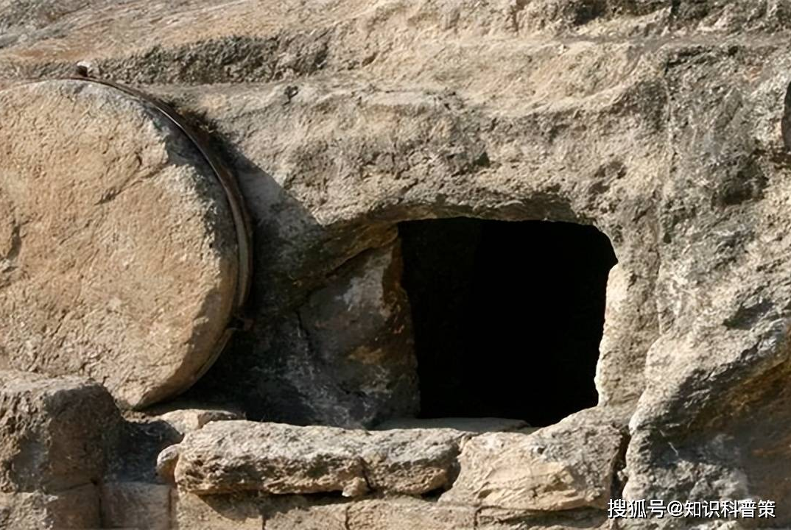
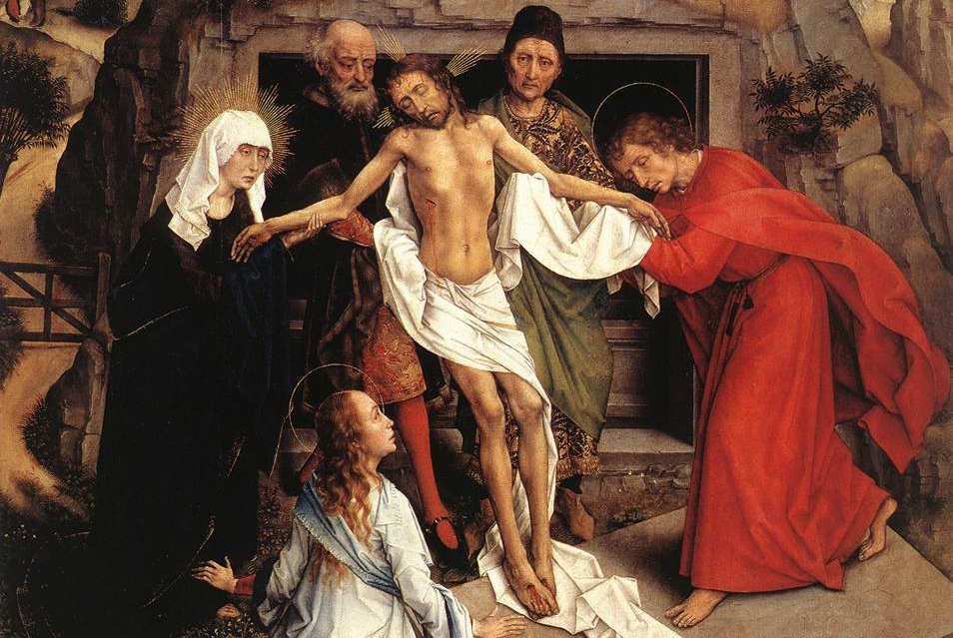
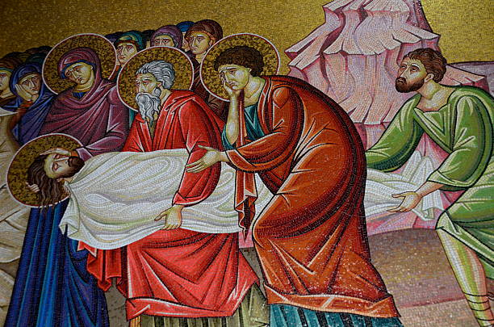

Slide 49
耶穌成为牺牲的“一粒麥子”
Jesus became a dead “grain of wheat”
彼拉多驚訝耶穌死亡 Pilate was amazed at the death of Jesus
約瑟的愛心與敬意 Joseph's Love and Respect
耶穌的身体死亡 Jesus was died：十字架的死亡不是終結，而是復活與永生的起點 The death of the cross is not the end, but the beginning of resurrection and eternal life.
  我實實在在地告訴你們，一粒麥子不落在地裏死了，仍舊是一粒，若是死了，就結出許多子粒來。(約翰福音 12:24 ) I tell you the truth, unless a kernel of wheat is planted in the soil and dies, it remains alone. But its death will produce many new kernels—a plentiful harvest of new lives.(John 12:24 NLT)
Notes:
根据罗马的刑法，钉十字架的刑罚通常是非常缓慢的死亡过程，通常会持续数小时甚至数天。耶稣在短短几小时内便死去，令彼拉多感到惊讶。
彼拉多驚訝耶穌的死亡：
約瑟的愛心與敬意：秘密的門徒，以尊貴的方式安葬耶穌。
耶穌真的死了：非虛構的故事，而是歷史事實；十字架的死亡不是終結，而是復活與永生的起點。
我實實在在地告訴你們，一粒麥子不落在地裏死了，仍舊是一粒，若是死了，就結出許多子粒來。(約翰福音 12:24 )

Slide 50
祷告 Prayer
親愛的主耶穌，我要紀念你真實的死亡，感謝你為我的罪走上十字架。你本無罪，卻為罪人捨命；你本尊貴，卻被葬於墳墓之中。你的手被釘，為贖我的罪恶；你的血流盡，洗淨我的污穢；你被葬于墳墓，卻為我開啓了永生的盼望。願我不再為自己而活，乃為你而活，讓十架的恩典，成為我每日的力量，讓你的愛，刻在我的心上。
Dear Lord Jesus, I want to commemorate your real death and thank you for going to the cross for my sins. You were sinless, yet You gave Your life for sinners; You were honorable, yet You were buried in a tomb. Your hands were nailed to atone for my sins; Your blood was shed to cleanse me; You were buried in the tomb, but You opened up the hope of eternal life for me. May I no longer live for myself, but for you, and let the grace of the cross be my daily strength, and let your love be engraved on my heart.
Notes:
“耶稣的死是神圣的爱的一部分，它消除了罪的权势，恢复了我们与神的关系。”奥古斯丁（Augustine of Hippo）
“耶稣的死并非仅仅为我们作了牺牲，它打破了死亡的锁链并让复活的力量进入了世界。” C.S. 路易斯（C.S. Lewis）
“耶稣的死标志着一个新时代的开始。祂的死不仅是人类罪的审判，也是永生的开始。”鲍勃·索菲尔（Bob Sofield）

Slide 51
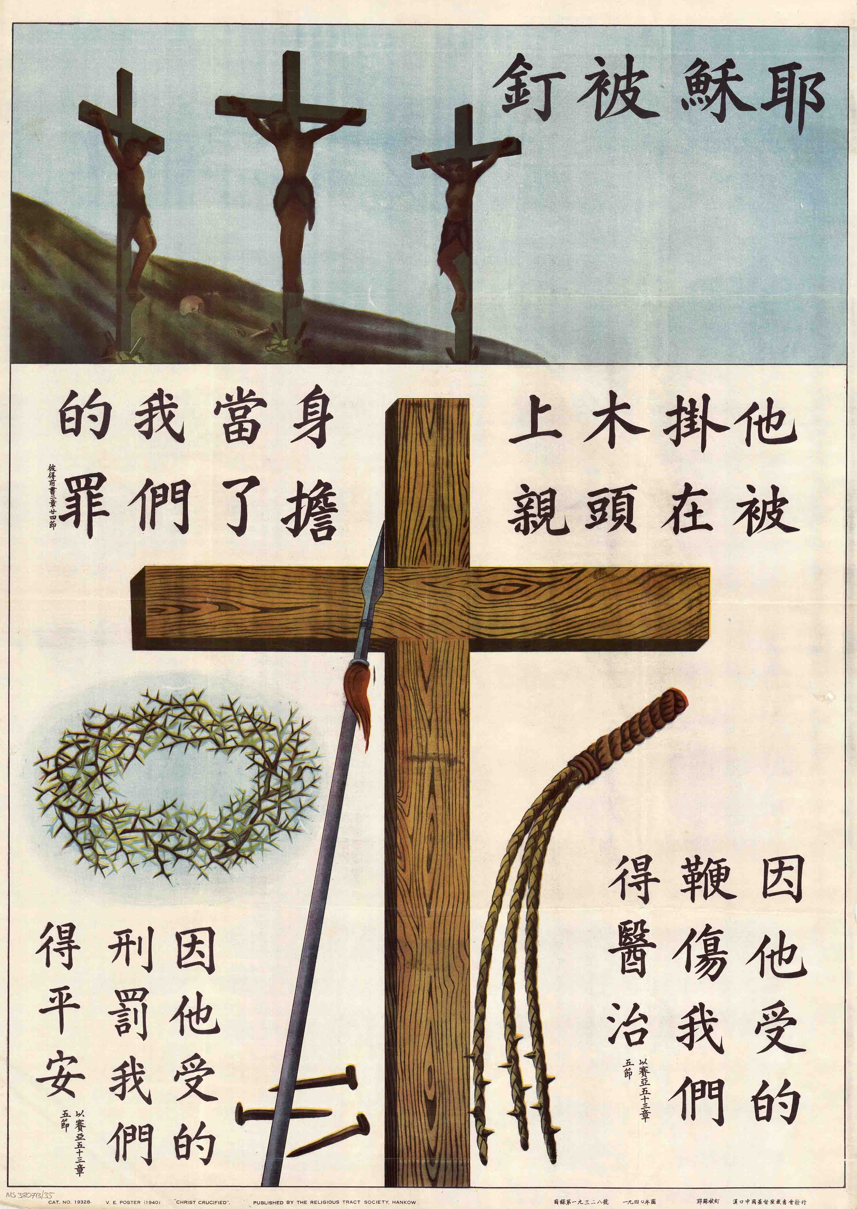
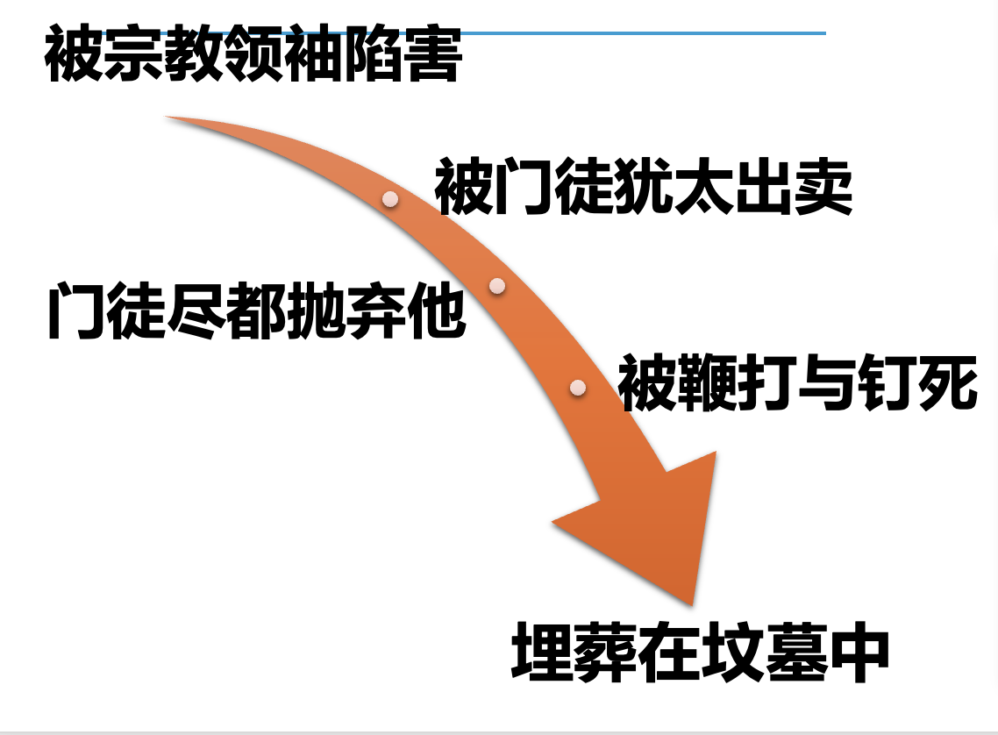

結語：何等恩典

