Slide 1



Immokalee CRA Redevelopment Plan Update
Focus Group
Ecotourism, agrotourism
&
Stormwater, lake Trafford water quality
May 6, 2021
6:00 p.m.

Slide 2
Agenda
HYBRID MEETING & HOW TO PARTICIPATE
Ecotourism and agrotourism
STORMWATER &LAKE TRAFFORD WATER QUALITY
Next Steps

Slide 3
Technical
Help
For sound or display issues contact Collier Staff
Monica Acosta
Email: Monica.Acosta@colliercountyFl.gov.
Phone: 239-867-0025
Notes:
If you need assistance with technical issues, please contact Christal at (239) 289-3310

Slide 4




Hybrid Meeting
Social Distancing
Zoom and in-person
Virtual attendees are in ‘Listen Only’ mode
Notes:
Due to the evolving social distancing guidelines, this meeting is allowing virtual and in-person attendance.
We are using the ZOOM online meeting platform for the presentation.
This meeting is being recorded and will be available on the Collier County website
All remote attendees will be placed in the “Listen Only” mode throughout the meeting
Questions will be addressed at the conclusion of the presentation in a rotating sequence from, in-person, online and phone participants.

Slide 5


Participating on Zoom
Online Participants
Online Participants have TWO OPTIONS.
Type your question in the Q&A section. The moderator will read aloud during the discussion session.
Use the Raise Hand feature. You will be able to unmute and speak when you are recognized during the discussion session.
Notes:
We encourage you to participate by submitting comments and questions.
There are multiple ways to do this:
If you are online, you can type your comments in the “Q&A” section on the control panel any time during the meeting. The chat feature is disabled.
During the questions and comments period you can also use the “Raise Hand” feature if you’d like to be called upon to speak.
For attendees in the room, just raise your hand during the Q&A session.
Just a reminder that questions will not be answered during the presentation portion.

Slide 6
Vision Statement
Immokalee is a family-oriented community that supports a healthy lifestyle. It is attractive, environmentally sustainable and offers a full range of housing, recreation, and educational opportunities to meet all residents’ needs. Immokalee has a safe, well-connected network to walk and bicycle about town, as well as a roadway network needed to support the transport of goods and services. Business and job opportunities flourish in trade and distribution, agri-business, and ecotourism.
Immokalee Area Master Plan - 2019

Slide 7
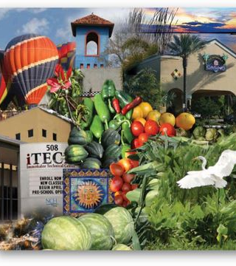
Immokalee
CRA
Baseline Data

Slide 8
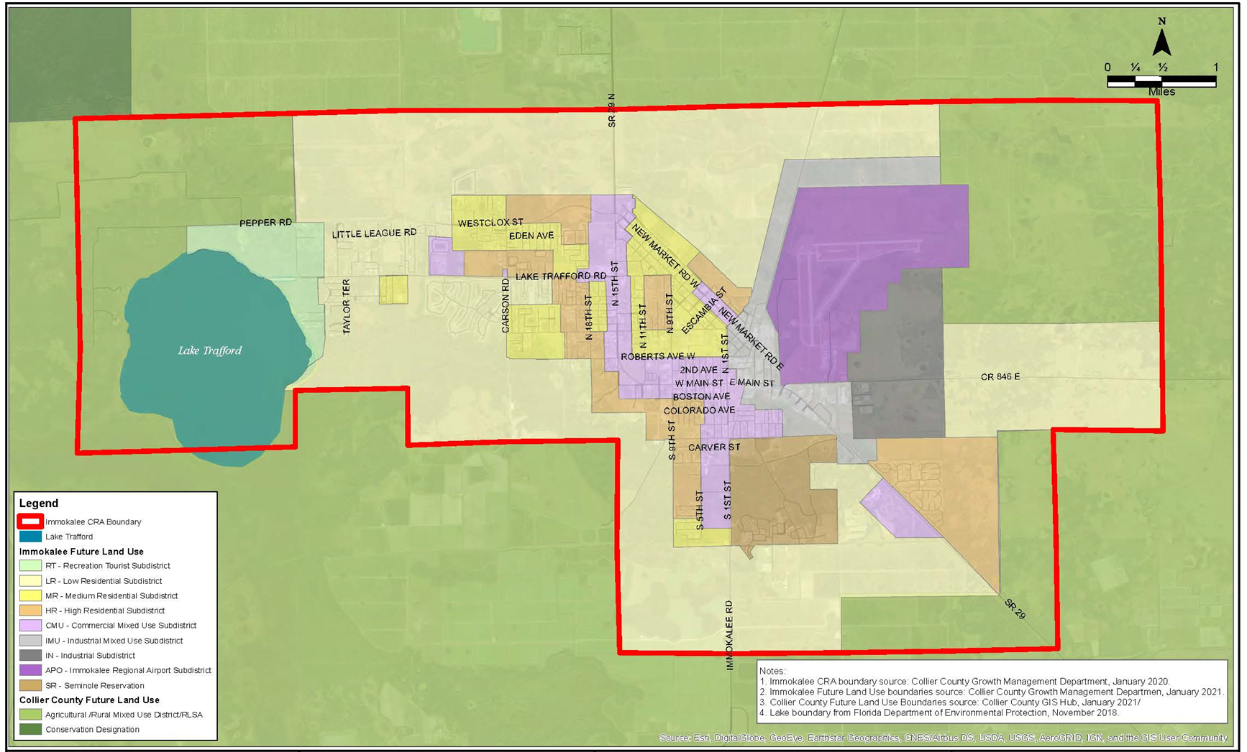
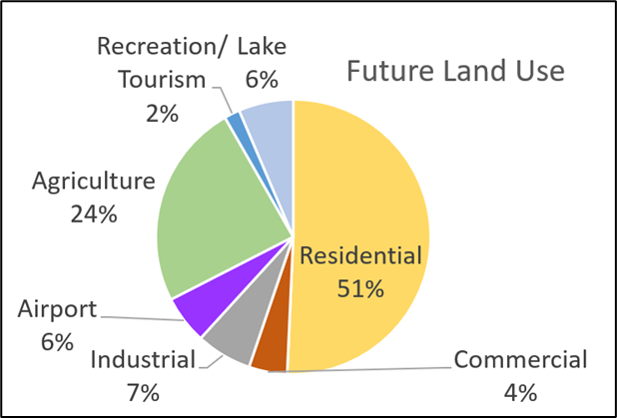
Current Land Use Map
Notes:
Are these opportunities supported by the community? Are there more you recommend?

Slide 9
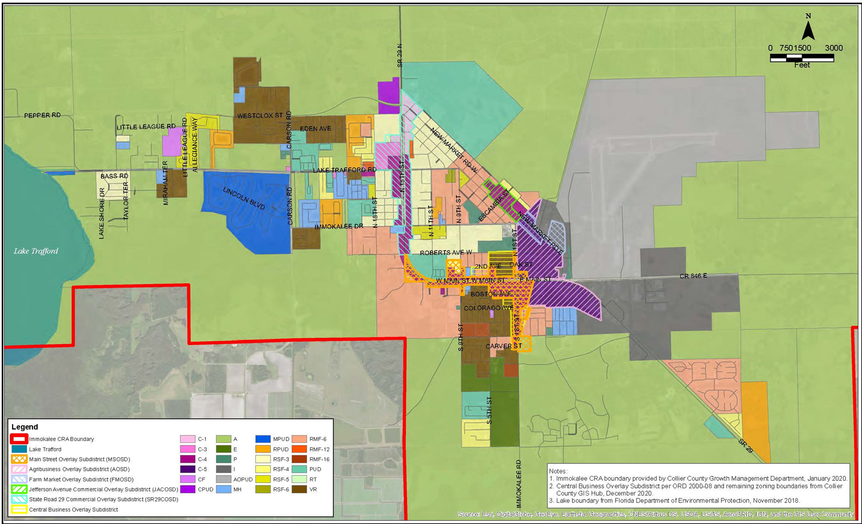
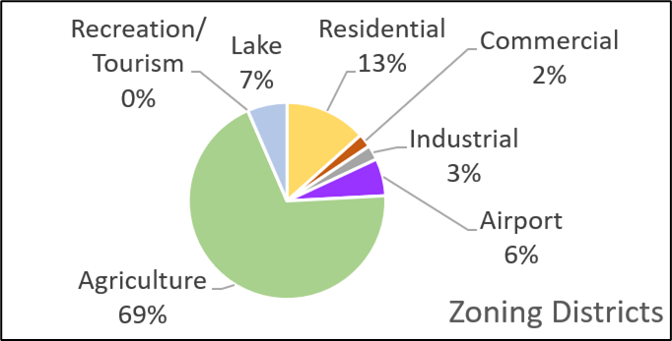
Current Zoning Map

Slide 10
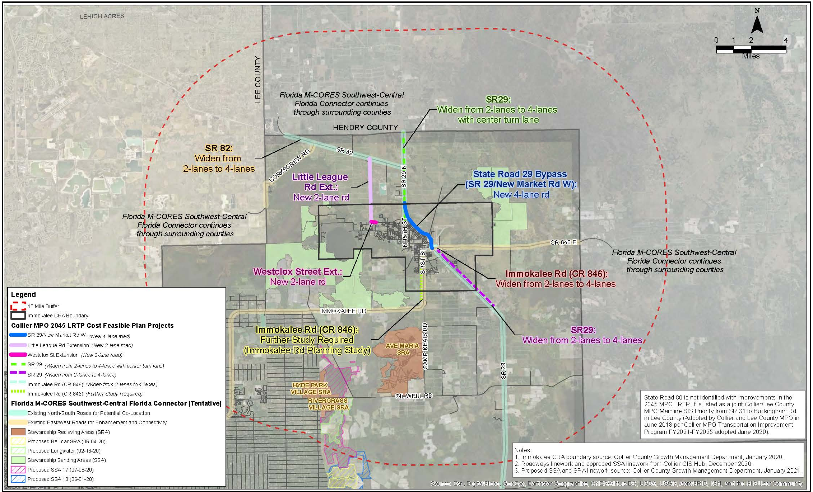
Regional Connections

Slide 11
Immokalee
CRA
Ecotourism
Agrotourism

Slide 12

What we’ve heard…
On February 16, we began a weekly online survey with a variety of questions to solicit public input on a variety of topics. We hope you will take a few minutes of your time to participate. The input gathered from the survey will be shared with the public. Over the next few months, there will be various public outreach events to gather additional input and comments on proposed changes.
The CRA has an online survey to gather your feedback on goals and issues to address in the Redevelopment Plan Update
Survey is available:
https://immokaleecra.com/
SURVEY Link https://immokaleecra.com/

Slide 13
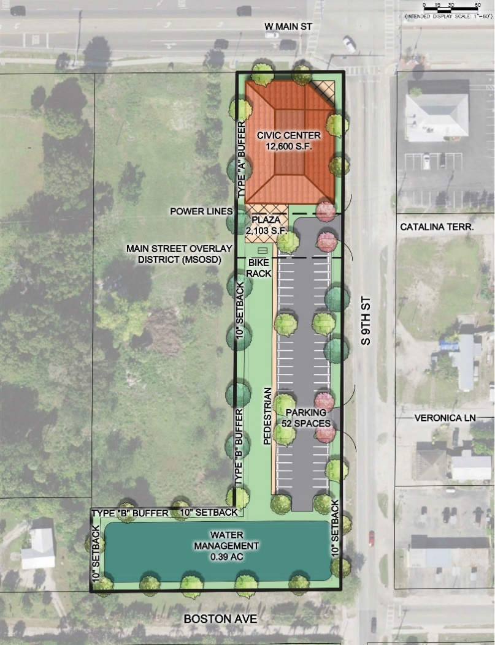
What we’ve heard…
Culture
  255 survey participants
  Very positive response to funding events & celebrating culture
  - 68% support a look and feel to celebrate different styles & cultures
  What is your culture: Mexican (56%), Immokalee native (14%)
  Most needed services: Housing related services (20%) & education/training (16%)
  Immokalee is safe but could use improvements (79%)
  60% do not perceive Immokalee as a place of opportunity
  74% support a public use on the CRA property @ W Main St and S 9th St
SURVEY Link https://immokaleecra.com/

Slide 14
What we’ve heard…
Economic Development
  66 Surveys as of 4.26.21
  68% consider Main Street as the “center” of Immokalee
  85% have shopped, dined, or received services at a business on Main Street within the last 12 months
  86% are small business owners (1 to 9 employees)
  64% of respondents are interested in training or higher education opportunities
  Biggest barriers for training & education:
    - Day/time of available classes (40%)
    - Tuition costs (35%)
SURVEY Link https://immokaleecra.com/

Slide 15
What we’ve heard…
Economic Development – 2020 FHERO Assessment
  What does success look like in 5 years =
  Diversified economy
  Growing Tax Base that alleviates infrastructure challenges
  A trained workforce and robust talent pipeline
  Jobs with a strong career path and strong wages
  Recognition of Immokalee’s uniqueness within the County
SURVEY Link https://immokaleecra.com/

Slide 16
Economic Development
Recreation
Immokalee Area Master Plan –
Objective – Promote and expand tourism, eco-tourism, entertainment, cultural opportunities
Policy: Encourage the expansion of restaurants, movie theaters, museums, and public spaces
Policy – Promote increasing tourism
Policy – Encourage the development of ecotourism focus on Lake Trafford and RT lands
Policy – Seminole Casino Immokalee – continue to work with the Seminole Tribe
Policy – Entertainment District – encourage the development of an entertainment district are near the casino that is complementary and connected to Immokalee’s existing downtown core.
Objective – Enhance and expand educational and cultural facilities and opportunities
Policy – Research and Development – seek to attract educational research facilities
Policy – Enhance the availability and variety of training programs
Community
Facilities
Housing
Mobility
Drainage & Lake
Trafford
Notes:
Reoccurring themes from various established plans and the Imm. Area Master Plan

Slide 17
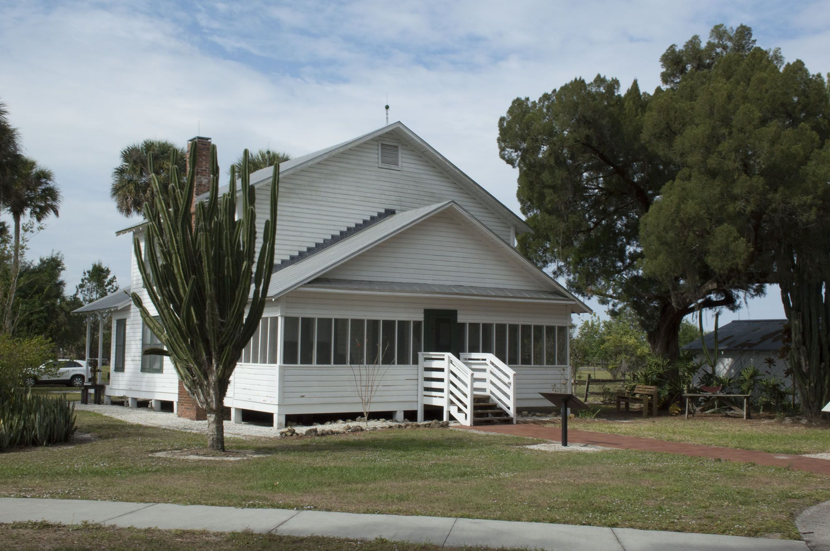
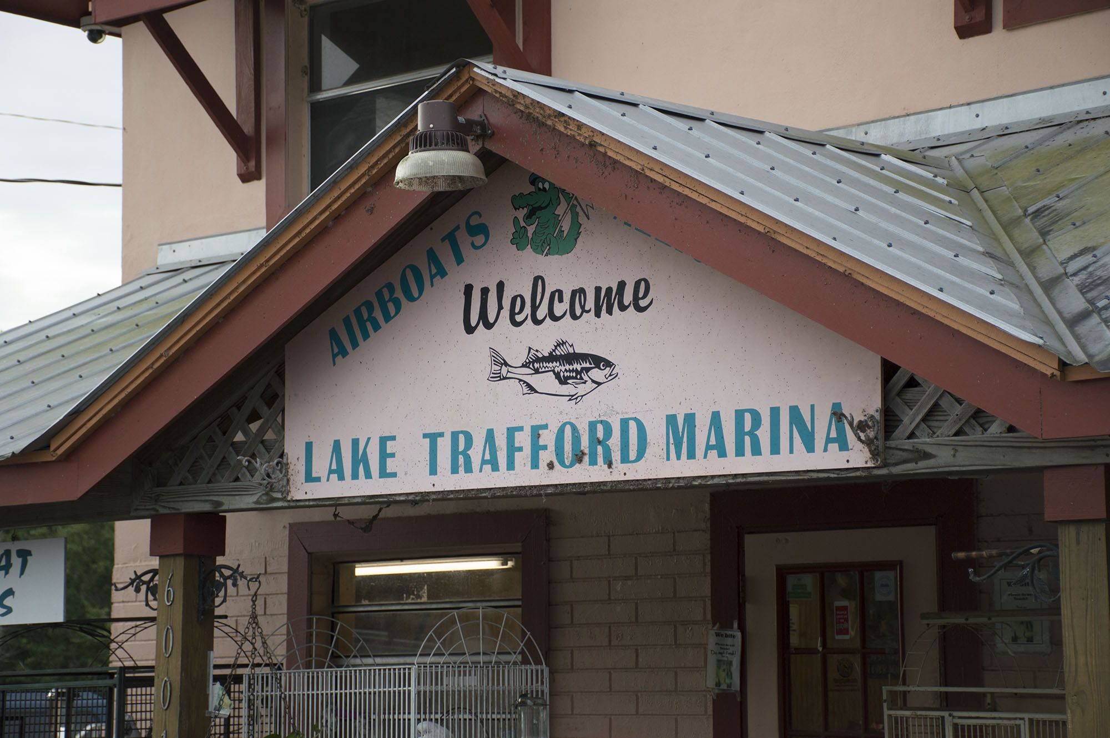
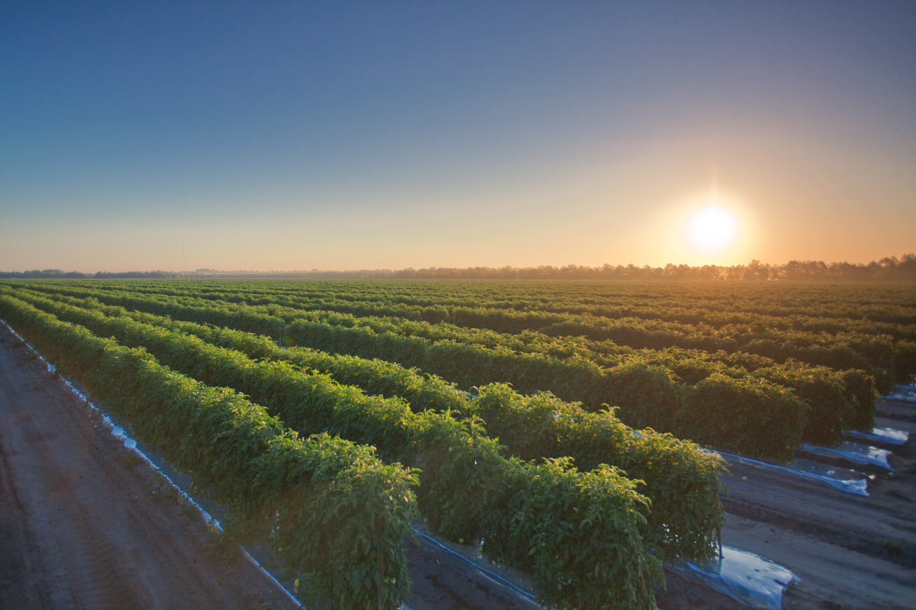
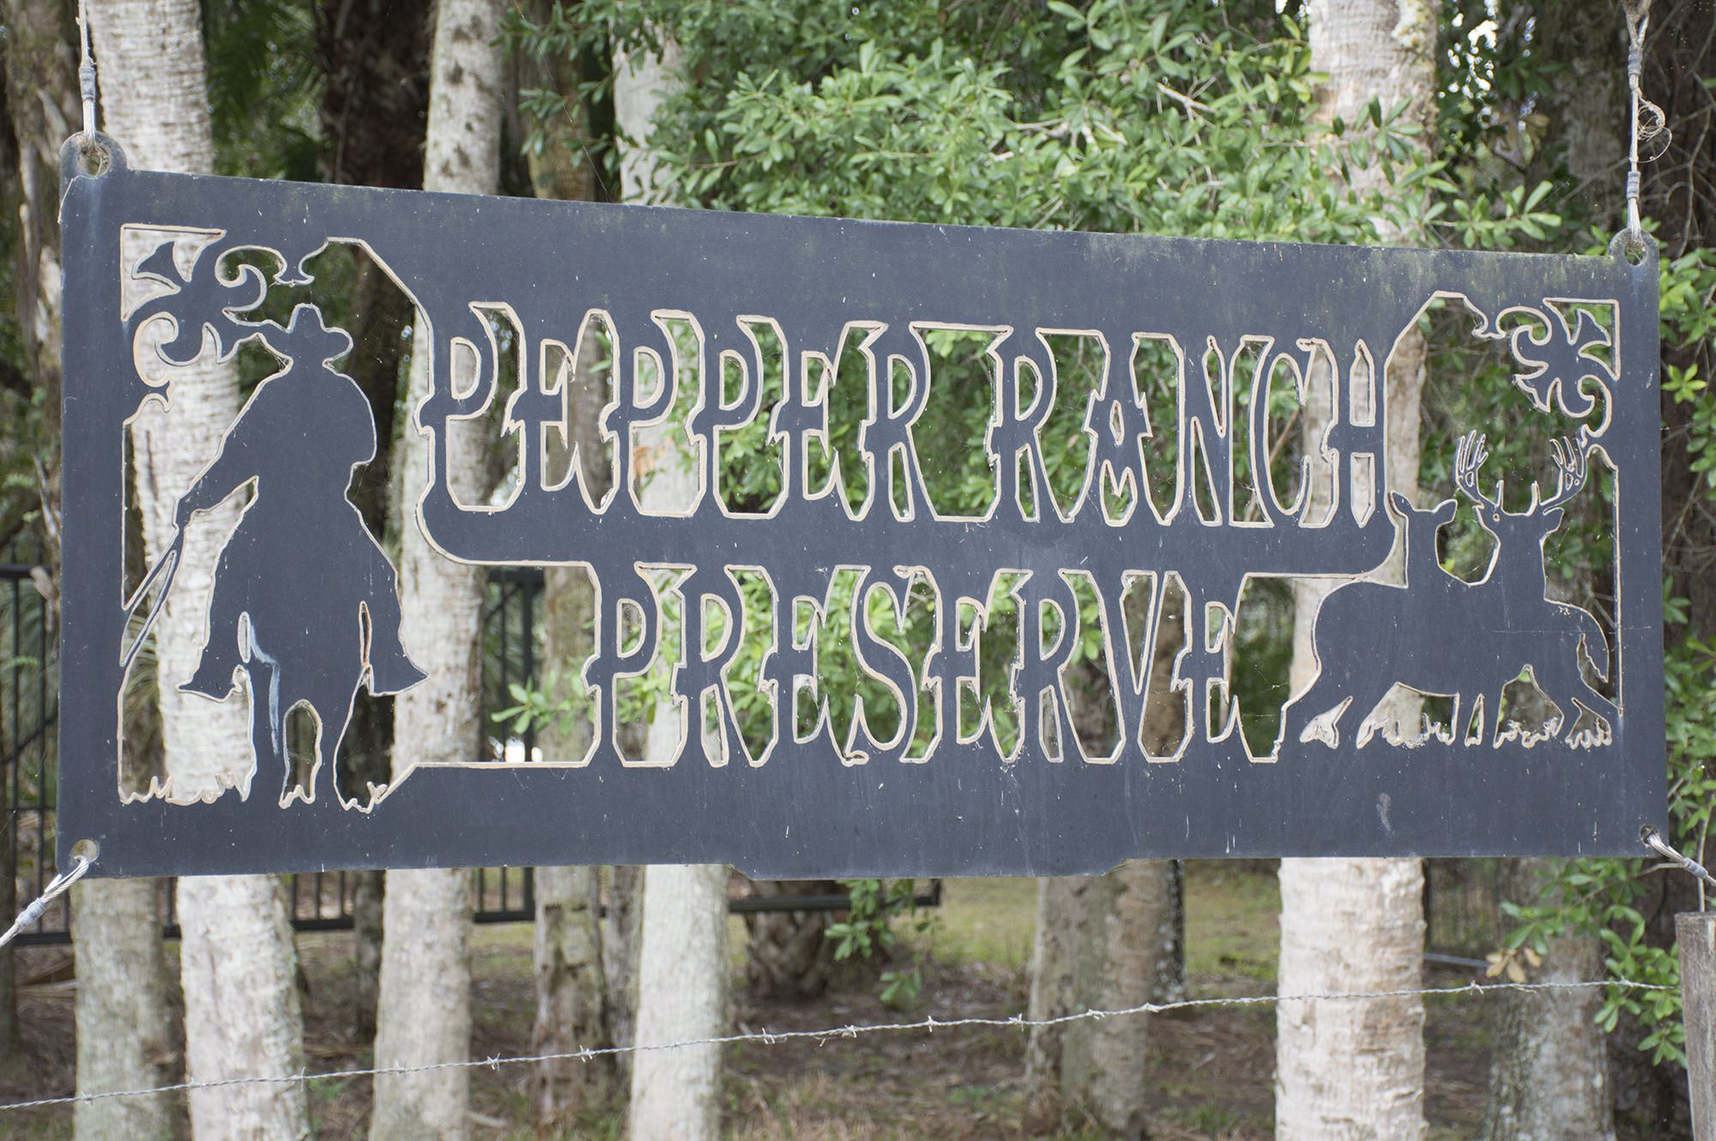
Ecotourism and Agrotourism
Recreation
Proposed Goal/Objective:
Direct public investment to promote ecotourism and agritourism business development, strengthen opportunities for marketing and branding developing Immokalee as a destination to attract visitors to the community.
Community
Facilities
Housing
Mobility
Drainage & Lake
Trafford
Notes:
Reoccurring themes from various established plans and the Imm. Area Master Plan

Slide 18
Ecotourism
Recreation
Ecotourism: catering to tourists wishing to experience the natural environment without damaging or disturbing its habitats. “Responsible Travel” to natural areas. Sustainable/Environmental Stewardship. Educate the tourists about conservation efforts and research developments in fragile natural areas
Examples:
Hiking
Kayaking
Interpretation Trails
Community
Facilities
Housing
Mobility
Drainage & Lake
Trafford
Notes:
Reoccurring themes from various established plans and the Imm. Area Master Plan

Slide 19
Agrotourism
Recreation
Agrotourism Definitions – brings visitors to the farm or ranch
Examples:
Farmers Markets
U-pick operations
Farm Museums
Local Product/traditional food
Farm Visits/Tours
Community
Facilities
Housing
Mobility
Drainage & Lake
Trafford
Notes:
Reoccurring themes from various established plans and the Imm. Area Master Plan

Slide 20
Immokalee
CRA
Drainage
Water Quality

Slide 21
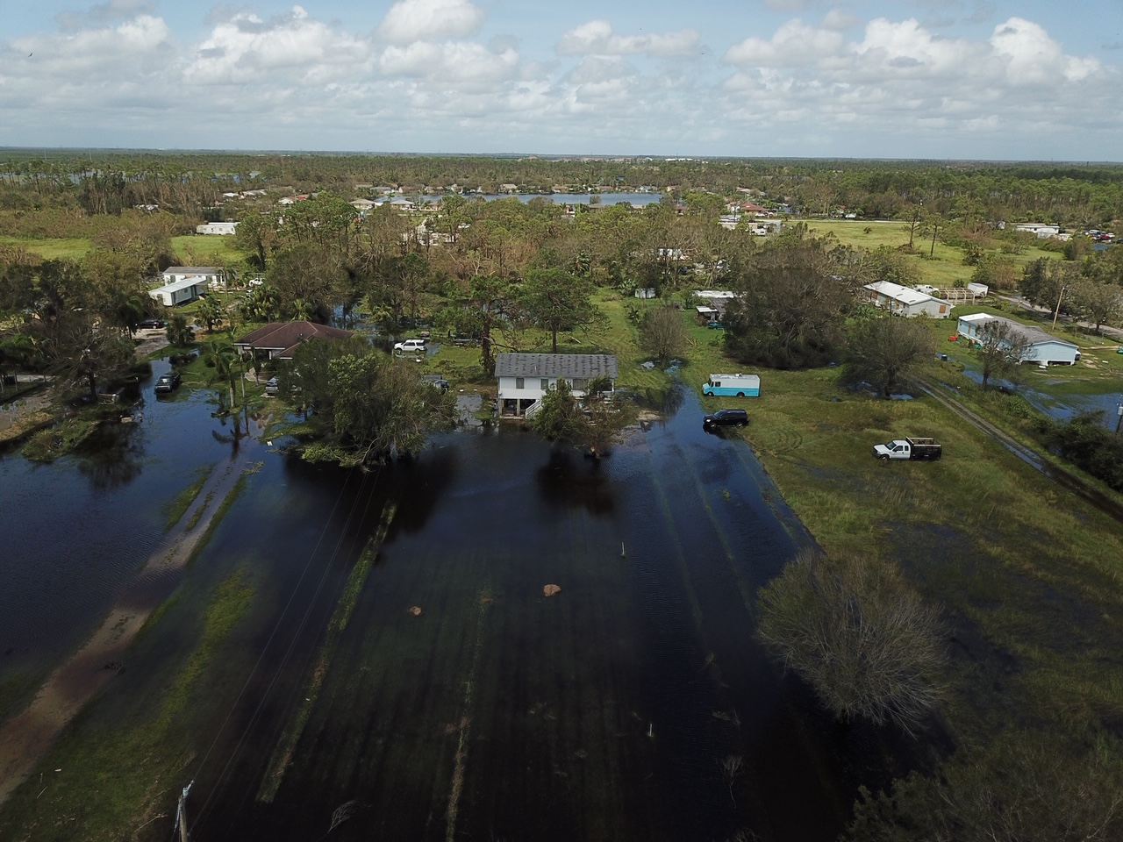
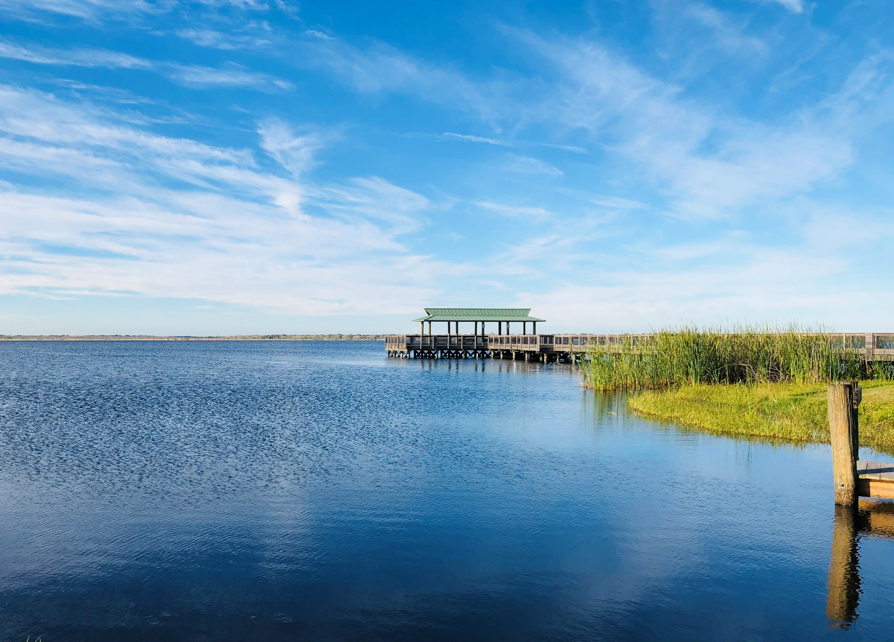
Drainage and Water Quality
Recreation
Proposed Goal/Objective:
Leverage funding to improve drainage and water quality in the community.
Community
Facilities
Housing
Mobility
Flooding – Westclox
Lake Trafford
Notes:
Reoccurring themes from various established plans and the Imm. Area Master Plan

Slide 22
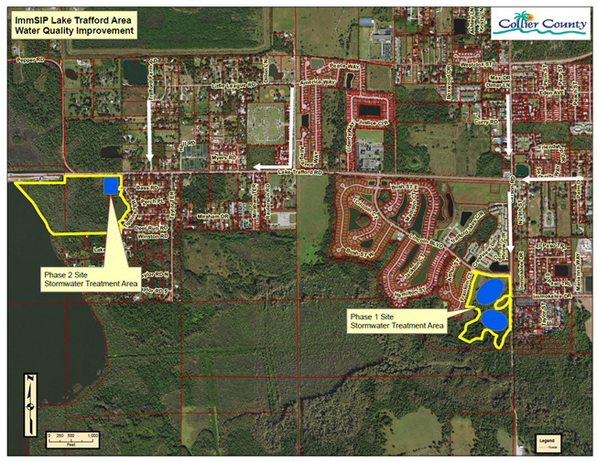
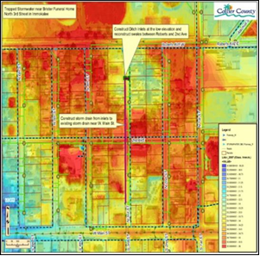
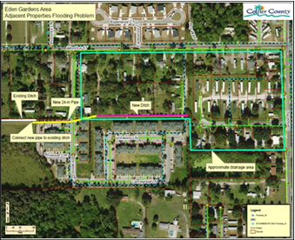
Drainage and Water Quality
Recreation
North 3rd. Street Stormwater Improvements
Lake Trafford Road Area
Housing
Mobility
Drainage & Lake
Trafford
Eden Gardens project:
Notes:
Reoccurring themes from various established plans and the Imm. Area Master Plan

Slide 23
Objectives and Strategies to Reach Goal
Goal Revisions?
OPEN DISCUSSION

Slide 24


Next Steps – Focus Groups
Culture
April 13, 2021
@ 6:00 p.m.
Housing
April 20, 2021
@ 6:00 p.m.
Economic
Development
Recreation
Mobility
Economic
Development
Ecotourism & Agrotourism
April 27, 2021
@ 6:00 p.m.
May 6, 2021
@ 6:00 p.m.
Community
Facilities
Stormwater & Lake
Trafford
SURVEY Link https://immokaleecra.com/

Slide 25
Next Steps – Redevelopment Plan
Online public survey & Community Kick of Meeting March/April 2021
Goal Validation Focus Group Meetings April/May 2021
CRA AB Meeting with Framework Maps May 19, 2021
    Develop Capital Project List for CRA funding
Redevelopment Plan Update drafting Summer 2021
Community Review Meeting &
CRA AB endorse Draft Redevelopment Plan September 2021
Planning Commission Oct – Nov 2021
Board of County Commissioners adoption Dec – Jan 2022
Final Completion date March 31, 2022
NEXT
NEXT

Slide 26
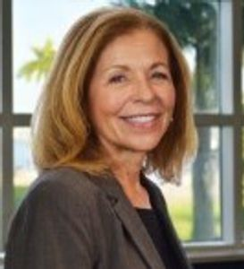
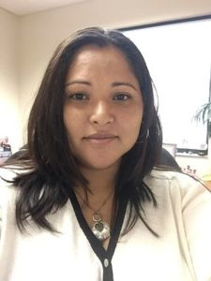
Contacts
Debrah Forester, Bayshore And Immokalee CRA Director
Email: Debrah.Forester@CollierCountyFL.gov
Phone: 239-252-8846
Christie A. Betancourt, Immokalee CRA Operations Manager
Email: Christie.Betancourt@colliercountyFl.gov
Phone: 239-867-0028
https://immokaleecra.com/

