Slide 1
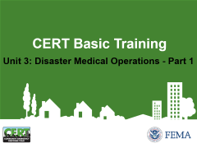


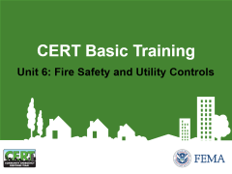




CERT Basic Training

Slide 2
Unit 1: Disaster Preparedness
CERT Basic Training

Slide 3
Setting the Stage
CERTs are able to:
  Assist emergency services personnel when requested in accordance with standard operating procedures (SOPs) developed by the sponsoring agency and by area of training
  Assume some of the same functions as emergency services personnel following a disaster
  Prepare families and communities prior to emergencies and assist neighbors during an emergency when first responders are not immediately available
PM 1-1
CERT Basic Training Unit 1: Disaster Preparedness
1-1

Slide 4
Course Preview
Unit 1: Disaster Preparedness
Unit 2: CERT Organization
Unit 3: Disaster Medical Operations, Part 1
Unit 4: Disaster Medical Operations, Part 2
Unit 5: Disaster Psychology
Unit 6: Fire Safety and Utility Controls
Unit 7: Light Search and Rescue Operations
Unit 8: Terrorism and CERT
PM 1-1
CERT Basic Training Unit 1: Disaster Preparedness
1-2

Slide 5
Unit 1 objectives
Describe the functions of CERT, discuss your role as a CERT volunteer, and explain how CERT fits into your community’s emergency preparedness structure
Describe the types of hazards most likely to affect your communities and their potential impact on people, health, and infrastructure
Prepare yourself and your family for potential disasters your community may face, including learning to create a family disaster plan and emergency preparedness kit
PM 1-1
CERT Basic Training Unit 1: Disaster Preparedness
1-3

Slide 6
Exercise 1.1
Work in groups of five to design and construct a free-standing tower that stands at least 5 feet tall from the bottom of the structure to the top
You will have a total of 10 minutes. Spend the first 5 minutes planning and designing the tower as a group. While you are planning, you should not touch any of the materials
Wait to be told when to begin construction and you will have 5 minutes from that point to complete the tower
PM 1-2
CERT Basic Training Unit 1: Disaster Preparedness
1-4

Slide 7
Community Preparedness Roles
Preparedness is important for communities of all sizes across the Nation
  Key priority in lessening the impact of disasters
  Critical that all community members take steps to prepare
  Effective when addresses unique attributes of community and engages whole community
PM 1-3
CERT Basic Training Unit 1: Disaster Preparedness
1-5

Slide 8
Government
Government has responsibility to:
  Develop, test, and refine emergency plans
  Ensure emergency responders have adequate skills and resources
  Provide services to protect and assist citizens
PM 1-3
CERT Basic Training Unit 1: Disaster Preparedness
1-6

Slide 9
Emergency Operations Plan (EOP)
All government agencies with a role in disaster response work to organize and coordinate their agencies’ activities before an emergency or disaster using EOP’s:
  Assigns responsibility to organizations and individuals
  Sets forth lines of authority
  Describes how people and property will be protected
  Identifies personnel, equipment, facilities, supplies, and other resources
PM 1-3
CERT Basic Training Unit 1: Disaster Preparedness
1-7

Slide 10
Community Leaders
Have a responsibility to participate in community preparedness:
  Participate on local collaborative planning council
  Identify and integrate appropriate resources into government plans
  Ensure facilities, staff, and customers served are prepared
PM 1-4
CERT Basic Training Unit 1: Disaster Preparedness
1-8

Slide 11
The Public
Learn about community alerts, warnings, and evacuation routes
Take training
Practice skills and personal plans
Network and help others
Provide feedback to community
Report suspicious activity
Volunteer
PM 1-4
CERT Basic Training Unit 1: Disaster Preparedness
1-9

Slide 12
Engaging the Whole Community
Whole Community approach to emergency preparedness seeks to engage the full capacity of society
Relationships and social connections are the foundation for a more resilient community that can bounce back after a disaster
Community coalitions strengthen relationships and provide a framework for organizing community preparedness efforts
PM 1-4
CERT Basic Training Unit 1: Disaster Preparedness
1-10

Slide 13
Get Involved
Preparedness requires active participation from all
  Talk to friends and family about hazards
  Ask about emergency planning outside the home
  Make sure those in charge have a plan
Training provides skills needed to help others and keeps skills current
  CERT program provides training, practice, and connection to others
  Participate in drills and exercises
  Talk to friends and family about volunteering
PM 1-5
CERT Basic Training Unit 1: Disaster Preparedness
1-11

Slide 14
Type of Disasters
Natural (e.g., earthquakes, wildfires, floods, extreme heat, hurricanes, landslides, thunderstorms, tornadoes, tsunamis, volcanic eruptions, winter storms)
Technological & Accidental (e.g., hazardous material spill, nuclear power plant accident)
Terrorism (e.g., chemical, biological, radiological, nuclear, explosive weapons)
PM 1-6
CERT Basic Training Unit 1: Disaster Preparedness
1-12

Slide 15
Key Disaster Elements
They are relatively unexpected
Emergency personnel may be overwhelmed
Lives, health, and the environment are endangered
PM 1-6
CERT Basic Training Unit 1: Disaster Preparedness
1-13

Slide 16
Local Hazard Vulnerability
Identify most common disasters that occur
Identify possible hazards with most severe impact
Consider recent or historical impacts
Identify susceptible locations in the community for specific hazards
Consider what to expect from disruption of services
PM 1-6
CERT Basic Training Unit 1: Disaster Preparedness
1-14

Slide 17
Infrastructure Damage
Resources will be applied to the highest priority need:
  Police will address incidences of grave public safety
  Firefighters will suppress major fires
  EMS personnel will handle life-threatening injuries
PM 1-7
CERT Basic Training Unit 1: Disaster Preparedness
1-15

Slide 18
Damage Related to Structure Type
You may not have opportunity to select type of structure when a disaster occurs
Engineered buildings have performed well in most types of disasters
Types of damage vary by structure
Differences in hazards and mitigation between single-family homes and multiple-unit dwellings
PM 1-8
CERT Basic Training Unit 1: Disaster Preparedness
1-16

Slide 19
Home Hazards
Gas line ruptures from water heaters or ranges displaced by shaking, water, or wind
Damage from falling books, dishes, or other cabinet contents
Risk of injury or electric shock from displaced appliances and office equipment
Fire from faulty wiring, overloaded plugs, frayed electrical cords
PM 1-9
CERT Basic Training Unit 1: Disaster Preparedness
1-17

Slide 20
Preparing for a Disaster(1 of 2)
Know local hazards, alerts, warning systems, evacuation routes, and sheltering plans
Consider important elements of disaster preparedness
Address specific needs for yourself and people you know
PM 1-10
CERT Basic Training Unit 1: Disaster Preparedness
1-18

Slide 21
Preparing for a Disaster((2 of 2)
Have the skills to evaluate the situation quickly and take effective action to protect yourself
Have a family disaster plan and practice the plan with drills
Assemble supplies in multiple locations
Reduce the impact of hazards through mitigation practices
Get involved by participating in training and volunteer programs
PM 1-10
CERT Basic Training Unit 1: Disaster Preparedness
1-19

Slide 22
Family Disaster Plan
Where will you meet family members?
Who is your out-of-state “check-in” contact?
Will you have an extended stay? Shelter in place? Evacuate?
How will you escape your home? Workplace? School? Place of worship?
What route (and several alternates) will you use to evacuate your neighborhood?
Do you have transportation?
Did you practice your plan?
PM 1-12
CERT Basic Training Unit 1: Disaster Preparedness
1-20

Slide 23
Disaster Supply Kit
After disaster strikes, you will not have time to shop or search for supplies
If you gather supplies in advance, you and your family will be better equipped for an evacuation or home confinement
Many of the items needed for your kits are already in your household
  These items can be assembled in appropriate locations for quick access in an emergency but used under normal circumstances whenever needed
PM 1-13
CERT Basic Training Unit 1: Disaster Preparedness
1-21

Slide 24
Escape Planning
Consider needs of children and individuals with access and functional needs
Inform all family members or office coworkers of the plan
Run practice escape drills
PM 1-17
CERT Basic Training Unit 1: Disaster Preparedness
1-22

Slide 25
Exercise 1.2
Take the scenario given and decide what things to bring with you and/or what to do in the time available
PM 1-18
CERT Basic Training Unit 1: Disaster Preparedness
1-23

Slide 26
Protective Actions
Assess situation
Decide to stay or change locations
  This is a critical early decision in disasters
Seek clean air and protect breathing passages
Protect from debris and signal if trapped
Remove contaminants
Practice good hygiene
PM 1-18
CERT Basic Training Unit 1: Disaster Preparedness
1-24

Slide 27
Sheltering
Shelter in place: sealing a room
  Identify internal room
  Stay for several hours
  Store supplies
Shelter for extended stay
  Stay for several days or up to 2 weeks
  Store emergency supplies
Mass care or community shelter
  Take 3-day disaster kits
  Shelters provide most supplies
PM 1-19
CERT Basic Training Unit 1: Disaster Preparedness
1-25

Slide 28
Mitigation
Mitigation is the reduction of loss of life and property by lessening the impact of disasters and includes any activity that prevents an emergency or reduces effects of hazards
CERT members should have adequate homeowners coverage
  Add flood insurance if in a flood hazard area
PM 1-20
CERT Basic Training Unit 1: Disaster Preparedness
1-26

Slide 29
Structural Mitigation Measures
Bolt houses to foundations
Install trusses or hurricane straps to reinforce roof
Strap propane tanks and chimneys
Strap mobile homes to their slabs
Raise utilities
Build a safe room
PM 1-20
CERT Basic Training Unit 1: Disaster Preparedness
1-27

Slide 30
Non-Structural Hazard Mitigation
Anchor heavy furniture
Secure appliances and office equipment
Childproof cabinet doors
Locate and label gas, electricity, and water shutoffs
Secure water heaters and have flexible gas lines installed
Install hurricane storm shutters
PM 1-20
CERT Basic Training Unit 1: Disaster Preparedness
1-28

Slide 31
Fortifying Your Home
Non-structural hazard mitigation by disaster type:
  Home fires: Burglar bars and locks on outside window entries easy to open from the inside
  Landslides: Flexible fittings are more breakage resistant
  Wildfires: Reduce fuel sources
    Avoid wooden shakes and shingles
    Clear flammable vegetation up to 30 feet from home and remove climbing vines from walls of home
PM 1-21
CERT Basic Training Unit 1: Disaster Preparedness
1-29

Slide 32
CERT Disaster Response
CERTs respond post-disaster by:
  Treating life-threatening injuries until professional assistance is available
  Helping disaster survivors cope with their emotional stressors
  Locating and turning off utilities, if safe to do so
  Extinguishing small fires
  Conducting light search and rescue operations
PM 1-22
CERT Basic Training Unit 1: Disaster Preparedness
1-30

Slide 33
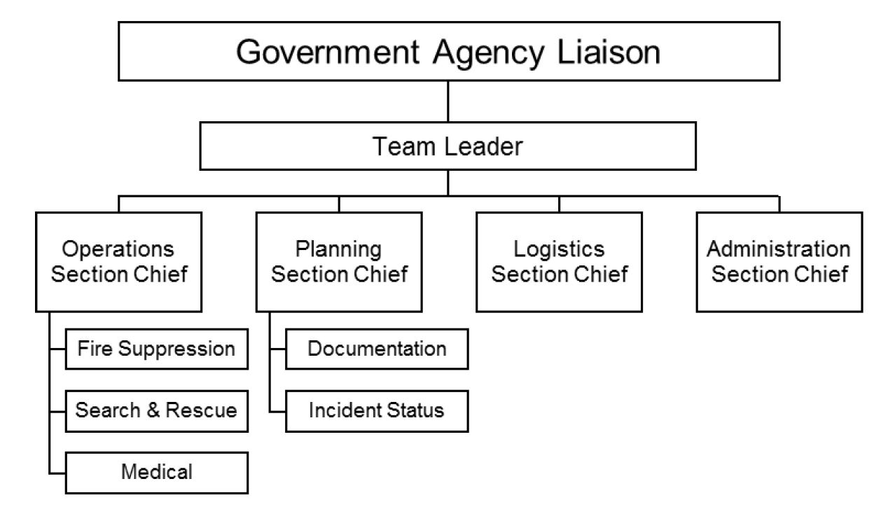
CERT Organization
PM 1-23
CERT Basic Training Unit 1: Disaster Preparedness
1-31

Slide 34
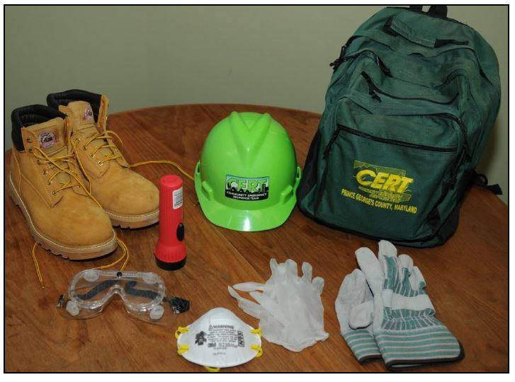
Personal Protective Equipment
Helmet
Goggles
N95 Mask
Gloves (work and non-latex)
Sturdy shoes or work boots
PM 1-24
CERT Basic Training Unit 1: Disaster Preparedness
1-32

Slide 35
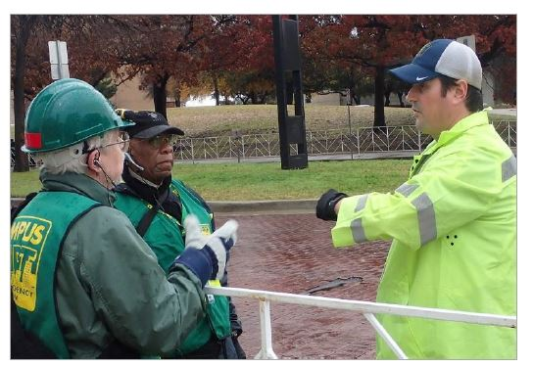
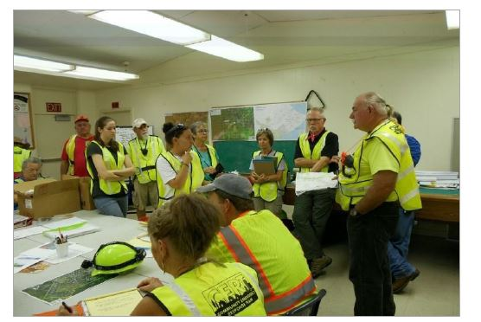
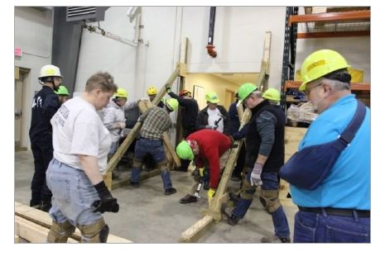
CERT in Action
PM 1-24
CERT Basic Training Unit 1: Disaster Preparedness
1-33

Slide 36
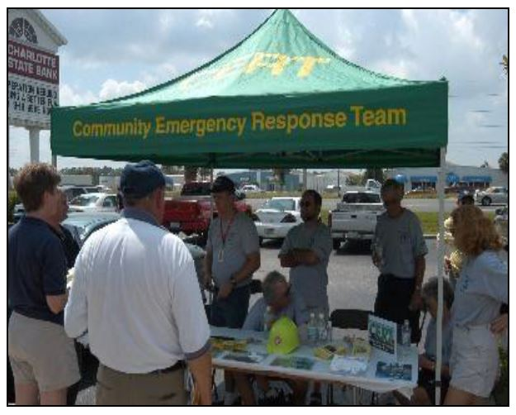
Non-Disaster Roles
Identify and aid neighbors/coworkers who might need assistance
Distribute preparedness materials; do demos
Staff first aid booths at special events
Assist with installation of smoke alarms
Participate in parade route management
PM 1-24
CERT Basic Training Unit 1: Disaster Preparedness
1-34

Slide 37
Protection for Disaster Workers
CERT members are generally protected by:
  “Good Samaritan” laws
  Volunteer Protection Act of 1997
  Relevant State statutes
PM 1-24
CERT Basic Training Unit 1: Disaster Preparedness
1-35

Slide 38
Additional Training
Advanced first aid
Animal issues in disasters
Automated External Defibrillator (AED) use
Community relations
CPR skills
Debris removal
Donations management
Shelter management
Special needs concerns
Traffic/crowd control
Utilities control
Online courses
PM 1-26
CERT Basic Training Unit 1: Disaster Preparedness
1-36

Slide 39
Unit Summary (Unit 1)
You should now be able to:
  Identify roles and responsibilities for community preparedness
  Describe types of hazards that affect communities, people, health, and infrastructure
  Undertake personal and organizational preparedness actions
  Describe functions of CERTs
PM 1-27
CERT Basic Training Unit 1: Disaster Preparedness
1-37

Slide 40
Homework Assignment (Unit 1)
Review the detailed information in Unit 1 of the Participant Manual
Read and familiarize yourself with Unit 2: CERT Organization in the Participant Manual
Discuss preparedness with family and friends and make a communications plan, including an out-of-state “check-in contact ”
Begin to assemble supplies in multiple locations
Examine your home for hazards and identify ways to prevent potential injury
PM 1-27
CERT Basic Training Unit 1: Disaster Preparedness
1-38

Slide 41
Unit 2: CERT Organization
CERT Basic Training

Slide 42
Unit 2 Objectives
Describe the CERT organizational structure
Explain the Incident Command System (ICS) and how CERT operates within this structure
Describe the 9-step one-scene size-up process
Describe how to use CERT standard documents
PM 2-1
CERT Basic Training Unit 2: CERT Organization
2-1

Slide 43
Principles of On-Scene Management
Maintain the safety of disaster workers
Provide clear leadership and organizational structure
Improve effectiveness of rescue efforts
PM 2-2
CERT Basic Training Unit 2: CERT Organization
2-2

Slide 44
CERT On-Scene Management
Well-defined management structure
Manageable span of control
Common terminology
Effective communication
Consolidated action plans
Comprehensive resource management
Accountability
PM 2-2
CERT Basic Training Unit 2: CERT Organization
2-3

Slide 45
Objectives for On-Scene Management
Identify scope of incident
Determine overall strategy
Deploy resources
Document actions and results
PM 2-2
CERT Basic Training Unit 2: CERT Organization
2-4

Slide 46
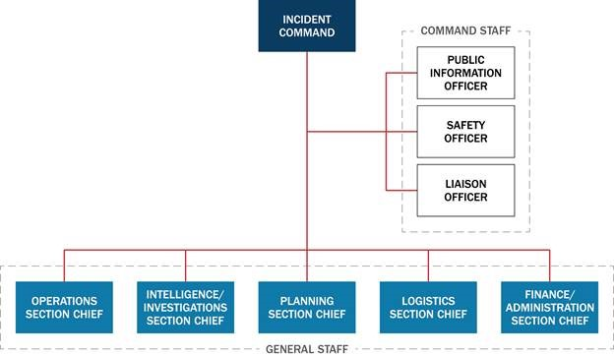
Incident Command System
PM 2-3
CERT Basic Training Unit 2: CERT Organization
2-5

Slide 47
CERT Operations
Command structure
CERT Team Leader
Command Post
Expanded structure as needed
PM 2-5
CERT Basic Training Unit 2: CERT Organization
2-6

Slide 48
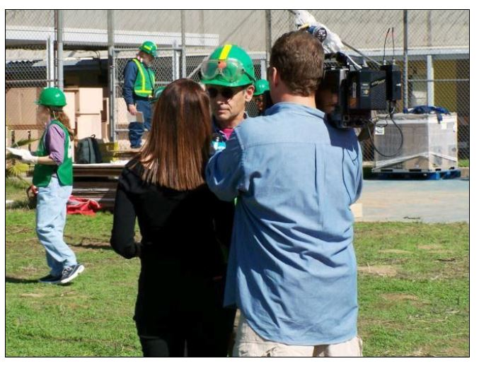
Dealing with the Media
Refer media inquiries to CERT Incident Commander/Team Leader
Do not let media inhibit CERT goals
Be careful about information released
PM 2-6
CERT Basic Training Unit 2: CERT Organization
2-7

Slide 49
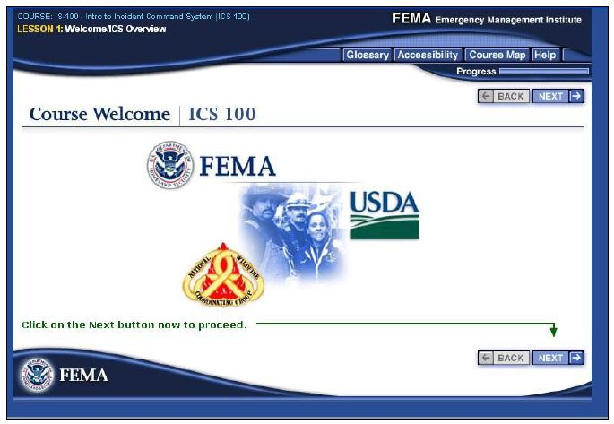
NIMS Implementation
Ability to work together
IS-100: Introduction to ICS
  https://emilms.fema.gov/IS100c/curriculum/1.html
IS-700: Introduction to NIMS
  https://emilms.fema.gov/IS700b/curriculum/1.html
PM 2-6
CERT Basic Training Unit 2: CERT Organization
2-8

Slide 50
Exercise 2.1
Using your knowledge about the ICS functions, decide under which function the following CERT activities would fall. Some activities may involve more than one function to be completed
Use the following key to fill in the blanks before each activity:
  Team Leader = TL
  Operations = O
  Planning = P
  Logistics = L
PM 2-6
CERT Basic Training Unit 2: CERT Organization
2-9

Slide 51
CERT Mobilization
CERTs take care of themselves, their families, their homes, their neighbors
Proceed to predesignated staging area
TL is established, organizes the group
TL prioritizes actions
Organization is flexible and evolves based on new information
PM 2-8
CERT Basic Training Unit 2: CERT Organization
2-10

Slide 52
On-Scene Size-up
Gather Facts
Assess and Communicate Damage
Consider Probabilities
Assess Your Own Situation
Establish Priorities
Make Decisions
Develop Plan of Action
Take Action
Evaluate Progress
PM 2-9
CERT Basic Training Unit 2: CERT Organization
2-11

Slide 53
Rescuer Safety
Rescuer safety = first priority
Heavy damage = No rescue
Moderate damage = Locate, assess, evacuate
Light damage = Locate, assess, continue size-up, and document
PM 2-10
CERT Basic Training Unit 2: CERT Organization
2-12

Slide 54
Documentation
Command Post
  Documents situation status
    Incident locations
    Access routes
    Identified hazards
    Support locations
Section Chiefs
  Provide Command Post with information
PM 2-11
CERT Basic Training Unit 2: CERT Organization
2-13

Slide 55

Documentation (image)
PM 2-11
CERT Basic Training Unit 2: CERT Organization
2-14

Slide 56
Documentation Forms
Damage Assessment
Personnel Resources Sign-In
CERT Assignment Tracking Log
Briefing Assignment
Treatment Area Record
Communications Log
Equipment Inventory
General Message
PM 2-13
CERT Basic Training Unit 2: CERT Organization
2-15

Slide 57
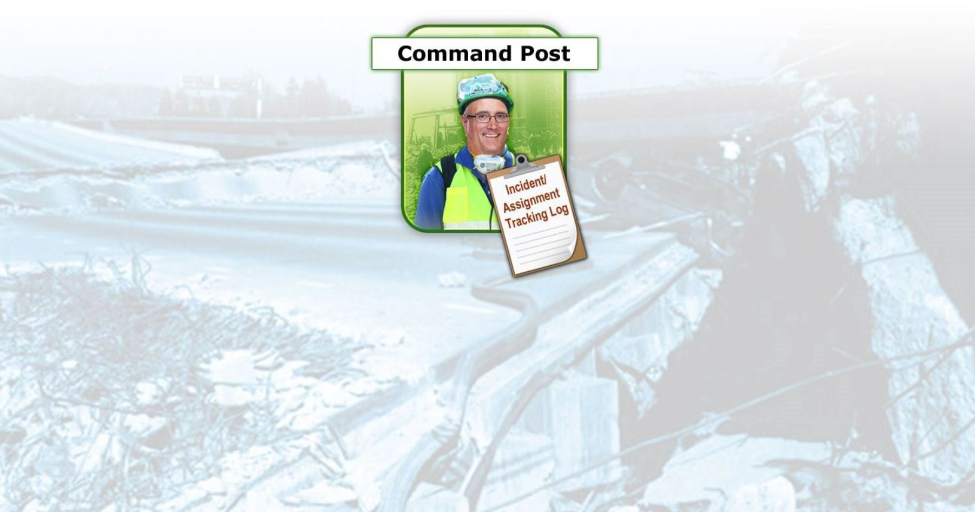
Documentation Flow(1 of 5)
PM 2-13
CERT Basic Training Unit 2: CERT Organization
2-16

Slide 58
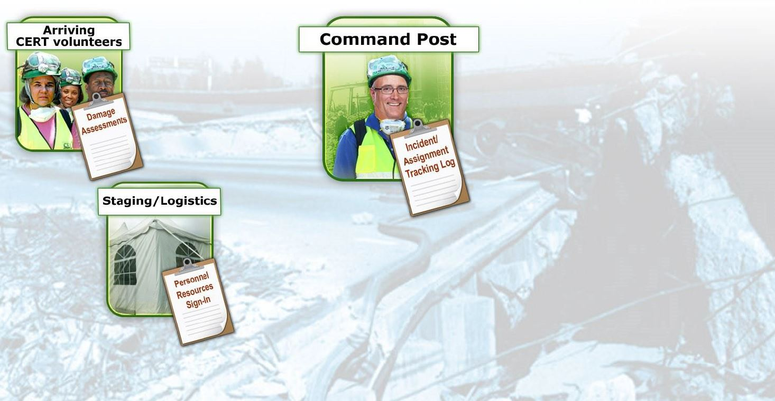
Documentation Flow (2 of 5)
PM 2-13
CERT Basic Training Unit 2: CERT Organization
2-17

Slide 59
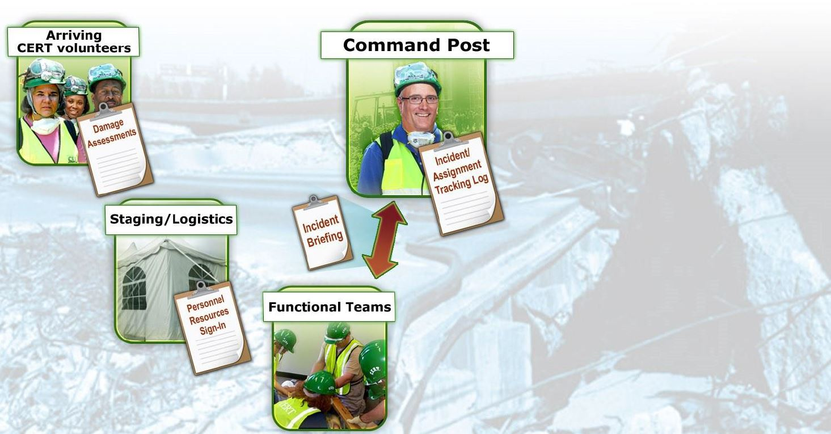
Documentation Flow (3 of 5)
PM 2-13
CERT Basic Training Unit 2: CERT Organization
2-18

Slide 60
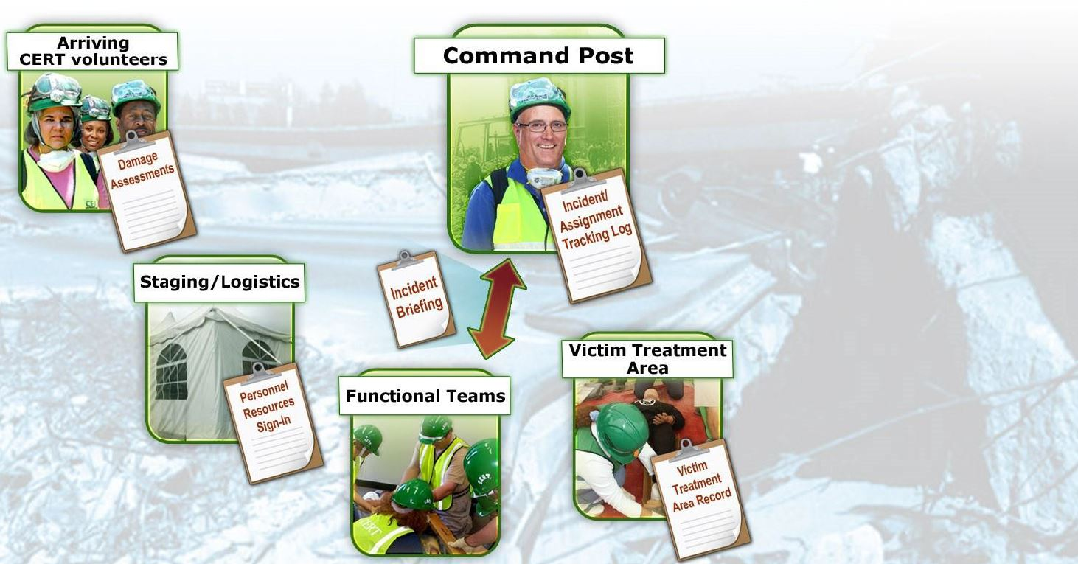
Documentation Flow (4 of 5)
PM 2-13
CERT Basic Training Unit 2: CERT Organization
2-19

Slide 61
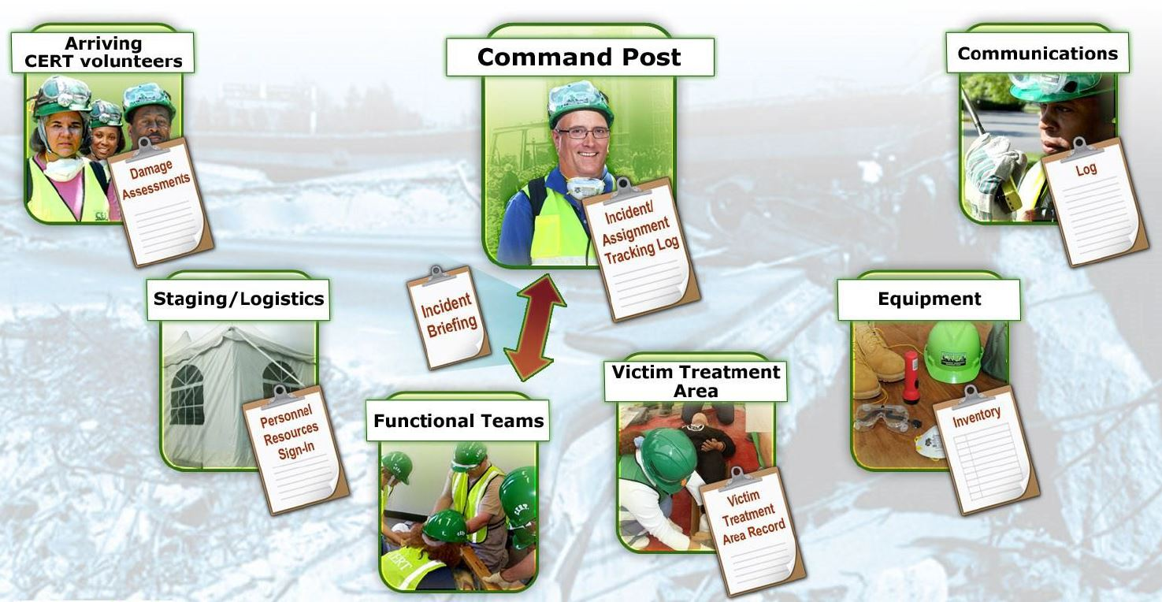
Documentation Flow (5 of 5)
PM 2-13
CERT Basic Training Unit 2: CERT Organization
2-20

Slide 62
Unit Summary (Unit 2)
ICS provides flexible means of organization
Ask “Is it safe to attempt the rescue?”
Document and communicate information to all CERT levels
Provide Command Post with ongoing information about damage assessment, group status, and needs
Command Post documents and tracks situation status
PM 2-25
CERT Basic Training Unit 2: CERT Organization
2-21

Slide 63
Homework Assignment (Unit 2)
Read unit to be covered in next session
Bring necessary supplies to next session
Wear appropriate clothes to next session
PM 2-25
CERT Basic Training Unit 2: CERT Organization
2-22

Slide 64
Unit 3: Disaster Medical Operations - Part 1
CERT Basic Training

Slide 65
Unit 3 Objectives
Identify life-threatening conditions resulting from trauma including severe bleeding, low body temperature, and airway blockage
Apply correct life saving techniques
Provide basic first-aid care for non-life threatening injuries
PM 3-1
CERT Basic Training Unit 3: Disaster Medical Operations – Part 1
3-1

Slide 66
Treating Life-Threatening Conditions
Without treatment, severe bleeding and airway obstruction can quickly lead to death
The first priority of CERT volunteers assisting in disaster medical operations is to attend to these conditions by controlling bleeding and positioning a patient so they can breathe
PM 3-2
CERT Basic Training Unit 3: Disaster Medical Operations – Part 1
3-2

Slide 67
Safety Considerations
Prior to treatment, ensure that both the patient and rescuer are in a safe environment to administer care
Some questions CERT volunteers to consider
  Do I feel safe at this spot?
  Should I leave and move to a safer location, or am I able to stay and start providing care immediately?
  If I leave, can I take anyone with me?
PM 3-2
CERT Basic Training Unit 3: Disaster Medical Operations – Part 1
3-3

Slide 68
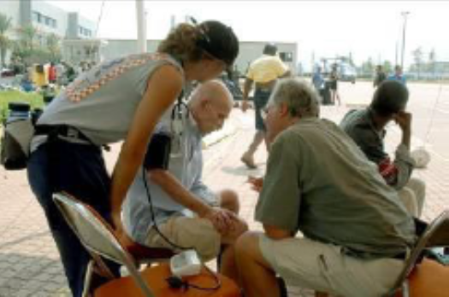
Approaching the Patient
Be sure patient can see you
Identify yourself
  Your name and name of your organization
Request permission to treat, if possible
Respect cultural differences
Protect patient privacy
PM 3-2
CERT Basic Training Unit 3: Disaster Medical Operations – Part 1
3-4

Slide 69
Life-Threatening Bleeding
Indicators of life-threatening bleeding:
  Spurting/steady bleeding
  Blood is pooling
  Blood is soaking through over lying clothes
  Blood is soaking through bandages
  Amputation
PM 3-3
CERT Basic Training Unit 3: Disaster Medical Operations – Part 1
3-5

Slide 70
Stages of Severe Bleeding
Stage | Blood Loss | Heart Rate | Blood Pressure | Breath Rate | Patient
I | Less than 15% | Normal (<100 bpm) | Normal | 14-20 | Patient appears normal
II | 15%-40% | Fast (>100 bpm) | Slightly Low | 20-30 | Patient may feel anxious
III | 30%-40% | Very Fast (>120 bpm) | Low | 30-40 | Patient feels confused
IV | Greater than 40% | Critical (>140 bpm) | Critical | >35 | Patient feels lethargic
PM 3-3
CERT Basic Training Unit 3: Disaster Medical Operations – Part 1
3-6

Slide 71
Types of Bleeding
Arterial bleeding: Arteries transport blood under high pressure
  Blood coming from an artery will spurt
Venous bleeding: Veins transport blood under low pressure
  Blood coming from a vein will flow
Capillary bleeding: Capillaries also carry blood under low pressure
  Blood coming from capillaries will ooze
PM 3-3
CERT Basic Training Unit 3: Disaster Medical Operations – Part 1
3-7

Slide 72
Types of Bleeding (image)
PM 3-3
CERT Basic Training Unit 3: Disaster Medical Operations – Part 1
3-8

Slide 73
Controlling Bleeding: Direct Pressure
Step 1: Find the source(s)
Step 2: Cover the source
Step 3: Apply pressure
Step 4: Maintain pressure until bleeding has stopped
PM 3-3
CERT Basic Training Unit 3: Disaster Medical Operations – Part 1
3-9

Slide 74
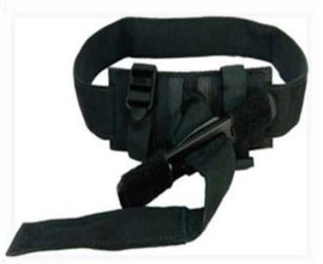
Controlling Bleeding: Tourniquets
Place on injured limb as high as possible
Pull strap through buckle
Twist rod until bleeding stops/slows
Secure the rod
If bleeding continues, place second tourniquet
Leave in place until EMS takes over
PM 3-4
CERT Basic Training Unit 3: Disaster Medical Operations – Part 1
3-10

Slide 75
Shock
Shock is often difficult to diagnose
Main signs of shock:
  Rapid and shallow breathing
  Capillary refill of greater than two seconds
  Failure to follow simple commands, such as “squeeze my hand
Symptoms of shock are easily missed. Pay careful attention to your patient
PM 3-5
CERT Basic Training Unit 3: Disaster Medical Operations – Part 1
3-11

Slide 76
Maintaining Body Temperature
Keep the patient warm
  Remove wet clothing
  Place something between patient and ground (e.g., cardboard, jacket, blanket)
  Wrap patient with dry layers (e.g., coat, blanket, Mylar emergency blanket)
  Shield patient from wind
PM 3-5
CERT Basic Training Unit 3: Disaster Medical Operations – Part 1
3-12

Slide 77
Exercise 3.1
After breaking into pairs, identify one person to take the role of the patient and one to take the role of the rescuer
Respond as if the patient has an injury on the right forearm, just below the elbow
Apply a pressure bandage or tourniquet (if available)
Repeat the process twice
Swap roles and have the new rescuer complete the above steps
PM 3-6
CERT Basic Training Unit 3: Disaster Medical Operations – Part 1
3-13

Slide 78
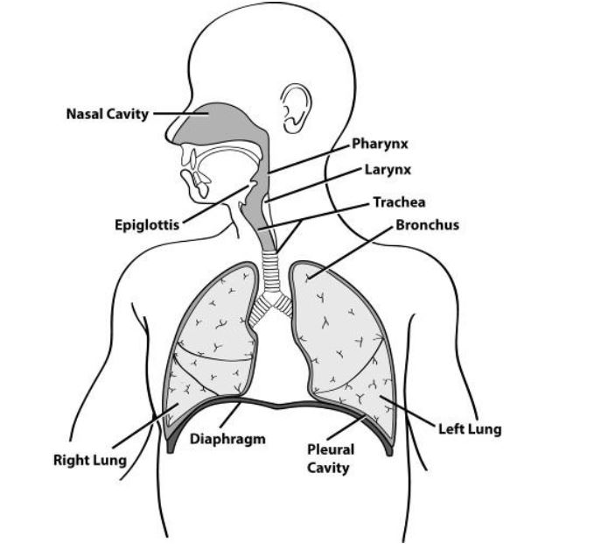
Opening the Airway
PM 3-6
CERT Basic Training Unit 3: Disaster Medical Operations – Part 1
3-14

Slide 79
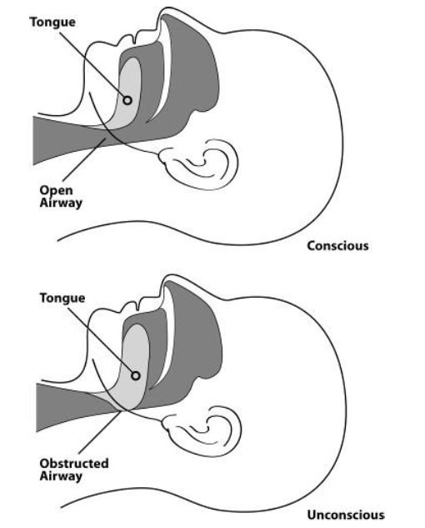
Open vs. Obstructed Airway
PM 3-6
CERT Basic Training Unit 3: Disaster Medical Operations – Part 1
3-15

Slide 80
Positioning a Conscious Patient
When sitting on a raised platform(e.g., chair, bench): Legs shoulder width apart, elbows or hands on knees, and leaning slightly forward
When standing: Legs shoulder width apart, hands on knees arms straight, and leaning forward with flat back
PM 3-6
CERT Basic Training Unit 3: Disaster Medical Operations – Part 1
3-16

Slide 81
Positioning an Unconscious Patient
PM 3-7
CERT Basic Training Unit 3: Disaster Medical Operations – Part 1
3-17

Slide 82
Recovery Position
Body: Laid on its side
Bottom Arm: Reached outward
Top Arm: Rest hand on bicep of bottom arm
Head: Rest on hand
Legs: Bent slightly
Chin: Raised forward
Mouth: Pointed downward
PM 3-7
CERT Basic Training Unit 3: Disaster Medical Operations – Part 1
3-18

Slide 83
Jaw-thrust Maneuver
Kneel above the patient’s head
Put one hand on each side of the patient’s head with the thumbs near the corners of the mouth pointed toward the chin, using the elbows for support
Slide the fingers into position under the angles of the patient’s jawbone without moving the head or neck
Thrust the jaw upward without moving the head or neck to lift the jaw and open the airway
PM 3-7
CERT Basic Training Unit 3: Disaster Medical Operations – Part 1
3-19

Slide 84
Exercise 3.2
Break into pairs and have one person play the rescuer and one person play the patient
Assume that the unconscious injured individual is breathing
Place them into the recovery position using the technique you just learned
PM 3-8
CERT Basic Training Unit 3: Disaster Medical Operations – Part 1
3-20

Slide 85
Providing Comfort
What can you do?
  Keep them warm
  Offer a hand to hold
  Maintain eye contact
  Be patient and understanding
  If you have to move on to provide aid to another person, let them know
PM 3-8
CERT Basic Training Unit 3: Disaster Medical Operations – Part 1
3-21

Slide 86
Treating Burns
Prevent hypothermia
Manage pain
Reduce risk of infection
PM 3-9
CERT Basic Training Unit 3: Disaster Medical Operations – Part 1
3-22

Slide 87
Burn Severity
Factors that affect burn severity:
  Temperature of burning agent
  Period of time survivor exposed
  Area of body affected
  Size of area burned
  Depth of burn
PM 3-9
CERT Basic Training Unit 3: Disaster Medical Operations – Part 1
3-23

Slide 88
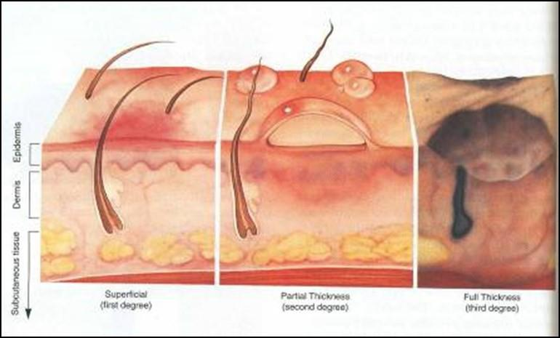
Burn Classifications
Superficial: epidermis
Partial Thickness: dermis and epidermis
Full Thickness: subcutaneous layer and all layers above
PM 3-9
CERT Basic Training Unit 3: Disaster Medical Operations – Part 1
3-24

Slide 89
Treatment for Chemical Burns
Remove cause of burn and affected clothing or jewelry
If irritant is dry, gently brush away as much as possible
  Always brush away from eyes, survivor, and yourself
Flush with lots of cool running water
Apply cool, wet compress to relieve pain
Cover wound loosely with dry, sterile or clean dressing
PM 3-10
CERT Basic Training Unit 3: Disaster Medical Operations – Part 1
3-25

Slide 90
Wound Care
Main treatment for wounds:
  Control bleeding
  Apply dressing and bandage
Apply dressing and bandage:
  Apply dressing directly to wound
  Bandage holds dressing in place
PM 3-11
CERT Basic Training Unit 3: Disaster Medical Operations – Part 1
3-26

Slide 91
Rules of Dressing
If active bleeding:
  Redress OVER existing dressing
If no active bleeding:
  Maintain the pressure and keep wound bandaged until further treatment by a medical professional
PM 3-11
CERT Basic Training Unit 3: Disaster Medical Operations – Part 1
3-27

Slide 92
Signs of Infection
Signs of possible infection:
  Swelling around wound site
  Discoloration
  Discharge from wound
  Red striations from wound site
PM 3-11
CERT Basic Training Unit 3: Disaster Medical Operations – Part 1
3-28

Slide 93
Amputations
If amputated body part is found:
  Save tissue parts, wrapped in clean material and placed in plastic bag
  Keep tissue parts cool, but NOT directly on ice
  Keep severed part with survivor
PM 3-11
CERT Basic Training Unit 3: Disaster Medical Operations – Part 1
3-29

Slide 94
Impaled Objects
When foreign object is impaled in patient’s body:
  Immobilize affected body part
  Do not attempt to move or remove
  Try to control bleeding at entrance wound
  Clean and dress wound, making sure to stabilize impaled object
PM 3-12
CERT Basic Training Unit 3: Disaster Medical Operations – Part 1
3-30

Slide 95
Fractures, Dislocations, Sprains, Strains
Immobilize injury and joints immediately above and below injury site
If uncertain of injury type, treat as fracture
PM 3-12
CERT Basic Training Unit 3: Disaster Medical Operations – Part 1
3-31

Slide 96
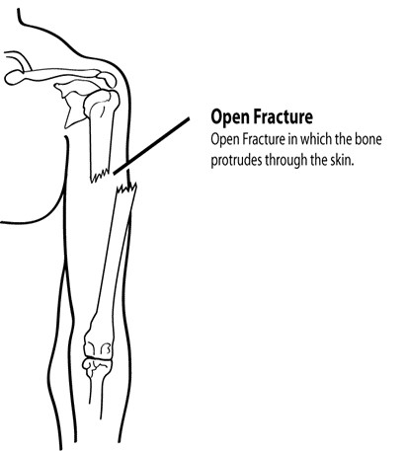
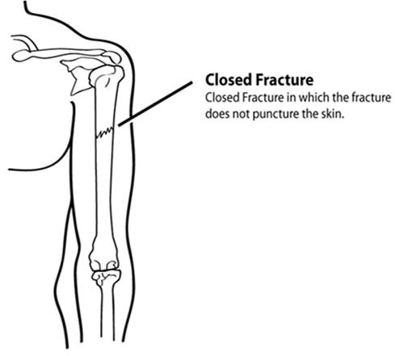
Types of Fractures (1 of 2)
PM 3-12
CERT Basic Training Unit 3: Disaster Medical Operations – Part 1
3-32

Slide 97
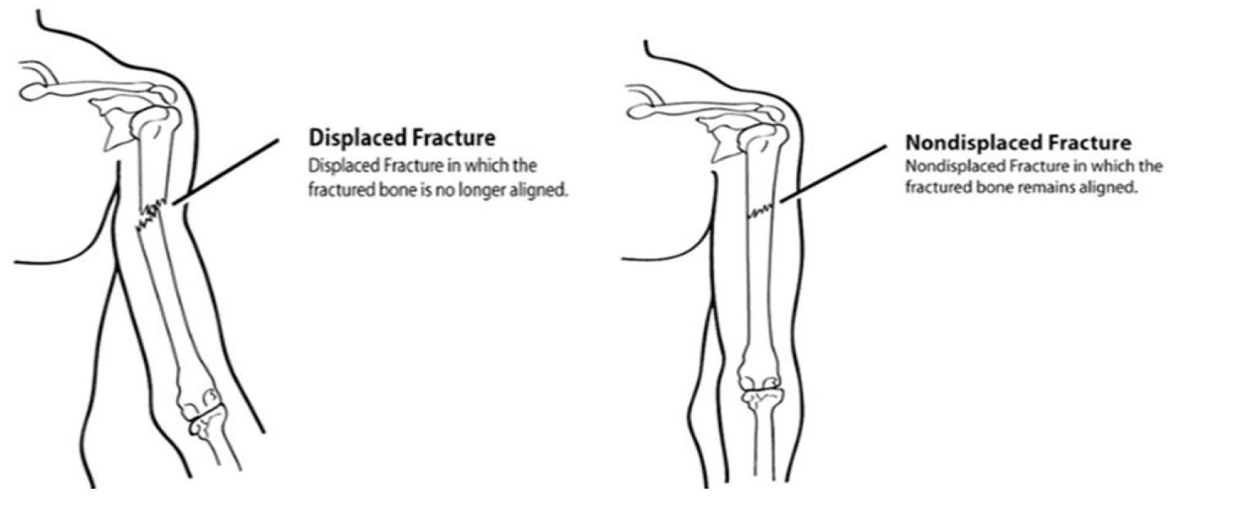
Types of Fractures (2 of 2)
PM 3-13
CERT Basic Training Unit 3: Disaster Medical Operations – Part 1
3-33

Slide 98
Treating Open Fractures
Do not draw exposed bone ends back into tissue
Do not irrigate wound
Cover wound with sterile dressing
Splint fracture without disturbing wound
Place moist dressing over bone end
PM 3-13
CERT Basic Training Unit 3: Disaster Medical Operations – Part 1
3-34

Slide 99
Dislocations
Dislocation is injury to ligaments around a joint
  It is so severe that it permits separation of bone from its normal position in a joint
Treatment:
  Immobilize; do NOT relocate
  Check Pulse, Movement, and Sensation (PMS) before and after splinting/immobilization
PM 3-13
CERT Basic Training Unit 3: Disaster Medical Operations – Part 1
3-35

Slide 100
Signs of Sprain
Tenderness at site
Swelling and bruising
Restricted use or loss of use
PM 3-14
CERT Basic Training Unit 3: Disaster Medical Operations – Part 1
3-36

Slide 101
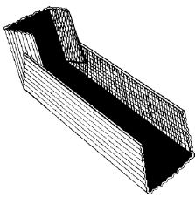
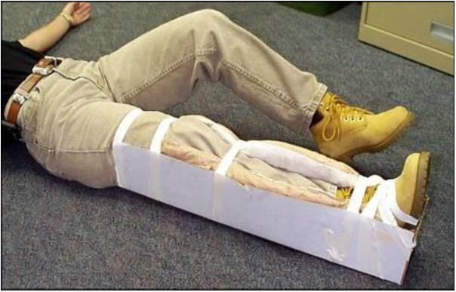
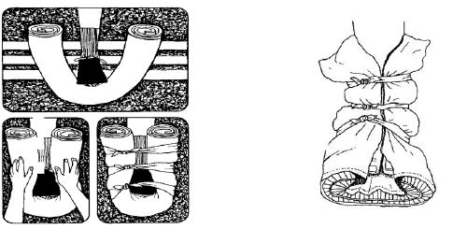
Splinting
PM 3-14
CERT Basic Training Unit 3: Disaster Medical Operations – Part 1
3-37

Slide 102
Cold-Related Injuries
Hypothermia:
  Occurs when body’s temperature drops below normal
Frostbite:
  Occurs when extreme cold shuts down blood flow to extremities, causing tissue death
PM 3-16
CERT Basic Training Unit 3: Disaster Medical Operations – Part 1
3-38

Slide 103
Symptoms of Hypothermia
Body temperature of 95°F or lower
Redness or blueness of skin
Numbness and shivering
Slurred speech
Unpredictable behavior
Listlessness
PM 3-16
CERT Basic Training Unit 3: Disaster Medical Operations – Part 1
3-39

Slide 104
Hypothermia Treatment
Remove wet clothing
Put something under the patient
Keep them sheltered and/or covered
Do not attempt to use massage
Place in the recovery position if unconscious
PM 3-16
CERT Basic Training Unit 3: Disaster Medical Operations – Part 1
3-40

Slide 105
Symptoms of Frostbite
Skin discoloration
Burning or tingling sensation
Partial or complete numbness
PM 3-16
CERT Basic Training Unit 3: Disaster Medical Operations – Part 1
3-41

Slide 106
Frostbite Treatment
Immerse injured area in warm (NOT hot) water
  Warm slowly!
Do not allow part to re-freeze
Do not attempt to use massage
Wrap affected body parts in dry, sterile dressing
PM 3-16
CERT Basic Training Unit 3: Disaster Medical Operations – Part 1
3-42

Slide 107
Heat-Related Injuries
Heat cramps
  Muscle spasms brought on by over-exertion in extreme heat
Heat exhaustion
  Occurs when exercising or working in extreme heat results in loss of body fluids
Heat stroke
  Survivor’s temperature control system shuts down
  Body temperature rises so high that brain damage and death may result
PM 3-17
CERT Basic Training Unit 3: Disaster Medical Operations – Part 1
3-43

Slide 108
Symptoms of Heat Exhaustion
Cool, moist, pale or flushed skin
Heavy sweating
Headache
Nausea or vomiting
Dizziness
Exhaustion
PM 3-17
CERT Basic Training Unit 3: Disaster Medical Operations – Part 1
3-44

Slide 109
Symptoms of Heat Stroke
Hot, red skin
Lack of perspiration
Changes in consciousness
Rapid, weak pulse and rapid, shallow breathing
PM 3-17
CERT Basic Training Unit 3: Disaster Medical Operations – Part 1
3-45

Slide 110
Treatment of Heat-Related Injuries
Remove from heat to cool environment
Cool body slowly
Have the heat exhaustion patient drink water, SLOWLY
Do not provide food or drink to the patient if he or she is experiencing vomiting, cramping, or is losing consciousness
PM 3-18
CERT Basic Training Unit 3: Disaster Medical Operations – Part 1
3-46

Slide 111
Treatment for Bites/Stings
If bite or sting is suspected, and situation is non-emergency:
  Remove stinger if still present by scraping edge of credit card or other stiff, straight-edged object across stinger
  Wash site thoroughly with soap and water
  Place ice on site for 10 minutes on and 10 minutes off
PM 3-18
CERT Basic Training Unit 3: Disaster Medical Operations – Part 1
3-47

Slide 112
Anaphylaxis
Calm the individual
If possible, find and help administer a patient’s Epi-pen
  Many severe allergy sufferers carry one at all times
Do not administer medicine aside from the Epi-pen
  This includes pain relievers, allergy medicine, etc.
PM 3-18
CERT Basic Training Unit 3: Disaster Medical Operations – Part 1
3-48

Slide 113
Unit Summary (Unit 3)
Life-saving measures CERT volunteers can take:
  Control bleeding using direct pressure and/or a tourniquet
  Maintain normal body temperature
  Open airway and position patient correctly
Other injuries that are common after disasters:
  Burns
  Wounds
  Amputations and impaled objects
  Fractures, dislocations, sprains, and strains
  Cold-related injuries
  Heat-related injuries
  Insect bites/stings
PM 3-19
CERT Basic Training Unit 3: Disaster Medical Operations – Part 1
3-49

Slide 114
Homework Assignment (Unit 3)
Read unit to be covered in next session
Wear appropriate clothes for next session
PM 3-19
CERT Basic Training Unit 3: Disaster Medical Operations – Part 1
3-50

Slide 115
Unit 4: Disaster Medical Operations – Part 2
CERT Basic Training

Slide 116
Unit 3 Review
Life-threatening conditions:
  Severe bleeding
  Low body temperature
  Airway obstruction
CERT Basic Training Unit 4: Disaster Medical Operations – Part 2
4-1

Slide 117
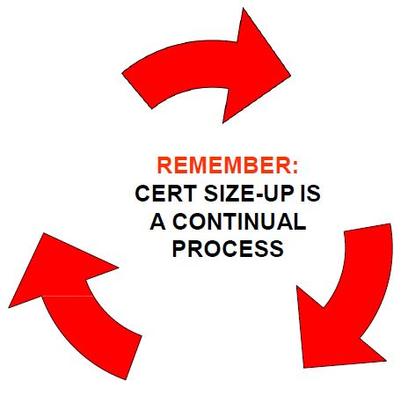
CERT Size-up
Gather Facts
Assess Damage
Consider Probabilities
Assess Your Situation
Establish Priorities
Make Decisions
Develop Plan of Action
Take Action
Evaluate Progress
PM 2-8
CERT Basic Training Unit 4: Disaster Medical Operations – Part 2
4-2

Slide 118
Unit 4 Objectives
Explain the role of the CERT volunteer during a mass casualty incident
Describe the functions of disaster medical operations
Describe how to set up survivor treatment areas
Perform head-to-toe patient assessments
Take appropriate sanitation and hygiene measures to protect public health
PM 4-1
CERT Basic Training Unit 4: Disaster Medical Operations – Part 2
4-3

Slide 119
Mass Casualty Incidents
Incidents in which the number of casualties overwhelms the local resources
  Commuter train derailment
  Multi-car accident
  Bus accident
  Building collapse
  Natural disasters (e.g., tornadoes)
PM 4-2
CERT Basic Training Unit 4: Disaster Medical Operations – Part 2
4-4

Slide 120
Role of First Responder Personnel (1 of 2)
During mass casualty events, first responder personnel will:
  Establish command and control of the incident area
  Conduct a scene size-up and set-up
  Send survivors with relatively minor injuries to a holding area to await treatment
  Identify survivors who require life-saving interventions and treat them immediately
PM 4-2
CERT Basic Training Unit 4: Disaster Medical Operations – Part 2
4-5

Slide 121
Role of First Responder Personnel (2 of 2)
During mass casualty events, first responder personnel will also:
  Identify deceased victims as well as survivors too severely injured to save
  Manage medical transportation for survivors who require additional treatment
  Secure the area to protect first responders, survivors, and evidence for law enforcement investigations
  Remove debris and other safety or health threats
PM 4-2
CERT Basic Training Unit 4: Disaster Medical Operations – Part 2
4-6

Slide 122
Role of CERT Volunteers (1 of 2)
Put on PPE and any CERT affiliated gear
Locate the nearest first responder and identify yourself/give them your local agency affiliation
If a first responder is not available, assess the situation and determine whether you can provide life-saving interventions
PM 4-2
CERT Basic Training Unit 4: Disaster Medical Operations – Part 2
4-7

Slide 123
Role of CERT Volunteers (2 of 2)
Once responders have arrived, provide them with detailed information from your size-up. Ask how you may be of assistance
  For your safety, first responders may ask you to leave the area. Report the incident and your role to your CERT Team Leader and local agency CERT affiliation
Communication is key for supporting first responders
PM 4-2
CERT Basic Training Unit 4: Disaster Medical Operations – Part 2
4-7

Slide 124
Functions of Disaster Medical Operations
Triage/Assessment
Treatment
Transport
Morgue
Supply
PM 4-4
CERT Basic Training Unit 4: Disaster Medical Operations – Part 2
4-8

Slide 125
Establish a Medical Treatment Area
Select site and set up treatment area as soon as injured survivors are confirmed
When determining best location(s) for treatment area, consider:
  Safety of rescuers and survivors
  Ease of access to resources
PM 4-5
CERT Basic Training Unit 4: Disaster Medical Operations – Part 2
4-9

Slide 126
Medical Treatment Areas
To help meet the challenge of limited resources, CERT may need to establish:
  Decentralized Treatment Areas (more than one location)
  Centralized Treatment Areas (one location)
PM 4-5
CERT Basic Training Unit 4: Disaster Medical Operations – Part 2
4-10

Slide 127
Safety for Rescuers and Survivors
In structures with light damage:
  Assess survivors as they are found
  Further medical treatment is performed in a safe location inside the designated treatment area
In structures with moderate damage:
  Assess survivors as they are found
  Survivors are sent to a medical treatment area a safe distance from the incident
  Individual safety is the number one priority
PM 4-5
CERT Basic Training Unit 4: Disaster Medical Operations – Part 2
4-11

Slide 128
Head-to-Toe Assessment
Objectives of head-to-toe assessment:
  Determine extent of injuries
  Determine type of treatment needed
  Document injuries
PM 4-7
CERT Basic Training Unit 4: Disaster Medical Operations – Part 2
4-12

Slide 129
DCAP-BTLS
Deformities
Contusions
Abrasions
Punctures
Burns
Tenderness
Lacerations
Swelling
PM 4-8
CERT Basic Training Unit 4: Disaster Medical Operations – Part 2
4-13

Slide 130
Conducting Head-to-Toe Assessment
Pay careful attention
Look, listen, and feel
Suspect a spinal injury in unconscious survivors and treat accordingly
Check own hands for patient bleeding
PM 4-8
CERT Basic Training Unit 4: Disaster Medical Operations – Part 2
4-14

Slide 131
Order of Assessment
Head
Neck
Shoulders
Chest
Arms
Abdomen
Pelvis
Legs
PM 4-8
CERT Basic Training Unit 4: Disaster Medical Operations – Part 2
4-15

Slide 132
Closed-Head, Neck, Spinal Injuries
If injuries to the head or spine are suspected, do no harm
  Minimize movement of head and neck while treating life-threatening conditions
If survivors exhibit signs or are found under heavy debris, treat them as having a closed-head, neck, or spinal injury
PM 4-8
CERT Basic Training Unit 4: Disaster Medical Operations – Part 2
4-16

Slide 133
Public Health Considerations
Maintaining proper hygiene
Maintaining proper sanitation
Purifying water (if necessary)
Preventing spread of disease
PM 4-11
CERT Basic Training Unit 4: Disaster Medical Operations – Part 2
4-17

Slide 134
Maintaining Hygiene
Wash hands frequently
  Or use alcohol-based hand sanitizer
Wear non-latex exam gloves
Keep dressings sterile
Wash areas that come in contact with body fluids
PM 4-11
CERT Basic Training Unit 4: Disaster Medical Operations – Part 2
4-18

Slide 135
Maintain Sanitation
Control disposal of bacterial sources
Put waste products in plastic bags
  Tie off bags and mark them as medical waste
Bury human waste
PM 4-11
CERT Basic Training Unit 4: Disaster Medical Operations – Part 2
4-19

Slide 136
Water Purification Methods
Boil water for 1 minute
Water purification tablets
Non-perfumed liquid bleach
  8 drops/gal of water
  16 drops/gal if water is cloudy
  Let stand for 30 minutes before use
PM 4-12
CERT Basic Training Unit 4: Disaster Medical Operations – Part 2
4-20

Slide 137
Unit Summary (Unit 4)
During a mass casualty incident, CERT volunteers should:
  Identify self as CERT volunteer and give agency affiliation
  Assess and provide life-saving interventions
  Provide responders with detailed information Communication is key
First responders may establish a central treatment location or multiple at different incident sites Treatment areas will take into consideration safety and access to resources
PM 4-13
CERT Basic Training Unit 4: Disaster Medical Operations – Part 2
4-21

Slide 138
Unit Summary Cont’d
Head-to-toe assessments should be:
  Hands-on and verbal
  Conducted in the same way each time
To safeguard public health, maintain proper hygiene and sanitation, and purify water
PM 4-13
CERT Basic Training Unit 4: Disaster Medical Operations – Part 2
4-21

Slide 139
Homework Assignment (Unit 4)
Read unit to be covered in next session
Practice complete head-to-toe assessment on friend or family member
PM 4-13
CERT Basic Training Unit 4: Disaster Medical Operations – Part 2
4-22

Slide 140
CERT Basic Training
Unit 5: Disaster Psychology

Slide 141
Unit 5 Objectives
Understand disaster trauma for survivors and rescuers, including CERT volunteers
List steps to take for personal and team well-being
Demonstrate key steps to apply when providing aid to someone with survivor’s trauma
PM 5-1
CERT Basic Training Unit 5: Disaster Psychology
5-1

Slide 142
Causes of Disaster Reactions
Dealing with your own personal losses
Working in your neighborhood
Assisting neighbors, friends, or coworkers who have also been injured
Feeling unsafe and insecure
PM 5-2
CERT Basic Training Unit 5: Disaster Psychology
5-2

Slide 143
The Five Fs
Freeze: “Stop, look, and listen,” or be on guard and watchful
Flight: Flee
Fight: Attempt to combat the threat
Fright: Tonic immobility when in contact with a predator, or playing dead
Faint: Fear-induced fainting
PM 5-2
CERT Basic Training Unit 5: Disaster Psychology
5-3

Slide 144
Psychological Symptoms of Trauma
Emotional
Cognitive
Spiritual
PM 5-2
CERT Basic Training Unit 5: Disaster Psychology
5-4

Slide 145
Physical Symptoms of Trauma
Loss of appetite
Headaches or chest pain
Diarrhea, stomach pain, or nausea
Hyperactivity
Increase in drug consumption
Nightmares
Insomnia
Fatigue
PM 5-3
CERT Basic Training Unit 5: Disaster Psychology
5-5

Slide 146
Team Well-Being
Actions can be taken before, during, and after an incident to help manage emotional impact of disaster response work
Knowing possible psychological and physiological symptoms of disaster trauma helps manage impact
Learn to manage stress:
  CERT volunteers for themselves
  CERT leaders during response
PM 5-4
CERT Basic Training Unit 5: Disaster Psychology
5-6

Slide 147
How to Reduce Stress
Get enough sleep
Exercise regularly
Eat a balanced diet
Balance work, play, and rest
Allow yourself to receive as well as give
Connect with others
Use spiritual resources
PM 5-4
CERT Basic Training Unit 5: Disaster Psychology
5-7

Slide 148
Take Care of Yourself
Be aware of trauma that can follow a disaster
Explain to family members and friends what you need:
  Listen when you want to talk
  Don’t force yourself to talk until you are ready
PM 5-4
CERT Basic Training Unit 5: Disaster Psychology
5-8

Slide 149
Self-Care Tool Box
This activity provides you with the opportunity to outline a number of self-care tools you can use before and during a crisis so that you are ready to respond during an emergency
Complete this exercise individually and at your own pace. When everyone has finished, you will have the opportunity to share your responses with the class if you would like
PM 5-5
CERT Basic Training Unit 5: Disaster Psychology
5-9

Slide 150
How Team Leaders Reduce Stress
Brief CERT personnel beforehand
Remember CERT is a team
Rest and regroup
Take breaks away from the incident site
Establish a culture of acceptance
Eat properly, stay hydrated
Be aware of changes in teammates
Rotate teams and duties
Phase out workers gradually
Defuse after shift
PM 5-7
CERT Basic Training Unit 5: Disaster Psychology
5-10

Slide 151
Emotional Phases of a Crisis
Pre-Disaster
Impact
Heroic
Honeymoon
Disillusionment
Reconstruction
PM 5-8
CERT Basic Training Unit 5: Disaster Psychology
5-11

Slide 152
Traumatic Crisis
A traumatic crisis is an event experienced or witnessed in which people’s ability to cope is overwhelmed by:
  Actual or potential death or injury to self or others
  Serious injury
  Destruction of their homes, neighborhood, or value possessions
  Loss of contact with family or close friends
PM 5-9
CERT Basic Training Unit 5: Disaster Psychology
5-12

Slide 153
Effects of Traumatic Stress
Traumatic stress may affect:
  Cognitive functioning
  Physical health
  Interpersonal relationships
PM 5-9
CERT Basic Training Unit 5: Disaster Psychology
5-13

Slide 154
Mediating Factors
Prior experience with a similar event
Intensity of disruption
Individual feelings about event
Emotional strength of individual
Length of time since event
PM 5-9
CERT Basic Training Unit 5: Disaster Psychology
5-14

Slide 155
Stabilizing Survivors
Assess survivors for injury or shock
Get uninjured people to help
Provide support by listening and empathizing
Help survivors connect with natural support systems
PM 5-10
CERT Basic Training Unit 5: Disaster Psychology
5-15

Slide 156
Listen, Protect, Connect
Listen to survivors and pay attention to what they say
Help survivors feel protected by providing support
Connect survivors to friends and loved ones
PM 5-10
CERT Basic Training Unit 5: Disaster Psychology
5-16

Slide 157
How to Be an Empathetic Listener
Put yourself in the speaker’s shoes
Listen for meaning, not just words
Pay attention to nonverbal communication
Paraphrase the speaker
PM 5-11
CERT Basic Training Unit 5: Disaster Psychology
5-17

Slide 158
What Not to Say
“I understand ”
“Don’t feel bad ”
“You’re strong ”
“You’ll get through this ”
“Don’t cry ”
“It’s God’s will ”
“It could be worse ”
“At least you still have…”
“Everything will be okay”
PM 5-12
CERT Basic Training Unit 5: Disaster Psychology
5-18

Slide 159
Say This Instead
“I’m sorry for your pain ”
“I’m so sorry this has happened ”
“Is it all right if I help you with…?”
“I can’t imagine what this is like for you ”
“What do you need?”
PM 5-12
CERT Basic Training Unit 5: Disaster Psychology
5-19

Slide 160
Managing the Death Scene
Cover the body; treat it with respect
Follow local laws and protocols
Talk with local authorities
PM 5-12
CERT Basic Training Unit 5: Disaster Psychology
5-20

Slide 161
Unit Summary (Unit 5)
Prepare yourself, as rescues may be unpleasant and uncomfortable
Know the psychological and physiological symptoms of trauma
Understand the six emotional phases of a disaster
Take steps to reduce stress, which affects cognition, health, and interactions
Stabilize individuals
Listen, protect, and connect to support survivors
Be an empathetic listener
PM 5-13
CERT Basic Training Unit 5: Disaster Psychology
5-21

Slide 162
Homework Assignment (Unit 5)
Read unit to be covered in next session
Bring necessary supplies to next session
Wear appropriate clothes to next session
PM 5-13
CERT Basic Training Unit 5: Disaster Psychology
5-22

Slide 163
Unit 6: Fire Safety and Utility Controls
CERT Basic Training

Slide 164
Unit 6 Objectives
Explain the role CERTs play in fire safety and response, including the CERT size-up process and minimum safety precautions
Extinguish a small fire using a fire extinguisher
Identify and reduce potential fire, utility, and hazardous materials hazards at home and in the community
PM 6-1
CERT Basic Training Unit 6: Fire Safety and Utility Controls
6-1

Slide 165
Role of CERTs
CERTs play very important role in fire safety by:
  Extinguishing small fires
  Preventing additional fires by removing fuel sources
  Shutting off utilities
  Assisting with evacuations, when necessary
PM 6-1
CERT Basic Training Unit 6: Fire Safety and Utility Controls
6-2

Slide 166
CERT Priorities
Rescuer safety is number one priority
  Always work with a buddy
  Always wear safety equipment
  CERT Goal:
  Do the greatest good for the greatest number
PM 6-1
CERT Basic Training Unit 6: Fire Safety and Utility Controls
6-3

Slide 167
The Fire Triangle
PM 6-3
CERT Basic Training Unit 6: Fire Safety and Utility Controls
6-4

Slide 168
Classes of Fire
Class A: Ordinary combustibles
Class B: Flammable and combustible liquids
Class C: Energized electrical equipment
Class D: Combustible metals
Class K: Cooking oils
PM 6-3
CERT Basic Training Unit 6: Fire Safety and Utility Controls
6-5

Slide 169
CERT Fire Size-up
Helps CERT volunteers decide:
  Whether to attempt to suppress a fire
  A plan of action
Answers these questions:
  Do my buddy and I have the right equipment?
  Are there other hazards?
  Is the building structurally damaged?
  Can my buddy and I escape?
  Can my buddy and I fight the fire safely?
  Remember: The safety of individual CERT volunteers is always the top priority
PM 6-4
CERT Basic Training Unit 6: Fire Safety and Utility Controls
6-6

Slide 170
Firefighting Resources
Local fire department
Fire alarm system
Sprinkler systems
Portable fire extinguishers
Interior wet standpipes
PM 6-7
CERT Basic Training Unit 6: Fire Safety and Utility Controls
6-7

Slide 171
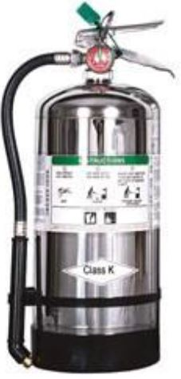
Fire Extinguishers
Water
Dry chemical
Carbon dioxide
Specialized
PM 6-7
CERT Basic Training Unit 6: Fire Safety and Utility Controls
6-8

Slide 172
Extinguisher Rating/Labeling
Labels show types of fires for which that extinguisher is used
  Class A fire ratings: 1A to 40A
  Class B fire ratings: 1B to 640B
Higher number on label = greater amount of extinguishing agent
PM 6-8
CERT Basic Training Unit 6: Fire Safety and Utility Controls
6-9

Slide 173
Sample Label
PM 6-8
CERT Basic Training Unit 6: Fire Safety and Utility Controls
6-10

Slide 174
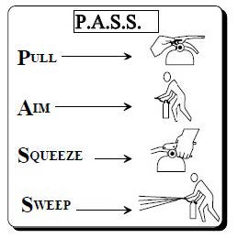
P.A.S.S.
Test the extinguisher after pulling the pin
PM 6-11
CERT Basic Training Unit 6: Fire Safety and Utility Controls
6-11

Slide 175
Interior Wet Standpipes
Usually found in commercial buildings or apartments
CERT volunteers should not operate
PM 6-11
CERT Basic Training Unit 6: Fire Safety and Utility Controls
6-12

Slide 176
Fire Suppression Safety
Safety of individual CERT members is top priority
PM 6-12
CERT Basic Training Unit 6: Fire Safety and Utility Controls
6-13

Slide 177
Fire Suppression Dont’s
Don’t get too close
Don’t try to fight a fire alone
Don’t try to suppress large fires
Don’t enter smoke-filled areas
PM 6-12
CERT Basic Training Unit 6: Fire Safety and Utility Controls
6-14

Slide 178
Reducing Electrical Hazards
Avoid the “electrical octopus”
Don’t run cords under carpets
Check for and replace broken or frayed cords
Maintain appliances
PM 6-14
CERT Basic Training Unit 6: Fire Safety and Utility Controls
6-15

Slide 179
Electrical Emergencies
Know where power shutoffs are
  Appliances
  Circuit breakers
  Fuses
Post shutoff directions next to all utilities
Know procedures for turning power back on after the fire
PM 6-14
CERT Basic Training Unit 6: Fire Safety and Utility Controls
6-16

Slide 180
Shutoff Procedures
Circuit box with shutoff
Fuse box with shutoff
PM 6-14
CERT Basic Training Unit 6: Fire Safety and Utility Controls
6-17

Slide 181
Natural Gas Hazards
Asphyxiant
  Displaces oxygen in the body
Explosive
  Can readily ignite under the right conditions
PM 6-15
CERT Basic Training Unit 6: Fire Safety and Utility Controls
6-18

Slide 182
Natural Gas Hazard Awareness
Install natural gas detector
Install carbon monoxide detector in home
Test batteries for natural gas and carbon monoxide detectors every month
  Change batteries every six months
Locate and label gas shutoffs
  Have proper non-sparking tool
PM 6-15
CERT Basic Training Unit 6: Fire Safety and Utility Controls
6-19

Slide 183
Gas Shutoff
Locate and label gas shutoff valves
If not automatic, know procedures for shutting off gas
PM 6-16
CERT Basic Training Unit 6: Fire Safety and Utility Controls
6-20

Slide 184
L.I.E.S.
Always read labels
Use L.I.E.S. storage procedures
  (Limit, Isolate, Eliminate, Separate)
PM 6-17
CERT Basic Training Unit 6: Fire Safety and Utility Controls
6-21

Slide 185
Hazardous Materials
Corrode other materials
Explode or are easily ignited
React strongly with water
Are unstable when exposed to heat or shock
Are otherwise toxic to humans, animals, or the environment through absorption, inhalation, injection, or ingestion
PM 6-18
CERT Basic Training Unit 6: Fire Safety and Utility Controls
6-22

Slide 186
Identifying Stored Hazardous Materials
PM 6-19
CERT Basic Training Unit 6: Fire Safety and Utility Controls
6-23

Slide 187
The White Quadrant
NFPA 704 Diamond White Quadrant:
  W: Shows unusual reactivity with water
  OX: Possesses oxidizing properties
PM 6-19
CERT Basic Training Unit 6: Fire Safety and Utility Controls
6-24

Slide 188
STOP!
CERT Basic Training Unit 6: Fire Safety and Utility Controls
6-25

Slide 189
Global Harmonized System
PM 6-20
CERT Basic Training Unit 6: Fire Safety and Utility Controls
6-26

Slide 190
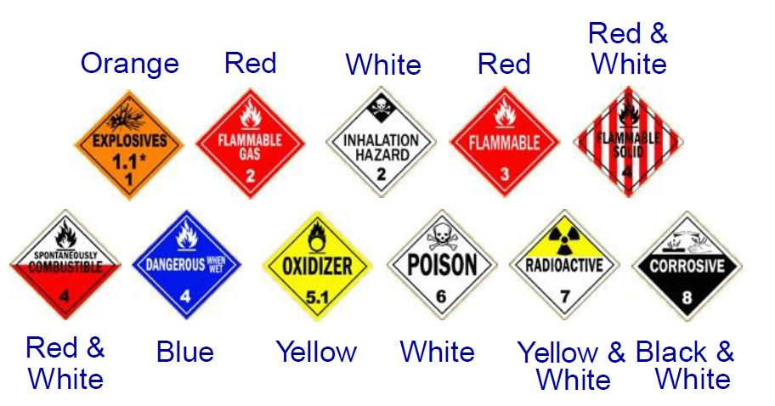
HazMats in Transit
PM 6-21
CERT Basic Training Unit 6: Fire Safety and Utility Controls
6-27

Slide 191
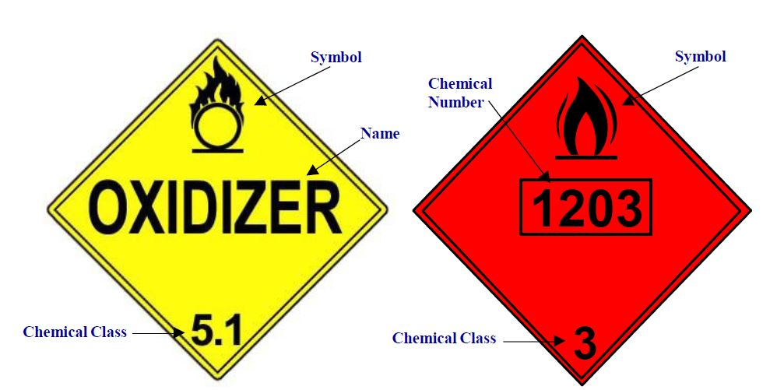
UN and NA Placards
PM 6-21
CERT Basic Training Unit 6: Fire Safety and Utility Controls
6-28

Slide 192
Greater Than 1?
Remember:
All hazardous material placards are a stop sign for CERT volunteers!
CERT Basic Training Unit 6: Fire Safety and Utility Controls
6-29

Slide 193
Exercise 6.1
Practice using a portable fire extinguisher to suppress a small fire
Apply teamwork to fire suppression
PM 6-22
CERT Basic Training Unit 6: Fire Safety and Utility Controls
6-30

Slide 194
Unit Summary (Unit 6)
You should know:
  Keys to effective fire suppression
  Classes of fire and types of fire extinguishers
  P.A.S.S.
  How to identify hazardous materials
  Always follow the safety rules established for CERTs. Personal safety comes first!
PM 6-23
CERT Basic Training Unit 6: Fire Safety and Utility Controls
6-31

Slide 195
Homework Assignment (Unit 6)
Read unit to be covered in next session
Bring necessary supplies to next session
Wear appropriate clothes to next session
PM 6-23
CERT Basic Training Unit 6: Fire Safety and Utility Controls
6-32

Slide 196
Unit 7: Light Search and Rescue Operations
CERT Basic Training

Slide 197
Unit 7 Objectives
Identify and apply CERT size-up requirements for potential search and rescue situations
Demonstrate common techniques for light search and rescue
Demonstrate safe techniques for debris removal and survivor extraction during search and rescue operations
PM 7-1
CERT Basic Training Unit 7: Light Search and Rescue Operations
7-1

Slide 198
Unit 7 Topics
Search and Rescue Size-up
Conducting Interior and Exterior Search Operations
Conducting Rescue Operations
PM 7-1
CERT Basic Training Unit 7: Light Search and Rescue Operations
7-2

Slide 199
Search and Rescue
Search and rescue consists of three separate operations
  Size-up: Using 9-step, continual model
  Search: Locating survivors and documenting
  Rescue: Extricating survivors
PM 7-1
CERT Basic Training Unit 7: Light Search and Rescue Operations
7-3

Slide 200
Deciding to Attempt Rescue
Rescue attempt decisions are based on three factors
  Risks involved for the rescuer and survivor
  Greatest good for the greatest number
  Resources and manpower available
PM 7-1
CERT Basic Training Unit 7: Light Search and Rescue Operations
7-4

Slide 201
Goals of Search and Rescue
Rescue greatest number in shortest amount of time
Get walking wounded out first
Rescue lightly trapped survivors next
Keep the rescuers and survivors safe
PM 7-1
CERT Basic Training Unit 7: Light Search and Rescue Operations
7-5

Slide 202
Effective Search and Rescue
Depends on:
  Effective size-up
  Rescuer safety
  Survivor safety
PM 7-1
CERT Basic Training Unit 7: Light Search and Rescue Operations
7-6

Slide 203
CERT Size-up
Gather Facts
Assess Damage
Consider Probabilities
Assess Your Situation
Establish Priorities
Make Decisions
Develop Plan of Action
Take Action
Evaluate Progress
PM 7-3
CERT Basic Training Unit 7: Light Search and Rescue Operations
7-7

Slide 204
Size-up Step 1
Gather Facts:
  Time of event and day of the week
  Construction type/terrain
  Occupancy
  Weather
  Hazards
  Search subject profile
PM 7-5
CERT Basic Training Unit 7: Light Search and Rescue Operations
7-8

Slide 205
Exercise 7.1
Brainstorm the following questions:
  What does this scenario tell you about the probable density for the affected area?
  What does this scenario tell you about the facts that must be gathered?
  What impact could these facts have on search and rescue operations?
  What kinds of search and rescue operations are probable?
  What, if any, are the constraints that search and rescue personnel may face in this scenario?
  Can these constraints be overcome within the established CERT mission? If so, how?
PM 7-5
CERT Basic Training Unit 7: Light Search and Rescue Operations
7-9

Slide 206
Size-up Step 2
Assess and Communicate Damage
  The CERT mission changes if damage is light, moderate, or heavy
PM 7-6
CERT Basic Training Unit 7: Light Search and Rescue Operations
7-10

Slide 207
Light Damage
Superficial
Broken windows
Superficial cracks or breaks in wall surface
Minor damage to the interior contents
Safe to enter and remain
PM 7-6
CERT Basic Training Unit 7: Light Search and Rescue Operations
7-11

Slide 208
Moderate Damage
Visible signs of damage
Decorative work damaged or fallen
Many visible cracks or breaks in wall
Major damage to interior contents
Building still on foundation
Enter only to save lives
PM 7-6
CERT Basic Training Unit 7: Light Search and Rescue Operations
7-12

Slide 209
Heavy Damage
Partial or total collapse
Tilting
Obvious structural instability
Building off foundation
Smoke, fire, gas leaks, or hazardous material
Rising water
Do not enter a building with heavy damage under any circumstances!
PM 7-7
CERT Basic Training Unit 7: Light Search and Rescue Operations
7-13

Slide 210
Size-up Step 3
Consider Probabilities:
  How stable is the situation?
  What secondary factors should be considered?
  What else could go wrong?
  What does it mean for the search and rescue?
PM 7-8
CERT Basic Training Unit 7: Light Search and Rescue Operations
7-14

Slide 211
Size-up Step 4
Assess Your Situation:
  Is the situation safe enough to continue?
  What risks will rescuers face?
  What resources are needed?
  What resources are available?
PM 7-9
CERT Basic Training Unit 7: Light Search and Rescue Operations
7-15

Slide 212
Rescue Resources
Personnel:
  Firefighters
  Police officers
  Doctors, Nurses
  Contractors
Tools:
  Crowbars
  Auto jacks
  Chainsaws
Equipment
PM 7-9
CERT Basic Training Unit 7: Light Search and Rescue Operations
7-16

Slide 213
Size-up Step 5
Establish Priorities:
  What should be done?
  In what order?
  How do you rescue the greatest number in the shortest amount of time?
PM 7-10
CERT Basic Training Unit 7: Light Search and Rescue Operations
7-17

Slide 214
Size-up Step 6
Make Decisions:
  Keep in mind:
    Safety of CERT members
    Life safety for survivors and others
    Protection of the environment
    Protection of property
PM 7-10
CERT Basic Training Unit 7: Light Search and Rescue Operations
7-17

Slide 215
Size-up Step 7
Develop Plan of Action:
  Focus operation on established priorities and decisions
  Provide documentation to give to responding agencies
  Provide documentation to become part of CERT records
PM 7-11
CERT Basic Training Unit 7: Light Search and Rescue Operations
7-17

Slide 216
Size-up Step 8
Take Action:
  Base action on plan developed during Step 7
PM 7-11
CERT Basic Training Unit 7: Light Search and Rescue Operations
7-20

Slide 217
Size-up Step 9
Evaluate Progress:
  Most critical step
  Monitor plan’s effectiveness and safety
PM 7-11
CERT Basic Training Unit 7: Light Search and Rescue Operations
7-21

Slide 218
Exercise 7.2
Given the disaster and the specific building, answer the following questions
  What are the pertinent facts that must be gathered?
  What kind of prediction can you make regarding damage, based on the incident and the building construction?
  What probable search and rescue problems can you identify?
  What specific safety considerations can you identify?
PM 7-12
CERT Basic Training Unit 7: Light Search and Rescue Operations
7-22

Slide 219
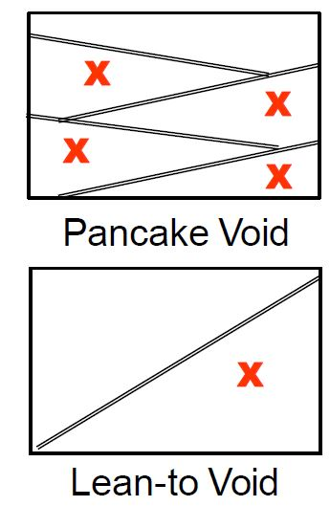
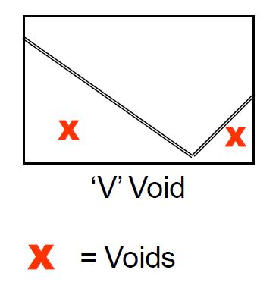
Structural Voids
If you see collapsed floors or walls, GET OUT!
PM 7-13
CERT Basic Training Unit 7: Light Search and Rescue Operations
7-23

Slide 220
Individual Voids
Survivors may seek protection in various places
  Inside bathtubs
  Underneath desks
  Inside cabinets
  Under/next to beds
  Inside closets
PM 7-13
CERT Basic Training Unit 7: Light Search and Rescue Operations
7-24

Slide 221
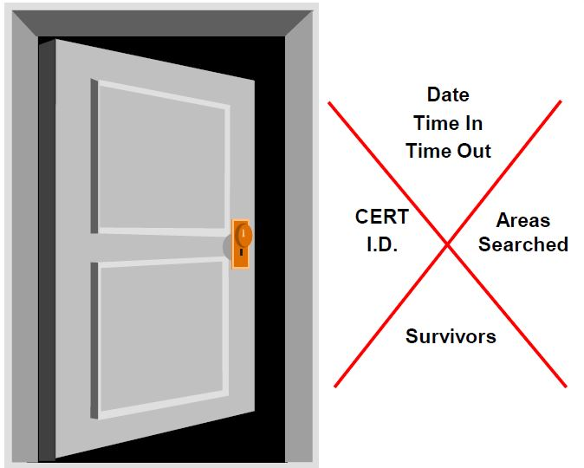
Search Markings (1 of 3)
Upon entering search area:
  Make a slash
  Enter info
Upon leaving search area:
  Complete ‘X’
  Enter info
PM 7-14
CERT Basic Training Unit 7: Light Search and Rescue Operations
7-25

Slide 222
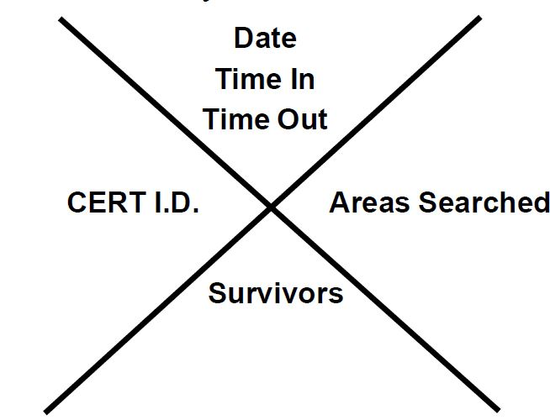
Search Markings (2 of 3)
What information do you mark?
PM 7-14
CERT Basic Training Unit 7: Light Search and Rescue Operations
7-26

Slide 223
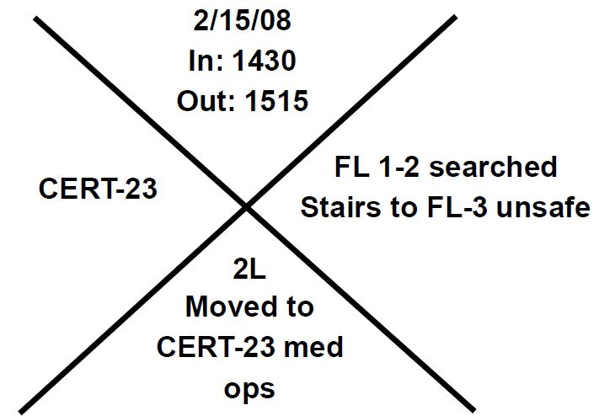
Search Markings (3 of 3)
Sample
PM 7-14
CERT Basic Training Unit 7: Light Search and Rescue Operations
7-27

Slide 224
Search Methodology (1 of 5)
Remain within arm’s reach of one other CERT member
Call out to survivors, “If anyone can hear my voice, come here”
Ask any survivors who do respond for more information about the building or others who may be trapped
Survivors might be in shock or confused
PM 7-14
CERT Basic Training Unit 7: Light Search and Rescue Operations
7-28

Slide 225
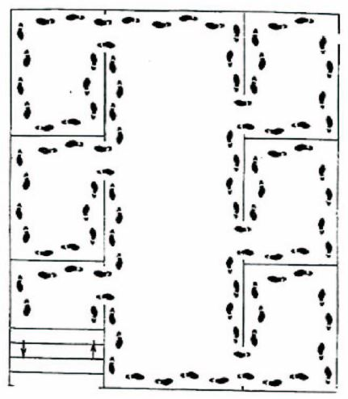
Search Methodology (2 of 5)
Bottom-up/top-down for a multi-story building
Right wall/left wall for a single floor
Stop frequently to listen
PM 7-15
CERT Basic Training Unit 7: Light Search and Rescue Operations
7-29

Slide 226
Search Methodology (3 of 5)
Stop frequently to listen for:
  Tapping
  Movement
  Voices
PM 7-15
CERT Basic Training Unit 7: Light Search and Rescue Operations
7-30

Slide 227
Search Methodology (4 of 5)
Triangulation allows rescuers to view a location from several perspectives
PM 7-15
CERT Basic Training Unit 7: Light Search and Rescue Operations
7-31

Slide 228
Search Methodology (5 of 5)
Keep records of rescued survivors and of those who remain trapped or who are dead
Report information to emergency services personnel
PM 7-15
CERT Basic Training Unit 7: Light Search and Rescue Operations
7-32

Slide 229

Exterior Search
Set up a grid search:
  Set distance between searchers according to visibility and debris
  Overlap patterns for full coverage
  Search in as straight a line as possible
  Mark areas that have been searched
PM 7-15
CERT Basic Training Unit 7: Light Search and Rescue Operations
7-32

Slide 230
Rescue Operations
Remove objects and debris to free survivors and create safe rescue environment
Assess survivors
Remove survivors
PM 7-17
CERT Basic Training Unit 7: Light Search and Rescue Operations
7-34

Slide 231
Creating a Safe Environment
Maintain rescuer safety
Assess survivors in lightly and moderately damaged buildings
Evacuate survivors as quickly as possible
PM 7-17
CERT Basic Training Unit 7: Light Search and Rescue Operations
7-35

Slide 232
Precautions to Minimize Risk
Know your limitations
Follow safety procedures
Remove debris by leveraging and cribbing
PM 7-17
CERT Basic Training Unit 7: Light Search and Rescue Operations
7-36

Slide 233
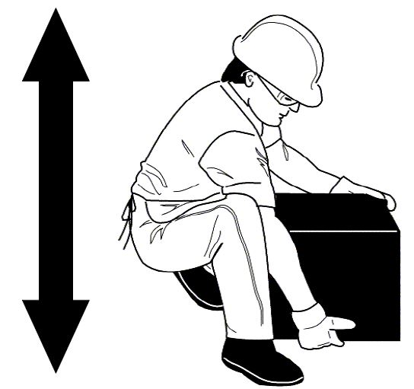
Proper Lifting Procedures
Back straight
Bend knees
Keep load close to body
Push up with legs
PM 7-18
CERT Basic Training Unit 7: Light Search and Rescue Operations
7-37

Slide 234
Leveraging and Cribbing
For heavy lifting
Performed in tandem
Helps extricate survivors
Various materials and objects may be used
PM 7-18
CERT Basic Training Unit 7: Light Search and Rescue Operations
7-38

Slide 235
Two Types of Removal
Self removal or assist; and
Lifts and drags
PM 7-21
CERT Basic Training Unit 7: Light Search and Rescue Operations
7-39

Slide 236
Which Extrication Method?
Extraction method depends on a number of criteria
  General stability of the immediate environment
  Number of rescuers available
  Strength and ability of the rescuers
  Condition of survivor
PM 7-21
CERT Basic Training Unit 7: Light Search and Rescue Operations
7-40

Slide 237
One-Person Arm Carry
Lift around survivor’s back and under his or her knees
Lift survivor by keeping your own back straight and lifting with your legs
PM 7-21
CERT Basic Training Unit 7: Light Search and Rescue Operations
7-41

Slide 238
Pack-Strap Carry
PM 7-22
CERT Basic Training Unit 7: Light Search and Rescue Operations
7-42

Slide 239
Two-Person Carry
PM 7-22
CERT Basic Training Unit 7: Light Search and Rescue Operations
7-43

Slide 240
Chair Carry
PM 7-23
CERT Basic Training Unit 7: Light Search and Rescue Operations
7-44

Slide 241
Blanket Carry
PM 7-24
CERT Basic Training Unit 7: Light Search and Rescue Operations
7-45

Slide 242
Log Rolling
PM 7-25
CERT Basic Training Unit 7: Light Search and Rescue Operations
7-46

Slide 243
Blanket Drag
PM 7-25
CERT Basic Training Unit 7: Light Search and Rescue Operations
7-47

Slide 244
Exercise 7.3
Break into teams of seven
Members of your team will volunteer to be “victims” that other team members will move using the drags and carries demonstrated in the class
Use chairs and other items as needed to perform the drags and carries
Trade off “victim” and “rescuer” roles so that everyone on your team has a chance to practice the drags and carries
Know your limits! Do not attempt any lift or carry that will not be safe for you and the victim
PM 7-26
CERT Basic Training Unit 7: Light Search and Rescue Operations
7-48

Slide 245
Exercise 7.4
Break into teams of seven
Your team will be directed to a “damage site.” Consider your plan of action
Enter “damage site” and conduct room search. Locate victims and make plan to extricate them from debris
Leverage and crib as needed to free the survivor
Use appropriate lifts and drags to remove victims from the room (and, if possible, from the building)
If there is a second “damage site,” conduct another rescue operation
PM 7-26
CERT Basic Training Unit 7: Light Search and Rescue Operations
7-49

Slide 246
Unit Summary (Unit 7)
You should know
  How to decide whether to attempt rescue
  The objectives of interior and exterior search and rescue
  How to perform search and rescue size-up
  Building markings
  Rescue functions
  How to remove debris
  How to extricate survivors
PM 7-27
CERT Basic Training Unit 7: Light Search and Rescue Operations
7-50

Slide 247
Homework Assignment (Unit 7)
Read unit to be covered in next session
Bring necessary supplies to next session
Wear appropriate clothes to next session
PM 7-27
CERT Basic Training Unit 7: Light Search and Rescue Operations
7-51

Slide 248
Terrorism and CERT
CERT Basic Training Unit 8

Slide 249
Unit 8 Objectives
Define terrorism
List the eight signs of terrorism and describe how to report suspicious activity
Explain the role of a CERT volunteer during a terrorist incident
Describe activities to prepare for a terrorist incident at home, at work, and in the community
PM 8-1
CERT Basic Training Unit 8: Terrorism and CERT
8-1

Slide 250
Unit 8 Topics
Defining terrorism
Terrorist goals and tactics
Preparing your community until help arrives
HazMat and Chemical, Biological, Radiological, Nuclear, and Explosive (CBRNE) materials.
PM 8-1
CERT Basic Training Unit 8: Terrorism and CERT
8-2

Slide 251
What Is Terrorism?
The unlawful use of force or violence against persons or property to intimidate or coerce a government, the civilian population, or any segment thereof in furtherance of political or social objectives
  Terrorism in the United States is seen as an act of violence with the motive to create ideological change.
PM 8-2
CERT Basic Training Unit 8: Terrorism and CERT
8-3

Slide 252
Terrorist Goals
Influence government policy and achieve specific objectives
  Hamas / Rajnish Cult
Undermine the public’s sense of safety and their confidence in the government
  Aum Shinrikyo / Japan
Portray the government as ineffective, weak, or otherwise incapable
  Boko Haram / Kenya
PM 8-2
CERT Basic Training Unit 8: Terrorism and CERT
8-4

Slide 253
New Tactics
Active Shooter
Improvised Explosive Devices (IEDs)
Cyber Attacks
Complex Coordinated Terrorist Attacks
PM 8-2
CERT Basic Training Unit 8: Terrorism and CERT
8-5

Slide 254
Potential Indicators
If you see something, say something!
Understand the signs of terrorist activity
Contact local law enforcement
Use the FBI Suspicious Activity Reporting Tip Line
PM 8-5
CERT Basic Training Unit 8: Terrorism and CERT
8-6

Slide 255
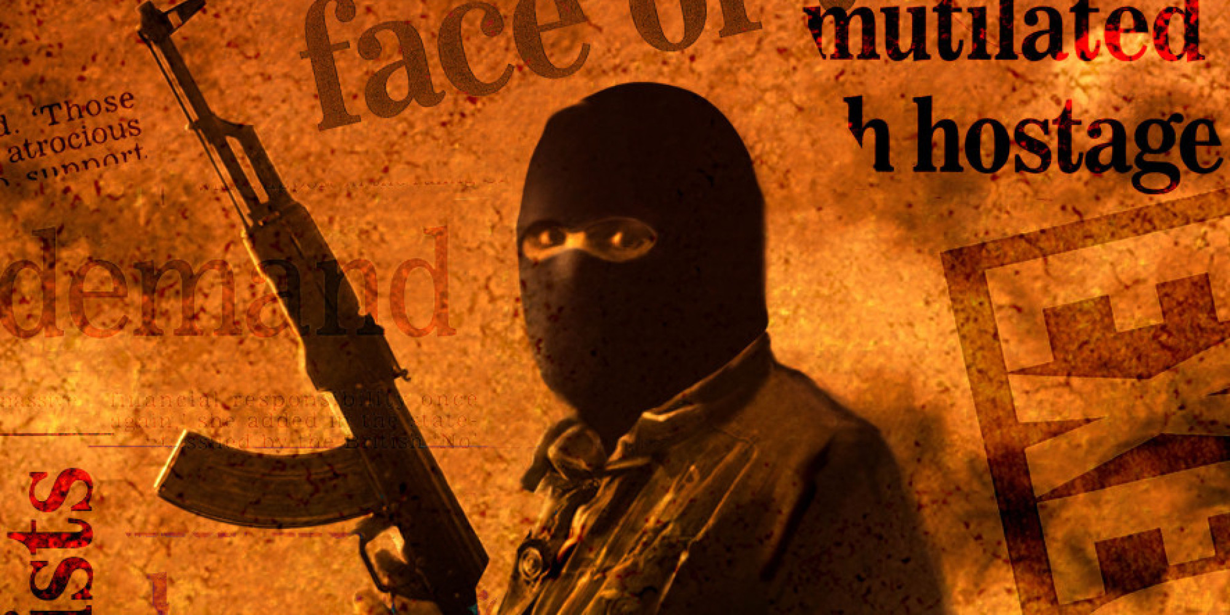
Eight Signs of Terrorism
Surveillance
Elicitation
Tests of security
Funding
Acquiring supplies
Impersonation or suspicious people
Rehearsals and dry runs
Deployment
PM 8-5
CERT Basic Training Unit 8: Terrorism and CERT
8-7

Slide 256
Potential Targets
Soft Targets
  schools, parks, large gathering spaces, cafes, and concert halls
Less Secure
  targets include malls, movie theaters, and universities
Think about how you would react and be able to render assistance in any of the above situations for the following exercise.
PM 8-6
CERT Basic Training Unit 8: Terrorism and CERT
8-8

Slide 257
Exercise 8.1
Purpose: As with all types of disasters and emergencies, preparation is key to planning for a terrorism related event. Although it is often difficult to predict when such an event may occur, there are a number of steps you can take today to be prepared
Instructions:
  Break into small table groups
  As a group, create a list of activities that CERT volunteers can do at home or work to better prepare for a terrorism related emergency. Be prepared to share your list with the rest of the class
PM 8-6
CERT Basic Training Unit 8: Terrorism and CERT
8-9

Slide 258
Active Shooter
Run
  If there is an accessible escape path, attempt to evacuate the premises
Hide
  If evacuation is not possible, find a place to hide where the active shooter is less likely to find you
Fight
  If you are unable to run, evacuate or hide and when your life is in imminent danger, you may attempt to disrupt and/or incapacitate the active shooter
PM 8-7
CERT Basic Training Unit 8: Terrorism and CERT
8-10

Slide 259
Until Help Arrives
CERT volunteers are NOT equipped or trained to respond to terrorist incidents
If you find yourself in a situation that you believe to be a terrorist attack, focus on the most lifesaving interventions:
  Move those in grave danger to a safe place
  Stop bleeding, prevent shock
  Maintain body temperature
  Move unconscious survivors into recovery position
  Offer comfort and support to those around you
PM 8-10
CERT Basic Training Unit 8: Terrorism and CERT
8-11

Slide 260
Considerations
Before assisting those around you, consider:
  How stress and fear of the situation may affect you
  Immediate health affects of certain types of attacks
PM 8-10
CERT Basic Training Unit 8: Terrorism and CERT
8-12

Slide 261
Secondary Attacks
Be prepared for a secondary attack
Be aware of your surroundings
Move away from danger as soon as you are able
Move others to safety if you are able
PM 8-11
CERT Basic Training Unit 8: Terrorism and CERT
8-13

Slide 262
What Professional Responders Will Do
Follow size-up steps
  What is going on?
  How bad is the situation, and how much worse could it get?
  What measures can be taken to control the incident safely?
  What resources will be needed?
PM 8-12
CERT Basic Training Unit 8: Terrorism and CERT
8-14

Slide 263
Basic Decontamination Procedures
Leave the contaminated area
Take decontamination action
  Remove everything
  Wash hands
  Flush the entire body
  Blot dry
Report for decontamination
PM 8-13
CERT Basic Training Unit 8: Terrorism and CERT
8-15

Slide 264
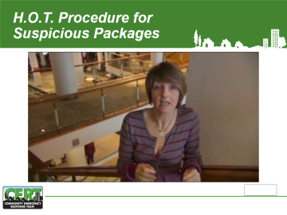
CBRNE Indicators
Vapor clouds or mists that are unusual for the area or for the time of day
Out of place and unattended packages, boxes, or vehicles
If you observe any indicators
  Do not touch
  Move away
  Report it
PM 8-14
CERT Basic Training Unit 8: Terrorism and CERT
8-16

Slide 265
Nuclear Weapons
Derives destructive force from nuclear reaction
Affected area is larger as contaminated objects spread
Potential for casualties extends beyond initial attack
Long-term effects difficult to monitor and track
PM 8-14
CERT Basic Training Unit 8: Terrorism and CERT
8-17

Slide 266
Shelter-in-Place Procedures
Shut off ventilation systems
Go to your shelter-in-place room
Use precut plastic sheeting to cover air openings
Tape sheeting over doors, windows, vents
Use duct tape to seal other areas
Listen to a battery-powered radio
Ventilate room once contaminants are gone
8-15
CERT Basic Training Unit 8: Terrorism and CERT
8-18

Slide 267
Unit Summary (Unit 8)
When terrorists attack, their goals are to:
  Create mass casualties
  Disrupt critical resources, vital services, and the economy
  Cause fear
New Tactics
  Active Shooter
  Improvised Explosive Devices
  Complex Coordinated Attacks
  Cyber Attacks
CERT volunteers are NOT equipped or trained to respond to terrorist incidents
PM 8-17
CERT Basic Training Unit 8: Terrorism and CERT
8-19

Slide 268
Homework Assignment (Unit 8)
Review the materials for the next session
Wear appropriate clothing for next session
PM 8-18
CERT Basic Training Unit 8: Terrorism and CERT
8-20

Slide 269
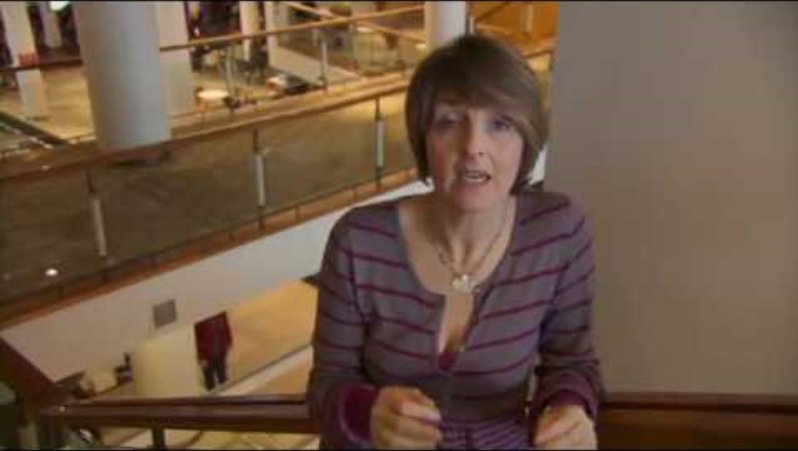
H.O.T. Procedure for Suspicious Packages

