Slide 1

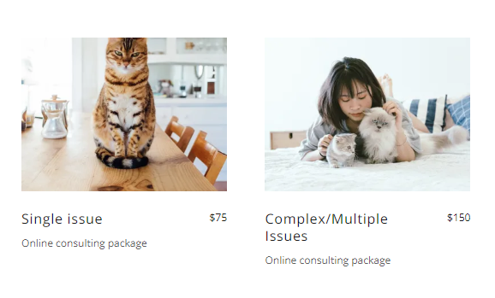
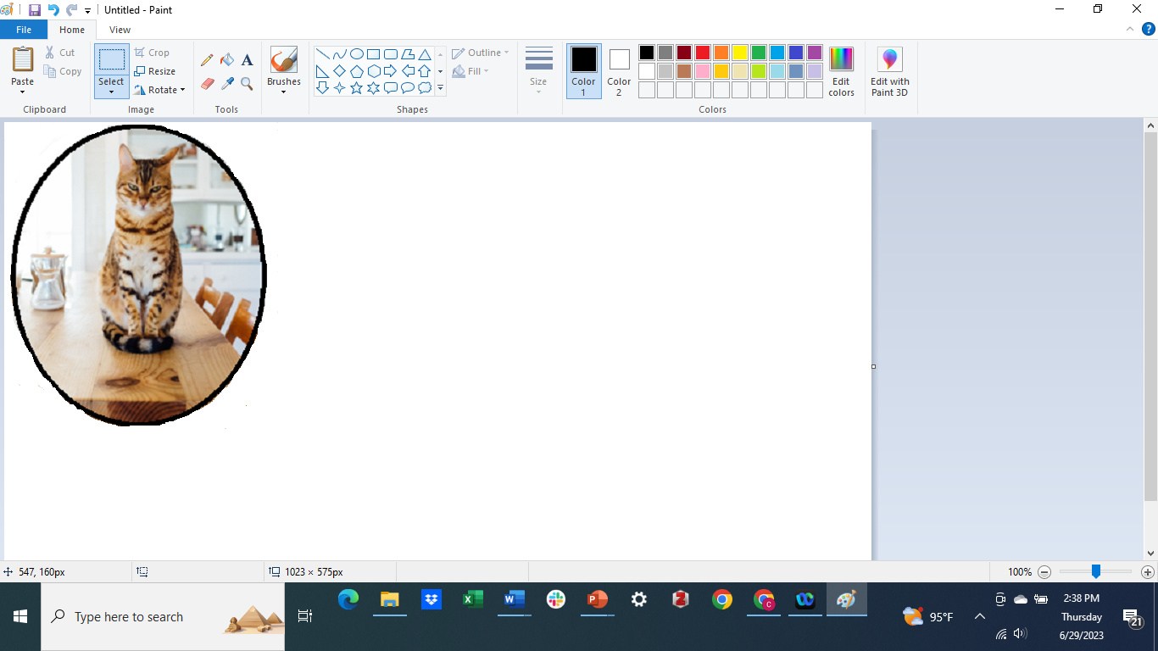
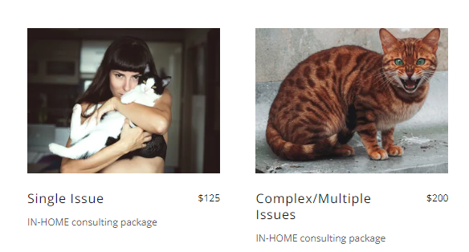
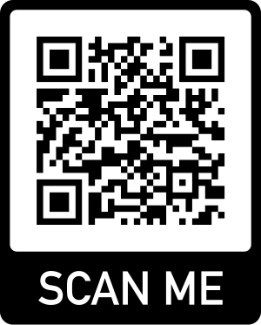
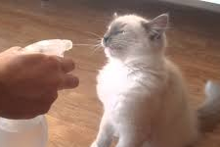

Services Pricing
Free first assessment call; Custom packages available
Online consulting packages*
Certified Feline Behavior and Training Specialist & Consultant
Resolving issues with evidence-based behavior modification - humanely
Single Cat / Issue $110 Multiple Cats / Issues $185
Includes 2-4 video consults, educational resources, and 60
days of phone or email follow-up as needed.
In-home consulting packages*
Single Cat / Issue $145 Multiple Cats / Issues $230
Includes 1-3 in-home consults, educational resources and 90
days of video, phone or email follow-up as needed
*Not all issues can be addressed via online consultations
Add more sessions as needed
Pricing on website
Purrfectcat4me.com
Keep them in their homes
Behavior Resource for North Central FL Veterinarians
Purrfectcat4me@gmail.com
352-328-6412
Online and in-home services for your clients

Slide 2
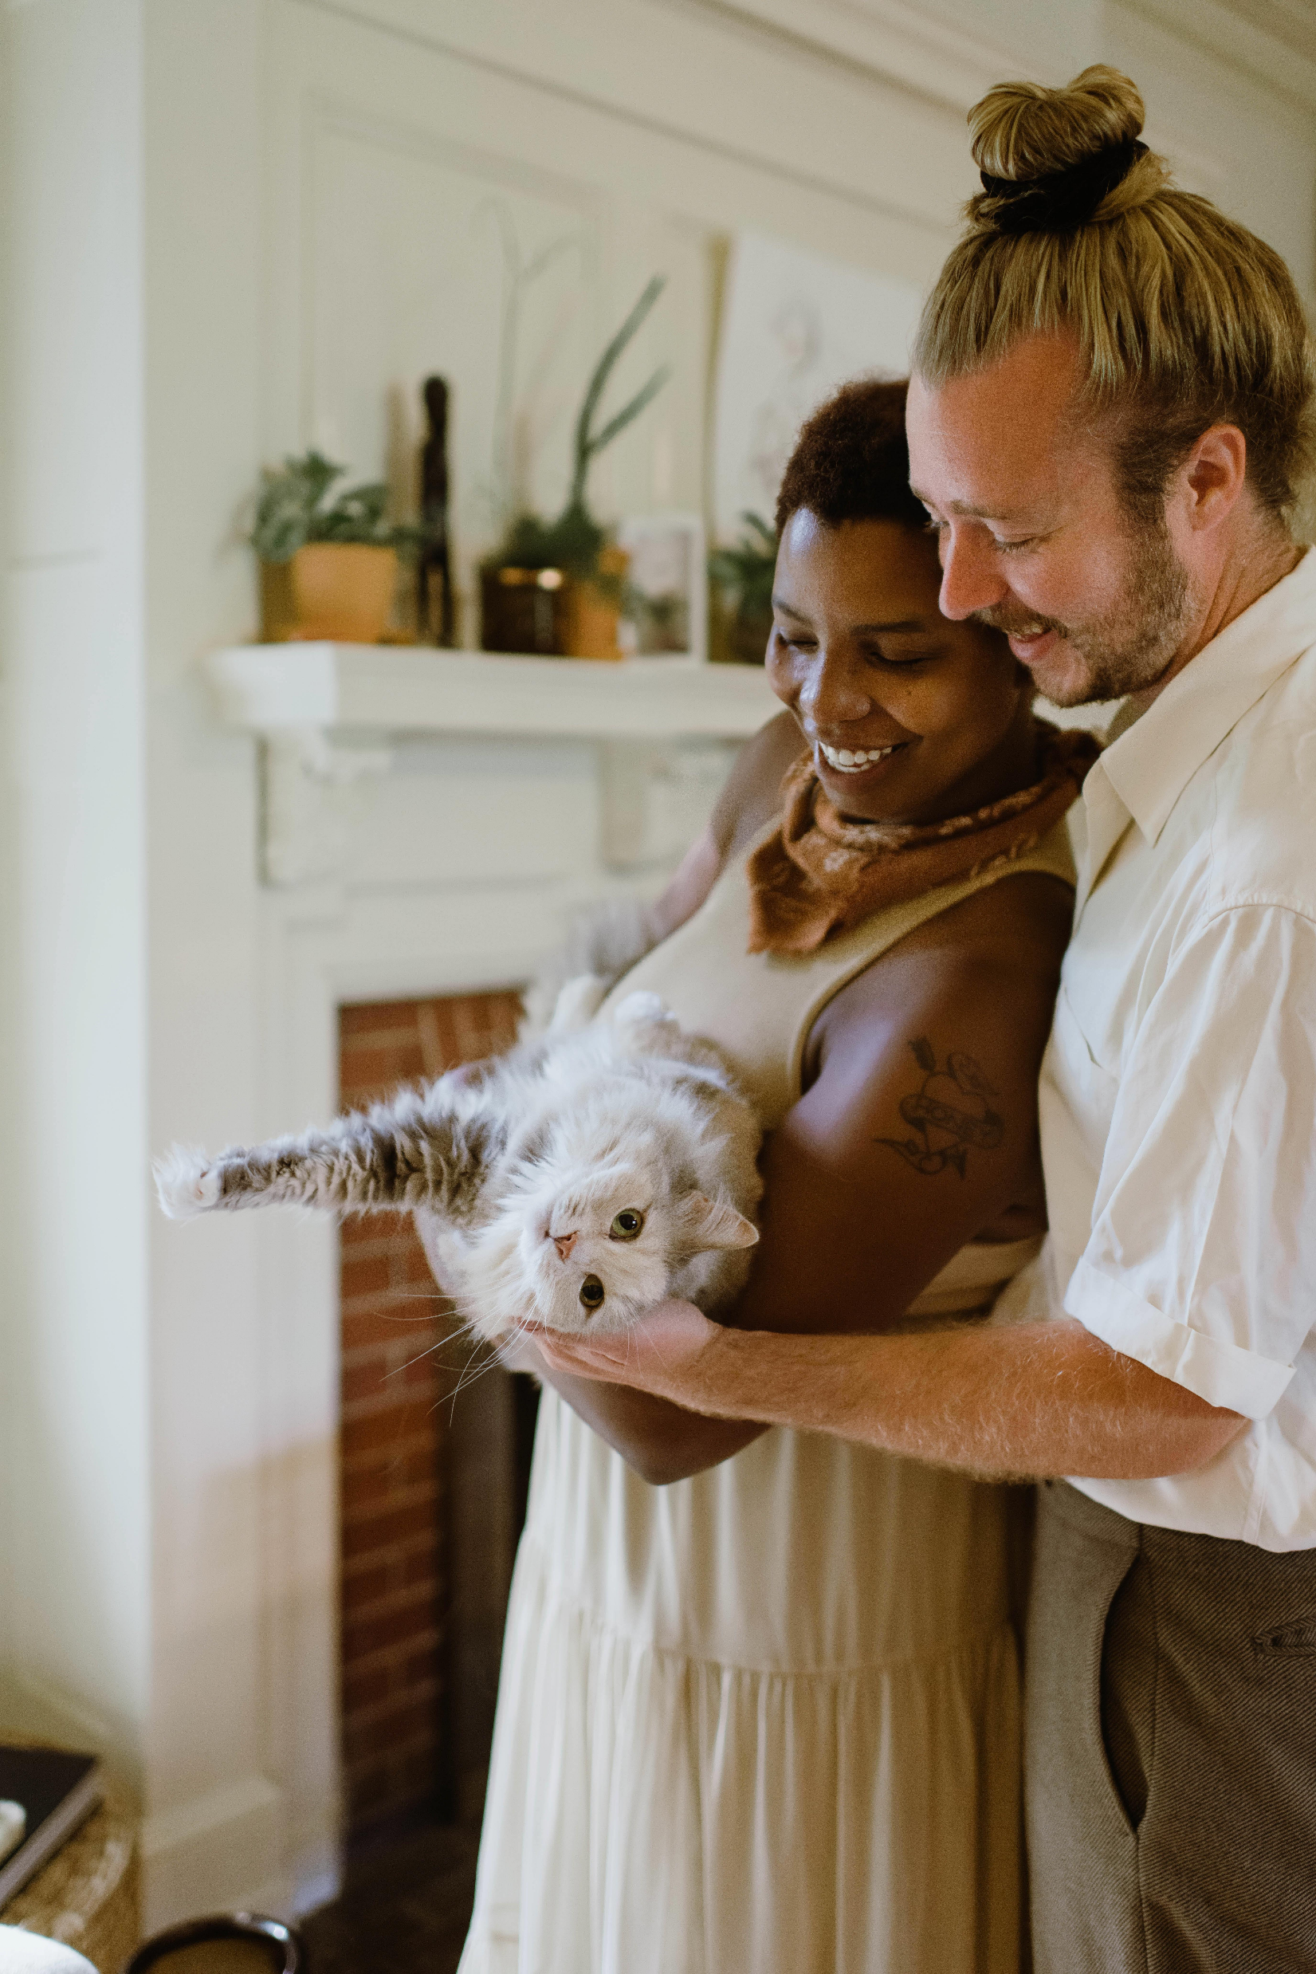
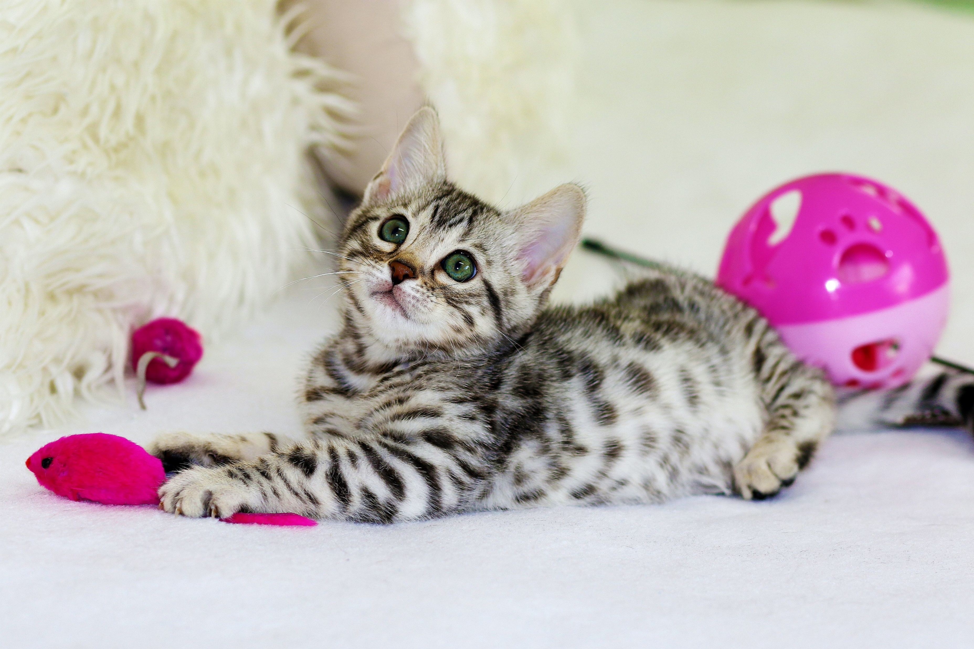

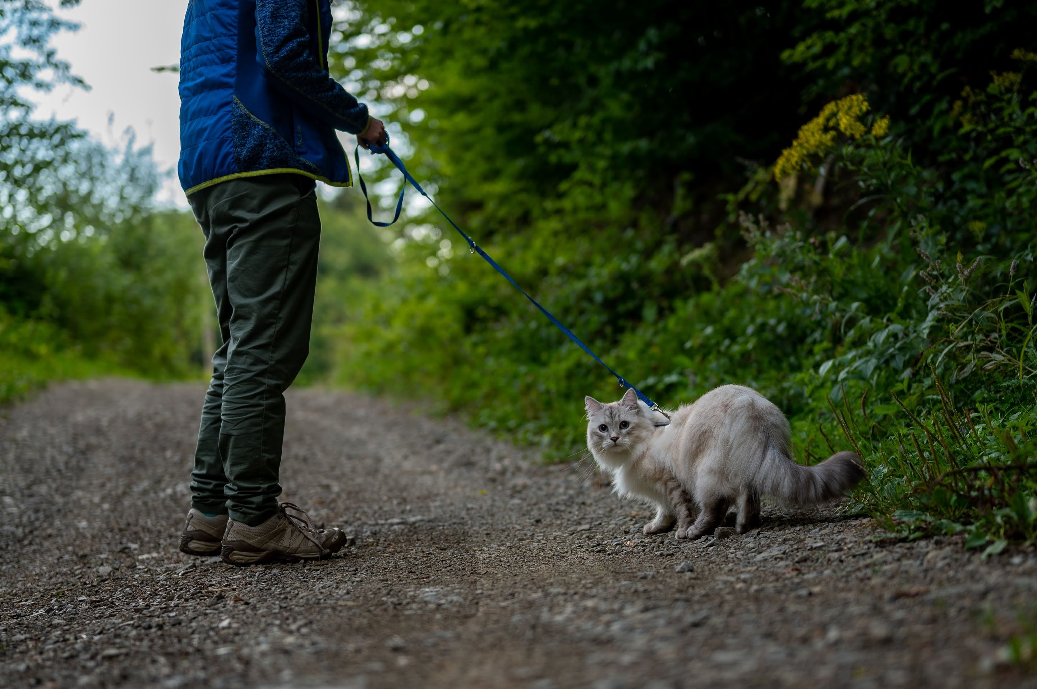
Benefits to Your Clinic
A trusted behavior consultant resource to refer patients to for problems that need home assessment and/or selected topic education
Add a critical home environmental assessment and behavior modification plan if a cat needs medications for behavior issues
Reinforce your key educational messages on feline integration, low-stress handling or enrichment
Differentiate your clinic – offer behavior services!
Assist caregivers implementing behavior modification
Access to a national network of feline behavior professionals and veterinary behaviorists
Testimonials
Chris’s knowledge and passion for improving behavior was integral in improving aggression among our 5 cats – MK, Florida
- Chris gave me great practical advice on how to divert and deter Moxie from unwanted behaviors and introduced me to positive reinforcement: praise, treats & clicker training - MZ , New Jersey
I can help caregivers to:
Understand what causes stress for a cat
Ensure adherence to the “5 pillars of a healthy feline environment” for optimal well being
Introduce a new partner, dog or baby to the home
Solve litterbox problems
Address aggression (people or other cats) or biting
Calm an over-stimulated or fearful cat
Reduce furniture clawing or other destructive behavior
Multi-cat integration issues
Yowling, excessive vocalization
Train cats: for example, staying off the counter/table, leash/harness training, low-stress medicating or nail trims, sitting calmly, etc.
Qualifications & Training
Lifelong cat & horse caretaker/horse trainer for equine triathlons
August 2023 - Feline Behavior & Training Certification from the accredited Animal Behavior Institute
2022/2023 - Behavior extern/observer at All Cats Vet Clinic in Gainesville, FL; Dr. Grace White
2023 – Behavior extern at Newberry Animal Hospital; Dr. Kimberly Hall
Early 2023 - audited prestigious feline behavior consultant course through the *International Association of Animal Behavior Consultants
2022 - 2025 Completed 75+ hours of feline behavior CEUs at international, national and online conferences
Cat/kitten foster mom and cat enrichment volunteer for the Humane Society of North Central FL
Have taken numerous community cats through the Alachua county (TNR) program - Operation Catnip
Mature, excellent problem solver - dedicated to doing what it takes to resolve or reduce issues working as a team
Pursuing *IAABC certification in 2026
See professional resume for more details

