Slide 1
💚Instructions💙
PURPOSE
GAMES
This kit includes Conversation Prompts, Choose Your Favorite Sheets, and Games.
This kit is designed to:
Help residents feel heard and valued
Support meaningful one-on-one connection
Reduce memory pressure
Encourage gentle engagement
This kit includes the following games:
Matching cards
Playing cards / UNO
Expression brain games
Word search
Watercolor cards
Puzzles
Sensory toys

Slide 2
💚 Instructions (Cont’d) 💙
LEVEL A
LEVEL B
Not Very Lucid
Sensory | Present-moment | No memory pressure
Use the “Choose Your Favorite…” sheets by asking the resident to point to their selections.
If they cannot point, gently point and ask, “Is this a good choice?”
Response to use after selections: “That’s a great choice.”
Lucid
Find their story | Identity | Meaning | Wisdom
Use the “Choose Your Favorite…” sheets by expanding on the questions:
  “What do you like about that?”
  “Did you ever have a pet?”
  “Did you like to dance?”

Slide 3

💚 Instructions (Cont’d) 💙
Phrases to Use
Reminders
Tips
“I’m happy to be here with you.”
“Thank you for sharing that.”
“That sounds important.”
“We can just sit together.”
“You have a nice smile.”
Connection does not require perfect conversation.
The most meaningful moments can be:
A shared smile
Sitting quietly together
Your presence matters.
Share something about yourself, too.
Keep questions simple and present-focused.
Avoid correcting or challenging memory.
Celebrate small responses.
Pause/stop if a resident becomes tired.
Notes:
“I’m happy to be here with you.”
“Thank you for sharing that.”
“Would you like to try another card?”
“That sounds important.”
“We can just sit together.”

Slide 4
💚Conversation Prompts💚
FEELING BASED
GENTLE PROMPTS
Are you feeling okay today?
Does this song make you smile?
Do you feel cozy right now?
Do you like when people sit and talk with you?
May I sit with you?
Would you like a sensory item?
Can I read something to you?
Would you like to listen to music together?
ENGAGEMENT
GAMES
Using the “Choose Your Favorite” sheets, ask the resident to point to his/her favorite from each category.
“Do you have a favorite hobby?”
Would you like to complete a puzzle together?
Use the memory cards to ask questions around animals, cars, etc.
Would you like to play UNO or a card game?
Notes:
May I sit with you?
Would you like to hold my hand?
Can I read something to you?
Would you like to listen to music together?

Slide 5
💙Conversation Prompts💙
LIFE & IDENTITY
RELATIONSHIPS
What is something you are proud of?
What kind of child were you?
What did you enjoy most about adulthood?
What was a turning point in your life?
Who influenced you most?
What makes a lasting friendship?
What makes someone trustworthy?
What advice would you give young people about relationships?
CULTURE
SHARING WISDOM
What was the best thing about growing up in your time?
What do young people today get right?
What do you wish people understood about your generation?
What song takes you back instantly?
What does a good life mean to you?
What is more important: success or kindness?
What challenge made you stronger?
What do you hope people remember about you?
Notes:
What helped you get through difficult times?

Slide 6
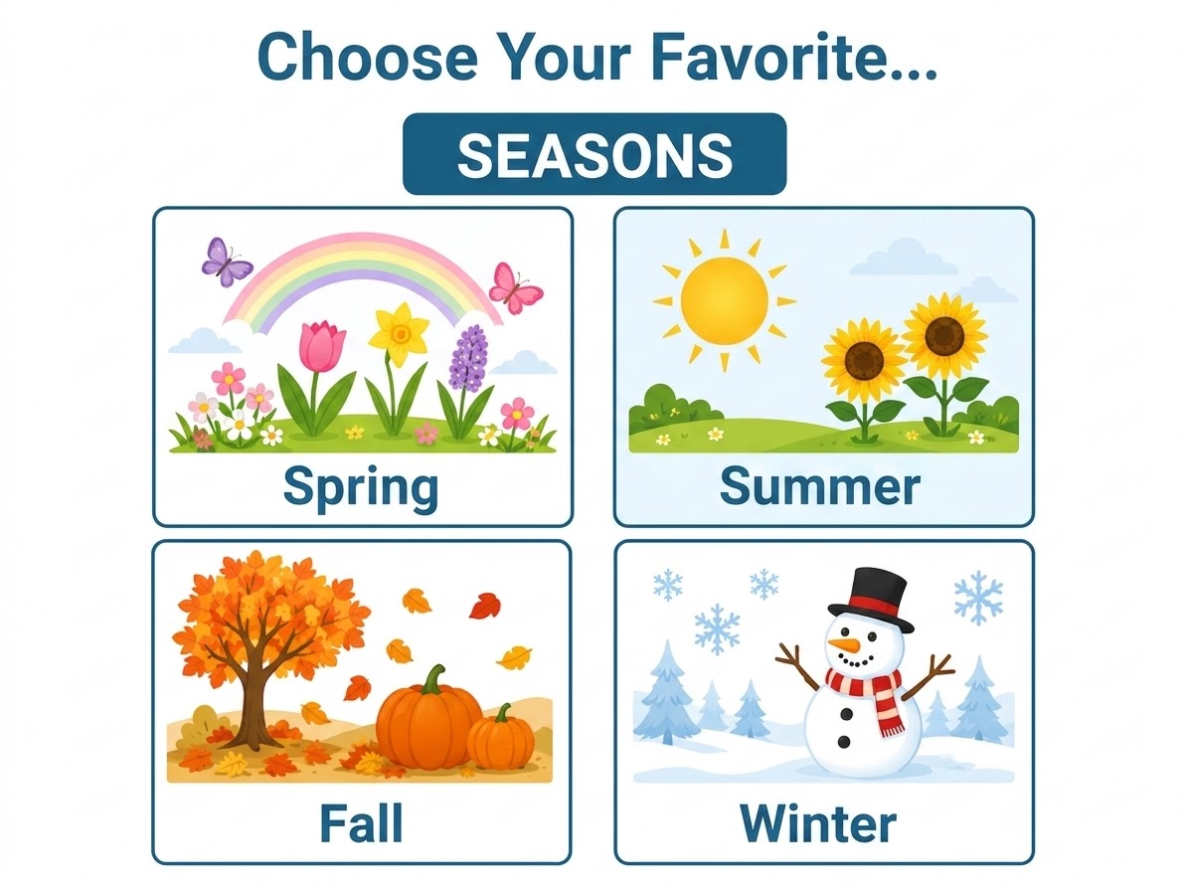

Slide 7
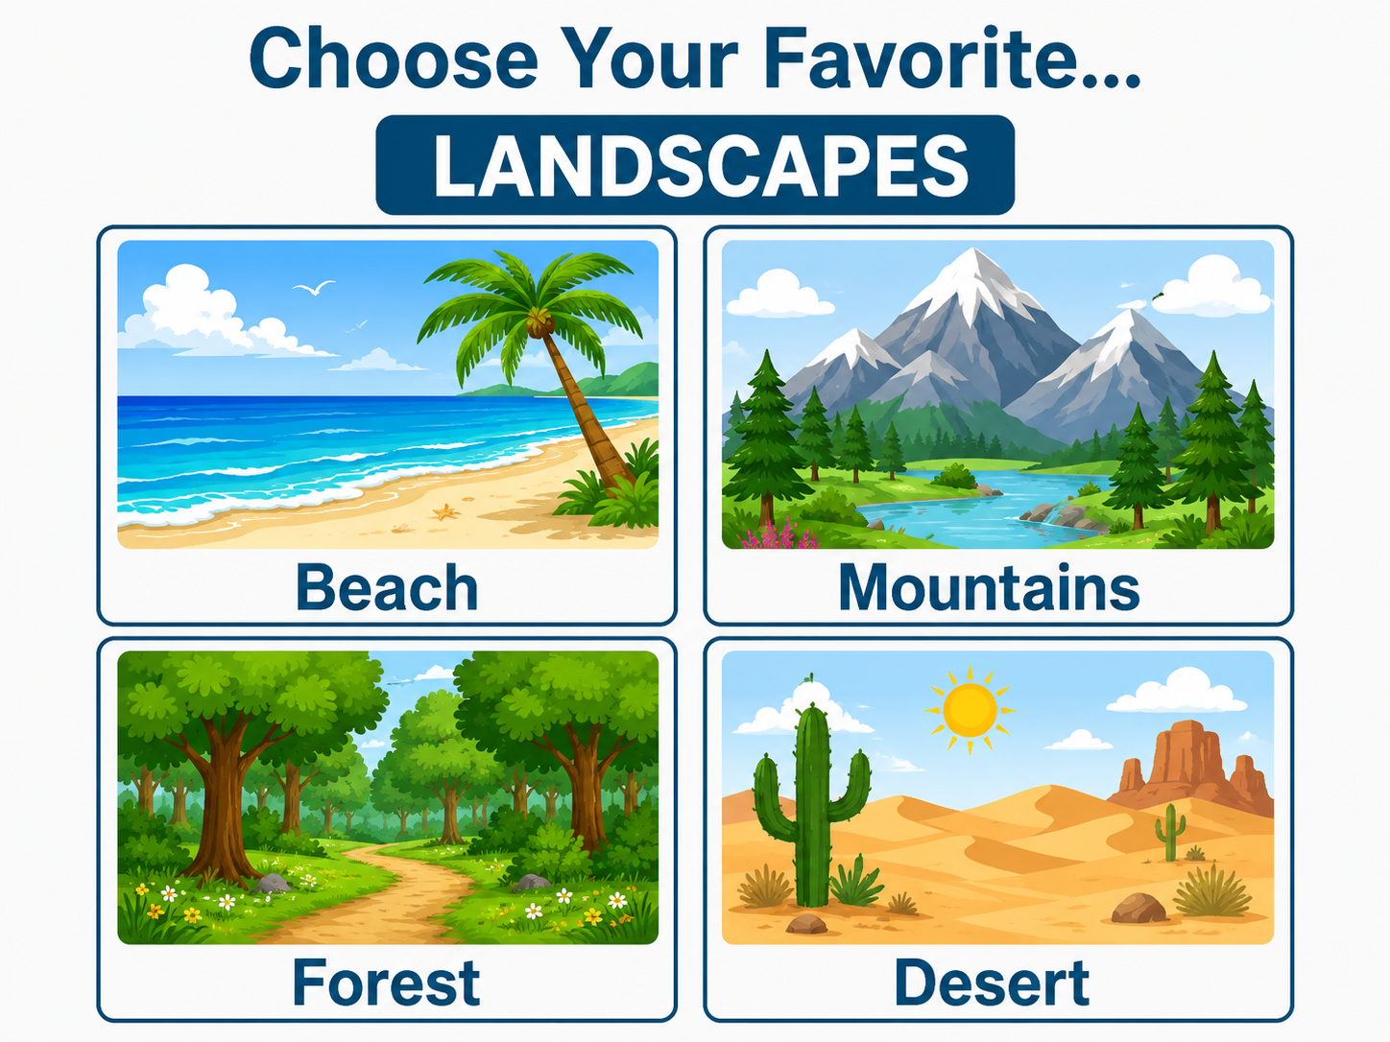
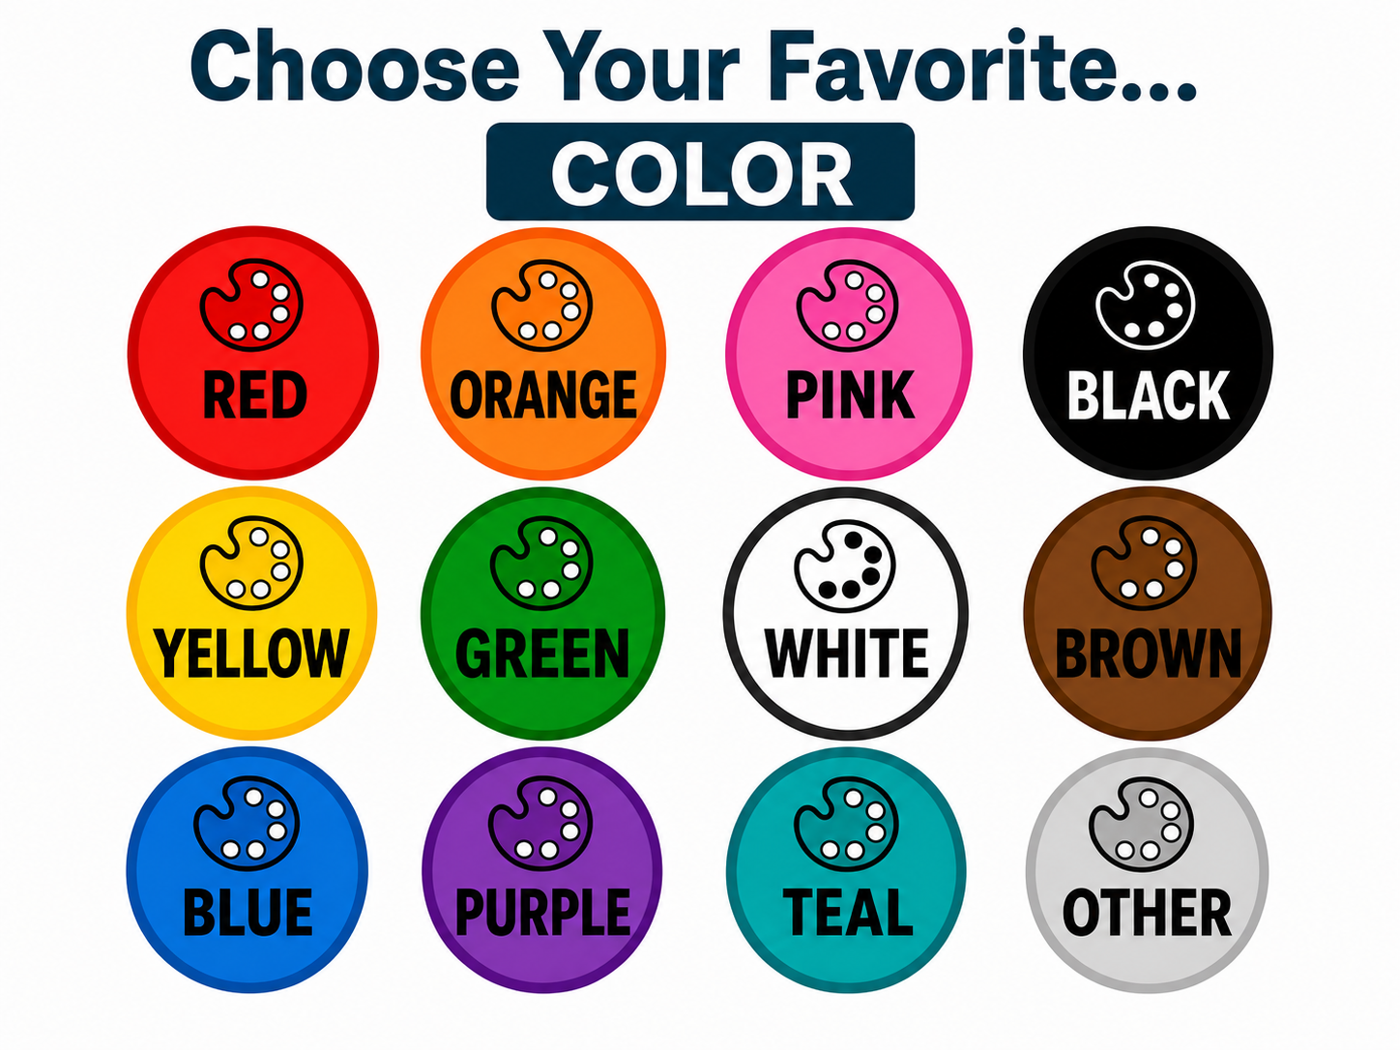
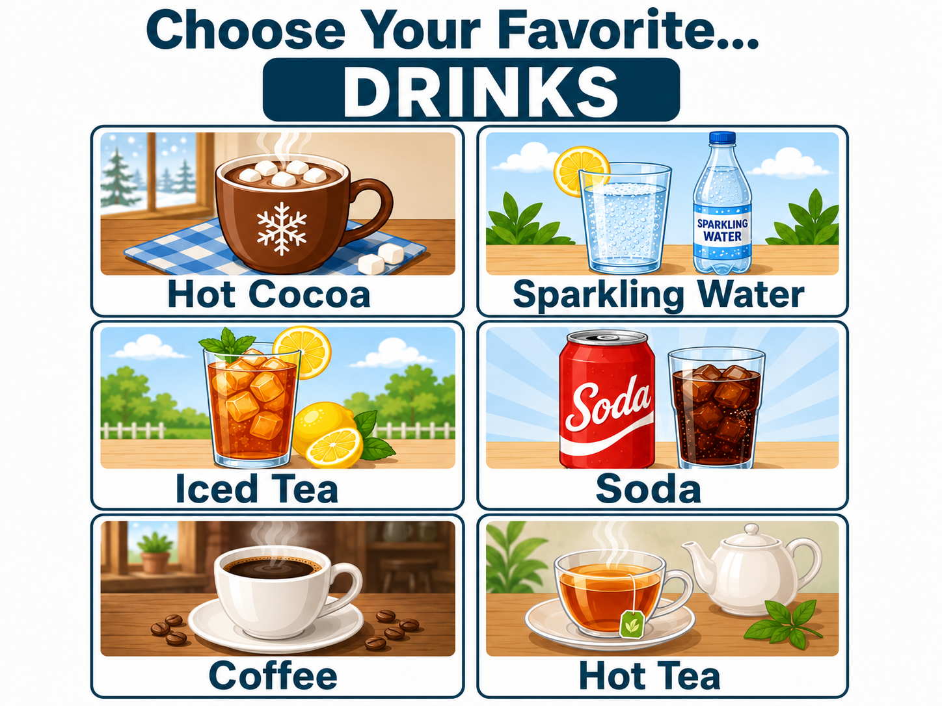

Slide 9
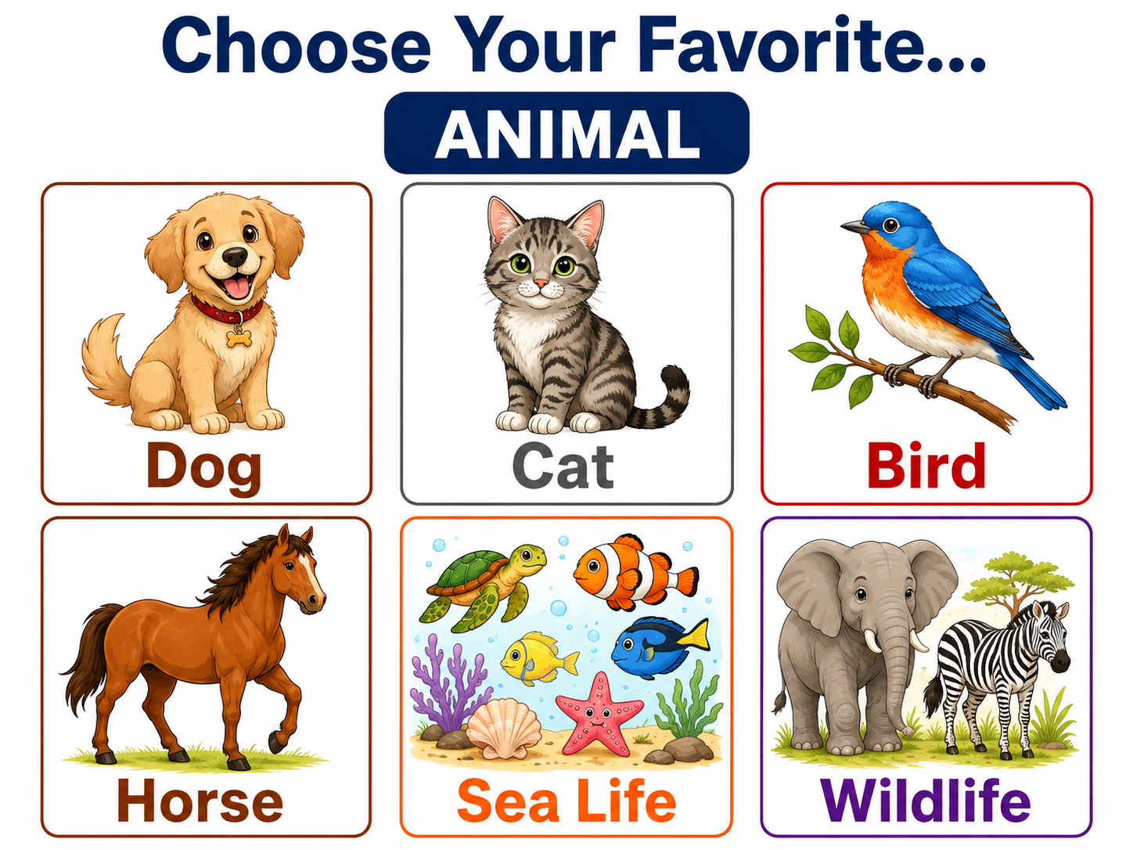

Slide 11
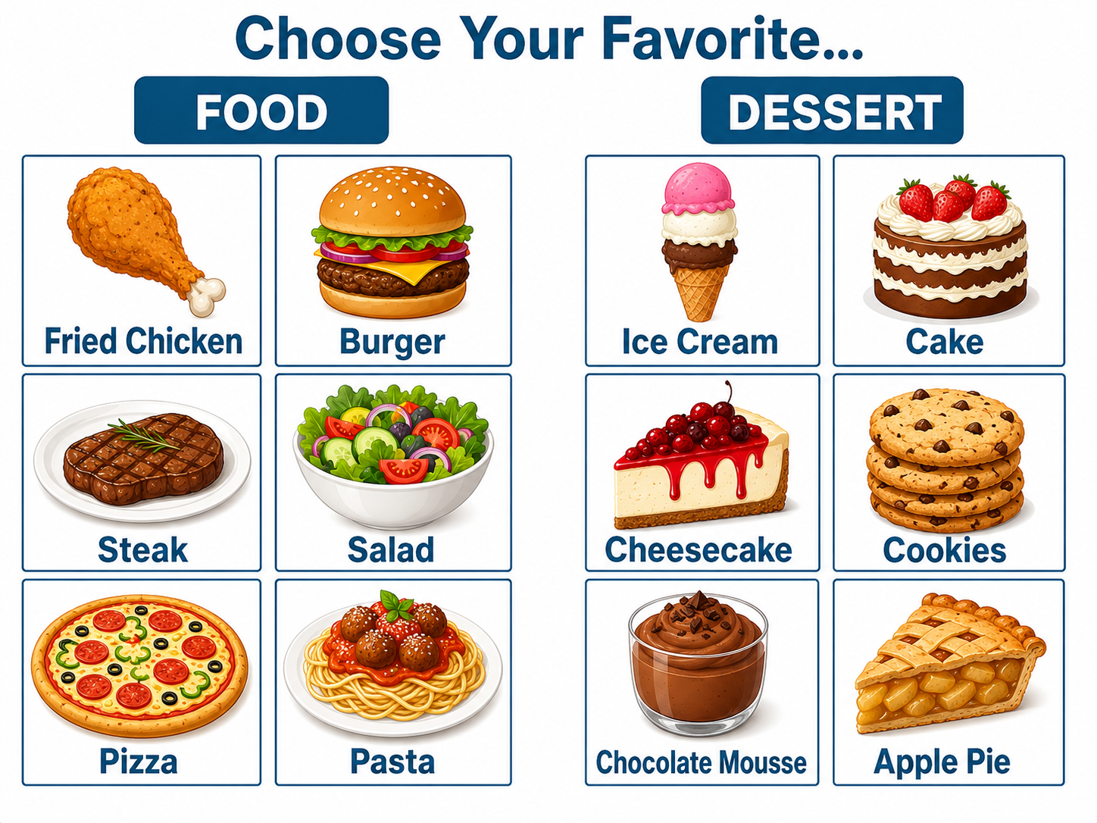

Slide 12
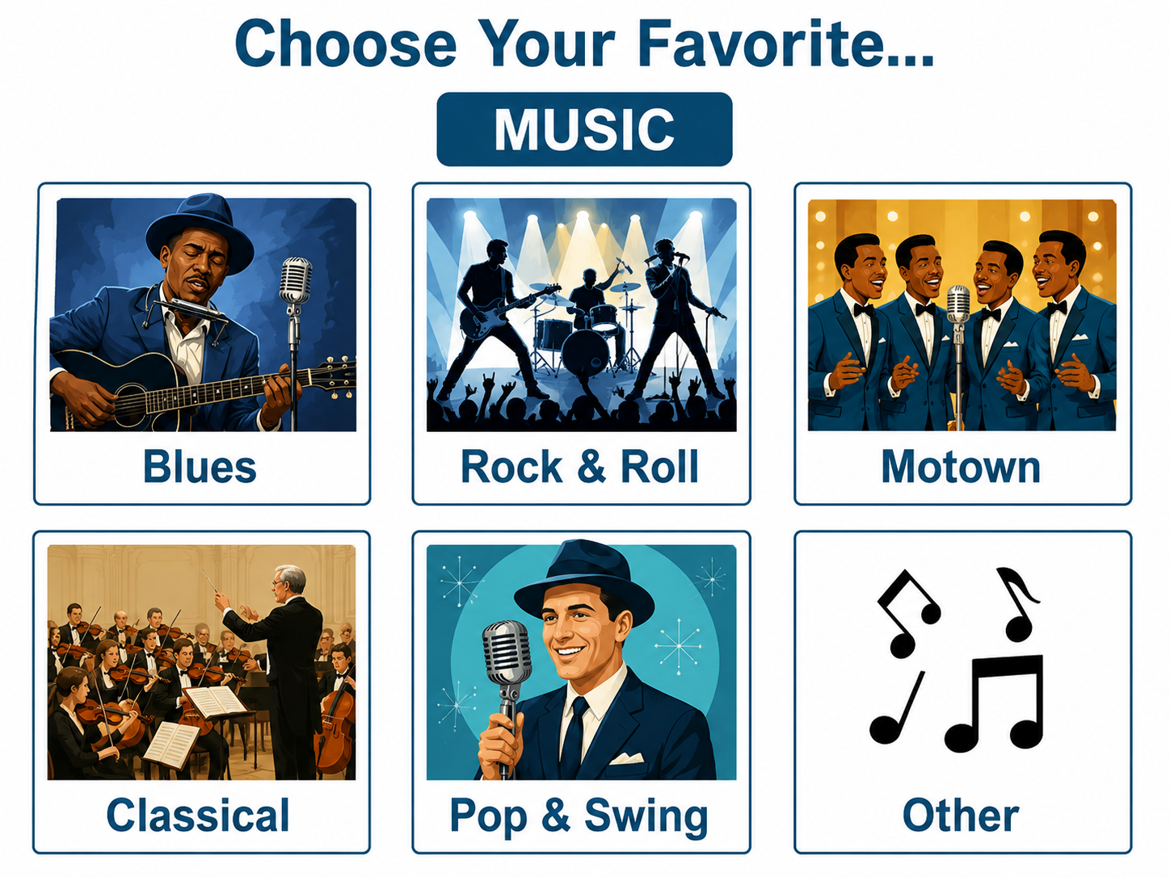

Slide 13


