Slide 1
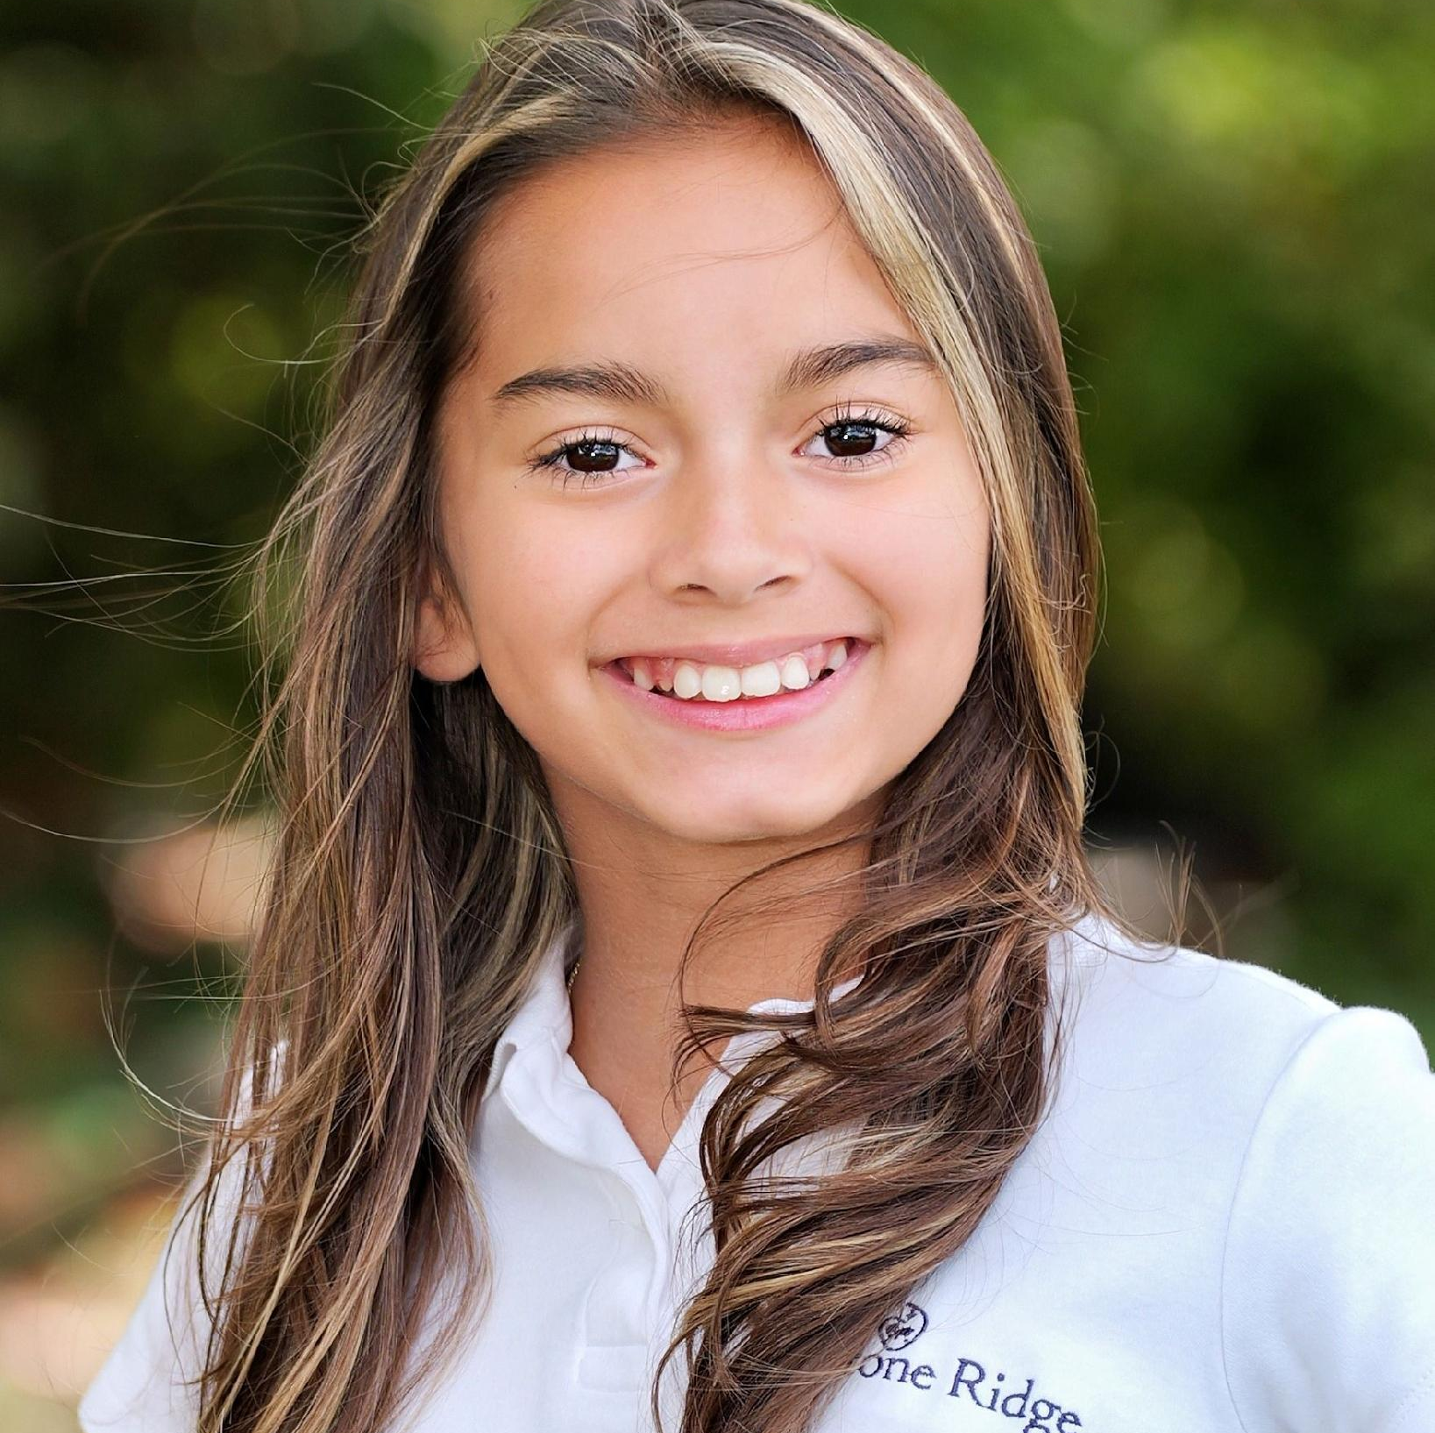





Hi there, I’m
Ana DeMola
Birthday: June 13
Zodiac Sign: Gemini
Age: 11
Favorite Color
Coffee or Tea
Pink
Coffee
Favorite Animal
Favorite Music
Dog & Hamster
Rock and Pop
Favorite Food
Favorite Season
Carbonara & Mussels
Summer
Favorite Dessert
Favorite Landscape
Chocolate Anything
Beach

Slide 2
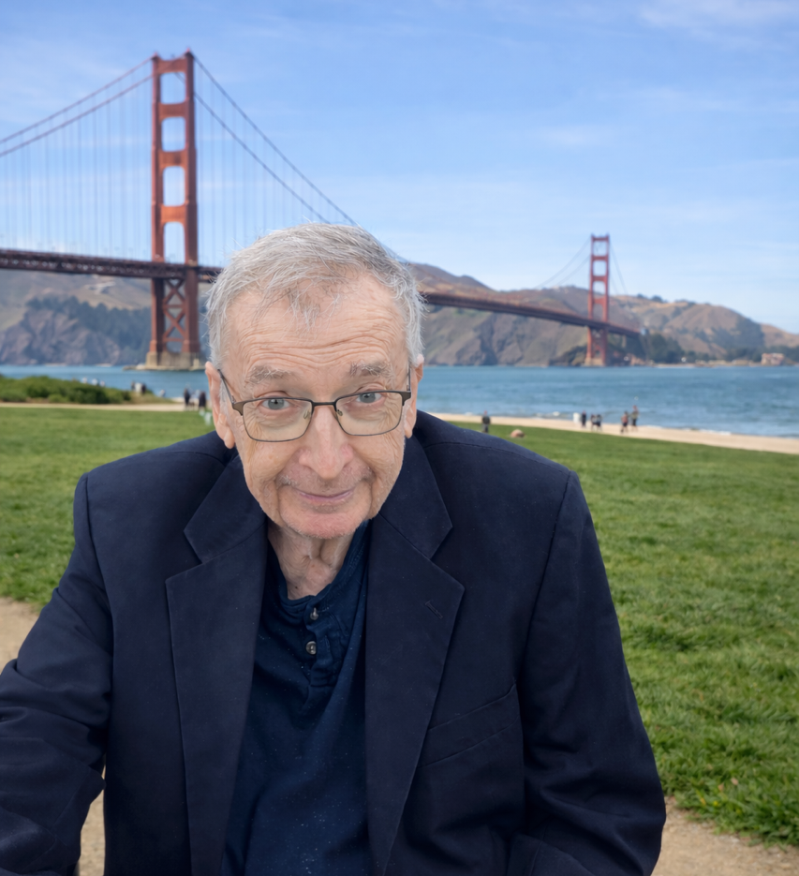
Hi there,
I’m Theodore
I spent a good amount of time in San Francisco
Favorite Color
Coffee or Tea
Blue
Coffee
Favorite Animal
Favorite Music
Dog
Rock and Roll
Favorite Food
Favorite Season
Though I don’t like cooking, I love a good Prime Rib!
Summer is my favorite season and I prefer to indoors during the winter
Favorite Dessert
Favorite Landscape
Cookies
I enjoy the San Francisco climate

Slide 3
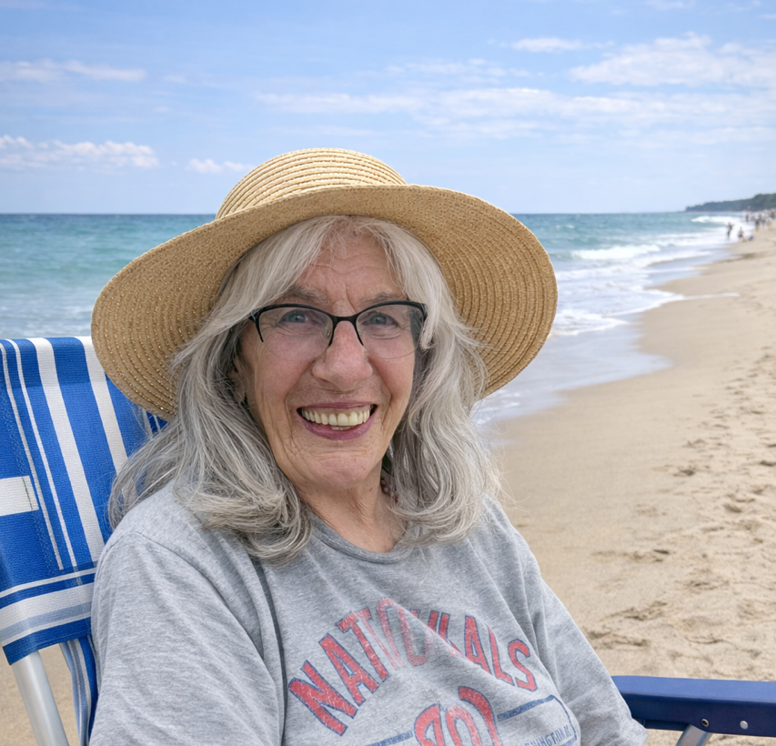
Hi there,
I’m Billie
I love country music and the beach on a hot summer day!
Favorite Color
Coffee or Tea
Purple
Coffee
Favorite Animal
Favorite Music
Dog
I enjoy country music
Favorite Food
Favorite Season
I’m not picky, I’ll eat anything!
Summer
Favorite Dessert
Favorite Landscape
Chocolate cake
Beach

Slide 4
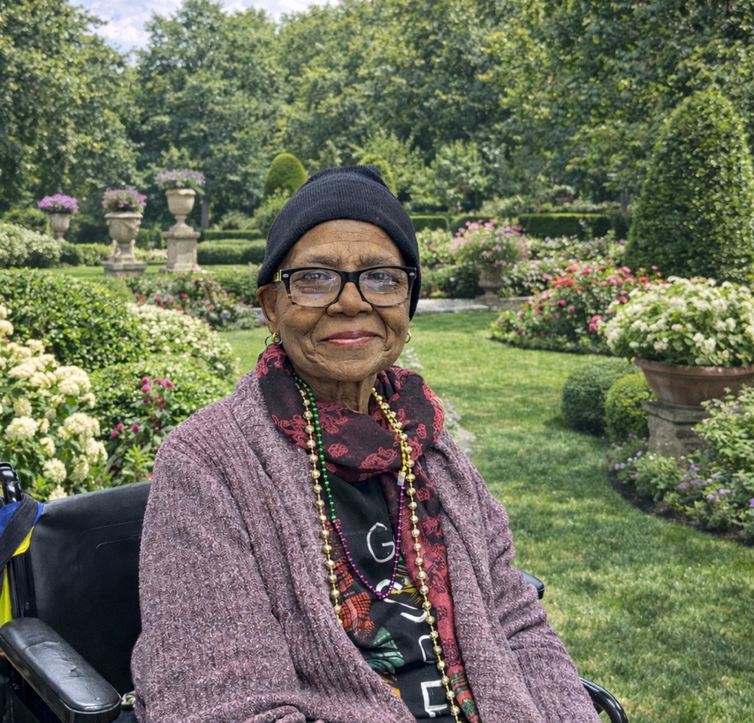
Hi there,
I’m Sharlene
My pup’s name was Zinx. I also love to dance and enjoy Gospel music.
Favorite Color
Coffee or Tea
Yellow
Tea. I enjoy Oolong tea all day!
Favorite Animal
Favorite Music
Dog
I enjoy Gospel music, it is very calming
Favorite Food
Favorite Season
I enjoy eating and cooking chicken
Summer
Favorite Dessert
Favorite Landscape
Cheesecake with strawberry topping. I also prefer vanilla to chocolate
I enjoy the peacefulness of being at home

