Slide 1
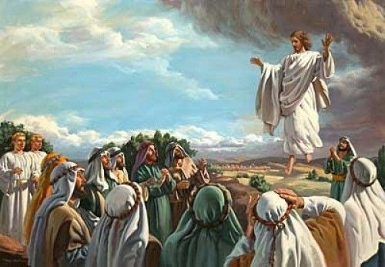
Friends of
Jesus and Mary
Solemnity of the Ascension
Matthew 28, 16-20
www.fcpeace.org

Slide 2
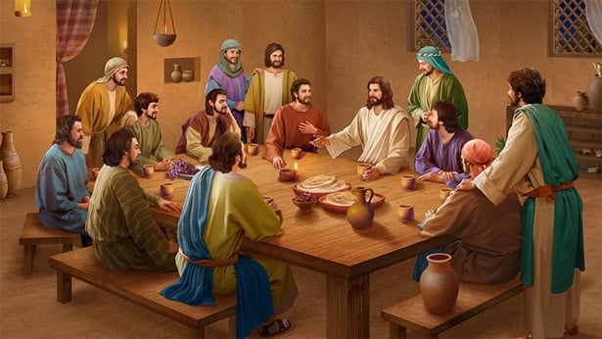
First Reading:
(Acts of the Apostles 1:1-11)
While meeting with them, he enjoined them not to depart from Jerusalem, but to wait for “the promise of the Father about which you have heard me speak; for John baptized with water, but in a few days, you will be baptized with the Holy Spirit.”
(Acts 1:4-5)

Slide 3
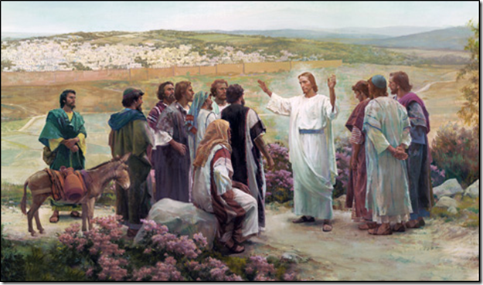
Gospel according to Matthew 28, 16-20
The eleven disciples went to Galilee, to the mountain to which Jesus had ordered them. When they saw him, they worshiped, but they doubted. Then Jesus approached and said to them, “All power in heaven and on earth has been given to me. Go, therefore, and make disciples of all nations, baptizing them in the name of the Father, and of the Son, and of the Holy Spirit, teaching them to observe all that I have commanded you. And behold, I am with you always, until the end of the age.”

Slide 4
Gospel according to Matthew 28, 16-20
And behold, I am with you always, until the end of the age.”

Slide 5
REFLECTION

Slide 6
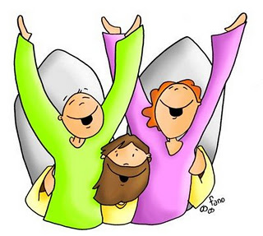
Jesus wants all the world to hear what God did for them, so He sends His Friends to preach the Gospel to everyone. What does Gospel mean?
The
Good News

Slide 7
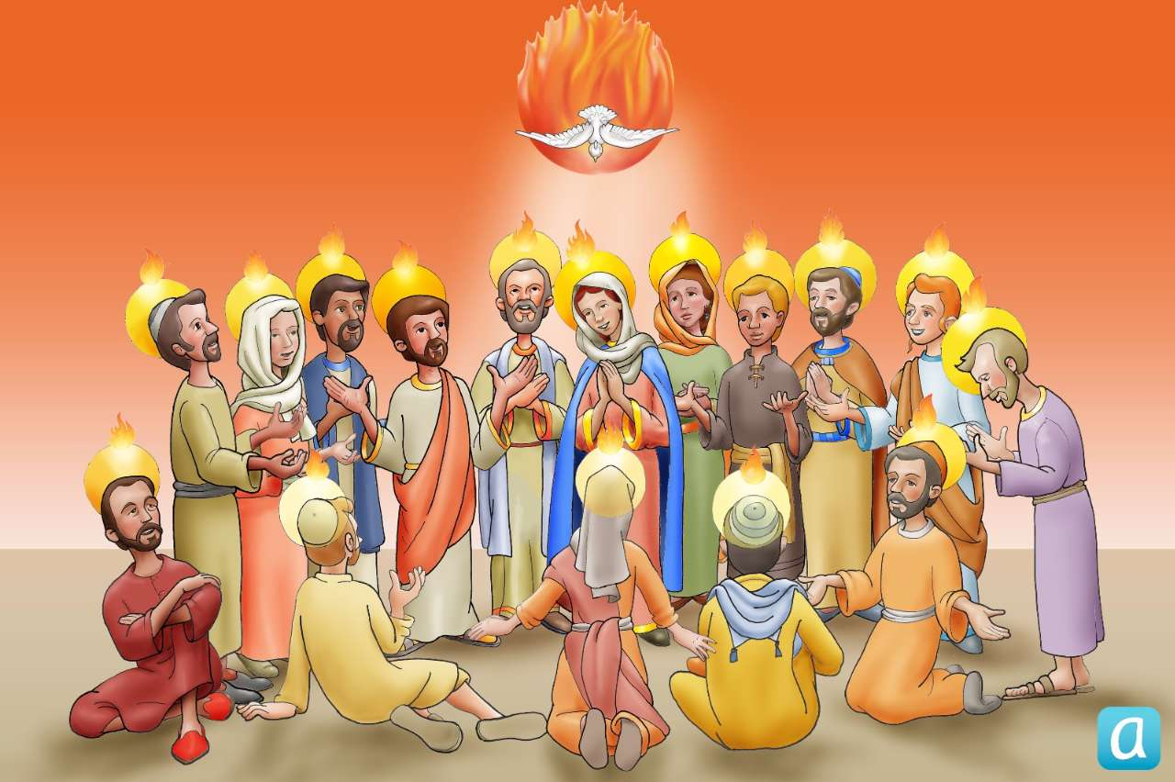
Jesus wants them to wait for the coming of the Holy Spirit. Why?
Jesus knows they will need the help of the Holy Spirit to proclaim the Gospel to everyone.
Jesús sabe que necesitan su ayuda, a través del Espíritu Santo,
para proclamar el Evangelio.

Slide 8
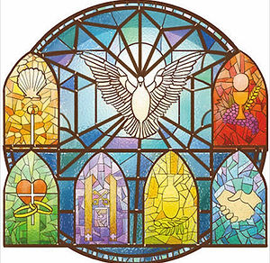

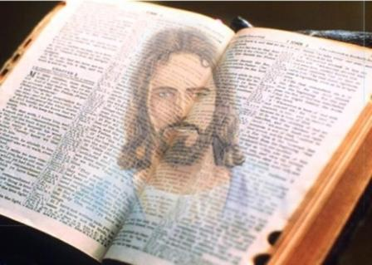
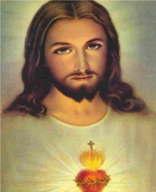

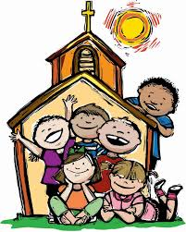
After Jesus ascended into Heaven, how did He remain with them as He had promised?
In the Scriptures
Through the Holy Spirit in the Sacraments
In the Eucharist, His Body and Blood
In the Community of Believers
In our Hearts when we invite Him

Slide 9
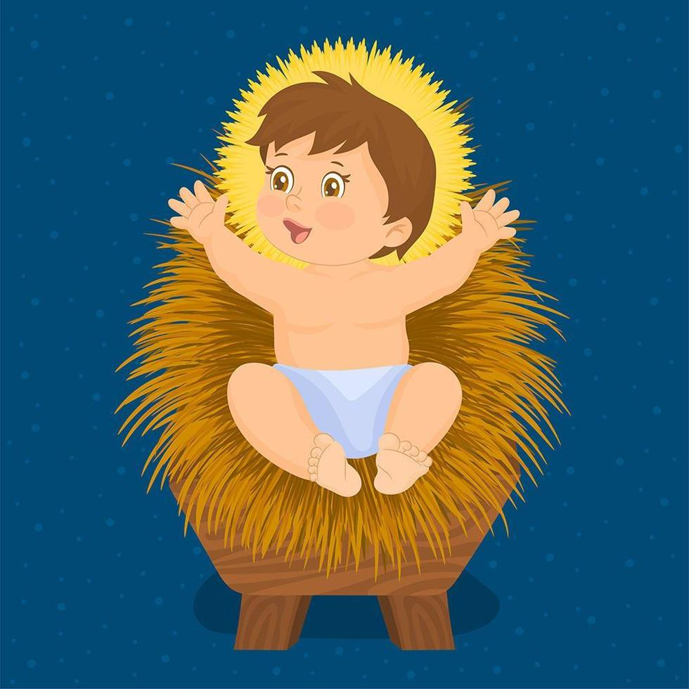
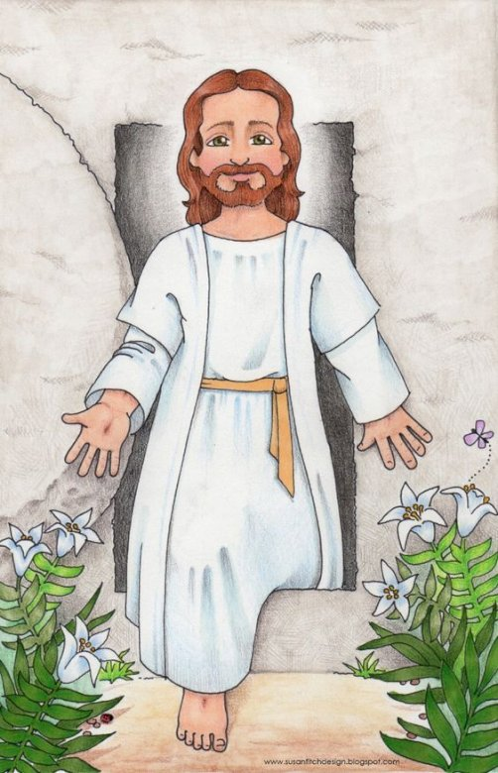
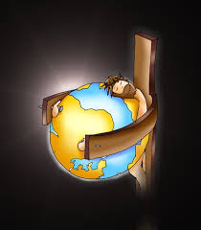
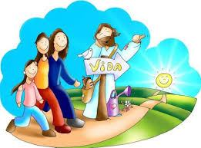
What is the Good News that Jesus wants the world to know?
He resurrected victorious over death.
For Love of Us, God became Man.
…to die on the cross for us so our sins could be forgiven.
And opened the gates of Heaven for those who follow Jesus.

Slide 10
How Will you help Jesus to spread the Good News?
JESUS LOVES US!
Share.

Slide 11
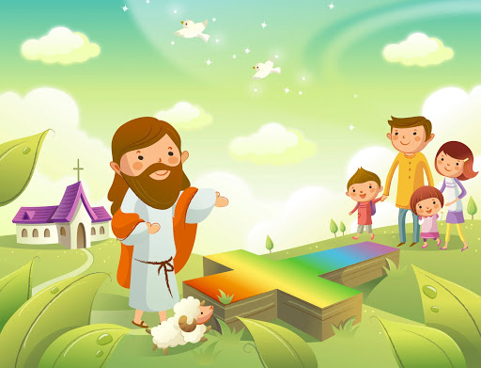
PRAYER
Lord, you send us to announce God’s love for all, and the salvation that comes from you. You promised to stay with us to help us. Give us your light and wisdom to recognize each moment of the day when we can be your witness through our actions of honesty, justice, love and service to all.
Amen.

Slide 12

Activity

Slide 13
Put the Gospel story in the correct order.
He resurrected victorious over death.
And opened the gates of Heaven for those who follow Jesus.
For Love of Us, God became Man.
2……to die on the cross for us so our sins could be forgiven.

Slide 14
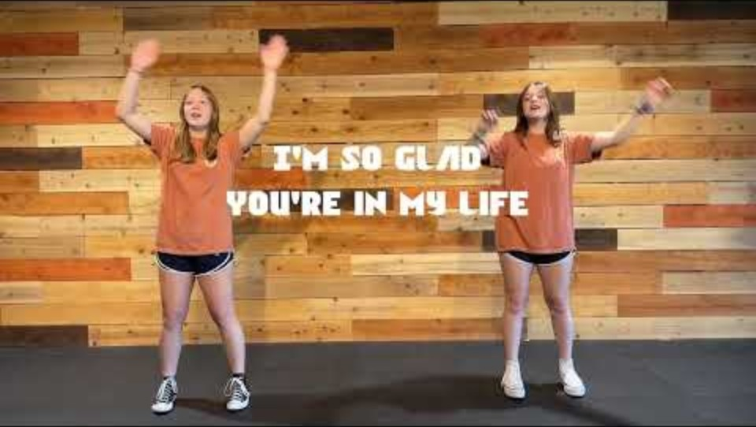
Lord, I Lift Your Name on High, Worship Motions (Ctrl Click) https://youtu.be/1XbscBPPt2I?si=cjM1f0pkb-TlfuFY

