Slide 1
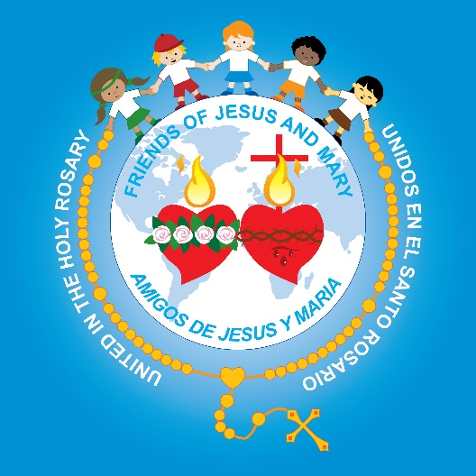
Friends of Jesus and Mary
Cycle B-I Sunday in Ordinary Time
The Baptism of Jesus - Mark 1, 7-11

Slide 2
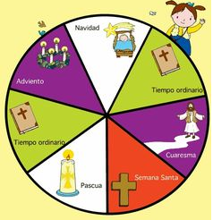
We Begin Ordinary Time.
During Ordinary Time, Jesus teaches us about God’s love and how we should love.

Slide 3
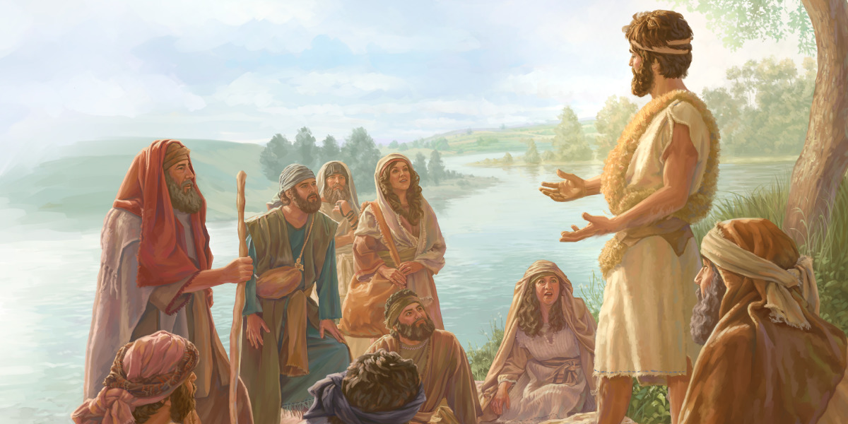
This is what John the Baptist proclaimed: "One mightier than I is coming after me. I am not worthy to stoop and loosen the thongs of his sandals.

Slide 4
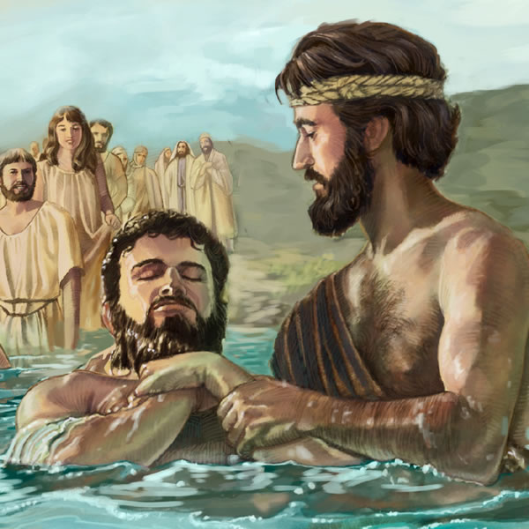
I have baptized you with water;
he will baptize you with the Holy Spirit."

Slide 5
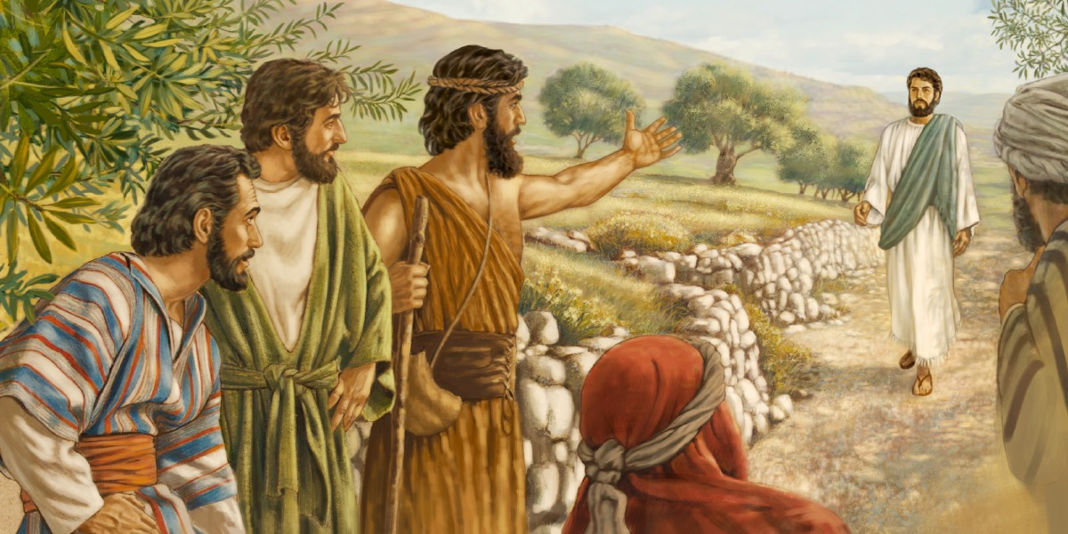
It happened in those days that Jesus came from Nazareth of Galilee and was baptized in the Jordan by John.

Slide 6
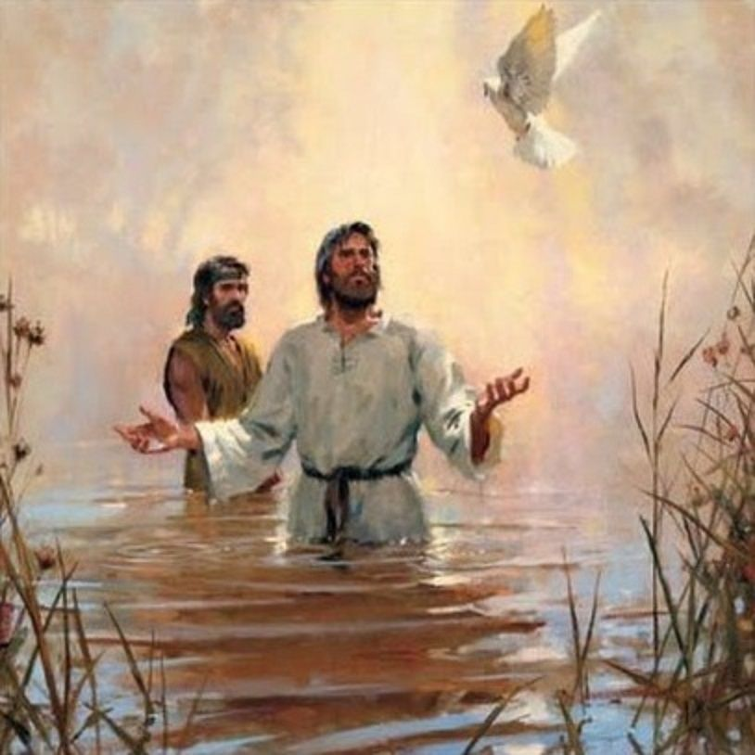
On coming up out of the water he saw the heavens being torn open and the Spirit, like a dove, descending upon him.
And a voice came from the heavens, "You are my beloved Son; with you I am well pleased."
The Gospel of the Lord
Praise to you, Lord Jesus Christ.

Slide 7
John the Baptist proclaimed his baptism was only with water.
What did he mean?

Slide 8
…John’s baptism is only symbolic of conversion.
It has no power!

Slide 9
He says another will come who will baptize with the Holy Spirit. How do we see Jesus’ power in this Gospel?
The heavens opened and the Spirit, like a dove, descended upon him.
And a voice came from the heavens, "You are my beloved Son; with you I am well pleased."

Slide 10
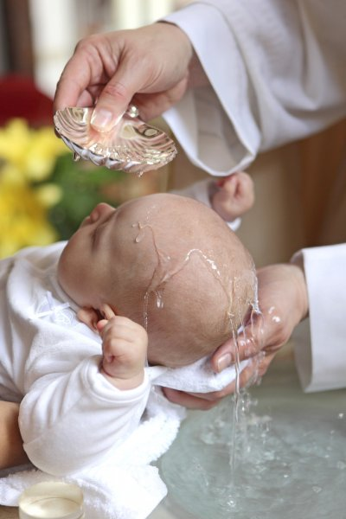
What happens to us when we receive the Sacrament of Baptism?

Slide 11
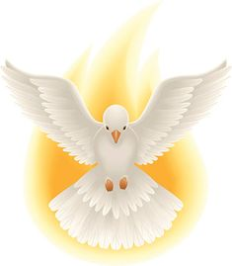
God erases the stain of Original Sin, the sin of Adam and Eve, and we receive the Holy Spirit, God himself, in our heart.

Slide 12
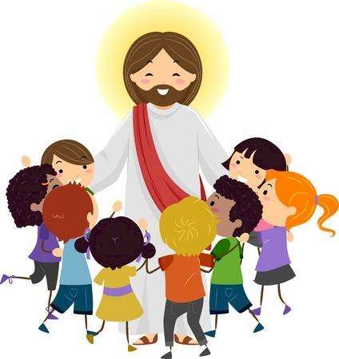
We enter into God’s family.

Slide 13
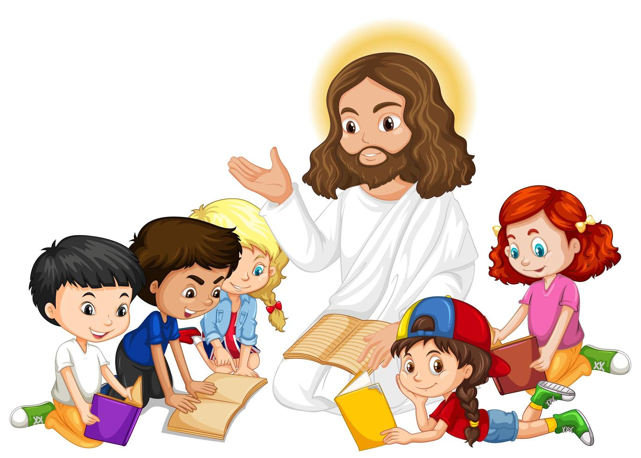
And we share in the mission of Jesus for the world.

Slide 14
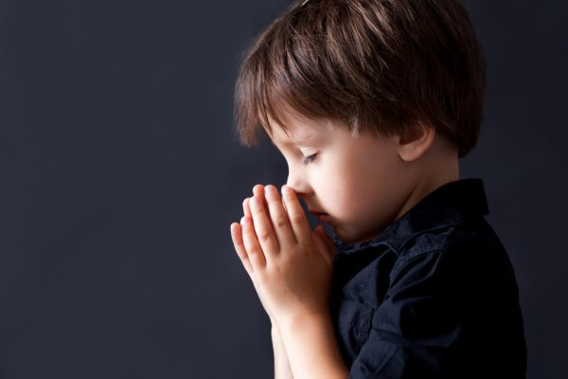
What is Jesus’ mission and our mission?
To listen to, to obey, and to love God.
To take God’s love to everyone so they too may know and love God.

Slide 15
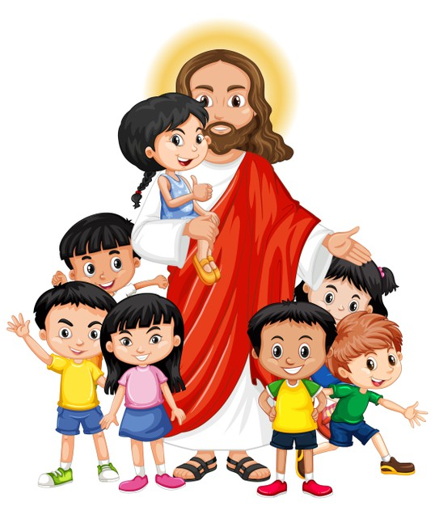
The Church gives us 7 Sacraments so we may be closer to God. In the Sacraments, God becomes present and acts in our life. He gives us His Grace, which is participation in His life.

Slide 16
The Sacraments use symbols to represent the action of God which we cannot see.

Slide 17
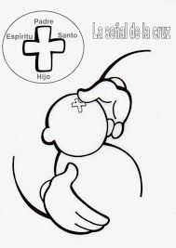
SYMBOLS OF THE SACRAMENT OF BAPTISM
THE BAPTISMAL WATER
In nature, water not only cleans, but most importantly gives life.
It symbolizes the purification of sin and, by the power of the Holy Spirit, gives us new life, the life of Grace, God’s life.
THE SIGN OF THE CROSS
The celebrant traces a cross on the forehead of the kids and invites the parents and godparents to do the same. This cross is like the mark of Jesus; the sign that from that moment on, they belong to Him.
THE CHRISM OIL
God sends His Holy Spirit to help us combat sin.

Slide 18
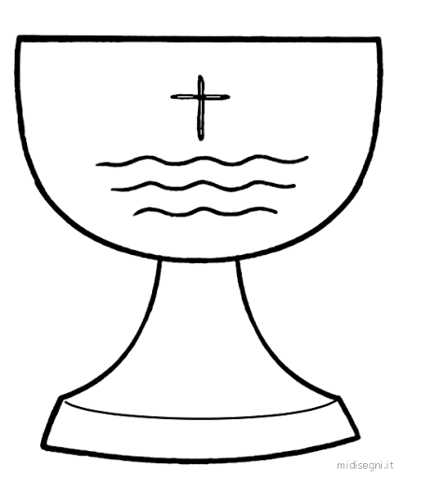
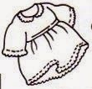
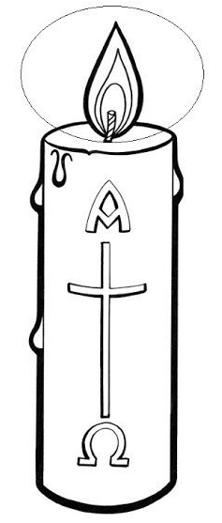
SYMBOLS OF THE SACRAMENT OF BAPTISM
THE BAPTISMAL FONT - It contains the water used to baptize.
THE WHITE GARMENTS- The baptized is purified and is “dressed of Jesus”.
THE CANDLE – Jesus illuminates the baptized who then becomes light for others.

Slide 19
Actividad

Slide 20
What are the symbols and what do they represent?
The sign of the cross symbolizes we belong to Jesus.
The oil symbolizes we receive the Holy Spirit.
The water symbolizes we are purified from sin and receive new life in Jesus.
The white garments symbolize we are cleansed and “dressed of Jesus”.
The candle symbolizes the light of Jesus which shines in us.

Slide 21
Instructions:
Color; write the year we are in (the 4 numbers in each corner of the cross); cut and glue around an empty roll of toilet paper.
THE PASCHAL CANDLE
Symbolizes the Resurrected Christ.
The cross reminds us of His death.
The Greek letters Alfa and Omega, (beginning and end) and the current year, show Jesus is Lord of all time.
The Baptism candle is lit from this candle symbolizing we receive the light of Christ at Baptism.

Slide 22
Prayer Lord Jesus, you came to make us a part of your family. You freed us from sin and death. Help us to take your message of love to everyone. Amen. Song He is the light, Lifetree Kids https://youtu.be/fzoOmdZxrx8

