Slide 1
The Holy Rosary-Joyful Mysteries

Slide 2
Yancy, Holy Spirit Come, https://youtu.be/6f1zaNUMoy4 Open the Eyes of my Heart Lord, https://youtu.be/r_2xLdgkNKs
PRAYERS TO THE HOLY SPIRIT
(Choose One)
Come Holy Spirit – Catholic Youth Parramatta, https://youtu.be/FqvWfRIwcVU

Slide 3
We thank you Lord for:

Slide 4
We Praise You. Lord you are:

Slide 5
Lord, we are sorry for:

Slide 6
Lord, we ask you for:

Slide 7
Dear Jesus, Mary, Joseph:
I pray for (name) who I have spiritually adopted during the 9 months of my school year, that he/she will be born to live a life as a child of God. Amen.

Slide 8
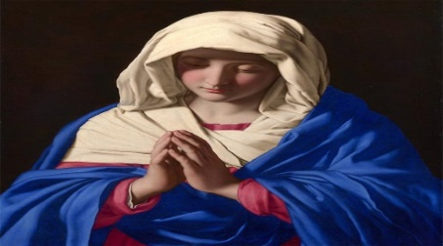
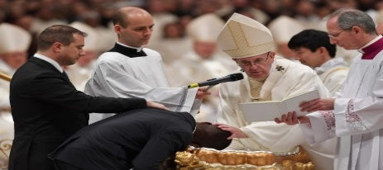
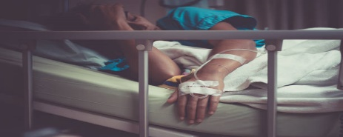
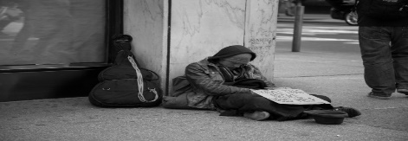
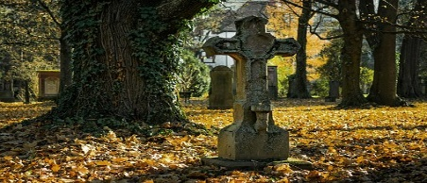
INTENTIONS
For the intentions of Our Blessed Mother,
For our Holy Catholic Church, for Pope Francis, our priests and religious.
For our country’s leaders, that they may promote life, peace, and justice for all,
For the elderly, and the sick, and those caring for them,
For the homeless, the poor, and all those struggling financially,
For all the children and youth, especially the abandoned, abused, and at-risk unborn,
For healing for our family and friends and all those that have asked for prayer,
For the souls in Purgatory and for those who do not know or have rejected the love of Christ. Amen.

Slide 9
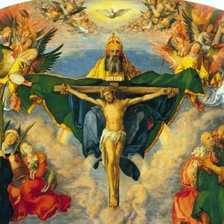
In the name of the Father and of the Son and of the Holy Spirit. Amen.

Slide 10
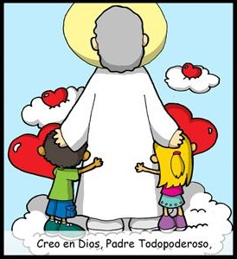
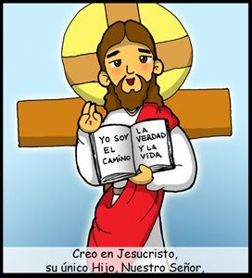
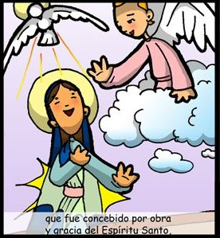
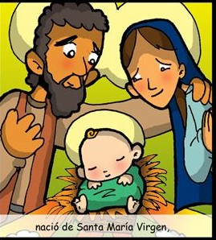
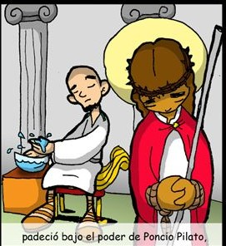
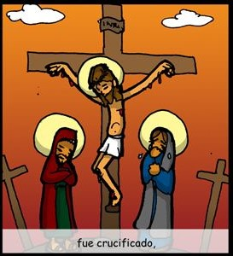
THE
CREED
I believe in one God, the Father Almighty,
Creator of Heaven and Earth,
and in Jesus Christ,
His only Son, Our Lord,
who was conceived
by the Holy Spirit,
born of the Virgin Mary,
suffered under Pontius Pilate,
Was crucified,

Slide 11
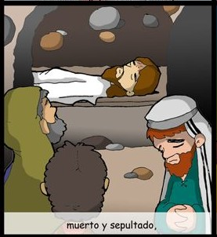
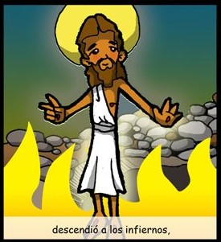
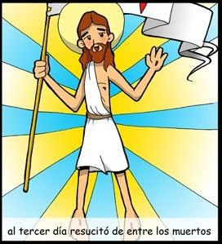
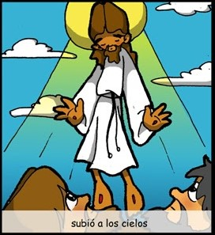
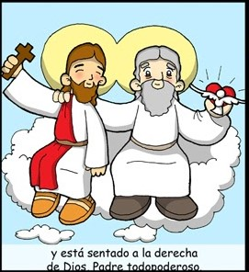
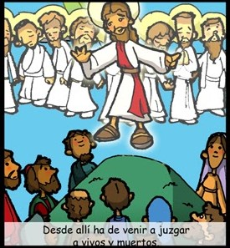
died and was buried.
He descended into Hell,
On the 3rd day He rose from the dead,
ascended into Heaven,
And is seated at the
right hand of the Father.
From thence He shall come
to judge the living and the dead.
I believe in the Holy Spirit,
the Holy Catholic Church,

Slide 12
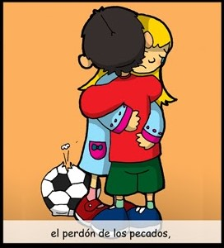
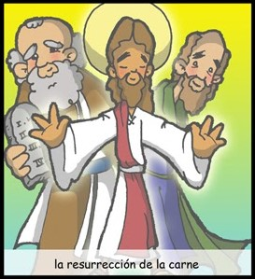
the communion of Saints,
The forgiveness of sins,
the resurrection of the body,
and life everlasting.
AMEN

Slide 13
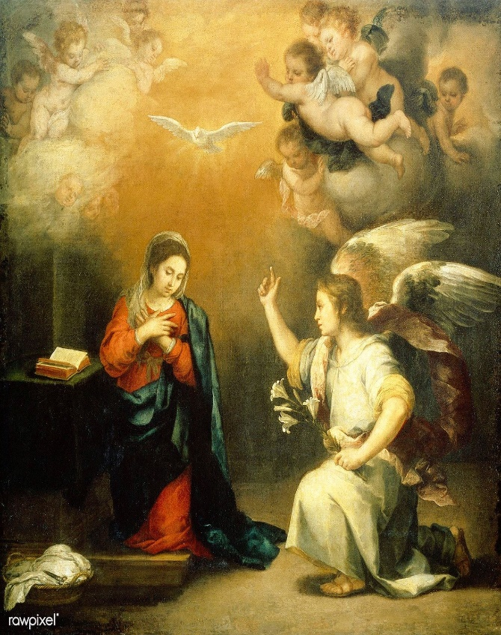
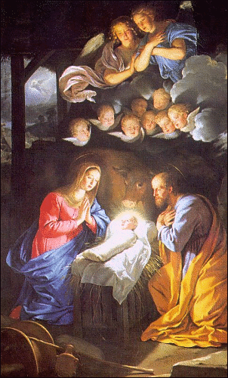
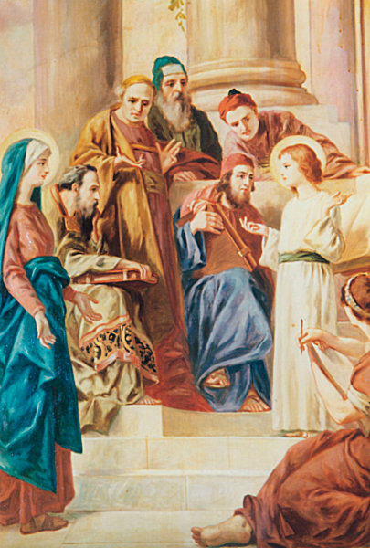
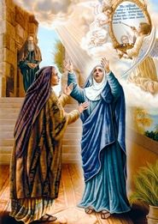
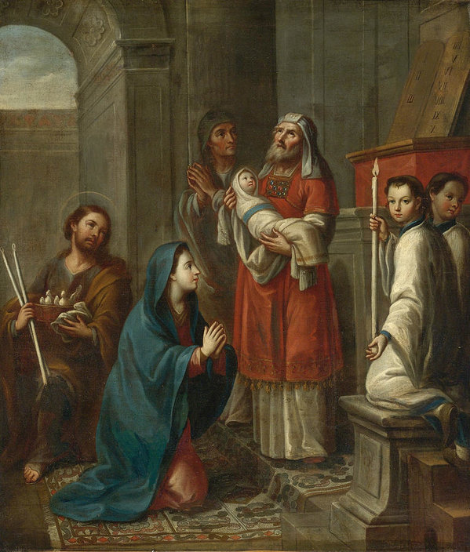
The Joyful Mysteries
1-The Annunciation:
The Angel Gabriel Announces God’s Plan
3-The Nativity:
Jesus is Born
5-Jesus Lost and Found at the Temple
2-The Visitation:
Mary Visits Elizabeth
4-The Presentation at the Temple
Fruit of the Mystery
Humility
Fruit of the Mystery
Poverty of Spirit
Fruit of the Mystery
Piety
Fruit of the Mystery
Love of Neighbor
Fruit of the Mystery
Obedience

Slide 14
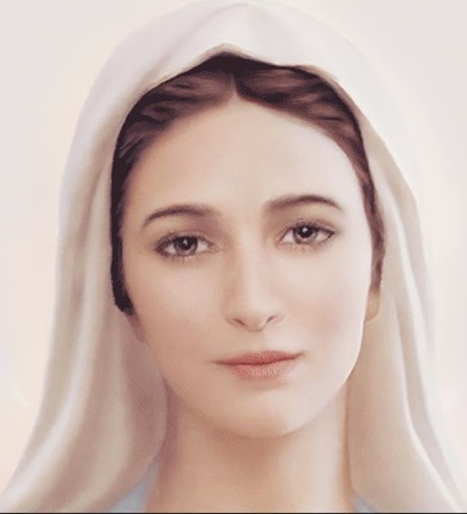
Our Father, who are in heaven, holy is your name. Your Kingdom come.
Your will be done, on earth as it is in Heaven. Give us this day our daily bread. And forgive us our trespasses, as we forgive those who trespass against us. And lead us not into temptation, but deliver us from evil. Amen.
Hail Mary, full of grace, the Lord is with you: blessed are you among women, and blessed is the fruit of your womb, Jesus. Holy Mary, Mother of God,
pray for us sinners, now and at the hour of our death. Amen.
Glory be to the Father, and to the Son, and to the Holy Spirit, as it was
in the beginning, is now, and ever shall be, world without end. Amen

Slide 15
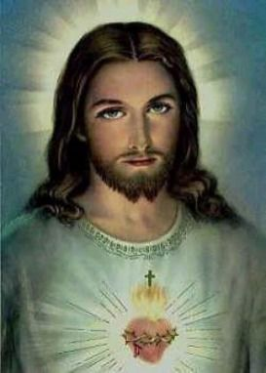
Oh my Jesus, Forgive us our sins. Save us from the fires of Hell. Lead all souls to Heaven, especially those in most need of your Mercy. Amen.

Slide 16
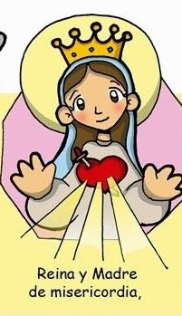
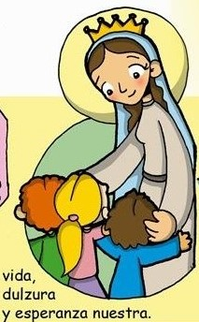
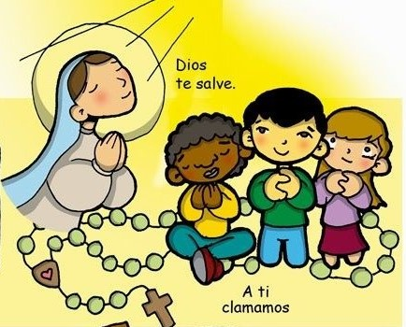
Hail Holy Queen
Hail Holy Queen
Mother of Mercy
our
Life our
sweetness
To thee do we cry
and our hope.
Poor banished children of Eve
To thee do we
send up our sighs
mourning and weeping
Turn then most gracious advocate
in this valley of tears.

Slide 17
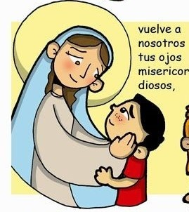
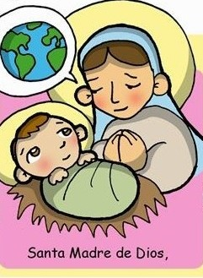
Thine eyes of mercy toward us
Oh clement, Oh loving
Oh sweet Virgin
Mary
And after this our exile
Show
unto us
The blessed fruit
of thy womb, Jesus
Pray for
us
That we may be made worthy
Of the promises of Christ,
Oh Holy Mother of God
Amen

Slide 18
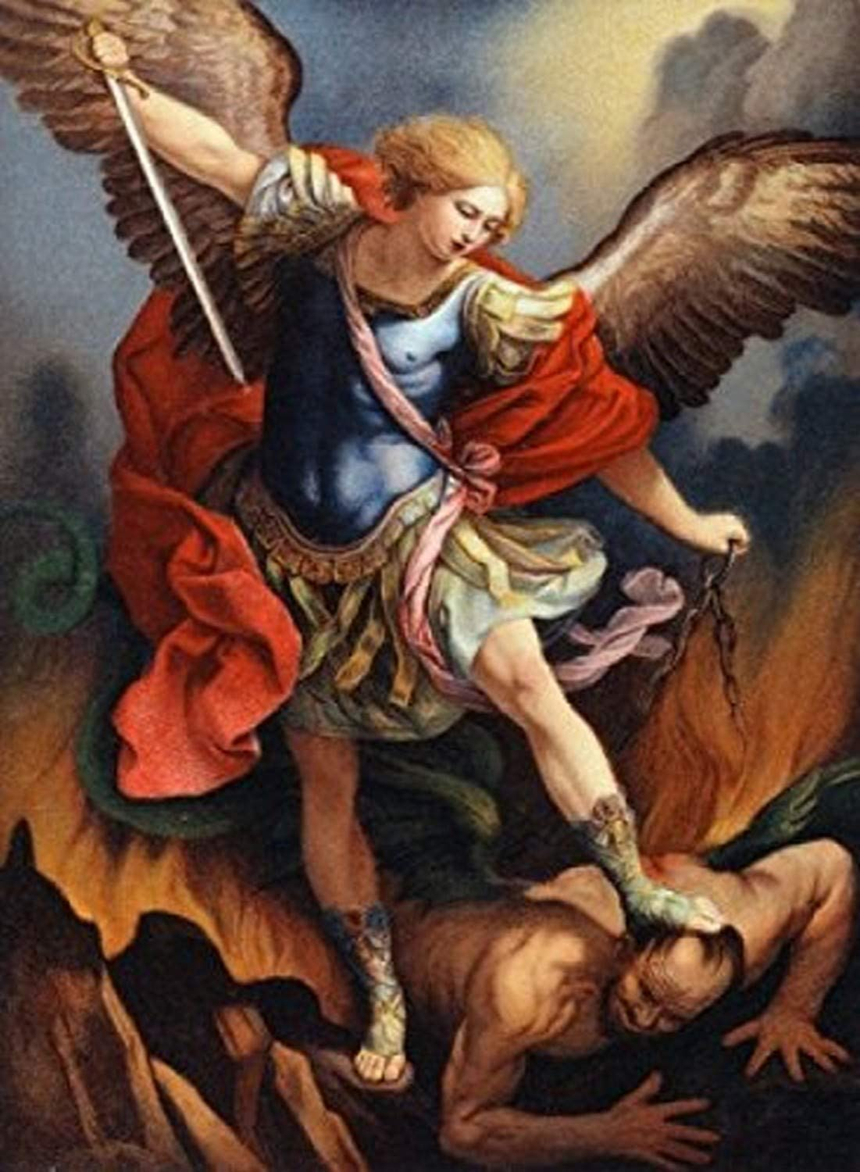
St. Michael the Archangel, defend us in battle. Be our protection against the wickedness and snares of the Devil. May God rebuke him, we humbly pray, and do thou, O Prince of the heavenly hosts, by the power of God, thrust into hell Satan, and all the evil spirits, who prowl about the world seeking the ruin of souls. Amen

Slide 19
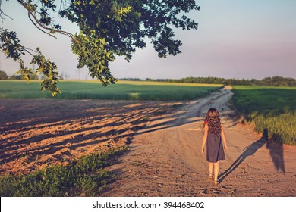
Angel of God, my guardian dear, to whom God's love commits me here. Ever this day be at my side, to light, to guard, to rule, to guide. Amen

Slide 20
In the name of the Father and of the Son and of the Holy Spirit. Amen.

Slide 21
Put the Joyful Mysteries in Order
1-The Annunciation:
The Angel Gabriel Announces God’s Plan
4-The Presentation at the Temple
2-The Visitation:
Mary Visits Elizabeth
5-Jesus Lost and Found at the Temple
3-The Nativity:
Jesus is Born

