Slide 1
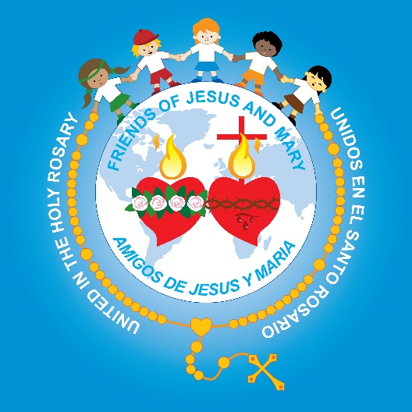
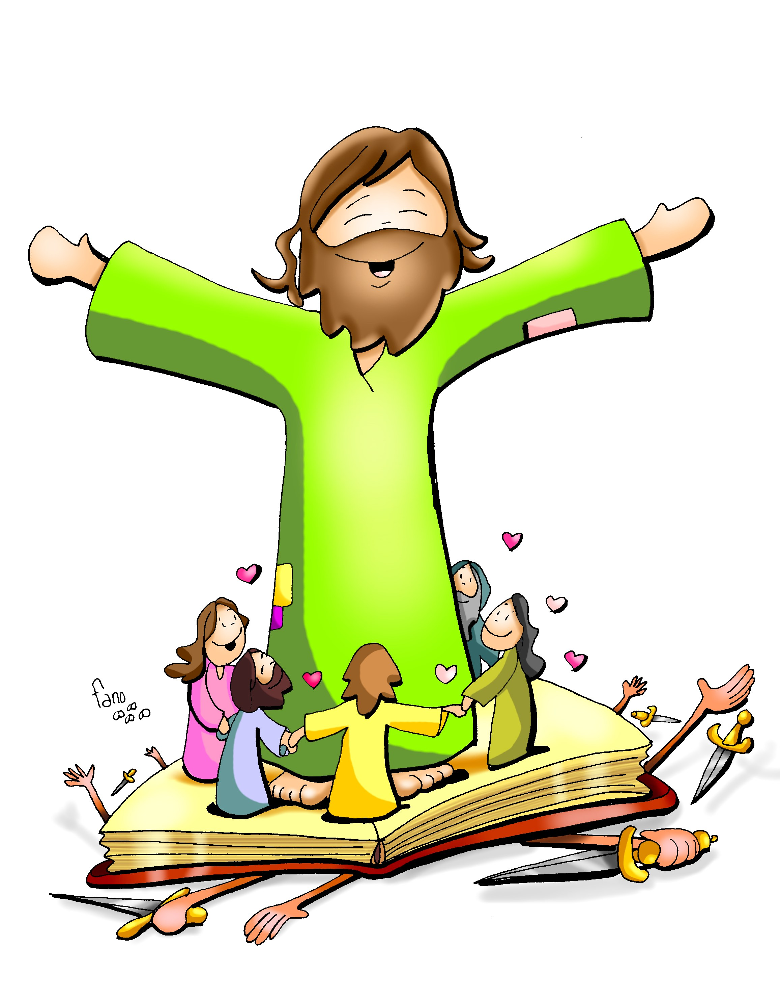
Ministry
Friends of Jesus and Mary
Prayer Group for Children
Cycle B-XXVI Sunday in Ordinary Time
Mark 9, 38-43.45.47-48
Whoever is not against us is for us.
www.fcpeace.org

Slide 2
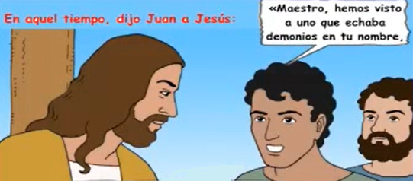
At that time, John said to Jesus,
Teacher, we saw someone driving out demons in your name,
and we tried to prevent him because he does not follow us.

Slide 3
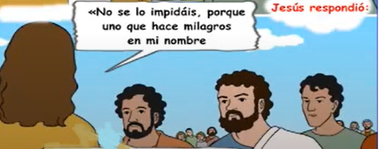
Do not prevent him. There is no one who performs a mighty deed in my name…
Jesus responded:
…who can at the same time speak ill of me. For whoever is not against us is for us.

Slide 4
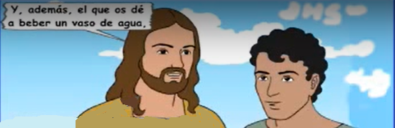
Anyone who gives you a cup of water to drink…
… because you belong to Christ, amen, I say to you, will surely not lose his reward.

Slide 5
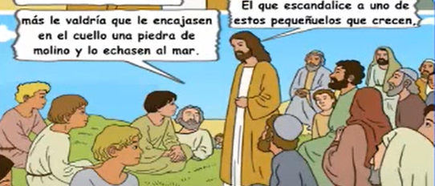
…it would be better for him if a great millstone were put around his neck and he were thrown into the sea.
Whoever causes one of these little ones who believe in me to sin,

Slide 6
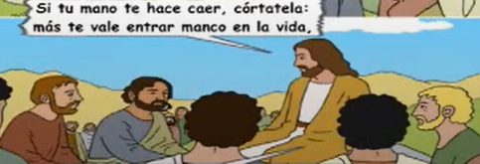
If your hand causes you to sin, cut it off.
It is better for you to enter into life maimed than with two hands to go into Gehenna, into the unquenchable fire.

Slide 7
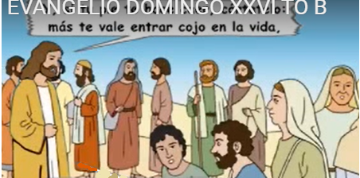
And if your foot causes you to sin, cut if off.
… It is better for you to enter into life crippled than with two feet to be thrown into Gehenna.

Slide 8
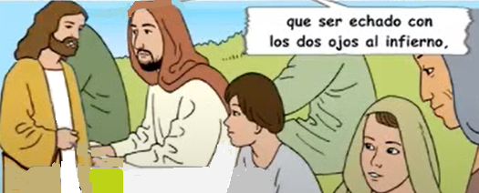
And if your eye causes you to sin, pluck it out.
Better for you to enter into the kingdom of God with one eye than with two eyes to be thrown into Gehenna,
… where their worm does not die, and the fire is not quenched.
The Gospel of the Lord. Praise to you Lord Jesus Christ.

Slide 9
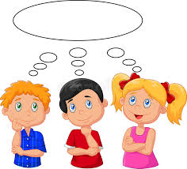
REFLECTION

Slide 10
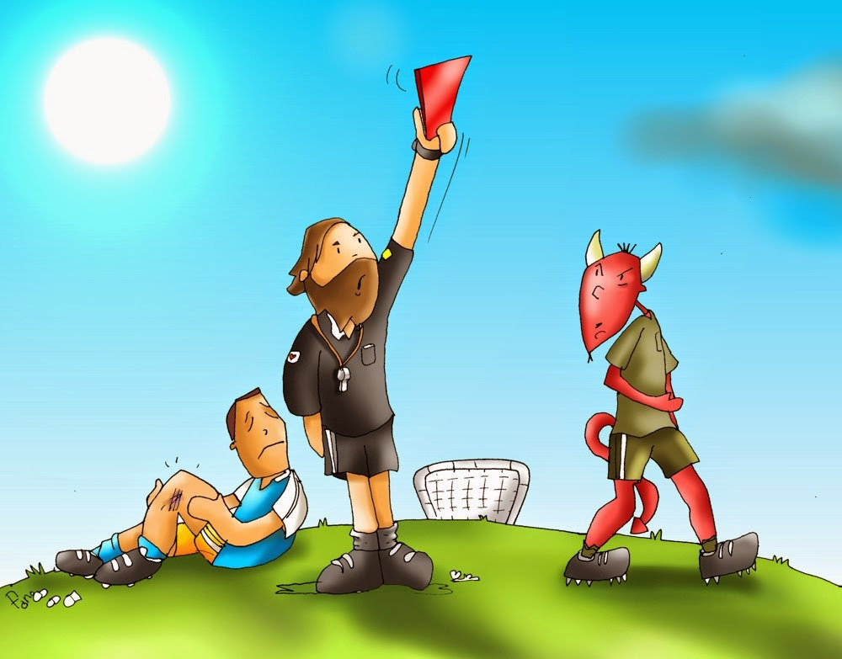
The apostles saw someone doing something that bothered them and tried to stop them.
What was the person doing?
A man they did not know was driving out demons in Jesus’ name.
Was the man doing something wrong?

Slide 11
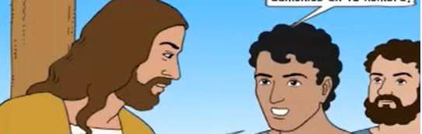
No, he was helping people with Jesus’ help.
Why did it bother them?

Slide 12
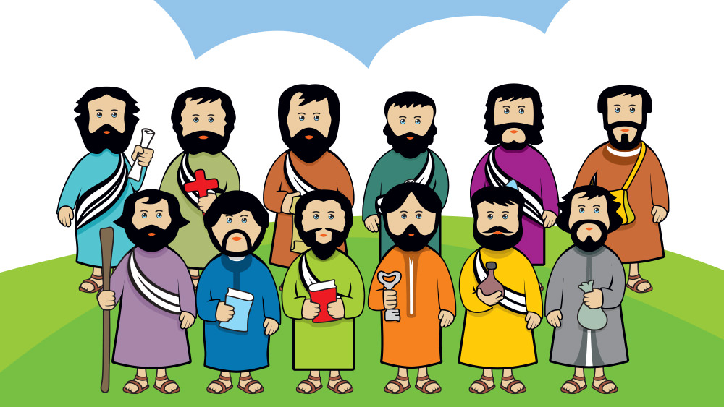
They felt that only they, that were with Jesus, should have the privilege of doing miracles in Jesus’ name.
What does Jesus think about this?

Slide 13
Do not prevent them; no one who does miracles in His name would speak badly of me.
Whoever is not against us, is with us.

Slide 14
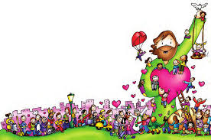
What does Jesus want to tell us?
We should appreciate those who help others in Jesus’ name, even if they are not part of our Church. We are all part of the same team.

Slide 15
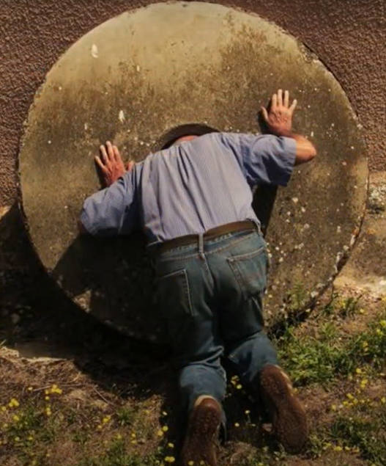
On the other hand, Jesus says that a person that causes one of His followers to sin, it would be better if what happened to them?
A great millstone were put around their neck and they were thrown into the sea.
Why?

Slide 16
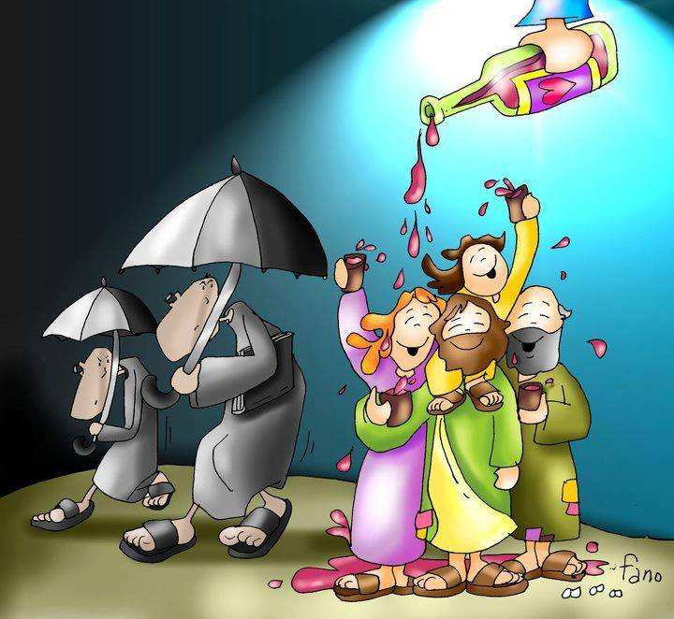
They would lose eternal life and instead would spend eternity in the place of punishment where there is much suffering.

Slide 17
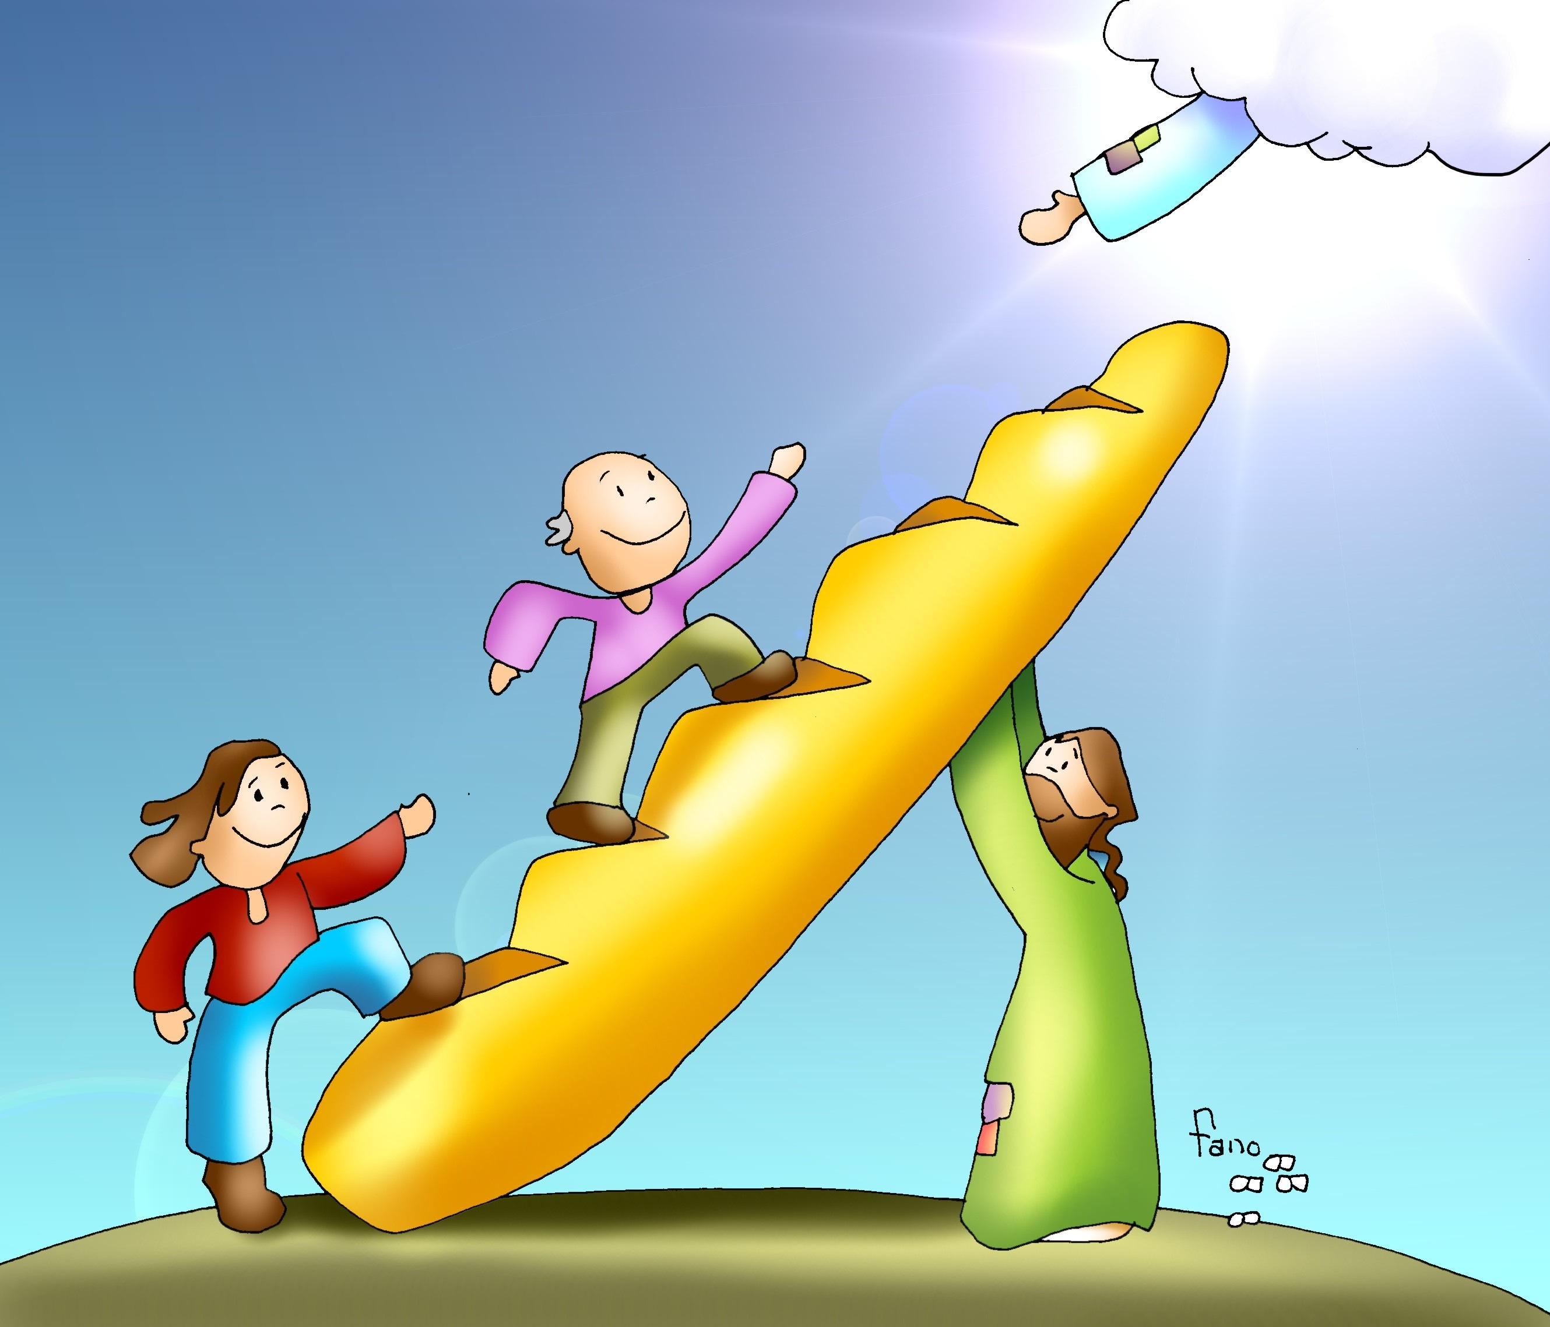
Jesus wants us to avoid SIN at all cost.
Because Jesus loves us and wants us to be saved and spend eternity in happiness with Him in Heaven.

Slide 18

Activity

Slide 19
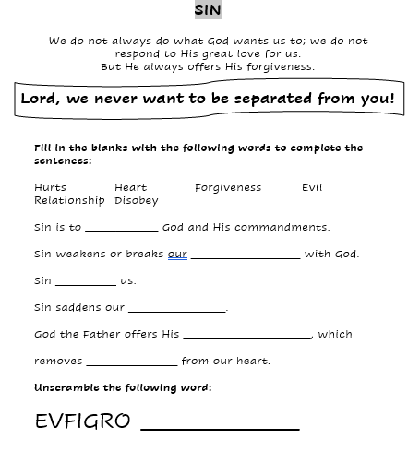
Disobey
Relationship
Hurts
Heart
Forgiveness
Evil
F O R G I V E

Slide 20
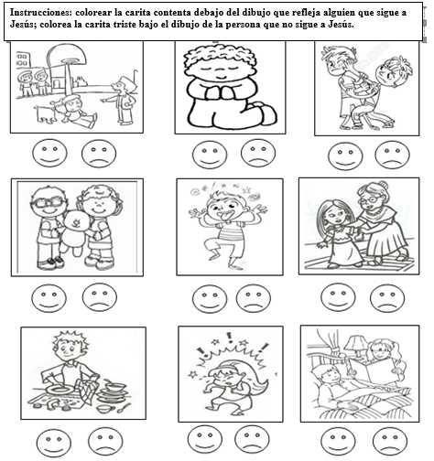









Instructions: Color the Happy Face if the picture shows someone who follows Jesus. Color the Sad face if the picture shows someone who does not follow Jesus.

Slide 21
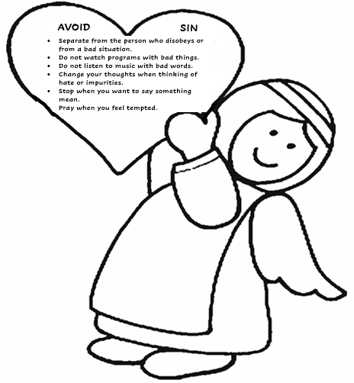

Slide 22
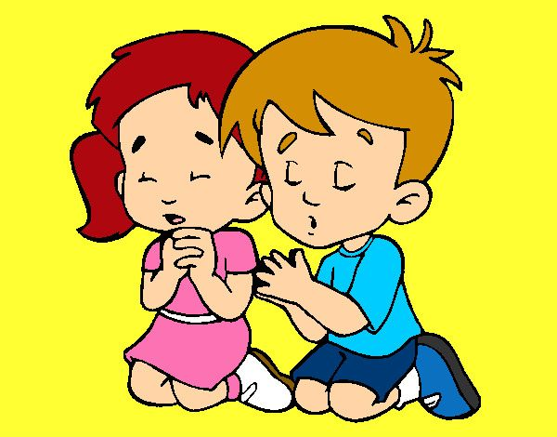
Lord, you call us to follow you always, joining our efforts to those of many others to help build a better world. Please don’t let us be separated from you ever.
Amen
Prayer

Slide 23
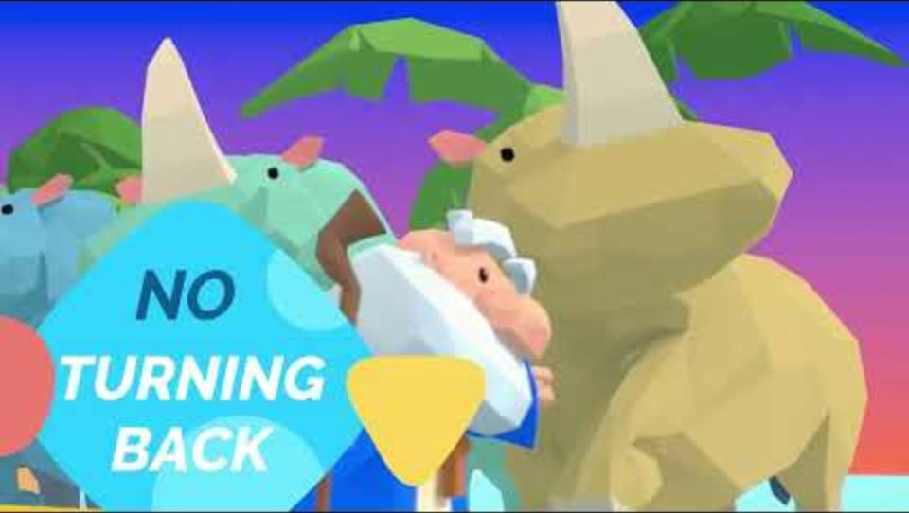
I have decided to follow Jesus, Lifetree kids https://youtu.be/sEL0WpeH088 (8+ yrs.)
Ma Col: https://youtu.be/KQ9f8sFh2vA?si=OvkKCMWG139VW6iv (3-7 yrs.)

