Slide 1
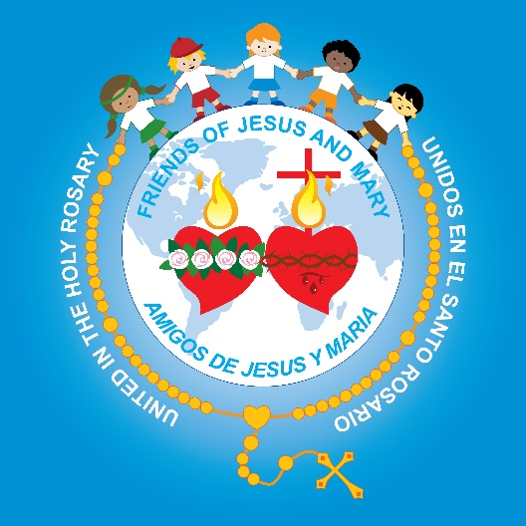
Friends of Jesus and Mary
Cycle B-IV Sunday in Ordinary Time
Jesus Expels an Unclean Spirit-Mark 1, 21-28
www.fcpeace.org

Slide 2
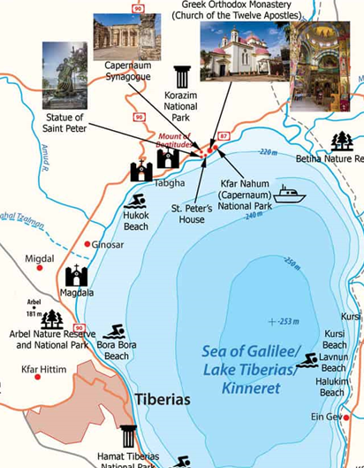
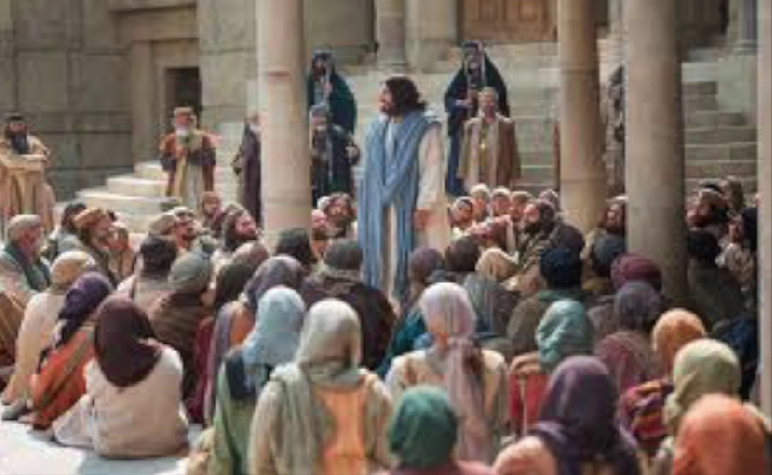
Then they came to Capernaum,
and on the sabbath Jesus entered the synagogue and taught.

Slide 3
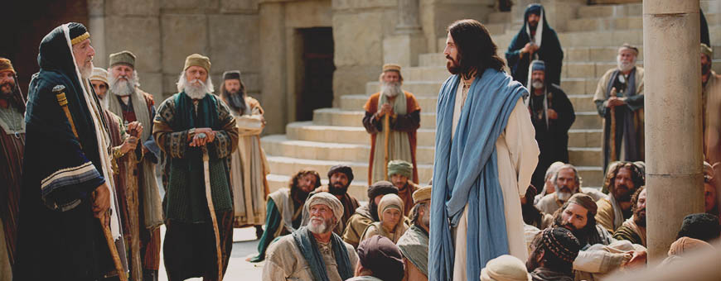
The people were astonished at his teaching, for he taught them as one having authority and not as the scribes.

Slide 4
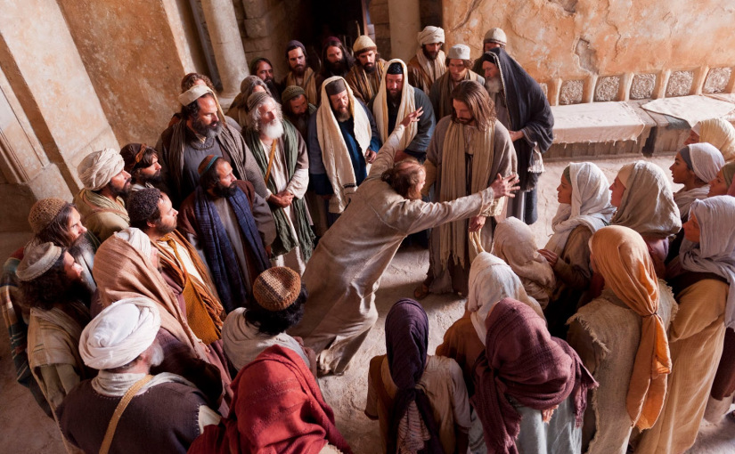
In their synagogue was a man with an unclean spirit; he cried out,
What have you to do with us, Jesus of Nazareth?
I know who you are—the Holy One of God!
Have you come to destroy us?

Slide 5
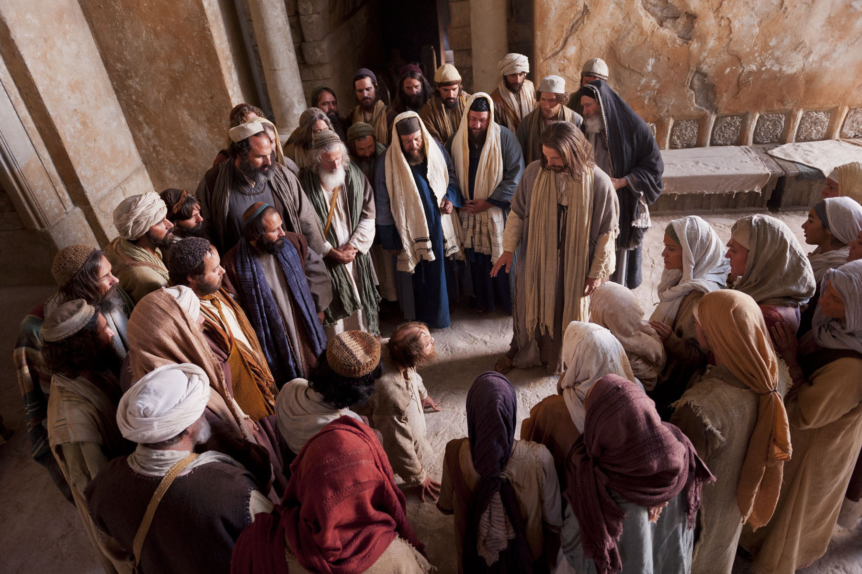
Jesus rebuked him and said,
Quiet! Come out of him!
The unclean spirit convulsed him and with a loud cry came out of him.

Slide 6
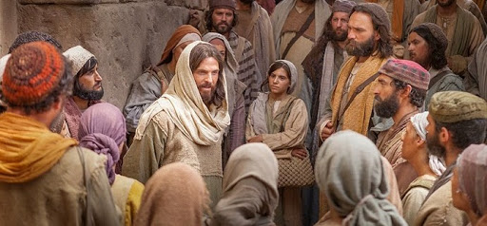
All were amazed and asked one another,
He commands even the unclean spirits and they obey him.
What is this? A new teaching with authority.

Slide 7
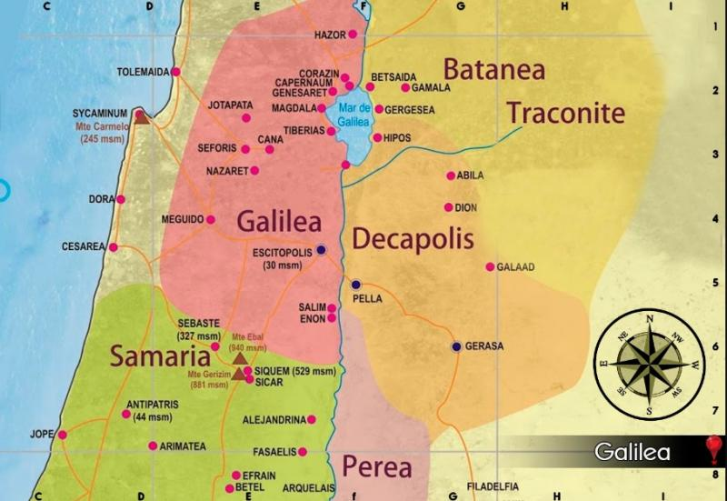
His fame spread everywhere throughout the whole region of Galilee.
The Gospel of the Lord
Praise to you Lord Jesus Christ

Slide 8
REFLECTION

Slide 9
Jesus taught as one with authority, not like the scribes. Why?

Slide 10
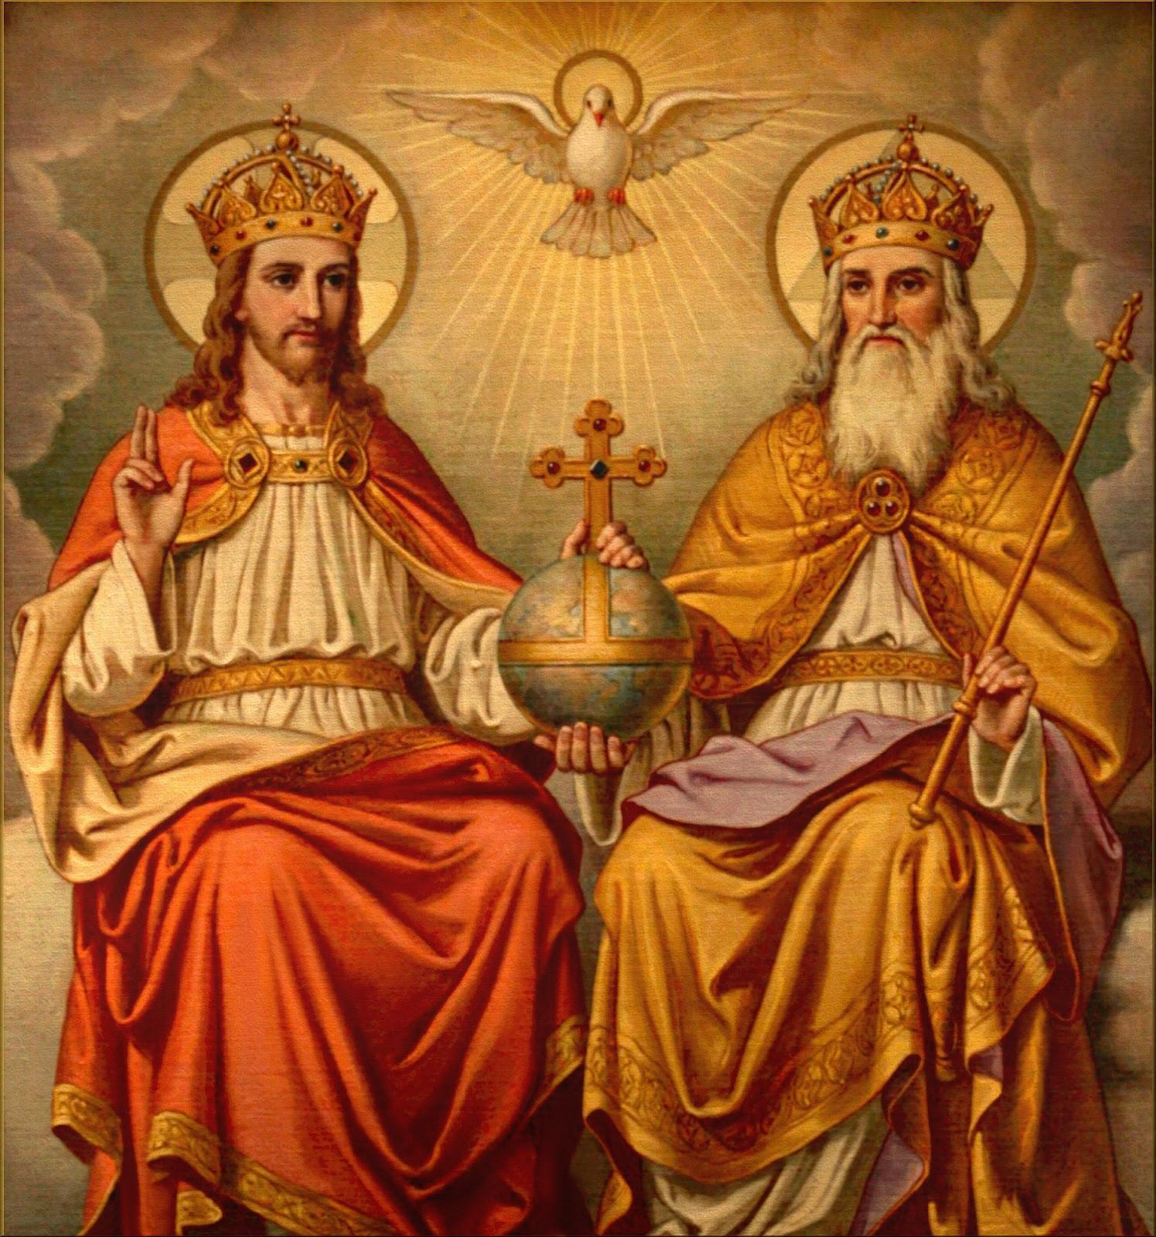
Jesus, the Father, and the Holy Spirit are one.
Jesus knows exactly who God is, Himself, and it shows in His words.

Slide 11
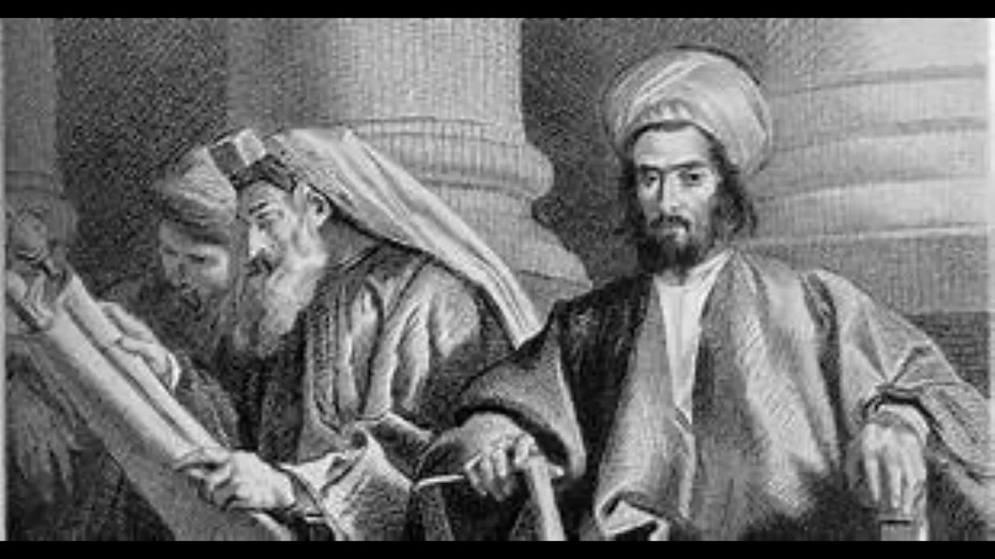
The scribes knew the law but did not know God in their hearts and it showed in their words.

Slide 12
There was a man possessed by a demon. What did the demon yell at Jesus?
The demon knows His name and that Jesus has authority and power over them.
What have you to do with us, Jesus of Nazareth?
What does he call Jesus?
Have you come to destroy us?
“The Holy One
of God”

Slide 13
What did Jesus do?
He was compassionate and removed the evil spirit from the man.

Slide 14
How did the people react?
All were amazed at His power and authority and asked one another, “Who is this?”

Slide 15
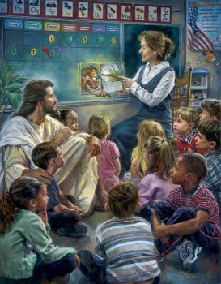
What power does Jesus have over our lives?
He loves us, guides us, teaches us, helps us, protects us, heals us, forgives our sins…

Slide 16
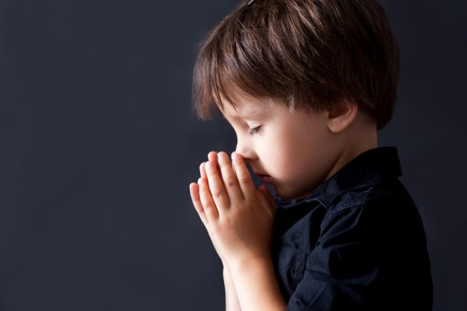
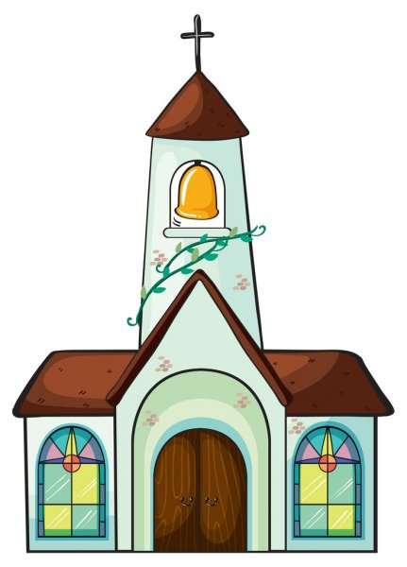
How can we speak about God with more authority?
…reading the bible,
Getting to know God better in prayer,
…in the sacraments,

Slide 17
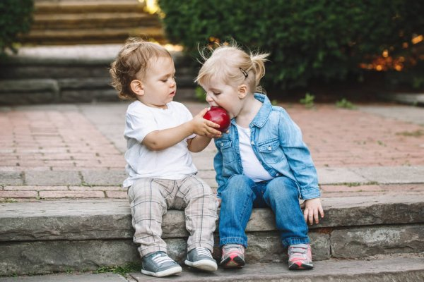
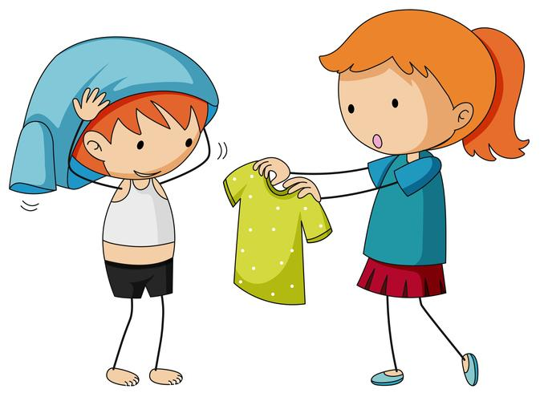
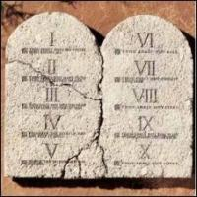
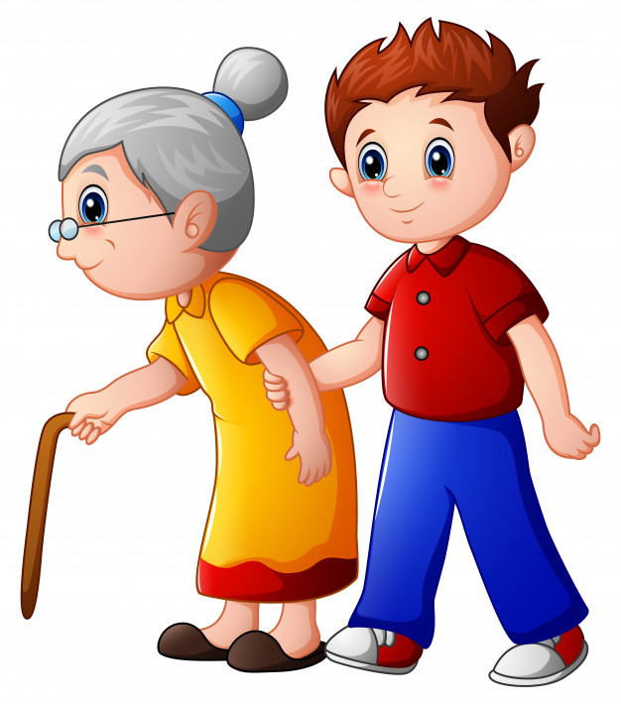
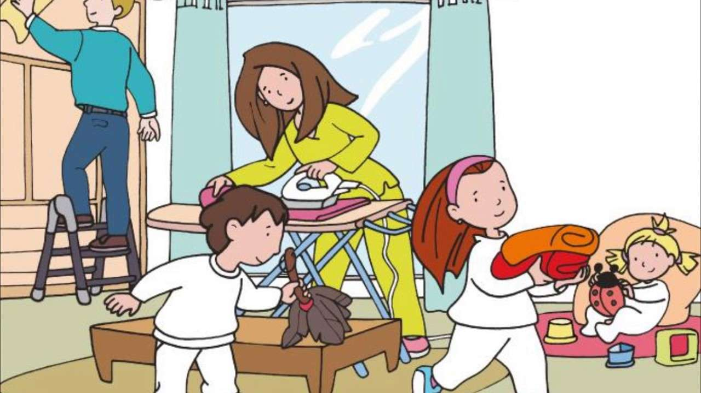
…obeying His commandments,
And sharing His love with everyone.

Slide 18
Activity

Slide 19
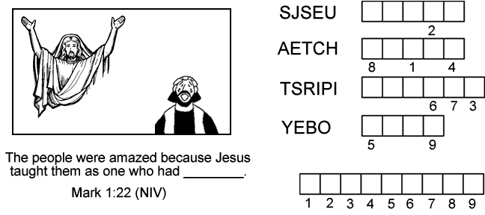
J
E
S
U
S
T
E
A
C
H
S
P
I
R
I
T
O
B
E
Y
A
U
T
H
O
R
I
T
Y

Slide 20
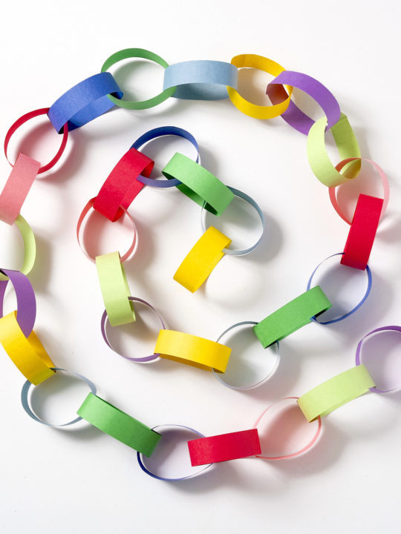
ACTIVITY Cut strips of construction paper lings 1’x4”. On each link ask the children to write one thing that is evil or makes people unhappy. Make a chain by gluing or stapling a link into a circle, then consecutively linking each link. Gather to pray. The children will take turns praying over one link: Jesus, we pray that all people will be free from________ (what is written on the link). Then the child breaks that link. All respond: “Thank you Jesus, for setting us free.”

Slide 21
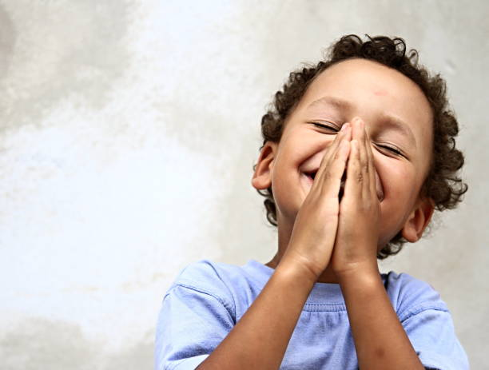
Prayer Jesus, Holy One of God, who is almighty and all loving, help me to know and love you more every day. Help me to trust completely in your love and power in my life. Amen.

Slide 22
Song: My God is Powerful, Life Lifter, https://youtu.be/ddTxcQFAlQ0?si=ecRjt_DzNehlfjFb

