Slide 1
Ministry Friends of Jesus and Mary
The Child Jesus in the Temple, The Holy Family
Cycle C- I Sunday in Christmas, Luke 2, 41-52
www.fcpeace.org

Slide 2
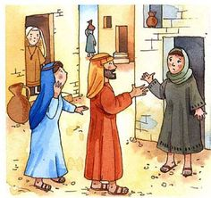
Be Alert…
Luke 2, 41-52
Each year Jesus’ parents went to Jerusalem for the feast of Passover, and when he was twelve years old, they went up according to festival custom. After they had completed its days, as they were returning, the boy Jesus remained behind in Jerusalem, but his parents did not know it. Thinking that he was in the caravan, they journeyed for a day and looked for him among their relatives and acquaintances, but not finding him, they returned to Jerusalem to look for him.

Slide 3
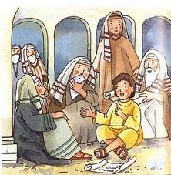
After three days, they found him in the temple, sitting in the midst of the teachers, listening to them and asking them questions, and all who heard him were astounded at his understanding and his answers. When his parents saw him, they were astonished, and his mother said to him, “Son, why have you done this to us? Your father and I have been looking for you with great anxiety.” And he said to them, “Why were you looking for me? Did you not know that I must be in my Father’s house?”

Slide 4
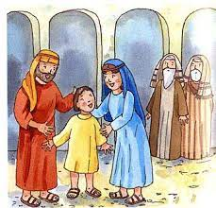
But they did not understand what he said to them. He went down with them and came to Nazareth, and was obedient to them; and his mother kept all these things in her heart. And Jesus advanced in wisdom and age and favor before God and man.

Slide 5
REFLECTION

Slide 6
¿What important feast did the Jews celebrate in the Temple every year in Jerusalem?

Slide 7
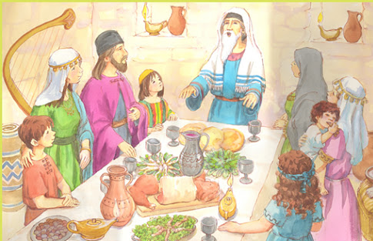
They celebrated Passover, when God liberated them from slavery in Egypt.

Slide 8
What happened there the year Jesus turned 12 years old?

Slide 9
Joseph and Mary returned to Nazareth in their separate caravans and Jesus was missing.

Slide 10
How must have Joseph and Mary felt on not finding Jesus?
Share

Slide 11
After 3 days of searching, where did they find Him?

Slide 12
They found him in the Temple, listening to the teachers of the Law of Moses.

Slide 13
His Mother asked Him why he had done this and what did He answer?

Slide 14
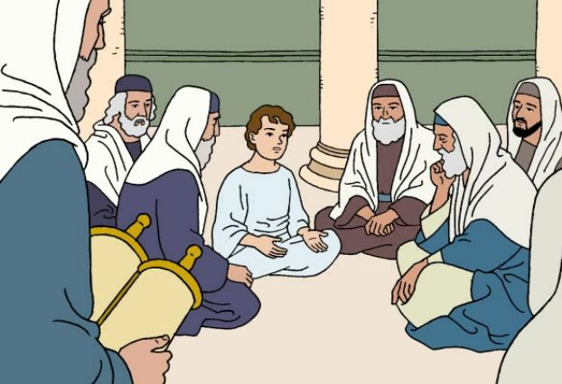
“Did you not know that I must be in my Father’s house?”
For the first time, Jesus calls God, “Father”, revealing He was God’s son.
Mary keeps these things in her heart.

Slide 15
Why did Jesus go to the Temple?

Slide 16
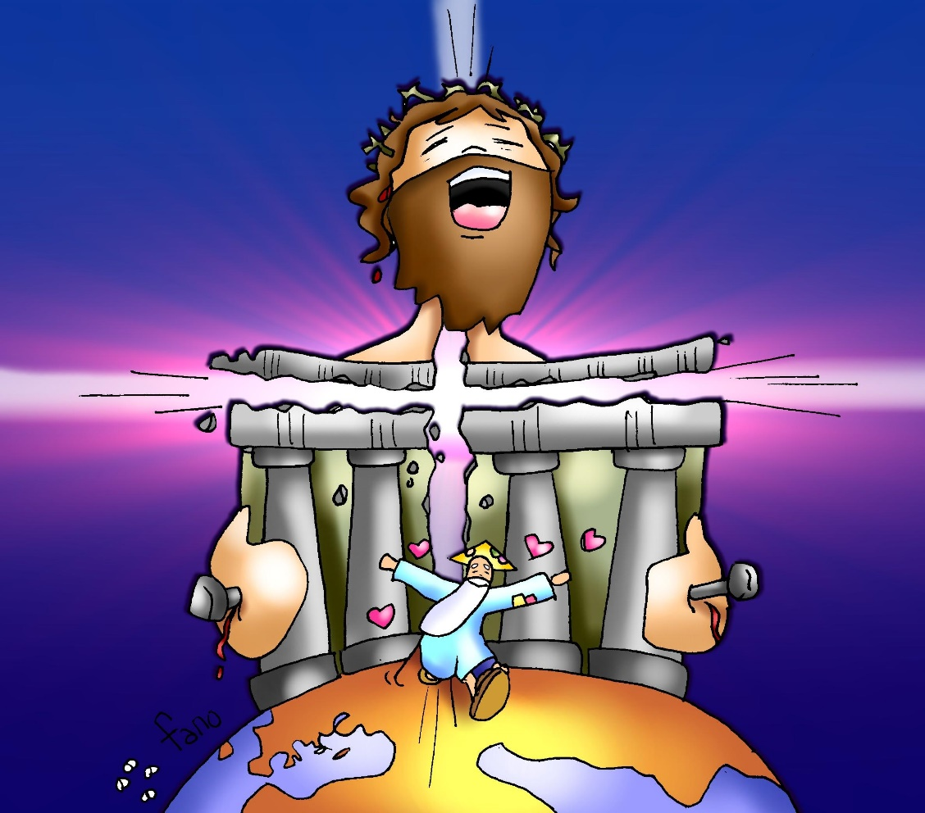
Jesus felt at home in the Temple because God, His Father, was there.

Slide 17
Jesus taught us to call God, Father, when He taught us the Our Father prayer. Do we also feel that desire to be close to God, our Father, in Church and to speak to Him in the Eucharist?

Slide 18
ACTIVITIES

Slide 19
FEAST OF THE HOLY FAMILY
(Answer the following questions about the Holy Family.)
c
c
They lived in _____________. 5. Joseph descended from King ________.
Jerusalem a. Jehoahaz
Bethlehem b. Nebuchadnezzar
Nazareth c. David.
Joseph was a ____________. 6. God sends Joseph messages _________.
Mason a. Via prophets
Carpenter b. In dreams
Fisherman c. With Messenger pigeons
They _________ a lot. 7. They were very ____________.
Fought a. Generous
Prayed b. Selfish
Yelled c. Rich
They obeyed ___________. 8. Who were the parents of the Virgin Mary?_____
God’s Commandments a. Abraham and Sarah
The Romans b. Joaquin and Ana
Herod c. Isaac and Rebecca
b
b
b
a
a
a

Slide 20
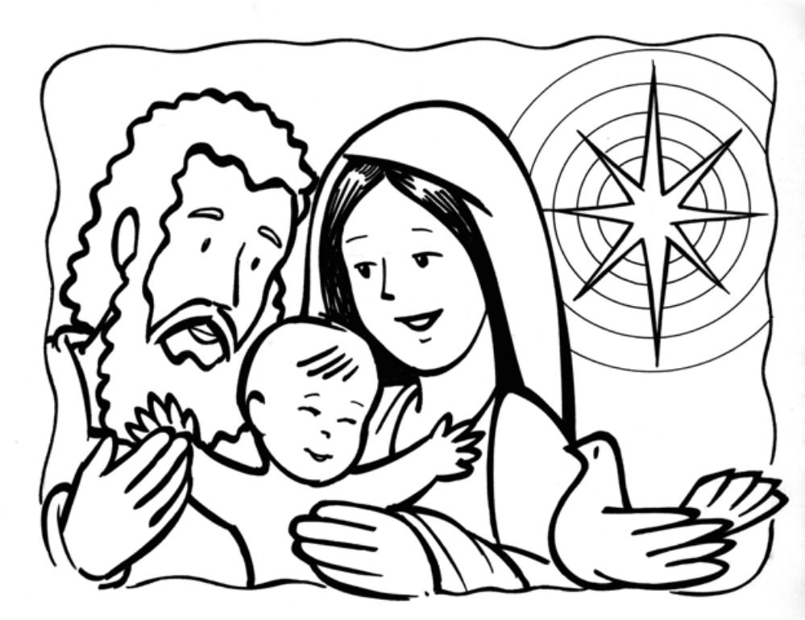
Color
Remember that the Holy Family is also our family who love us and take care of us from Heaven.

Slide 21
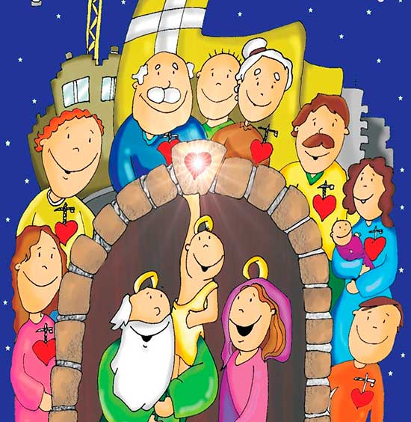
PRAYER
Jesus, help us to love you more and to seek you in Church where you are present in the Eucharist, in scripture, and in our Church family. Thank you for sending your Son and for calling me your son. Thank you for my family here and in Heaven.
Amen.

Slide 22
Come and Go With Me…Malone at Good Shepard, (Ctrl Click) https://youtu.be/yeilvKrnMXM (3-6 yrs.) God with Us, Lifetree Kids, (Ctrl Click) https://youtu.be/0DkoPQTHBIc (7+ yrs.)

