Slide 1
Ministry Friends of
Jesus and Mary
VI Week in Ordinary Time
Jesus Heals a Leper
Mark 1, 40-45
Feast of Our Lady of Lourdes

Slide 2
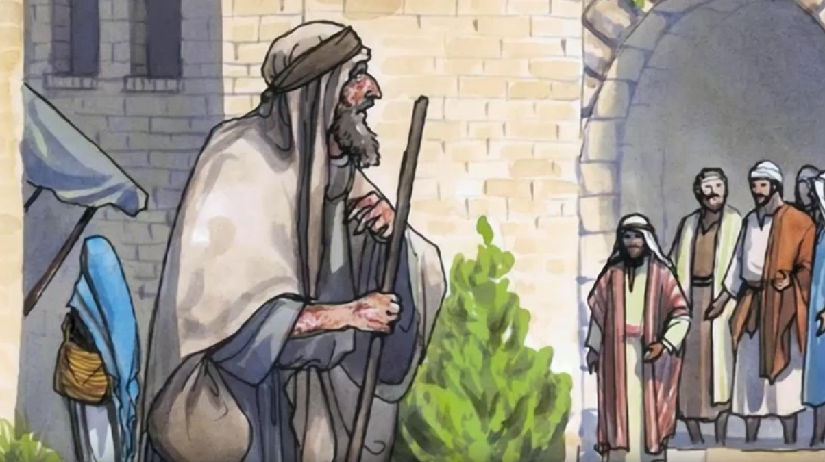
Gospel according to St. Mark, 1, 40-45
A leper came to Jesus and kneeling down begged him and said,

Slide 3
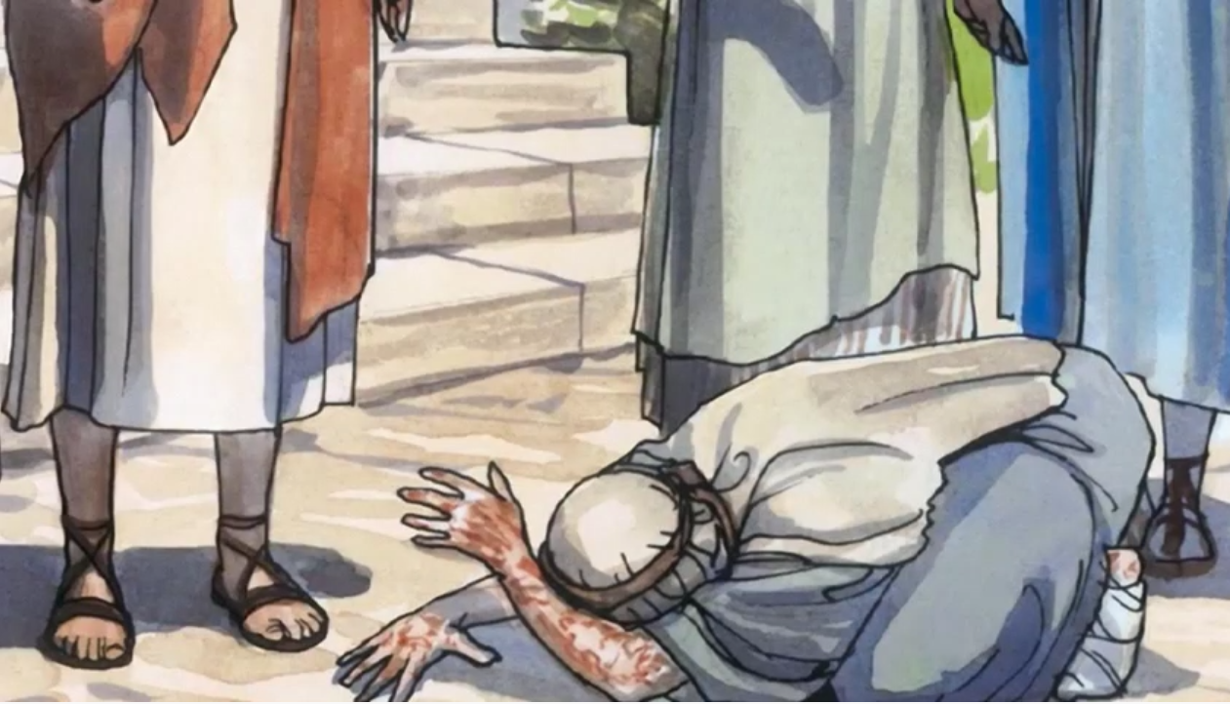
“If you wish, you can make me clean”

Slide 4
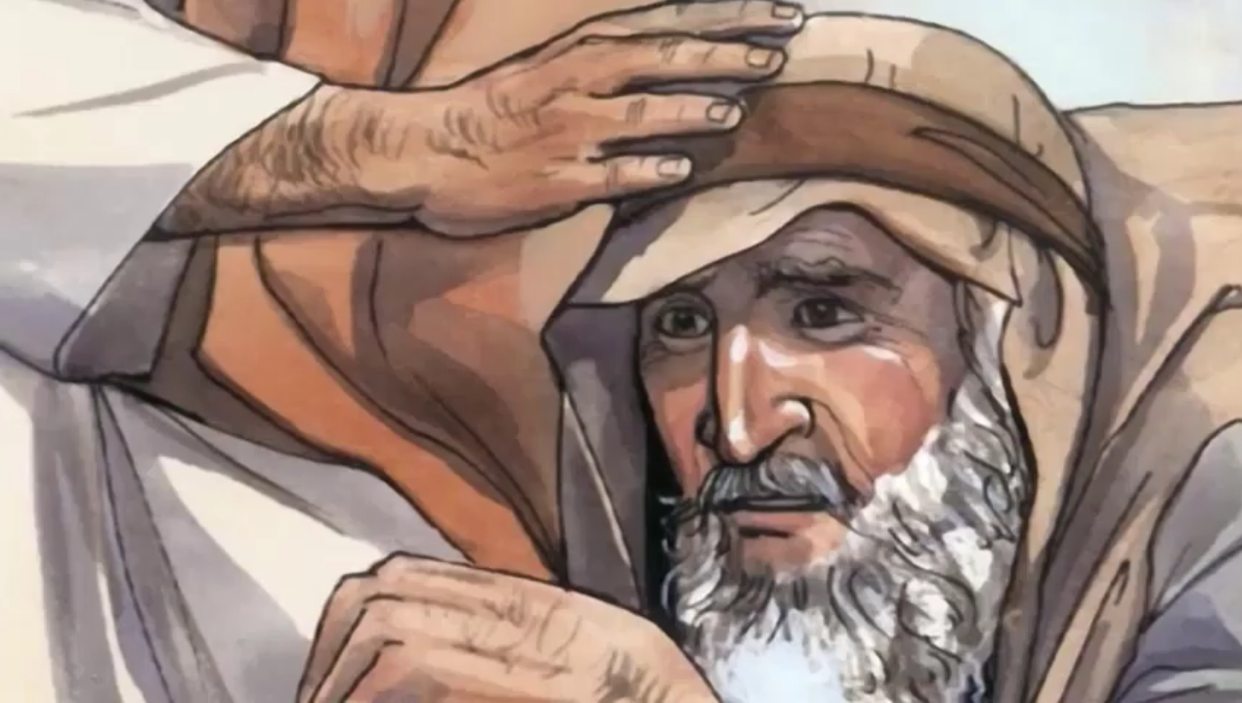
Moved with pity, he stretched out his hand, touched him, “I do will it. Be made clean.”

Slide 5
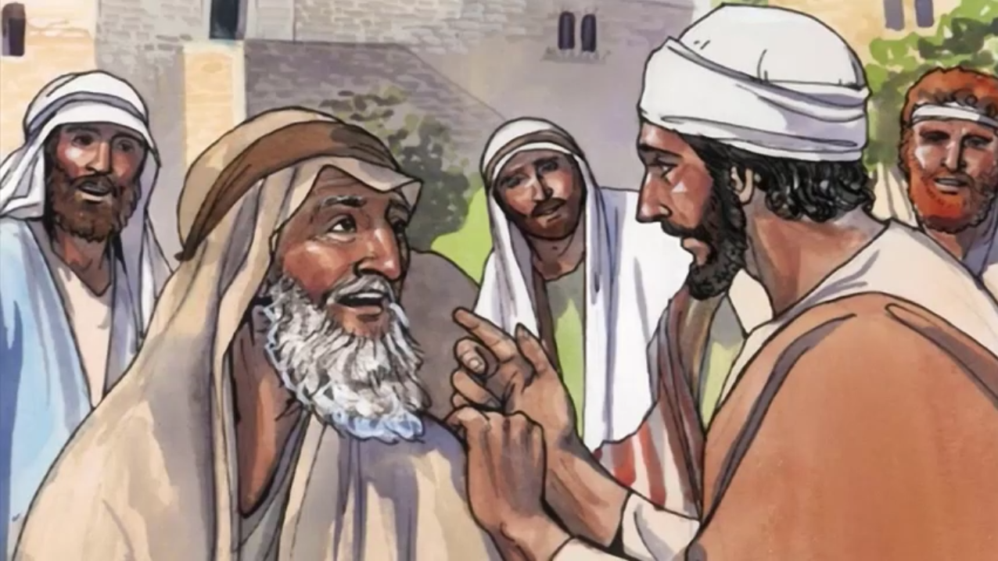
The leprosy left him immediately, and he was made clean. Then, warning him sternly, he dismissed him at once. He said to him, “See that you tell no one anything,

Slide 6
but go, show yourself to the priest and offer for your cleansing what Moses prescribed; that will be proof for them.”

Slide 7
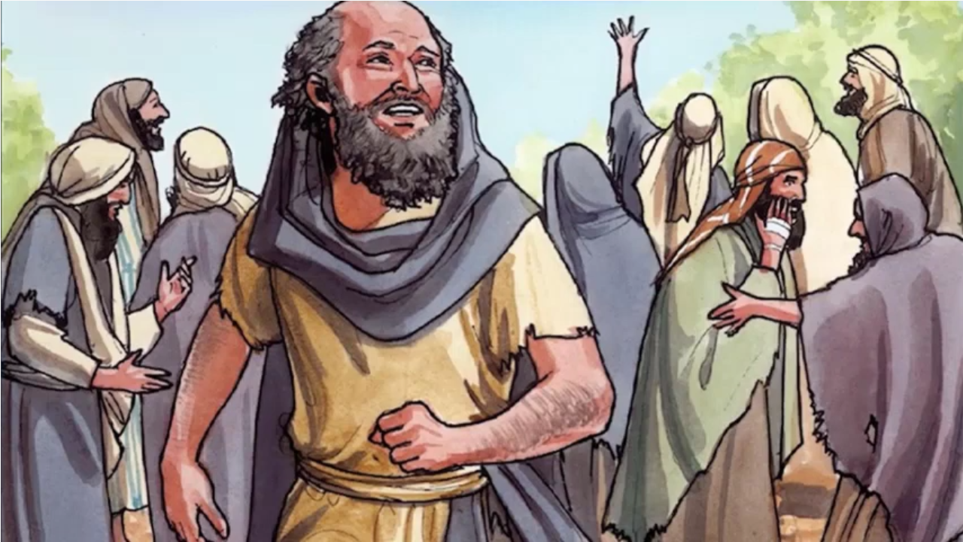
The man went away and began to publicize the whole matter. He spread the report abroad so that it was impossible for Jesus to enter a town openly.

Slide 8
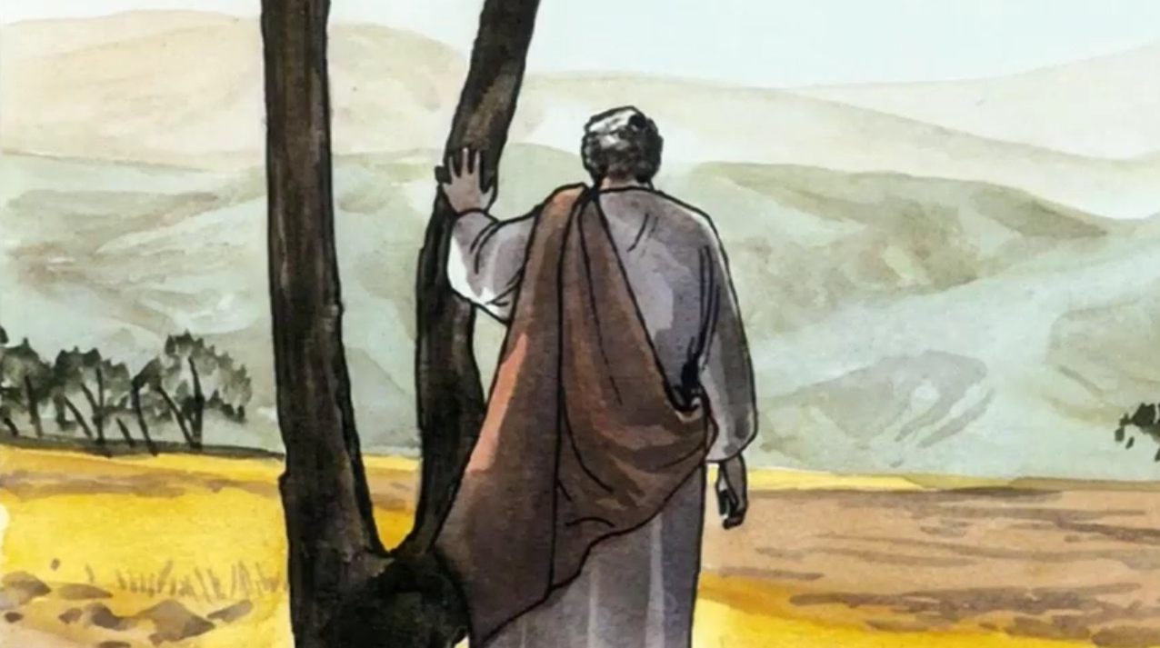
He remained outside in deserted places,

Slide 9
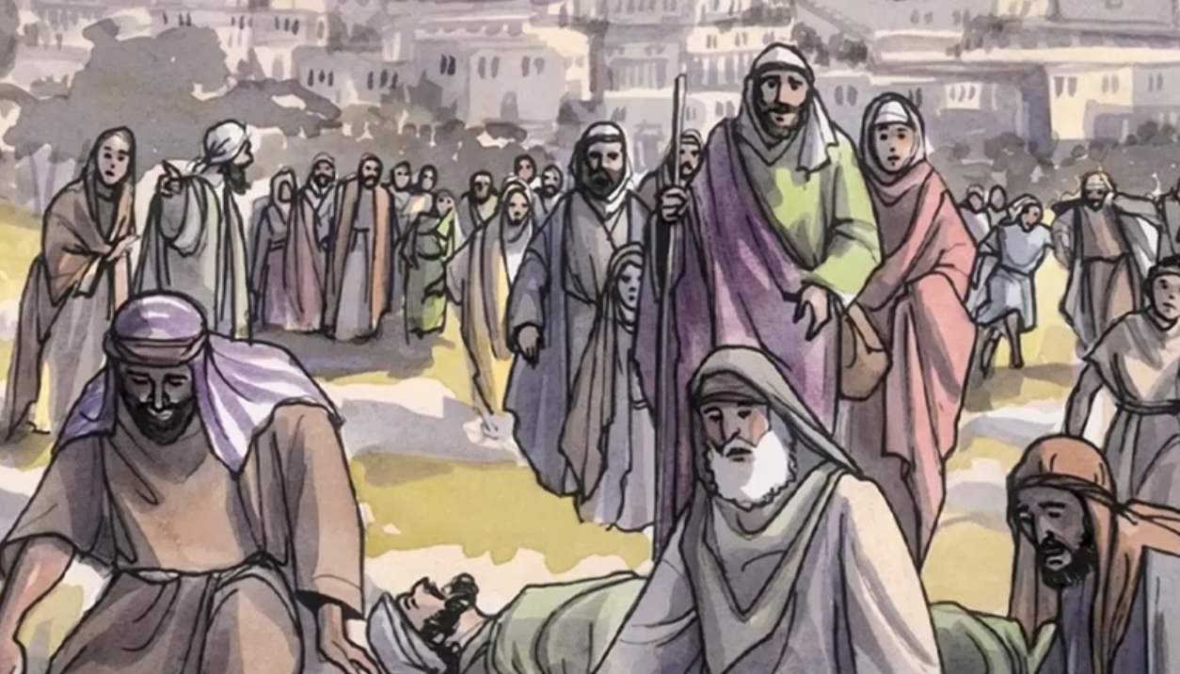
and people kept coming to him from everywhere.
THE GOSPEL OF THE LORD.
GLORY TO YOU LORD JESUS CHRIST

Slide 10
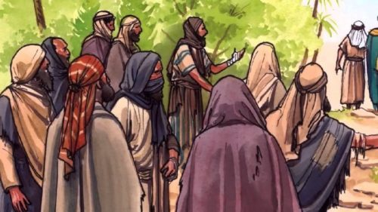
REFLECTION
What is a leper?
A person who has leprosy, a chronic and contagious disease of the skin. Sores deform the body, the hands and feet, the nose and mouth; and teeth fall out. Because of their unpleasant appearance and of fear of getting the disease, people reject the lepers.
Leprosy is transmitted by air, especially by coughing or sneezing.
How do you think is the life of a leper?
They lived isolated from their family and friends, without working so as not to spread the disease. They could not beg for money either because no one would approach them. They lived poor and abandoned. They also felt ashamed because all thought their sickness was punishment for their sins.

Slide 11
What does the leper do when he sees Jesus?
With much humility, kneeling before Him, he begs to be cured.
How does Jesus respond to this request?
Jesus felt compassion and, although it was prohibited to touch a leper because of the danger, He stretched out His hand and touched him saying, “I do will it…”
What did the law say about Lepers?
They must separate from the community and they could not return until they were cured (which was almost impossible). If cured, they had to present themselves before the priest to approve the healing and the leper must offer a sacrifice of purification.

Slide 12
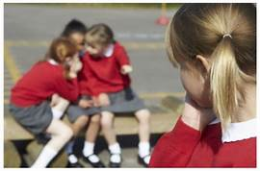
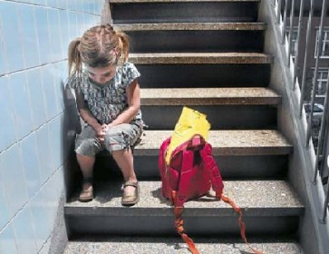
REFLECTION
How do you imagine the happiness of the leper now? How must his life be without leprosy?
He won’t have to live apart; he can return to his family.
He no longer will be looked down upon by others.
He no longer will feel hunger, nor pains in his body. His face and body are healed. He can work and will have a NEW LIFE thanks to JESUS!
Do you know anyone who is rejected in school, in your neighborhood, or on your sports team?
How do they feel?
How can you show compassion for that person?

Slide 13
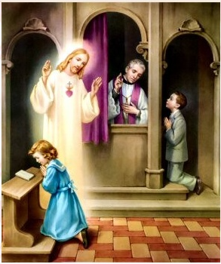
REFLECTION
We have a SACRAMENT in which Jesus touches our soul. He heals us and cleanses our sins. Our soul shines after receiving it.
Do you know which Sacrament this is?
CONFESSION OR RECONCILIATION
You only need to approach Jesus like the leper did: with Humility, Faith, and repentance.
You no longer are separated from God; you reestablish your friendship with Him.
Without sin, you are full of Grace (God’s life), or in a state of Grace. You will feel happy to be able to receive the Eucharist!!
Thank you JESUS because you HEAL MY SOUL. I LOVE YOU JESUS

Slide 14
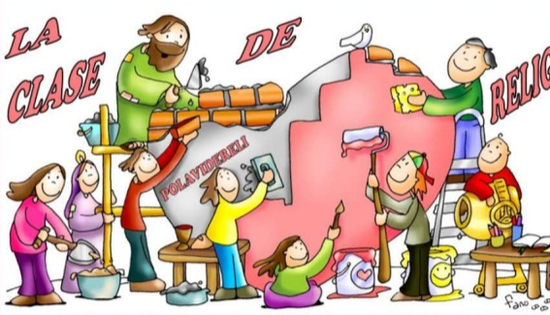
ACTIVITY

Slide 15
T
O
U
C
H
P
U
R
M
D
I
S
E
A
S
E
B
E
X
L
S
C
L
E
A
N
S
E
D
T
I
F
D
L
T
R
H
E
A
L
E
D
A
S
H
A
M
E
D
P
D
I
R
D
O
S
Y

Slide 16
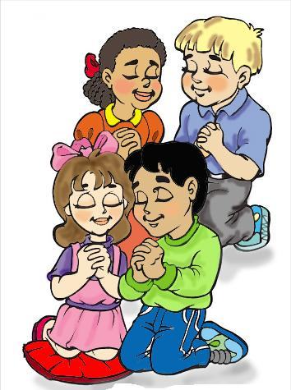
PRAYER
Jesus,
Lord, in your great compassion, you reject no one. Teach us to see everyone as your beloved child so all may feel Your love. Thank you for your great compassion for us. Give us the joy of your salvation so that we can share it with others. Amen

Slide 17
Song: Love One Another Lullaby, Dakota Pyle

Slide 18
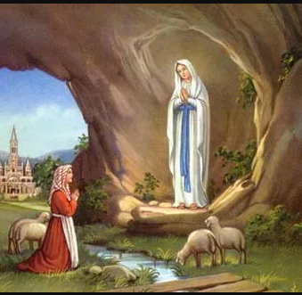
Our Lady of Lourdes
February 11

Slide 19
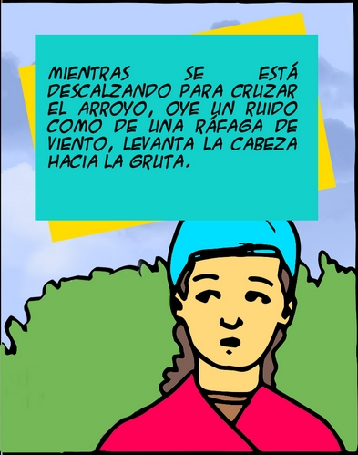
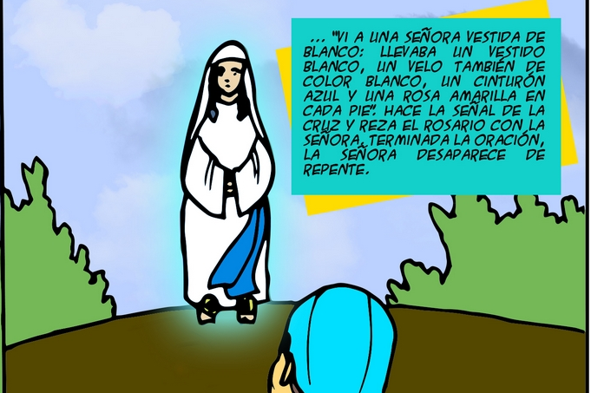
The 11th of February 1858, 3 girls: Bernadette Soubirous, her sister, and a friend set out to gather firewood at the grotto of Massabielle.
…”I saw a lady dressed in white: she wore a white dress and a white veil, a blue ribbon around her waist, and a yellow rose on each foot.” She makes the sign of the cross and they pray the Rosary together. Upon finishing, the woman disappears.
While taking off her socks to cross the stream, she heard the sound of a strong wind and raised her head to see the grotto.

Slide 20
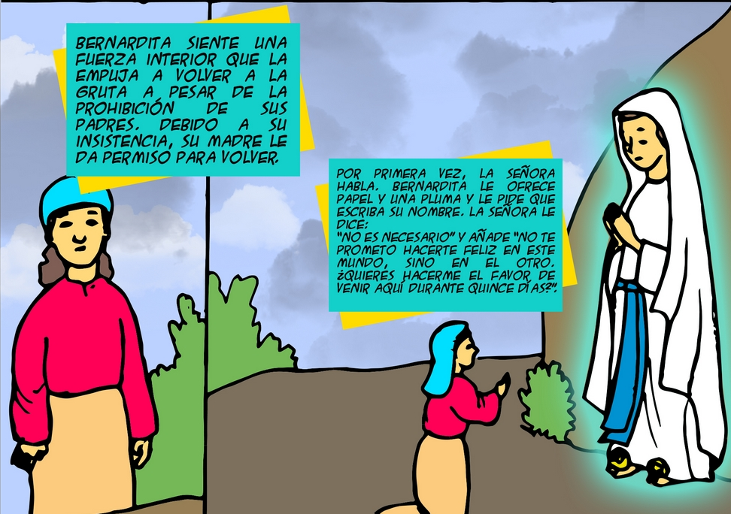
Bernadette feels an internal force that pushes her to return to the grotto against her parent’s wishes. Because she insists, her mother gives her permission.
The lady speaks for the 1st time. Bernadette offers her a paper and pen to write her name. The lady tells her: “This is not necessary.” And she adds, “I do not promise you happiness in this world, but in the next. Do you want to do me the favor of coming here during 15 days?”

Slide 21
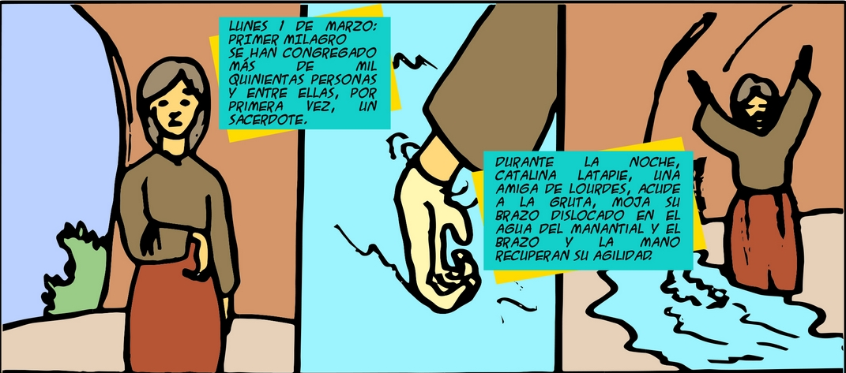
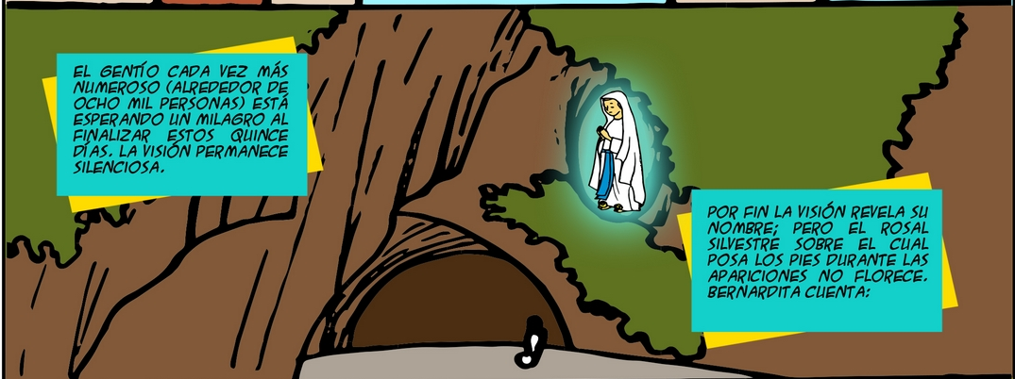
Monday, March 1st: First miracle-More than 1500 persons have gathered, and amongst them, for the first time, is a priest.
During the night, Catalina Latapie, a friend of Lourdes, goes to the grotto, dips her crippled arm in the stream the lady provided, and she is healed.
The crowd which grows each day (now around 8000) is waiting for a miracle on the 15th day. The vision is silent.
Finally, the vision reveals her name: but the wild rose bush over which she always appeared, does not flower. Bernadette recounts:

Slide 22
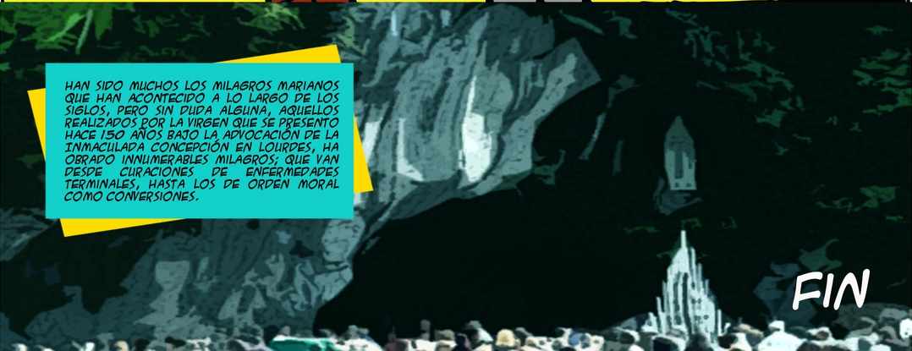
Raising her eyes to the sky, and joining her hands in prayer, she said: “I am the Immaculate Conception.”
These words moved the good pastor, since Bernadette did not know this theological expression which names the Holy Virgin. Only 4 months earlier in 1854, Pope Pius IX had declared this expression a truth of the faith.
Many are the Marian miracles occurring throughout the centuries; but, numerous are those made by the Virgin who appeared 150 years ago in Lourdes, France as the Immaculate Conception, from healings of terminal illnesses, to moral healings as conversions of hearts.

