Slide 1
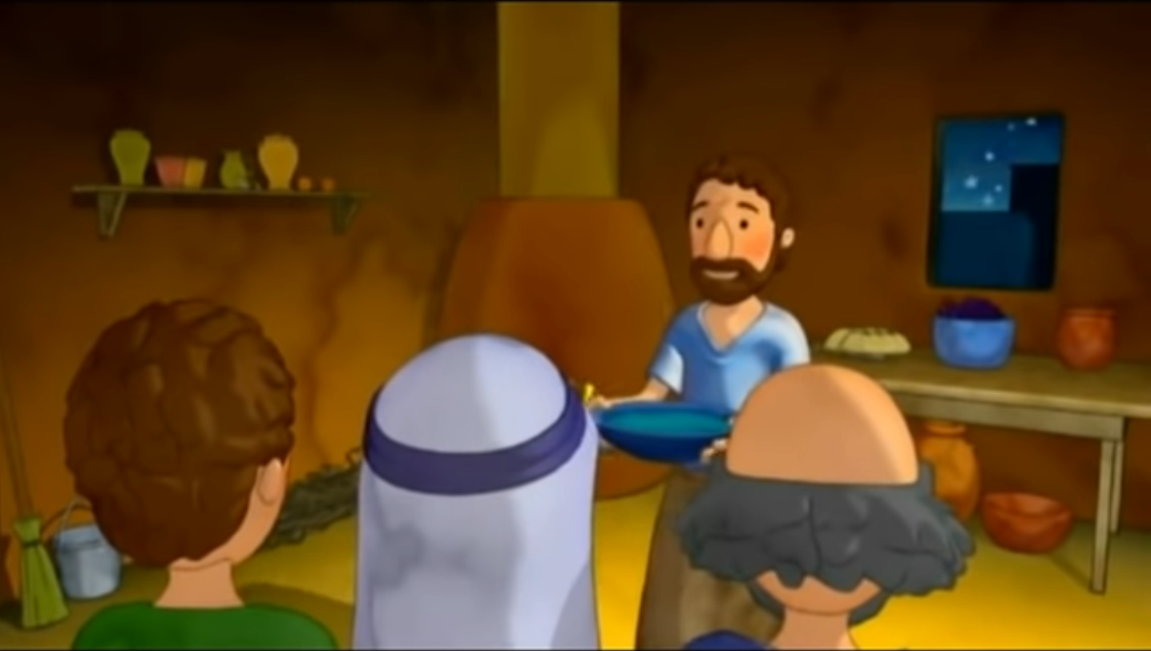
Cycle B - XXIX Gospel of Ordinary Time The Son of Man came to serve. Mark 10, 35-45
MINISTRY FRIENDS OF JESUS AND MARY
www.fcpeace.org

Slide 2
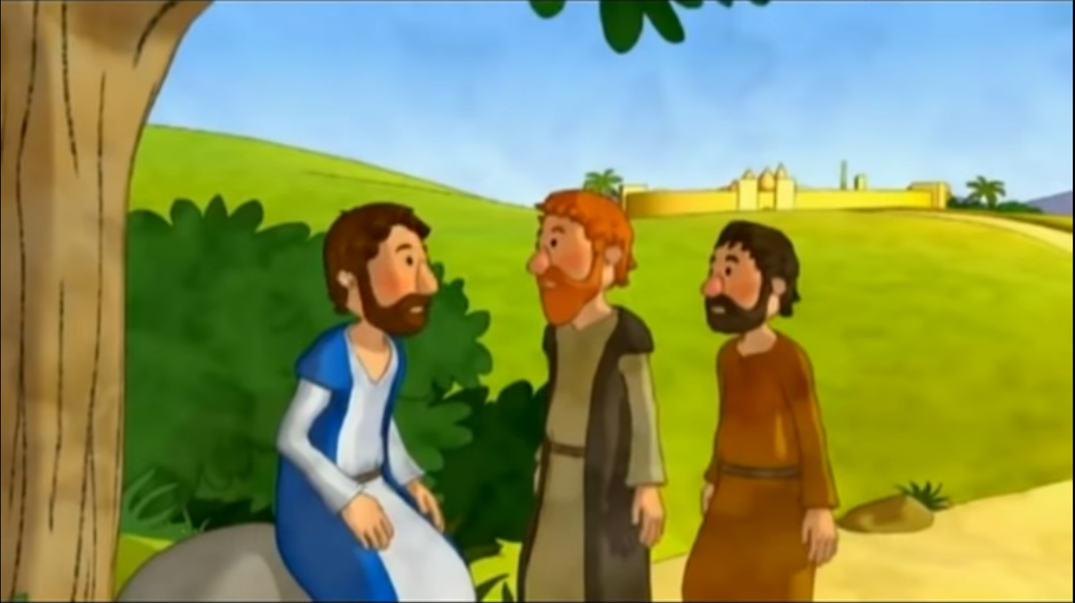
James and John, the sons of Zebedee, came to Jesus and said to him, "Teacher, we want you to do for us whatever we ask of you."

Slide 3
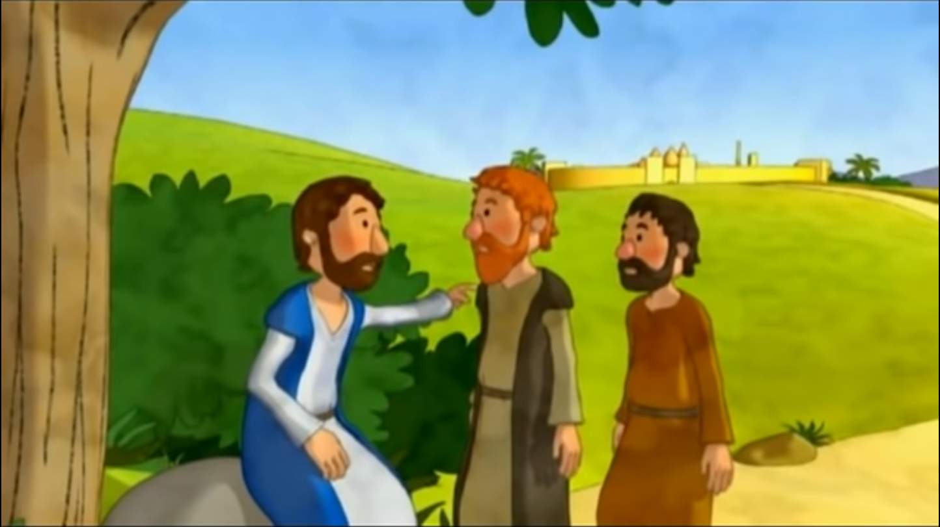
He replied, "What do you wish me to do for you?" They answered him, "Grant that in your glory we may sit one at your right and the other at your left." Jesus said to them, "You do not know what you are asking.”

Slide 4
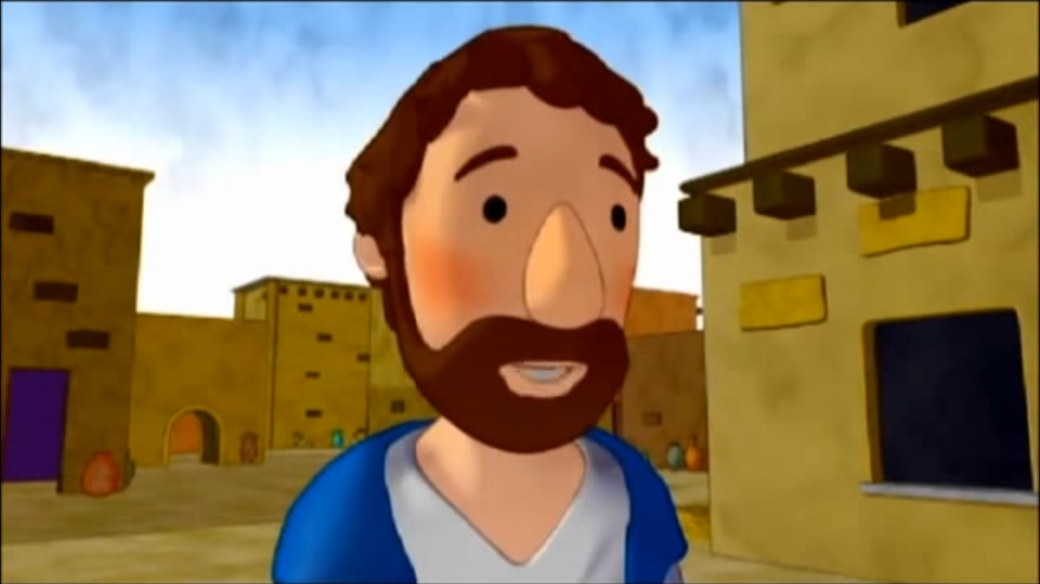
Can you drink the cup that I drink or be baptized with the baptism with which I am baptized?" They said to him, "We can."

Slide 5
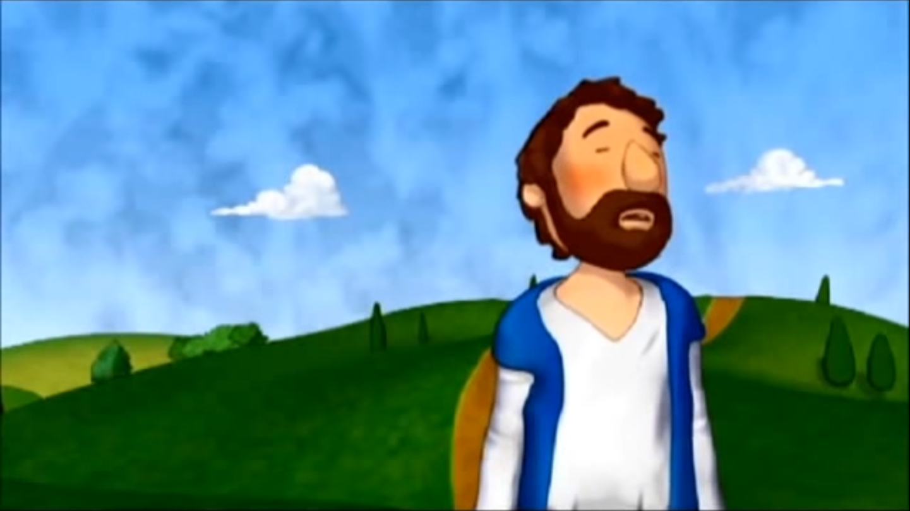
Jesus said to them, "The cup that I drink, you will drink, and with the baptism with which I am baptized, you will be baptized; but …

Slide 6
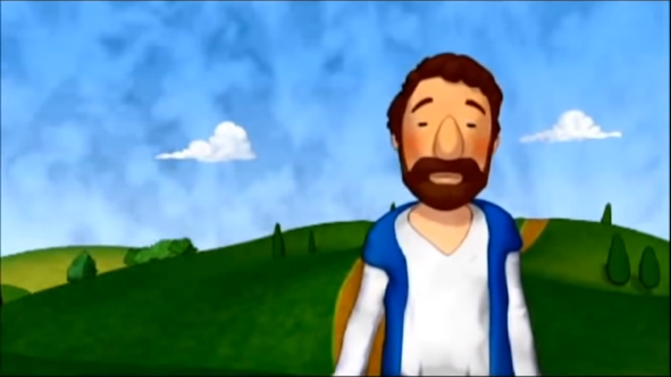
…to sit at my right or at my left is not mine to give but is for those for whom it has been prepared."

Slide 7
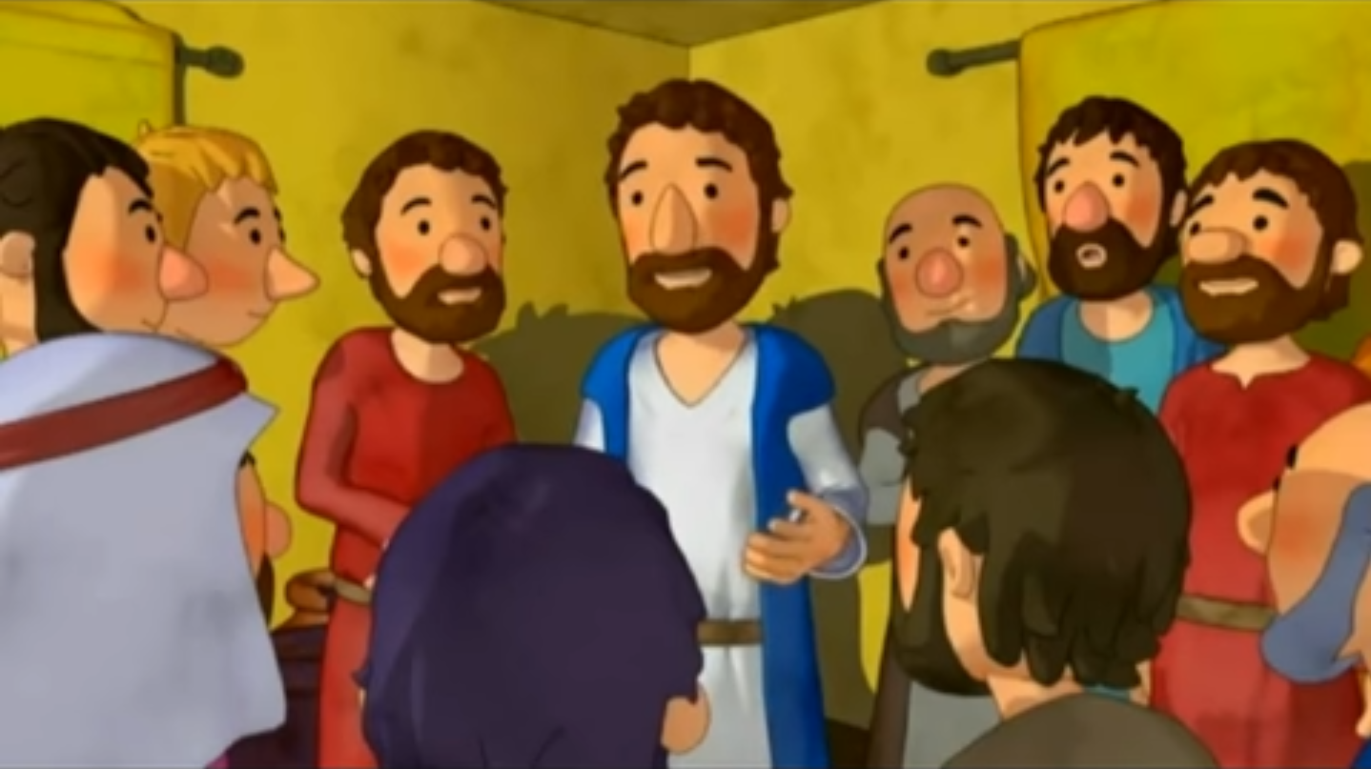
When the ten heard this, they became angry at James and John. Jesus summoned them and said to them…

Slide 8
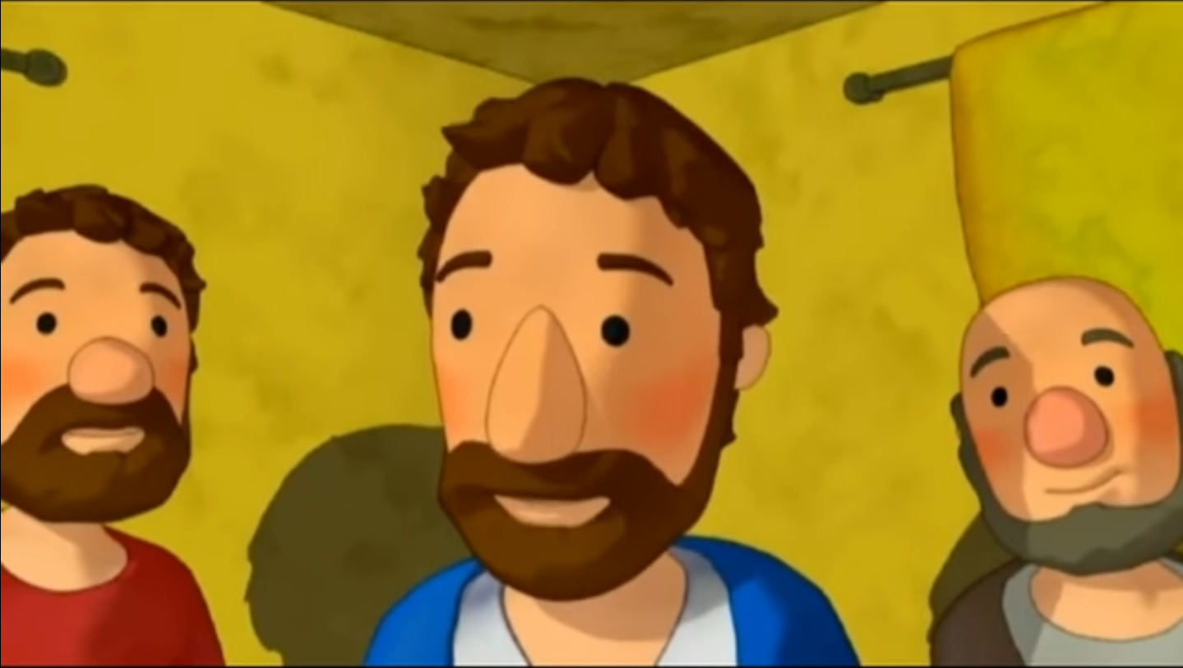
"You know that those who are recognized as rulers over the Gentiles lord it over them, and their great ones make their authority over them felt. But it shall not be so among you.

Slide 9
Entonces dijo María: “Mi alma glorifica al Señor y mi espíritu se llena de júbilo en Dios, mi salvador, porque puso sus ojos en la humildad de su esclava.
“Rather, whoever wishes to be great among you will be your servant; whoever wishes to be first among you will be the slave of all. For the Son of Man did not come to be served but to serve and to give his life as a ransom for many."
THE GOSPEL OF THE LORD. PRAISE TO YOU LORD JESUS CHRIST.

Slide 10
REFLECTION
The brothers James and John asked Jesus something that was very important to them.
Why did James and John ask to sit next to Jesus in Heaven?
They wanted to be recognized as the most important apostles…

Slide 11
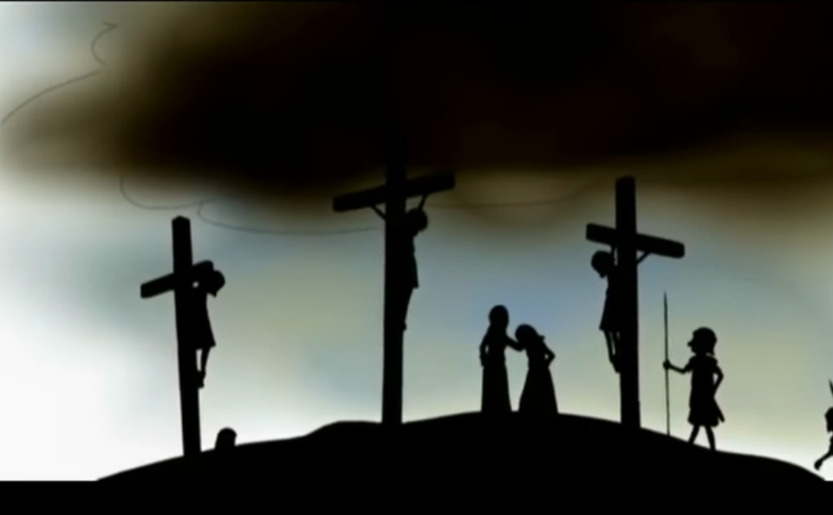
REFLECTION
Jesus responds, "You do not know what you are asking. Can you drink the cup that I drink or be baptized with the baptism with which I am baptized?"
Jesus wanted to know if they were willing to suffer and die for Him.
Jesus had already told them that He would suffer greatly in Jerusalem, but James and John were already planning their future and wanted to guarantee their places of importance.
Jesus is worried about their desire to be the most important.
To whom does He compare them?

Slide 12
REFLECTION
Jesus compares them to the rulers and governors of nations who lord their authority and oppress people.
How does Jesus want them to be if they want to be great or first amongst others?
They must have a spirit of service to others.

Slide 13
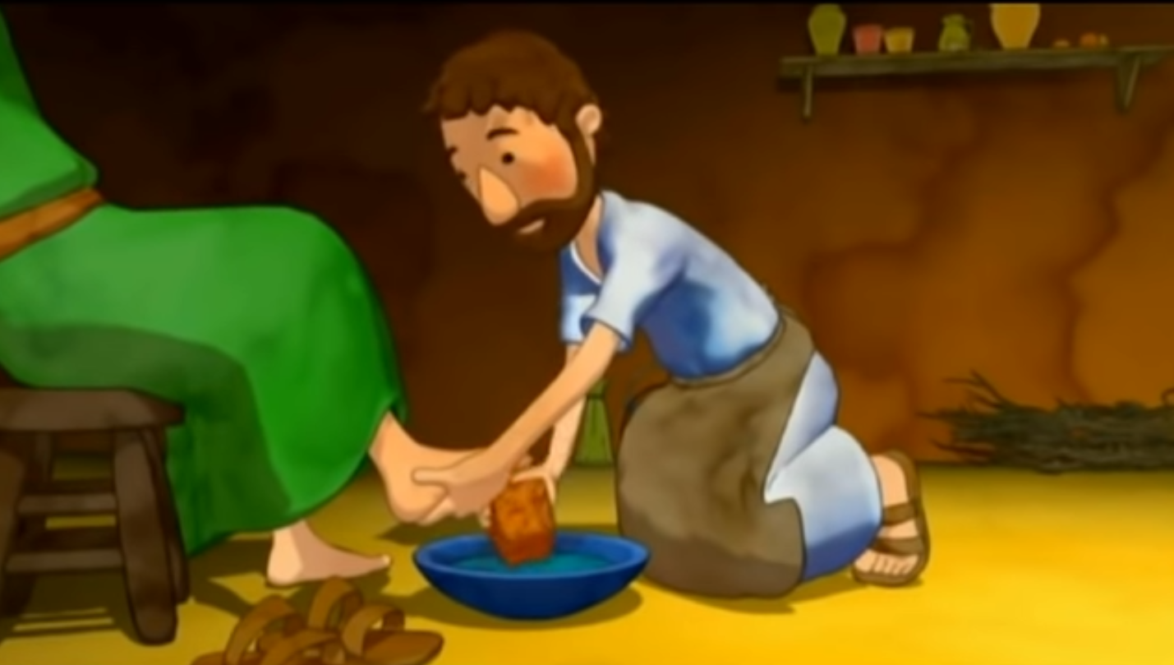
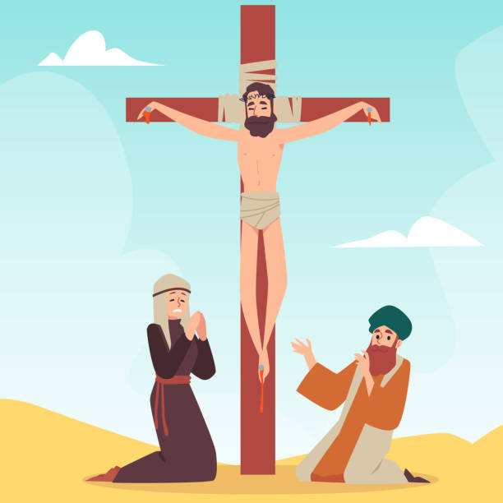
REFLECTION
Jesus says, whoever wishes to be great, should be the servant. Whoever wishes to be first, should be the slave of all.
Jesus always tried to help others; on one occasion, He washed His apostles feet.
Finally, He gave His life for the salvation of everyone.
How can you show that you want to be great or first, in the eyes of Jesus?

Slide 15
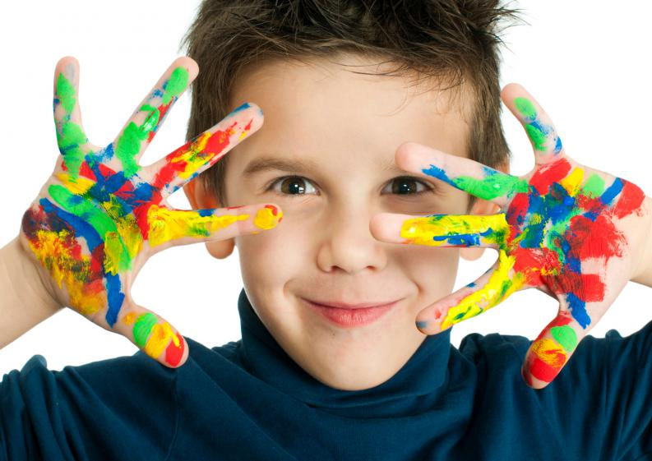
ACTIVITY

Slide 16
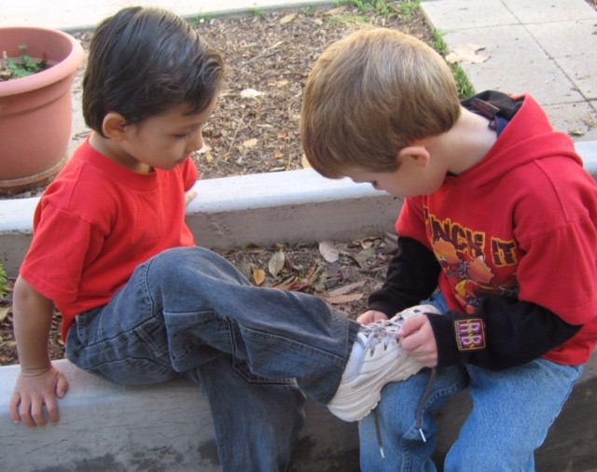
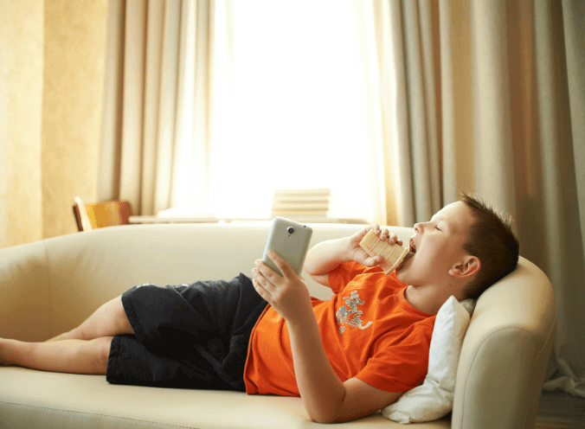
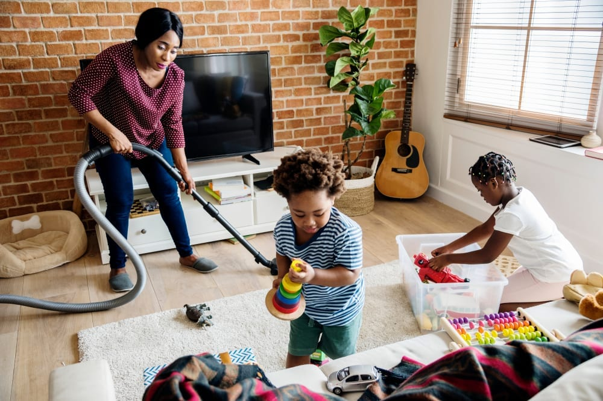
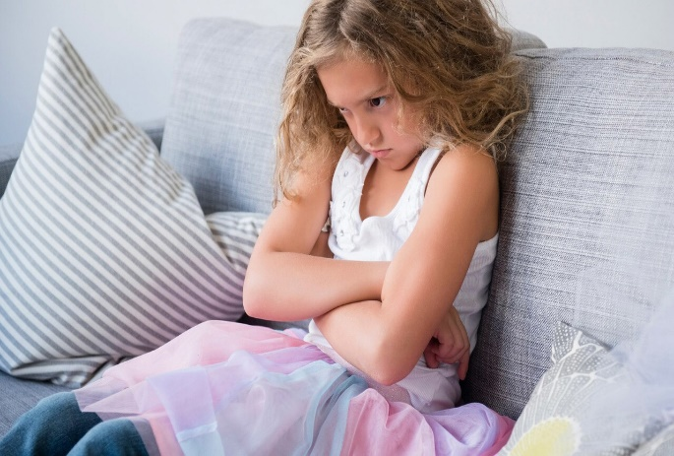
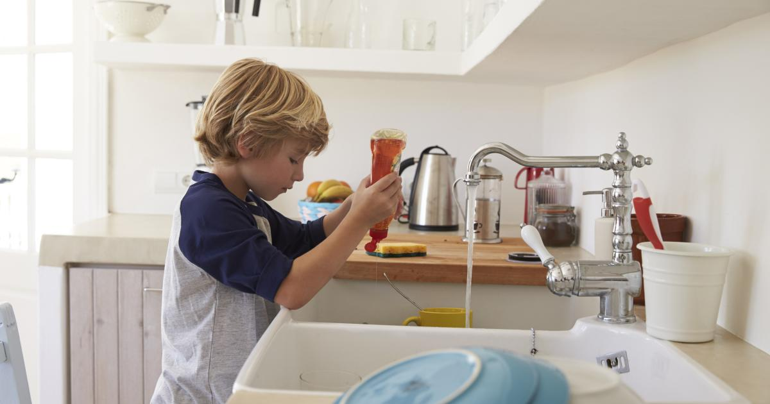
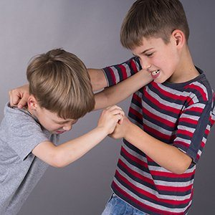
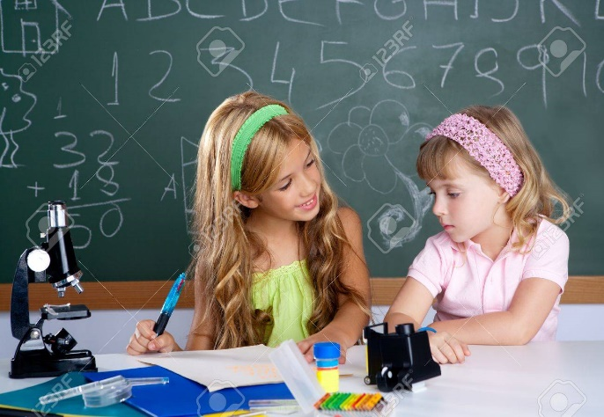
Who serves? Who doesn’t serve?

Slide 17
The Prayer Of Mary
My soul proclaims the ______________ of the Lord, my spirit rejoices in God my Savior for he has looked with favor on his lowly ___________. From this day all generations will call me _________: the Almighty has done great things for me, and ______ is his Name.
He has ________ on those who fear him in every generation. He has shown the ___________ of his arm, he has scattered the ________ in their conceit.
He has cast down the mighty from their thrones, and has _________ up the lowly. He has _______ the hungry with _______ things, and the rich he has sent away empty.
He has come to the _______ of his servant Israel for he remembered his __________ of mercy, the promise he made to our fathers, to Abraham and his children ____________.
greatness
Instructions:
Fill in the blanks with the following words:
servant
blessed
proud
lifted
help
mercy
blessed
holy
forever
promise
good
servant
strength
filled
greatness
holy
mercy
strength
proud
lifted
filled
good
help
promise
forever

Slide 18
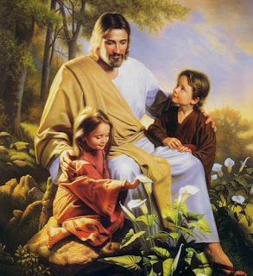
PRAYER
Jesus, I want to imitate you. Help me to want to serve my family and my community with love. Teach us to be your light in this world.
Amen.

Slide 19
(3-7 yrs. old) Make me a Servant, Assidors kids, https://youtu.be/zw_FNbF1LrU?si=uBsUIeGAoZGHviJ5

Slide 20
(8+ years old) The Servant Song (Ctrl Clck) https://youtu.be/kdmgpMfnjdU

