Slide 1
Friends of Jesus and Mary
Prayer Group for Children
XXVII Sunday in Ordinary Time
…Let the children come to me.…
Mark 10, 2-16
www.fcpeace.org

Slide 2
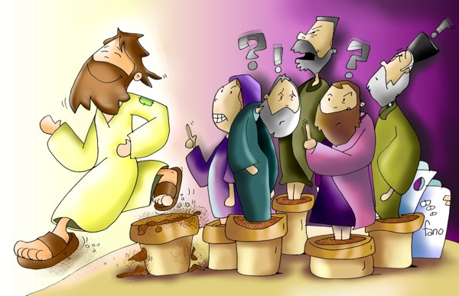
…Let the children come to me.…
Mark 10, 2-16
The Pharisees approached Jesus and asked, "Is it lawful for a husband to divorce his wife?" They were testing him.
He said to them in reply, "What did Moses command you?"
They replied, "Moses permitted a husband to write a bill of divorce and dismiss her."

Slide 3
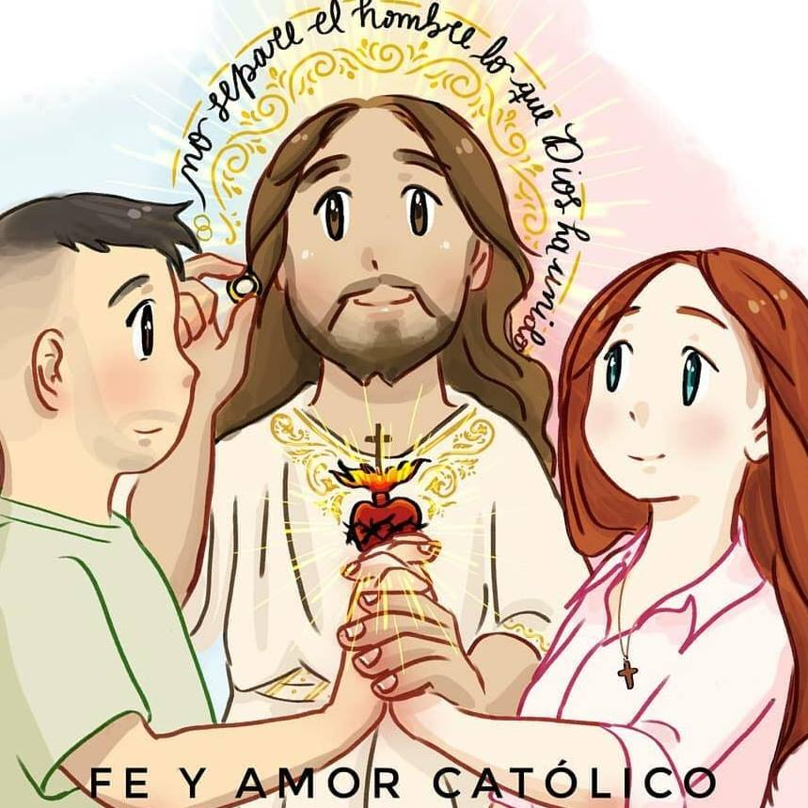
But Jesus told them, "Because of the hardness of your hearts he wrote you this commandment. But from the beginning of creation, God made them male and female. For this reason, a man shall leave his father and mother and be joined to his wife, and the two shall become one flesh. So, they are no longer two but one flesh.
Therefore, what God has joined together, no human being must separate."

Slide 4
In the house the disciples again questioned Jesus about this. He said to them,
"Whoever divorces his wife and marries another commits adultery against her; and if she divorces her husband and marries another, she commits adultery."

Slide 5
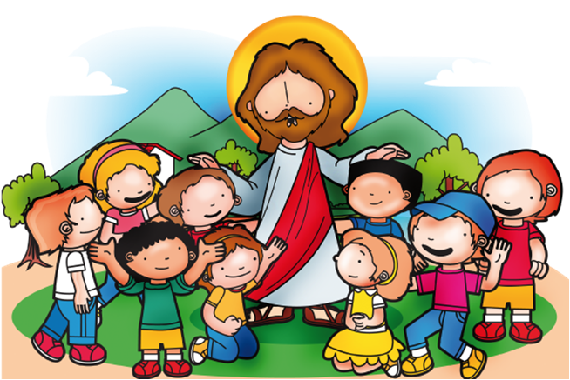
And people were bringing children to him that he might touch them, but the disciples rebuked them.
When Jesus saw this, he became indignant and said to them,
"Let the children come to me; do not prevent them, for the kingdom of God belongs to such as these.
Amen, I say to you, whoever does not accept the kingdom of God like a child will not enter it."
Then he embraced them and blessed them, placing his hands on them.
The Gospel of the Lord, Praise to You Lord Jesus Christ.

Slide 6
REFLECTION

Slide 7
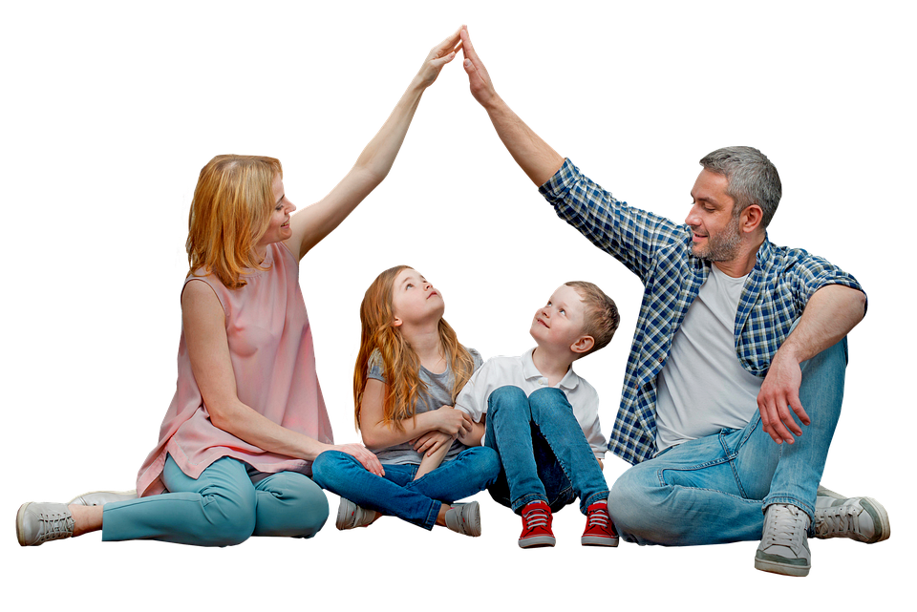
The gospel first speaks about marriage, then speaks about children. Children learn to love God and others from a loving family.

Slide 8
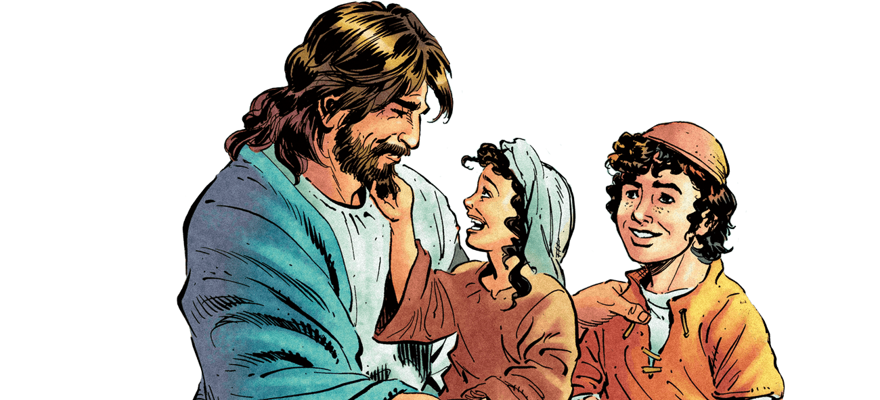
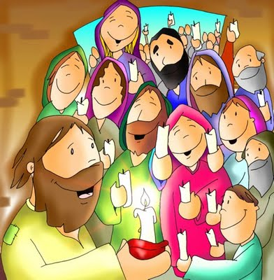
People were taking children to Jesus, but the disciples tried to stop them. Why?
They felt it was more important that Jesus talk to the adults.
What does Jesus tell them?

Slide 9
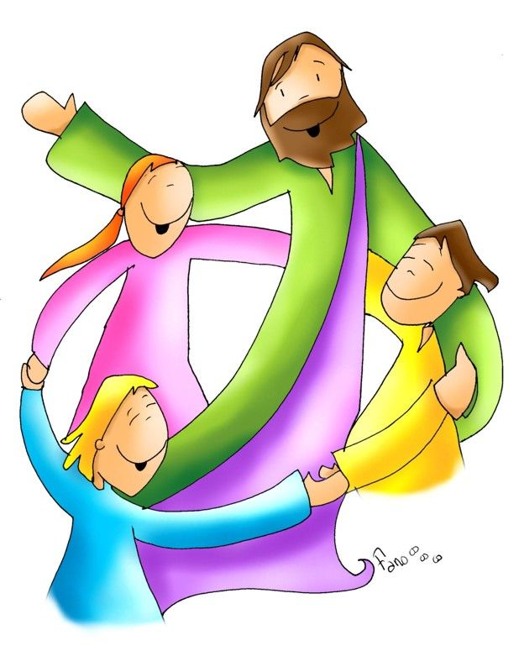
He said angrily,
“Let the children come to me; for the kingdom of God belongs to such as these.”

Slide 10
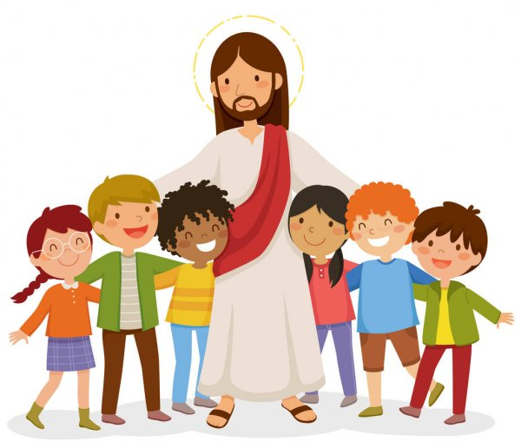
Describe children.

Slide 11
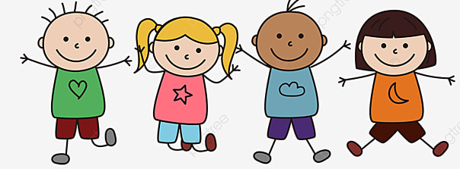
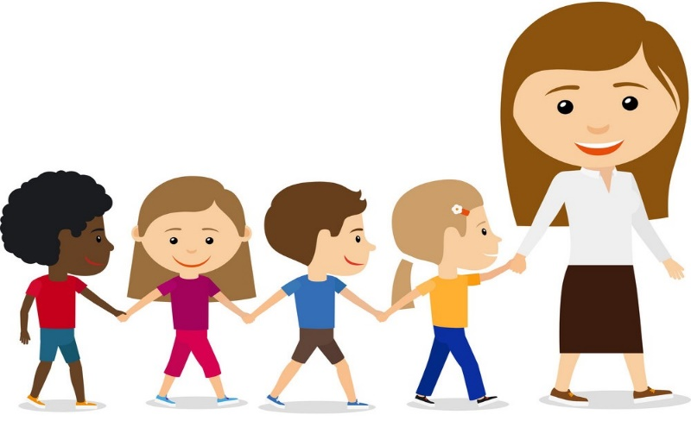
Children are simple,
and they return love with much love.
trusting of adults,

Slide 12
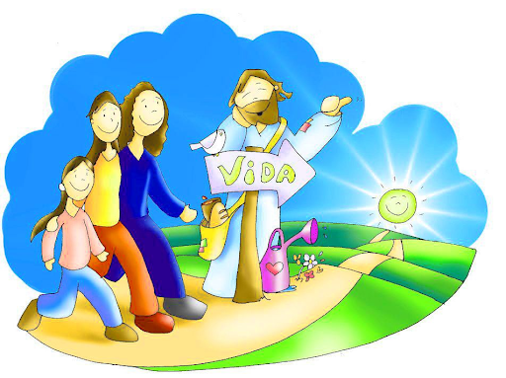
Jesus says, “The kingdom of God belongs to such as these.”
How does Jesus want all of us to be so we may enter God’s Kingdom?

Slide 13
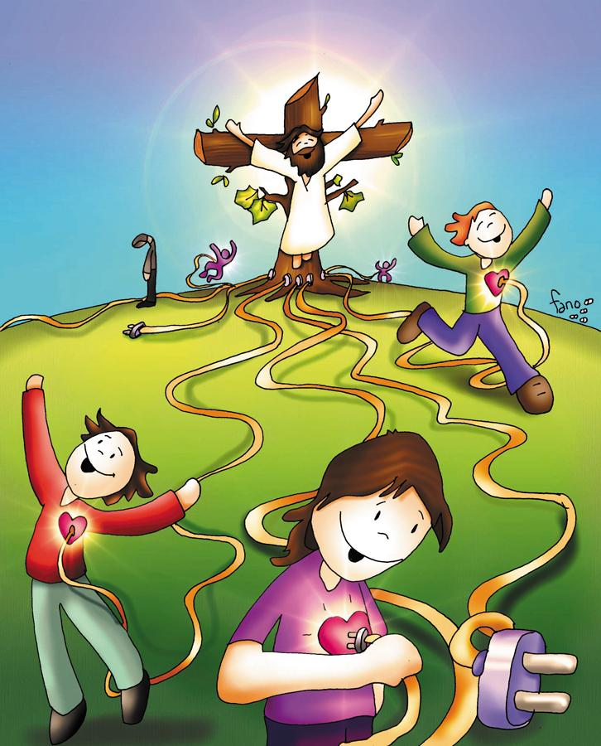
He wants us to be simple; trusting in God and His Word; and to return to Him and others the great love He gives us every day.

Slide 14
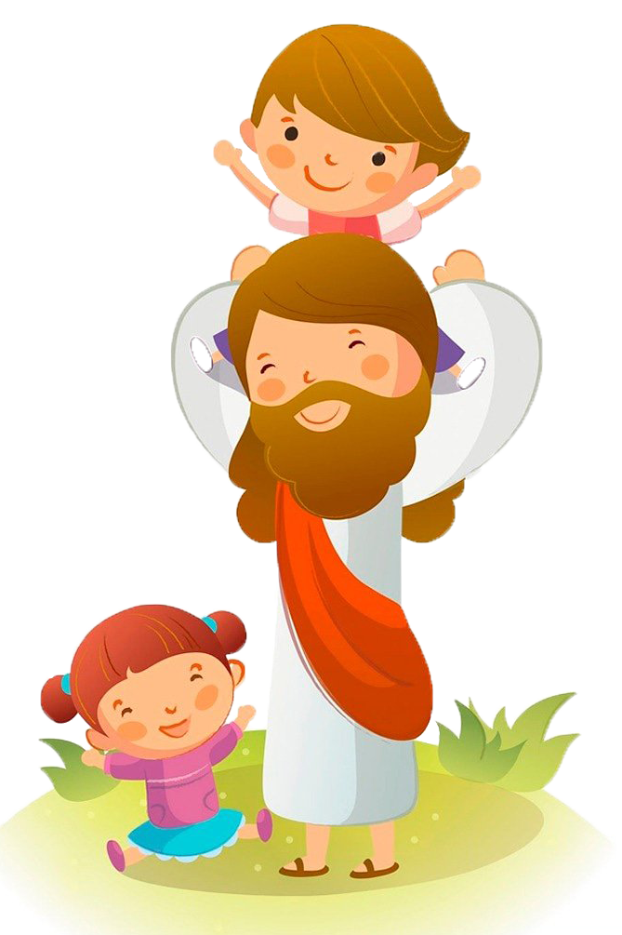
Jesus showed how much He loves children when He hugged them and blessed them.

Slide 15
ACTIVITIES

Slide 16
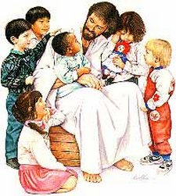
And people were bringing children to him that he might touch them, but the disciples rebuked them. When Jesus saw this, he became angry and said to them,
Place the words below in the appropriate space to read Jesus’ message.
"Let the ___________ _______ to me; do not ________ them, for the ___________ of ____ _________ to such as _______.”
children
come
prevent
Kingdom
God
belongs
these
prevent
these
kingdom
God
children
belongs
COME

Slide 17
Make a sign that Jesus loves me and I love Him. Pray the prayer before the Blessed Sacrament.
Jesus,
I believe,
I adore,
I trust,
And I love
You.
Instructions: Color, cut, and decorate the hearts. Glue a stick to the back. Say the prayer before the Blessed Sacrament.
My Name:
Jesus Loves Me

Slide 18
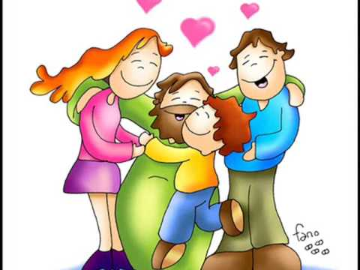
PRAYER
Lord, thank you for your love. Help me to love you more each day and to always trust you. I pray for those who do not believe, do not adore, do not trust, and do not love you. Amen.
Amen

Slide 19
Jesus Loves Me, CPH VPS https://youtu.be/_Sa-DxClTXw (2-6 yrs.)
Jesus Loves Me, Lifetree Kids https://youtu.be/PhHhvn-ZmU4 (7+ yrs.)

