Slide 1
Ministry Friends of Jesus and Mary
Cycle A - IX Sunday in Ordinary Time
Solemnity of the
Most Holy Trinity
www.fcpeace.org

Slide 2
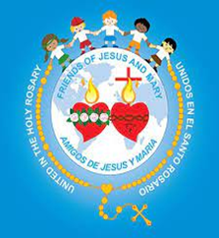
THE GOSPEL ACCORDING TO ST. JOHN 3, 16-18

Slide 3
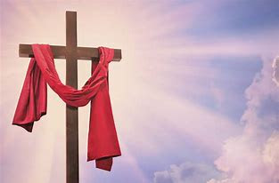
God so loved the world that he gave his only Son, so that everyone who believes in him might not perish but might have eternal life. For God did not send his Son into the world to condemn the world, but that the world might be saved through him. Whoever believes in him will not be condemned, but whoever does not believe has already been condemned, because he has not believed in the name of the only Son of God.

Slide 4
REFLEXION
THE GOSPEL OF THE LORD,
PRAISE TO YOU,
LORD JESUS CHRIST.

Slide 5
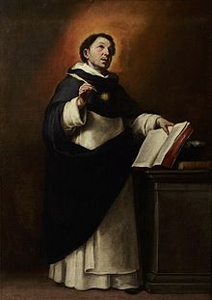
WHAT IS LOVE???
St. Thomas Aquinas says it is desiring good things for the other person.
It is not a feeling, but an act of the will.

Slide 6
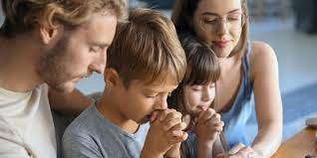
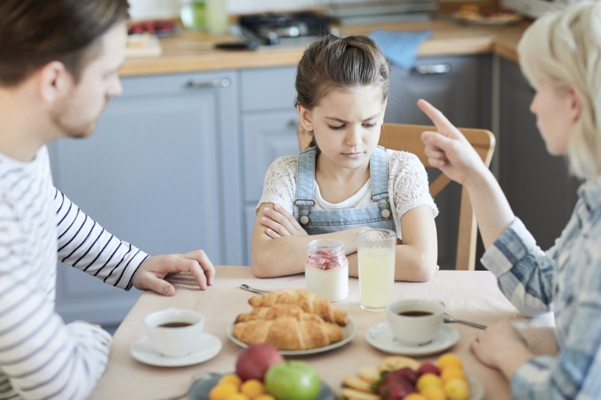
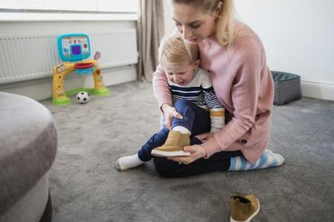
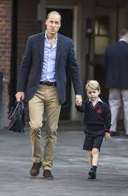
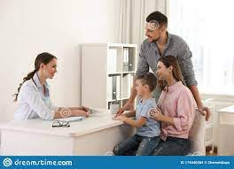
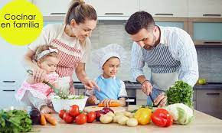
Our parents love us. How do they show us their love?

Slide 7
The Bible tells us that God is Love.
He always shares His love with us.

Slide 8
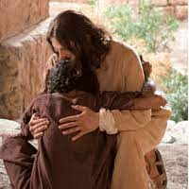
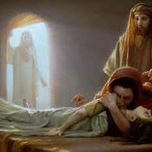
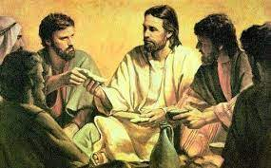
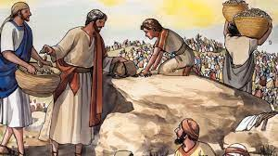
How does God show us His love?
He sent His son to…

Slide 9
…and, most importantly, to give His life for us on the cross, to pay for our sins and to open the gates of Heaven.

Slide 10
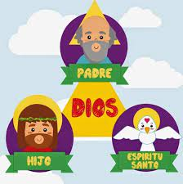
We see how love is always shared.
Today we celebrate our God,
The Holy Trinity, 1 God in 3 Persons.
FATHER
GOD
SON
HOLY
SPIRIT

Slide 11
THE HOLY TRINITY
God the Father, who is LOVE, and who created us to share His love with us.
God the Holy Spirit, who LOVES and guides us to Heaven.
FATHER
God the Son, who is LOVED by God the Father, and who came to share that love by saving us from our sins by dying on the cross;
GOD
SON
HOLY
SPIRIT

Slide 12
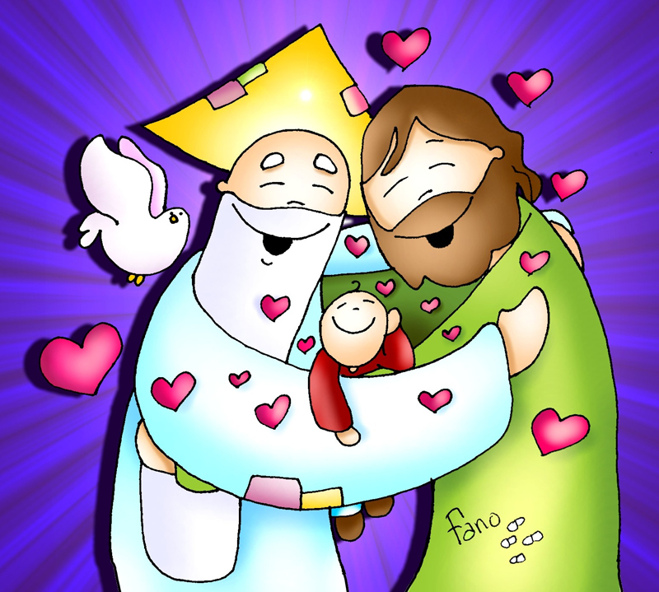
It is a mystery which we cannot understand because we are too small and God is infinite.
THE HOLY TRINITY
A FAMILY WHO LOVES.

Slide 13
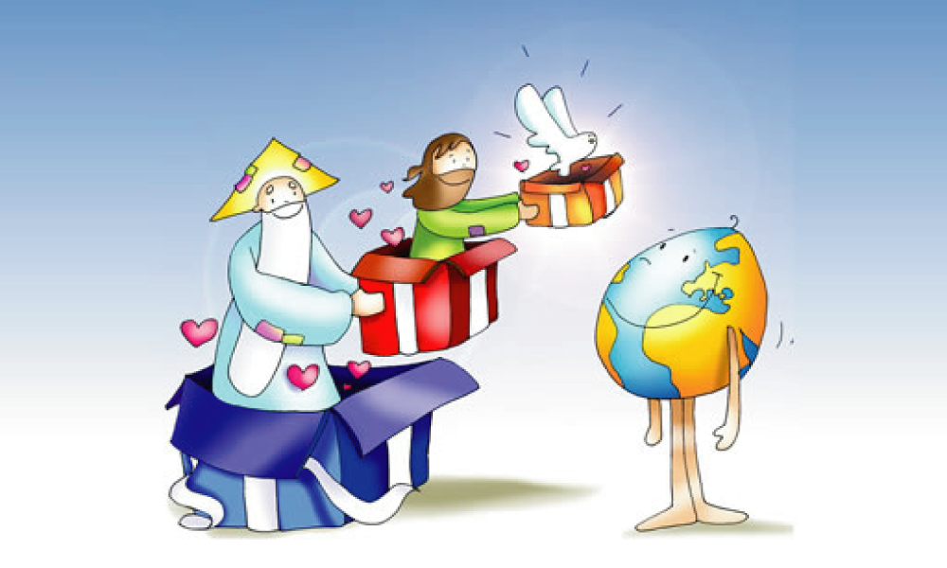
But Jesus told us that He and the Father are one;
And the Spirit of Truth is one with Jesus and the Father.

Slide 14
St. Augustine tried to understand the mystery of the Holy Trinity, 1 God in 3 persons, but Jesus appeared to him and told him this was not possible.

Slide 15
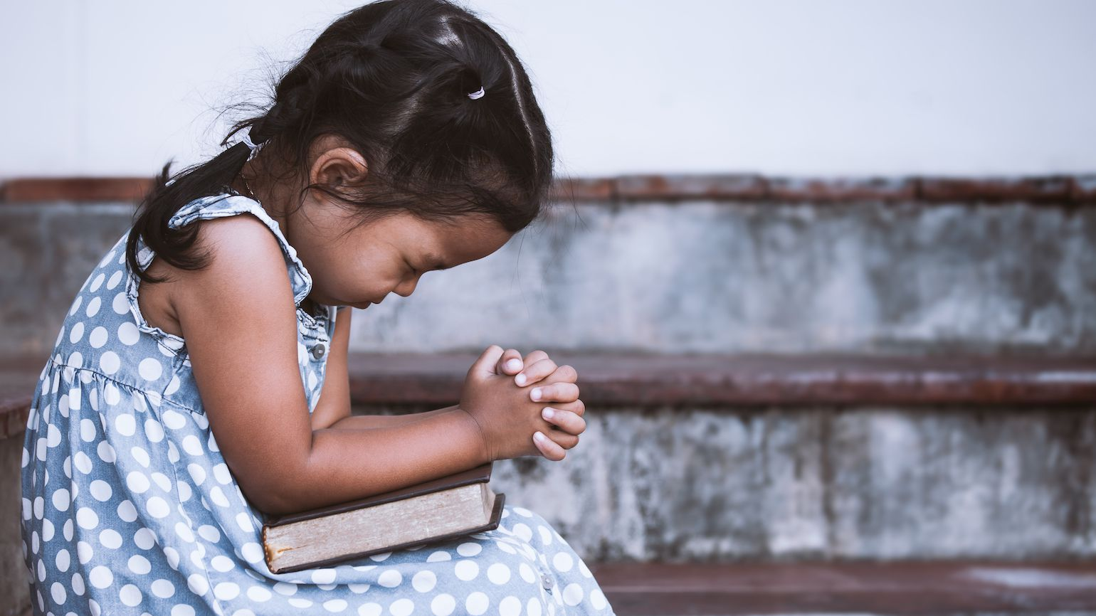
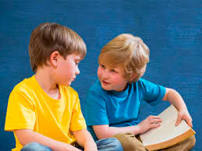
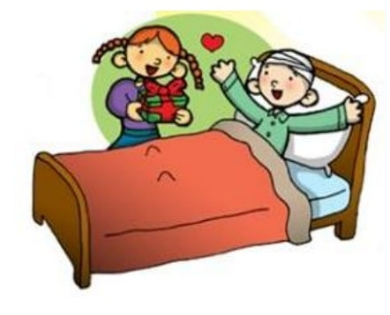
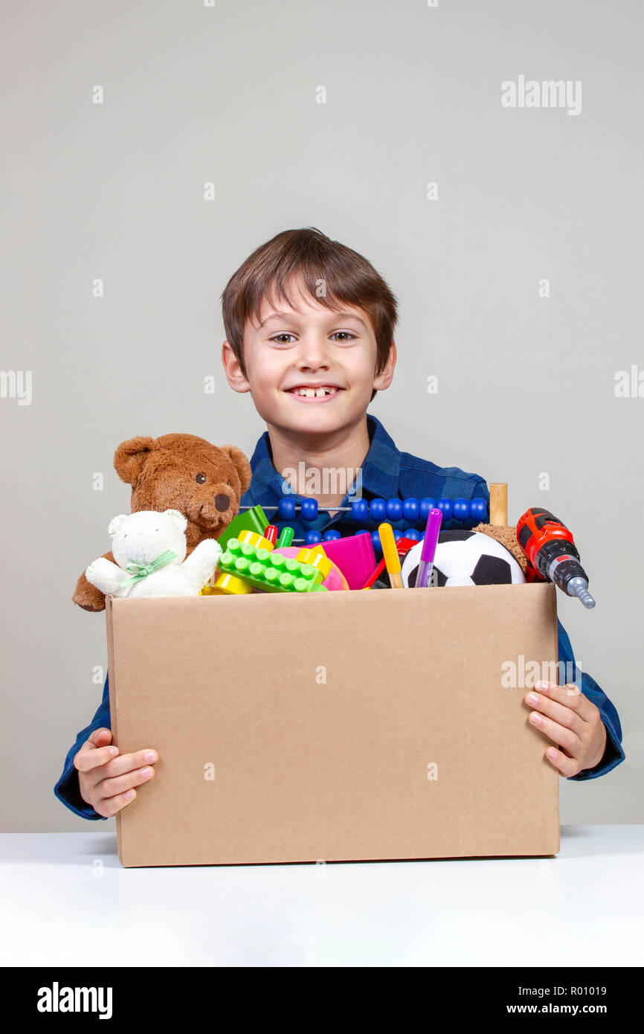
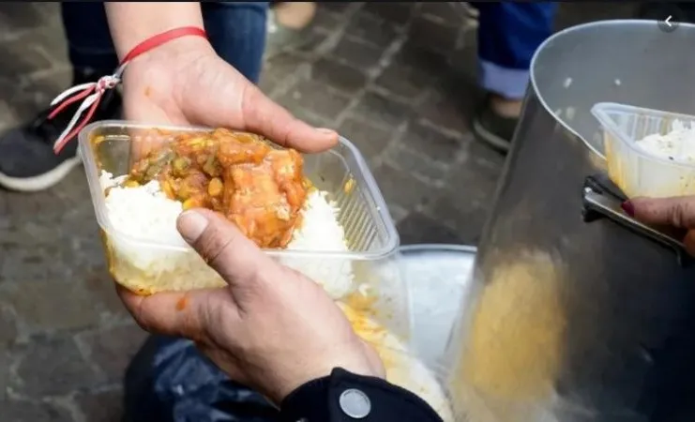
How can we imitate the Holy Trinity in sharing love with God and others?

Slide 16
ACTIVITIES

Slide 17
Fill in the blanks with the correct words (see words below): The Holy__________. 1 God in __ persons. God the Father, the _________. is ______. God the Son, the _________. is _______. God the ___ ____, ____ ___ _____ __ (Spirit, Guides, Creator, Loved, Loves, me, and, Trinity, 3, Savior, Love, Holy)
Trinity
3
Creator
Love
Savior
Loved
Holy Spirit
Loves and Guides me.

Slide 18
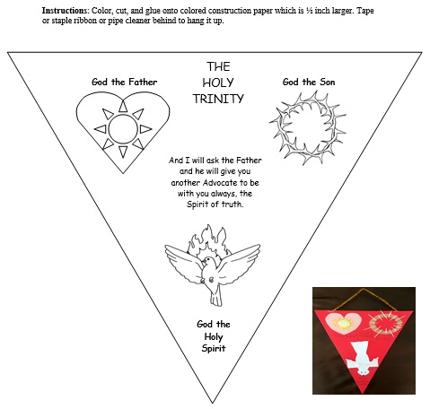

Slide 20
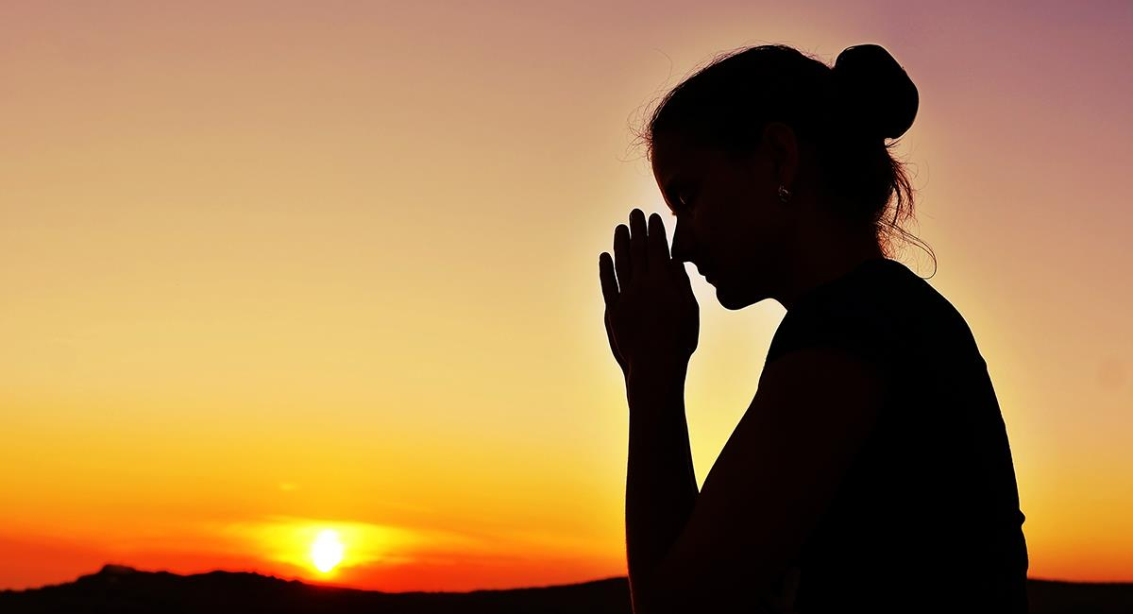
PRAYER
God the Father, who gave me life, a beautiful world, and infinite love, help me to love you more.
God the Son, who died on the cross for love, help me to love like You do.
God the Holy Spirit, my guide, protector, and advocate, fill my heart with Your Love.
Amen.

Slide 21
Trinity Roll Up, Christ Music Kids, https://youtu.be/mO_YzyHp30k

Slide 22
Trinity Song, U-Nite-TV, https://youtu.be/gZ_vnP0kwrQ

