Slide 1
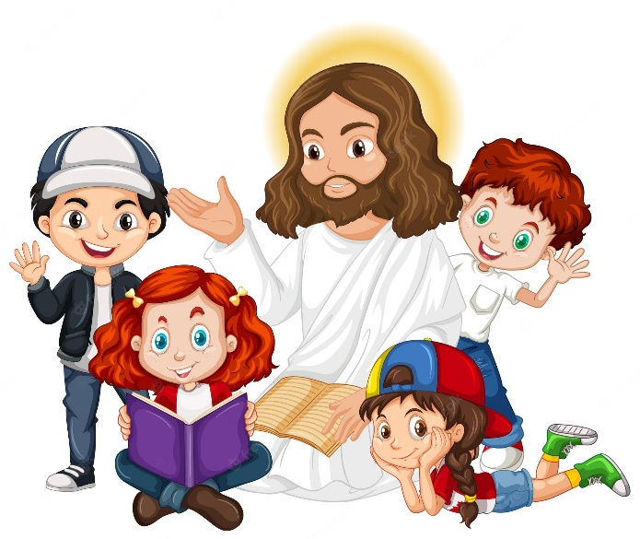
Friends of Jesus and Mary
Prayer Group for Children
Cycle A - IV Sunday in Ordinary Time
Gospel According to Matthew 5, 1-12 a
The Beatitudes
www.fcpeace.org

Slide 2
When Jesus saw the crowds, he went up the mountain, and after he had sat down, his disciples came to him. He began to teach them, saying:

Slide 3
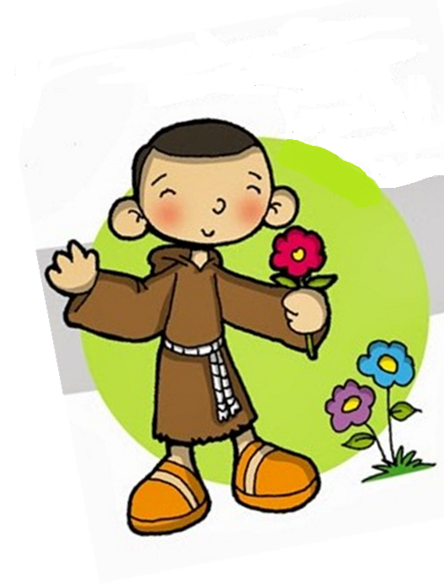
Blessed are the poor in spirit, for theirs is the kingdom of heaven.

Slide 4
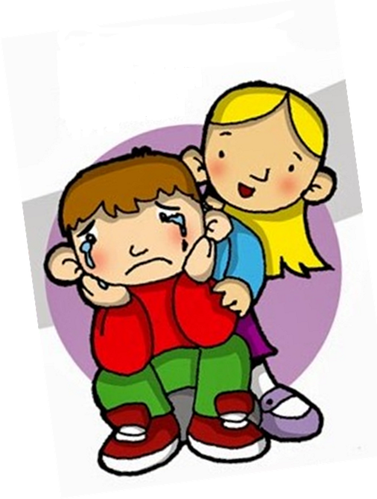
Blessed are they who mourn, for they will be comforted.

Slide 5
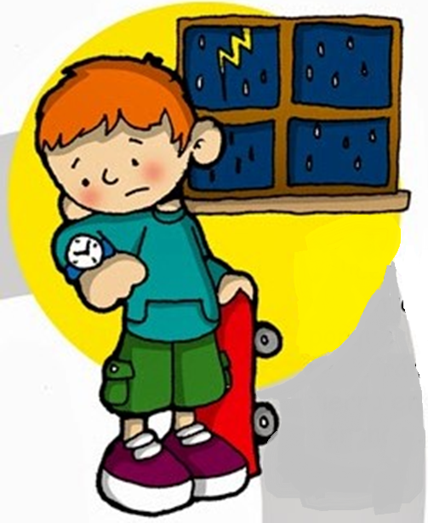
Blessed are the meek, for they will inherit the land.

Slide 6
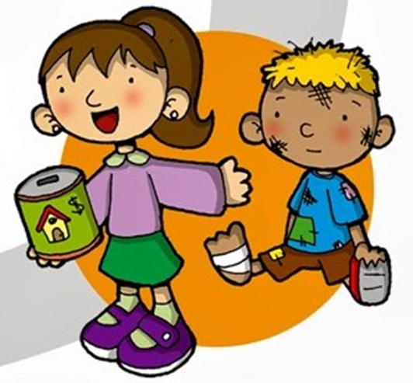
Blessed are they who hunger and thirst for righteousness, for they will be satisfied.

Slide 7
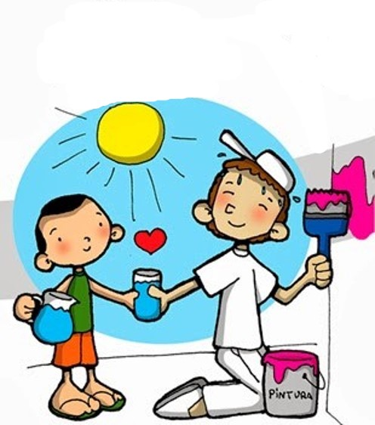
Blessed are the merciful, for they will be shown mercy.

Slide 8
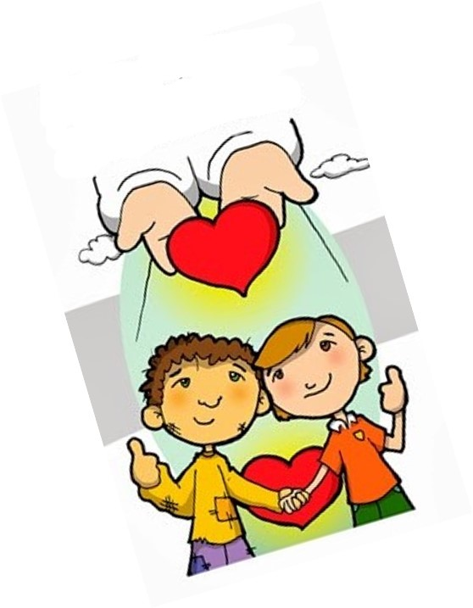
Blessed are the clean of heart, for they will see God.

Slide 9
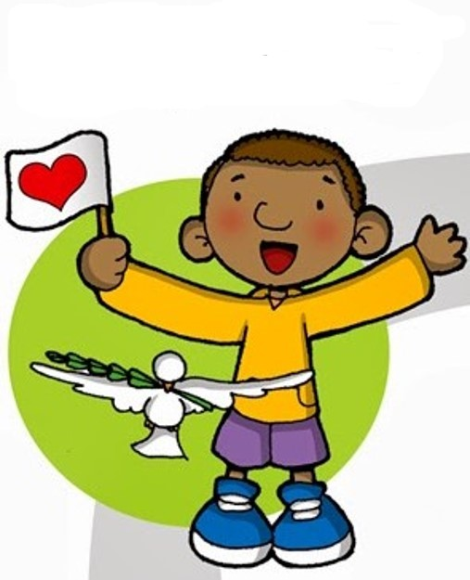
Blessed are the peacemakers, for they will be called children of God.

Slide 10
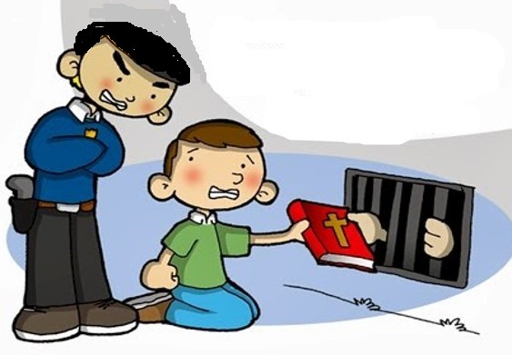
Blessed are they who are persecuted for the sake of righteousness, for theirs is the kingdom of heaven.

Slide 11
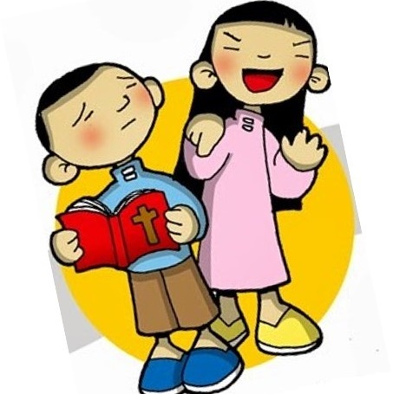
Blessed are you when they insult you and persecute you and utter every kind of evil against you falsely because of me.

Slide 12
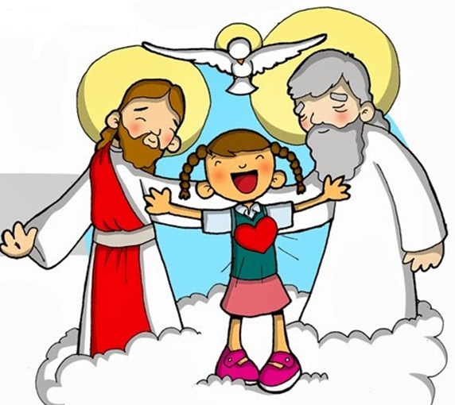
Rejoice and be glad, for your reward will be great in heaven.

Slide 13
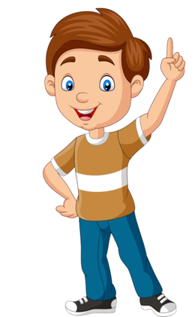
REFLECTION

Slide 14
What does Beatitude mean?
It means a blessing or happiness.
Jesus explains to us how to be happy or blessed. But it is not how the world sees happiness.

Slide 15
How does the world often see happiness?
Having riches, popularity, fame…
Jesus uses words like poor, mourn, persecuted. Are these words we use when we think of happiness?
NO

Slide 16
Why does Jesus call blessed: those who are poor in spirit, those who mourn, are persecuted…?
We seek God when we are sad or in need of help. We remember that we need Him.
God is close to those who are poor in spirit, those who cry…consoling, helping, loving them.

Slide 17
Do we usually ask God for help when we are happy or sad?
When everything goes well in our life do we tend to pray more or less?
Often, we pray less when we are happy. When we are satisfied, we often forget God. We may even think we obtained everything ourselves. We can forget that everything good comes from God.

Slide 18
Can we be happy without God?
No, we can never have true happiness or eternal happiness without God.
Notes:
COMPARTIR , HABLAR A LOS DEMAS DE LA PAZ, JUSTICIA, DEFENDER LA VIDA, CONECTARME CONTIGO A TRAVES DE TU PALABRA

Slide 19
Jesus said: blessed are those with a clean heart because they will see God.
Where is the Kingdom of God?
In Heaven and in our heart - wherever Jesus is present.

Slide 20
Do you like visiting a house that is dark, dirty, and smelly?
Do you think Jesus feels comfortable in a heart full of sin, hate, anger, and pride?

Slide 21
How can we make our heart beautiful for Jesus?

Slide 22
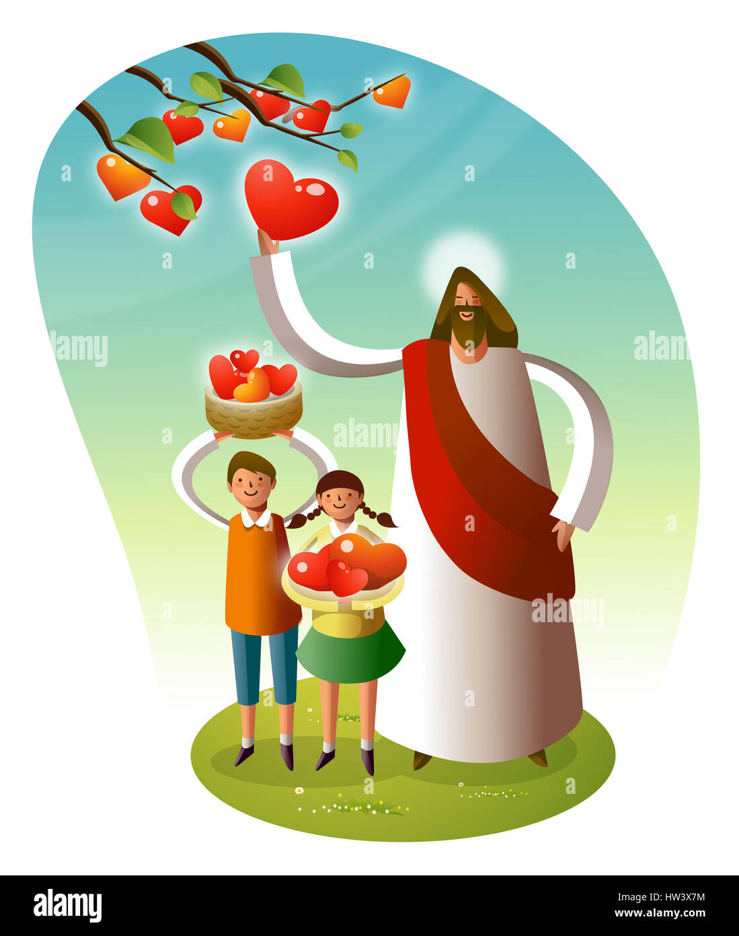
Jesus also said, blessed are those who desire justice, are merciful, and work for peace.
These good works are the fruits of having Jesus in our heart?

Slide 23
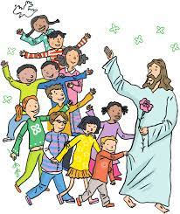
Jesus lived the Beatitudes. He wants us to follow Him so we may have true happiness in this life and in the next.
Notes:
COMPARTIR , HABLAR A LOS DEMAS DE LA PAZ, JUSTICIA, DEFENDER LA VIDA, CONECTARME CONTIGO A TRAVES DE TU PALABRA

Slide 24
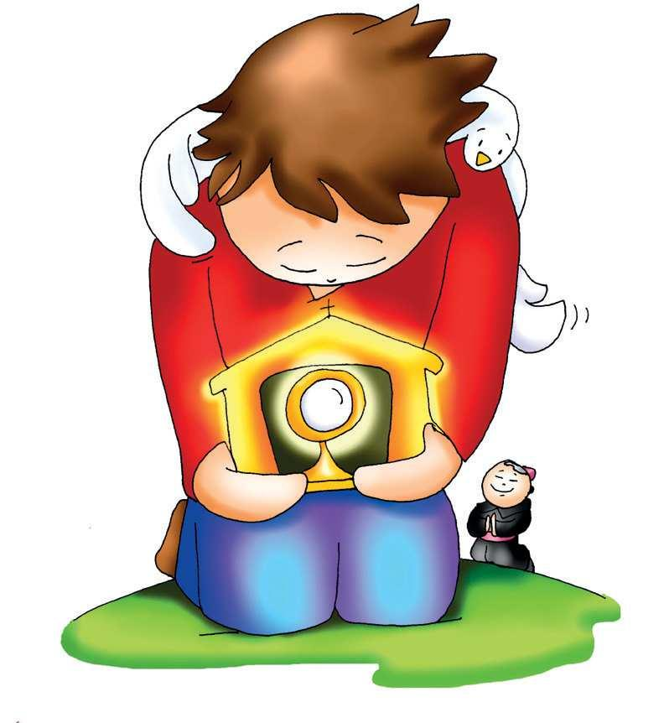
PRAYER
Jesus,
I want to follow you. Help me to imitate you, avoiding sin, forgiving those who hurt me, and working for your Kingdom. I offer you my sufferings for the conversion of sinners. I love you very much.
Amen

Slide 25
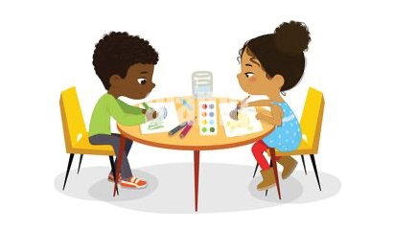
ACTIVITIES

Slide 26
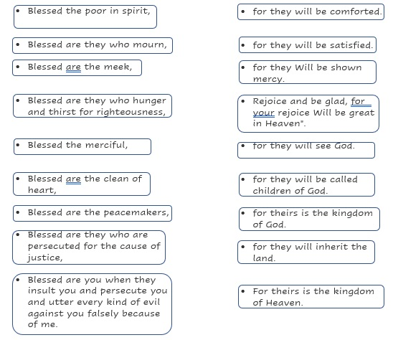
MATCH THE BEGINNING WITH ITS END FOR EACH BEATITUDE.

Slide 27
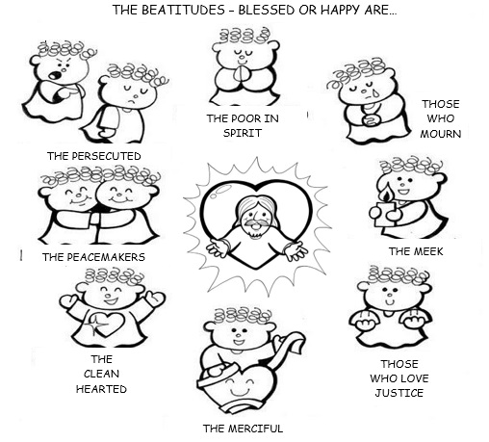
COLOR

Slide 28
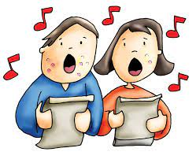
SONGS:

Slide 29
Beatitudes, Kingdom Kids, https://youtu.be/QMm9F9VXWLg (4-7)

Slide 30
Beatitudes, Brentwood Benson, https://youtu.be/05GkhZfbANg (8+)

