Slide 1
Friends of Jesus and Mary
Cycle A-I Sunday of Advent
Be Prepared, Matthew 24, 37-44
www.fcpeace.org

Slide 2
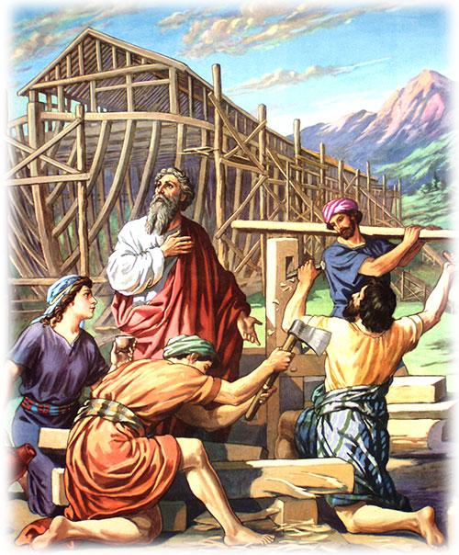
Jesus said to his disciples: "As it was in the days of Noah, so it will be at the coming of the Son of Man. In those days before the flood, they were eating and drinking, marrying and giving in marriage, up to the day that Noah entered the ark. They did not know until the flood came and carried them all away. So will it be also at the coming of the Son of Man. Two men will be out in the field; one will be taken, and one will be left. Two women will be grinding at the mill; one will be taken, and one will be left. Therefore, stay awake! For you do not know on which day your Lord will come. Be sure of this: if the master of the house had known the hour of night when the thief was coming, he would have stayed awake and not let his house be broken into. So too, you also must be prepared, for at an hour you do not expect, the Son of Man will come."
Be Prepared
Matthew 24, 37-44
Jesus said to his disciples: "As it was in the days of Noah, so it will be at the coming of the Son of Man. In those days before the flood, they were eating and drinking, marrying and giving in marriage, up to the day that Noah entered the ark. They did not know until the flood came and carried them all away. So will it be also at the coming of the Son of Man. Two men will be out in the field; one will be taken, and one will be left. Two women will be grinding at the mill; one will be taken, and one will be left.

Slide 3
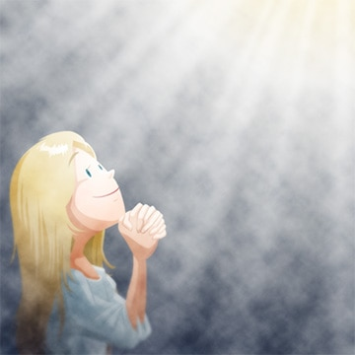
Jesus said to his disciples: "As it was in the days of Noah, so it will be at the coming of the Son of Man. In those days before the flood, they were eating and drinking, marrying and giving in marriage, up to the day that Noah entered the ark. They did not know until the flood came and carried them all away. So will it be also at the coming of the Son of Man. Two men will be out in the field; one will be taken, and one will be left. Two women will be grinding at the mill; one will be taken, and one will be left. Therefore, stay awake! For you do not know on which day your Lord will come. Be sure of this: if the master of the house had known the hour of night when the thief was coming, he would have stayed awake and not let his house be broken into. So too, you also must be prepared, for at an hour you do not expect, the Son of Man will come."
Be Prepared
Matthew 24, 37-44
Therefore, stay awake! For you do not know on which day your Lord will come. Be sure of this: if the master of the house had known the hour of night when the thief was coming, he would have stayed awake and not let his house be broken into. So too, you also must be prepared, for at an hour you do not expect, the Son of Man will come”.
The Gospel of the Lord, Praise to You Lord Jesus Christ.

Slide 4
REFLECTION

Slide 5
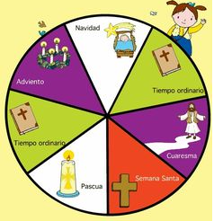
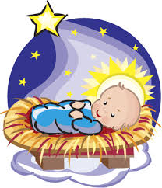
What Liturgical or Church season begins this Sunday??
CHRISTMAS
ADVENT
ORDINARY TIME
?
ORDINARY TIME
LENT
HOLY WEEK
EASTER
Advent, the beginning of the Liturgical year, is 4 weeks to prepare our heart for the spiritual birth of Jesus on Christmas.

Slide 6
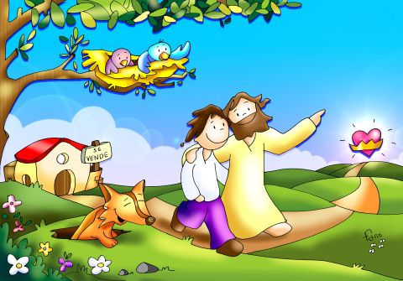
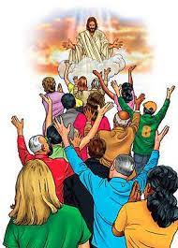
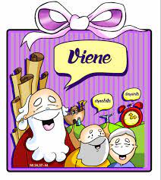
In the Gospel, Jesus tells us to stay awake and prepare for the coming of the Lord. When is the Lord coming?
He will come to take us to Heaven at the end of our life;
COMING
and in the last days, He will come again to take His children to Heaven.

Slide 7
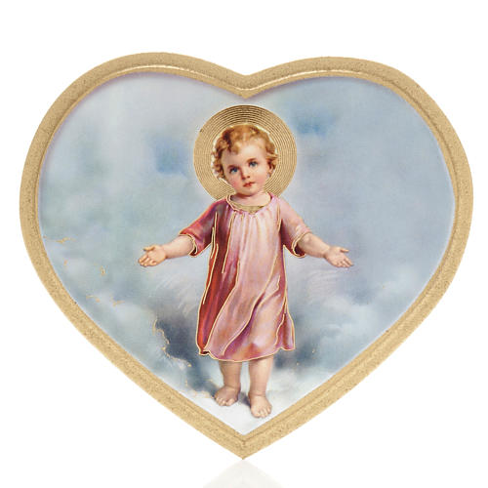
During Advent, we also prepare for his spiritual birth in our heart on Christmas morning.
COMING

Slide 8
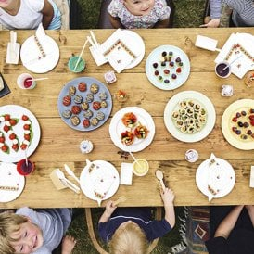
In all cases, we must prepare our heart.
How do we prepare our home when we have invited an important guest?
We clean,
We prepare food,
We decorate…

Slide 9
In the same way we prepare our home so it’s clean and welcoming, we must prepare our heart so Jesus feels welcome, loved, and happy .
SELFISHNESS
FORGIVENESS
HATE
AMOR
We don’t want Him to find it filled with selfishness, hatred, or lies;
PEACE
LIES
only love, peace, generosity, and forgiveness.
GENEROSIDAD

Slide 10
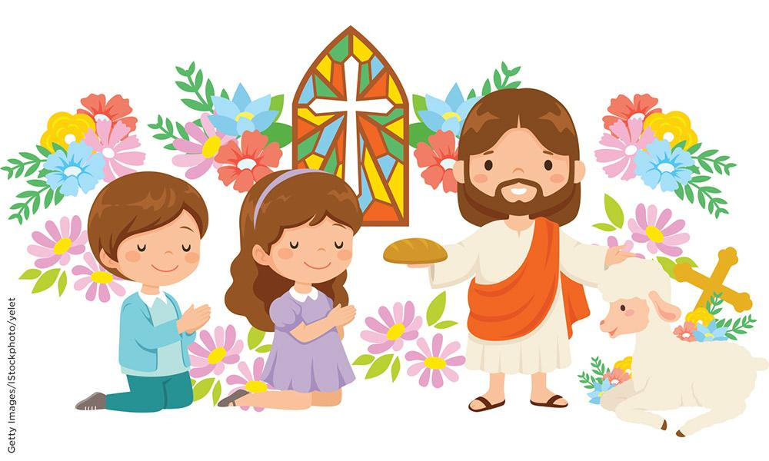
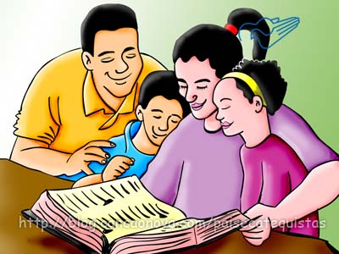
How do we prepare our hearts?
Obeying our parents and teachers
Seeking Jesus in prayer and in the sacraments, especially the Eucharist and Reconciliation
Offering small sacrifices
Sharing
Helping

Slide 11
ACTIVITIES

Slide 12
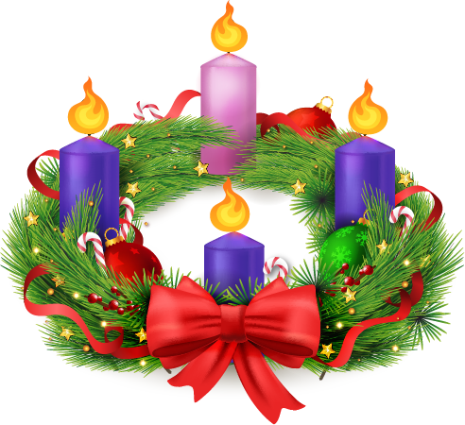
The Symbols of the Advent Wreath
Guess what each symbol means. The answers are below.
2. The green branches
1. The red bow
3. The circular form
4. The four candles
3
It’s a symbol that God’s love is eternal, without a beginning or an end. Also our love for God and eachother should never end.
1
It represents our love for God and God’s love that surrounds us always.
2
It represents the color of hope and life.
4
They represent the light of Christ that illuminates the darkness caused by sin which separates us from God.

Slide 13
In the Liturgical Year, the Church celebrates all year for Jesus.
CHRISTMAS
ADVENT
Advent – Jesus is coming.
Christmas – Jesus is born.
Lent – Jesus will die and resurrect.
Holy Week – Jesus dies.
Easter – Jesus resurrects.
Ordinary Time – Jesus teaches us.
ORDINARY TIME
?
ORDINARY TIME
LENT
HOLY WEEK
EASTER

Slide 14
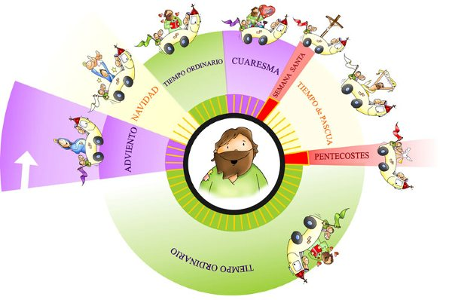
Each season has a symbolic color which the priest wears during Mass.
Purple: Used in Advent and Lent (Signifies penance and preparation).
Pink: Used the 3rd week of Advent and 2 weeks before Easter (Means anticipation and joy).
White/Gold: Used in Christmas, Easter, Feasts of Mary and martyred saints (Means joy and purity).
Green: Used in ordinary time (Means hope and growth).
Red: Used on Passion Sunday, Good Friday, Feast days of the Apostles and martyrs. (Means sacrifice).

Slide 15
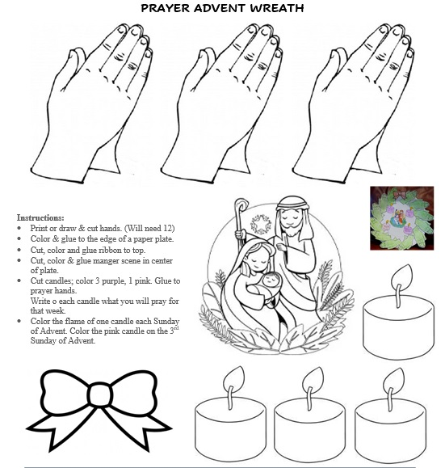
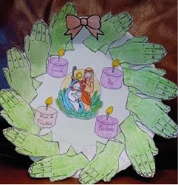

Slide 16
PRAYR
Baby Jesus, you are a child like me; I love you so much and wish to receive you in my heart this Christmas. Help me to prepare well this Advent so my heart will be a warm and welcoming place for you.
Amen

Slide 17
Lord Jesus Come, https://youtu.be/3wFE0muUzw8

